Slide 1
Dyslipidemia

Slide 2
definition

Slide 3
types

Slide 5
Normal lipid panel

Slide 6
Lipid metabolism

Slide 7
Primary dyslipidemia 1) Familial hypercholesterolemia (FH)

Slide 8
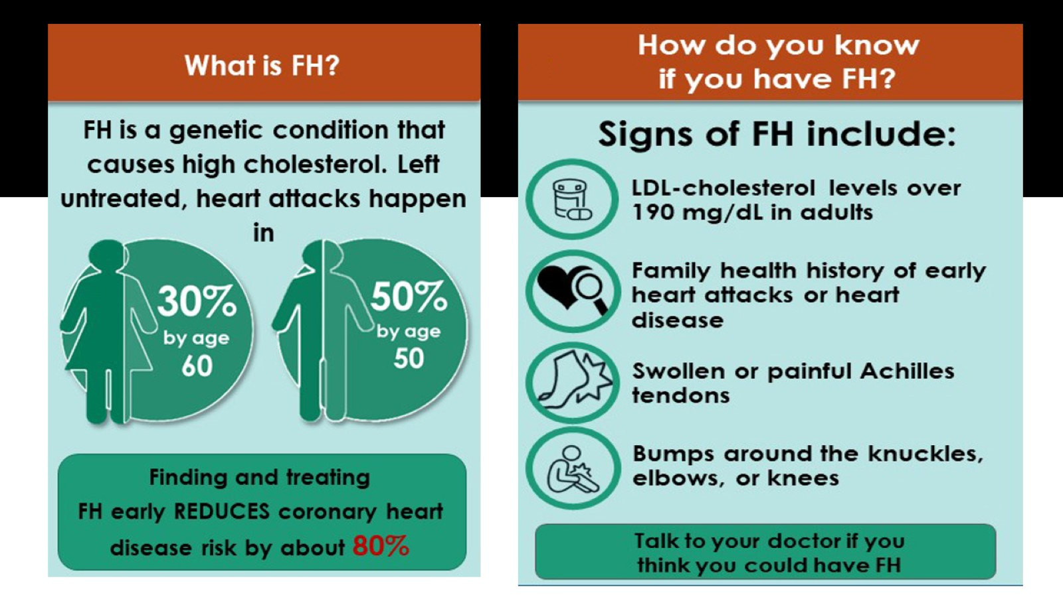

Slide 9
2) Familial Hypertriglyceridemia

Slide 11
3) Familial Combined Hyperlipidemia

Slide 12
Secondary dyslipidemia

Slide 15
Causes of secondary dyslipidemia

Slide 16
Clinical presentation

Slide 19
investigations

Slide 20
Lipid panel

Slide 26
Dyslipidemia screening

Slide 28
management

Slide 29
ASCVD Components

Slide 30
Risk of ASCVD assessment

Slide 31
Non-diabetic patients aged 40 to 75 years with LDL between 70 to 190 mg/dL

Slide 32
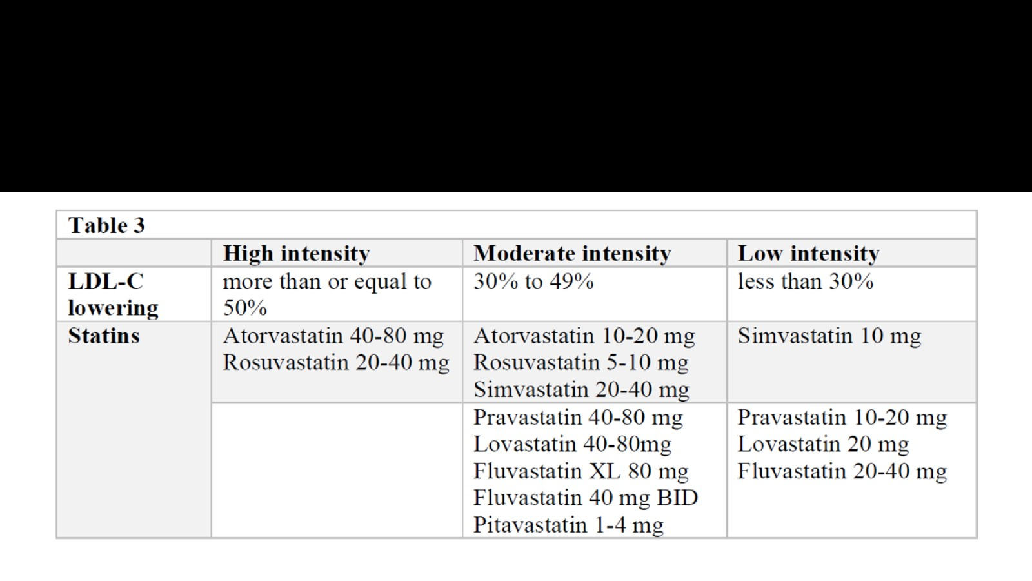

Slide 33
ADA recommendations of statin therapy in Diabetics patients

Slide 35
Lipid lowering classes

Slide 36
Drug selection

Slide 41
When to refere

Slide 42
Lifestyle management

