Slide 1
URINARY TRACT INFECTION
in children
التبييض باللون الأخضر
DR SALMA AJARMEH
ASSOCIATE PROFESSOR OF PEDIATRICS CONSULTANT PEDIATRIC NEPHROLOGIST
MUTAH UNIVERSITY

Slide 2
UTI WHY CARE ABOUT UTIs ??
UTIs
Important risk factor for : renal insufficiency
renal scarring : HTN risk .
end-stage renal disease

Slide 3
WHY CARE ABOUT UTI ??
UTI Accounts for almost 1% of office visits to the pediatrician and 5-15% of the ER visits
renal damage reported in about 5% of children with UTI
The major cause of CKD & ESRD in children is reflux nephropathy and congenital
renal anomalies (CAKUT) kidney hypoplasia ,dysplasia , agenesis , cystic kidney ,obs neuropathy

Slide 4
UTI….
INCIDENCE
It is difficult to estimate the true incidence of UTIs in children because many children have only fever with no specific urinary symptoms, and is affected by the method the urine sample is collected.
Urinary tract infections (UTIs) before 12yr age occur in 5-8% of girls and 2% of boys.
In girls, the first UTI usually occurs by the age of 5 yr, with peaks during infancy
and toilet training.
In boys, most UTIs occur during the 1st yr of life

Slide 5
Male: female ratio :
more common in males in the first year of age then more common in females beyond 1 yr age
Recurrence after first UTI :
- 50-60% of children will develop a second UTI within 1yr.

Slide 6
WHEN TO SUSPECT UTI
CLINICAL MANIFESTATIONS
Pyelonephritis :
Present with abdominal or flank pain, fever,
malaise, nausea, vomiting, and occasionally diarrhea especially less than 1y
this indicates Involvement of the renal parenchyma

Slide 7
CLINICAL MANIFESTATIONS
Cystitis
Indicates bladder involvement.
Symptoms include dysuria, urgency, frequency, suprapubic pain, incontinence, and malodorous urine.
It does not cause fever and does not result in renal injury.
Hematuria more with cystitis mainly if there is a time for hematuria during the voiding

Slide 8
WHEN TO SUSPECT?
Fever ???
the prevalence of UTI is 5% in children <2yr presenting with fever > 38.0 and no defined focus
In newborns and infants
Nonspecific symptoms such as jaundice, poor feeding, irritability Weight loss/ FTT in recurrent febrile UTI

Slide 9
PATHOGENESIS
Most UTIs are ascending infections from bacteria in fecal flora that colonize the perineum.
Rarely hematological spread ( neonates )
Neonatal sepsis ends with uti.
Most common pathogens: In females, 75–90% of all
infections are caused by Escherichia coli, the remaining are caused by Klebsiella and Proteus.
In males older than 1 yr of age, Proteus is as common as E. coli;

Slide 10
PATHOGENESIS
others : gram-positive organisms as (enterococcus).. in males.
Staphylococcus saprophyticus is a pathogen in both sexes.
Viral infections, particularly adenovirus may cause cystitis.
Pseudomonas spp is the most common nonenteric gram negative bacteria; may indicate renal tract abnormality.
Group B Strept is rare and mostly seen in neonatal sepsis
Fungal (candida) in immunodeficiency disease

Slide 11
Escherichia coli - Most common organism; causative agent in > 80% of 1st UTI
Klebsiella species - 2nd most common organism. Seen more in young infants
Proteus species - May be more common in males
Enterobacter species - cause < 2% of UTI’s
Pseudomonas species - cause < 2% or UTI’s
Enterococci species- Uncommon > 30 days of age
Coagulase-negative staphylococcus - Uncommon in childhood
Staphylococcus aureus - Uncommon > 30 days of age mainly contaminated
Group B streptococci - Uncommon in childhood
f

Slide 12
PATHOGENECITY
THE PATHOGENECITY IS DETERMINED BY bacterial pili or fimbriae on the bacterial surface.There are two types of fimbriae, type I and type II..The attachment of type II fimbriae is more potent to the uroepithelial cells.
(Type II) P fimbriae are expressed by only certain strains of E. coli and they are more likely to cause pyelonephritis.
Between 76–94% of pyelonephritogenic strains of E. coli have P fimbriae, compared with 19–23% of the cystitis strains .

Slide 13
UTI :THE RISK !
The incidence of UTIs varies based on age and sex
Sex :The prevalence of UTI among febrile infant girls is more than twice that
among febrile infant boys
Uncircumcised boys is 4 -20 times higher
first-time symptomatic UTI are highest in boys during the first year of life and markedly decrease after that while the peak for girls is around 4-5yr age

Slide 14
RISK FACTORS FOR URINARY TRACT INFECTION
Female
Uncircumcised male Vesicoureteral reflux
Toilet training
retention try to avoid public toilet uses
Voiding dysfunction
Obstructive uropathy
Urethral instrumentation
Wiping from back to front
Bubble bath
Tight clothing (underwear)
Pinworm infestation
Constipation compress the bladder leads to stasis
P fimbriated bacteria
Anatomic abnormality (e.g., labial adhesion)
Neuropathic bladder
Sexual activity
Pregnancy

Slide 15
Diagnosis

Slide 16
DIAGNOSIS
The major goal for a pediatrician treating a febrile young child is early diagnosis of UTI,
allow early treatment to preserve the function of the growing kidney by preventing scarring.

Slide 17
DIAGNOSIS
Clinical Picture
UA ( R&M / dip stick ) 3- Urine Culture
4- Imaging

Slide 18
A UTI may be suspected based on :
the symptoms , findings on urinalysis , or both,
but
urine culture is necessary for confirmation and appropriate therapy. UTI is a positive UC
Thus, the diagnosis of UTI depends on having the proper sample of urine ..
For URINE CULTURE

Slide 19
OBTAINING A URINE SAMPLE
May be obtained by:
Bag ….not very reliable method high risk for contamination , IF negative UC its reliable but if its positive we need to repeat it
A mid stream void in a toilet trained child….usually
satisfactory
Catheter or suprapubic sample (SPA)

Slide 20
URINE ANALYSIS
-Dipstick qualitative : present or not
Blood /Protein/Glucose/pH/S.Gravity /nitrite , leukocyte esterase
-Microscopy quantitative : gives number
RBC/WBC
epithelial ,tubular cells and casts

Slide 21
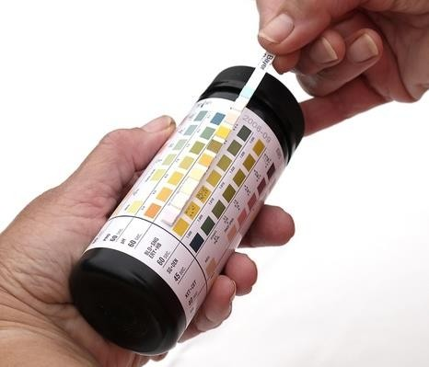
NORMAL URINE ANALYSIS
1 - Dipstick :
- Blood : presence of Hb This test is based on the pseudoperoxidase activity of
Hb which catalyzes the reaction of tetramethylbenzidine and buffered organic peroxide;
The resulting color ranges from greenish-yellow to dark blue.-

Slide 22
DIPSTICK
-False +ve Hb test:
Myoglobinuria
Oxidizing agents contaminating the urine specimen (hypochlorite,povidone) Heavy bacterial contamination ( bacterial peroxidase effect )
-False –ve: reducing substances as ascorbic acid

Slide 23
URINE ANALYSIS DIPSTICK
-Protien :
Color changes from yellow to green .
Not a quantitative method and affected by concentrated urine .
albumin is detected better than other protein as globuline , tubular proteins

Slide 24
DIPSTICK
Protein In Dipstick :
Trace
+1
+2
+3
+4
0.15g/L
0.3g/L
1.0 g/L
3.0 g/L
20 g/ L
Needs further quantification of protein ( 24 hr collection and
Uprt / UCr ratio if persisted

Slide 25
OTHER ITEMS ON DIPSTICK
glucose
PH normally around 5 , >6 : alkaline urine indicate UTI
specific gravity normally 1,010 – 1,025
<1,010 : diluted urine
> 1,025 : concentrated urine
Nitrite if its positive means gram negative bac which reduces nitrate
Leukocyte esterase if its positive indicste wbcs present

Slide 26
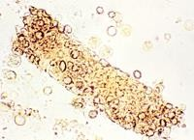
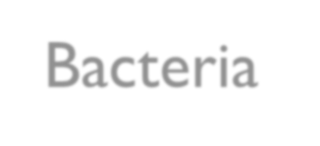
URINE ANALYSIS R&M
2- Microscopy:
-For cells
RBC WBC
-Bacteria
0-3 RBC/HPF
0-5 WBC/HPF
Rbc cast +hematuria indicates glomerulonephritis
For Cast ; Hyaline cast / epithelial cast,
RBC cast: are always pathological

Slide 27
URINE ANALYSIS ,,,,,, INTERPRETATION
A urinalysis should be obtained from the same specimen as that cultured.
Pyuria (leukocytes in the urine) suggests infection, but infection can occur in the absence of pyuria.
Conversely, pyuria can be present without UTI LIKE IN (bacteremia , lupus , vasculitis , ATN , AKI .
Nitrites and leukocyte esterase are usually positive in infected
urine.
Microscopic hematuria is common in acute cystitis
if the child is symptomatic, a UTI is possible, even if the
urinalysis result is negative

Slide 28
DIAGNOSIS URINE CULTURE
Positive Urine culture :
If the urine culture shows greater than 100,000 colonies of
a single pathogen
_Mixed pathogen : almost contamination
If there are 10,000 colonies and the child is symptomatic, it is considered a UTI
Any gram negative growth from a suprapubic sample is positive culture

Slide 29
Asymptomatic bacteriuria refers to individuals who have a positive urine culture without any manifestations of infection and occurs almost exclusively in girls . It is a benign condition except in pregnancy…

Slide 30
DIAGNOSIS
OTHER LABS
leukocytosis, neutrophilia, CBC
elevated erythrocyte sedimentation rate and/or C-reactive protein are common
Because sepsis is common in pyelonephritis especially in younger children, blood cultures should be taken..

Slide 31
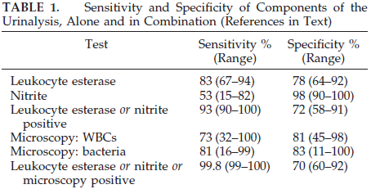

Slide 32
DIAGNOSIS CLINICAL PICTURE
History :
Risk
Constipation
Urine retention /dysfunctional voiders
Enuresis ( esp if with day symptoms )
Family history (UTI or congenital anomalies)
Antenatal: oligohydramnios/hydronephrosis/
Lung hypoplasia ….potter sequence in very young infants

Slide 33
DIAGNOSIS
CLINICAL PICTURE
Physical exam
Abdomen exam look for suprapubic mass which indicates distended bladder , above this region maybe kidney mass like hydronephrosis , pckd Wilms tumor
Costophrenic (renal angle) tenderness
Back for sacral dimple or hair tuft look for spina bifida occulta
Lower limbs: tone, power knee reflex
Check BP
Check growth parameters look for FTT : CHRONIC PROBLEM

Slide 34
ENURESIS
Enuresis :
Is the involuntary voiding of urine at least twice a week for 3 consecutive months in a child older than 5 years.
Primary enuresis: bedwetting in a child who has never been
dry
Secondary enuresis: a dry period of at least 6 months
PROBLEMATIC ENURESIS : abnormal neurological exam , comes with UTI symptoms

Slide 35
TYPES ENURESIS
Nocturnal enuresis: passing of urine while asleep
Diurnal enuresis : leakage of urine during the day
Monosymptomatic ( uncomplicated )nocturnal enuresis: normal voiding in the bed at night in the absence of other
genitourinary or gastrointestinal symptoms (80%-85% of cases)
Polysymptomatic (complicated) nocturnal enuresis:
bedwetting associated with daytime symptoms, such as urgency, frequency, urge incontinence, constipation, or encopresis
( 5%-10% of cases )
a patient with both diurnal and nocturnal enuresis (needs more workup)

Slide 36
Nocturnal enuresis is more common in boys,
Diurnal enuresis is more common in girls
5% only of cases of nocturnal enuresis are due to organic cause while
Diurnal and combined enuresis associated with a higher rate of
UTIs and with neurologic bladder
Treatment : behavioral changes
MINIRIN : vasopressin: ADH (oral at night for 6m _1y )

Slide 37
TREATMENT

Slide 38
TREATMENT
The goals of treatment a child with UTI:
Resolution of the acute symptoms of the infection
Prevention of progressive renal disease by eradication of the bacterial pathogen
Identification of any urinary tract abnormalities
Preventing recurrent UTIs

Slide 39
MANAGEMENT ANTIBIOTIC OPTIONS
Initiating treatment orally or parenteral is of equal efficacy.
the choice of AB agent should be based on local antimicrobial sensitivity patterns and specific pathogen sensitivity
The clinician should choose 7 - 14 days as the duration of antimicrobial
therapy
AAP 2012

Slide 40
HOSPITALIZATION & IV TREATMENT
IV treatment and hospitalization indication
Patients whom clinicians judge to be “toxic”
Or those who are unable to retain oral intake
for children <3months
Any child who started oral antibiotics and is still symptomatic or febrile should
receive IV A.B
Patient with vomiting , diarrhea , dehydration and congenital anomaly
Otherwise most children can be treated orally for pyelonephritis
Therapy should be 7-14 days ( AAP) / or
7-10 days (NICE guidelines)…..
Weather you start oral or IV doesn't matter !
AAP 2012

Slide 41
TREATMENT …CYSTITIS
Acute cystitis should be treated promptly to prevent its possible progression to pyelonephritis, after obtaining culture treatment is started immediately for a 3 to 5- day course until the urine culture result is back
Antibiotic choices
with trimethoprim-sulfamethoxazole balkatrin
Nitrofurantoin (5–7 mg/kg/24 hr in three to four divided doses)
Amoxicillin (50 mg/kg/24 hr) is also effective as initial treatment but has no clear advantages over the sulfonamides or nitrofurantoin

Slide 42
ANTIBIOTICS ..PYELONEPHRITIS
either regimen;
IV treatment with 3rd generation cephalosporin like ceftriaxone (rocephin ) or Claforan ( cifitaxime)
or
Ampicillin and Aminoglycoside (gentamicin)
-Oral third-generation cephalosporins such as cefixime (suprax) are as effective as parenteral ceftriaxone against a variety of gram-negative organisms other than Pseudomonas, it is the treatment of choice for oral therapy for pyelonephritis.

Slide 43
ANTIBIOTICS ..PYELONEPHRITIS
Nitrofurantoin should not be used in children with a febrile UTI because
it does not achieve significant renal tissue levels..it is good for cystitis .
fluoroquinolone ciprofloxacin is an alternative agent for resistant microorganisms, particularly Pseudomonas, in patients older than 17 yr.

Slide 44
TREATMENT ---COMPLICATIONS
Renal / perirenal abscess or with infection in obstructed urinary tracts require surgical or percutaneous drainage in addition to antibiotic therapy.

Slide 45
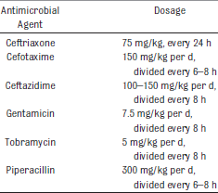
IV CHOICES

Slide 46
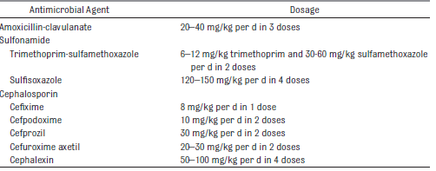
ORAL OPTIONS

Slide 47
Imaging
I

Slide 48
IMAGING STUDIES
The goal of imaging studies in children with a febrile UTI is to identify anatomic abnormalities that predispose to infection. And to identify children who might develop renal injury and scarring

Slide 49
IMAGING
About 5-10 % of children will develop renal scarring after the first (pyelonephritis) and risk increases more with recurrent uti or presence of VUR
Up to 50% of children with a febrile UTI will have an anatomical abnormality

Slide 50
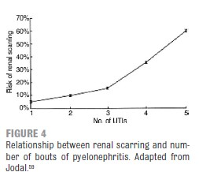
RISK SCARRING

Slide 51
IMAGING TYPES
Ultrasonography
VCUG voiding cystourithrogram.. contrast or radionuclide
DMSA scan (technitium 99 Dimercaptosuccinic acid)

Slide 52
US
For Every One !
Is the first standard imaging investigation to be done
US is recommended during the first 2 days of treatment
US provides an evaluation of the renal parenchyma , obstruction, hydronephrosis ,corticomedullary differentiation (cortex with dark color , medulla with bright one ) and size that can be used to monitor renal growth
The main purpose of US is to detect anatomic abnormalities that require further evaluation, (mainly additional imaging) and (VCUG) and urologic consultation

Slide 53
ULTRASOUND
ultrasonography also may show acute pyelonephritis (in 30–60% of cases) by demonstrating an enlarged kidney
Ultrasonography demonstrates only 30% of renal scars.
only 40% of children with reflux have any abnormality on the ultrasound

Slide 54
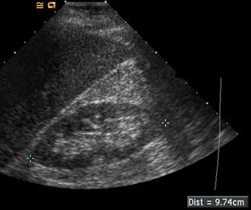
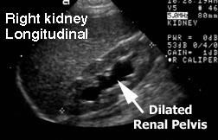
Large pelvis , thin cortex , destroyed corticomedullary differentiation , grade 1 hydronephrosis )

Slide 55
VCUG
The best investigation to diagnose vesicoureteral reflux VUR
provide anatomic definition of the bladder, allow precise grading of reflux, demonstrate a paraureteral diverticulum, or show whether reflux is occurring into a duplicated collecting system or an ectopic ureter

Slide 56
VCUG
VCUG & FIRST UTI
Trend has shifted towards not doing VCUG after first UTI !
VCUG should not be performed routinely after the first febrile UTI; VCUG is only indicated if :
US reveals hydronephrosis
evidence of scarring on DMSA,
findings that would suggest either high-grade VUR or obstructive uropathy
Atypical UTI infections!
Significant family history of VUR
AAP 2012

Slide 57
VUR

Slide 58
TYPES OF VUR
primary or secondary .
Primary reflux is a developmental anomaly of the VU junction (ie:VUR in an otherwise normally functioning lower urinary tract),
Secondary reflux is VUR that is associated with or caused by an obstructed lower urinary tract, posterior urethral valves or a neurogenic bladder
Conditions such as bladder instability can precipitate reflux or worsen pre-existing reflux.

Slide 59
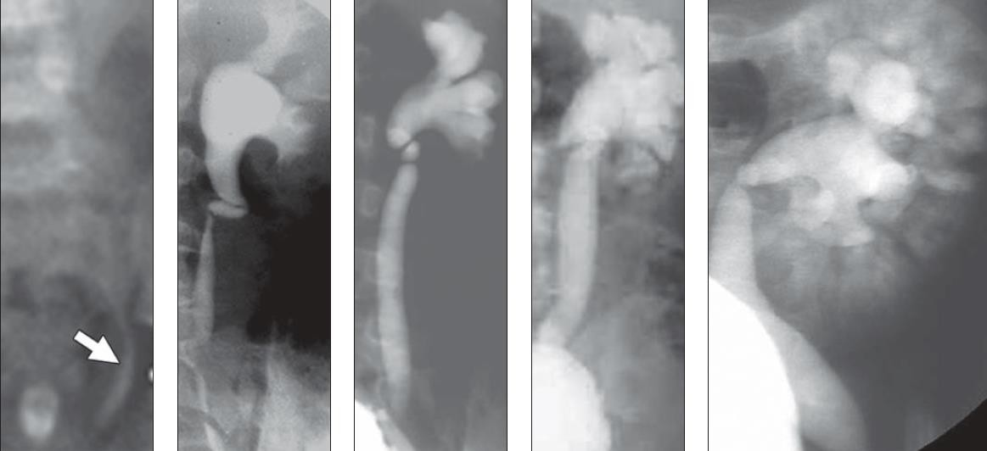

Slide 60
Grade I - Reflux into nondilated ureter
Grade II - Reflux into renal pelvis and calyces without dilation
Grade III - Reflux with mild-to-moderate dilation and minimal blunting of fornices
Grade IV - Reflux with moderate ureteral tortuosity and dilation of pelvis and calyces
Grade V - Reflux with gross dilation of ureter, pelvis,
and calyces, loss of papillary impressions, and ureteral tortuosity

Slide 61
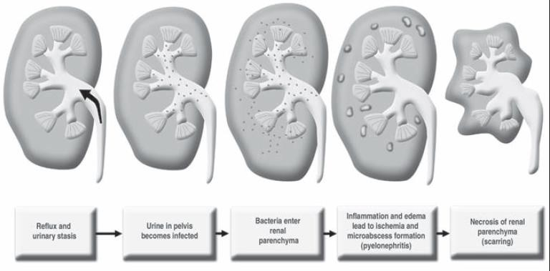
REFLUX NEPHROPATHY
Start with normal kidney
Due to recurrent infection and fibrosis >> atrophic kidney

Slide 62
DMSA SCAN
The DMSA is the most sensitive and accurate study for demonstrating
scarring
If the DMSA scan shows acute pyelonephritis, approximately 50% will acquire a scar in that site over the following 5 mo.
However, if the DMSA scan is normal during a febrile UTI, no scarring
results from that particular infection

Slide 63
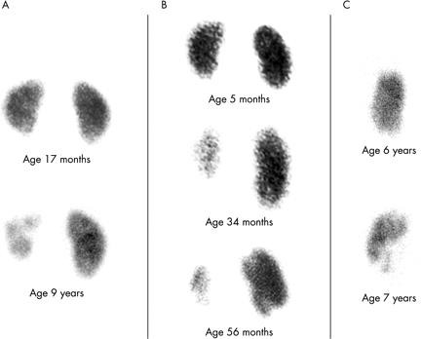
DMSA scans in three children, all imaged from behind, so the left kidney is on the left. (A) A girl presented promptly at 3 months, acutely ill with a UTI. Grade III VUR was identified, but no scarring was present at 17 months. She was monitored closely and remained infection-free on trimethoprim prophylaxis until 4 years of age, and then discharged. She had several UTIs from 6 to 9 years of age, when she had continuing VUR and had acquired severe left renal scarring. (B) A girl was imaged at 5 months because her brother had developed reflux nephropathy. Bilateral VUR was identified without renal scarring. Her parents were consistently non-compliant, and she suffered repeated, prolonged UTIs. A scan at 34 months shows severe left kidney damage, and one at 56 months also showed scars at both poles of her right kidney. (C) A boy had multiple complex congenital abnormalities, including a solitary left kidney with VUR. He remained free of UTIs for over 6 years on prophylaxis, but then suffered several UTIs that were difficult to diagnose, and subsequently acquired scarring.
Affected kidney : reduced uptake , irregular shape

Slide 64
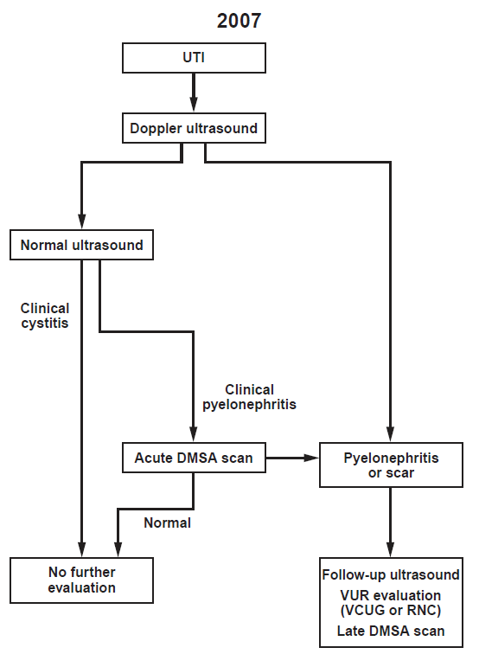

Slide 65
FOLLOW UP AFTER FEBRILE UTI
Insure good voiding habit and avoid constipation
No need to do routine cultures in healthy asymptomatic children
annual US, Urine dipstick and BP check indicated for every child with renal tract
abnormality .
Antireflux surgery for high grade VUR with recurrent UTI and continuing renal scarring

Slide 66
PROPHYLAXIS ?
Prophylaxis antibiotics indicated for for:
recurrent febrile UTI in those with renal tract abnormality and patients with worsening imaging results, Under 2 y

Slide 67
PROPHYLAXIS ANTIBIOTICS
Prophylaxis options: same antibiotic but lower doses .
-TMP and SMX( Septra)
-Nitrofurantoin
-Nalidixic acid
- Cephalexin ( ultrasporin)

Slide 68
PREVENTION
Drink large amount of water
Teaching for dysfunctional voiders
Children should have access to clean toilet and encouraged to empty bladder
Treat constipation

Slide 69
CRANBERRIES
بحكو التوت البري مفيد
As prophylactic
works on fimbriae like antibiotic
Some evidence suggests that cranberry juice might be beneficial to prevent recurrence of UTI in children

Slide 70
Thank You

