Slide 1
2- CARDIAC CYCLE
Prof. Sherif W. Mansour
Physiology dpt., Mutah School of medicine

Slide 2
The cardiac cycle
-It is the period from the end of one heart contraction to the end of the next.
-It starts by systole of both atria followed by systole of both ventricles and then diastole of the whole heart.
-The cycle is initiated by S.A. node. The action potential travels rapidly through the atria and then through the AV bundle into the ventricles.
-However there is a delayed period of 0.1 seconds in the A.V. node allows the atria to pump before the ventricular contraction.
-The complete cardiac cycle last about 0.8 sec if the heart rate is 75 beat/minute.
* The ventricular systole 0.3 sec. The ventricular diastole 0.5 sec
* The atrial systole 0.1 sec. The atrial diastole 0.7 sec
When the heart rate increases, the cycle shortens, especially the diastole.

Slide 3
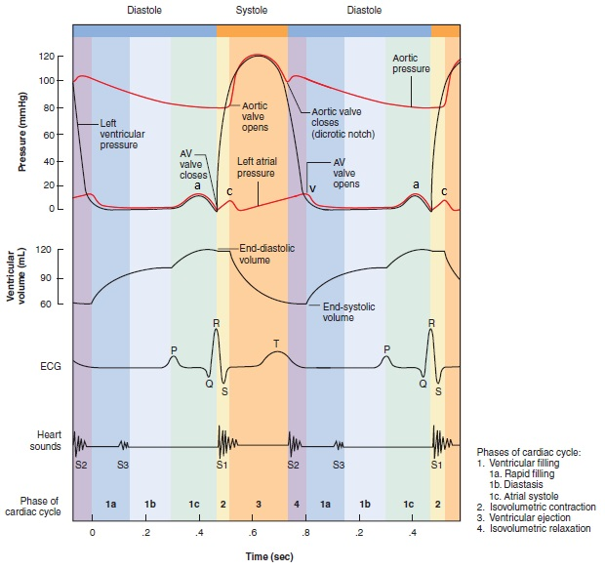

Slide 4
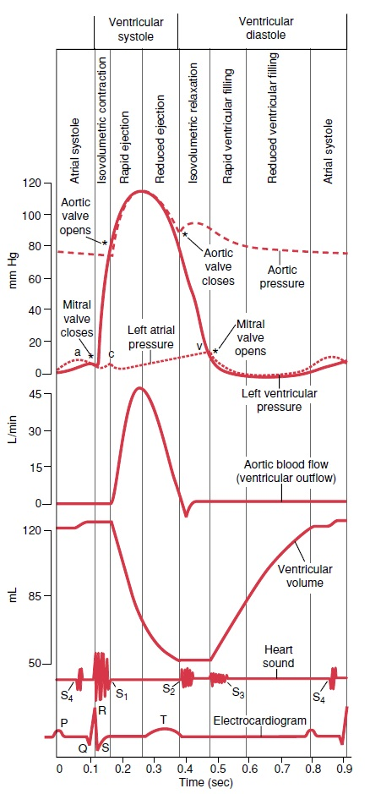
The cardiac cycle includes the following phases:
A. Atrial systole :
1. Atrial contraction phase (late diastole):
- Duration : 0.1 Sec.
- Events : the atria contract and pump 30% of the ventricular filling (to the ventricles).
The atrial pressure: rise from 4 mmHg to 8 mmHg and return to 4 mmHg at the end of this phase due to the atria evacuation.
Ventricular pressure : rise from 4 mmHg to 8 mmHg and return to 4 mmHg at the end of this phase as the ventricles dilate to accommodate the blood passing to it.
- Ventricular volume : Increased by (20 ml) to reach the end diastolic volume (E.D.V. = 140 ml).
- Heart sounds : The 4th heart sound which is weak and inaudible due to vibration of atrial muscle during the contraction and rushing of blood into the ventricles.
- Valves : - The semilunar valves are closed.
- The A.V. valves are opened .
- ECG : P wave of ECG starts before atrial contraction by 0.02 sec due to the atrial depolarization.

Slide 5
B. Ventricular systole :
2. Isometric (iso-volumetric) contraction phase :
- Duration : 0.05 sec
- Events : It begins by closure of A.V. valve and the ventricles begin to contract isometrically (without change in muscle fiber length).Thus the ventricles are closed chambers filled with blood.
- Atrial pressure : rise due to bulging of the A.V. valves into the atria and also due to regurgitation of some blood into the atria before closure of the A.V. valves.
- Ventricular pressure : rise from 4 mmHg to 80 mmHg in the left ventricle.
- Ventricular volume : is constant (isometric) this is because the blood is not compressible.
- Heart sounds; the first components of the 1st heart sound due to closure of the A.V. valves.
-Valves : are closed (A-V and semilunar valve) .
- ECG : QRS complex starts before the ventricular contraction by 0.02 seconds to ventricular depolarization.

Slide 6
3. Rapid (maximum) ejection phase :
- Duration : 0.15 sec
- Events : it begins by opening of the aortic valve and rushing of blood into the aorta where 70% of stroke volume ejected in this phase.
- The atrial pressure : decreases due to down displacement of the A.V. valve during shortening of ventricular muscles.
- The ventricular and aortic pressures : rise from 80 to 120 mmHg. Because the amount of blood ejected through the aortic valve exceeds that which leaves the aorta.
- Ventricular volume :decreases greatly due to change of the isometric contraction to isotonic contraction and ejection of the blood.
- Heart sounds : the second component of the 1st heart sound due to rushing of blood into the aorta and vibration of the aortic wall.
- Valves : - The semilunar valves are opened.
- The A.V. valve is closed .
- ECG : Beginning of T wave of ECG (repolarization of the ventricles).

Slide 7
4. Reduced (minimum) ejection phase :
- Duration : 0.1 sec.
- Events : the remaining 30% of stroke volume is ejected to the aorta.
- The ventricular and aortic pressures : reach their maximum and begin to decrease (due to escape of blood to peripheral circulation is more than the amount of blood ejected from the ventricle.
Atrial pressure : increased due to venous return.
Ventricular volume :decreases to reach the end systolic volume (ESV = 70ml).

Slide 8
C. Ventricular diastole :
5. Protodiastolic phase :
- Duration : 0.04 sec
- Events : the period between the end of ventricular systole and the closure of the aortic valve.
- The ventricular and aortic pressures: The ventricle begins to relax but still contracted and its pressure decreases about 20 mmHg and the aortic pressure decreases also (due to escape of blood to peripheral circulation). But still above the ventricular pressure. This causes the blood in the aorta to regurgitate to the ventricles leading to closure of the aortic valve at the end of this phase.
- The closure of semilunar valves occurs as a result of fall of ventricular pressure below that of aortic and pulmonary arteries.
- The closure of the aortic valve and the change of potential energy to kinetic energy leads to sharp momentary fall in the aortic pressure called the dicrotic (incisura) notch.
- Ventricular volume : is constant.
- ECG : down slope of the (T) wave.

Slide 9
6. Isometric relaxation phase :
- Duration : 0.06 sec
- Events : it begins by closure of the aortic valve and the ventricles relax isometrically without change in the ventricular volume.
- Atrial pressure : increased above the ventricular pressure due to accumulation of venous return, this pressure can open the A.V. valve at the end of this phase.
- Ventricular pressure : falls rapidly from 90 to 0 mmHg.
- Aortic pressure : due to elastic recoil of the aorta its pressure increased leading to upward (dicrotic) wave.
- Heart sounds : the 2nd heart sound due to closure of the aortic valve and pulmonary valve (semilunar valves).
- The semilunar valves (aortic, pulmonary) close at the beginning of this phase- The A.V. valves open at the end of this phase.
- ECG : end of T wave.

Slide 10
7. Maximal (rapid) filling phase :
- Duration : 0.1 sec.
- Events : It begins by opening of A.V. valve due to the increased atrial pressure above the ventricular pressure (60% of stroke volume is rushed to the ventricle).
- Atrial and ventricular pressure : around zero.
- Ventricular volume : increased.
- Aortic pressure: decreases due to escape of blood to peripheral vessels.
- Heart sounds: the 3rd heart sound due to rushing of blood into the ventricles and vibration of the ventricular wall.
8-.Reduced filling phase :
- Duration : 0.2 sec.
- Events : 10% of the stroke volume flow slowly to the ventricle.
- The ventricular volume increase gradually.
- The ventricular pressure rises to 4 mmHg.

Slide 11
* Changes in pressures during the cardiac cycle:
* During the diastole :
1. The ventricular filling occurs in early diastole.
2. The ventricles rest.
3. The coronary blood flow occurs.
* ECG changes :
- P wave : start before atrial systole by 0.02 sec.
- QRS complex : start before ventricular systole by 0.02 sec.
- T wave : the ventricular systole ends just after T wave.
 | Rt. Vent | L. Vent | Pul. art | Aorta
Systolic Pr | 25 | 120 | 25 | 120
Diast Pr | 0 | 0 | 8 | 80

Slide 12
Thank You

