Slide 1
Immunology Lab 5 ABO Blood Antigens

Slide 2
ABO blood antigens
The ABO antigens are carbohydrates linked to cell surface proteins and lipids that are synthesized by polymorphic glycosyltransferase enzymes.
Most individuals possess a fucosyltransferase that adds a fucose moiety to a nonterminal sugar residue of the core glycan, and the resulted fucosylated glycan is called the H antigen (O antigen).
A single gene on chromosome 9 encodes a glycosyltransferase enzyme that may further modify the H antigen.
There are three allelic variants of this enzyme
O allele gene product: is devoid of enzymatic activity and cannot attach terminal sugars to the H antigen and express only the H antigen.
A allele– encoded enzyme: transfers a terminal N-acetylgalactosamine moiety onto the H antigen.
B allele gene product: transfers a terminal galactose moiety.

Slide 3
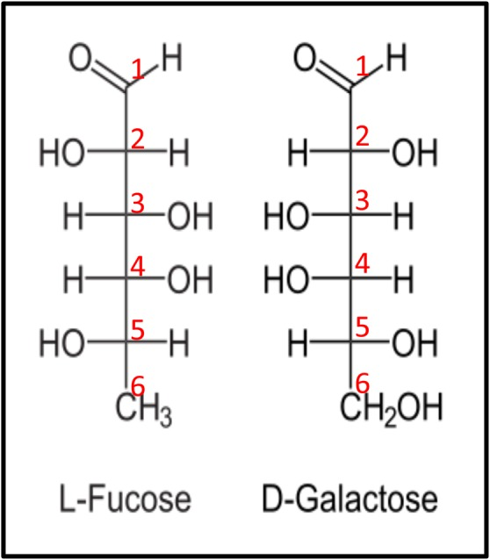
The C-6 carbon of l-fucose lacks a hydroxyl group present at the C-6 position of d-galactose. l-Fucose can also be described as 6-deoxy-l-galactose.

Slide 4
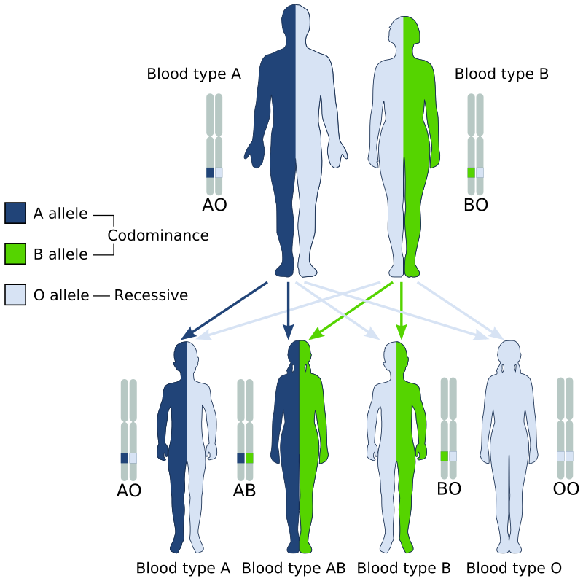

Slide 5
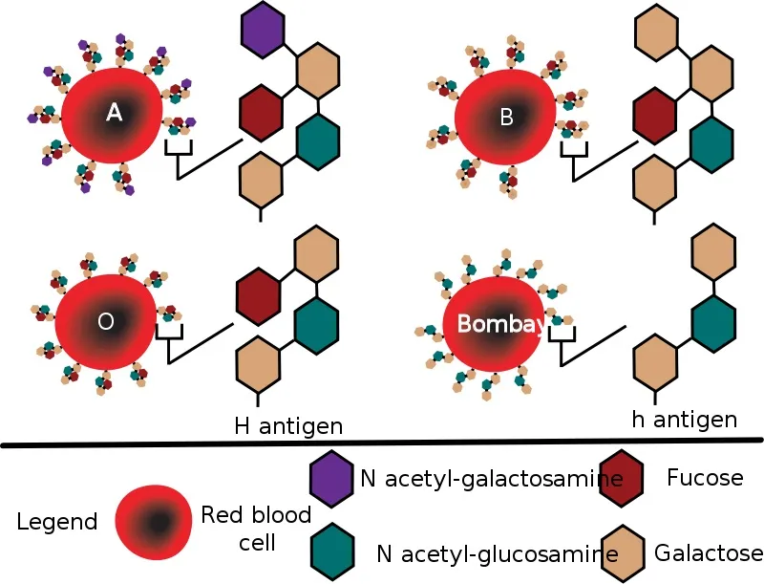
Diagram showing the carbohydrate chains that determine the ABO blood group

Slide 6
Mutations in the gene encoding the fucosyltransferase that produces the H antigen without fucose are rare; people who are homozygous for such a mutation are said to have the Bombay blood group. And cannot produce H, A, or B antigens. and cannot receive type O, A, B, or AB blood.

Slide 7
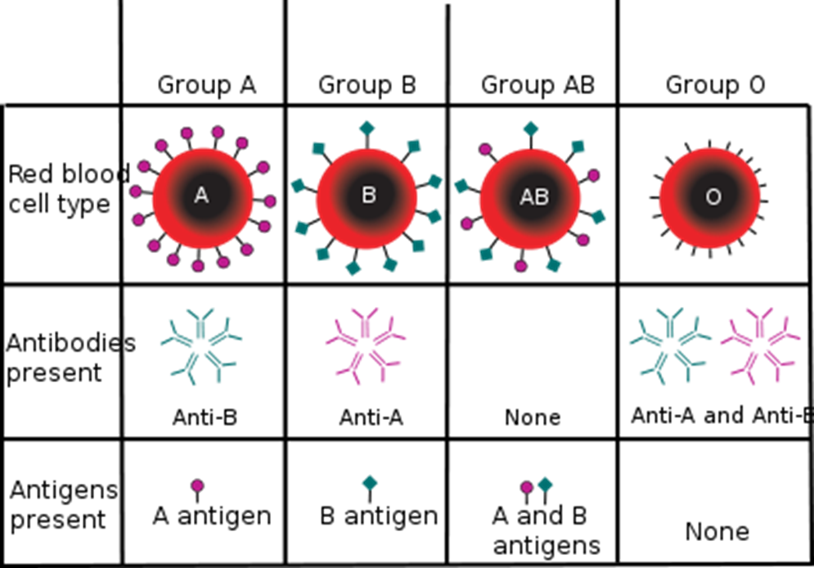

Slide 8
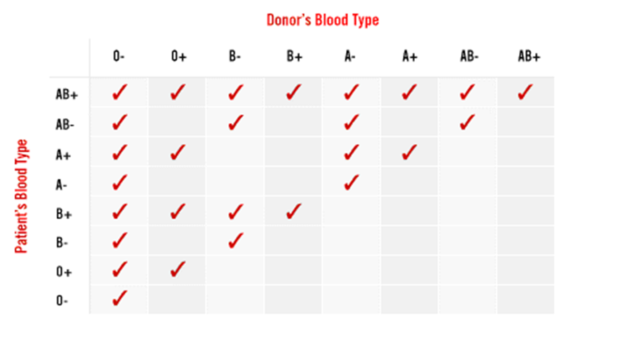
Most Common Transplantation -Blood Transfusion-

Slide 9
Percentages of the 8 blood groups
AB-negative (. 6 percent)
B-negative (1.5 percent)
AB-positive (3.4 percent)
A-negative (6.3 percent)
O-negative (6.6 percent)
B-positive (8.5 percent)
A-positive (35.7 percent)
O-positive (37.4 percent)

Slide 10
O-negative is the universal blood type, meaning any other blood type may receive it (see our blood type compatibility chart here).
This can quickly deplete the stores of O-negative that blood centers have on the shelves.
While 45% of the population is type O, less than 7% is O-negative. So as you can see, the most needed type of blood is also the hardest to collect.
AB negative is the rarest of the eight main blood types - just 1% of our donors have it. Despite being rare, demand for AB negative blood is low

Slide 11
Chromosome | Epitope or carrier, notes | System symbol | Blood groupingSystem
9 | Carbohydrate (N-Acetylgalactosamine, galactose). A, B and H antigens | ABO | ABO
4 | Main antigens M, N, S, s. | MNS | MNS
1 | Protein. C, c, D, E, e antigens (there is no "d" antigen; lowercase "d" indicates the absence of D | RH | Rh
7 | Glycoprotein. K₁ can cause hemolytic disease of the newborn (anti-Kell), which can be severe. | KEL | Kell
6 | Polysaccharide | Li | LI
1 | Protein (chemokine receptor). Main antigens Fyª and Fy^{b}. Individuals lacking Duffy antigens altogether are immune to malaria caused by Plasmodium vivax and Plasmodium knowlesi. | FY | Duffy

Slide 12
RH blood antigen
Rh antigens are non-glycosylated, hydrophobic cell surface proteins found in red blood cell membranes.
15% of the population has a deletion or other alteration of the RhD allele.
Rh status is inherited from our parents, separately from our blood type.
If you inherit the dominant Rhesus D antigen from one or both of your parents, then you are Rh-positive (85% of us). If you do not inherit the Rhesus D antigen from either parent, then you are Rh-negative (15% of us).

Slide 13
Rh System
Rh Antigens and Encoding Genes
Subsequently it was confirmed that the RH locus is on chromosome 1 and comprises two highly homologous, very closely linked genes, RHD and RHCE.
The Rh blood group system consists of 49 defined blood group antigens, among which the five antigens (D, C, c, E, and e) are the most important.
There is no d antigen. D antigen is the main that its presence or absence mean RH+ or RH- respectively.
The main antigens are D, C, E, c and e, which are encoded by two adjacent gene loci, the RHD gene which encodes the RhD protein with the D antigen and the RHCE gene which encodes the RhCE protein with the C, E, c and e antigens
The RHCE gene has four main alleles; CE, Ce, ce and cE.
This concept of D and CcEe genes linked closely and transmitted together is consistent with the Fisher nomenclature.
Examples on antigens in RH+ and -
D− C+ E+ c− e+ (RhD−)
D+ C+ E− c− e+ (RhD+)

Slide 14
Each locus has its own set of alleles which are Dd , Cc , and Ee . The D gene is dominant to the d gene, but Cc and Ee are co-dominant (meaning that all of the inherited alleles lead to expression of the coded antigens).
Antibodies to Rh antigens can be involved in hemolytic transfusion reactions and antibodies to the Rh(D) antigens confer significant risk of hemolytic disease of the fetus and newborn.

Slide 15
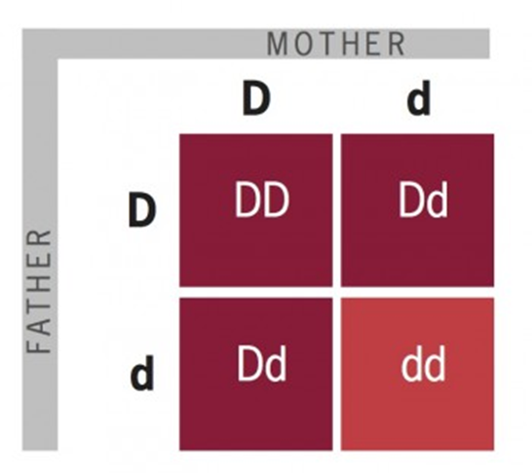

Slide 16
Rh System
Antibodies
Antibodies directed against all Rh antigens, except d, have been described: anti-D, anti-C, anti-c, anti-E and anti-e.
Rh antigens are restricted to red cells and Rh antibodies result from previous alloimmunization by previous pregnancy or transfusion.
Immune Rh antibodies are predominantly IgG.

Slide 17
…Rh Antibodies
Anti-D is clinically the most important antibody.
It may cause hemolytic transfusion reactions and was a common cause of fetal death resulting from hemolytic disease of the newborn before the introduction of anti-D prophylaxis.

Slide 18
hemolytic disease of the newborn
When the condition is caused by the Rh D antigen-antibody incompatibility, it is called Rh D Hemolytic disease of the newborn
The major clinical significance of anti-Rh antibodies is related to hemolytic reactions associated with pregnancy that are similar to transfusion reactions.
(Rh-negative mothers) carrying an Rh-positive fetus can be sensitized by fetal red blood cells that enter the maternal circulation, usually during childbirth. IgG antibodies are generated in Rh-negative mothers.
Subsequent pregnancies in which the fetus is Rh positive are at risk because the maternal anti-Rh D IgG antibodies can cross the placenta and mediate the destruction of the fetal red blood cells. This causes anemia, dyspnea, jaundice and erythroblastosis fetalis.

