Slide 1
Osmolarity and overview of respiratory system
Dr. ARWA RAWASHDEH

Slide 2
Objectives
Osmolarity
Overview of respiratory system
Function
Overview of gas exchange

Slide 3
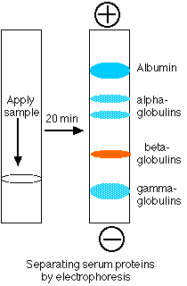
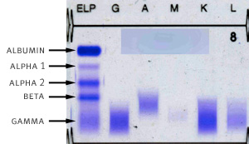
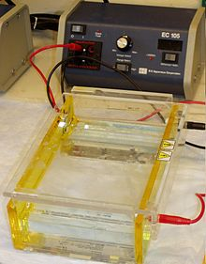
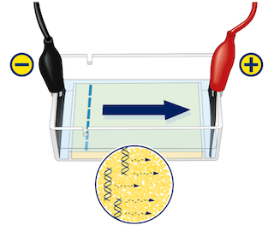
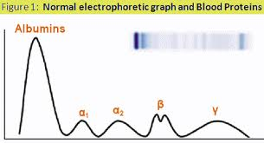
Composition of blood plasma
Electrophoresis

Slide 4
If you add 4millimole of KCL to 1 L of water you will end up with 8 mosm/L
How to quantify numerically the tonicity of solution?

Slide 6
Physiological saline is 0.9% NaCl. This means that 100 ml's of physiological saline contains 0.9 g of NaCl. One liter of physiological saline must contain 9 g of NaCl. We can determine the molarity of a physiological saline solution by dividing 9 g by 58 g... since we have 9 g of NaCl in a liter of physiological saline, but we have 58 grams of NaCl in a mole of NaCl. When we divide 9 g by 58 g, we find that physiological saline contains 0.154 moles of NaCl per liter. That means that physiological saline (0.9% NaCl) has a molarity of 0.154 molar. We might express this as 0.154 M... or 154 millimolar (154 mM).
A 0.9% NaCl and a 0.154 M NaCl solution are the same thing. They are physiologic isotonic solution

Slide 7
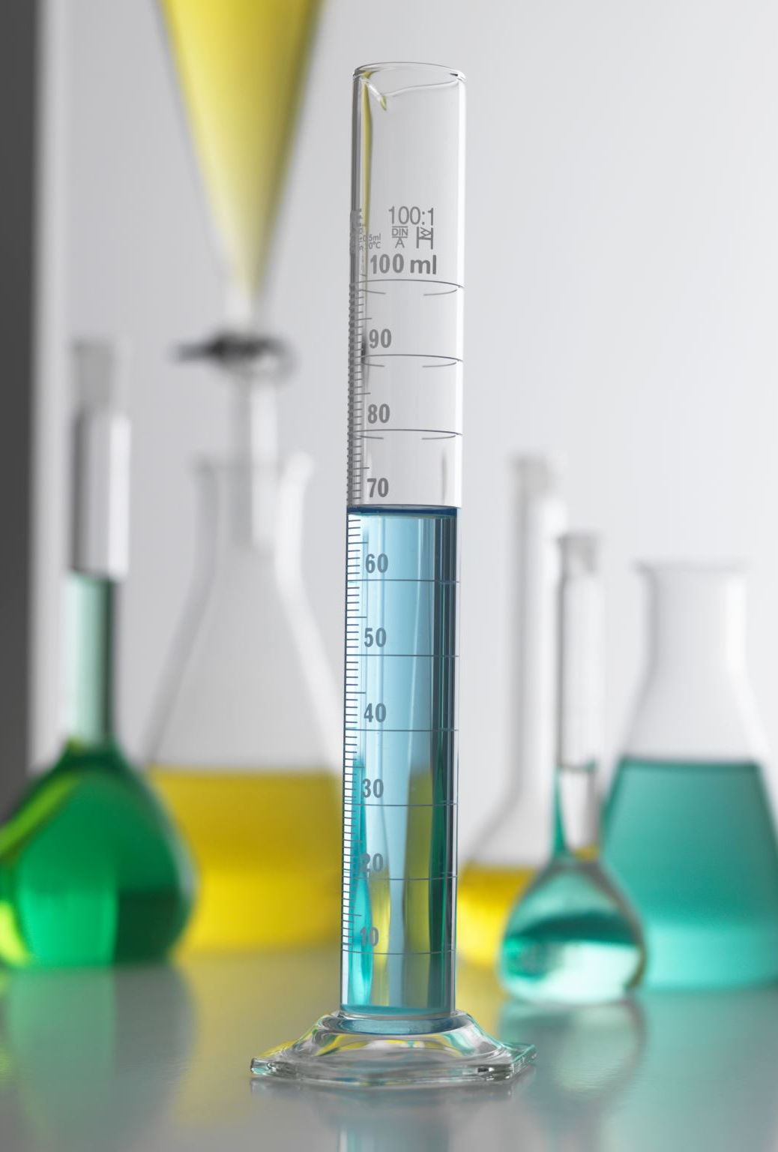
How to quantify numerically the tonicity of solution?
A 3% sodium chloride (NaCl) solution is hypertonic and when infused intravenously would increase extracellular fluid volume and osmolarity, thereby causing water to flow out of the cell. This would decrease intracellular fluid volume and further increase extracellular fluid volume.
The 0.9% NaCl solution and 5% dextrose solution are isotonic, and therefore would not reduce intracellular fluid volume.
Pure water and the 0.45% NaCl solution are hypotonic, and when infused would increase both intracellular and extracellular fluid volumes

Slide 8
Overview of respiratory system

Slide 9
Pulmonary ventilation
Air moves in and out of lungs
Continuous replacement of gases in alveoli (air sacs)
External respiration
Gas exchange between blood and air at alveoli
O2 (oxygen) in air diffuses into blood
CO2 (carbon dioxide) in blood diffuses into alveoli
Internal respiration
Gas exchange in capillaries between blood and tissue cells
O2 in blood diffuses into tissues
CO2 waste in tissues diffuses into blood
Cellular respiration
Oxygen (O2) is used by the cells
O2 needed in conversion of glucose to cellular energy (ATP)
Carbon dioxide (CO2) is produced as a waste product
The body’s cells die if either the respiratory or cardiovascular system fails

Slide 10
Overview of respiratory system
Conducting zone
Respiratory passages that carry air to the site of gas exchange
Filters,
humidifies
and warms air
Respiratory zone
Site of gas exchange
Composed of
Respiratory bronchioles
Alveolar ducts
Alveolar sacs

Slide 11
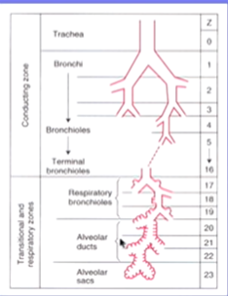
FACTS OF VENTILATION
Swiss anatomist dr. weibel counted the air ways in the lung and measures their sizes and he came up with idealized airway model called weibel model

Slide 12
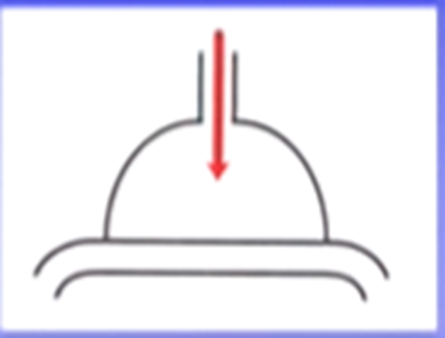

Slide 13
