Slide 1
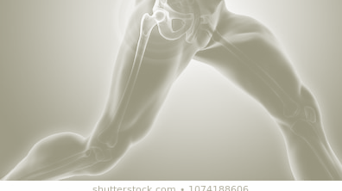
OSTEOARTHRITIS
Edited by;
Lana Sabateen
Malak Al-Majali
Sara Khreisat
Mohammad Said Dawood, M.D.
Orthopedics and Reconstructive Surgery Consultant
Faculty of Medicine , Mut’ah University, 2020

Slide 2
TYPES OF CARTILAGE IN OUR BODIES
Hyaline or articular cartilage.
Fibroelastic cartilage; in meniscus and in the labrum of the hip and shoulder joints.
Fibrocartilage; found at tendon and ligament insertion into bone)
Elastic cartilage; in trachea.
Physeal cartilage; growth plate.

Slide 3
HYALINE CARTILAGE
Composition
A gel-like extracellular matrix consisting of a proteoglycan ground substance with an embedded architecturally structured collagen (mainly Type II) network.
A relatively sparse scattering of specialized cells, the chondrocytes, which are responsible for producing all the structural components of the tissue.
A high-water content (60–80%), most of which is exchangeable with the synovial fluid.
Function
Transmit load and movement from one skeletal segment to another.
Distributes compressive forces widely to the subarticular bone.
Decrease frictional resistance to movement and surface gliding.

Slide 4
OSTEOARTHRITIS (OSTEOARTHROSIS) - DEFINITION
A chronic joint disorder in which there is progressive softening and disintegration of articular cartilage accompanied by new growth of cartilage and bone at the joint margins (osteophytes), cyst formation and sclerosis in the subchondral bone, mild synovitis and capsular fibrosis.
It is either primary, most common form, where it’s unaccompanied by any systemic illness and is seen in elderly.
Secondary where it follows a demonstrable abnormality and occurs as a combination of
Weakening of the articular cartilage due to genetic defects in type II collagen or enzymatic activity, trauma or a previous inflammatory disorders [gout, rheumatoid diseases]
Increased mechanical stress in some part of the articular surface [increased load or in a reduction of the articular contact area]

Slide 5
OSTEOARTHRITIS – RISK FACTORS
Occupation
Trauma
Obesity
Family history
In certain occupations that cause repetitive stress;
OA of the knees in workers engaged in knee-bending activities
OA in the upper limbs in people working with heavy vibrating tools and OA of the hands in cotton mill workers.
OA in sporting activity; Footballers with OA of the knees and baseball pitchers with OA of the shoulder.
Fractures involving the articular surface are obvious precursors of secondary OA.
Increased joint loading predisposes to OA.
Women whose mothers had generalized OA are more likely to develop the same condition.

Slide 6
OSTEOARTHRITIS - SYMPTOMS
Pain
The usual presenting symptom.
It is often quite widespread, or it may be referred to a distant site (i.e. pain in the knee from OA of the hip).
Starts insidiously and increases slowly over months or years (from 6 weeks – 3 months).
Aggravated by exertion and relieved by rest, although with time relief is less and less complete. In the late stage the patient may have pain in bed at night.
Patients usually present after middle age (50s – 60s).
Joint involvement follows several different patterns:
One or two of the weightbearing joints (hip or knee).
The interphalangeal joints (especially in women).
Any joint that has suffered a previous affliction.
A family history is common in patients with polyarticular OA.
Typically, the symptoms of OA follow an intermittent course, with periods of remission sometimes lasting for months.
The typical course of the disease is Pain → Swelling → Stiffness and Loss of ROM → Deformity.
Stiffness
Common; characteristically it occurs after periods of inactivity, but with time it becomes constant and progressive.
Swelling
May be intermittent (suggesting an effusion) or continuous (with capsular thickening or large osteophytes).
Deformity
May result from capsular contracture or joint instability (but be aware that the deformity may have preceded and contributed to the onset of OA).

Slide 7
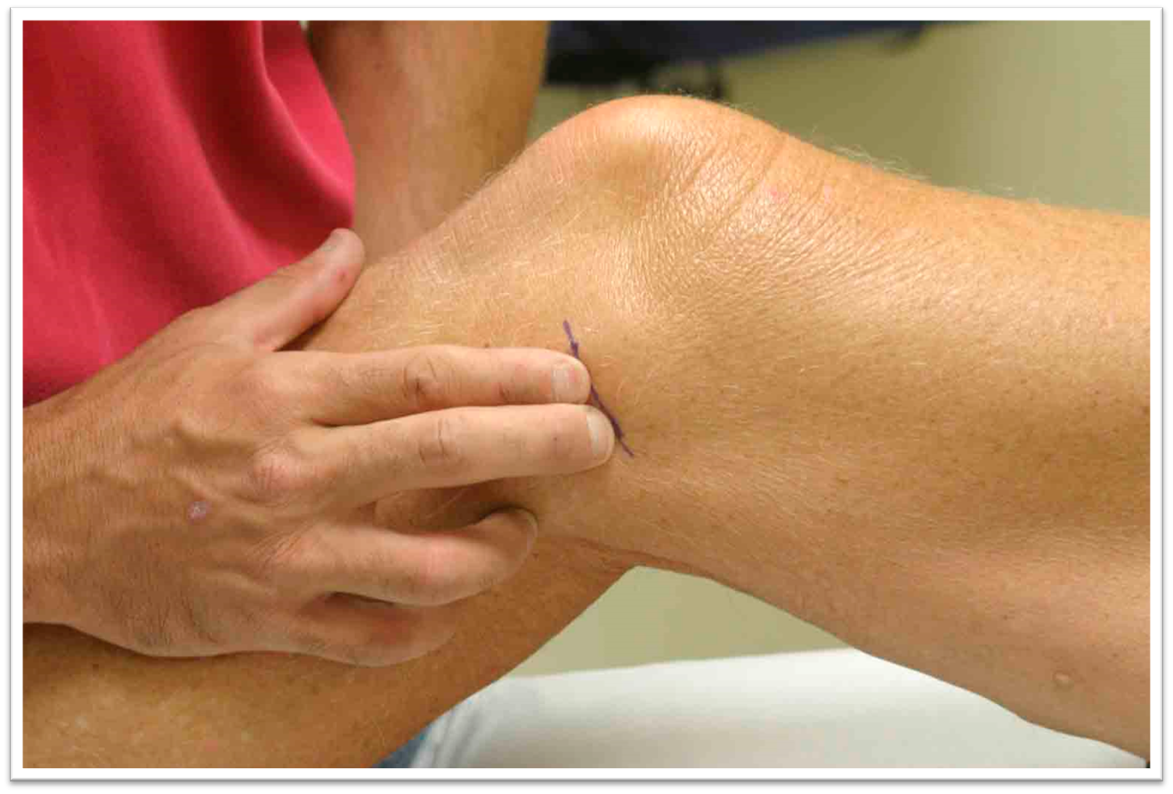
OSTEOARTHRITIS – SIGNS
Swelling.
Tenderness (around joint line).
Crepitus on movement.
Deformity.
Muscle wasting.
In contrast to inflammatory joint disease, OA is unassociated with any systemic manifestations.

Slide 8
OSTEOARTHRITIS – IMAGING
X-ray appearances are so characteristic that other forms of imaging are seldom necessary for ordinary clinical assessment. They should be taken while the patient is standing.
The cardinal signs of osteoarthritis:
Narrowing of the ‘joint space (asymmetrical loss of cartilage)
Sclerosis of the subchondral bone under the area of cartilage loss.
Formation of cysts close to the articular surface.
Formation of osteophytes at the margins of the joint.
Re-modelling of the bone ends on either side of the joint.
Late features may include joint displacement and bone destruction.

Slide 9
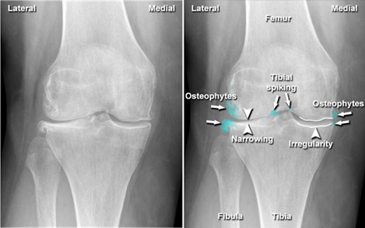
OSTEOARTHRITIS – IMAGING

Slide 10
OSTEOARTHRITIS - TREATMENT
Conservative Treatments (In mild/early staged)
Lifestyle modification.
Pharmacological.
Intraarticular.
Operative treatment.
The treatment options are discussed upon the recommendation of the AAOS.

Slide 11
OSTEOARTHRITIS – LIFESTYLE MODIFICATION
We suggest weight loss for patients with symptomatic osteoarthritis of the knee and a BMI ≥ 25.
We recommend that patients with symptomatic osteoarthritis of the knee participate in self-management programs, strengthening, low-impact aerobic exercises, and neuromuscular education; and engage in physical activity (walking & swimming)
We cannot recommend using acupuncture in patients with symptomatic osteoarthritis of the knee.
Weight Reduction
Exercise
Acupuncture

Slide 12
OSTEOARTHRITIS - TREATMENT
We are unable to recommend for or against the use of physical agents (including electrotherapeutic modalities) in patients with symptomatic osteoarthritis of the knee.
We are unable to recommend for or against the use of a valgus directing force brace (medial compartment unloader) for patients with symptomatic osteoarthritis of the knee.
We cannot suggest that lateral wedge insoles be used for patients with symptomatic medial compartment osteoarthritis of the knee.
Physical Agents
Brace
Insoles

Slide 13
OSTEOARTHRITIS - PHARMACOLOGICAL
NSAIDs
Acetaminophen
Glucosamine and Chondroitin
We recommend nonsteroidal anti-inflammatory drugs (NSAIDs; oral or topical) or Tramadol for patients with symptomatic osteoarthritis of the knee.
We are unable to recommend for or against the use of acetaminophen, opioids, or pain patches for patients with symptomatic osteoarthritis of the knee.
Acetaminophen provides pain relief only without an anti-inflammatory effect.
Opioids are not recommended for controlling pain symptoms due to the long course of the disease and risk of dependence.
We cannot recommend using glucosamine and chondroitin for patients with symptomatic osteoarthritis of the knee.
Both are structural components of cartilage and are degraded to amino acids. They are given as oral supplements and the body will not discriminate from what source it came from. Useless and harmless.

Slide 14
OSTEOARTHRITIS – INTRAARTICULAR
We cannot recommend using hyaluronic acid for patients with symptomatic osteoarthritis of the knee.
It reduces the pain without regenerating the joint.
We are unable to recommend for or against growth factor injections and/or platelet rich plasma for patients with symptomatic osteoarthritis of the knee.
The activation of the PRP platelets causes the release of platelet content related to tissue repair to the outside, and it joins to the circulating biomolecules in the plasma. Thus, the levels of many growth factors will depend on the platelet concentration of the PRP. This is yet to be proven.
We are unable to recommend for or against the use of intraarticular (IA) corticosteroids for patients with symptomatic osteoarthritis of the knee.
Corticosteroids IA injection will alter the osmolarity of the joint space; the cartilage receives nutrition by diffusion thus altering the nutrition of the hyaline cartilage.
In end stage osteoarthritis, when the patient is contraindicated or unwilling to undergo surgery, corticosteroids are used for brief symptomatic relief (however it will not regenerate the joint.)
IA Hyaluronic Acid
PRP (Platelet-rich plasma)
IA Corticosteroids

Slide 15
OSTEOARTHRITIS – OPERATIVE TREATMENT
We cannot recommend performing arthroscopy with lavage and/or debridement in patients with a primary diagnosis of symptomatic osteoarthritis of the knee.
It is a symptomatic treatment. The patient will be pain free for 1 month – year and then pain will recur.
The practitioner might perform a valgus producing proximal tibial osteotomy in patients with symptomatic medial compartment osteoarthritis of the knee.
Strength of Recommendation: Limited; Not done in elderly patients (more than 50yrs), in lateral compartment OA or in presence of ligament imbalance.
Arthroscopy with Lavage
Osteotomy

Slide 16
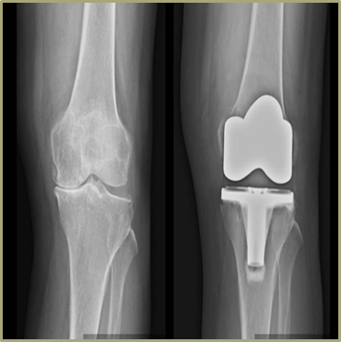
OSTEOARTHRITIS – OPERATIVE TREATMENT
Replacement Surgery
Indicated in severe OA with pain.
Involves debridement of the joint, removal of the end of the bone and replacing it with a prosthetic.
Surgery lasts for 15 – 20 years (not a lifelong solution).

Slide 17
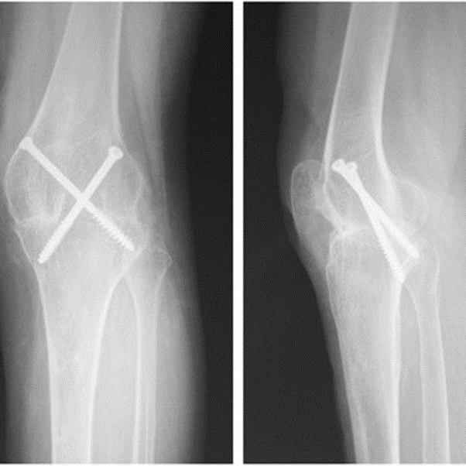
OSTEOARTHRITIS – OPERATIVE TREATMENT
Arthrodesis
Indicated in joints of the hand, feet and ankle.
In cases of failed replacement.
It eliminates the joint movement (No motion = no pain)

Slide 18
OSTEOARTHRITIS

