Slide 1
DYSLIPIDEMIA
BY: Mariam Dabaeen

Slide 2
Definition:
Defined as abnormal concentration of lipids in blood (elevated LDL, TAGs and low levels of HDL
Dyslipidemia is a major risk factor in developing atherosclerosis which increases the risk for cardiovascular events

Slide 3
Etiology :
mostly acquired:
- obesity (BMS >25 kg/m²) (excessive consumption of saturated fats and trans-fatty acids)
- sedentary lifestyle
- DM and insulin resistance
- cholestatic liver disease
- hypothyroidism
- heavy alcohol consumption
- Cushing disease
- nephrotic syndrome
- drugs: (antipsychotics, beta blockers (e.g., metoprolol), oral contraceptive pill, high-dose diuretic use)
Inherited: single or multiple gene mutations resulting in impairment of LDL and TAGs production or clearance.

Slide 4
Clinical manifestations
skin manifestations
01
Eye manifestations
02
04
Premature atherosclerosis
GI manifestations
03
Xanthoma and xanthalasma
Lipemia retinalis and corneal arcus
Fatty liver and pancreatitis

Slide 5
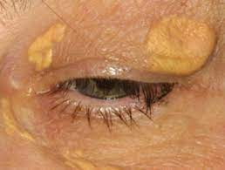
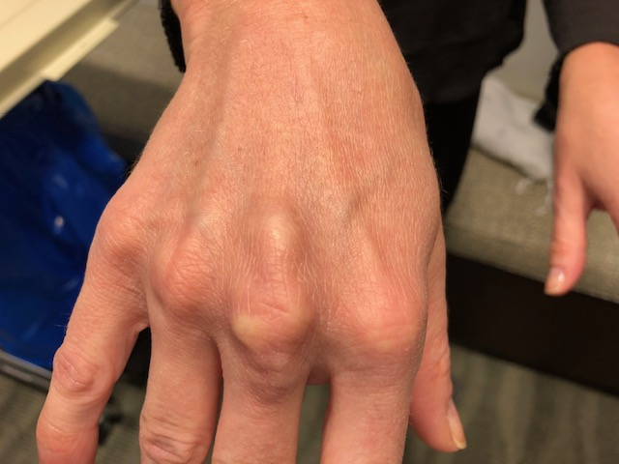
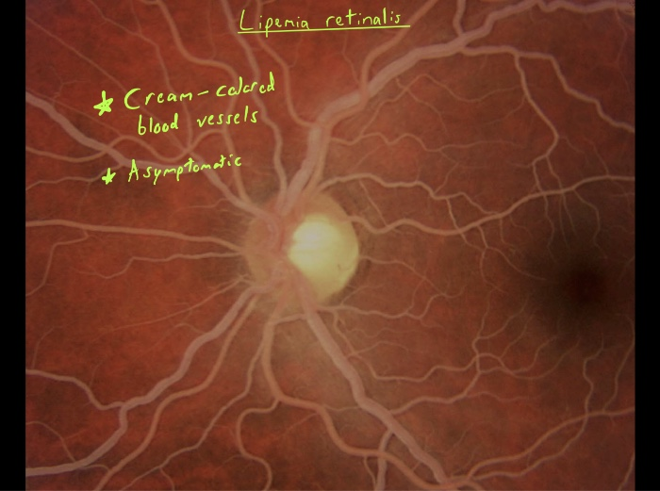
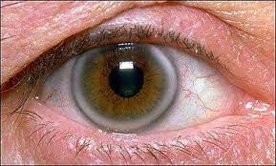
Clinical manifestations

Slide 6
Diagnosis:
Pts may be incidentally diagnosed on routine blood tests and have no presenting clinical features
In Hx carry out a systemic review for vascular disease focusing on symptoms of CAD, cerebrovascular diseases and peripheral arterial diseases.
Investigations: lipid profile includes: total cholesterol, TAGs, HDL, LDL
Values of Lipids:
● LDL
○ < 100 →Optimal
○ 100-129 → Near optimal
○ 130-159 → Borderline
○ 160-189→ High
○ ≥ 190 → Very High

Slide 7
Diagnosis:
● Total Cholesterol
○ < 200 → Desirable
○ 200-239 → Borderline
○ ≥240 → High
● HDL
○ < 40 → Low
○ ≥ 60 → High
● Serum Triglycerides
○ < 150 → normal
○ 150-199 → Borderline
○ 200-499 → High
○ ≥ 500 → Very High

Slide 8
Screening indications:
Men over 35 and woman over 45.
● Anyone with atherosclerotic symptoms regardless of age
● Anyone with diabetes regardless of age
● Family history of premature CVD
● Inflammatory diseases (lupus, rheumatoid arthritis, psoroasis)
● Children of patients with severe dyslipidemia
● Clinical signs of hyperlipidemia; Xanthelasma, tendon xanthoma, corneal arcus.
● Erectile dysfunction
● Chronic renal disease
● Metabolic syndrome

Slide 9
diagnosis of familial hypercholesterolemia

Slide 10
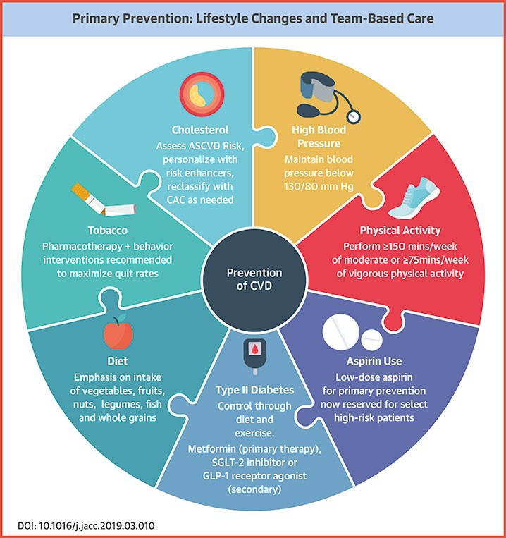
Treatment:
Includes: primary and secondary prevention
Primary prevention:
Life style modification : an intake of total fat should be between 25% and 35%, saturated fat of <7%, and a trans fat intake of <1% of total daily calories. The intake of cholesterol from food should be limited to <300 mg/day.

Slide 11
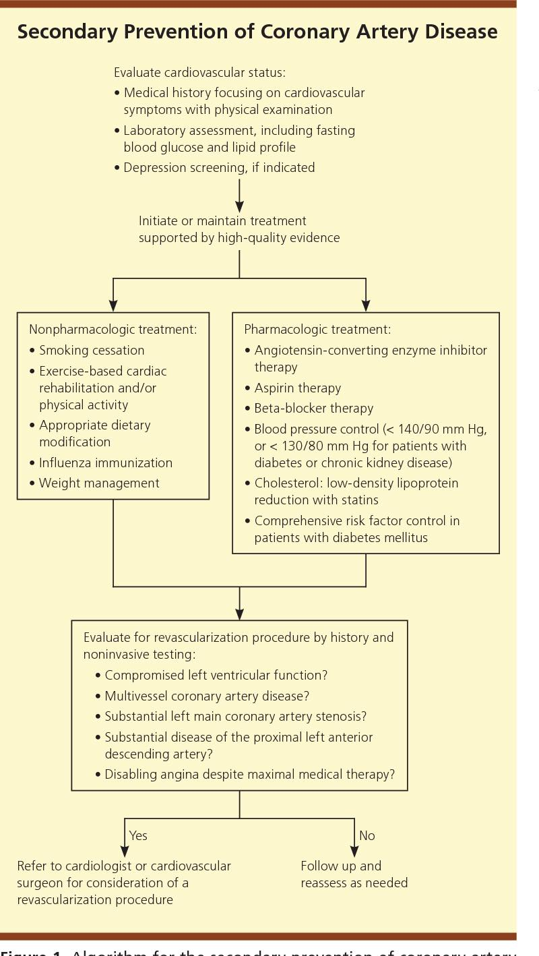
Treatment:
Secondary prevention: patient already has atherosclerotic vascular disease and at high risk of developing CV events

Slide 12
Treatment:
Statin therapy: (Atorvastatin, Rosuvastatin, Simvastatin, Fluvastatin…etc)
High-Intensity Statin Daily dose lowers LDL-C, on average by approximately ≥50%
Moderate-Intensity Statin Daily dose lowers LDL-C, on average by approximately 30% - <50%
Low-Intensity Statin Daily dose lowers LDL-C, on average by approximately <30%

Slide 13
Treatment:
Non-statin therapy:
Ezetimibe: Impairs dietary and biliary cholesterol absorption at the intestinal brush border by interaction with specific receptors
PCSK9 inhibitors (evolocumab, alirocumab) (PCSK9 binds LDL receptors, facilitating their degradation.)
Bile acid sequestrants: Work by binding bile acids in the intestine and preventing their re-absorption.The loss of cholesterol-rich bile acids leads to a lowering of intrahepatic cholesterol and an up-regulation of LDL receptors.

Slide 14
THANK YOU

