Slide 1
Introduction Bone Tumors
Cases discussion

Slide 2
10 year old
Pain and swelling of the right ankle after twisting injury
Localized tenderness lateral aspect of the ankle

Slide 4
Detailed history and physical examination
Lab investigation
MRI
CT
Management

Slide 5
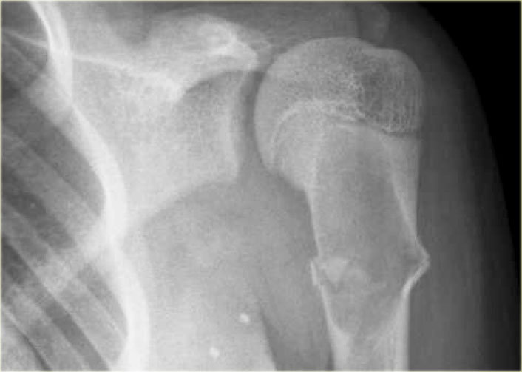
Direct trauma left shoulder
Pain and limitation movement

Slide 6
Detailed history and physical examination
Lab investigation
MRI
CT
Management

Slide 7
Describe this lesion

Slide 10
Left Knee swelling
No history of trauma
History
Physical examination

Slide 11
Differential Diagnosis

Slide 13
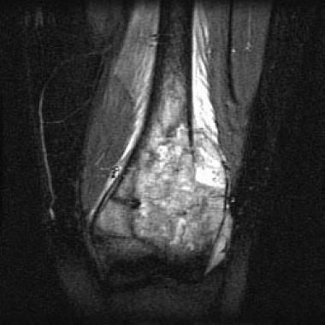
MRI
CT
Bone scanning

Slide 14
Next in management

Slide 15
Describe this lesion

Slide 18
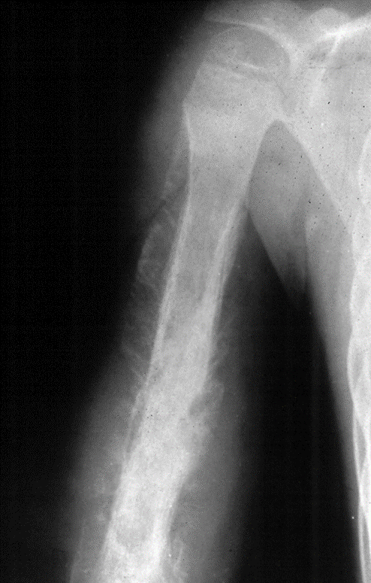

Slide 22
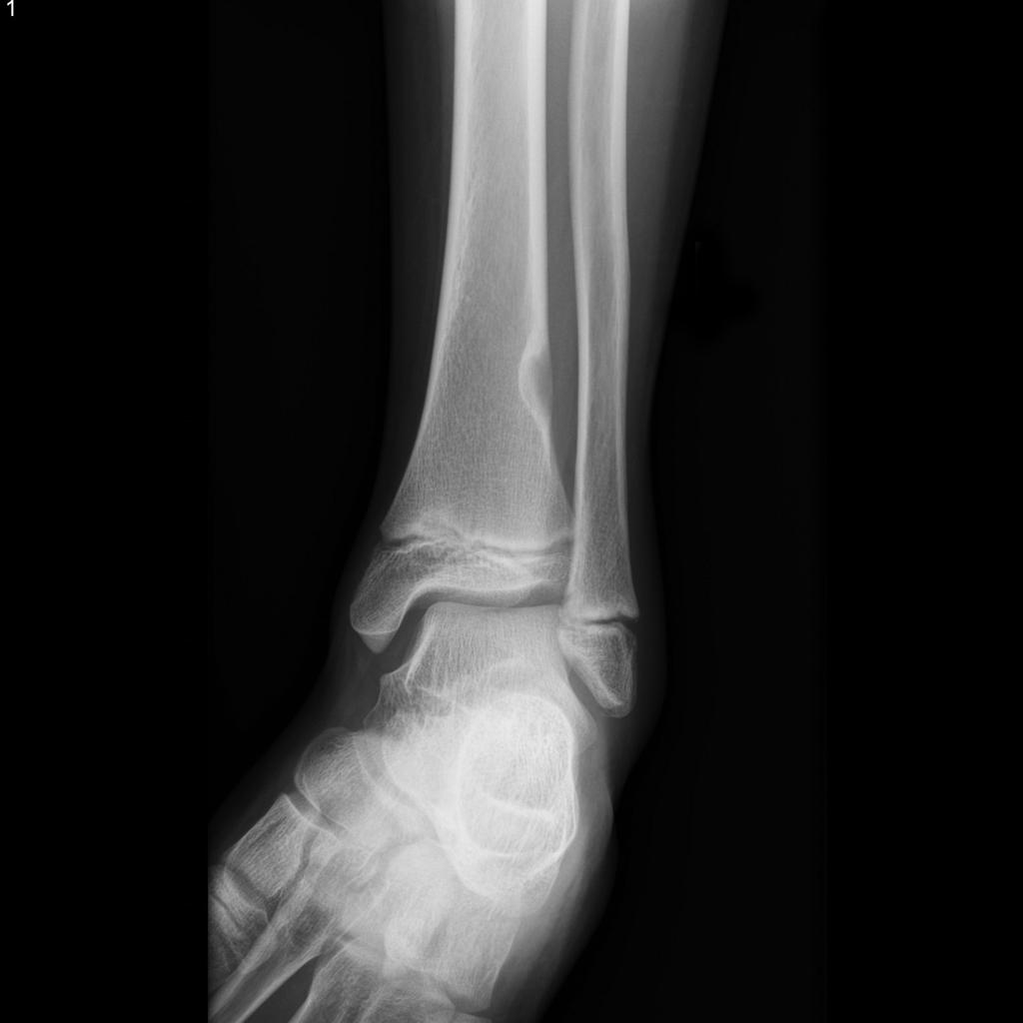

Slide 32
