Slide 1
وسهلا
أهلا
الأستاذ الدكتور/ يوسف حسين
أستاذ التشريح وعلم الأجنة
كلية الطب – جامعة الزقازيق- مصر
دكتوراة من جامعة كولونيا المانيا
د. يوسف حسين (استاذ التشريح)

Slide 2
NOSE & PARA-NASAL SINUSES

Slide 3
frontal process of the maxilla
1
Nasal bone
nasal cartilage
Greater alar cartilage
Boundaries External nose

Slide 4
2
infratrochlear nerve ophth N.
external nasal nerve ophth. N.
Infraorbital nerve
Max. N
Blood supply of external nose as the nerve supply
Nerve supply
of External nose

Slide 5
3
Nasal Cavity

Slide 6
- The cavity of the nose is dividing into right and left halves by the nasal septum.
Each cavity opens
A- Anteriorly on the face by the anterior nasal aperture (nostril)
B- Posteriorly into the nasopharynx by the posterior nasal aperture.
4

Slide 7
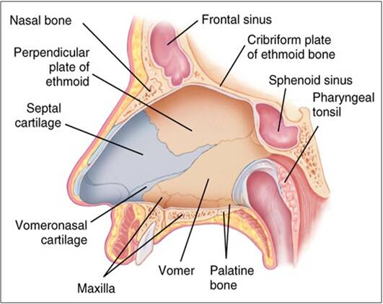
Roof
Frontal sinus and frontal bone
Body of sphenoid
Medial wall
Palatine process of
5
Floor

Slide 8
Boundaries of the nasal cavity
The floor: hard palate separating it from the oral cavity (palatine process of maxilla & horizontal plate of palatine bone).
The roof : has the following parts:
Anterior sloping part: formed by the nasal and frontal bones.
Middle horizontal part: formed by cribriform plate of ethmoid.
Posterior Sloping part: formed by body of sphenoid.
The medial wall (nasal septum) : is formed by :
Anteriorly, septal cartilage.
Postero-superiorly, perpendicular plate of ethmoid.
Postero-inferiorly, Vomer bone (single bone).
6

Slide 9
Lateral wall
Anterior
Posterior
Nasal bone
Ethmoid bone
Frontal process of of the maxilla
lacrimal bone
medial Pterygoid plate of the sphenoid bone
maxilla
Palatine bone
Inferior concha
7

Slide 10
8
Lateral wall of the nasal cavity
A- Anteriorly, cartilage, nasal bone and frontal process of maxilla.
B- Posteriorly
- Upper part, ethmoid bone, lacrimal bone.
- Lower part, inferior concha, maxilla, palatine bone, and medial pterygoid plate,.

Slide 11
Nasal conchae
Superior concha of the ethmoid bone
inferior concha
middle concha
9

Slide 12
10
Features of the lateral wall,
- It is irregular and shows the following:
Vestibule; a small dilatation above the anterior nasal aperture.
Atrium: a shallow depression above and behind the vestibule.
Nasal conchae(turbinates): 3 shelves-like elevations separated by spaces called meatuses.
Superior Concha: is the smallest one and is part of the ethmoid bone (superior meatus below it).
Middle Concha: is medium sized and also part of the ethmoid bone (middle meatus below it).
Inferior Concha: is the largest one and is a separate bone (inferior meatus below it).
Spheno-ethmoidal recess: above the superior concha

Slide 13
Lateral wall
Sphenoethmoidal recess
Frontal sinus
Superior concha
Superior meatus
Middle meatus
sphenoid air sinus
inferior concha
middle concha
Inferior meatus
11

Slide 14
Openings in the nasal meatuses of the lateral wall:
(1) Spheno- ethmoidal recess: above the superior concha.
- It receives the opening of the sphenoidal air sinus.
Superior Meatus: receives opening of the posterior ethmoidal air sinus.
Middle meatus: shows,
a- Bulla ethmoidalis: a rounded elevation overlies the middle ethmoidal air sinus and receives its opening.
b- Hiatus semilunaris: a crescent groove below the bulla ethmoidalis receiving the opening of
1) Frontal air sinus opens into the anterior end.
2) Anterior ethmoidal air sinuses.
3) Maxillary air sinus opens near the posterior end.
Inferior-meatus: receives the opening of nasolacrimal duct.
12

Slide 15
13
Roof & upper part
Ophthalmic nerve
Pterygopalatine ganglia

Slide 17
Arterial blood supply of the nose
14
2 ethmoidal ICA
2 palatine ECA
2 Superior ECA
Kieselbach’s plexus,- common site for epistaxis
Anterior superior alveolar artery

Slide 18
A- Arterial supply of the nose:
1- Sphenopalatine artery: from the 3rd of maxillary artery (main source of blood supply).
2- Greater palatine from the 3rd of maxillary artery,
3- Anterior and posterior ethmoidal from ophthalmic artery.
4- Septal branch of the superior labial artery (facial artery).
5- Anterior superior alveolar artery (from infra orbital artery)3rd part of maxillary artery.
B- Venous drainage
The veins drain into the pterygoid and pharyngeal venous plexus and facial vein.
Lymphatic drainage
- Anterior Part: drains into the submandibular lymph noes.
- Posterior Part: drains into the retropharyngeal and upper deep cervical lymph nodes.
15

Slide 19
16
Applied anatomy,
Little’s area is an area on the inferior and anterior part of the nasal septum showing rich arterial anastomosis (Kieselbach’s plexus). This anastomosis is formed by;
1) Spheno-palatine artery.
2) Greater palatine artery.
3) Anterior and posterior ethmoidal arteries.
4) Septal branch of superior labial artery.
- This area is a common site for epistaxis (bleeding from the nose).
- To stop the bleeding:
a- Nasal pack soaked with adrenaline in the vestibule.
b- Cauterization of the bleeding arteries.
c- Legation of the 3rd part of the maxillary artery.
d-sit down and firmly pinch the soft part of the nose for 10-15 min , not lean backward because blood drains to throat

Slide 20
Anastomosis between ECS & ICA in the lateral wall of the nose
1- Anterior and posterior ethmoidal from ophthalmic artery (internal carotid artery).
2- Sphenopalatine artery: from the 3rd of maxillary artery (main source of blood supply). (external carotid artery)
3- Greater palatine branch of the 3rd of maxillary artery, (external carotid artery)
4- Septal branch of the superior labial artery (facial artery). (external carotid artery)
5- Anterior superior alveolar artery (from infra orbital artery) 3rd part of maxillary artery . (max. A external carotid artery)
17

Slide 21
4
18

Slide 23
Definition: they are air filled spaces inside the skull bones related to the nose and opens in the lateral wall of the nasal cavity.
Functions:
1) Lighten the weight of the skull.
2) Gives resonance to the voice.
3) Warming and humidification of inspired air.
19

Slide 24
Paranasal sinuses
frontal sinus
20
Sphenoidal sinus
Ethmoidal air sinuses
Between nose & orbit
- Anterior
- Middle
- Posterior
Sphenoidal sinus is related to
- Pituitary gland (above)
- Cavernous sinus (on each side)

Slide 25
Paranasal sinuses
 | Frontal | Sphenoidal | Ethmoidal | Maxillary
Site | frontal bone | body sphenoid | ethmoid bone | maxilla
Opening | hiatus semilunaries of middle meatus | spheno-ethmoidal recess | - Posterior into superior meatus. - Middle into bulla ethmoidalis - Anterior into hiatus semilunaris | hiatus semilunaris of middle meatus
Nerve & blood vessels | supratrochlear and supraorbital (ophthalmic N&VS) | posterior ethmoidal | a- posterior by posterior ethmoidal b- Anterior and middle by anterior ethmoidal | Post, midd, ant. superior alveolar N&VS
Lymph nodes | submandibular | Retro-pharyngeal | a- posterior into retropharyngeal b- Anterior & middle into submandibular | submandibular
21

Slide 26
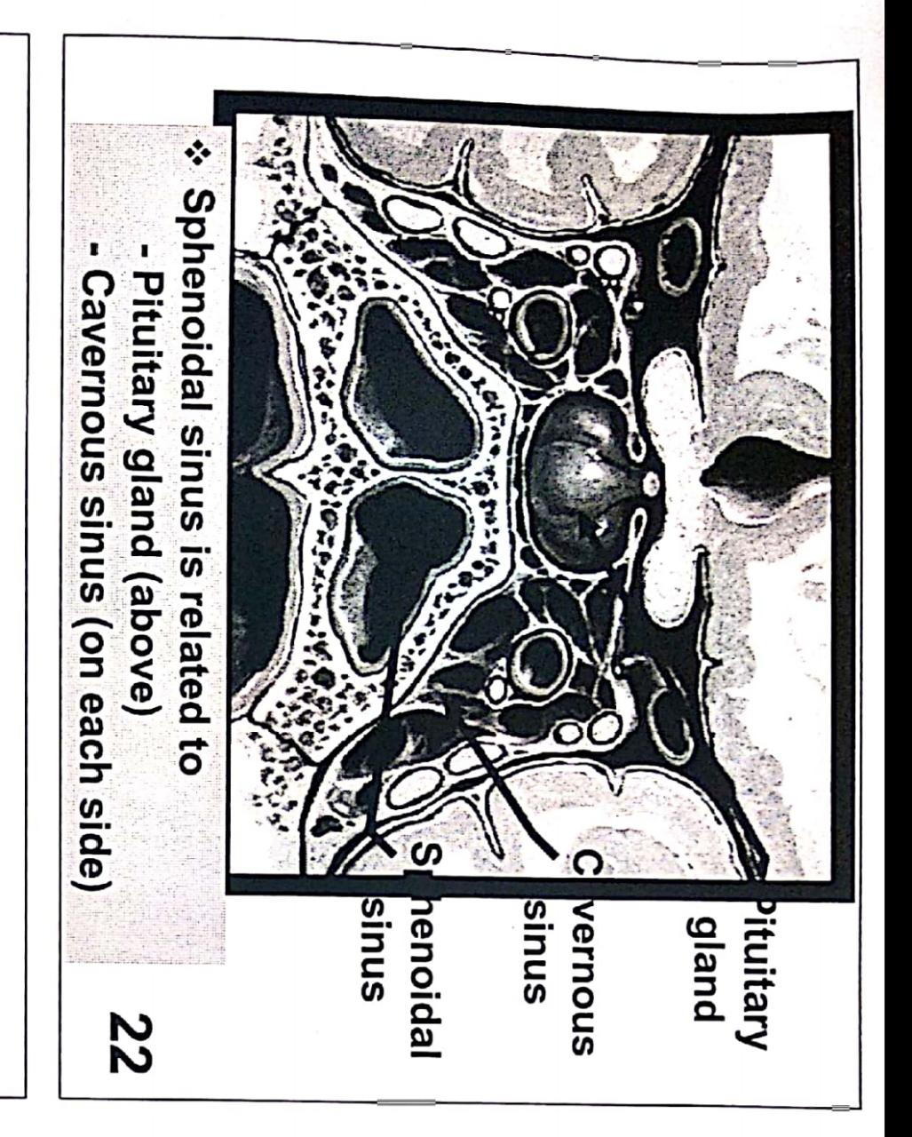

Slide 27
Maxillary sinus
22

Slide 28
Maxillary sinus
23
Base
Roof
The floor of the orbit
The lateral wall of the nasal cavity
Apex
Zygomatic process of maxilla
Roots of upper teeth
Alveolar process of maxilla
Floor
Notes:
Maxillary sinus
Is the largest of the paranasal air sinuses and is the only paranasal sinus that may be present at birth.

Slide 29
Maxillary sinus
Shape pyramidal in shape
Relations:
(1) Apex: directed laterally and lies at the zygomatic process of maxilla.
(2) Base: directed medially and formed by the lateral wall of the nasal cavity and contains the opening of the sinus.
(3) Roof: formed by the floor of the orbit. The roof is traversed by the infra orbital canal containing infra-orbital nerve and vessel.
(4) Floor: formed by the alveolar process of maxilla (Roots of molar and premolar teeth).
(5) Anterior Wall: anterior surface of maxilla.
(6) Posterior wall: posterior surface of maxilla.
24

Slide 30
Clinical notes about maxillary sinus
Opening of the sinus in the upper part of the base so the higher position makes the drainage difficult leading to sinusitis.
Posterior superior alveolar nerve supplies both-sinus and upper molar so inflammation of the sinus can be confused with toothache(REFERRED PAIN ).
The roots of the upper molars bulge into the floor of the sinus but not perforated. During Dental Extraction must be care to avoid fraction of the root because the fractured root may be driven into the maxillary sinus forming communication between the sinus and oral cavity.
25

Slide 31
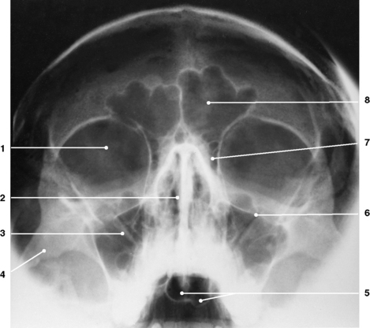
26

Slide 32
