Slide 1
Assessment of the Extracted Nucleic Acid
Dr. Nesrin Mwafi
Biochemistry & Molecular Biology Department
Faculty of Medicine, Mutah University

Slide 2
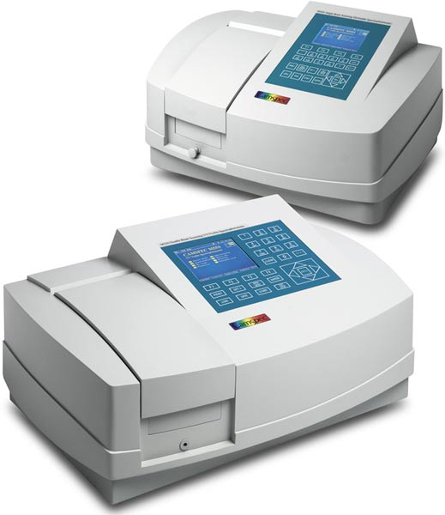
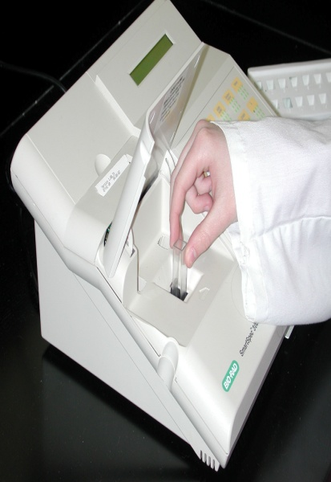
Assessment of Extracted Nucleic Acid
Three routine tests can be performed to check for quantity (concentration/amount) and quality (purity and integrity) of the extracted product
Take an aliquot of the sample (5µl out of 50µl )
Measurement of concentration

Slide 3
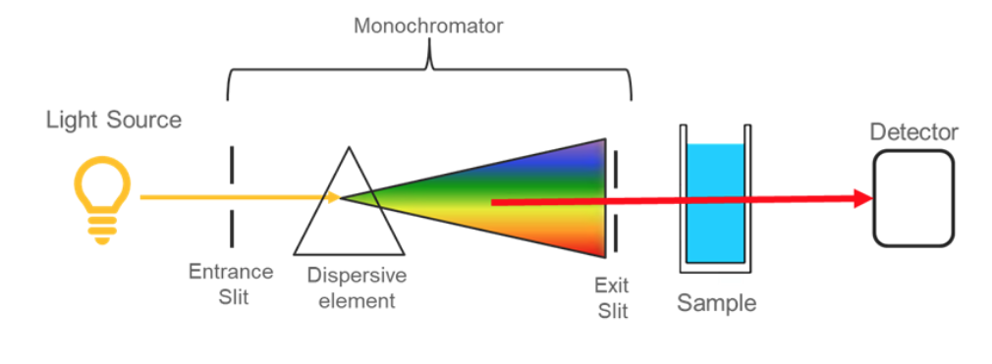
Assessment of Extracted Nucleic Acid
UV-Vis spectrophotometer (ultraviolet-visible spectrophotometer) instrument is used to measure the concentration and the yield of the extracted nucleic acid (DNA or RNA)
Electromagnetic Spectrum of Light
I◦
I_{t}
Wavelength
selector

Slide 4
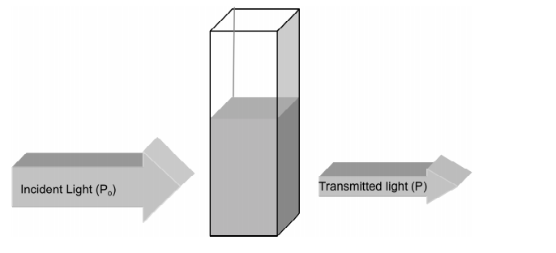
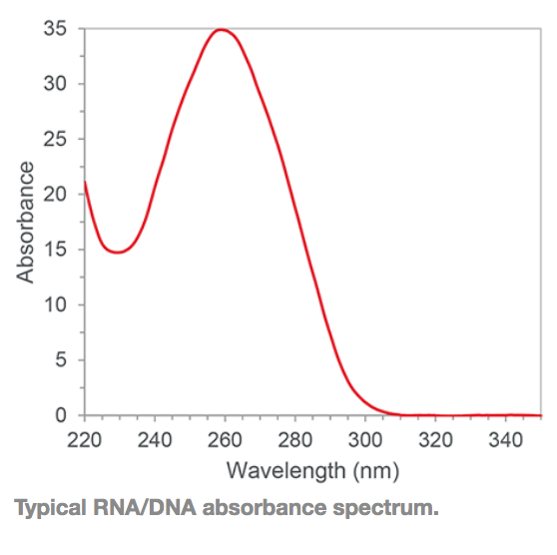
Assessment of Extracted Nucleic Acid
Part of the incident light will be absorbed by the sample particles (depending on the concentration)
The attenuation in the light that reaches the detector is measured in relation to the incident light and expressed as optical density (OD)
Nucleic acids absorb UV-light with maximum absorbance at wavelength of 260 nm (λ= 260nm)

Slide 5
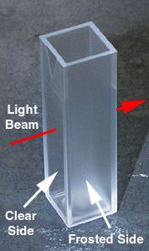
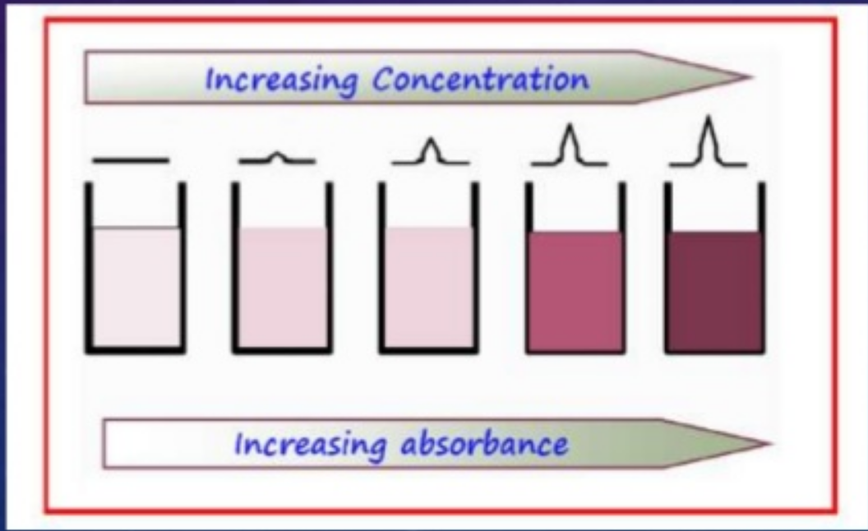
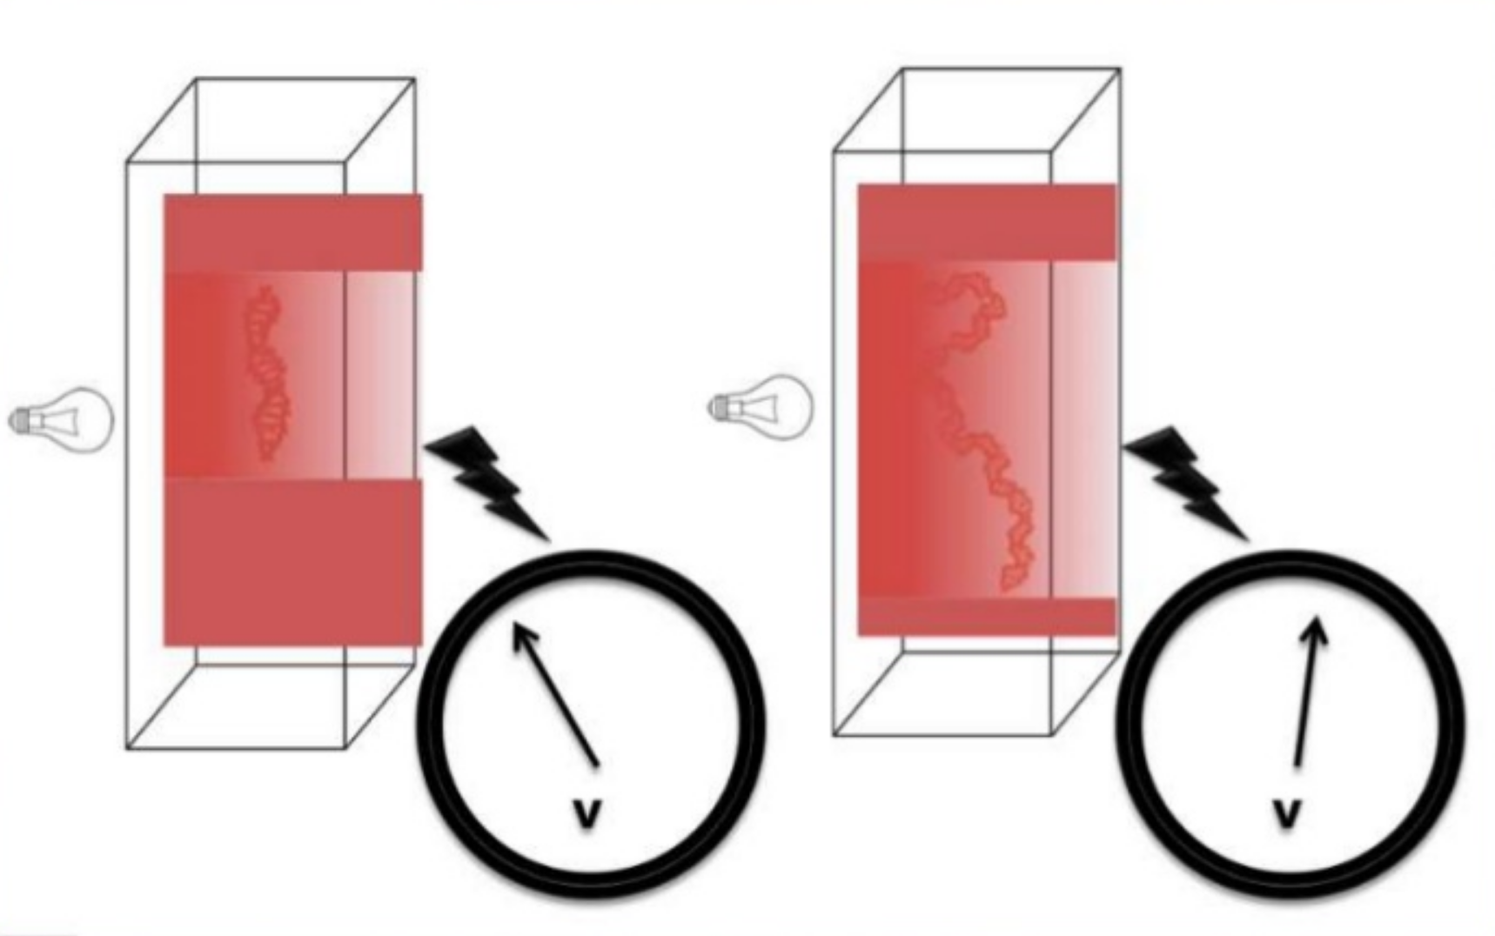
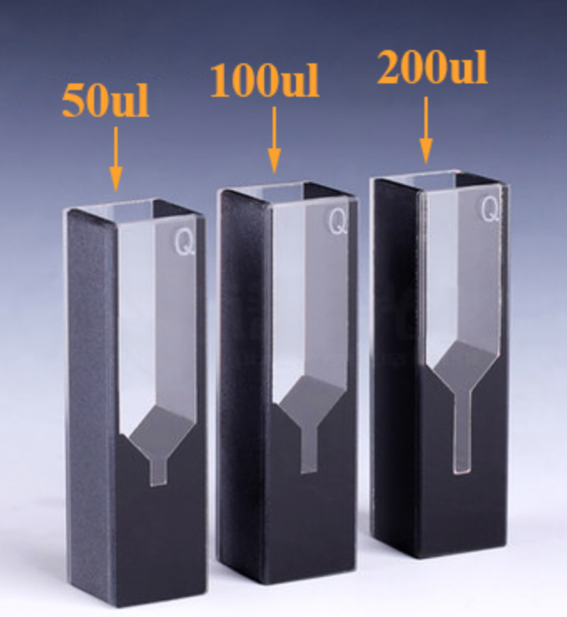
Assessment of Extracted Nucleic Acid
Cuvette is made of plastic (disposable) or quartz with two transparent and two opaque (foggy/frosted) sides
Before sample measurement, a blank must be measured (the buffer or solvent used to dissolve the sample)

Slide 6
Assessment of Extracted Nucleic Acid
The concentration is estimated per one optical density unit (1OD) according to the type of nucleic acid (e.g. 1 OD unit = 50 µg/ml dsDNA)
The concentration is calculated according to the following equation:
DNA Concentration (µg/ml) = OD₂₆₀ × dilution factor × 50 µg/ml
Nucleic Acid | Concentration (µg/ml) or (ng/µl) per 1 OD Unit
ds DNA | 50
ss DNA | 33
ss RNA | 40

Slide 7
Assessment of Extracted Nucleic Acid
Example 1: OD₂₆₀ = 0.6, dilution factor = 100, sample of genomic DNA
Answer:
DNA conc. = 0.6 x 100 x 50 ng/µl or µg/ml
= 3000 ng/µl or 3000 µg/ml or 3 µg/µl
Example 2: Calculate the dilution factor if 5µl of sample was added to 95µl of water?
Answer: dilution factor = total volume / sample volume
100 / 5 = 20 (dilution factor) 1:20
Example 3: Calculate the amount (yield) of DNA in the above example if total volume is 50 µl ?
Answer: Amount = concentration X total volume of the extracted sample
= 3000 ng/µl X 50 µl
= 150000 ng or 150 µg
Note: 1g = 1000mg 1L = 1000 ml
1mg = 1000 µg 1ml = 1000 µl
1 µg = 1000 ng

Slide 8
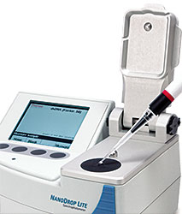
Assessment of Extracted Nucleic Acid
NanoDrop is automatically
calculate the concentration in ng/µl

Slide 9
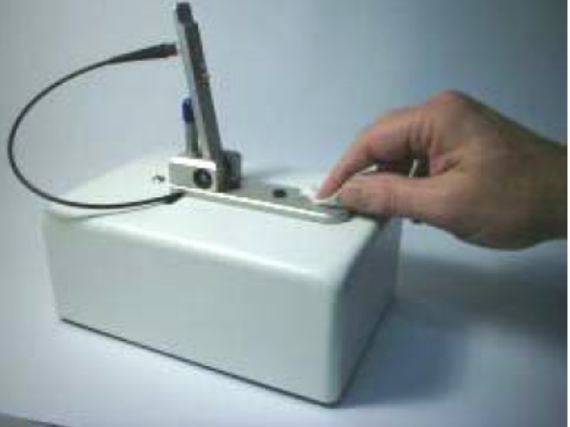
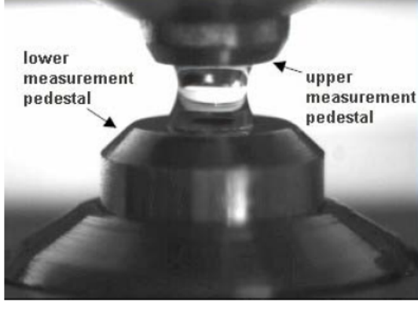
Assessment of Extracted Nucleic Acid
NanoDrop spectrophotometer has similar principle to the standard cuvette spectrophotometer
Load 1µl blank onto the lower pedestal, close the sampling arm and click on blank (wait 10-15 second)
Wipe the pedestals and repeat the same steps using 1µl DNA or RNA sample and click on measure

Slide 10
Assessment of Extracted Nucleic Acid
Sample purity:
The reading of absorbance at 260nm is divided by the reading at 280nm to estimate sample purity
Aromatic amino acids of protein have maximum absorption at 280nm
This ratio is most commonly used to determine the presence of protein in the isolated sample
The acceptable range for this ratio:
Sample type | Ideal | Accepted range
DNA | 1.8 | 1.7-1.9
RNA | 2.0 | 1.9-2.1

Slide 11
Assessment of Extracted Nucleic Acid
The ratio of A260/A230 is used as secondary measure of nucleic acid purity (chaotropic salts, TRIzol and peptide bonds of protein absorb at 230nm)
The expected value is 2.0-2.2 (should be greater than A260/A280 ratio)
Low ratio indicate possible contaminants

Slide 12
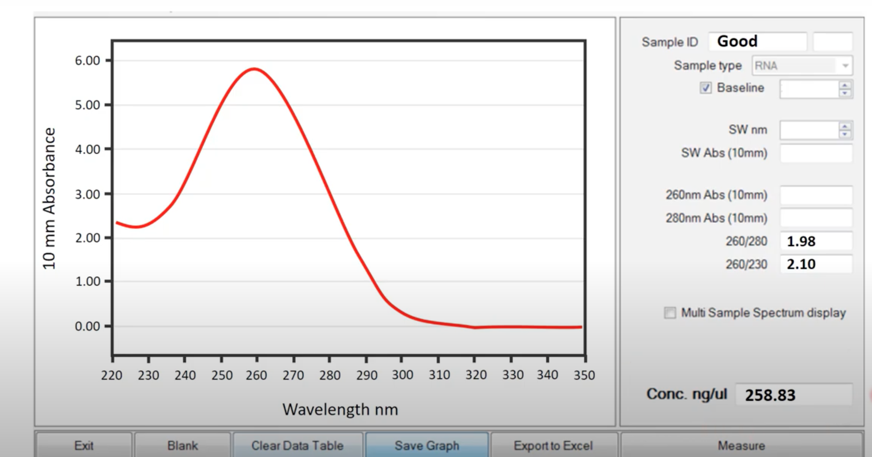
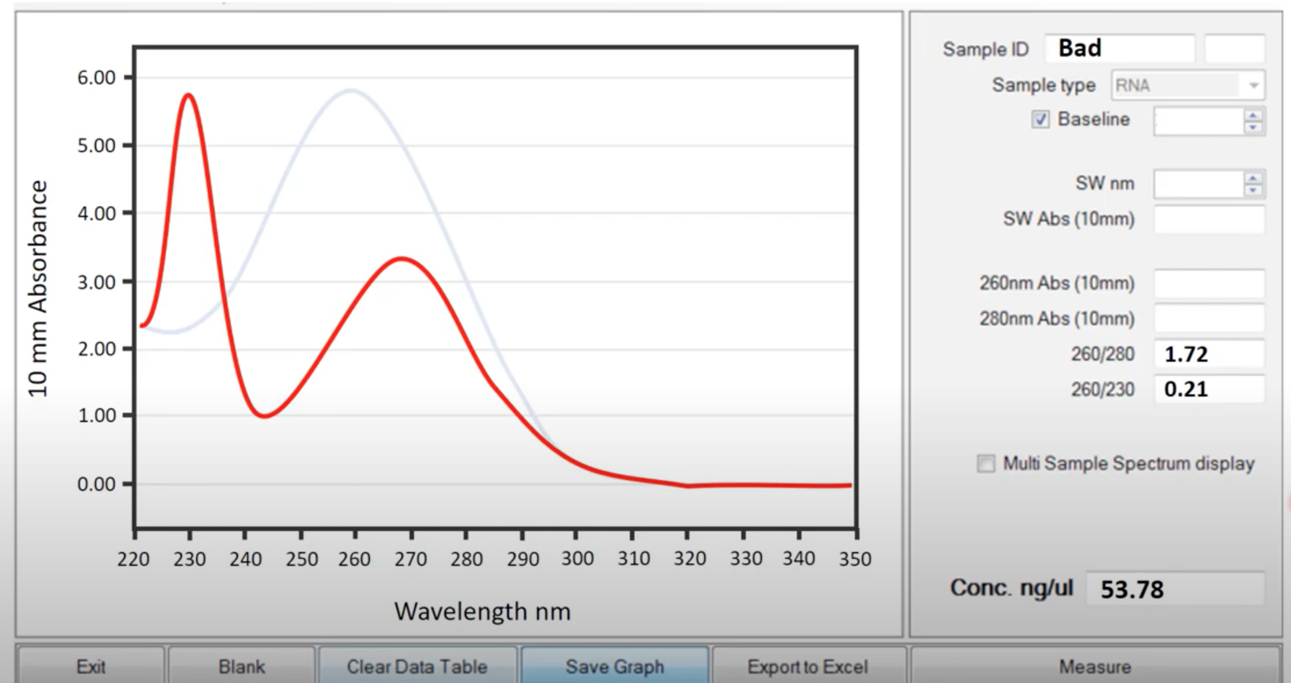
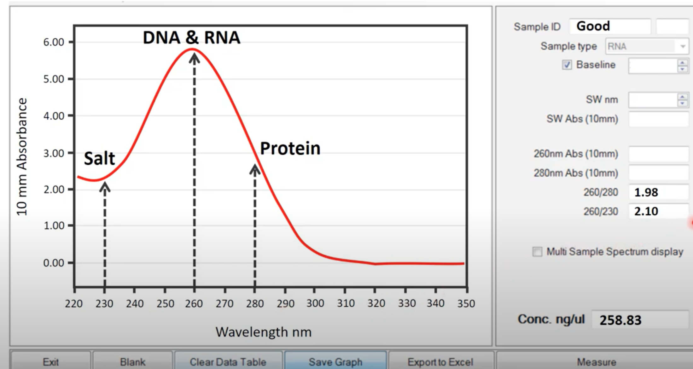
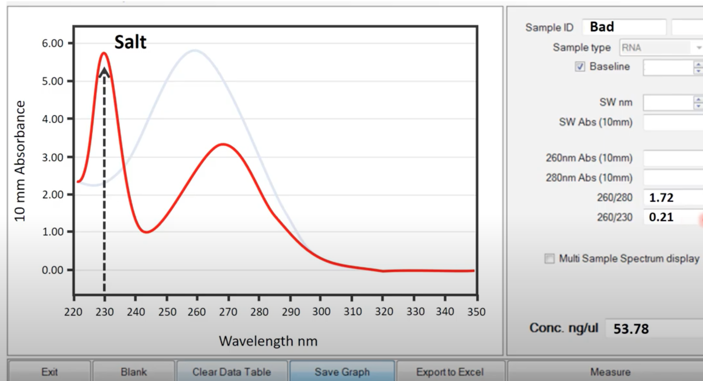
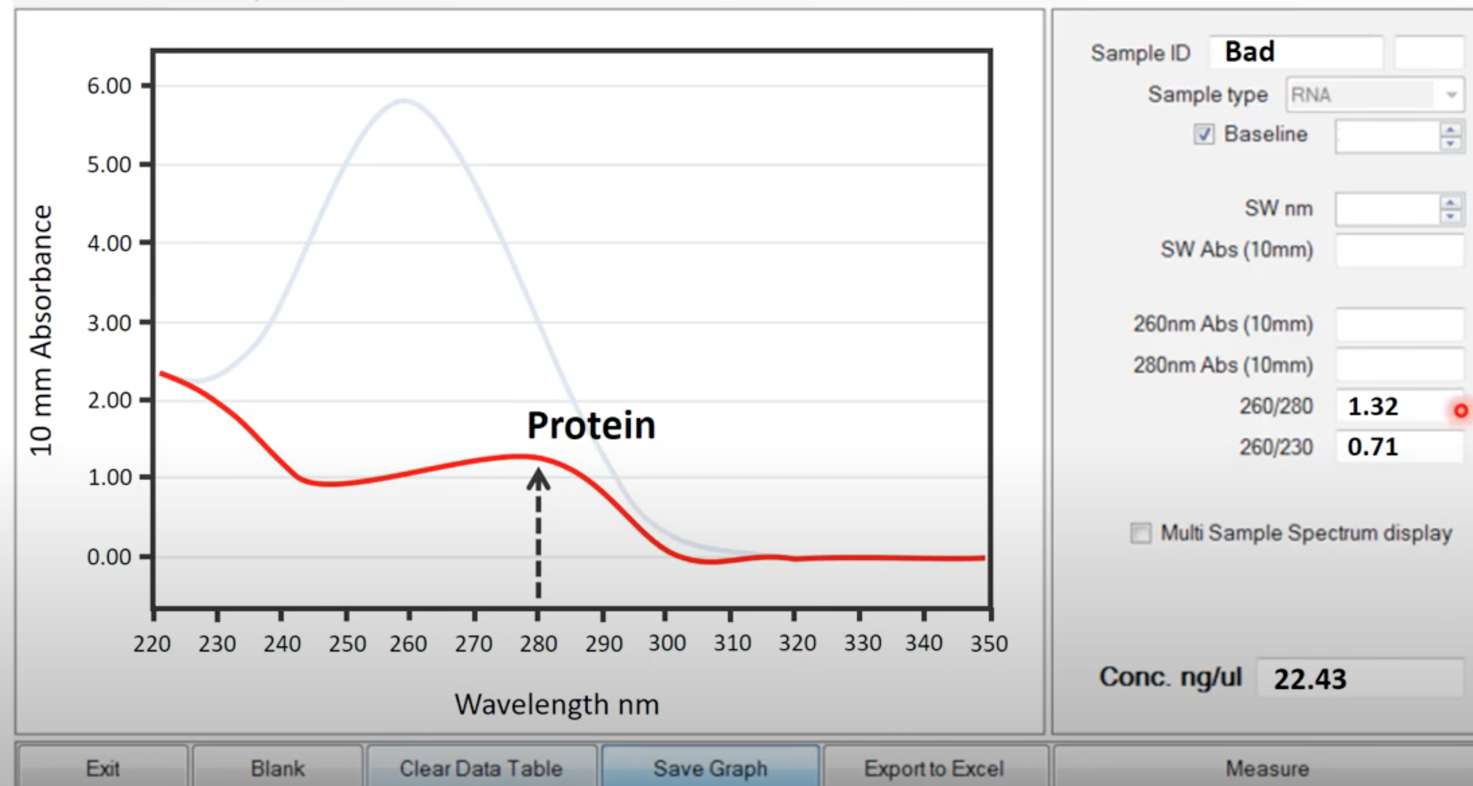
Interpretation of Nanodrop Results

Slide 13
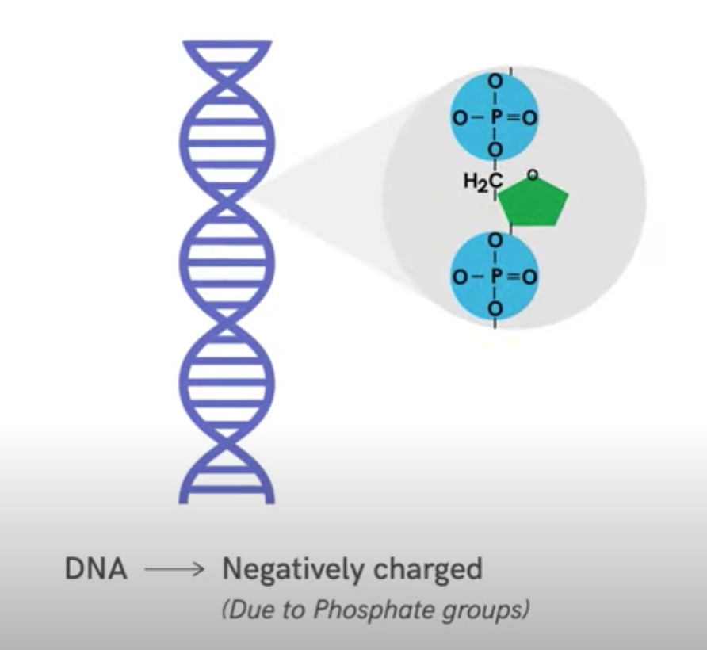
Assessment of Extracted Nucleic Acid
Gel electrophoresis:
Gel electrophoresis is a standard lab procedure for separation nucleic acids based on their sizes under the influence of electric field
The concept: DNA and RNA are negatively charged molecules they move toward the positive electrode (usually red)

Slide 14
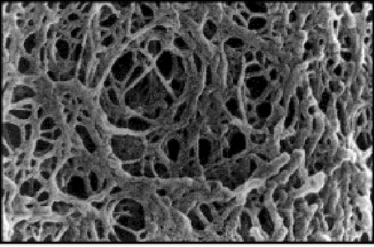
Assessment of Extracted Nucleic Acid
Two types of gel can be used: polyacrylamide gel (suitable to separate small fragments up to 500bp) and agarose gel (suitable to separate larger fragments)
Gel matrix acts as sieve or mesh (porous) and the smallest fragments migrate faster through the pores
_
Direction of
fragments
migration
+

Slide 15
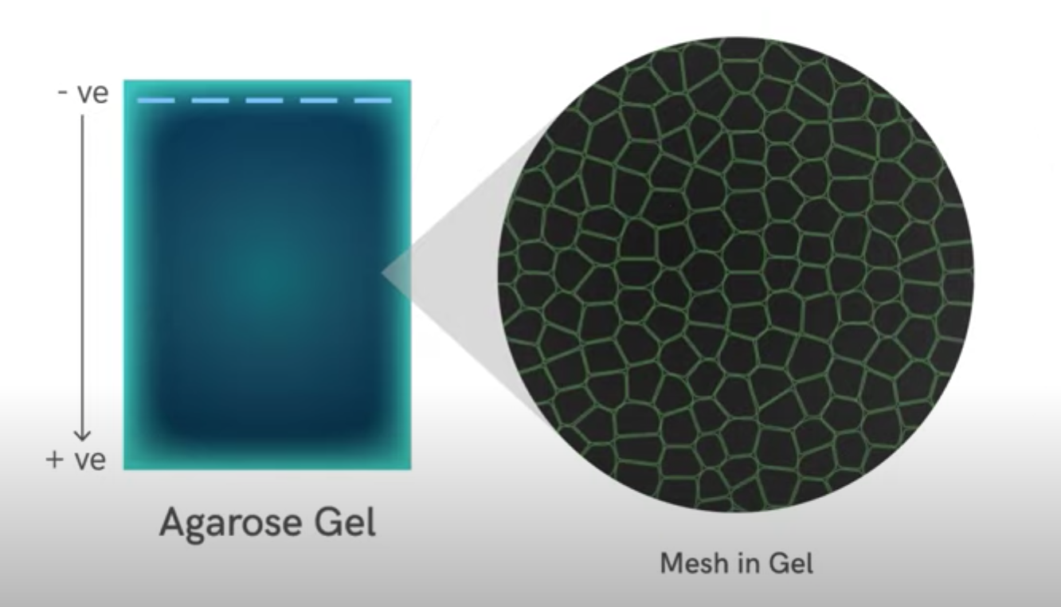
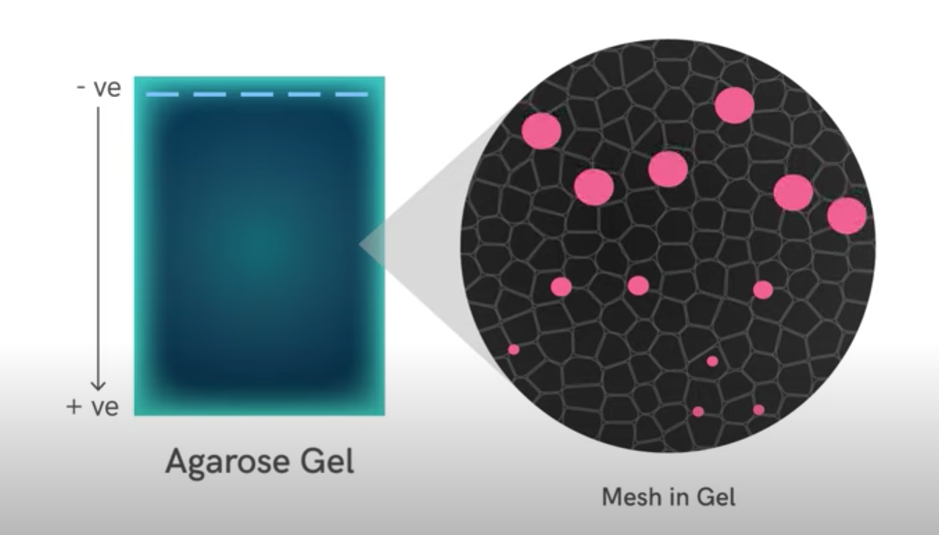
Assessment of Extracted Nucleic Acid

Slide 16
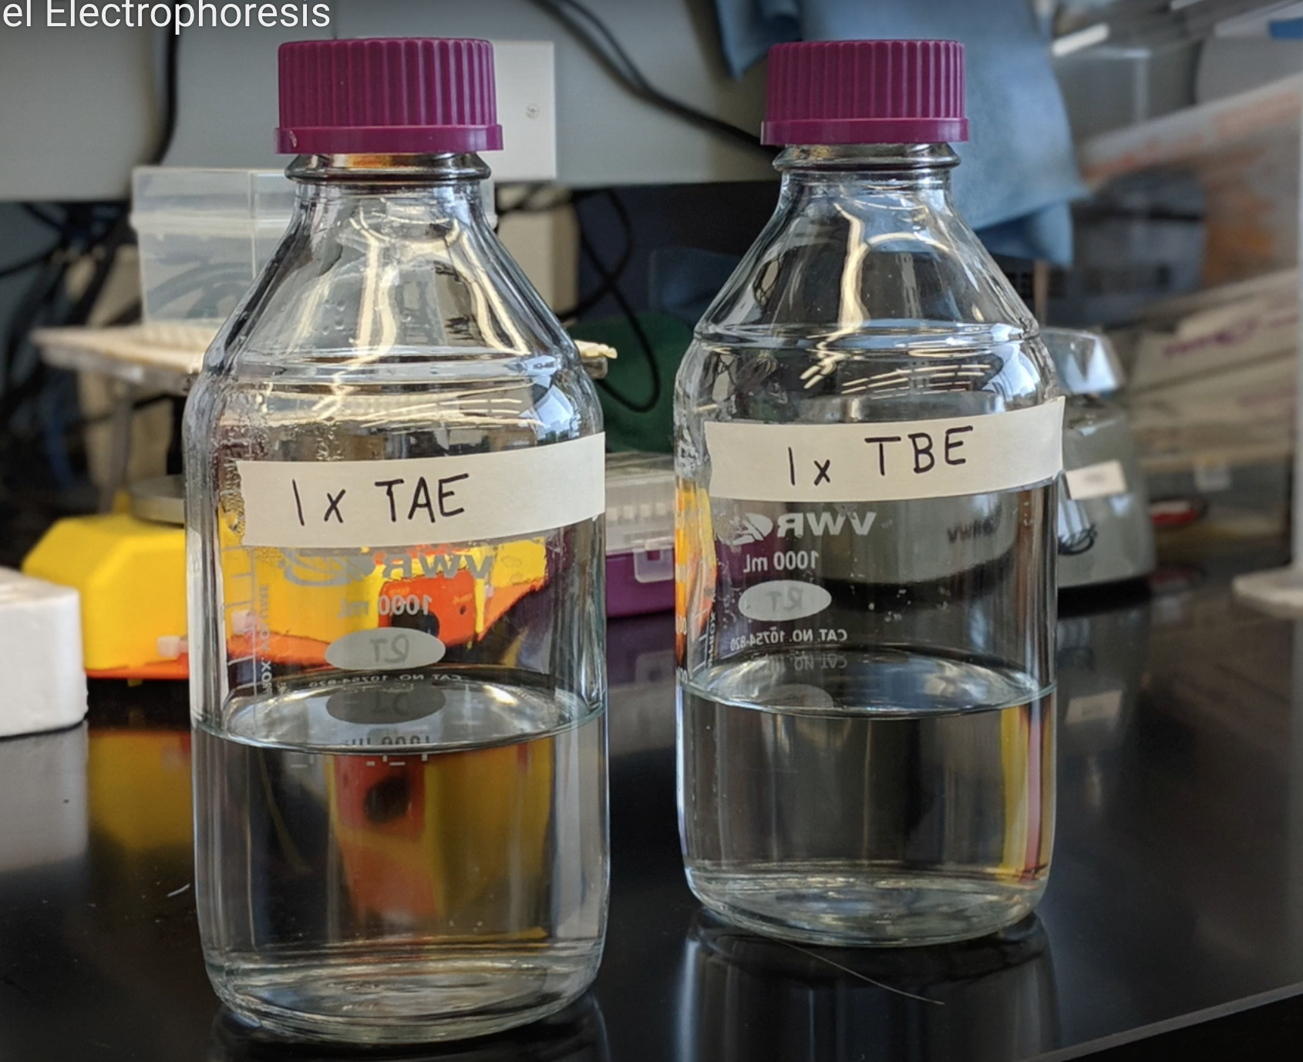
Assessment of Extracted Nucleic Acid
Agarose gel (0.7% - 2%) is prepared by dissolving the powder in TAE buffer (Tris/Acetate/EDTA buffer) or TBE buffer (Tris/Borate/EDTA buffer)
For example: to prepare 1% agarose gel (1g/100ml) dissolve 1g of agarose powder in100ml of 1X TAE
add few drops of nucleic acid fluorescent dye to the dissolved gel solution then pour it into casting tray (don’t forget to add the comb to make the wells)

Slide 17
Assessment of Extracted Nucleic Acid
The nucleic acid fluorescent dye is used to visualize the nucleic acid under UV light (acts by intercalation): Ethidium Bromide (mutagen). GelRed and SYBR green I (expensive but safe)
The gel tray is placed in an electrophoresis chamber and filled with running buffer (1X TAE buffer) until it covers the gel piece. Buffer is used to provide ions that carry the current and to maintain pH

Slide 18
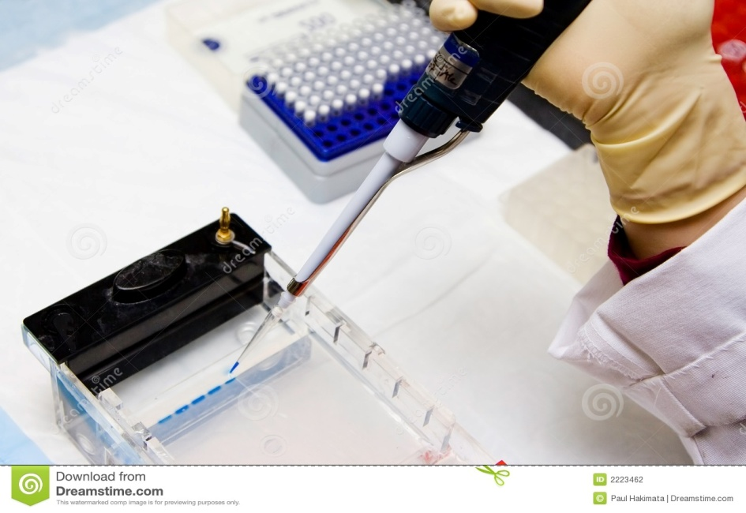
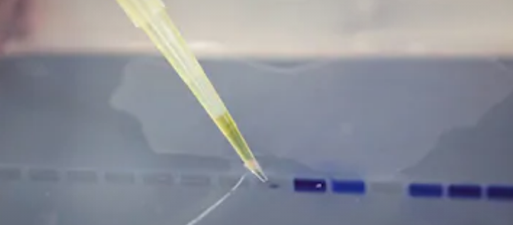
Assessment of Extracted Nucleic Acid
Load the DNA or RNA sample into wells after mixing with loading dye (blue dye to increase viscosity of sample and prevents it from floating out of the wells and to track the migrated fragments)
The electrodes are attached to a power supply and an electrical current is applied

Slide 19
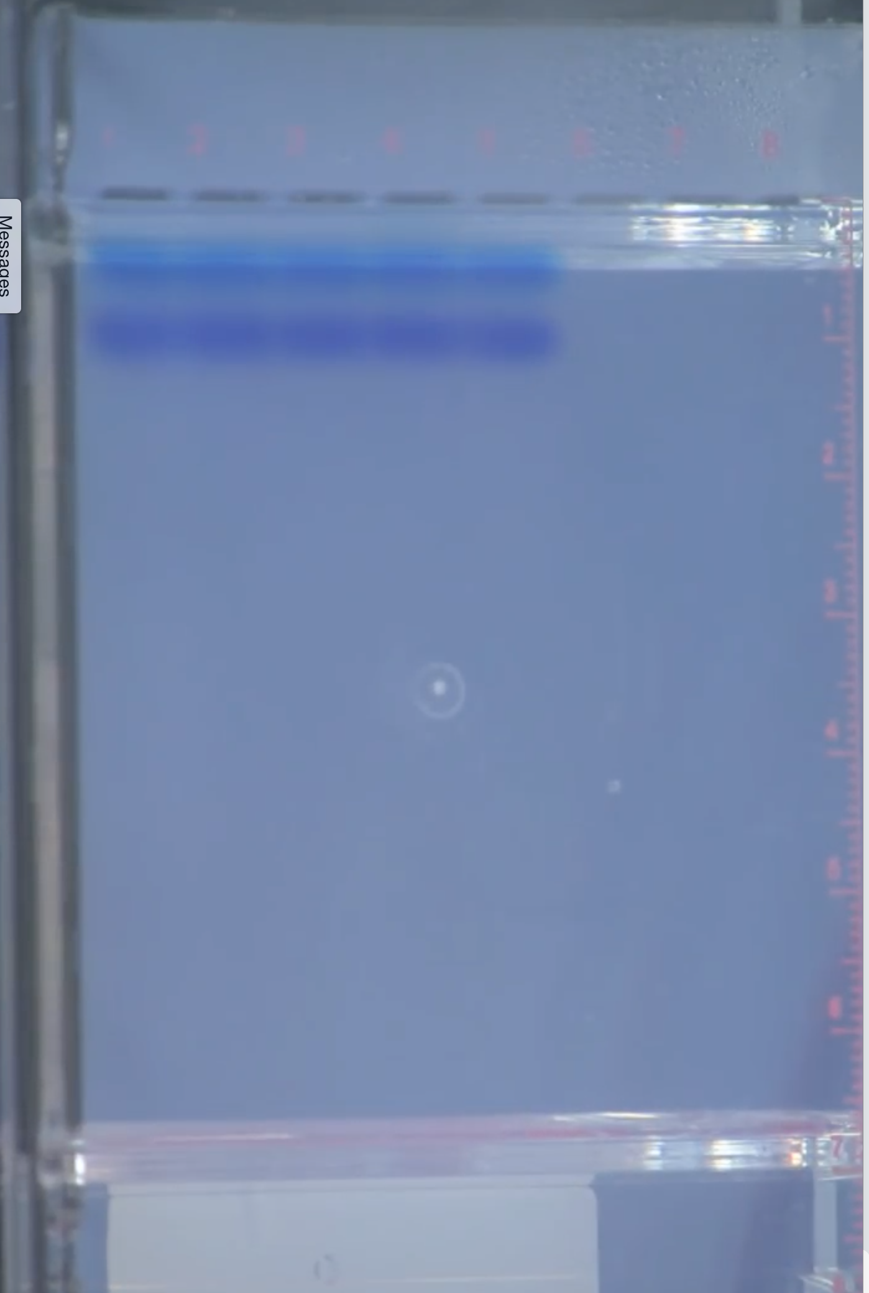
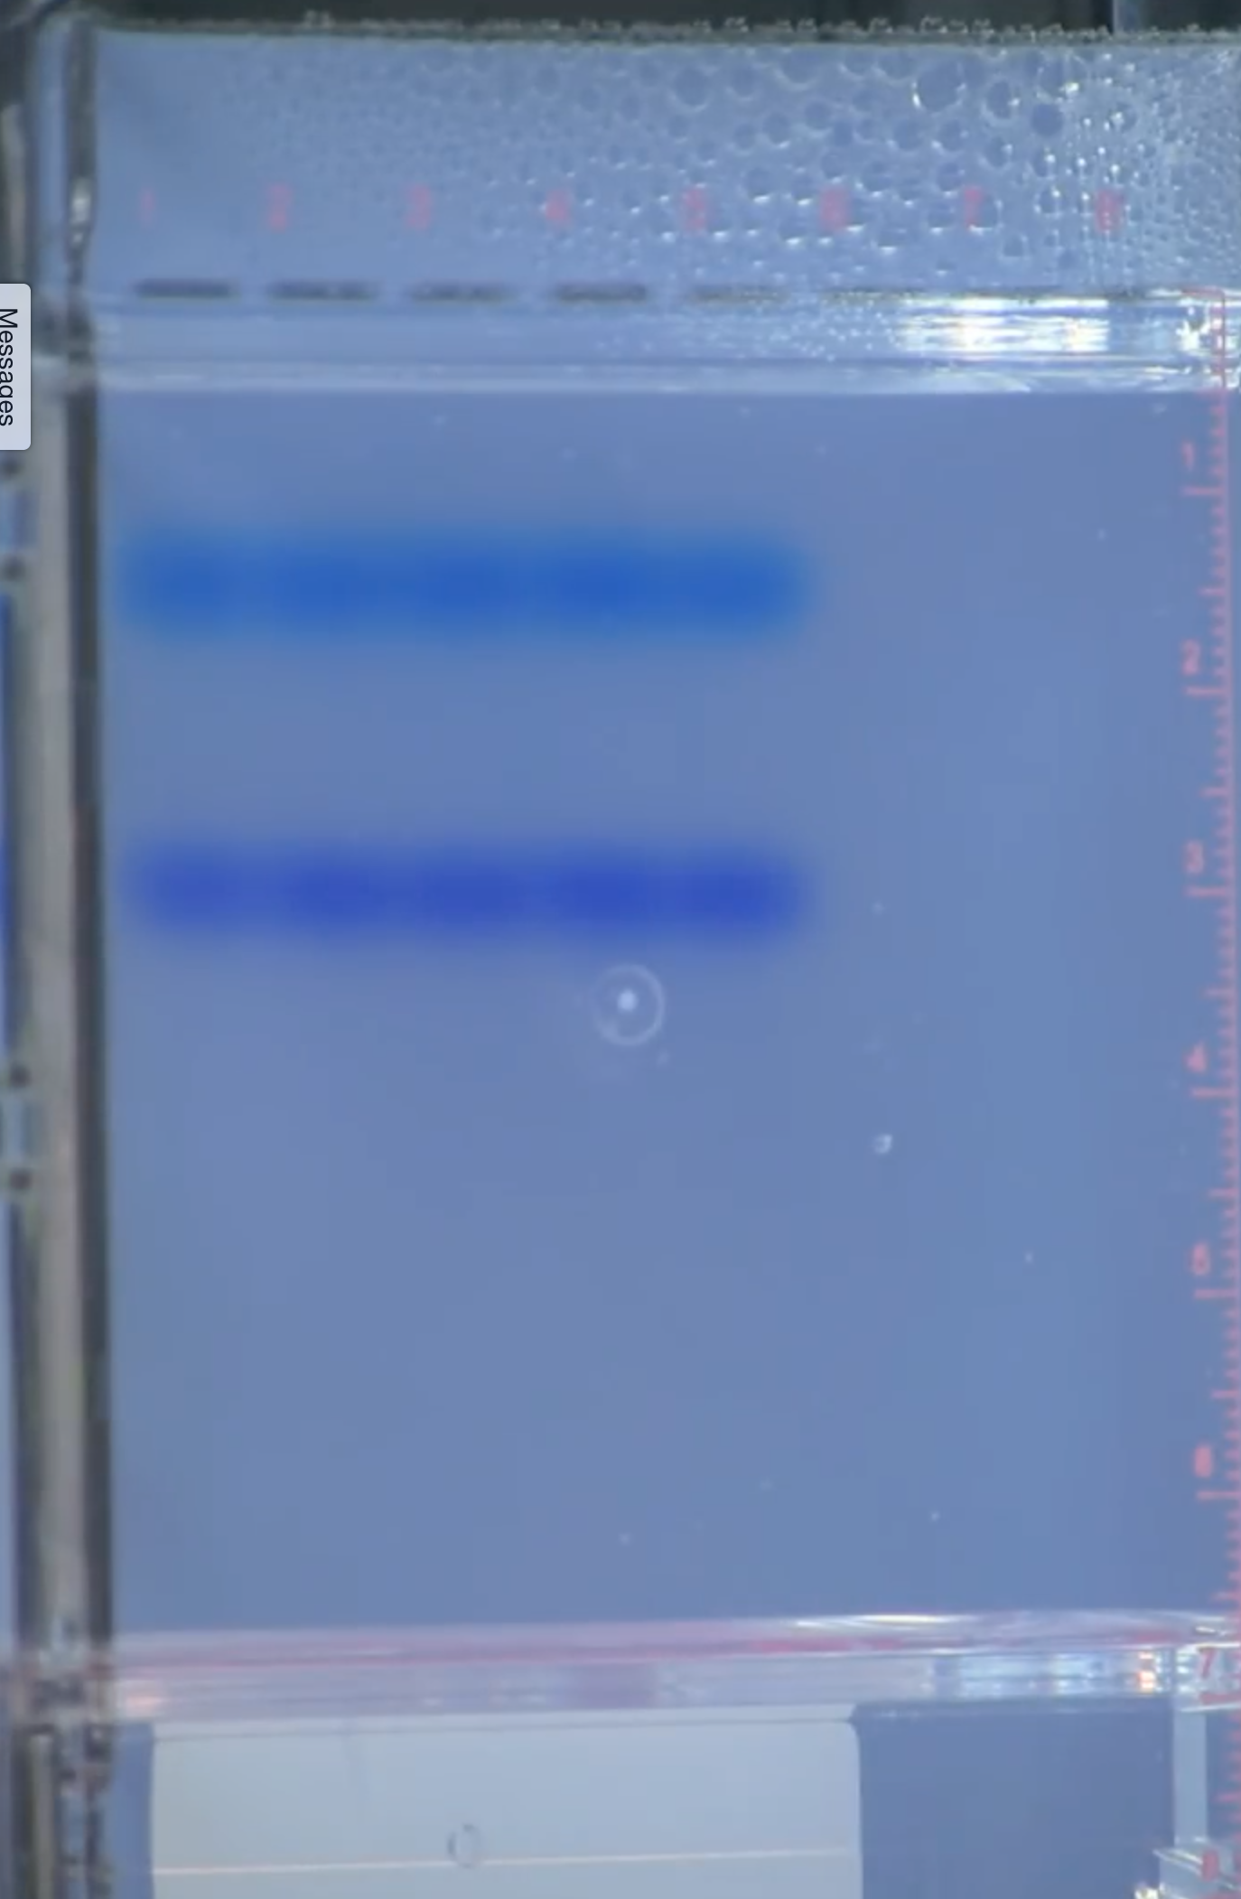
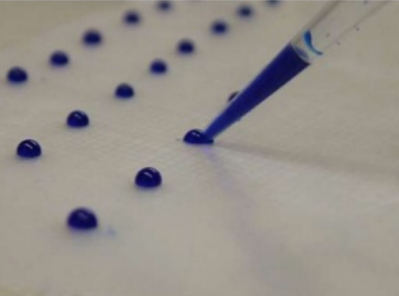
Assessment of Extracted Nucleic Acid
After 5 min
After 20 min

Slide 20
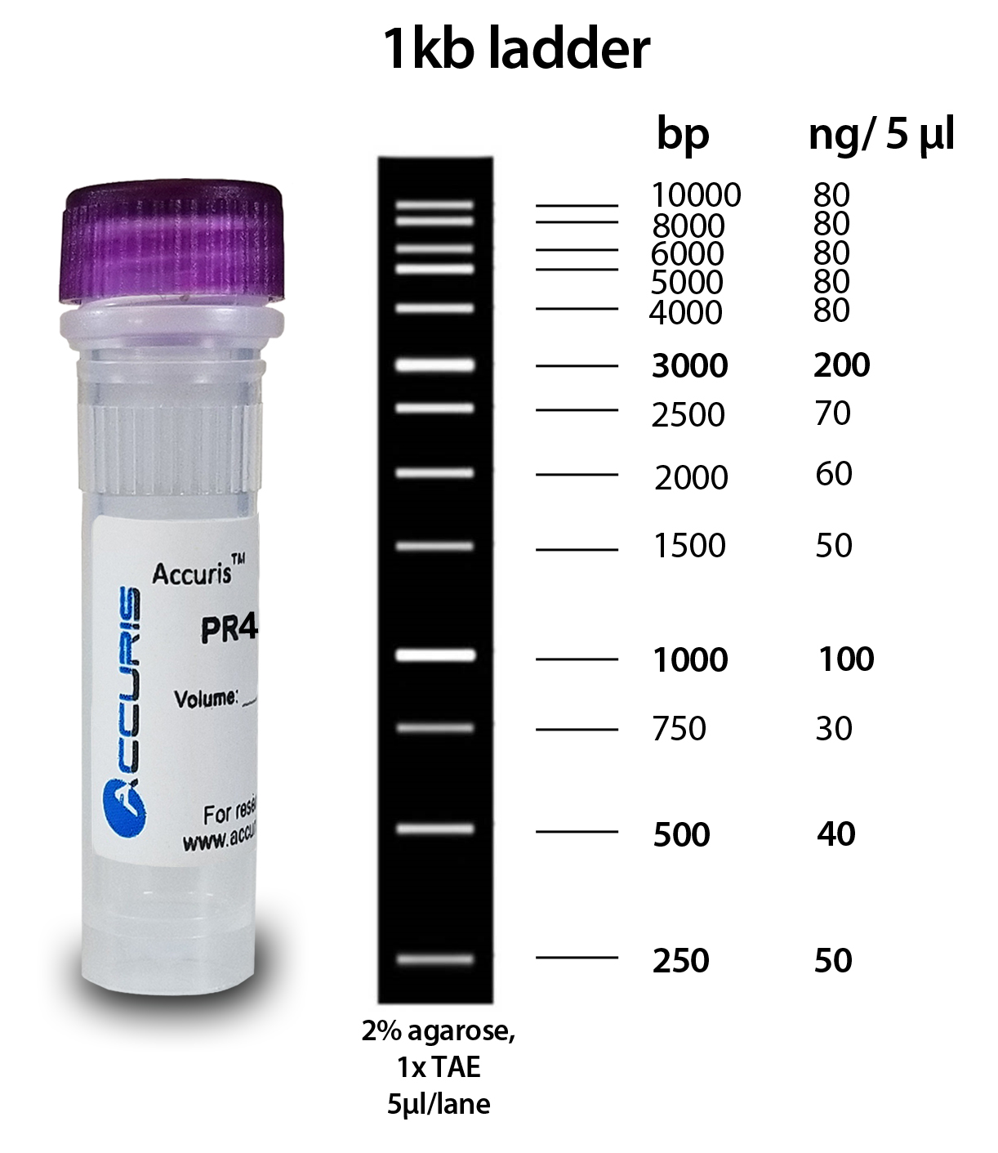
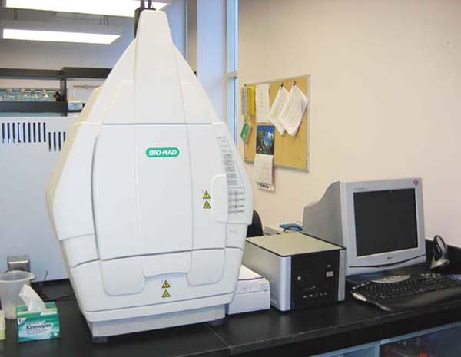
Assessment of Extracted Nucleic Acid
Load DNA or RNA ladder (fragments with known sizes) into the first well (acts a ruler to compare and identify sizes of different bands)
Gel documentation system
“Gel Doc System”

Slide 21
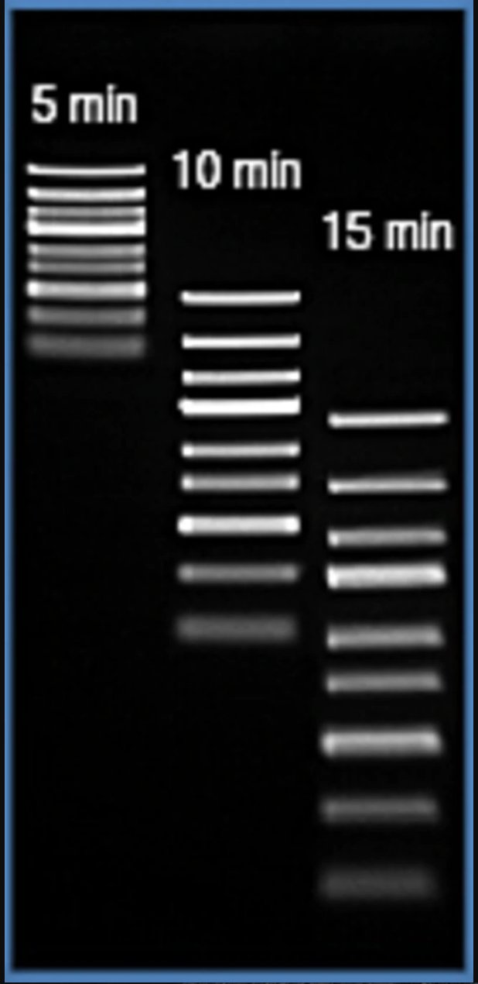
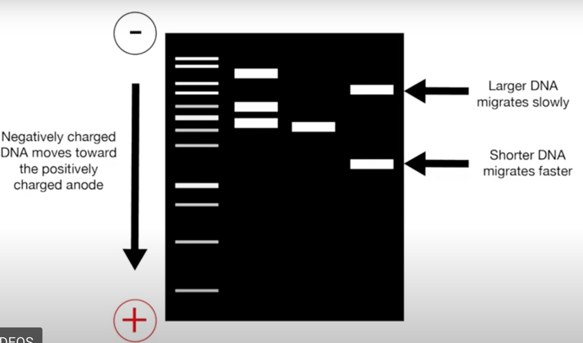
Assessment of Extracted Nucleic Acid

Slide 22
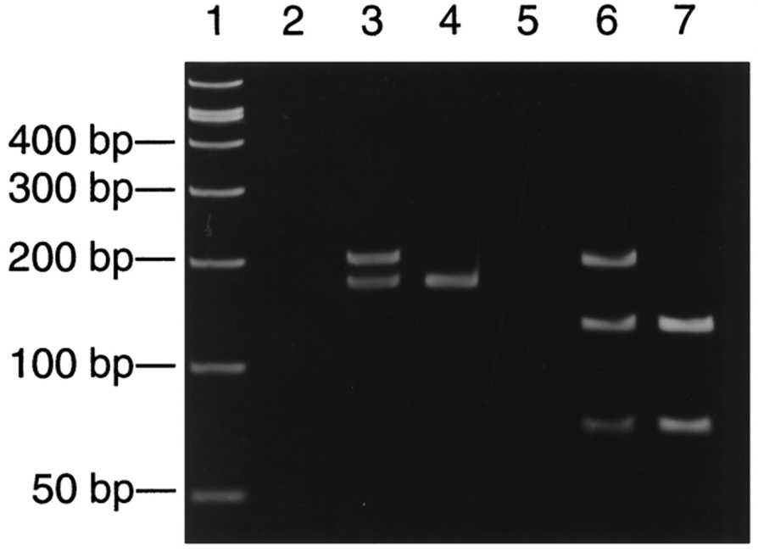
Assessment of Extracted Nucleic Acid

Slide 23
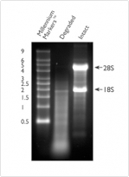
Assessment of Extracted Nucleic Acid
Total RNA

Slide 24
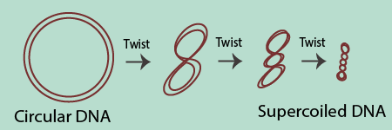
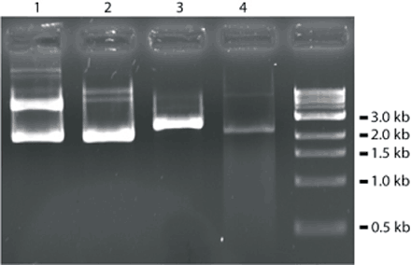
Assessment of Extracted Nucleic Acid

