Slide 1
Pediatric history
Abdulhadi Alzaben, MD
Pediatric hematology oncology and stem cell
transplant

Slide 2
Differences of a Pediatric History
Prenatal and birth history
Developmental history
Vaccination
Feeding History
Parents are historians

Slide 3
Profile
Name, age, sex
Historian relation to patient
Children above the age of 4 may be able to provide some of their own history
Observation of parent-child interactions
Parental behaviors/emotions are important

Slide 4
Chief complaint
Patient own wards
Brief statement of primary problem (including duration) that caused family to seek medical attention

Slide 5
History of present illness
Concise chronological account of the illness, including any previous treatment with full description of symptoms pertinent positives and pertinent negatives
It belongs here if it is relates to the differential diagnosis for the chief complaint.

Slide 6
Review of Systems
Weight - recent changes, weight at birth
Skin and Lymph - rashes, adenopathy, lumps, bruising and bleeding, pigmentation changes
Cardiac - cyanosis and dyspnea, heart murmurs, exercise tolerance, squatting, chest pain, palpitations

Slide 7
HEENT - headaches, concussions, unusual head shape, strabismus, conjunctivitis, visual problems, hearing, ear infections, draining ears, cold and sore throats, tonsillitis, mouth breathing, snoring, apnea, oral thrush, epistaxis, caries

Slide 8
Respiratory - pneumonia, bronchiolitis, wheezing, chronic cough, sputum, hemoptysis, TB
GI - stool color and character, diarrhea, constipation, vomiting, hematemesis, jaundice, abdominal pain, colic, appetite
GU - frequency, dysuria, hematuria, discharge, abdominal pains, quality of urinary stream, polyuria, previous infections, facial edema

Slide 9
Musculoskeletal - joint pains or swelling, fevers, scoliosis, myalgia or weakness, injuries, gait changes
Pubertal - secondary sexual characteristics, menses and menstrual problems, pregnancies, sexual activity
Allergy - urticaria, hay fever, allergic rhinitis, asthma, eczema, drug reactions

Slide 10
Prenatal
Maternal health during pregnancy: bleeding, trauma, hypertension, fevers, infectious illnesses, medications, drugs, alcohol, smoking, Diabetes or any other disease
Rupture of membranes
Antenatal visits and findings
Supplements and drugs
Investigations and blood group

Slide 11
Natal
Gestation age at delivery
Birth weight
Mode of delivery
APGAR Score
NICU admission and coarse
Jaundice

Slide 12
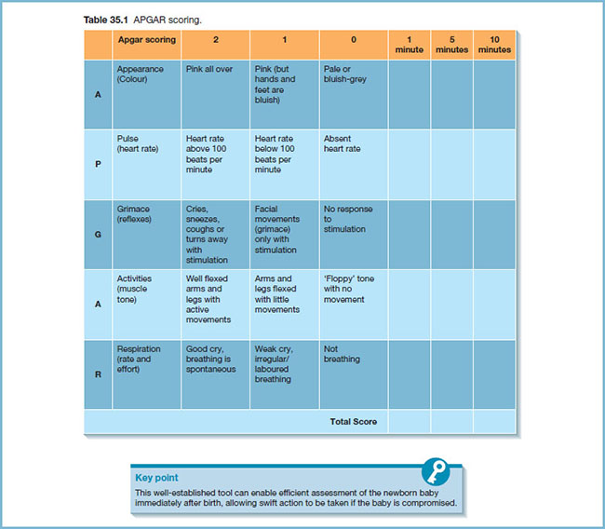

Slide 13
Past Medical History
Major medical illnesses
Major surgical illnesses-list operations and dates
Trauma-fractures, lacerations
Previous hospital admissions with dates and diagnoses
Current medications
Known allergies (not just drugs)
Immunization status - be specific, not just up to date

Slide 14
Immunization
Vaccines given
Side effects
Extra vaccines

Slide 15
Developmental History
Gross
Fine motor and vision
Language and hearing
Social

Slide 16
Feeding History
Breast or bottle fed
types of formula
Frequency and amount, reasons for any changes in formula
Weaning
Supplements

Slide 17
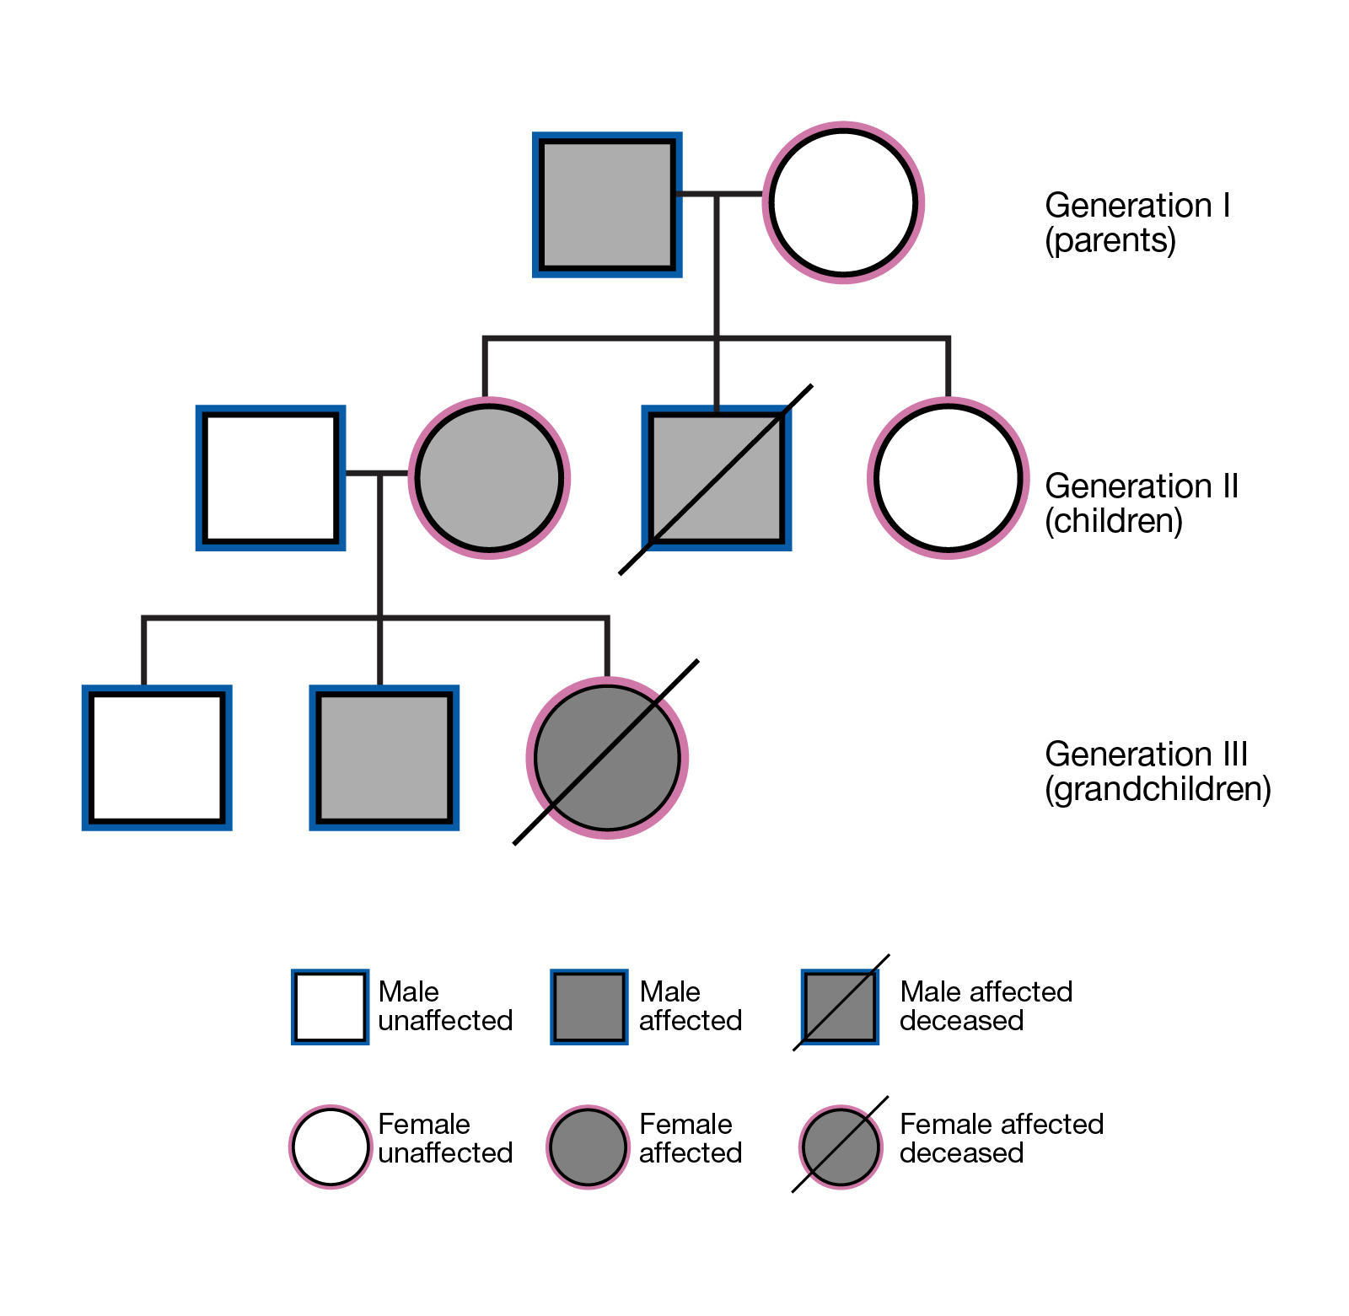

Slide 18
Family History
Consanguinity
Pedigree
Any genetic disease
Developmental delay

Slide 19
Social
Living situation and conditions
daycare, safety issues
Occupation of parents

Slide 20
Physical exam
General inspection
Vital signs
Growth parameters
General and systemic exam

Slide 21
Differences
Gather much information by observation
Stay at the child level
least distressing to most distressing

Slide 22
General inspection
Does the child looks well or ill?
Level of consciousness
Signs of dehydration:
Sunken eyes
Fontanel
Capillary refill
Skin turgor
Dysmorphic features

Slide 23
General inspection
Signs of respiratory distress
Suprasternal retraction
Intercostal retraction
Subcostal retraction
Nasal flaring
Use of accessory muscles
Cyanosis:

Slide 24
Vital signs
Temperature
Oral, rectal, axillary
HR
Apical or femoral for infants
Antecubital or radial pulse for older children
Respiratory rate
Observe for a minute.
Blood pressure
Appropriate size cuff - 2/3 width of upper arm

Slide 25
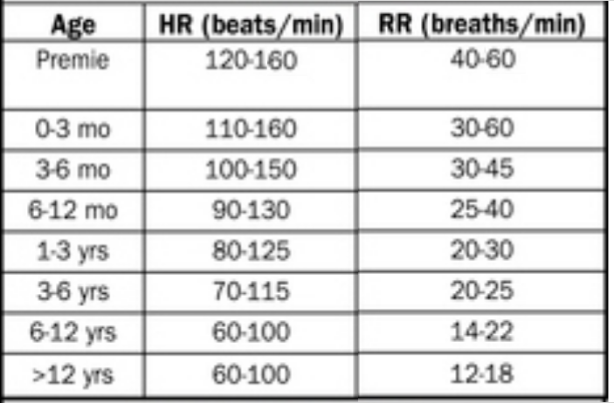

Slide 26
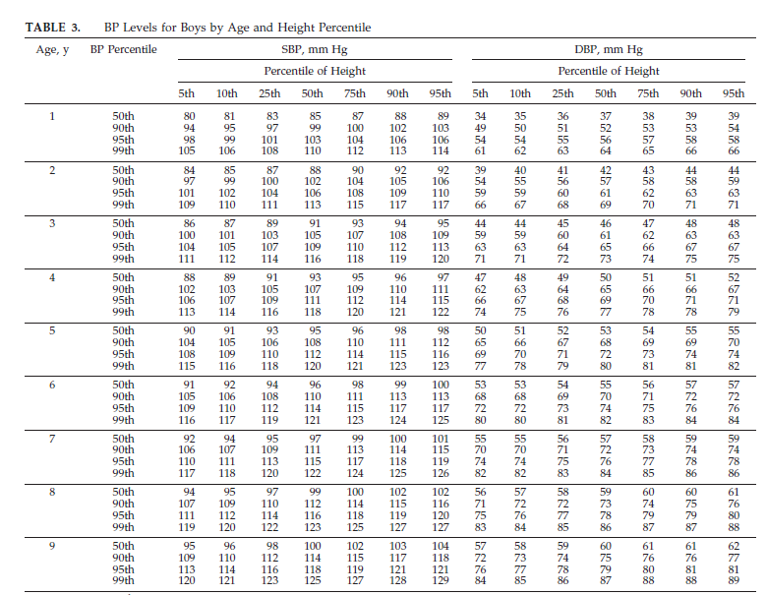

Slide 29
Growth parameters
Use growth charts
Weight :2.5 -4.2 kg ,double around 4-5 months and triple at 12 months
Length/Height: 50 cm at birth,75 cm at 12 months, double or 100 cm at age 4 years
Head circumference:33-37 cm, increases 12 cm first year of life then 12 cm rest of life
2cm per month first 3 months then 1 cm per month second 3 months then 0.5 cm per months next 6 months
BMI

Slide 30
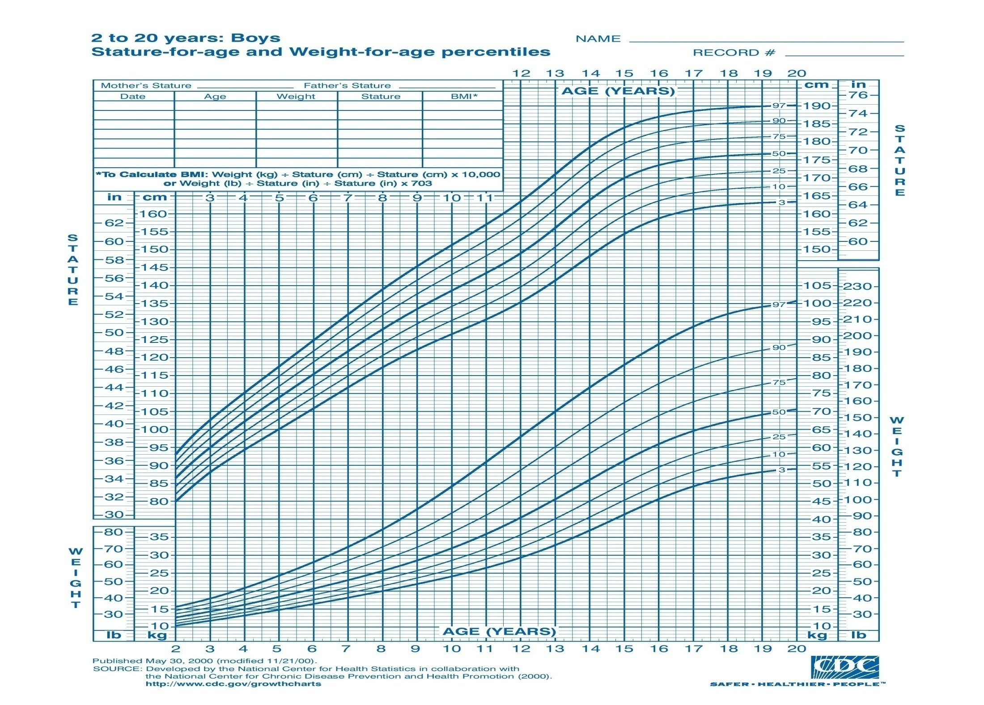

Slide 31
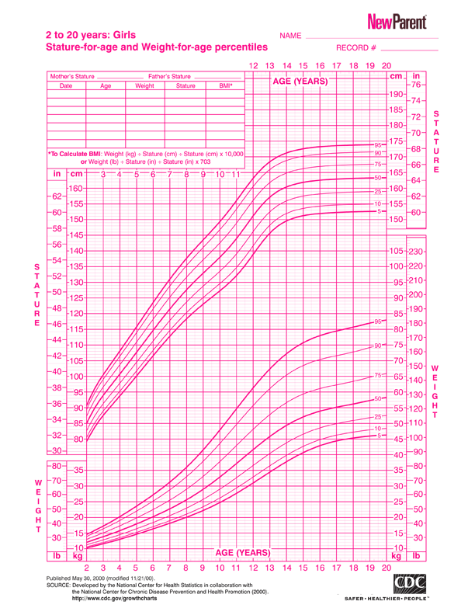

Slide 32
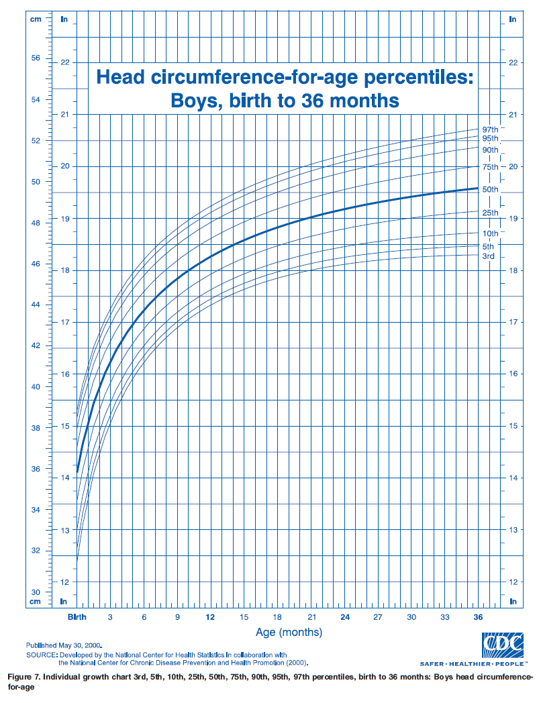

Slide 33
Terms
FFT:
fall over 2 or more percentile
are persistently below the third or fifth percentiles
are less than the 80th percentile of median weight for height measurement.
Stunting: Low height for age
Wasting: Low weight for height

Slide 34
Short stature: less than 3rd centile for age and sex
Microcephaly: less than 3rd centile for age and sex
Macrocephaly: more than 97th centile for age and sex

Slide 35
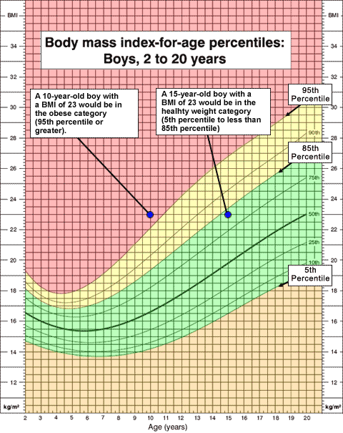

Slide 36
Skin and Lymphatics
A. Birth marks - nevi, hemangiomas, mongolian spots etc
B. Rashes, petechiae, desquamation, pigmentation, jaundice
C. Lymph node enlargement, location, mobility, consistency
D. Scars or injuries, especially in patterns suggestive of abuse

Slide 37
Head
Size and shape
Fontanelle(s)
Size
Tension - calm and in the sitting up position
Sutures - overriding

Slide 38
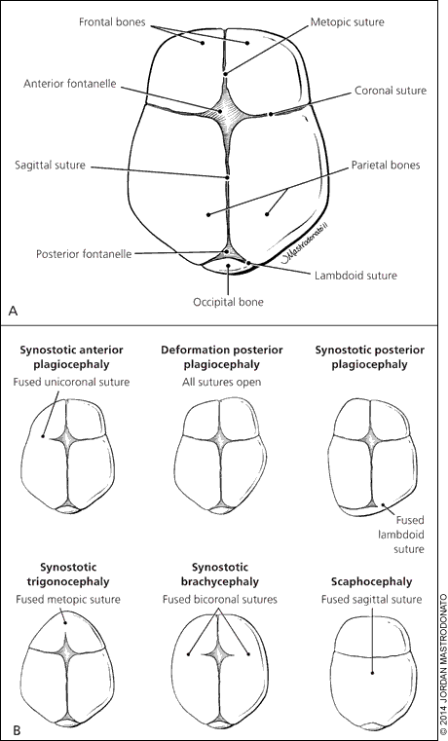

Slide 39
Eyes
Slant of palpebral fissures
Hypertelorism
Pupils
Conjunctiva, sclera, cornea
Red reflex
Visual fields - gross exam

Slide 40
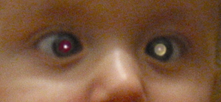

Slide 41
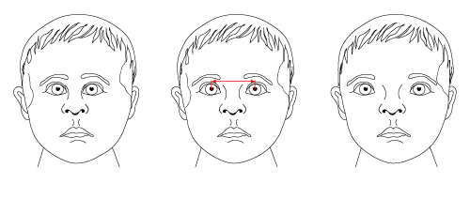
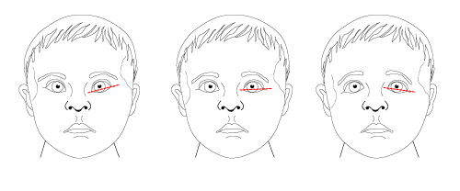

Slide 42
Ears
Ears Position of ears
Tympanic membranes
In infants pull pinna downward, in older children pull it back and up
look for swelling, perforation, redness and dullness

Slide 43
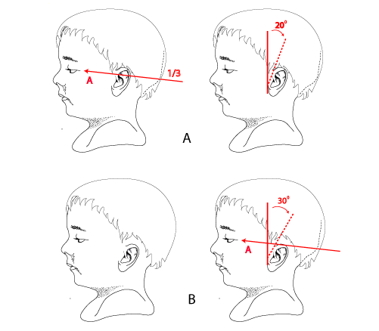

Slide 44
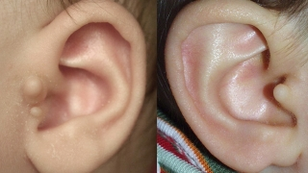

Slide 45
Nose
Nasal septum
Mucosa (color, polyps)
Sinus tenderness
Discharge
Notes:
salute

Slide 46
Mouth and Throat
Lips and buccal
Tongue
Teeth and gums
Palate (intact, arch)
Tonsils (size, color, exudates)
Posterior pharyngeal wall

Slide 47
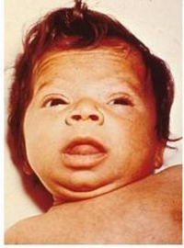

Slide 48
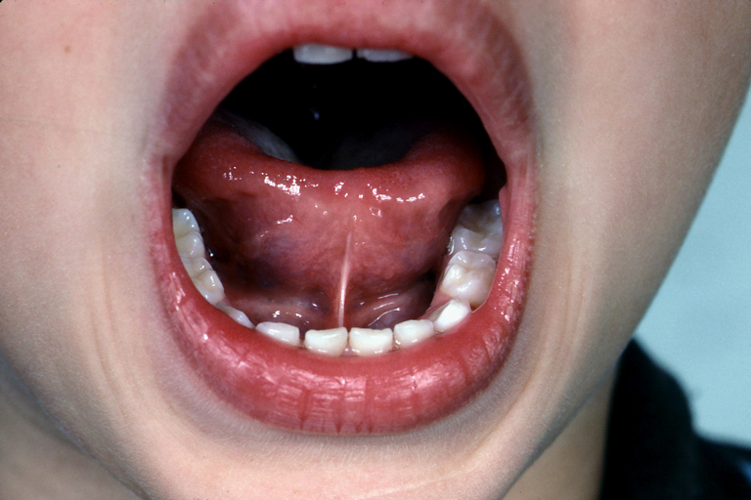
Notes:
ankyloglossia

Slide 49
Neck
Thyroid
Trachea position
Masses (cysts, nodes)
Presence or absence of nuchal rigidity

Slide 50
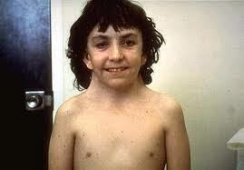
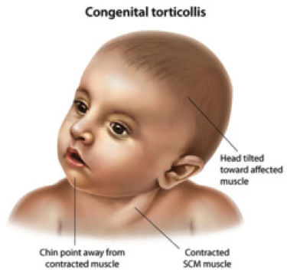
Notes:
Webbed
torticollus

Slide 51
Lungs/Thorax
Inspection
Pattern of breathing
Abdominal breathing is normal in infants
Periodic breathing is normal in infants (pause < 15 seconds)
Respiratory distress
Chest wall configuration
Kyphosis
b. Scolisis
c. Pectus excavatum or carniatum
d. Hyperinflated
4. Scars

Slide 52
Lungs/Thorax
Palpation and percussion
Tracheal deviation
Apex beat
Chest expansion in older children
Auscultation
Equality of breath sounds
wheezes, crackles
Upper airway noise

Slide 53
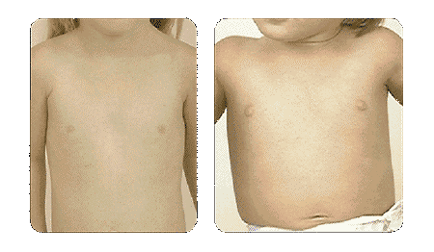
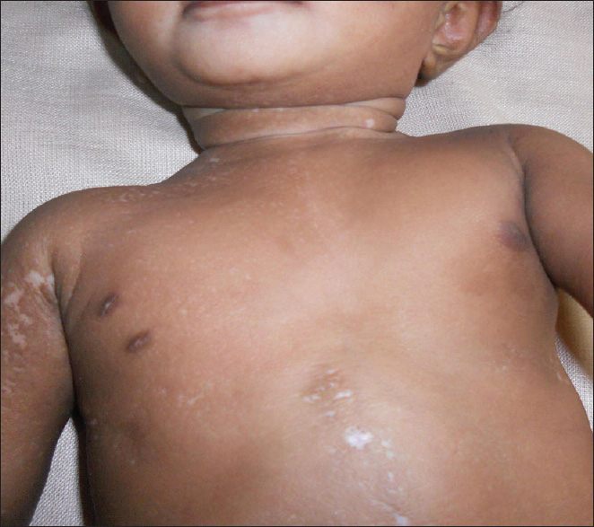

Slide 54
Cardiovascular
Vital signs
General Exam
Central cyanosis + pallor
Hands
Respiratory distress
JVP for age > 8 years
Pulse
Radio femoral delay in older children, or brachial femoral in infants
c. Heart auscultation
D. Liver and lung

Slide 55
Innocent murmur
Soft 1-3
Systolic
Not conducted posteriorly
Variable with position and respiration

Slide 56
Abdomen
Inspection
Shape
a. Infants usually have protuberant abdomens
b. Becomes more scaphoid as child matures
2. Umbilicus
Palpation
1. Tenderness - avoid tender area until end of exam
Liver, spleen, kidneys: May be palpable in normal setting
DRE is not routine

Slide 57
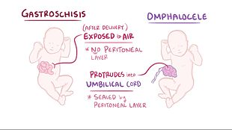

Slide 59
Musculoskeletal
Sacral dimple
Kyphosis, lordosis or scoliosis
Joints and muscles
Extremities
1. Deformity
2. Fingers
3. Edema
4. Clubbing

Slide 60
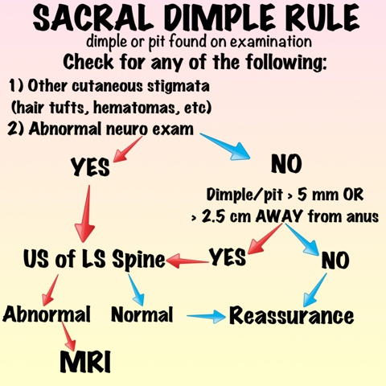
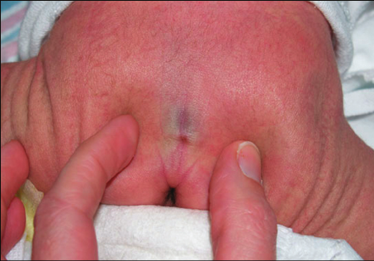

Slide 61
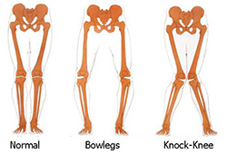
Notes:
BR

Slide 62
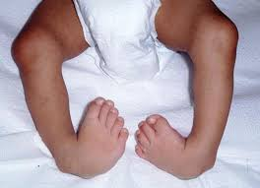
Club foot

Slide 63
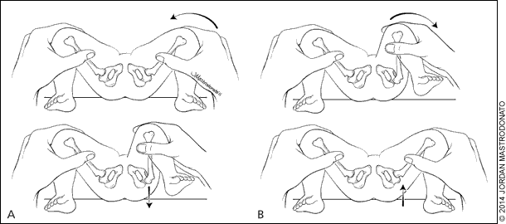
DDH

Slide 64
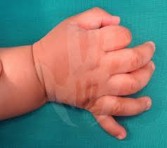
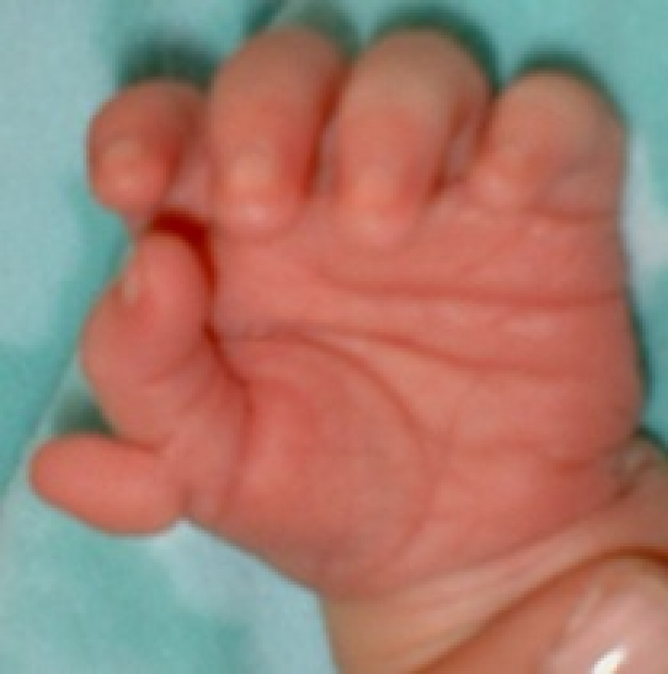
Postaxial (ulnar) Preaxial (radial) : more associated with syndrome
Common

Slide 65
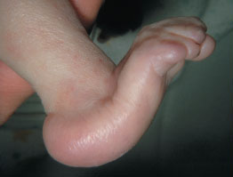
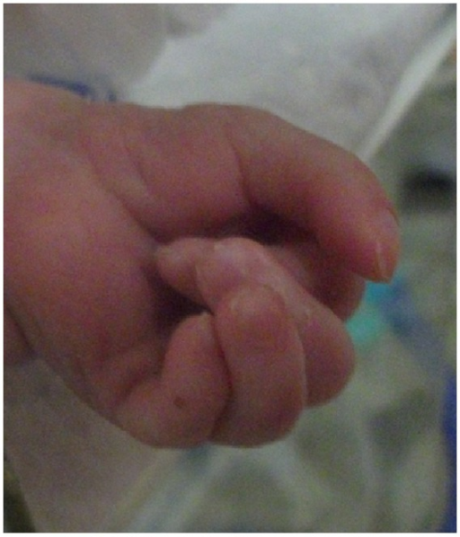
Rocker bottom feet Overriding fingers

Slide 66
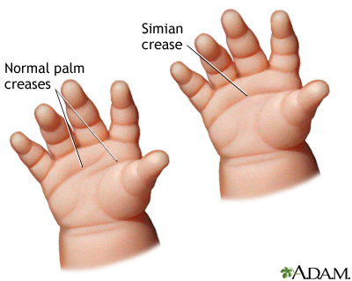
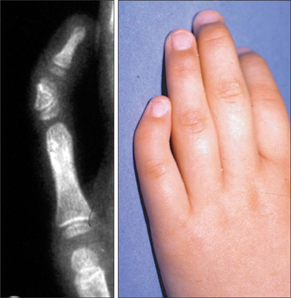
3-10% of normal population
May be associated with Down
Clinodactly: may be associated with Turner

Slide 67
Neurologic
Most accomplished through observation alone
Skin exam
Tone, Power, DTR
Sensory
Cerebellum
Cranial nerves
Primitive reflexes
Developmental evaluation

Slide 68
Reflex
Moro reflex
Stepping reflex
Rooting reflex
Sucking reflex
Asymmetrical tonic neck reflex
grasp reflex
Planter reflex
Galant reflex
Babkin reflex

Slide 69
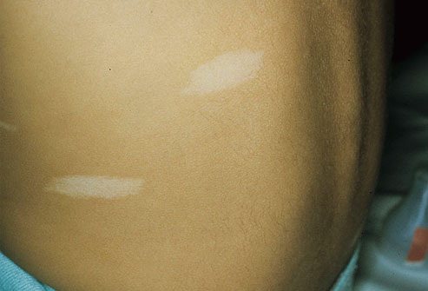
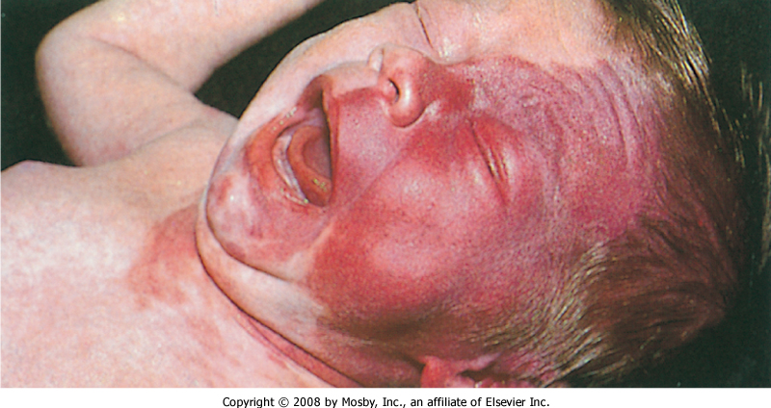
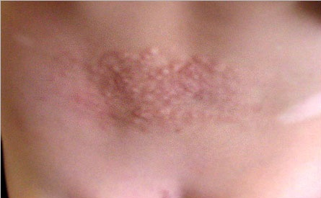

Slide 70
GU
Size of penis
Urethral opening
Scrotum and testicles
Testicular volume
Term female newborns have prominent labia majora, whereas preterm female newborns have prominent labia minora and clitoris
Vaginal discharge

Slide 71
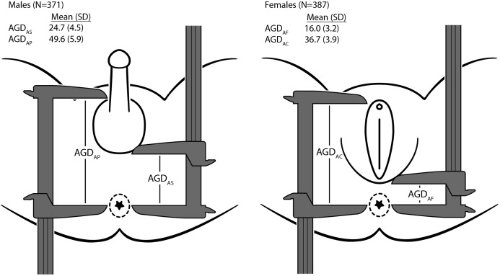
Ambiguous genitalia
Phallus length < 1.9 cm
Clitoromegaly ( length > 1cm)
Non palpable gonads in male
Hypospadias associated with undescended testis or separation of scrotal sac
Anogenital ratio > 0.5

Slide 72
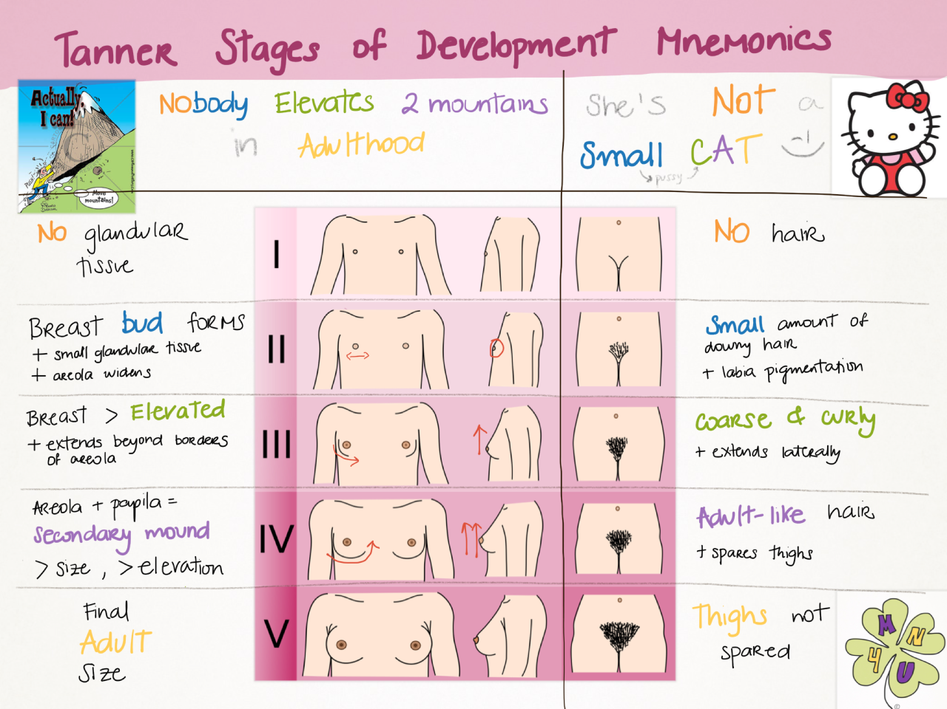
Tanner stage

Slide 73
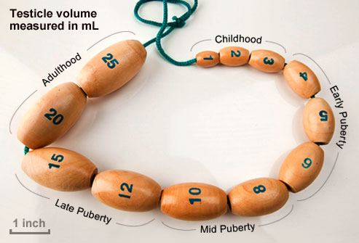
Orchidometer
Pubertal testicle:
4 ml
2.5 cm cm long axis

Slide 74
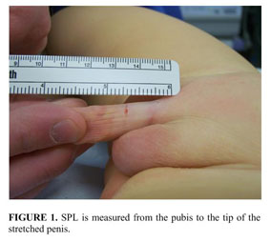
Stretched penile length
Normally 2.5 cm or more in term newborn

Slide 75
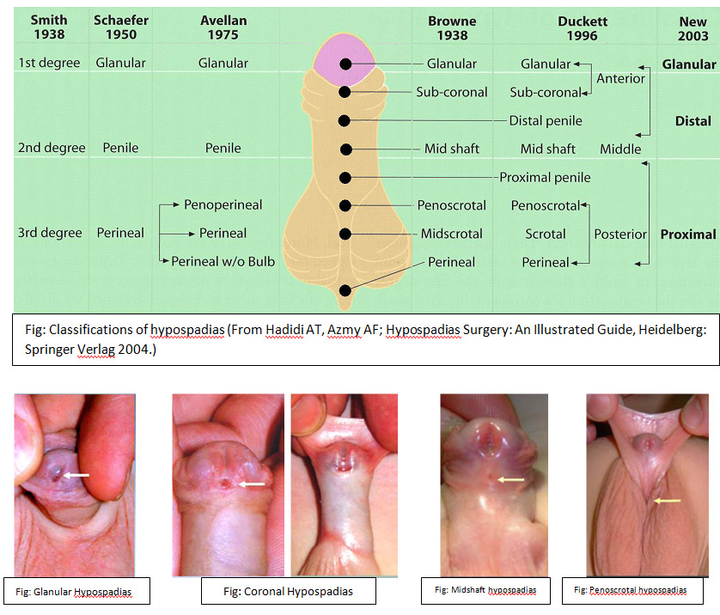
Hypospadius

Slide 77
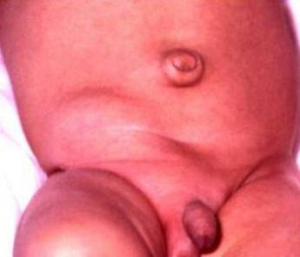
Inguinal hernia
More in prematures
More at right side
More in males

Slide 78
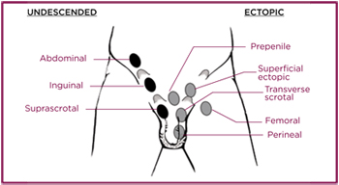
Undescended testicles
More in prematures
Most descended by age of 1 year except 0.3%
Check if retractile testicles

