Slide 1
Common problems in neonate
Supervised by: Dr . Amjad Al Tarawneh
Done by: Aya Musleh
Hala Ìhmoud
Rama Ismail
Marwa Rateb

Slide 2
Meconuim Aspiration

Slide 3
What is meconuim ?
It is the first intestinal discharge from newborns, which is a viscous, dark green substance composed Of:
Water which is the major liquid constituent, comprising 85-95% of meconium.
the remaining 5-15% of ingredients consists of solid constituents, primarily intestinal secretions(eg. Bile), mucosal cells, and solid elements of swallowed amniotic fluid, such as proteins and lipids.
Meconium is sterile and does not contain bacteria.
PH of meconium 5.5 to 7.0.
. Normally meconium should pass after delivery, within the first 48 hours.

Slide 4
Several factors plays a role in the passage of meconium into the amniotic fluid. The major two factors are fetal hypoxic stress and fetal maturity.
Other Factors include:
Placental insufficiency
maternal hypertension
Preeclampsia
Oligohydramnios
infection
Acidosis
maternal drug abuse( especially use of tobacco and cocaine)
THE EXACT MECHANISM OF MECONIUM PASSAGE INTO THE AMNIOTIC FLUID IS NOT COMPLETELY UNDERSTOOD AND IT MAY BE A COMBINATION OF SEVERAL FACTROS.

Slide 5
Pathophysiology
Effects of meconium passage into the amniotic fluid are:
1- Reduction in antibacterial activity.
2- Irritation of the fetal skin.
3- Aspiration of meconium-stained amniotic fluid.

Slide 6
This aspiration induces its effect via four major pulmonary effects:
Meconuim aspiration
Airway obstruction
Pulmonary hypertension
Surfactant dysfunction
Chemical pneumonitis

Slide 7
1- Airway Obstruction
Complete obstruction of the airways by meconium results in atelectasis.
Partial obstruction causing ball-valve effect.
A ball valve effect (BVE) is a partial obstruction which causes an inflow of air during the inspiration phase of breathing and, on the other hand, as expiration begins, prevents outflow.
This results in air trapping and Hyperdistention of the alveoli, may rupture or leak into the pleura (pneumothorax), mediastinum (pneumomediastinum), or pericardium(pneumopericardium).

Slide 8
Ball Valve effect :

Slide 9
2- Surfactant Dysfuncton :
The extent of surfactant inhibition depends on both the concentration of surfactant and meconium. If the surfactant concentration is low, even very highly diluted meconium can inhibit surfactant function whereas, in high surfactant concentrations, the effects of meconium are limited. Meconium may impact surfactant mechanisms by preventing surfactant from spreading over the alveolar surface, decreasing the concentration of surfactant proteins (SP-A and SP-B), and by changing the viscosity and structure of surfactant.
So interfere with the normal function of the surfactant
This will leads to respiratory distress syndrome

Slide 10
3- Chemical pneumonitis:
Once meconium is aspirated into the lungs, it activates the immune system, causing a release of inflammatory cytokines (TNF-α, IL-1ß, IL-6, IL-8, IL-13), which initiate a diffuse pneumonitis that will cause tissue damage.
This may begin within a few hours of aspiration (First 72 hours after birth)
All of these pulmonary effects can produce a gross ventilation-perfusion (V/Q) mismatch.

Slide 11
4- Persistent pulmonary hypertension
Primary or secondary PPHN frequently accompany meconium aspiration as a result of chronic in utero stress and thickening of the pulmonary vessels, with right-to-left shunting via( PDA and foramen ovale) caused by increased pulmonary vascular resistance.
PPHN further contributes to the hypoxemia caused by meconium aspiration syndrome.
PPHN in newborns is the leading cause of death in MAS.
although meconium is sterile, its presence in the air passages can predispose the infant to pulmonary infection.

Slide 12
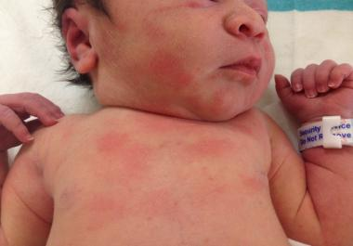
Effect to the skin:
meconium is irritating to fetal skin, thus increasing the incidence of erythema toxicum syndrome.

Slide 13
Clinical presentation :
Symptoms of severe respiratory distress may be present shortly after delivery :
Cyanosis.
End-expiratory grunting.
Nasal flaring.
Intercostal retractions.
Tachypnea.
Barrel chest. due to the presence of air trapping
Auscultated rales and rhonchi.
Yellow-green staining of fingernails, umbilical cord, and skin may be also observed.
Green urine may be noted in newborns with MAS less than 24 hours after birth.

Slide 15
Investigtion
Pulse oximetry and ABGs
* Metabolic acidosis from perinatal stress is complicated by respiratory acidosis
* Hypoxia.
* Hypercapnia.
continuous measurement of oxygenation by pulse oximetry are necessary for appropriate management.

Slide 16
Serum electrolytes
Obtain sodium, potassium, and calcium concentrations at 24 hours of life in infants with meconium aspiration syndrome because the (SIADH) and acute renal failure are frequent complications of perinatal stress.

Slide 17
CBC count
Polycythemia
Echo
To ensure normal cardiac structure
Severity of PPHN and right to left shunting

Slide 18
Chest X-ray
The typical chest radiograph is characterized by patchy infiltrates, coarse streaking of both lung fields, increased anteroposterior diameter, and flattening of the diaphragm.

Slide 19
Bilateral diffuse asymmetrical patchy areas of infiltration :

Slide 20
Air trapping and hyperexpansion :

Slide 21
Acute atelectasis :

Slide 22
Management of meconium aspiartion

Slide 24
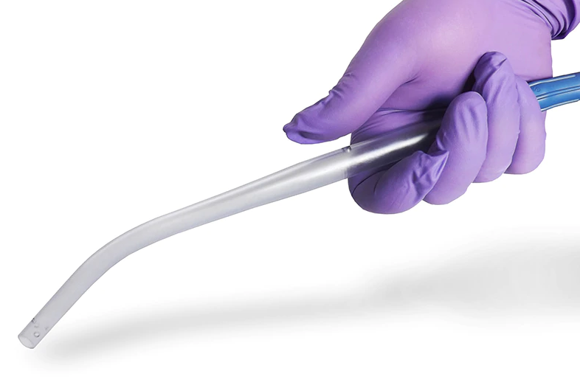
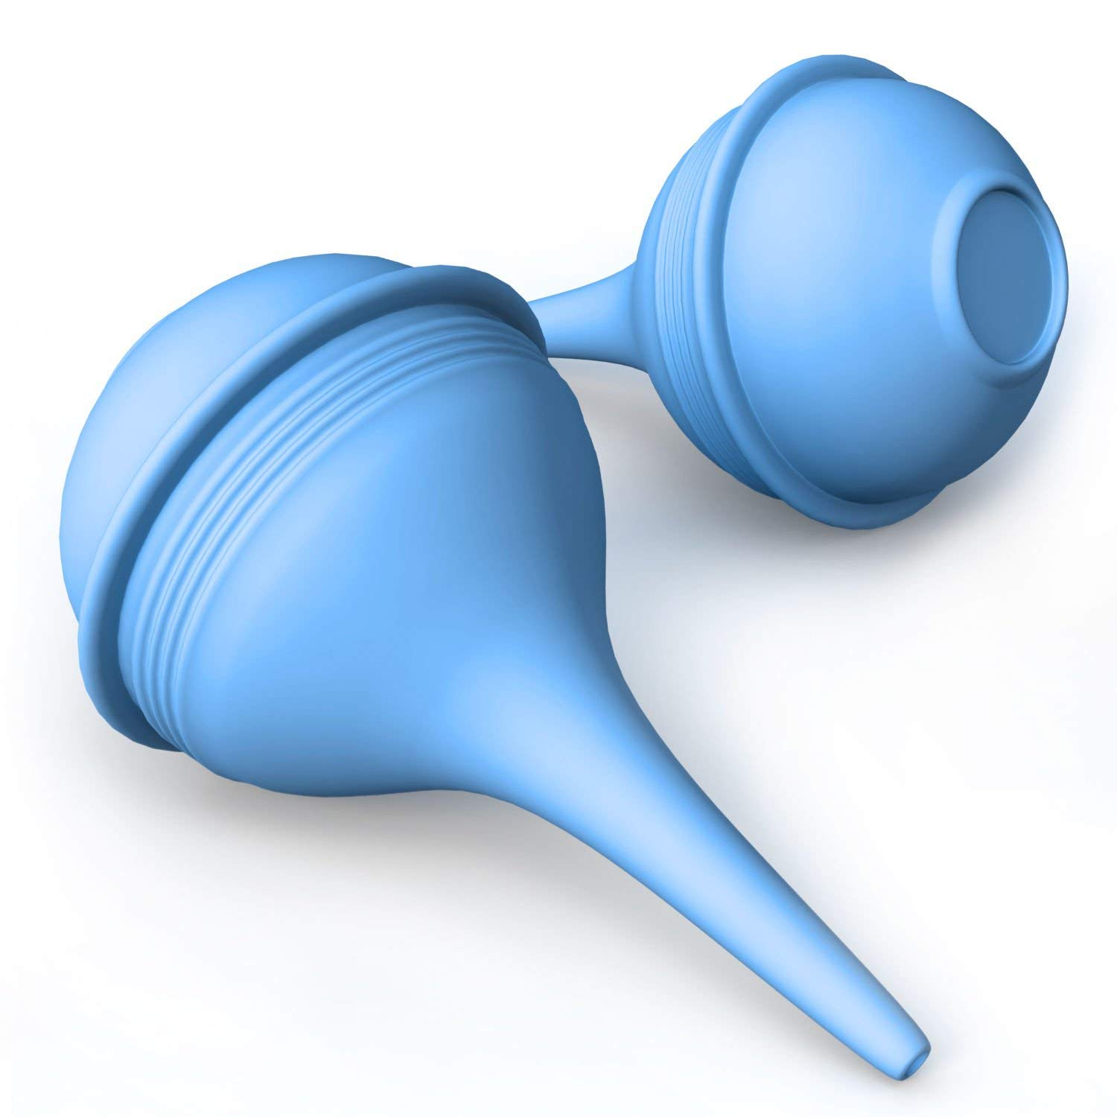
If the baby is vigorous (defined as normal respiratory effort, normal muscle tone, and heart rate >100 bpm) → Do not electively intubate.
Clear secretions and meconium from the mouth and nose with a bulb syringe or a large-bore suction catheter.

Slide 25
If the baby is not vigorous (defined as depressed respiratory effort, poor muscle tone, and/or heart rate < 100 bpm) → Use direct laryngoscopy, intubate, and suction the trachea immediately after delivery. Suction for no longer than 5 seconds. Suction befor his first breath
→ If no meconium is retrieved, do not repeat intubation and suction.
→ If meconium is retrieved and no bradycardia , HR <100 is present, > reintubate and suction.
→ If the heart rate is low, administer positive pressure ventilation and consider suctioning again later.

Slide 26
Continued care in the NICU
Minimal handling is essential because these infants are easily agitated, Agitation can increase pulmonary hypertension and right-to-left shunting, leading to additional hypoxia and acidosis. Sedation may be necessary to decrease agitation.
Continue respiratory care. Oxygen therapy via positive pressure is crucial in maintaining adequate arterial oxygenation.
Notes:
systemic vasopressors (Dopamine is often the first-line) are critical in maintaining systemic blood pressure greater than pulmonary blood pressure, thereby decreasing the right-to-left shunt through the patent ductus arteriosus.

Slide 27
Mechanical ventilation in 30% of cases (hyperventilation)
Surfactant when needed
prophylactic antibiotic is not indicated if there is no pneumonia
Inhaled NO → for PPHN (Persistent pulmonary hypertension of the newborn)
Notes:
AB → No studies have shown prophylactic antibiotics to reduce the incidence of sepsis in neonates born through meconium-stained amniotic fluid; thus, antibiotic use may be reserved for suspected or documented infections.

Slide 28
Prevention :
The risk of meconium aspiration may be decreased by
rapid identification of fetal distress and suction before his first breath if non vigourus
Amnioinfusion or routine intrapartum nasopharyngeal suctioning in infants with meconium-stained amniotic fluid do not reduce the risk for MAS.
Notes:
amnioinfusion with warm, sterile to dilute the meconium in the amniotic fluid → minimizing the severity of the aspiration.
Current recommendations no longer advise routine intrapartum suctioning for infants born to mothers with meconium staining of the amniotic fluid.

Slide 29
Prognosis :
The mortality rate of MAS 4-5%.
The decline in neonatal deaths due to MAS during the last decades is related to improvements in obstetric and neonatal care.
Residual lung problems are rare but include symptomatic cough, wheezing, and persistent hyperinflation for up to 5- 10 yr.
The ultimate prognosis depends on the extent of CNS injury from asphyxia and the presence of associated problems such as pulmonary hypertension

Slide 30
Complication :
PPHN.
chronic lung disease from intense pulmonary intervention.
Infants with MAS have a slightly increased incidence of respiratory infections in the first year of life because the lungs are still in recovery.
Notes:
PPHN is a serious breathing condition in a newborn in which lung vessels are not open wide enough meaning that oxygen and blood flow is restricted

Slide 31
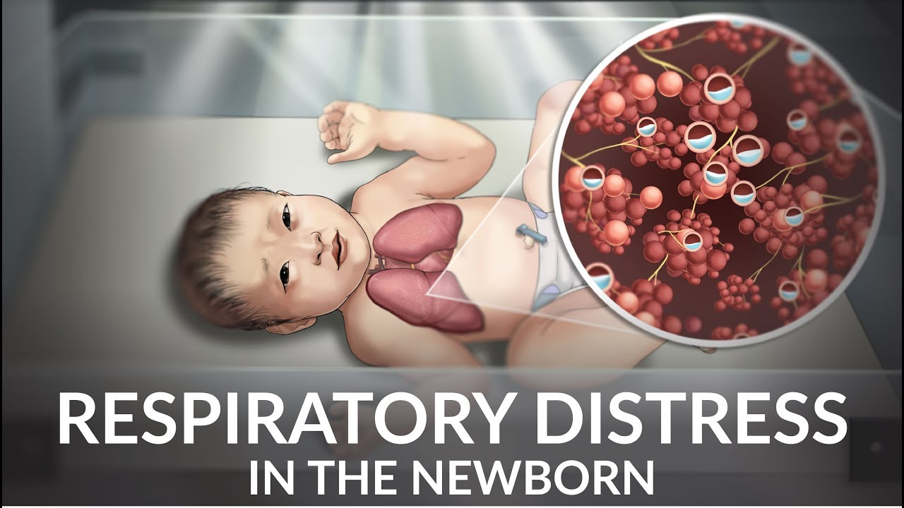
Transient Tachypnea of the newborn
(TTN)
Notes:
In the past it was called RDS type 2

Slide 32
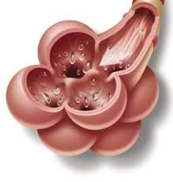
Definition:
IT Is a self-limited disease commonly seen in term or slightly preterm neonates
develops in approximately 1% of all newborn infants and results in admission to NICU.
Notes:
In general ttn is benign , self limited disease
Mainly we see it in term or post term
The incidence = 1%

Slide 33
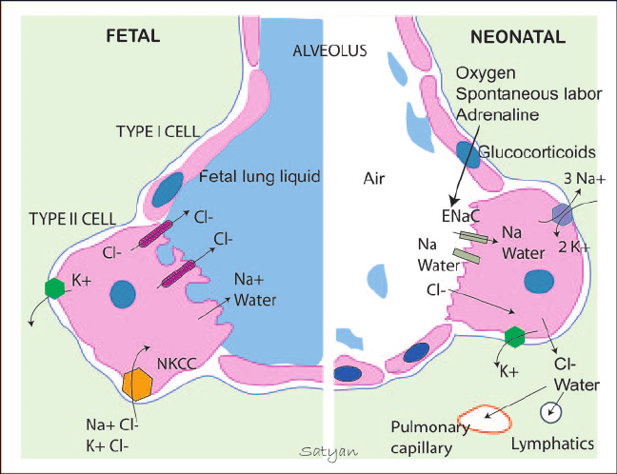
Pathophysiology :
IT is believed to be secondary to slow resorption of fetal lung fluid, resulting in decreased pulmonary compliance (because of increased surface tension) and tidal volume and increased dead space.
So accumulation of fluid will cause inhibition in gas exchange or v/p mismatch .
Notes:
-Lung comliance: is a measure of the lung's ability to stretch and expand (distensibility of elastic tissue).
-Tidal volume: (symbol VT or TV) is the lung volume representing the normal volume of air displaced between normal inhalation and exhalation when extra effort is not applied. In a healthy, young human adult, tidal volume is approximately 500 mL per inspiration or 7 mL/kg of body mass.
-Dead space is the volume of air that is inhaled that does not take part in the gas exchange, because it either remains in the conducting airways or reaches alveoli that are not perfused or poorly perfused.
During fetal life, the potential airspaces of the lung are filled with fluid. At birth, the fetal lung must rapidly clear its fluid-filled potential airspaces to allow effective gas exchange in postnatal life.

Slide 34
fetal lung fluid clearance :
35% clears by a few days prior to birth, owing to changes in the ENaC (epithelial Na channel)
- 30% during active labor owing to mechanical transpulmonary forces and catecholamine surge
- 35% is cleared postnatally during active crying and breathing
Notes:
Clearance by? –chest compression (during vaginal delivery )
-active crying and breathing
An infant born by CS is at risk of having excessive pulmonary fluid as a result of not having experienced all of the stages of labor and subsequent lack of appropriate catecholamine surge, which results in low release of counter-regulatory hormones at delivery.
The result is alveoli with retained fluid that inhibit gas exchange.
Neonatal Lung Passive movement of sodium through epithelial sodium channels (ENaC) is believed to be the principle mechanism of reabsorption of fetal lung fluid with starling forces and thoracic squeeze playing a minor role in clearance.
*Four primary counter-regulatory hormones—glucagon, epinephrine, cortisol, and growth hormone—help maintain blood glucose levels and can produce hyperglycemia in excess.

Slide 35
RISK FACTORS :
1- infant born via C-section .
2- infant of diabetic mother.
3-macrosomic baby .
4-neonatal asphyxia .
5-prolong rupture of membrane .
6-used excessive sedation material during delivery .
Other factors: Maternal asthma and smoking, low APGAR score, male patient, age <39 weeks
Notes:
The term macrosomia is used to describe a newborn with an excessive birth weight.

Slide 36
Signs & symptoms :
1- tachypnea RR>60
2- grunting and flaring
3- retardation
4- cyanosis
5- clear lung fluids or crackles.
→ The resolution of these respiratory distress symptoms occur within 72 hrs .

Slide 37
By examination:
-immediately or within first 6 hrs of delivery the baby will develop early onset tachypnea
with grunting, retractions, flaring, on extreme cases severe hypoxia and cyanosis (but rarely).
-the Chest in general is clear without added sounds except rarely you can find crackles , with normal air entry
Notes:
Early onset of tachypnea ? Different between ttn and rds ?
rds → deteriorated with time if there is no good mangment
Ttn→ will improve with time .
The maternal history in (TTN) consists of CS without labor or precipitous delivery.+ Gestational age (preterm)

Slide 38
Work-up :
1- ABG, Pulse oximetry :
-ABGs do not reflect CO2 retention
2-CXR :
Chest radiography is the diagnostic standard for TTN .
- The main finding : fluid/ edema in the fissure , and maybe found small pleural effusion or hyperinflation .
3-ECHO :
- rule out cardiac cause or pulmonary HTN

Slide 39
Notes:
. Frontal radiograph of the chest of a term newborn shows streaky, perihilar linear densities, indistinctness of the blood vessels and fluid in the minor fissure (white arrow) along with a small right effusion (red arrow), all signs of increased fluid in the lungs.

Slide 40
DDX :
1- congenital HD
2- diaphragmatic hernia
3- congenital lung defect
4- pneumothorax
5- meconium aspiration
6- RDS
7- PPHN (Persistent Pulmonary Hypertension of the Newborn)
8- neonatal pneumonia

Slide 41
Treatment :
-Supportive TX.
I-V Fluid
- O2 supplement
- correct any metabolic disorders
-regulate temperature
Notes:
Low flow o2 (usually need 30-40% fio2 cons. )
Rarely need mechanical ventilation .
Continuous positive airway pressure (CPAP) (fio2 40-0%)
→ Show very rapid response to tx .
→the disease is very good prognosis without residual lung problem .

Slide 42
Birth injuries

Slide 43
Definitions
Birth injury :
Is defined as the structural destruction or functional deterioration of the neonate’s body due to a traumatic event at birth.
-Is used to denote avoidable and unavoidable mechanical and hypoxic- ischemic injury incurred by an infant during labor and delivery.
-Birth injuries are a significant cause of neonatal morbidity
and mortality.

Slide 44
Birth trauma :
Injuries to the infant that result from mechanical forces during the birth process.
Birth defect:
A congenital disorder present at birth regardless of its cause, may result in disabilities that may be physical , intellectual or developmental.

Slide 45
Epidemiology
Significant birth injury accounts for fewer than 2% of neonatal deaths and stillbirths in the United States.
It still occurs occasionally and unavoidably, with an average of 6-8 injuries per 1000 live births.
In general, larger infants are more susceptible to birth trauma.
Higher rates are reported for infants who weigh more than 4500g.

Slide 46
Risk factors
Maternal
Fetal
Delivery
1- primigravida 2- pelvic abnormality 3- oligohydramnious
4- small maternal stature 5- cephalopelvic disproportion
1- very low BW. 2- Extreme prematurity 3- fetal anomalies 4- fetal macrosomia 5- breech presentation
1- prolonged or rapid labor 2- instrument use
3- version + extraction
4- deep, transverse, arrested descend

Slide 47
Types :
Soft Tissue Injury
Nerve Injury
Brachial Plexus Injury
Cranial Nerve Injury
Laryngeal Nerve Injury
Spinal Cord Injury
Bone Injury
Intra-Abdominal Injury

Slide 48
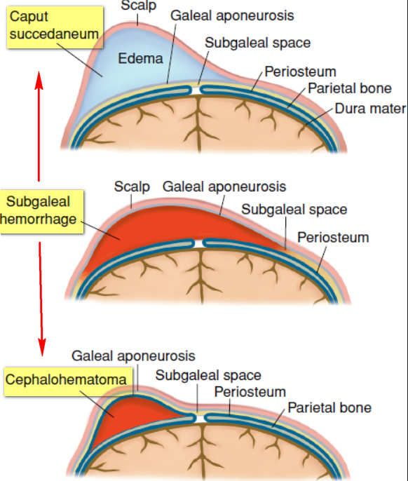

Slide 49
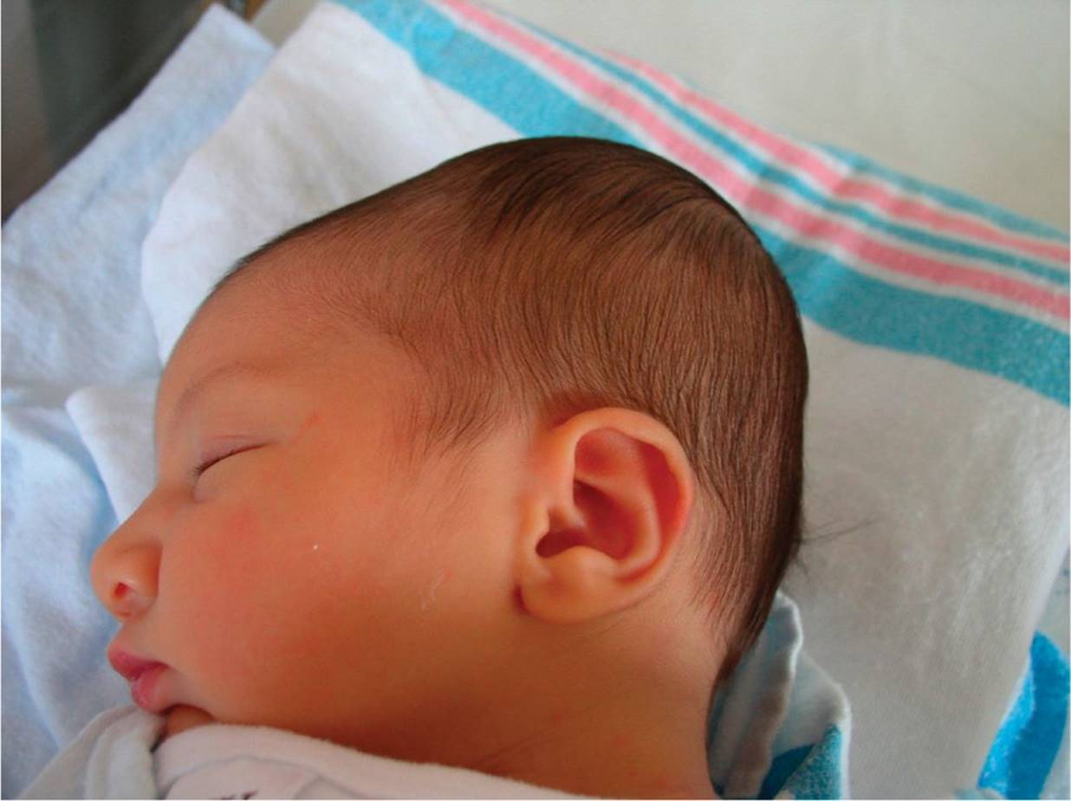
1. cephalohematoma
Is a localized subperiosteal hemorrhage that does not cross the suture lines.
It maybe unilateral or bilateral.
Most commonly over the parietal bones.
A linear skull fracture rarely may be seen underlying a CH . And it doesn’t require specific interventions unless associated with abnormal neurologic findings.
With time, it may calcify, and form a central depression.
Between 1 -2 % of all babies born will develop CH during or after birth, so it’s not a rare condition.

Slide 50
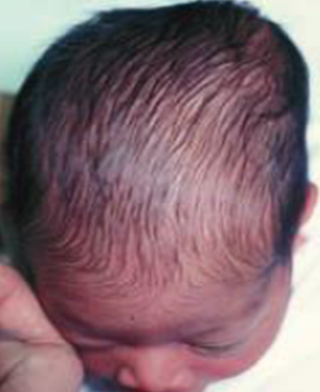
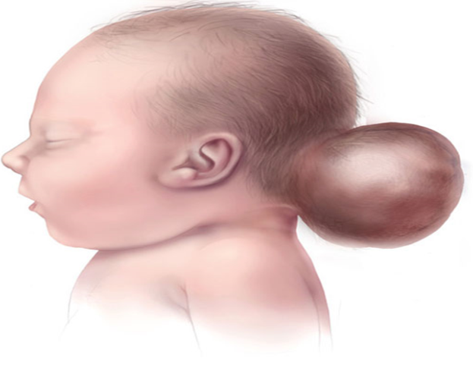
It’s also not dangerous. The blood is sitting on top of the skull, not under the skull. That means the brain isn’t affected
The most obvious CH symptom will be a soft, unusual bulge on the back of a baby’s skull. You likely won’t see a cut or bruise on the surface of the skin over the bulge.
Over the course of a few weeks, the bulge may feel harder as the blood calcifies. After a few weeks, the blood will start to disappear, and the bulge will shrink.
Occipital CHs are uncommon and may be confused as encephalocele.
encephalocele

Slide 51
Beyond this bulge, infants with CH may not display any obvious symptoms or behavioral differences. Instead, the symptoms may be more internal. These could include :
1. Anemia , or low RBC count
2. Jaundice, or yellowish discoloration
3. Infection
Notes:
The extent of hemorrhage may be sever enough to cause anemia and hypotension (uncommon). Significant bleeding is a risk; when the blood is reabsorbed it can worsen neonatal jaundice.
Secondary infection is rare, may cause osteomyelitis or meningitis.
The latter transluminates, is pulsatile, and is associated with underlying bony defect. An ultrasound or a CT scan os indicated to differentiate between the two .
is a neural tube defect characterized by sac-like protrusions of the brain and the membranes that cover it through openings in the skull. These defects are caused by failure of the neural tube to close completely during fetal development.

Slide 52
DIAGNOSIS
A full-body physical examination. Often, the appearance of the bulge alone is enough to make a diagnosis “clinical Dx” ( By examination → palpable edge at the margin of the lesion)
For added precaution , additional tests, including :
X-ray
CT scan
MRI scan
Ultrasound

Slide 53
MANAGEMENT
In almost all cases, an infant won’t need treatment for CH. That’s because most of these injuries will heal on their own. You can expect the bump to go away in several weeks to a few months. Some injuries may take up to three months to heal completely.
Management consist mainly of observation, if anemia or hypovolemia is present resuscitation including transfusion may be needed, aspiration is not required

Slide 54
2.Caput succedaneum

Slide 55
Localized swelling, or edema, of the soft tissue of scalp that appears as a lump or bump on their head shortly after delivery.
This condition is harmless. It doesn’t indicate damage to the brain or the bones of the cranium.
Causes :
Prolonged pressure from the dilated cervix or vaginal walls on the baby’s head causes swelling, puffiness, and bruising.
The use of vacuum suction or forceps also can increase the risk of this type of swelling.
Scalp swelling may be more likely if the amniotic sac membranes rupture early in labor.
Notes:
The edema which is sometimes ecchymotic typically crosses the suture lines and the midline of the skull because it is located above the periosteum.
Scalp swelling may be more likely if the amniotic sac membranes rupture early in labor. In some cases, if the membranes rupture very early or if there’s too little fluid in the amniotic sac, the mother’s pelvic bones will put pressure on the infant’s head. As a result, this kind of scalp swelling may occur before labor and can be seen in utero on ultrasound.
**

Slide 56
A physical exam of the newborn infant is all that’s necessary for a diagnosis “clinical Dx”
- It has ill-defined margin, no need for X-ray and will resolve in days.
- Not associated with fractures but may have skin ecchymosis.
Significant bleeding is rare ; but jaundice can worsen if blood is reabsorbed.
No Management needed.
Notes:
Scalp swelling may be more likely if the amniotic sac membranes rupture early in labor. In some cases, if the membranes rupture very early or if there’s too little fluid in the amniotic sac, the mother’s pelvic bones will put pressure on the infant’s head. As a result, this kind of scalp swelling may occur before labor and can be seen in utero on ultrasound.

Slide 57
Caput Succedaneum | Cephalhaematoma
1. Present at birth on normal vaginal delivery | 1. Appears within a few days after birth on normal or forceps delivery
2. May lie on sutures , not well defined | 2. Well defines by suture , gradually developing , hard edge
3. Soft , pits on pressure | 3. Soft , elastic but does not pit on pressure
4. Skin ecchymosis | 4. No skin change
5. Size largest at birth , gradually subsides within a day | 5. Become largest after birth and then disappears within 6-8 weeks to few months
6. No underlying skull bone fracture | 6. There maybe an underlying skull bone fracture
7. No treatment required | 7. No treatment required

Slide 58
3.Subgaleal hematoma
It is a life threatening bleeding in the potential space between the periosteum and the scalp aponeurosis .
Cross suture lines.
90% of cases result from a vacuum applied to the head at delivery.
It’s highly associated with head trauma → fractures or ICH or it may be the 1st presentation of hemophilia.
May cause significant bleeding → hypotension, shock, coagulopathy, jaundice.

Slide 59
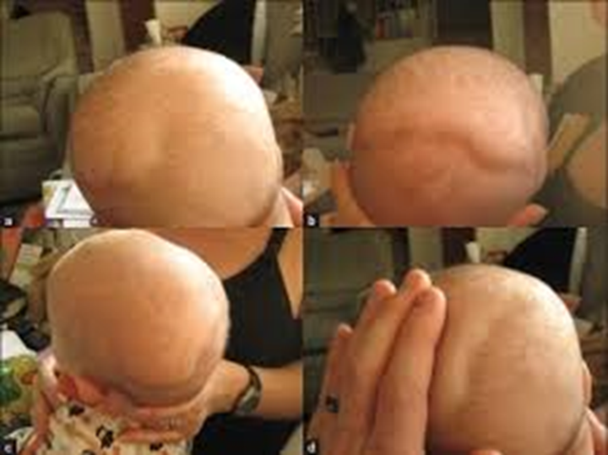
DIAGNOSIS
Is generally clinical :
Fluctuant boggy mass “pitting edema” developing over the scalp (especially over the occiput).
Develops gradually 12-72 hour after delivery.
Usually insidious and may not be recognized for hours.
Swelling may obscure the fontanelle and cross suture lines “distinguishing it from cephalohematoma”.

Slide 60
Laboratory evaluation may consist of hematocrite evaluation, and coagulation studies may be required.
Management consists of strict observation and providing treatment when needed.
In the absence of shock or intracranial injury, the long-term prognosis is generally good.

Slide 61
4. Abrasions and lacerations
Abrasion : is a partial thickness wound caused by damage to the skin by friction and can be superficial involving only the epidermis to deep involving the deep dermis.
- usually involve minimal bleeding.
laceration: a deep cut or tear in skin or flesh.
Abrasions and lacerations sometimes may occur as scalpel cuts during cesarean delivery or during instrumental delivery (ie, vacuum, forceps).
Infection remains a risk, but most of these lesions uneventfully heal.

Slide 62
Management consists of careful cleaning, application of antibiotic ointment, and observation.
Lacerations occasionally require suturing.

Slide 63
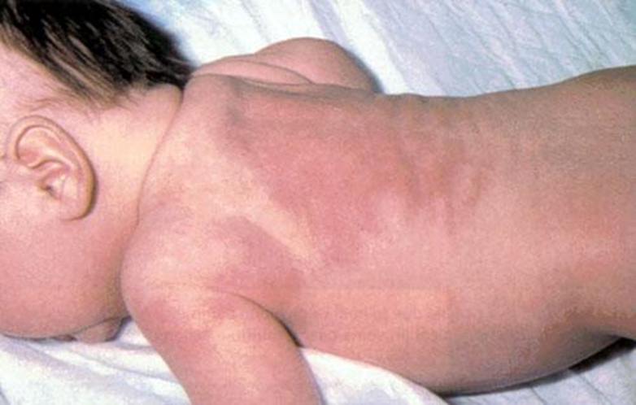
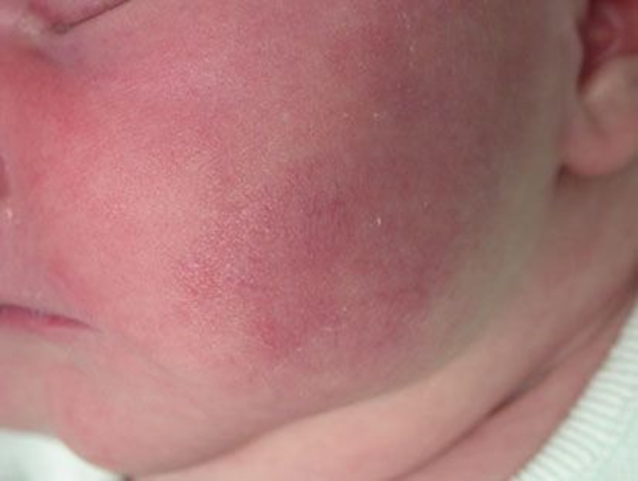
5. Subcutaneous fat necrosis
Irregular, hard, subcutaneous plaques with overlying dusky, red-purple discoloration on the extremities, face, trunk, or buttocks may be caused by pressure during delivery.
It occurs in the first weeks after birth.
it is a form of panniculitis.
Risk factors
Fetal distress during labor
Large birth weight
CS
Low O2 level
Cold temperature
Infection
Notes:
Panniculitis (inflammation of the subcutaneous fat)

Slide 64
The most common complication of subcutaneous fat necrosis is HYPERCALCAEMIA causing : irritability, constipation, poor weight gain and, rarely heart rhythm disturbance.
Thrombocytopenia and hyperlipidaemia have also been observed.
Treatment :
Focusses on management of hypercalcaemia, if it occurs.
Hypercalcaemia may be treated by increased fluid intake, low calcium milk feeds, frusemide.
The inflammation of the fat often settles without specific treatment.

Slide 65
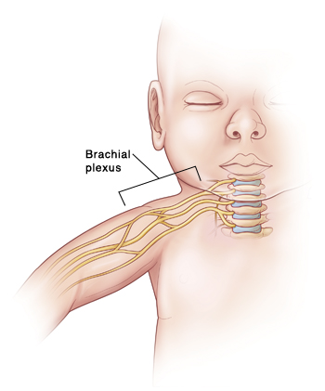
The Brachial Plexus
The brachial plexus is a network of nerves (formed by the anterior rami of the lower four cervical nerves and first thoracic nerve (C5, C6, C7, C8, and T1)).
It supplies afferent and efferent nerve fibers to the chest, shoulder, arm, forearm, and hand.

Slide 66
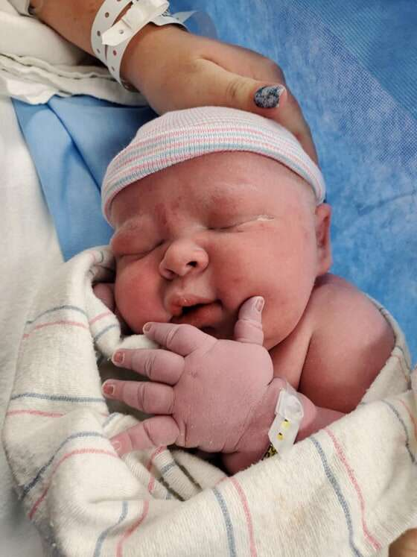
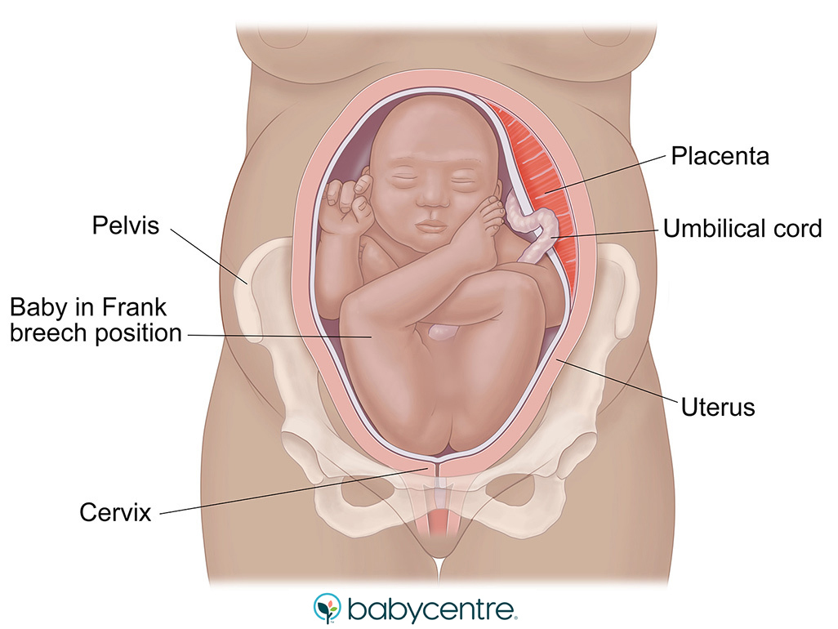
Brachial Plexus Injury
How does the injury happen ?
Injury to the nerves of the brachial plexus may result from excessive traction, on the neck, during birth.
Approximately, 2 out of every 1000 baby delivered, suffer for a form of Brachial Plexus Birth Palsy (BPBP).
This Injury can happen during difficult deliveries, such as:
Large baby.
Breech delivery (bottom first).
Prolonged delivery.
Shoulder dystocia.

Slide 67
Shoulder dystocia is when, after delivery of the head, the baby's anterior shoulder gets caught above the mother's pubic bone.
Stretching and injury of the brachial plexus can happen.

Slide 68
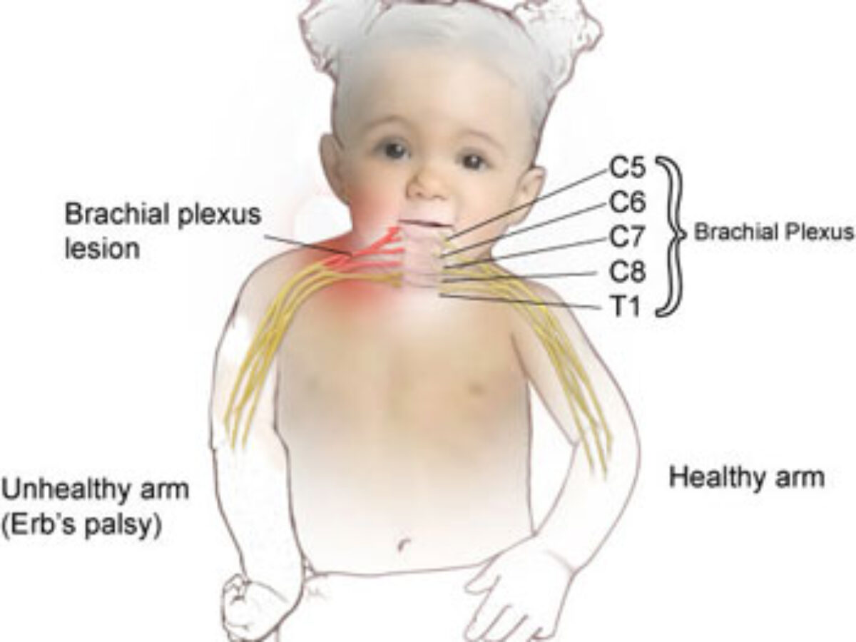
Erb’s Palsy (C5-C6)
Most common form of brachial plexus birth palsy, accounting for 45% of all injuries.
C7 can be involved in 20% of the cases.
The usual picture is of: Painless adduction, internal rotation of the arm, and pronation of the forearm.
The Moro reflex is absent on the involved side, and the hand grasp is intact.

Slide 69
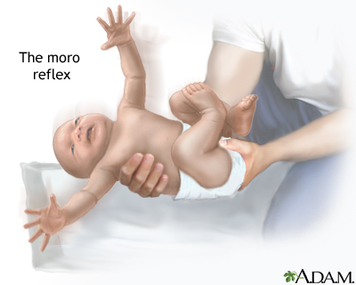
Normal Moro Reflex

Slide 70
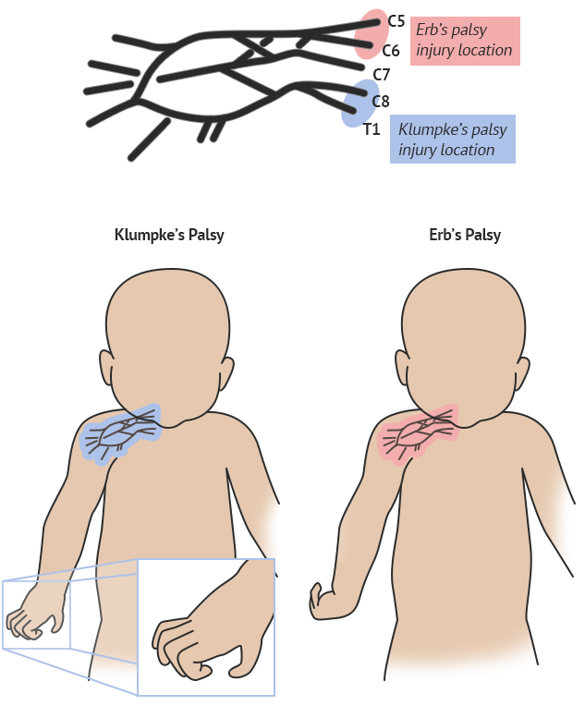
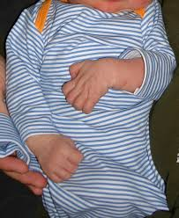
Klumpke’s Palsy (C7-C8-T1)
It is a form of Brachial Plexus Birth Palsy (BPBP), and it is much less common than Erb’s Palsy.
is caused by injury to the seventh and eighth cervical nerves and the first thoracic nerve, resulting in a paralyzed hand (Claw hand).
If the sympathetic nerves are injured, an ipsilateral Horner syndrome happens.
Grasp Reflex is absent.

Slide 71
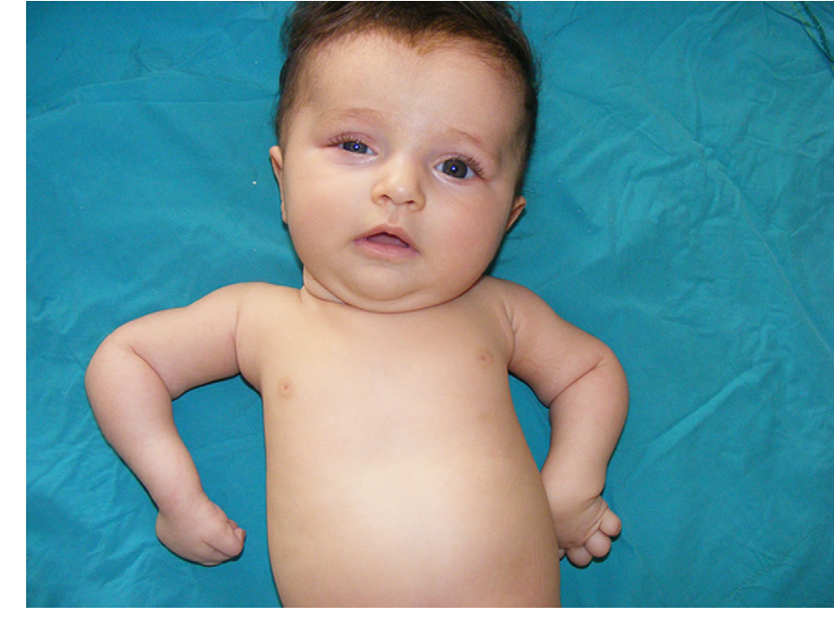
Horner Syndrome:
Ptosis, Miosis and Ipsilateral anhidrosis.

Slide 72
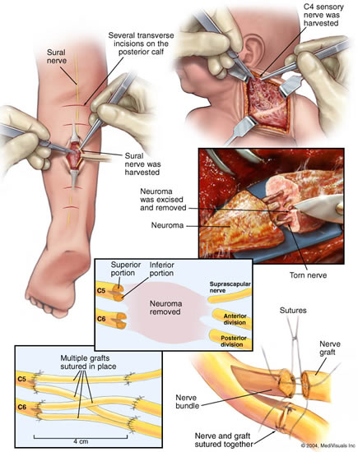
How Is a Brachial Plexus Injury Treated?
Most babies with a brachial plexus injury regain both movement and feeling in the affected arm. In mild cases, this might happen without treatment.
Other babies might need daily physical therapy.
If pain, weakness, or numbness continue, surgery often can help.
Surgical treatments include nerve grafting.

Slide 73
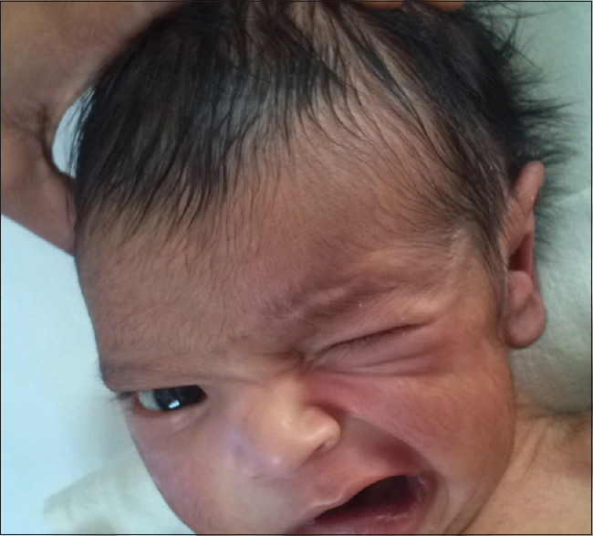
Cranial Nerve Injuries
The nerves in a bundle that originates from the brain stem instead of the spinal cord are called cranial nerves and these can be damaged by stretching during childbirth. Depending on which nerve or nerves are damaged, a child may be born with various weaknesses or paralysis.

Slide 74
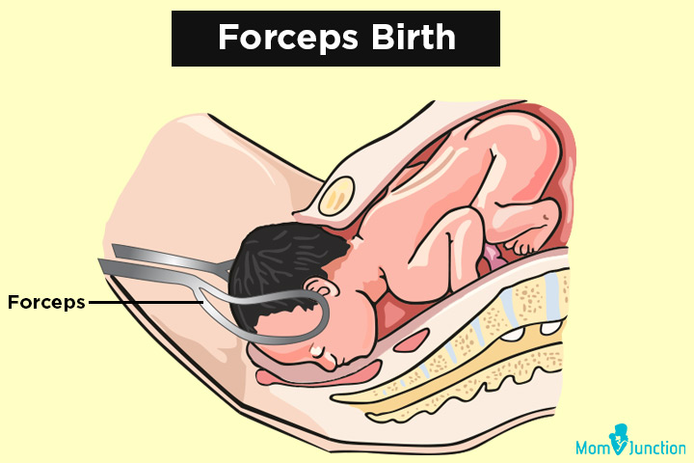
Facial Nerve injury
Facial nerve injury may be the result of compression of the seventh nerve between the facial bone and the mother’s pelvic bones or the physician’s forceps.

Slide 75
Facial Nerve Palsy
Symptoms of this type of injury are:
Asymmetrical movements in the face
One side of the mouth being drawn toward the other side.
Smoother skin on the paralyzed side.
General lack of movement and expression on the affected side of the face.

Slide 76
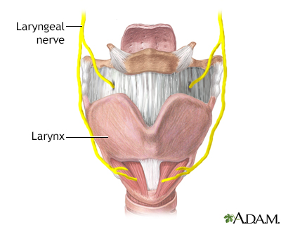
Laryngeal Nerve Injury
Damage to the laryngeal nerve may affect a child’s ability to breathe and swallow.
This damage often occurs when an infant’s head is turned to the side during childbirth.
If the nerve injury is Unilateral, the baby will present with hoarse cry or stridor.
But if the injury is Bilateral, the baby will have respiratory distress or asphyxia.
Most babies born with laryngeal nerve damage will recover within a few months.

Slide 77
Spinal Cord Injury
In very rare cases the spinal cord may be stretched and damaged. This is a serious injury.
The result is typically paralysis below where the damage occurred. These spinal cord injuries are most often permanent and leave a child with a lifelong paralysis of a part of the body.
The clinical presentation is:
Stillbirth
Rapid neonatal death with failure to establish adequate respiratory function especially in cases involving the upper cervical cord or lower brainstem.
Lifelong paralysis of a part of the body.

Slide 78
Bone Injury
Skull Fractures
They are rare.
May occur as a result of pressure from :
1) Forceps
2) Maternal symphysis pubis .

Slide 79
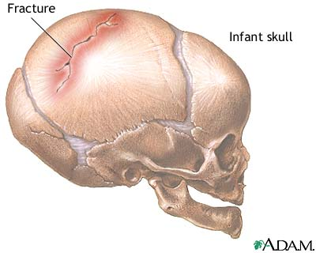
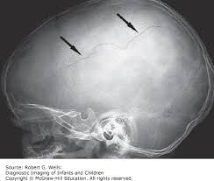
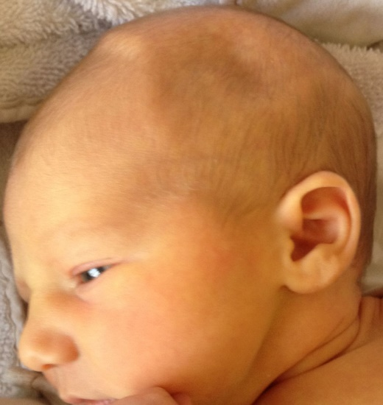
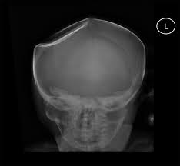
Types of skull fracture
Linear Fractures: A linear fracture is a simple break, but one that does not cause the bone to move. These are not usually too serious, but there may be underlying bleeding.
Depressed Fractures: A depressed skull fracture has the potential to be much more serious. This occurs when the skull is actually sunken inwards. It is more likely to cause bleeding and to put pressure on the brain.

Slide 80
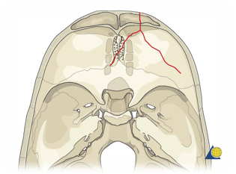
Types of Skull Fracture
Continued..
3. Basilar skull fracture: Basilar skull fractures are fractures to the bones at the base of the skull. The pressure from this type of fracture often causes bruising around the eyes and behind the ears.

Slide 81
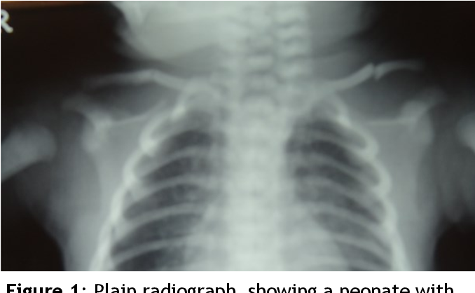
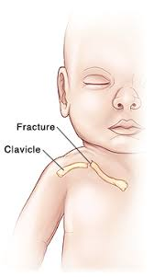
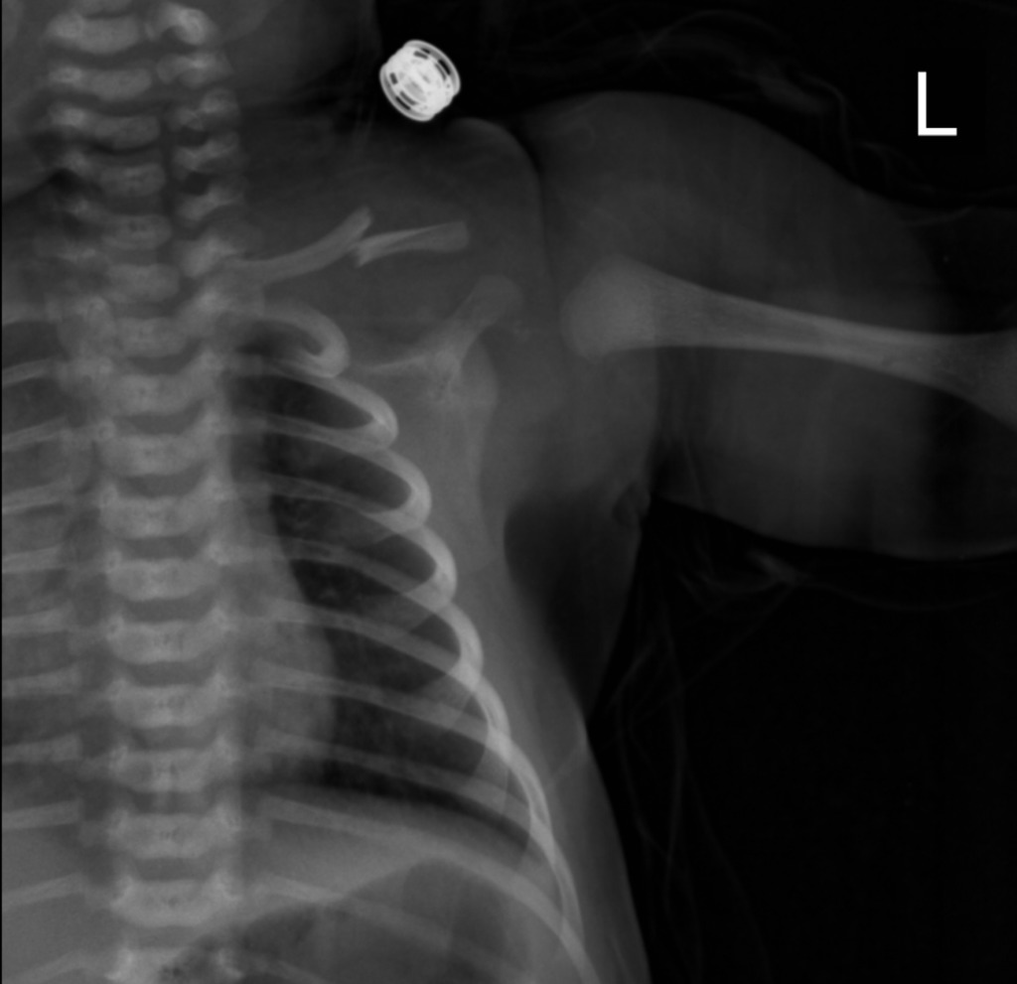
Clavicle Fracture
Fractures of the clavicle usually are unilateral and are noted in macrosomic infants, shoulder dystocia, and midforceps delivery. Often a snap is heard after a difficult delivery, and the infant exhibits an asymmetrical Moro response and decreased movement of the affected side.
Examination may reveal crepitus, palpable bony irregularity, and sternocleidomastoid muscle spasm. Radiographic studies confirm the fracture.

