Slide 1
The Hand

Slide 3
We are more aware of our hands than of any other part of the body; when they go wrong, we know about it from a very early stage

Slide 4
Hand infections

Slide 5
Infection of the hand is frequently limited to one of several well-defined compartments:
Under nailfold (paronychia).
Pulp space (whitlow or felon).
Subcutaneous tissue.
Tendon sheath.
One of the deep fascial space or a joint
Usually the cause is a Staphylococcus *
Notes:
which has been implanted during fairly trivial injury.
cuts contaminated with unusual organisms account for about 10% of cases.

Slide 6
Pathology
The response to infection is an acute inflammatory reaction with edema, suppuration and increased tissue tension.
In closed tissue compartments (e.g. the pulp space or tendon sheath) pressures may rise to levels where the local blood supply is threatened, with the risk of tissue necrosis.
In neglected cases infection can Spread from one compartment to another and the end result may be a permanently stiff and useless hand. There is also a danger of lymphatic and Hematogenous spread; even apparently trivial infections may give rise to lymphangitis and septicemia

Slide 7
Clinical Features
Usually there is history of Trauma( can be unnoticed).
Within a day or two the finger or hand becomes painful and tensely swollen.
The patient may feel ill and feverish and the pain becomes throbbing.
There is obvious redness and tenderness over the site of infection.
Finger movement may be markedly restricted.
**The arm should be examined for lymphangitis and swollen glands, and the patient examined more generally for signs of septicemia
** DO NOT forget to enquire about predisposing conditions such as diabetes mellitus, intravenous drug abuse and immunosuppression

Slide 8
Principles Of Treatment
flucloxacillin ,fusidic acid or cephalosporin
Antibiotics
Rest, splintage and elevation
Drainage
Rehabilitation.

Slide 9
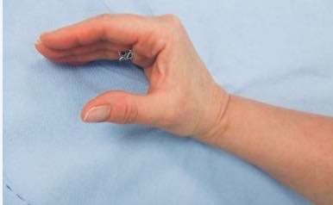
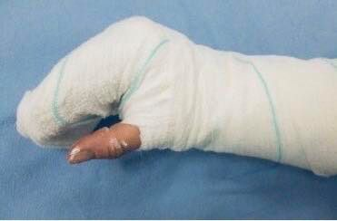
Rest, Splintage and Elevation
The hand must be splinted in the position of safe immobilization
With the wrist slightly extended
The MCP joints in full flexion
The IP joints extended
the thumb in abduction

Slide 10
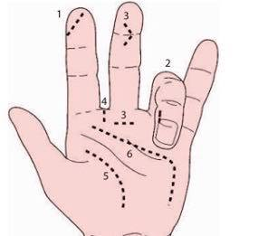
Drainage
Signs of an Abscess ( throbbing pain, tenderness and toxemia).
The incision should be planned to give access to the abscess without causing injury to other structures but never at right angles across a skin crease
Necrotic tissue is excised and the area washed and cleaned (debridement)
The area is thoroughly washed out and, in some cases, a catheter may be left in place for further postoperative irrigation (e.g. in cases of flexor tenosynovitis)
Notes:
The incisions for surgical
drainage are shown here: (1)pulp space (directly over
the abscess); (2)nail-fold (it may also be necessary
to excise the edge of the nail); (3)tendon sheath;
(4) web space; (5)thenar space; (6)mid-palmar space

Slide 11
The wound is either left open or lightly sutured and then covered with non-stick dressings.
A pus specimen is sent for microbiological investigation
At the end of the operation the hand is splinted in the position of safe immobilization
The hand should be re-examined within the next 24 hours to ensure that drainage is effective; if it is not, further operative drainage may be needed.
Inadequate drainage of acute infection may lead to chronic infection
Notes:
A removable splint will permit repeated wound dressings and exer-cises. A sling is used to keep the arm elevated.

Slide 12
Specific types of infection
cellulitis
Paronychia.
pulp space infection (felon)
Subcutaneous infections.
Tendon sheath infection.
Deep fascial space infection.
Joints infection.
Bites.

Slide 13
Cellulitis
Is an acute inflammation of the connective tissue of the skin, caused by infection with streptococcus ,staphylococcus or other bacteria .
The skin tissues in the infected area become red, hot, irritated and painful “Tight, glossy, "stretched" appearance of the skin“ with Skin lesion or rash (macule) (Sudden onset ,Usually with sharp borders, Rapid growth within the first 24 hours)
Additional symptoms that may be associated with this disease:
Nausea and vomiting /joint stiffness caused by swelling of the tissue over the joint /Hair loss at the site of infection
Cellulitis is most common on the Legs and the Arms or Hands
Notes:
When there is a break in the skin, however, bacteria can enter the body and grow there, causing infection and inflammation

Slide 14
Risk factors for cellulitis include:
Insect bites
History of peripheral vascular disease
Diabetes -related or ischemic ulcers
Injury or trauma with a break in the skin (skin wounds)
Use of immunosuppressive or corticosteroid medications
Treatment:
Antibiotic /NSAID/splintage

Slide 15
NAIL-FOLD INFECTION(PARONYCHIA)
Is an infection of the perionychium (also called eponychium), which is the epidermis bordering the nail ,it is the commonest hand infection
Acute paronychia is usually the result of localized trauma to the skin surrounding the nail plate (after rough nail-trimming)
Staphylococcus aureus and Streptococcus pyogenes
The edge of the nail-fold becomes red and swollen and increasingly tender. A tiny abscess * may form in the nail-fold; if this is left untreated, pus can spread under the nail.
Notes:
is infection is usually the result of dishwashing, a manicure, an ingrown nail, and usually becomes evident two to five days post-trauma.
Paronychia in children is usually the result of thumb sucking.

Slide 16
Treatment
At the first sign of infection, treatment with Antibiotics and frequent warm soaks to increase the blood flow may be effective
if pus is present, it must be released by an Incision at the corner of the nail-fold in line with the edge of the nail; a pledget of paraffin gauze is used to keep the nail-fold open.
If pus has spread under the nail, part or all of the nail may need to be removed

Slide 17
Chronic paronychia
Chronic nail-fold infection may be due to :
(1) inadequate drainage of an acute infection
(2) fungal infection : which requires specific treatment, Topical or oral antifungal agents are used to eradicate fungal infection
BUT, Failing antifungle , or for Chronic bacterial infection, the nail bed may
have to be laid open (‘marsupialized’); care should be taken to avoid damaging the germinal nail matrix.

Slide 18
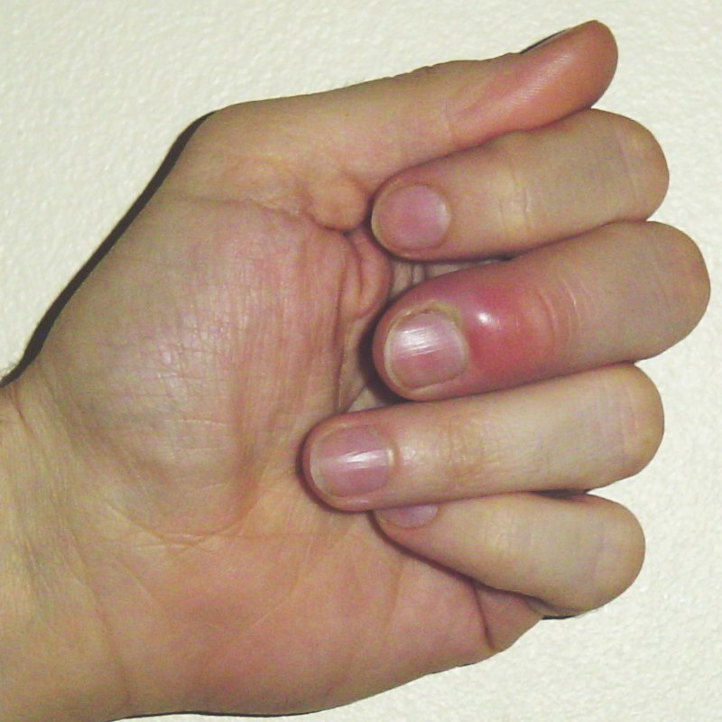

Slide 19
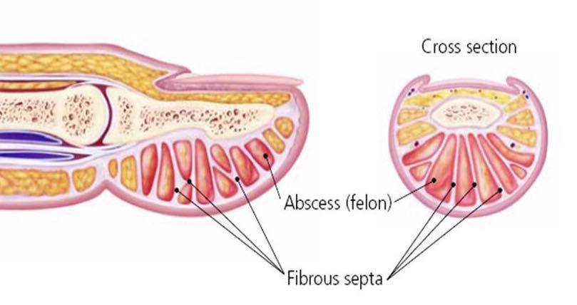
Pulp space infection (Felon)
The distal finger pad is essentially a closed fascial compartment filled with compact fat and subdivided by radiating fibrous septa
A rise in pressure within the pulp space causes intense pain and, if unrelieved, may threaten the terminal branches of the digital artery which supply most of the terminal phalanx

Slide 20
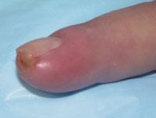
Pulp space infection (Felon)
Pulp space infection ( usually due to prick or splinter injury) causes throbbing pain.
The fingertip is swollen, red and acutely tender
The most common organism is : Staphylococcus aureus

Slide 21
Pulp space infection (Felon)
Antibiotics treatment is started immediately, however if PUS has formed it must be released via a small incision over the site of maximal tenderness
Postoperatively the finger is dressed with a loose packing of gauze, The wound will gradually heal by secondary intention.
Complications are:
osteomyelitis
sinus formation
digital vessel obliteration
flexor tenosynovitis
septic arthritis of DIPJ
Notes:
If treatment is delayed, infection may spread to the bone, the joint or the flexor tendon sheath.
Postoperatively the finger is dressed with a loose packing of gauze; antibiotic treatment is modified if
the results of culture and sensitivity so dictate, and is continued until all signs of infection have cleared. The
wound will gradually heal by secondary intention.

Slide 22
Herpetic whitlow
The HSV-1 may enter the fingertip, possibly by auto-inoculation from the patient’s own mouth or genitalia, or by cross infection during dental surgery
Small vesicles form on the fingertip, then coalesce and ulcerate
The condition is self-limiting and usually subsides after about 10 days, but it may recur from time to time.
Herpetic whitlow should not be confused with a Staphylococcal felon!
Surgery is unhelpful and may be harmful, exposing the finger to secondary infection
Aciclovir may be effective in the early stages

Slide 24
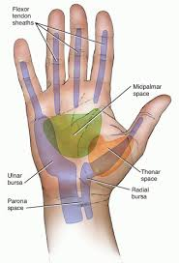
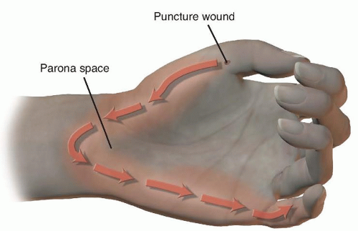
Tendon sheath infections
The tendon sheath is a closed compartment extending from the distal palmar crease to the DIP joint. In the thumb and little finger, the sheaths are co-extensive with the radial and ulnar bursae, which envelop the flexor tendons in the proximal part of the palm and across the wrist; these bursae also communicate with Parona’s space in the lower forearm
Notes:
Space of Parona (SOP) infections are rare and can potentially be a limb threatening complication of pyogenic flexor tenosynovit
Parona’s space is located deep in the distal forearm between the pronator quadratus muscle and the flexor digitorum profundus tendons. This space is contiguous with the radial bursa, ulnar bursa and midpalmar space.

Slide 25
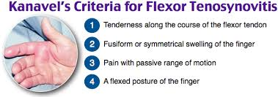
Pyogenic tenosynovitis
It is Uncommon but Dangerous. It usually follows a penetrating injury
The commonest organism being Staphylococcus aureus ; however, Streptococcus and Gram-negative organisms are also encountered.

Slide 26
Early diagnosis is based on Clinical findings; X-rays are unhelpful but ultrasound scanning may be useful.
Delayed diagnosis results in a progressive rise in pressure within the sheath and a consequent risk of vascular occlusion and tendon necrosis.
In neglected cases infection may spread proximally within the radial or ulnar bursa*, or from one to the other (a ‘horse-shoe’ abscess); it can also spread proximally to the flexor compartment at the wrist and into Parona’s space in the forearm*. Occasionally this results in Median nerve compression.

Slide 27
Treatment
The hand is Elevated and splinted and IV Antibiotics (ideally a broad-spectrum penicillin or a systemic cephalosporin)
surgical drainage : Two Incisions are needed, one at the proximal end of the sheath and one at the distal end; using a fine catheter, the sheath is then Irrigated (always from proximal to distal) with irrigation solution. Additional proximal, incisions may be needed if the synovial bursae are infected.
Postoperatively the hand is swathed in absorbent dressings and splinted in the position of safe immobilization.
Notes:
Treatment must be started as soon as the diagnosis is suspected
If there is no improvement after 24 hours, surgical drainage is essential
The dressings should not be too bulky, as this will make it difficult to ensure correct positioning

Slide 28
DEEP FASCIAL SPACE INFECTION
The large Thenar and Mid-palmar fascial spaces may be infected directly by penetrating injuries or by secondary spread from a web space or an infected tendon sheath
Clinical signs can be misleading; the hand is painful but, because of the tight deep fascia, there may be little or no swelling in the palm while the dorsum bulges like an inflated glove. There is extensive tenderness and the patient holds the hand as still as possible
Occasionally, deep infection extends proximally across the wrist, causing symptoms of Median nerve compression

Slide 29
7)Bites
1) Dog bite (70%)
rarely involve hand ( lower part of body )
Streptococcus, Staphylococcus, Pasteurella multocida
TTT :-irrigation, debridement, delayed 1⁰ suture
Augmentin useful
Cat bite (10%)
more frequently lead to infection, deeper penetration ( in face)
> 50% Pasteurella multocida
rapid inflammatory response (within 24 hrs)
TTT:- antibiotics and surgical drainage
Augmentin
Human bite ( 15%)
often delayed presentation
may not give accurate history
fist fights cause 60-80% of human bites
S. aureus, Streptococci….
TTT:- debride, explore, look for MCPJ involvement
Augmentin

Slide 30
C) Human bites:-
Human bite injuries to the hand usually result from a direct bite or a "fight bite" (also known as a "clenched-fist" injury).
Direct human bite injuries are often visually evident. A clenched-fist injury typically is characterized by a 3- to 5-mm laceration on the dorsum of the hand or overlying an MCP joint
A tooth may penetrate an extensor tendon and MCP joint capsule, sometimes fracturing a metacarpal or phalangeal bone .
Do x-ray : to exclude fracture / f.b involve

Slide 31
Gram stain results should guide initial antibiotic therapy. The wound should not be sutured but allowed to heal by secondary intention. The hand should be splinted in a position of function and elevated. Occupational rehabilitation can be considered once the infection has cleared.

Slide 32
Common disorder

Slide 33
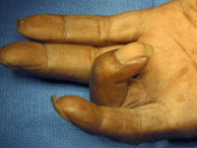
Tendon pathology
Trigger Finger
Etiology :
more common in patients with diabetes, and People with rheumatoid disease
Repeated motion of fingers may cause irritation, producing tenosynovitis Inflammation of tendon sheath (flexor tendons of wrist, fingers and thumb, abductor pollicis)
Thickening forming a nodule that does not slide easily

Slide 34
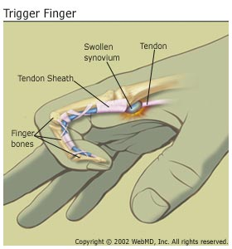
Signs and Symptoms
Resistance to re-extension, produces snapping that is palpable, audible and painful
Palpation produces pain and lump can be felt within tendon sheath MCP
**Recurrent triggering up to 6 months
later occurs in over 30% of patients

Slide 35
Management
Early cases may be cured by an injection of corticosteroid carefully placed at the mouth of the tendon sheath.
Recurrent triggering up to 6 months later occurs in over 30 % of patients – particularly younger patients and those with diabetes, who
may then need a second injection.
Refractory cases need operation, through an incision over the distal
palmar crease, or in the MCP crease of the thumb –
the A1 section of the fibrous sheath is incised until the tendon moves freely.

Slide 36
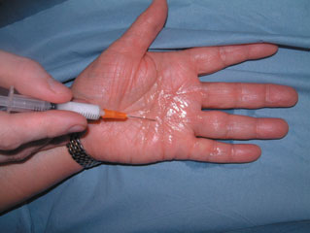
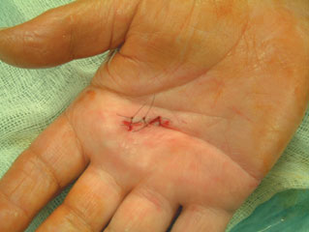
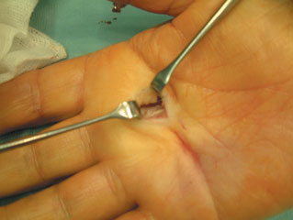
the A1 section of the fibrous sheath is incised until the tendon moves freely

Slide 37
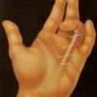
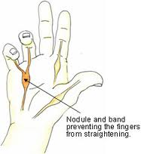
Dupuytren’s Contracture
nodular hypertrophy and contracture of the superficial palmar fascia (palmar aponeurosis) due to proliferation of Myofibroblasts and fibrous tissue formation causing flexion deformities of the MCP and PIP joints.
Dupuytren’s Contracture
palmar fibromatosis

Slide 38
Epidemiology & genetics
autosomal dominant
5-7 th decade of life with 2:1 male to female ratio
the prevalence increases with age
Disease associations
HIV ,alcoholism, diabetes, epilepsy “phenytoin therapy”, COPD
Dupuytren’s Contracture

Slide 39
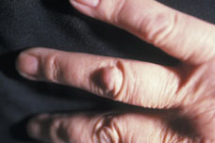
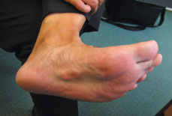
The initial description of Dupuytren’s disease diathesis included 4 factors:
1)the patient is below the age of 50 years old(MIDDLE AGE)
2)positive family history 60%
3)both of the hands are affected
4)The palm is puckered, nodular and thick. (Garrod’s pads).
About 60 % of patients give a family history.
Similar nodules may be seen on the soles of the feet Ledderhose’s nodules.

Slide 40
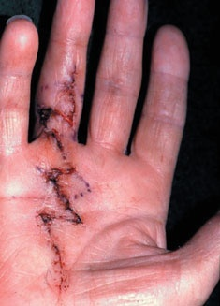
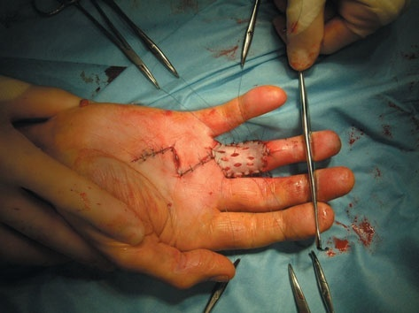
Nonoperative
for the most part ineffective
steroid injections in nodules that are not associated with a cord can slow progression of disease
Operative
regional palmar fasciectomy

Slide 41
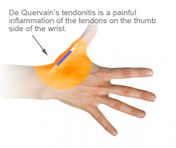
Wrist Injuries / DE QUERVAIN’S DISEASE
- thumb/wrist
stenosing tenosynovitis of the extensor pollicis
brevis and abductor pollicis longus.
Non suppurative
Contributing variables include :
idiopathic
overuse
post-traumatic
postpartum

Slide 42
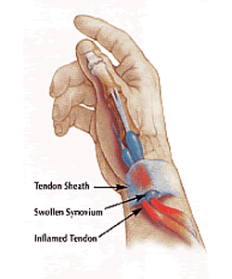
Clinical features
a woman aged 40–50, who complains of pain on the radial side of the wrist.
Sometimes there is a visible swelling over the radius
styloid and the tendon sheath feels thick and hard.
Tenderness is most acute at the very tip of the radial styloid

Slide 43
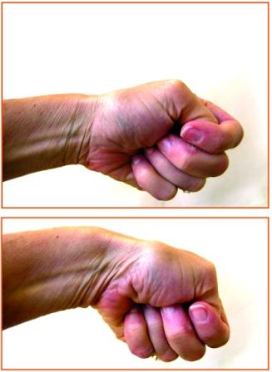
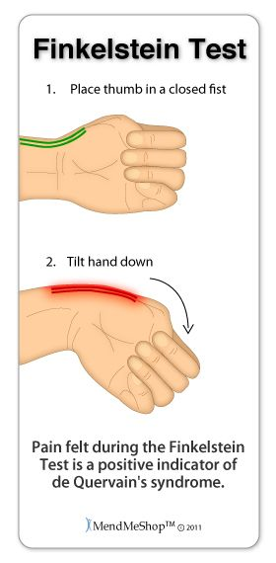
Special Test: = Finkelstein’s test
hitch-hiker’s sign

Slide 44
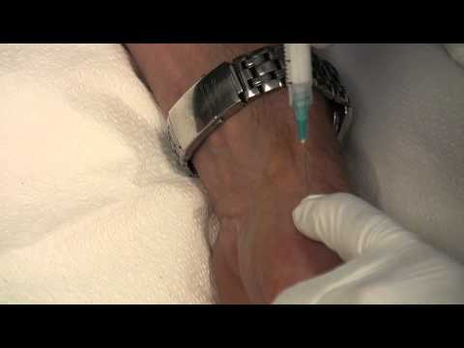
Treatment
Rest and NSAID
Corticosteroid injection
Resistant cases need an operation, which consists of slitting the thickened tendon sheath.

Slide 45
Hand manifestation in Reumatology

Slide 51
Boutennierre deformity

