Slide 1
2- Muscle physiology - II
Prof. Sherif W. Mansour
Physiology dpt., Mutah School of medicine

Slide 2
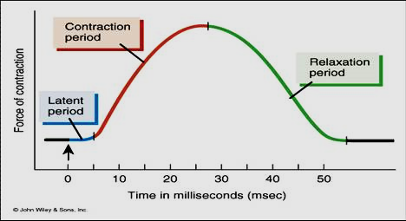
The simple muscle twitch
Definition: It is the response of the muscle to a single maximal stimulus and consists of:
1) Latent period: -It is the time between time of stimulus & response.
-About 0.01 second duration. - Due to: 1- conduction of impulse in nerve 2- production of MEP potential. 3-conduction of impulse in the muscle. 4- contraction and 5- the time of recording.
2) Contraction period: during it the muscle contracts either isometrically or isotonically.(0.04 sec.)
3) Relaxation period: the muscle relaxed (= 0.05 sec. In isotonic relaxation).
N.B.: The simple muscle twitch can be studied in the nerve muscle preparation (siatic – gastrocnemius frog muscle).

Slide 3
Factors affecting the simple muscle twitch:
1-Type of muscle: there are 2 types of muscle fibers:
N.B.: most muscle contain both types but one is predominant.

Slide 4
2- Temperature:
Warming of the muscle as in muscular exercise leads to stronger and rapid contraction by acceleration of the chemical reactions and decrease the muscle viscosity. But overheating (> 45°C) → heat rigor (stiffness).
3- Initial length:
The strength of contraction (in isotonic contraction) and the developed tension (in isometric contraction) are directly proportional to the initial length of the muscle fibre up to limit (Starling’s law).
4- Fatigue:
•Definition:- It is the gradual decrease in the muscle contraction and prolonged duration of all phases of the SMT, especially relaxation due to repeated and strong stimulation of the muscle. • The effect: decrease strength and prolonged duration of contraction and incomplete or absent relaxation
•The cause of fatigue: - In case of indirect stimulation (via stimulation of its motor nerve) is the gradual exhaustion of Ach at the MEP.
-Also direct stimulation of the muscle may lead to fatigue due to exhaustion of energy sources (ATP) or accumulation of metabolites.
- In living muscle (after exercise), fatigue is caused by:
1-Decrease blood supply to the muscle. 2-Decrease energy sources.
3-Accumulation of metabolites which depress the brain and spinal cord (central effect).
- Contracture may occur with fatigue due to decrease in ATP required for separation between the thin and thick filaments and muscle relaxation.

Slide 5
5- Stair-case (Treppe) phenomenon:
-It occurs in the skeletal and cardiac muscle.
-It is a gradual increase in muscle contraction until plateau.
-This occurs by application of series of maximal stimuli just after relaxation period of each muscle twitch.
-This is due to: 1- accumulation of Ca++ intracellular.
2- ↑ temperature of the muscle.
3- ↓ K+ & ↑ Na+ intra-cellulary → ↑ Ca+2 release from sarcoplasmic reticulum→↑contraction.

Slide 6
Summation of muscle contractions
Since the contraction phase in the skeletal muscle starts with the relative refractory period, the muscle respond to another stimulus during either cont. or relaxation → summation of contraction.
(a) Effect of two successive stimuli:
According to frequency of stimulation:
If the 2nd stimulus falls in relation to preceding one:
1- During the latent period → no response (during ARP).
2- During the contraction period → more strong contract.
3- During the relaxation period → 2 peaks contraction.
4- Just after the relaxation period→ stair-case phenomenon.
5- After relaxation → normal second contraction.
(b) Effect of multiple successive stimuli:
1- If the frequency is low → separate twitches with Stair – case phenomenon.
2- If the frequency increases and stimuli falls during relaxation phase of preceding twitch → Clonus (incomplete tetanus).
3- If the frequency increases more and stimuli falls during contraction phase → sustained contraction (complete tetanus).
N.B.: Cooling, fatigue & anticholinesterase (Eserine) change clonus into complete tetanus. However, warmness and rest cause the reverse.

Slide 7
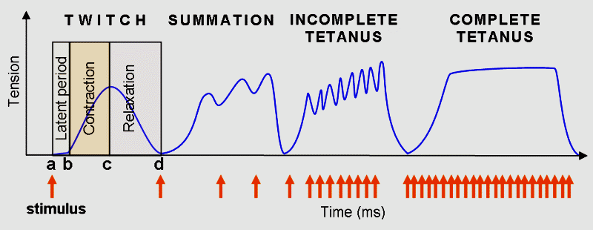
Treppe
Clonus

Slide 8
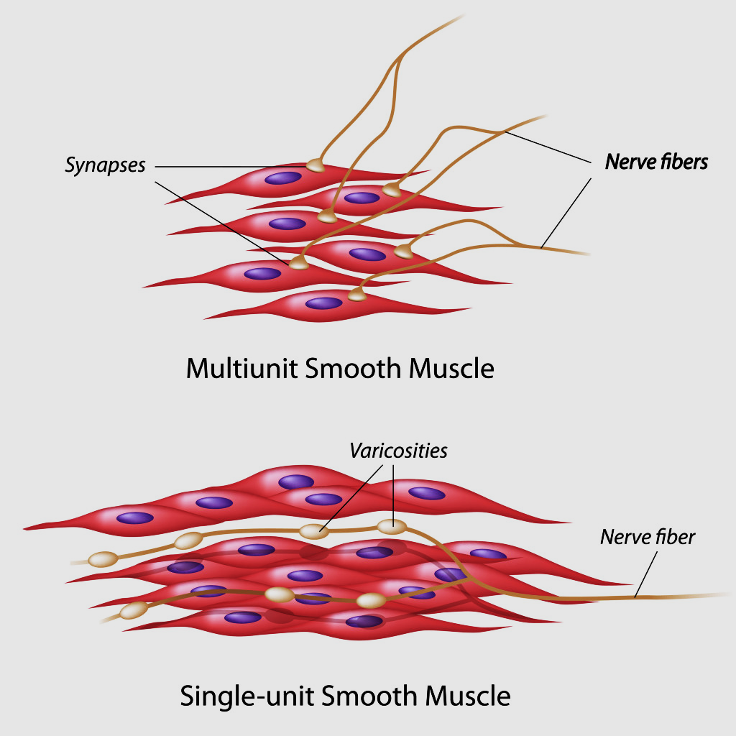
Smooth Muscle
•Site: it presents in wall of most viscera, bl. vessels, some glands, intraocular muscles and erector pilae ms. So, it controls the involuntary activities.
•Structure:
- Smooth muscle fibers are spindle-shaped, non striated (plain) cells with central long nuclei.
- Fiber’s length is 20-500 microns and diameter 2-5 microns.
- S.M. contains more actin filaments which attached to each other and to dense bodies .
- S.M contain calmodulin instead of troponin-tropomyosin.
- S.M contain less mitochondria and endoplasmic reticulum.
-S.M innervated by autonomic nervous system.
Types of smooth muscles

Slide 9
•S.M of two types:
-S.M has no motor end plate but at nerve endings (sympathetic or parasympathetic) there are special nodes (varicosities) via it neuromuscular transmission occurs → depolarization followed by contraction or hyperpolarization followed by relaxation according to the type of chemical transmitter.

Slide 10
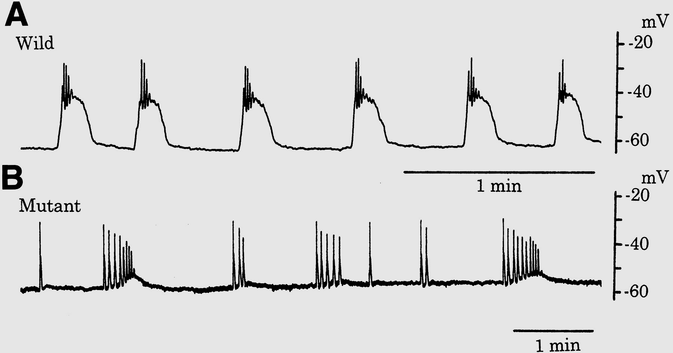
Excitability of S.M
•RMP: is unstable and about – 40 to –60 mvolt. with slow sine waves.
•Action potential of four types:
a-Spike potential as in sk. ms with duration of 50 msec. Present in the single unit S.M fibers.
b-Action potential with prolonged plateau (hundreds of m.sec) due to delayed repolarization as in uterus (similar to cardiac potential).
c-Spike pot. with serrations as in small intestine.
d-Pacemaker potential (slow – wave potential): It occurs due to rhythmical activity of Na+-K+ pump. When the wave reach the firing level (-35 mv) → action potentials which spread over the muscle. This type of potential initiates rhythmical contraction of GIT (as in the automatic cardiac fibers).
•Ionic base of action potential: may due to Na+ influx or Ca++ influx or both.

Slide 11
Contractility of S.M.
•Excitation contraction coupling:
-Contraction: Extracellular Ca++ influx or intracellular Ca++ release from the sarcoplasmic reticulum→↑ intracellular Ca++ which combine with calmodulin → activate myosin light chain kinase enzyme → phosphorylation of the light chain of myosin → binding of actin & myosin → shortening (contraction).
-Relaxation: ↓ intra-celular Ca++ (by Ca++ pump) → stimulate myosin phosphatase enzyme → removal of phosphate from light chain of myosin → stop contraction → relaxation.
-Characters of S.M. contractility:
1-Spontaneous contraction but under nervous regulation.
2-Slow cycling of cross bridges
3-Slow onset of contraction and relaxation.
4-Energy and O2 consumption is low and depends mainly on anaerobic glycolysis. So it is not easily fatigued.
5-SM has great ability to shorten as far greater percentage of its length.
6-Its contraction is sluggish and excitation / contraction coupling is very slow also Ca++ pump is slow so contraction is maintained than in skeletal muscle.
7-Latch mechanism, as prolonged tonic contraction needs less energy, less nervous or chemical stimulation than initial activity. So this delays fatigue.
8- Stress relaxation (plasticity) in which if SM is slowly stretched → increased tension at first then the tension gradually decreases inspite of continuous stretch (e.g., the urinary bladder can receive large volumes of urine without marked increase in wall tension).
9-Visceral SM shows: Tone = continuous mild contraction
Rhythm = irregular cont. due to repetitive discharge of spike potential.

Slide 12
Factors affecting excitability & contractility

Slide 13
Thank You

