Slide 1
Allergic rhinitis, Sinusitis & Asthma
Presented by :
Bana Jarah Rahaf Aqarbeh Rasha Hiyasat
Rayah Rawashdeh Sara Bin Tareef Dania Mubaideen

Slide 2
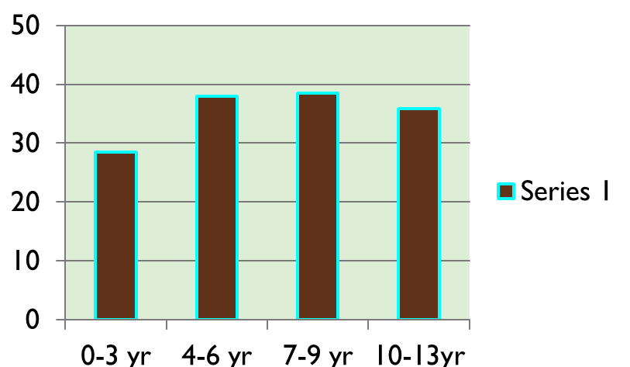
“Allergic Rhinitis “
Inflammatory disorder of nasal mucosa marked by nasal congestion, sneezing,itching, rhinorrhea…… and may be triggered by many allergens.
It is considered the most common allergic disease in children of all
ages .
Prevalence of Allergic Rhinitis
•

Slide 3
Clinical Presentation
Chronic OR Recurrent ( seasonal or followed by an allergen exposure )
Severity :
:

Slide 4
Clinical Presentation
Symptoms Sneezing, rhinorrhea, obstruction of nasal passage, snoring, headache & lacrimation.
Also, cough ( which is worse at night ).
Conjunctival, nasal and pharyngeal itching .

Slide 5
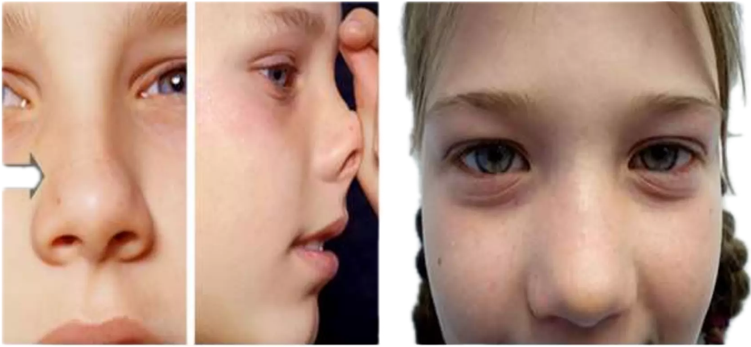
Clinical Presentation
Signs
Swollen nasal turbinates, puffy eyes, post nasal
drip & allergic shiners .
Nasal crease
Allergic shiners

Slide 6
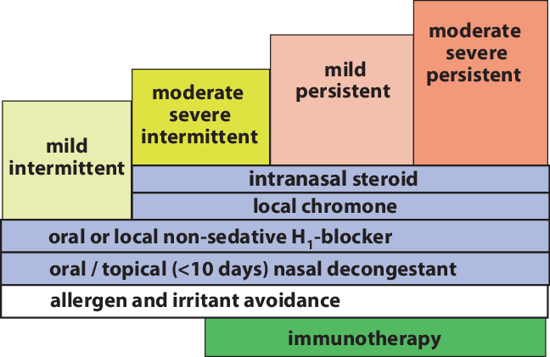
Treatment

Slide 7
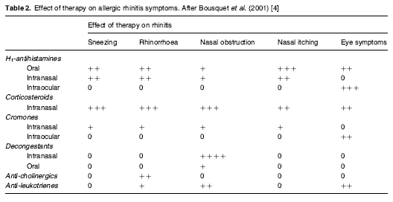
Treatment

Slide 8
Link between asthma and allergic rhinitis
Asthma prevelance is increased in allergic and non allergic rhinitis.
Rhinitis may be considered a risk factor for asthma as 40% of patients having AR may develop asthma .
While asthmatic patients almost always have rhinitis, up to 90% of them .
So, the relationship between asthma and allergiec rhinitis is
bidirectional .

Slide 9
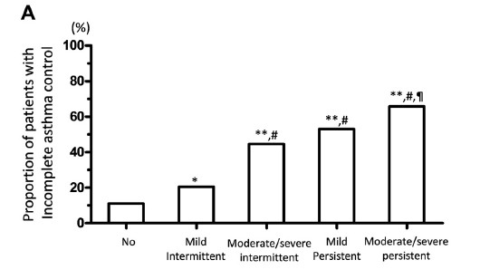
Link between asthma and allergic rhinitis

Slide 10
Review on effectiveness of AR therapies in preventing progression to asthma
Antihistamines: good AR therapy, no significant effect on asthma.
•Nasal steroids: most effective AR therapy, improves concomitant asthma,
but no evidence it can prevent progression from AR to asthma.
•Montelukast: moderate effect on both asthma and AR, no evidence to
prevent progression from AR to asthma.
•Specific Immunotherapy; subcutaneous (SCIT) or sublingual (SLIT): effective AR therapy, may improve concomitant asthma, both have promising evidence in children and adults to prevent progression from AR to Asthma.

Slide 11
Summary
AR is quite common in children of all ages.
•AR is treated with antihistamines, nasal steroids and immunotherapy, short
courses of decongestants relieve symptoms.
•Asthma and AR are common co-morbidities with a bidirectional relationship.
•AR has a great impact on asthma, progression possibly controlled by
immunotherapy.

Slide 12
SINUSITIS

Slide 13
SINUSITIS
¾ is a common illness of childhood and adolescence.
¾ Classification :
¾ According to
¾ etiology :Viral , bacterial or fungal .
¾ duration : -Acute sinusitis :is defined by duration of <30 days
-subacute: by duration of 1-3 months
- chronic :by duration of longer than 3 months

Slide 14
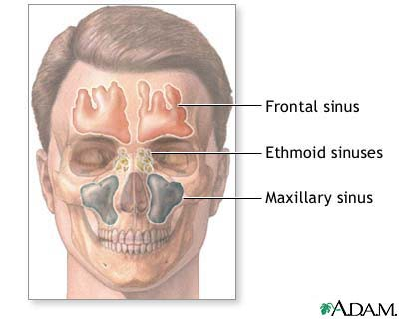
¾ Typically the ethmoidal and maxillary sinuses are present at birth
¾ The maxillary sinuses were thought to be not pneumatized until 4 yr of age, modern studies prove they are open and can get infected in infancy
¾ The sphenoidal sinuses are present by 5 yr of age, whereas the frontal sinuses begin development at age 7-8 yr and are not completely developed until adolescence.

Slide 15
ETIOLOGY
¾ Acute bacterial sinusitis causes :
Streptococcus pneumoniae (~30%).
nontypeable Haemophilus influenzae (~20%) .
Moraxella catarrhalis (~20%).
¾
¾
¾
Approximately 50% of H. influenzae and 100% of M. catarrhalis are β-lactamase positive.
Approximately 25% of S. pneumoniae may be penicillin resistant.
H. influenzae, a- and β-hemolytic streptococci, M. catarrhalis, S. pneumoniae, and coagulase-negative staphylococci are commonly recovered from children with chronic sinus disease. Anaerobes may also play a role in chronic sinusitis
¾ Immunosuppression predisposes to severe fungal sinusitis.

Slide 16
EPIDEMIOLOGY
¾ Acute bacterial sinusitis can occur at any age.
¾ Predisposing conditions include :
¾ viral upper respiratory tract infections.
¾ allergic rhinitis.
¾ cigarette smoke exposure.
¾ immune deficiencies particularly of antibody production (immunoglobulin IgG,
IgG subclasses, IgA), abnormalities of phagocyte function.
¾ cystic fibrosis .
¾ ciliary dysfunction.
¾ gastroesophageal reflux.
¾ anatomic defects (cleft palate), nasal polyps.
¾ nasal foreign bodies (including nasogastric tubes).

Slide 17
CLINICAL MANIFESTATIONS
¾ Children with sinusitis can present with nonspecific complaints, including :
¾ nasal congestion and purulent nasal discharge (unilateral or bilateral).
¾ Fever and cough.
¾ bad breath (halitosis) and a decreased sense of smell (hyposmia).
¾ periorbital edema.
¾ Headache, pressure exacerbated by bending forward, maxillary tooth pain and facial pain.
¾ Physical examination reveal erythema and swelling of the nasal mucosa with purulent nasal discharge.
Sinus tenderness and Transllimination opaque sinuses in adults.
¾ Differentiating bacterial sinusitis from a cold
Persistence of nasal congestion, rhinorrhea (of any quality) and daytime cough ≥10 days
without improvement.
Severe symptoms of temperature ≥39°C (102°F) with purulent nasal discharge >=3 days.
Worsening symptoms either by recurrence of symptoms after an initial improvement or new
symptoms of fever, nasal discharge and daytime cough.

Slide 18
DIAGNOSIS
¾ The clinical diagnosis of acute bacterial sinusitis is based on history and physical
examination
¾ Bacteria are recovered from maxillary sinus aspirates in 70% of children.
¾ Sinus aspirate culture is the only accurate method of diagnosis but is not practical
but necessary for immunosuppressed patients with suspected fungal sinusitis.
¾ sinus plain x-rays are not helpful and should not be done
¾ CT scans of the sinuses may show signs of sinusitis like opacification, mucosal thickening, or presence of an air–fluid level but are not recommended in otherwise healthy children with uncomplicated sinusitis

Slide 19
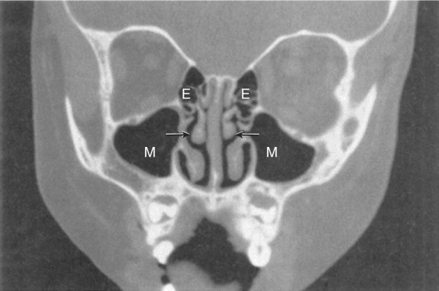
Coronal CT scan of normal 3 yr old child. Arrows point to middle meatus. E, ethmoid sinuses; M, maxillary sinuses

Slide 20
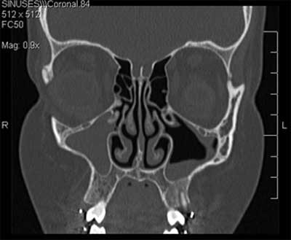
FIGURE 4: Complete opacification of the right
maxillary sinus in a caronal CT scan.

Slide 21
TREATMENT
¾ Amoxicillin-clavulunate is recommended in most guidelines as first line treatment,
usually in high dose (90 mg/kg/day)
¾ Alternative treatments or in penicillin allergic patients include: clindamycin +/- third
generation cephalosporins, levofloxacin, ceftriaxone, linezolid
¾ Adjuvant therapy: saline irrigation of the nose may help, some guidelines recommend
nasal steroids, usually decongestants are not effective and not recommended

Slide 22
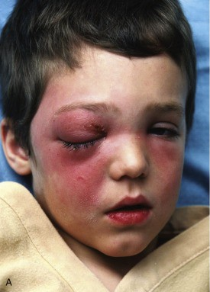
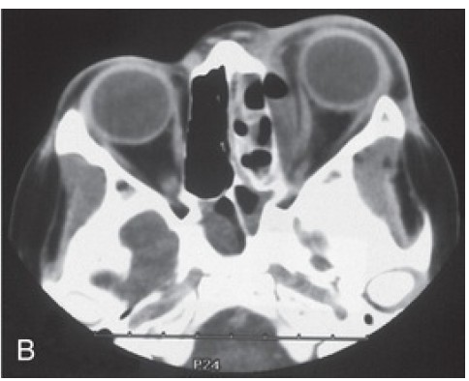
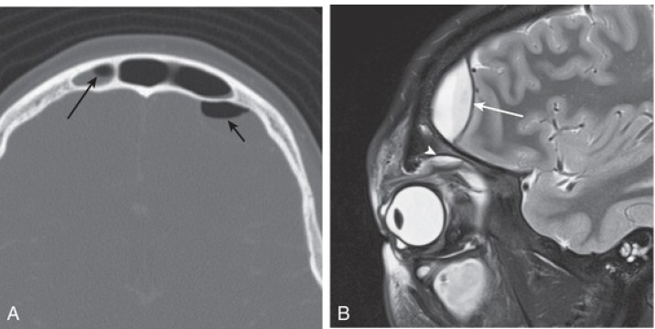
COMPLICATIONS
Orbital complication: Periorbital cellulitis and
orbital cellulitis. Needs admission
Intracranial complications: epidural abscess, meningitis, cavernous sinus thrombosis, subdural empyema, and brain abscess.
Osteomyelitis of the frontal bone (Pott puffy tumor), which is characterized by edema and swelling of the forehead and mucoceles, a chronic inflammatory lesions, causing displacement of the eye with resultant diplopia.

Slide 23
GINA DEFINITION OF ASTHMA
“Asthma is a heterogeneous disease, usually characterized by chronic airway inflammation. It is defined by the history of respiratory symptoms such as wheeze, shortness of breath, chest tightness and cough that vary over time and in intensity, together
with variable expiratory airflow limitation”

Slide 25
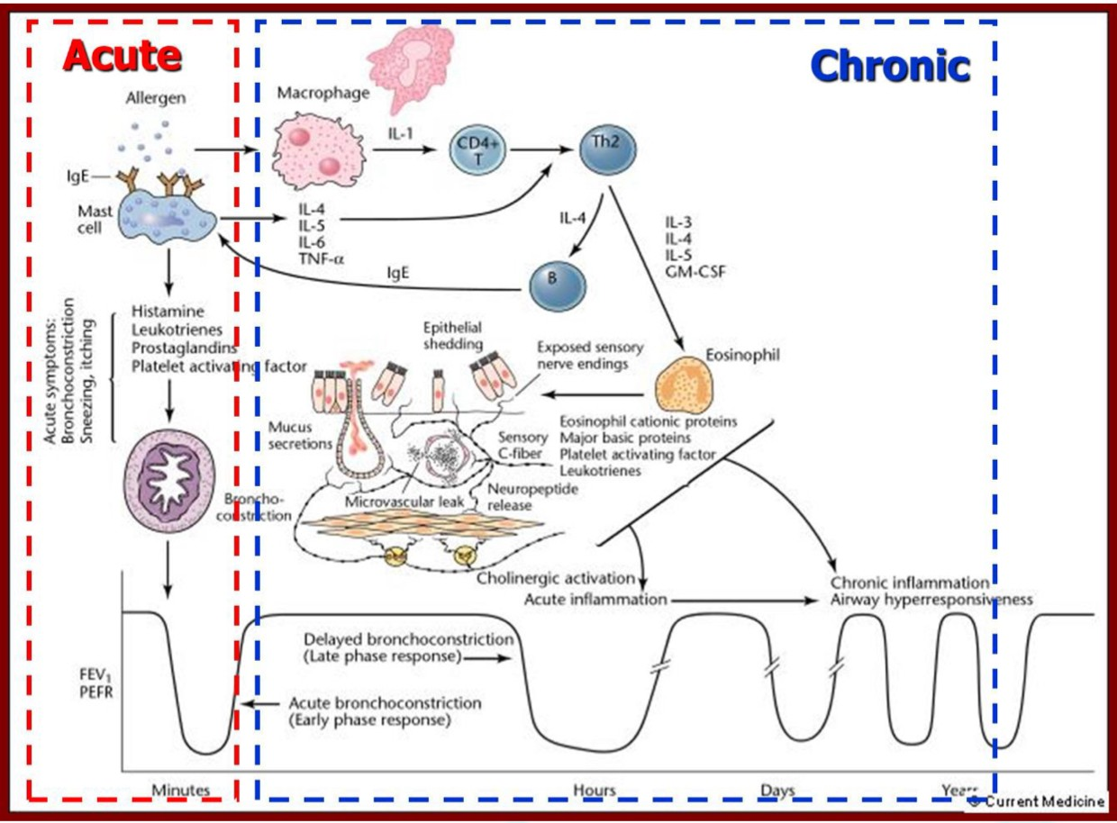

Slide 28
FEATURES SUGGESTING ASTHMA IN CHILDREN <5 YEARS
Feature | Characteristics suggesting asthma
Cough | Recurrent or persistent non-productive cough that may be worse at night or accompanied by some wheezing and breathing difficulties. Cough occurring with exercise, laughing, crying or exposure to tobacco smoke in the absence of an apparent respiratory infection
Wheezing | Recurrent wheezing, including during sleep or with triggers such as activity, laughing, crying or exposure to tobacco smoke or air pollution
Difficult or heavy breathing or shortness of breath | Occurring with exercise, laughing, or crying
Reduced activity | Not running, playing or laughing at the same intensity as other children; tires earlier during walks (wants to be carried)
Past or family history | Other allergic disease (atopic dermatitis or allergic rhinitis) Asthma in first-degree relatives
Therapeutic trial with low dose ICSClinical improvement during 2-3 months of controller treatment and worsening when treatment is stopped and as-needed SABA

Slide 29
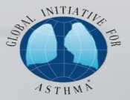
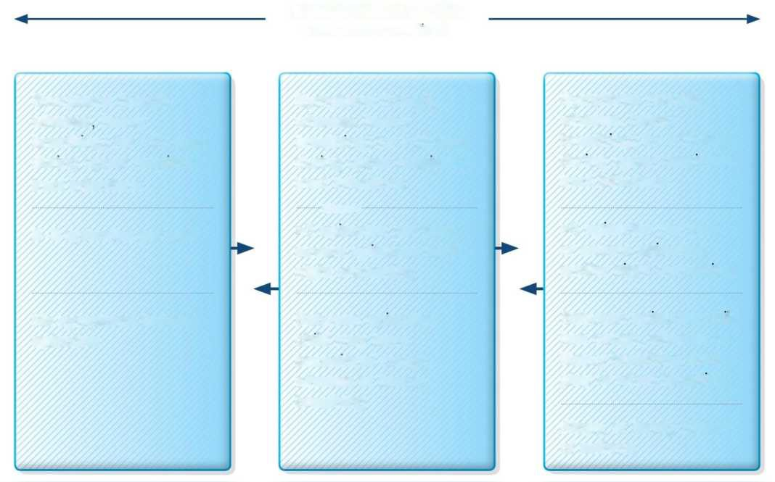
SYMPTOM PATTERNS IN CHILDREN <5 YEARS
SYMPTOM PATTERN
(may change over time)
Symptoms (cough,
Symptoms (cough, wheeze, heavy breathing) for >10 days
during upper respiratory tract infections
Symptoms (cough, wheeze, heavy breathing) for >10 days
during upper respiratory tract infections
wheeze
heavy
breathing) for <10 days during upper respiratory tract infections
//yyyy
2-3 episodes per year
>3 episodes per year, or severe episodes and/or night worsening
>3 episodes per year, or severe episodes and/or night worsening
No symptoms between episodes
Between episodes child may have occasional cough, wheeze or heavy breathing
Between episodes child has cough, wheeze or heavy breathing during
play or when laughing
Atopy, or family history of asthma
GINA 2014, Box 6-1
© Global Initiative for Asthma

Slide 30
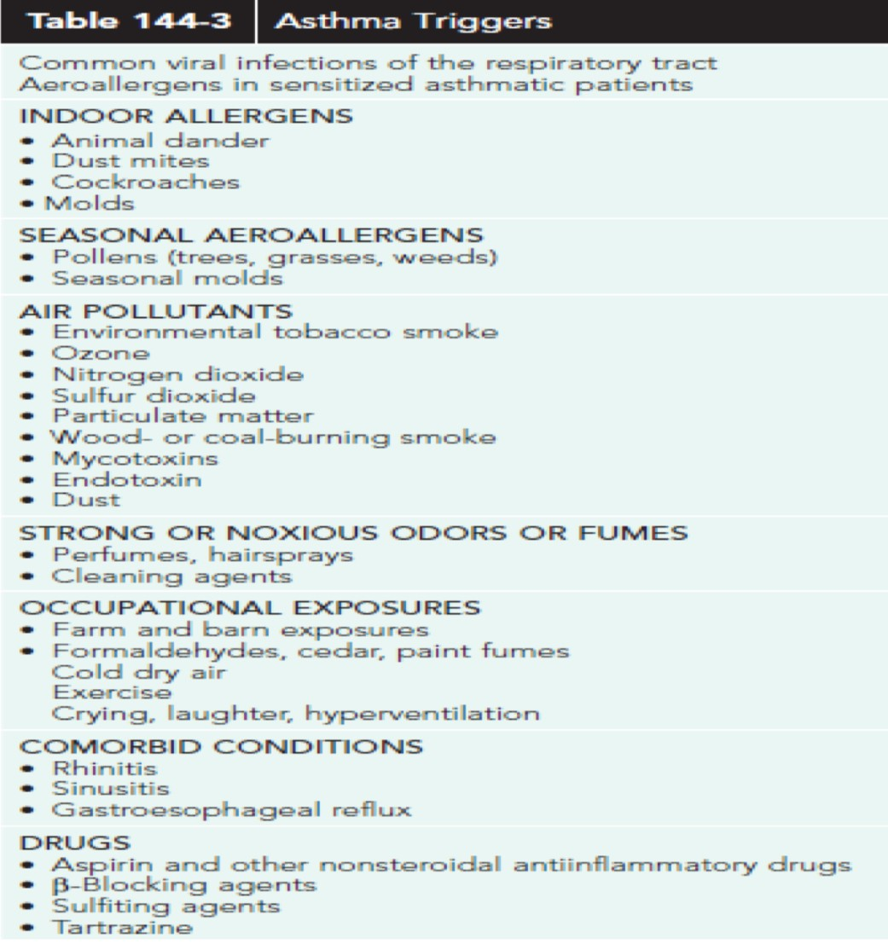

Slide 31
PHYSICAL EXAMINATION
Usually normal between episodes, signs of allergic rhinitis or eczema may be present
When symptomatic, expiratory wheeze may be heard on auscultation, loud wheezes may be audible without a stethoscope, in severe exacerbations the chest may be “silent”
During exacerbations, signs of respiratory distress may appear

Slide 32
DIAGNOSIS OF ASTHMA
A history of characteristic symptom patterns: usually recurrent episodes of cough, wheeze and shortness of breath
Evidence of variable airflow limitation, from bronchodilator reversibility
testing
or other tests
A useful method for confirming the diagnosis in children, especially when spirometry is not available or not possible, is a trial of treatment with short- acting bronchodilators and inhaled glucocorticosteroids. Marked clinical improvement during the treatment and deterioration when treatment is stopped supports a diagnosis of asthma
GINA

Slide 33
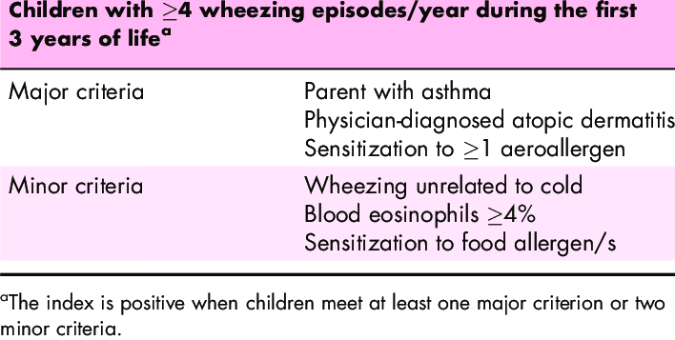
ASTHMA PREDICTIVE
INDEX
¾ It is used to predict the risk of asthma development at school age in preschool children. It has been used for screening high-risk groups for asthma development

Slide 34
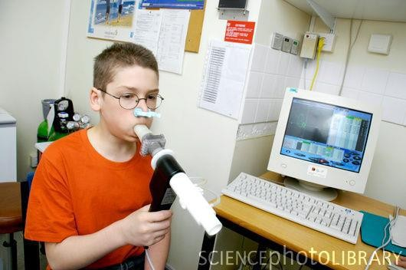
SPIROMET
RY
Flo
w
Normal
Volume
FEV
1
Asthma (after BD)
Normal
Asthma (before BD)
Asthma
(after
BD)
Asthma
(before
BD)
1
2 3 4 5
Time (seconds)
Volum
e
Note: Each FEV1 represents the highest of
three reproducible measurements

Slide 35
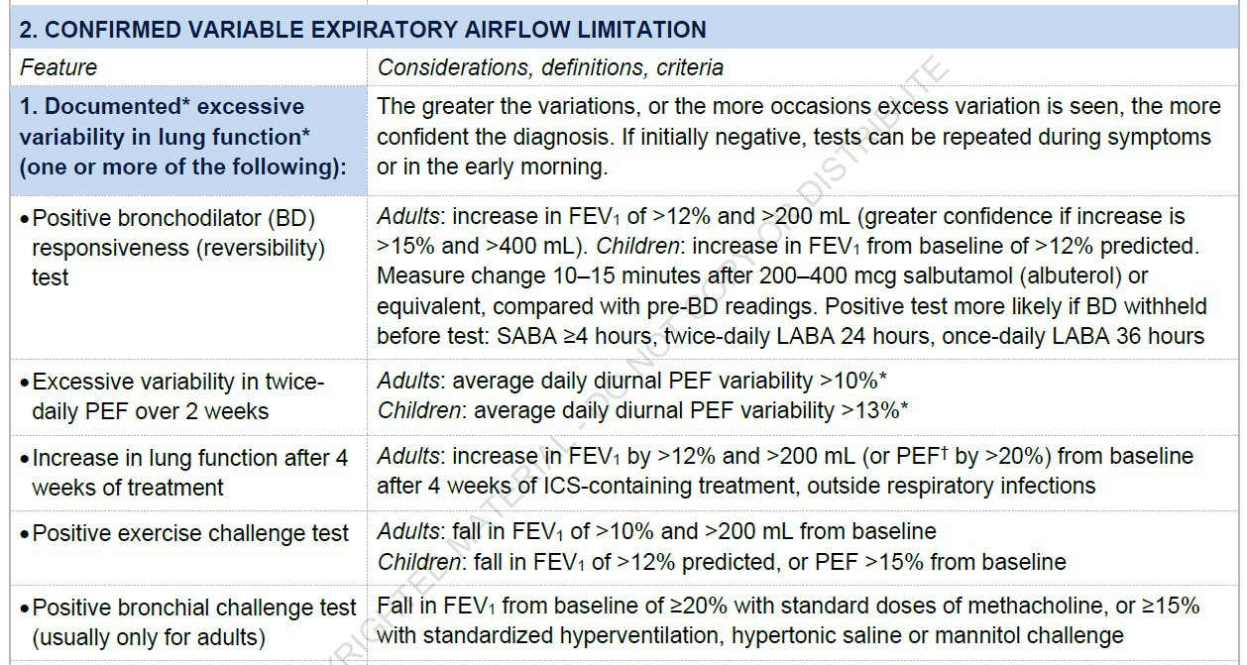
Measure change 10-15 minutes after salbutamol, compared with pre-BD readings. (SABA should be withheld ≥4 hr before test, LABA BID 24 hr, LABA once daily 36 hr)
Children: Increase in FEV1 from baseline of >12% predicted

Slide 36
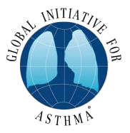
COMMON DIFFERENTIAL DIAGNOSES OF ASTHMA IN CHILDREN ≤5 YEARS
Condition Typical features
Recurrent viral respiratory infections
Mainly cough, runny congested nose for <10 days; wheeze usually mild;
no
symptoms between infections
Gastroesophageal reflux
Cough when feeding; recurrent chest infections; vomits easily especially
after large feeds; poor response to asthma medications
Foreign body aspiration
Episode of abrupt severe cough and/or stridor during eating or play;
recurrent chest infections and cough; focal lung signs
Tracheomalacia or bronchomalacia
Noisy breathing when crying or eating, or during URTIs; harsh cough; inspiratory or expiratory retraction; symptoms often present since birth; poor response to asthma treatment
Tuberculosis
Persistent noisy respirations and cough; fever unresponsive to normal antibiotics; enlarged lymph nodes; poor response to BD or ICS; contact with someone with TB
Congenital heart disease
Cardiac murmur; cyanosis when eating; failure to thrive; tachycardia;
tachypnea or hepatomegaly; poor response to asthma medications
GINA 2014, Box 6-3
© Global Initiative for Asthma

Slide 37
COMMON DIFFERENTIAL DIAGNOSES OF ASTHMA IN CHILDREN ≤5 YEARS (CONTINUED)
Condition Typical features
Cystic fibrosis
Cough starting shortly after birth; recurrent chest infections; failure to thrive (
malabsorption); loose greasy bulky stools
Primary ciliary dyskinesia
Cough and recurrent mild chest infections; chronic ear infections and purulent nasal discharge, No diarrhea; poor response to asthma medications; situs inversus (in ~50% children with this condition)
Vascular ring Respirations often persistently noisy; poor response to asthma medications
Bronchopulmonary dysplasia
Infant born prematurely; very low birth weight; needed prolonged mechanical
ventilation or supplemental oxygen; difficulty with breathing present from birth
Immune deficiency Recurrent fever and infections (including non-respiratory); failure to thrive
GINA 2014, Box 6-3
© Global Initiative for Asthma

Slide 38
MANAGEME
NT

Slide 39
m• aThnealognge-tmermegnoatls of asthma management are
Goals of asthma
Symptom control: to achieve good control of symptoms and maintain normal
activity levels
Risk reduction: to minimize future risk of exacerbations, fixed airflow limitation and
medication side-effects
Clinical Control of Asthma
¾No (or minimal)* daytime symptoms
¾No limitations of activity
¾No nocturnal symptoms
¾No (or minimal)* need for rescue medication
¾Normal lung function
¾No exacerbations
* Minimal = twice or less per week

Slide 40
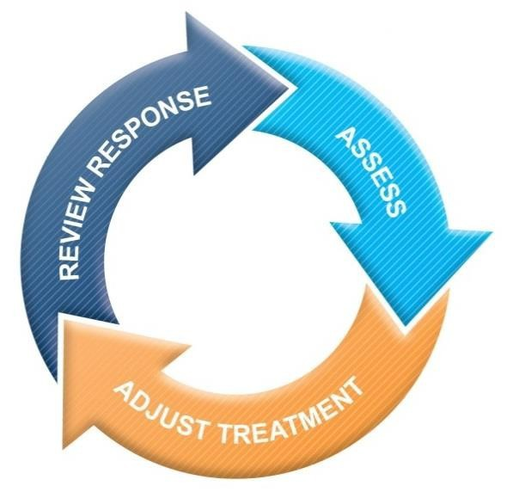
Treating to control symptoms and minimize
Esrtiasbklish a patient-doctor partnership:
Communication, education
Explain the nature of the disease and the overall management plan
Demonstrate how to use medications & devices (inhalers, spacer)
Discuss family’s concerns, especially “steroid-phobia” & “inhaler-phobia”
Manage asthma in a continuous cycle:
Assess
Adjust treatment (pharmacological and non-pharmacological)
Review the response
Teach and reinforce essential skills
Inhaler skills
Adherence
Guided self-management education:
Written asthma action plan, Self-monitoring, Regular medical
review
GINA

Slide 41
Asthma treatment is a dynamic process involving continuous assessment, treatment adjustments,
and patient response evaluation, focusing on symptom control and future risk factors.
1- Making decisions about asthma
treatment
Population-level decisions: Based on the best treatments for the majority of patients. (Eg. National guidelines)
Individual patient care: Considers patient-specific characteristics and phenotypes.(Ie. predict the risk of exacerbations
and adverse outcomes, as well as the likely
response to treatment.)
Reduce exposure to risk
facto• rSstay away from tobacco smoke
Patients should not avoid exercise
Identify other triggers and avoid them, although of less proven clinical
benefit

Slide 42
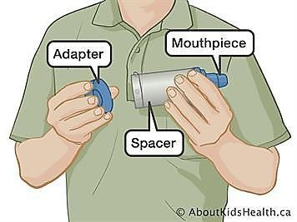
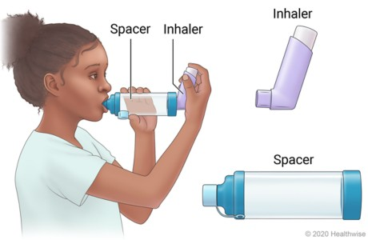
Spacers may be used in children, those experiencing side effects from steroid inhalers, or people having difficulty with inhaler technique

Slide 43
MEDICATIONS –
Controllers:
Inhaled glucocorticosteroids: Budesonide, Fluticasone, Beclomethasone, Mometasone
Leukotriene modifiers: Montelukast
Long-acting β2-agonists: Salmeterol, Formoterol
Long-acting anti-cholinergic: Tiotropium
Methylxanthines: Theophylline
Systemic glucocorticosteroids
“Biologics”: Anti-IgE: omalizumab, anti-IL4 & 5: dupilumab, benralizumab, mepolizumab, anti-TSLP: tezepelumab
Immunotherapy

Slide 44
MEDICATIONS – Relievers:
Rapid-acting inhaled β-agonists: Salbutamol (Albuterol),
epinephrine, Terbutaline, (formoterol)
Anticholinergics: Ipratropium
Systemic glucocorticosteroids: Methylprednisolone, Prednisolone, Prednisone, Dexamethasone, hydrocortisone
Mg sulfate
Methylxanthines: Aminophylline

Slide 45
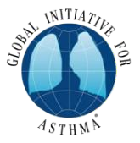
Adults & adolescents
12+ years
Confirmation of diagnosis if necessary
Symptom control & modifiable risk factors (see Box 2-2B) Comorbidities
Inhaler technique & adherence Patient
preferences and goals
Personalized asthma management
Assess, Adjust, Review
for individual patient needs
Symptoms
Exacerbations Side
-effects Lung
function
Patient satisfaction
Treatment of modifiable risk factors
and comorbidities
Non-pharmacological strategies
Asthma medications (adjust down/up/between tracks) Education &
skills training
STEP 5
STEP 4
Medium dose maintenance ICS-formoterol
Add-on LAMA
Refer for assessment of phenotype. Consider high dose maintenance ICS-formoterol,
± anti-IgE, anti-IL5/5R, anti-IL4R, anti-TSLP
STEP 3
Low dose maintenance ICS-formoterol
CONTROLLER and
PREFERRED RELIEVER
(Track 1). Using ICS-formoterol
as reliever reduces the risk of
exacerbations compared with
using a SABA reliever
STEPS 1 – 2
As-needed low dose ICS-formoterol
RELIEVER: As-needed low-dose ICS-formoterol
See GINA
severe
asthma guide
STEP 5
Add-on LAMA
Refer for assessment of phenotype. Consider high dose maintenance ICS-LABA, ± anti-IgE,
anti-IL5/5R, anti-IL4R,
anti-TSLP
STEP 4
Medium/high
dose maintenance ICS-LABA
STEP 3
Low dose maintenance ICS-LABA
CONTROLLER and
ALTERNATIVE RELIEVER
(Track 2). Before considering a
regimen with SABA reliever,
check if the patient is likely to be
adherent with daily controller
STEP 2
Low dose
maintenance ICS
STEP 1
Take ICS whenever
SABA taken
RELIEVER: As-needed short-acting beta2-agonist
Other controller options for either track (limited indications, or less evidence for efficacy or safety)
GINA 2022, Box 3-5A
Low dose ICS whenever SABA taken, or daily LTRA, or add HDM SLIT
Medium dose ICS, or add LTRA, or add HDM SLIT
Add LAMA or LTRA or HDM SLIT, or switch to high dose ICS
Add azithromycin (adults) or LTRA. As last resort consider adding low dose OCS but consider side- effects
© Global Initiative for Asthma, www.ginasthma.org

Slide 46
Children 6-11 years
Confirmation of diagnosis if necessary
Symptom control & modifiable risk factors (see Box 2-2B) Comorbidities
Inhaler technique & adherence
Child and parent preferences and goals
Personalized asthma management:
Assess, Adjust, Review
Symptoms Exacerbations Side-effects
Lung function
Child and parent
satisfaction
Treatment of modifiable risk factors &
comorbidities
Non-pharmacological strategies
Asthma medications (adjust down or up)
Education & skills training
STEP 5
Refer for phenotypic assessment
± higher dose
ICS-LABA or
add-on therapy,
e.g. anti-IgE,
anti-IL4R
Asthma medication options: Adjust treatment up and down for individual child’s needs
STEP 4
STEP 3
Low dose ICS- LABA, OR medium dose ICS, OR
very low dose* ICS-formoterol maintenance and reliever (MART)
Medium dose
ICS-LABA,
OR low dose† ICS-formoterol maintenance and reliever therapy (MART).
Refer for expert advice
STEP 2
Daily low dose inhaled corticosteroid (ICS)
(see table of ICS dose ranges for children)
PREFERRED
CONTROLLER
to prevent exacerbations
and control symptoms
STEP 1
Low dose ICS taken whenever SABA taken
Other controller options (limited indications, or less evidence for efficacy or safety)
Consider daily
low dose ICS
Daily leukotriene receptor antagonist (LTRA), or
low dose ICS taken whenever SABA taken
Low dose
ICS + LTRA
Add tiotropium
or add LTRA
Add-on anti-IL5 or, as last resort, consider add-on low dose OCS, but
consider side-effects
RELIEVER
As-needed short-acting beta2-agonist (or ICS-formoterol reliever in MART in Steps 3 and 4)
*Very low dose: BUD-FORM 100/6 mcg
†Low dose: BUD-FORM 200/6 mcg (metered doses).
Box 3-5B © Global Initiative for Asthma 2022, www.ginasthma.org

Slide 47
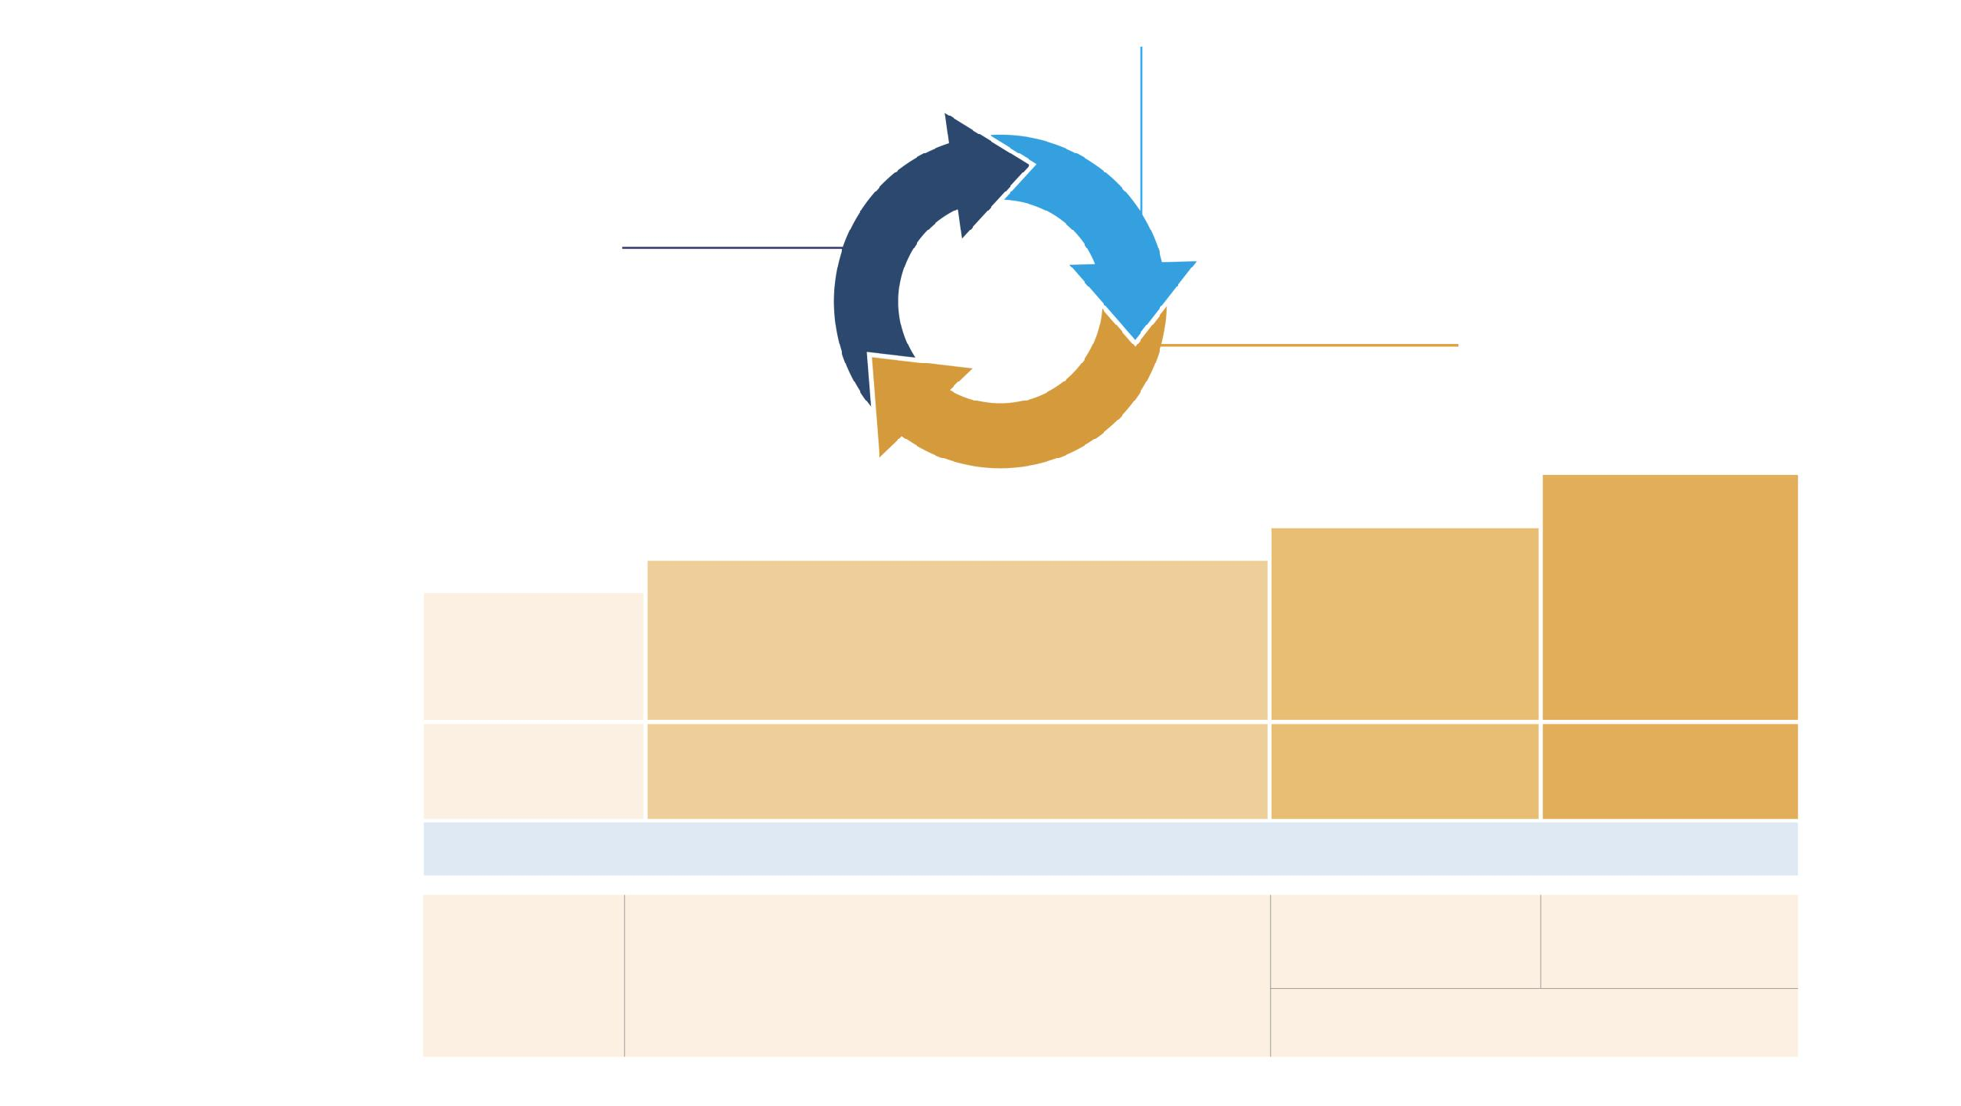
Children 5 years and younger
Exclude alternative diagnoses Symptom control & modifiable risk factors
Comorbidities
Inhaler technique & adherence
Parent preferences and goals
Personalized asthma management:
Assess, Adjust, Review response
Symptoms Exacerbations Side-effects Parent satisfaction
Treat modifiable risk factors and
comorbidities
Non-pharmacological strategies
Asthma medications Education
& skills training
Asthma medication options: Adjust treatment up and down for individual child’s needs
STEP 4
STEP 3
Continue controller & refer for specialist assessment
STEP 2
STEP 1
Daily low dose inhaled corticosteroid (ICS)
(see table of ICS dose ranges for pre-school children)
Double ‘low
dose’ ICS
PREFERRED CONTROLLER CHOICE
Other controller options (limited indications, or less evidence for efficacy or safety)
Consider intermittent short course ICS at onset of viral illness
Daily leukotriene receptor antagonist (LTRA), or intermittent short course of ICS at onset of respiratory illness
Low dose ICS + LTRA Consider specialist referral
Add LTRA, or increase ICS frequency, or add intermittent ICS
RELIEVER
As-needed short-acting beta -
agonist
2
CONSIDER THIS STEP FOR CHILDREN WITH:
Infrequent viral wheezing and no or few interval symptoms
Symptom pattern not consistent with asthma but wheezing episodes requiring SABA occur frequently, e.g. ≥3 per year. Give diagnostic trial for 3 months. Consider specialist referral.
Symptom pattern consistent with asthma, and asthma
symptoms not well-controlled or ≥3 exacerbations per year.
Asthma diagnosis, and asthma not well-controlled on low dose ICS
Asthma not well-controlled on double ICS
Before stepping up, check for alternative diagnosis,
check inhaler skills, review adherence and exposures
Box 6-5 © Global Initiative for Asthma 2022, www.ginasthma.org

Slide 48
PRINCIPLES OF
In Asthma, β-agonistsTshHouEldRalwAayPs Ybe given inhaled, never orally
Inhaled medications can be given via nebulizers or inhalers with equal efficacy
Two major types of inhalers:
Metered dose inhalers ( MDI )
Dry powder inhalers ( DPI ), common examples are the discus and the “turbuhaler”
GINA no longer recommends SABA-only treatment for Step 1 in adults and adolescents. This decision is rooted in evidence showing that SABA-only treatment increases the risk of severe exacerbations.
The addition of any Inhaled Corticosteroid (ICS) significantly reduces this risk.
GINA now advises that all adults and adolescents with asthma should receive ICS- containing controller treatment.
ICS can be administered through regular daily treatment or, in cases of mild asthma, through low-dose ICS-formeterol as needed.

Slide 49
PRINCIPLES OF
In children, ALL M^{T}DI^{H}’s ^{E}sh^{R}ou^{A}ld^{P}be^{Y}given via a spacer
Older children ( > 6 - 8 yr) may use dry powder inhaler devices
Inhaled steroids are safe
Ketotifen is NOT an asthma controller
Antihistamines (for allergic rhinitis) is safe in asthmatics
Ibuprofen is safe in asthmatic children, aspirin induced asthma is an adult disease
Short courses of systemic steroids achieve good control of exacerbations and are generally safe if not repeated frequently, good control by daily medications + preventive measures ¾ need for them
Inhaled steroids were NOT made for use in acute exacerbations
Treat co-morbidities: allergic rhinitis, GER

Slide 50
ACUTE
ASTHMA
A flare-up or exacerbation is an acute or sub-acute worsening
of symptoms and lung function compared with the patient’s usual
status

Slide 51
Patients at increased risk of asthma-related death should be
identified:
Any history of near-fatal asthma requiring intubation and ventilation
Hospitalization or emergency care for asthma in last 12 months
Not currently using ICS, or poor adherence with ICS
Currently using or recently stopped using OCS
(indicating the severity of recent events)
Over-use of SABAs, especially if more than 1 canister/month
Lack of a written asthma action plan
History of psychiatric disease or psychosocial problems
Confirmed food allergy in a patient with asthma
Flag these patients for more frequent review

Slide 52
ASSESSMENT OF ACUTE ASTHMA
¾ Assessment of acute asthma starts with a quick clinical evaluation, including signs of respiratory distress, RR, HR, effort of breathing, pulse oximetry, mental status and clinical history
¾ ABG in moderate / severe attacks
¾ CXR, other labs are rarely informative
¾ Spirometry and peak flow provide an objective measure of airflow obstruction

Slide 53
Objectiv
Assessment of acute asthma
Clinical
e
 | Mild | Moderate | Severe
Talks in | Sentences | Phrases | Words
RR | Increased + | Increased + + | Increased + + +
Retractio n | None - mild | Moderate | severe
Wheeze | Present, expiratory | Loud, ± inspiratory | Loud, or absent
HR | Mild tachy | Mod tachy | Tachy or bradycardi a
Alertness | Alert | Agitated | Agitated or drowsy
 | Mild | Moderat e | Severe
02 Sat | > 95% | 91 – 95% | < 90% ( ± cyanosi s)
Pa02 | normal | > 60 | < 60
PaC02 | ¾ or normal | < 45 | > 45
PEF or FEV1 | > 80% | 60 – 80% | < 60%

Slide 54
Assessment of Severity: Life Threatening Attack
Silent chest
Cyanosis
Poor respiratory effort
Hypotension
Exhaustion
Confusion
Coma

Slide 55
TREATMENT GOALS
¾ Correct hypoxemia
¾ Improve airflow obstruction
¾ Prevent worsening of clinical status
¾ Maintain control of symptoms

Slide 56
Initial management of asthma exacerbations in children ≤5 years
Therapy Dose and administration
Supplemental 24% delivered by face mask (usually 1L/min) to maintain oxygen oxygen saturation 94-98%
Inhaled SABA 2–6 puffs of salbutamol by spacer, or 2.5mg by nebulizer, every 20 min for first hour, then reassess severity. If symptoms persist or recur, give an additional 2-3 puffs per hour. Admit to hospital if >10 puffs required in 3-4 hours.
Systemic Give initial dose of oral prednisolone (1-2mg/kg up to corticosteroids maximum of 20mg for children <2 years; 30 mg for 2-5 years)
Additional options in the first hour of treatment
Ipratropium For moderate/severe exacerbations, give 2 puffs of bromide ipratropium bromide 80mcg (or 250mcg by nebulizer) every 20 minutes for one hour only
Magnesium Consider nebulized isotonic MgSO4 (150mg) 3 doses in first sulfate hour for children ≥2 years with severe exacerbation

