Slide 1
VIRAL GASTROENTERITIS
Dr. Amin Aqel,
Professor of Medical Microbiology
Faculty of medicine, Mutah university
GIT module, 2nd year medical students

Slide 2
VIRAL GASTROENTERITIS
ROTAVIRUS
ADENOVIRUS
CALICIVIRUS
ASTROVIRUS

Slide 3
ROTAVIRUSES

Slide 4
ROTAVIRUSES
DISEASES
Gastroenteritis (diarrhea), especially in young children

Slide 5
PROPERTIES
Member of the Reovirus family
Non-enveloped, dsRNA viruses with icosahedral symmetry
11 segments RNA
RNA-dependent RNA polymerase
The capsid has double shell
7 serotypes (A-G)

Slide 6
Rotavirus Epidemiology
Max. incidence of illness: 6 - 24 months
Re-infection common throughout life
Infections at < 6 months and > 5 years of age often asymptomatic or mild
sporadic

Slide 7
Rotavirus Clinical Illness
Characteristic clinical triad:
fever
vomiting
diarrhea
Frequent coryza and cough
Dehydration is leading complication

Slide 8
CLINICAL FINDINGS
Babies under 2 years are the main victims.
Incubation period: 1 - 3 days
Duration: 3 - 8 days
Nausea, vomiting some time projectile and watery, non-bloody diarrhea
Dehydration is the main complication

Slide 10
TRANSMISSION
Fecal-oral route
Season: winter
By age of 6 years, the majority of children have antibodies to at least one serotype.

Slide 11
PATHOGENESIS
Rotavirus replicates in the mucosal cells of the small intestine, damaging the transport mechanisms with consequent loss of fluids and electrolytes.
No inflammation occurs and the diarrhea is non-bloody.

Slide 12
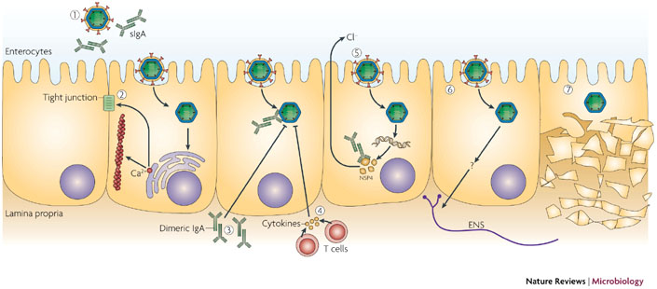

Slide 13
ADENOVIRUSES

Slide 14
Adenoviruses
Family Adenoviridae
dsDNA, non-enveloped; 70 - 75 nm
icosahedral capsid
Adenovirus is the only virus with a fiber protruding from each of the 12 vertices of the capsid.
The fiber is the organ of attachment and is a hemagglutinin.
There are 41 known antigenic serotypes
Types 40 and 41 cause infantile gastroenteritis.

Slide 15
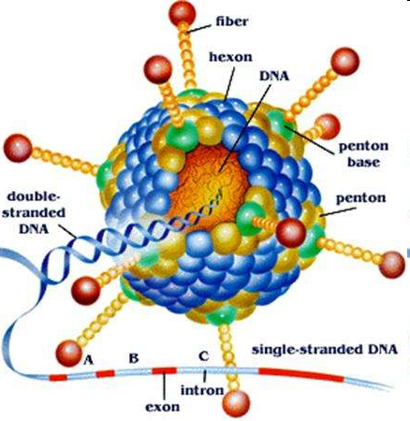

Slide 16
Adenovirus 40/41 Epidemiology
Second leading cause of cases (5-20%) and hospitalizations in infants
Occurs year around; no seasonal peak
Predominates in late fall and winter
Asymptomatic or mild illness in older children, adults
Transmission: person-to-person

Slide 17
Adenovirus 40/41 Clinical Illness
Incubation: 7-8 days
Duration: 8-12 days
Diarrhea predominates
Nausea / Vomiting
Cramping abdominal pain
Due to excessive fluid
Increased peristalsis
Absence of blood and fecal Leukocytes
Key to differential with bacterial infections

Slide 18
Physical Signs
Voluminous, non-bloody Stools
Dehydration
Decreased urination
Mental status changes
Dry mucous membranes
Lethargy

Slide 19
Clinical appearance of dehydration Photo Credit: Dr. D. Mahalanabis, World Health Organization

Slide 20
Caliciviruses Astroviridae
NOROVIRUS
ASTROVIRUS

Slide 21
GASTROENTERITIS VIRUSES

Slide 22
Guidelines for Specimen Collection
Collect stool within 48 hours after onset
Bulk sample; no preservatives; rectal swabs of little value
Refrigerate at 4°C; do not freeze

Slide 23
Laboratory Testing Available
Rotavirus: EIA*, EM, RT-PCR
Adenovirus 40/41: EIA*
Norovirus: RT-PCR*, EM
Astrovirus: RT-PCR*, EM
* Method of Choice

Slide 24
Management
Self limiting course
Replace fluids and electrolytes
Oral Rehydration (ORT)
Mild to moderate dehydration
Severe Dehydration
ORT can be successful
IV fluids
Shock
Uremia
Ileus
Fluid loss > 10 ml/kg/hr

Slide 25
VIRAL GASTROENTERITIS
Prevention
Hand washing; hygiene; dealing with infants
Vaccination like Rotavirus vaccine (RotaShield) contains four serotypes of live, attenuated virus.

