Slide 1
IV Fluids- electrolytes
Thara anwar
Nebal atallah
Mahd foqhaa
Amal jamel

Slide 2
IV Fluids

Slide 3
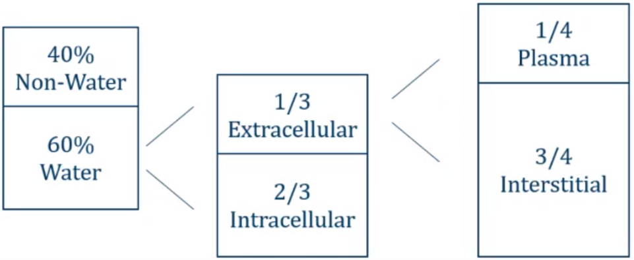
Fluid compartments

Slide 4
Fluid Intake and Output
• Normal oral intake ~2 L/day • Output: • Urine: 1.0 L/day • Insensible losses: • Stool: 0.25 L/day • respiration, sweating: 0.75 L/day •Insensible losses: pathologic states • Fever • Burns
Notes:
Insensible fluid loss is the amount of body fluid lost daily that is not easily measured, from the respiratory system, skin, and water in the excreted stool.

Slide 5
IV fluid therapy indications
• IV fluid therapy is used to maintain homeostasis when: • intake is insufficient • to replace any additional losses.
• These losses may occur from: GIT (due to severe vomiting, diarrhoea), urinary tract (eg, diabetes insipidus), blood loss from trauma or surgery. In addition, insensible losses can increase during fever or after suffering from burns because the barrier function of the skin is impaired.

Slide 6
Types of IV fluids
Crystalloid solutions
Colloid solutions
• Contain water and salts
• Examples: • Normal saline • Lactated ringers • half normal saline • D5W • Hypertonic saline.
•infusion : fluid loss ratio = 1:1
•infusion : blood loss ratio = 4:1 5:1
• Contain water and large molecules
• Mainly remains in the intravascular compartment.
• used for resuscitation in severe hypovolemia , blood loss and burns.
• Examples: albumin, gelatin, dextran solutions, hydroxyethyl starches
• Expensive
• infusion : blood loss ratio = 1:1
Notes:
Fluid losses (urine and insensible perspiration) are replaced in a 1:1 ratio with a balanced crystalloid infusion solution. Additionally, intravascular blood loss must be replaced in a 4–5:1 ratio.

Slide 7
osmolarity
Osmosis: simple diffusion of water from high conc of water to low conc of water across semi permeable membrane.
Osmolarity of solution is equal to number of osmoles per liter of solution.
Normal range of osmolarity in plasma is about 280-295 milli-osmoles per liter.
Tonicity is the total conc. of solutes which make an osmotic force across a membrane.
The term tonicity is used to describe the osmolarity of a solution relative to plasma. • Isotonic (osmolarity of a solution ~ to plasma) • hypertonic (osmolarity of a solution > to plasma) • hypotonic (osmolarity of a solution < to plasma)
ECF
ICF
Notes:
the osmolality of the extracellular fluid (ECF) is approximately equal to that of the intracellular fluid (ICF).
Osmole: the osmosis caused by a mole.

Slide 8
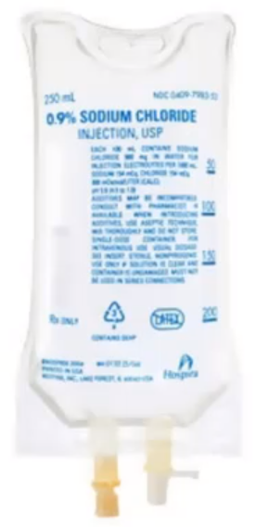
Normal Saline
0.9% Normal Saline
• Approximately same osmolarity as plasma • [Na] = [Cl] = 154 mmol/liter • total osmolarity = 308 mOsmol/liter vs. 285 m0sm/L plasma
• Normal saline is isotonic
• 25% remains in intravascular space
•Used for volume replacement • Hypovolemic shock • Septic shock

Slide 9
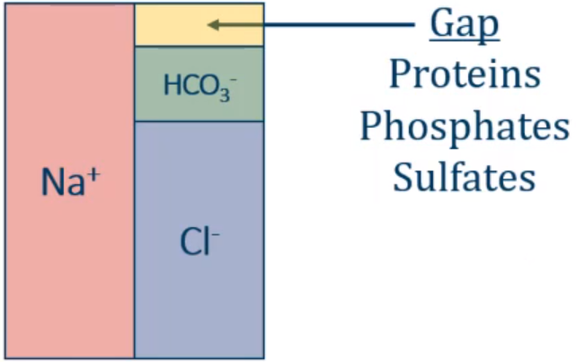
Normal Saline
cell
H+
K+
0.9% Normal Saline
• Normal Saline Results in influx of chloride ions (Cl)
• Causes shift of bicarbonate ions (HCO3) into cells
• Causes acidosis ( pH)
• Acidosis → potassium shift out of cells
• ↑ serum potassium
• “Hyperchloremic metabolic acidosis”
• C/O: CHF, CKD, Liver cirrhosis
Notes:
Hyperchloremic metabolic acidosis

Slide 10
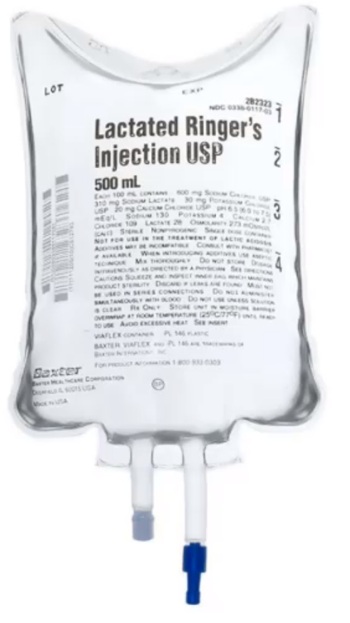
Lactated Ringers
• Sodium, chloride, potassium, calcium, and lactate.
• "Balanced fluid"
• Isotonic: osmolarity 286 mOsm/L
• 25% remains in intravascular space
• Lactate metabolized to bicarbonate
• Acts as buffer in acidotic states
• Most common use: trauma resuscitation

Slide 11
Indications & Contraindications
First-line replacement therapy in the perioperative period.
Fluid resuscitation after a blood loss due to trauma, surgery, or a burn injury.
Replace GI tract fluid losses.
Metabolic acidosis.
Poor liver function. (affect lactate metabolism → Lactic acidosis )
Hyperalkalosis
Citrated blood transfusions (Clumping of red cells if it is co-administered with blood products)
Notes:
Citrate is the anticoagulant used in blood products. It is usually rapidly metabolised by the liver.

Slide 12
Half Normal Saline
0.45% Normal Saline
• [Na] = [Cl] = 77 mmol/liter
• total osmolarity = 154 mOsmol/liter vs. 285 m0sm/L plasma
• Hypotonic solution concentration of sodium chloride
• Does not remain intravascular
• Used as "maintenance fluids"
• Replaces daily losses of sodium and water
• 5% dextrose often added: D5 half NS
• Potassium can be added: D5 half NS with 20mEq K
• Often used when oral intake is low

Slide 13
D5W
5% Dextrose
• IV fluid that contains Dextrose and free water.
• Dextrose is metabolized leaving only free water
• Used to correct hypernatremia to dilute sodium.
Notes:
Dextrose is not considered to have an osmotic effect because it is rapidly metabolized in blood

Slide 14
Hypertonic Saline
3% Saline
• Hypertonic: ~900 mOsm/liter
• Draws fluid out of tissues into vascular space
• ICF ECF
• Used in two circumstances: • Elevated intracerebral pressure • Severe hyponatremia

Slide 15
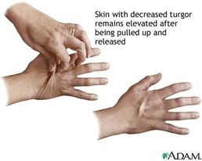
Hypovolemia
• Many causes: • Vomiting/diarrhea • Poor oral intake • Third spacing/fluid leak: sepsis, trauma
• Clinical features: • Decreased urine output • Dry mucous membranes • Poor skin turgor Hypotension
• Treatment: oral intake, IV fluids

Slide 16
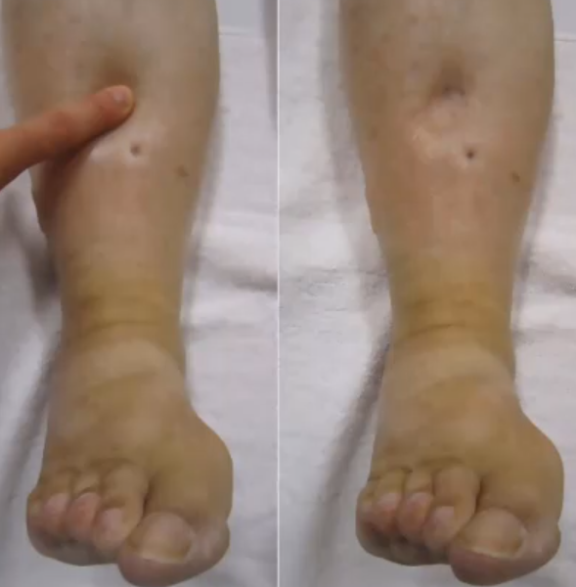
Hypervolemia
• Classic causes • Heart failure • Cirrhosis • Nephrotic syndrome
• Clinical features: • Weight gain • Pitting edema • Elevated jugular venous pressure • Pulmonary edema
• Treatment: diuretics

Slide 17
Maintenance of Fluids
(4-2-1 rule)
(4ml/kg for the first 10kg) + (2ml/kg for kg 11-20) + (1ml/kg for every kg above 20) = hourly rate
Example: Calculate the hourly maintenance fluid rate for a child who weighs 25kg
(4ml x 10kg) + (2ml x 10kg) + (1ml x 5kg) = hourly rate
40ml + 20ml + 5ml = 65ml/hr
Maintenance of electrolytes
Na+: 3 mEq/kg/day, K+ : 1 mEq/kg/day
e.g. 50 kg patient maintenance requirements
• fluid = 40 + 20 + 30 = 90 mL/hour = 2160 mL/day
• Na+ = 150 mEq/day
• K+ = 50 mEq/day

Slide 18
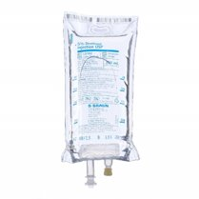
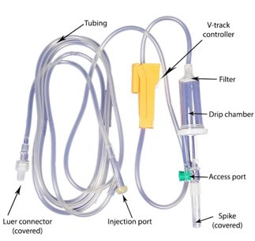
Equipment of I.V. therapy
I. Solution containers.
II. I.V. administration sets.

Slide 19
IV CANNULA
Present day IV cannula are available from sizes 14 gauge to 26 gauge with universal color coding for easy recognition of IV cannula. Smaller the gauge, wider is the cannula and has higher flow rate.
Normal adult size: 18-20 G
Situations requiring rapid fluid transfusion like trauma: 14-16 G
Preferred pediatric size: 22 G
Infants and neonates: 24-26 G
+pink is most commonly used

Slide 20
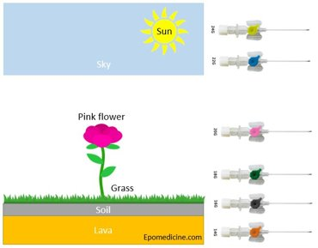
The earth has magma inside (orange color) – 14 G
There is soil on surface (grey color) – 16 G
Grass has grown on the soil (green color) – 18 G
Pink flower has grown above the grass (pink color) – 20 G
Above is the blue sky (blue color) – 22 G
The sun is in the sky (yellow color) – 24 G

Slide 21
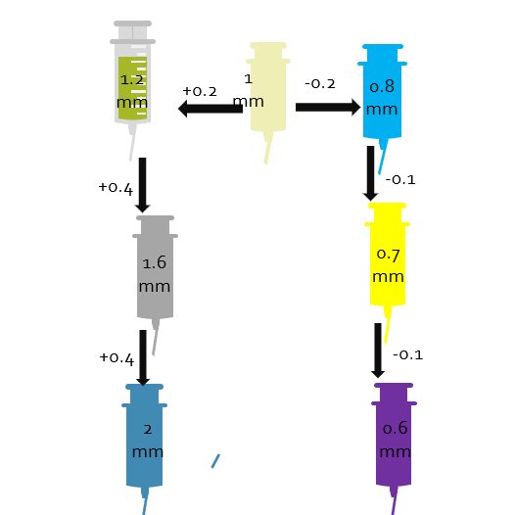
External diameter of cannula :
Remember the pink (20 G) cannula is 1 mm in diameter. For cannula next to pink: 1 +/- 0.2 mm
18 G (green): 1.2 mm
22 G (blue): 0.8 mm
For cannula smaller “gauze” than 18 G:
16 G (grey): 1.2 + 0.4 = 1.6 mm
14 G (orange):1.6 + 0.4 = 2 mm
For cannula larger than 22 G:
24 G (yellow): 0.8 – 0.1 = 0.7 mm
26 G (purple): 0.7 – 0.1 = 0.6 mm

Slide 22
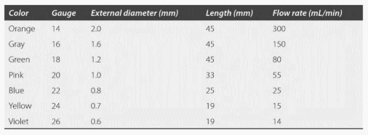

Slide 23
Electrolytes

Slide 24
Sodium (135 - 145 mEq/L)

Slide 25
HYPOnatremia plasma Na+ concentration <135 mmol/L. Symptoms usually begin when the Na+ level falls to <120 mEq/L.
Hyponatremia Plasma Osmolality
• Amount of solutes present in plasma
• Key solute: sodium
• Osmolality should be LOW in HYPOnatremia
• 1st step in hyponatremia is to make sure it's low
Serum Osmolality = 2 * [Na] + (Glucose/18) + (BUN/2.8)
*Normal = 285 (275 to 295)

Slide 27
HYPOnatremia (hypo/ hyper/ euvolemic)
1) Hypovolemic
There’s a depletion of both Na+ and water, but sodium deficit exceeds wter deficit
Causes of Na+ loss:
Extra-renal causes:
Low urine sodium (<10 mEq/L)
implies increased sodium retention by the kidneys to compensate for extrarenal losses of sodium containing fluid.
Na+ loss can be from GIT or skin (diarrhea, vomiting, diaphoresis, burn, nasogastric suction),
Renal causes:
High urine sodium (>20 mEq/L)
Causes are either :
Diuretic therapy, esp thiazides
Adrenocortical failure

Slide 28
HYPOnatremia (hypo/ hyper/ euvolemic)
Euvolemic
Hypervolemic
There’s no evidence of ECF expansion or contraction
Caused by:
Primary polydipsia
SIADH: Causes are numerous and include: CNS pathologies, malignancy (most commonly small cell lung cancer), surgery (postoperative hyponatremia)
Excessive electrolyte-free water infusion: if a patient is given D5W (or other hypotonic solution) to replace fluids, or if water alone is consumed after intensive exertion (with profuse sweating)
Hypothyroidism
Diagnosis mandates that the patient is euvolemic with the absence of renal, cardiac or hepatic diseases
This is due to water-retaining states that’re ass with volume expansion
The relative excess of water in relation to sodium results in hyponatremia
Causes are:
CHF
Cirrhosis
Nephrotic syndrome
CKD; during free water intake
Notes:
Syndrome of inappropriate antidiuretic hormone secretion (SIADH)

Slide 29
*Clinical Features
Symptoms development is upon rapidity of development of hyponatremia than severity of it
Hyponatremia can be classified into:
Upon chronicity:
Acute: develops within (24-48) hrs
Chronic: develops after 48 hrs
Upon severity:
Mild: (130-135) mmol/L
Moderate: (125-129) mmol/L
Severe: less than 124 mmol/L

Slide 30
Symptoms:
Neurologic:
Water shifts to brain causing brain swelling or oedema
Headache, dilirium and irritability
Muscle twitching and weakness
Hyperactive deep tendon reflexes
Increased ICP and coma
GIT:
N & V, Ileus and watery diarrhoea
CVS: HTN from increased ICP
Increased salivation and lacrimation
Oliguria and anuria
May ot be revesable if treatment wasn’t ASAP leading to ARF

Slide 31
HYPOnatremia (hypo/ hyper/ euvolemic)
Hypertonic saline rapidly increases the tonicity of ECF.
Do not increase sodium more than 8 mmol/L during the first 24 hours. An overly rapid increase in serum sodium concentration may produce central
pontine demyelination.
Diagnosis
1. Plasma osmolality — low in a patient with true hyponatremia
2. Urine osmolality (low when kidneys respond appropriately and dilute urine, high when ADH is increased as in SIADH, Hypothyroidism and CHF)
3. Urine sodium concentration
Urine Na+ should be low in the setting of hyponatremia
Treatment
1.Isotonic & hypertonic--- treat the underlying cause
2. Hypotonic
Mild (Na+ 120 to 130 mmol/L)— withhold free water, allow the patient to re-equilibrate spontaneously asalt tablets for SIADH
Moderate (Na+ 110 to 120 mmol/L)— loop diuretics (given with saline to prevent renal concentration of urine due to high ADH).
Severe (Na+ <110 mmol/L) or if symptomatic— give hypertonic saline to increase serum sodium by 1 to 2 mEq/L/hr until symptoms improve.

Slide 32
HYPERnatremia plasma Na+ concentration >145 mmol/L
Refers to excess sodium in relation to water; can result from water loss or rarely, sodium infusion.
Hypovolemic hypernatremia (sodium stores are depleted, but relatively more water has been lost)
Renal loss—from diuretics, osmotic diuresis (most commonly due to glycosuria in diabetics), renal failure
Extrarenal loss—from diarrhea, diaphoresis, respiratory losses
Isovolemic hypernatremia (sodium stores normal, water lost)
Diabetes insipidus: central or peripheral
(causes include lithium toxicity, hypercalcemia, hypokalemia, renal disease, drugs)
Hypervolemic hypernatremia (sodium excess)—occurs infrequently
Iatrogenic—most common cause of hypervolemic hypernatremia (e.g., large amounts of parenteral NaHCO3, TPN)
Exogenous glucocorticoids ( increases in Na retention)
Cushing syndrome
Notes:
Total parenteral nutrition (TPN)

Slide 33
HYPERnatremia plasma Na+ concentration >145 mmol/L
Diagnosis
1. Urine volume should be low if the kidneys are responding appropriately.
2. Urine osmolality should be >800 mOsm/kg.
Treatment
1. Hypovolemic hypernatremia—Give isotonic NaCl to achieve euvolemia and restore hemodynamics initially. Correction of hypernatremia can wait until the patient is hemodynamically stable, then replace the free water deficit.
2. Isovolemic hypernatremia—Patients with diabetes insipidus require vasopressin, low sodium diet, and thiazide diuretics. Prescribe oral fluids, or if the patient cannot drink, give D5W.
3. Hypervolemic hypernatremia—Give diuretics (such as furosemide, to correct
volume status) and D5W (to achieve normal sodium concentration) to remove
excess sodium. Dialyze patients with renal failure.

Slide 34
Calcium(8.5 to 10.5 mg/dL)
Calcium balance is regulated by hormonal control, but the levels are also affected by albumin and pH.
Albumin
Calcium in plasma exists in two forms:
Protein-bound form: most calcium ions are bound to albumin, so the total calcium concentration fluctuates with the protein (albumin) concentration.
Free ionized form: physiologically active fraction; under tight hormonal control (PTH), independent of albumin levels.
In hypoalbuminemia, the total calcium is low, but ionized calcium is normal, and can be estimated by the following formula:
total calcium—(serum albumin ×0.8).
pH
An increase in pH increases the binding of calcium to albumin. Therefore, in alkalemic states (especially acute
respiratory alkalosis), total calcium is normal, but ionized calcium is low and the patient frequently manifests the signs and symptoms of hypocalcemia..
Hormonal Control
Maintenance of calcium balance is a function of PTH , calcitonin, and vitamin D, and their target organs bone,
kidney, and gut.

Slide 35
Calcium(8.5 to 10.5 mg/dL)
Causes
HYPOcalcemia
1. Hypoparathyroidism (most common cause)
2. Renal insufficiency/ pancreatitis
3. Hyperphosphatemia
4. Hypomagnesemia—results in decreased PTH secretion.
5. Alkalemia— increase in pH causes increased calcium binding, serum levels will be normal but clinically important as ionized fraction is low
6. Blood transfusion (with citrated blood)—calcium binds to citrate
HYPERcalcemia
1. Hyperparathyroidism (most common cause in outpatients)
2. Malignancies (most common cause in inpatients) -- bony metastases, Multiple Myeloma

Slide 36
Calcium(8.5 to 10.5 mg/dL)
Clinical features
HYPOcalcemia
1. Asymptomatic
2. Rickets and osteomalacia
3. Increased neuromuscular irritability
Numbness /tingling /tetany /
Hyperactive deep tendon reflexes
4. Cardiac manifestations
a. Arrhythmias
b. Prolonged QT interval on ECG—hypocalcemia should always be in the differential diagnosis for a prolonged QT interval
HYPERcalcemia
“Stones”
“Bones”
“Grunts and groans”
“Psychiatric overtones”
“ECG—shortened QT interval”

Slide 37
Calcium(8.5 to 10.5 mg/dL)
Diagnosis
HYPOcalcemia & HYPERcalcemia
1. To evaluate for the above-listed etiologies, obtain the following: BUN, Cr,
magnesium, albumin, and ionized calcium. Amylase, lipase, and liver function
tests may also be warranted.
2. Serum PO43
3. PTH

Slide 38
Calcium(8.5 to 10.5 mg/dL)
Treatment
HYPERcalcemia
1. Patients usually do not require management beyond correction of underlying etiology unless hypercalcemia is severe (>14 mg/dL) or significant symptoms are present.
2. Increase urinary excretion in all patients.
a. IV fluids (NS)—first step in management
b. Diuretics (furosemide)—further inhibit calcium reabsorption
HYPOcalcemia
1. If symptomatic, provide emergency treatment with IV calcium gluconate.
2. For long-term management, use oral calcium supplements (calcium carbonate) and vitamin D.
3. It is also important to correct hypomagnesemia. It is very difficult to correct the calcium level if the magnesium is not replaced first.

Slide 39
Potassium(3.5 - 5 mEq/L)
Most of the body’s potassium (98%) is intracellular.
Hypokalemia—alkalosis and insulin administration may cause hypokalemia
because they cause a shift of potassium into the cells.
Hyperkalemia—acidosis and anything resulting in cell lysis increase serum K+ (both force K+ out of cells into the ECF).
Potassium secretion—most of the excretion of potassium occurs through the kidneys (80%); the remainder occurs via the GI tract. Aldosterone plays an important role in renal potassium secretion.

Slide 40
Hypokalemia
Causes
Clinical features
GI losses
(diarrhea, Vomiting and nasogastric drainage {volume depletion and metabolic alkalosis also result} , intestinal malabsorption)
Renal losses (Diuretics, Renal tubular or parenchymal disease, Primary and secondary hyperaldosteronism)
Other causes (insulin administration, β2 agonists)
1. Arrhythmias—prolongs normal cardiac conduction
2. Muscular weakness, fatigue, paralysis, and muscle cramps
3. Decreased deep tendon reflexes
4. Paralytic ileus
5. Polyuria and polydipsia
6. Nausea/vomiting

Slide 41
Hypokalemia
Treatment
Diagnosis
1. Treat the underlying cause & stop any medication that may cause hypokalemia.
2. Oral KCl is the preferred (safest) method of replacement and is appropriate in most instances, IV if severe
ECG changes : T wave flattens out; if severe, T wave inverts, U wave appears
urine potassium in hypokalemia:
Low with GI losses (<20 mEq/L)
High with renal losses (>20 mEq/L)
Serum K+ > 3.5 mEq/L
Cautions
Monitor K+ concentration and monitor cardiac rhythm when giving IV potassium.
May add 1% lidocaine to bag to decrease pain (potassium burns!)
Correct hypomagnesemia

Slide 42
Hyperkalemia
Increased total-body potassium
a. Renal failure (acute or chronic)
b. Hypoaldosterone states
ACE inhibitors, potassium-sparing diuretics (spironolactone)
c. Blood transfusion—usually due to lysed cells
Pseudohyperkalemia (spurious)
a. This refers to an artificially elevated plasma K+ concentration due to K+ movement out of cells immediately before or after venipuncture. (Repeat the test to confirm)
b. if the sample is not processed quickly, some red blood cells will hemolyze and cause spillage of K+ leading to a falsely elevate result.
Causes
Transcellular shifting
(from intracellular to extracellular)
a. Acidosis
b. Tissue/cell breakdown (chemotherapy,
hemolysis, burns)
c. GI bleeding
d. Insulin deficiency—insulin stimulates
the Na+-K+-ATPase and causes K+ to shift into cells.
e. Rapid administration of β-blocker

Slide 43
Hyperkalemia
Diagnosis
Treatment
ECG changes (when K+ >6)
Peaked T waves (by 10 mm)
A prolonged PR interval
Widening of QRS and merging of QRS with T wave
Ventricular fibrillation and cardiac arrest (with increasing levels of K+)
1. If the hyperkalemia is severe, or if ECG changes are present, first give IV Calcium, Why? Calcium stabilizes the resting membrane potential of the myocardial membrane that is, it decreases membrane excitability
2. Shift potassium into the intracellular compartment (by glucose & insulin, β-agonists)
3. Remove potassium from the body.
a. Kayexalate
b. Hemodialysis

Slide 44
Magnesium (1.8 to 2.5 mg/dL)
Location in the body—Most of the magnesium in the body (two-thirds) is in bones.
The remainder (one-third) is intracellular. Only 1% of magnesium is extracellular.
Many hormones can alter urinary magnesium excretion (e.g., insulin/glucagon, PTH, calcitonin, ADH, and steroids).
Magnesium absorption and balance—About 30% to 40% of dietary magnesium is
absorbed in the GI tract, but this percentage increases when magnesium levels are low. The kidney has a great capacity to reabsorb magnesium and is the major regulator of magnesium balance.

Slide 45
Magnesium (1.8 to 2.5 mg/dL)
Causes
HYPOmagnesemia
1. GI causes
Malabsorption, steatorrheic states (most common cause), Prolonged fasting
2. Alcoholism (common cause)—due to increased urinary excretion as well as
frequently concomitant diarrhea, pancreatitis, and poor diet
3. Renal causes
4.DKA, burns, pancreatitis, lactation
HYPERmagnesemia
1. Renal failure (most common cause)
2. Early-stage burns, massive trauma or surgical stress, severe ECF volume deficit,
severe acidosis
3. Rhabdomyolysis
4. Iatrogenic—usually in the obstetric setting in women with preeclampsia or
eclampsia being treated with magnesium sulfate

Slide 46
Magnesium (1.8 to 2.5 mg/dL)
Clinical features
HYPOmagnesemia
1. Marked neuromuscular and CNS hyperirritability
2. Effect on calcium levels: coexisting hypocalcemia is common because of decreased release of PTH and bone resistance to PTH when Mg2+ is low
3. Effect on potassium levels
Coexisting hypokalemia—in up to 50% of cases, usually due to etiology which leads to loss of both
4. ECG changes—prolonged QT interval, T-wave flattening, and ultimately, torsade de pointes
HYPERmagnesemia
1. Nausea, weakness
2. Facial paresthesia
3. Progressive loss of deep tendon reflexes (classically the first sign)
4. ECG changes resemble those seen with hyperkalemia (increased P-R interval,
widened QRS complex, and elevated T waves)
5.Death is usually caused by respiratory failure or cardiac arrest

Slide 47
Magnesium (1.8 to 2.5 mg/dL)
Treatment
HYPOmagnesemia
1. For mild hypomagnesemia—oral Mg2+ (e.g., magnesium oxide)
2. For severe hypomagnesemia—parenteral Mg2+ (e.g., magnesium sulfate)
HYPERmagnesemia
1. Withhold exogenously administered magnesium.
2. Prescribe IV calcium gluconate for emergent symptoms (cardioprotection as in
hyperkalemia).
3. Administer saline and furosemide.
4. Order dialysis in renal failure patients.
5. Prepare to intubate if respiratory depression is severe.

