Slide 1
CHILD ABUSE

Slide 2
Definition
Child abuse (including neglect) is any form of maltreatment of a child, either by inflicting harm or by failing to act to prevent harm.
Children may be abused by their family members, caregivers or unfrequently by a strangers.
They may be abused by adults or by other children.

Slide 3
Epidemiology
Child abuse is a worldwide phenomenon and can affect children of all ages; however, the highest incidence occurs to infants and toddlers.
It is difficult to gain a true estimate of child abuse due to the hidden nature of the problem.
In developed countries it is estimated that:
4% to 16% of children are physically abused, around 10% are neglected ( emotionally abused), 5% of boys and 5% to 10% of girls are exposed to penetrative sexual abuse, and 30% are exposed to any form of sexual abuse. Around 80% of child abuse is perpetrated by caregivers or parents

Slide 4
Etiology
There is no specific etiologic factor of child abuse; causes and risk factors are multifactorial:
Parental (or caregiver) risk factors:
Poor socioeconomic status
Inadequate child care and poor parental education
Psychological problems
Substance abuse
Unmet emotional needs on the part of the parent or caregiver may predispose toward neglect of a child
Lack of parenting knowledge may lead to unrealistic expectations of the child
Parental or caregiver exposure to maltreatment as a child
This is thought to be due to sex-role stereotypes and a repetition of a pattern of violence

Slide 5
Child risk factors:
Children with mental or physical health problems
Children with disabilities
Low birth weight
Excessive crying and/or frequent tantrums
Twins

Slide 6
classification
Physical abuse
May involve causing physical harm by hitting, shaking, burning, smothering, poisoning, biting, or throwing the child.
Injuries sustained by physical abuse may include bruises, fractures, burns, oral injuries, bites, head and spinal injuries, and abdominal injuries.
The challenge for the clinician is to distinguish inflicted injuries from accidental injuries.
Emotional abuse
This may involve conveying to the child that they are worthless, unloved, inadequate, or valued only as long as they meet the needs of another person. overprotection and limitation of exploration and learning, or preventing the child from participating in normal social interaction.
Any serious bullying, causing a child to feel frightened or in danger, or the exploitation of the child.

Slide 7
Sexual abuse
Sexual abuse involves forcing or enticing a child or young person to take part in sexual activities, including prostitution and pornography, whether or not the child is aware of what is happening.
Activities may involve physical contact, including penetrative or nonpenetrative acts.
Actions may include noncontact activities, such as involving children in the viewing or production of sexual images or encouraging children to behave in sexually inappropriate ways.
Neglect
Is the failure to meet the basic physical and/or psychological needs of a child, It may also include neglect of, or unresponsiveness to, the basic emotional needs and includes failure to Provide adequate food, clothing, and shelter (including exclusion from home or abandonment)
Protect a child from physical and emotional harm or danger
Ensure adequate supervision (including the use of inadequate caregivers)
Ensure access to appropriate medical care or treatment.
• Neglect may also occur during pregnancy as a result of the mother failing to consider the developing needs of the child.

Slide 8
Step-by-step diagnostic approach
Injuries caused by physical abuse such as bruising, fractures, oral injuries, bites, head and spinal injuries, abdominal injuries, and burns challenges the clinician to distinguish inflicted injuries from those that have occurred accidentally. Finding one or more of the above injuries in a child requires a full further evaluation for other injuries typical of abuse
Some markers currently used to identify children who should be assessed further for possible abuse or neglect (e.g., repeated presentation, age, injury type)
Clinical prediction rule, the TEN-4 rule, is highly specific and sensitive for identifying high-risk bruising that requires an abuse work up
A bruise on a child’s torso, ears, neck, or any part of the body of an infant <4 months old (TEN-4) should trigger an abuse evaluation

Slide 9
History suggestive of nonaccidental injury
A history of trauma inconsistent with the injuries, a changing history, unexplained coexistent injuries, or previous history of injuries.
Injuries that do not fit with the developmental age of the child (if children are not yet independently mobile, they unlikely to fall against certain objects). Details of the mechanism of injury may help determine whether the explanation is compatible with the injury and the developmental level of the child.
Faltering growth or failure to thrive
Poor parent-child bonding. Parental attempts at excusing or justifying the injury inappropriately or blaming a younger sibling or pet

Slide 10
To exclude non abusive causes; the clinician should take:
Perinatal history (birth-related trauma)
Prematurity
Physical therapy and medications
Iatrogenic causes
Past medical history of fractures or bleeding disorders.
Family history of fractures and deafness can help too
It is important to ask about all relevant information about the child's family/caregivers (attendance in primary or secondary care, registration with social services. Any history of drug dependency or previous convictions should be noted)

Slide 11
Head injuries
Abusive head trauma (AHT) is the most common cause of fatal physical abuse.
Presenting features range from severe neurologic compromise (coma) to symptoms such as seizures, lethargy, irritability, vomiting, poor feeding, and increasing head circumference.
Markers of AHT:
Subdural hemorrhages in children <1 year old
Bilateral or interhemispheric subdural hemorrhages
Significant head injury with no explanation of trauma
Coexisting apnea or other form of acute respiratory compromise
Coexisting bruising to the head or neck or torso
Retinal hemorrhages
Rib or long bone fractures
Skull fractures other than a simple linear parietal skull fracture
Seizure without prior history of seizure disorder or fever

Slide 12
Fractures
Linear Skull fractures
Depressed skull fracture
subdural hemorrhage

Slide 13
Retinal hemorrhages in multiple retinal layers and extending to the periphery is highly specific for AHT, and it is seen in approximately 85% of cases
Other medical causes of retinal hemorrhages (birth, coagulation disorders, carbon monoxide poisoning)
Infants <6weeks of age may have minor retinal hemorrhages following birth, particularly after an instrumental delivery
Subdural hemorrhages are the most common intracranial injury seen in AHT, and may occur in combination with other extra-axial hemorrhages or injuries to the brain itself.
Physical abuse is the most common cause of subdural hemorrhage in children less than 1 year old
Are typically small and multiple
They occur commonly over the convexity and in the interhemispheric fissure
They may have different or mixed densities on CT or MRI
Epidural hemorrhages, however, are more commonly seen with accidental head trauma

Slide 14
Spinal injuries
Spinal injuries are uncommon in children with physical abuse
If it happens it would be masked with the loss of consciousness a combined with the AHT e.g. Unstable spinal fractures such as hangman's fracture
Sites of injury:
Cervical spine mostly in infants
Thoracolumbar spine mostly in toddlers
Presentation:
Bony tenderness over the site of the vertebral
Specific neurologic signs, such as paraplegia, quadriplegia, incontinence, or absent sensation below the level of cord injury.
Unexplained kyphosis in an older child should also raise a suspicion of previous abuse

Slide 15
Abdominal injuries
They are predominantly seen in children <5 years.
no specific history of trauma to the abdomen.
present with nonspecific symptoms (nausea, vomiting, loss of consciousness, and/or an acute abdomen).
Frequently, there is a delay in seeking care.
Abdominal injuries may occasionally be masked by symptoms and signs of head injury.
The most specific abdominal injuries as a consequence of abuse are hollow viscus injuries (e.g., small bowel and splenic injury).

Slide 16
Fracture
Age less than 18 months with no history of trauma
Multiple fractures
Rib fracture
Femoral fracture
Humeral fracture

Slide 17
Fractures
Long bones fractures
Metaphyseal fracture
Rib fractures

Slide 18
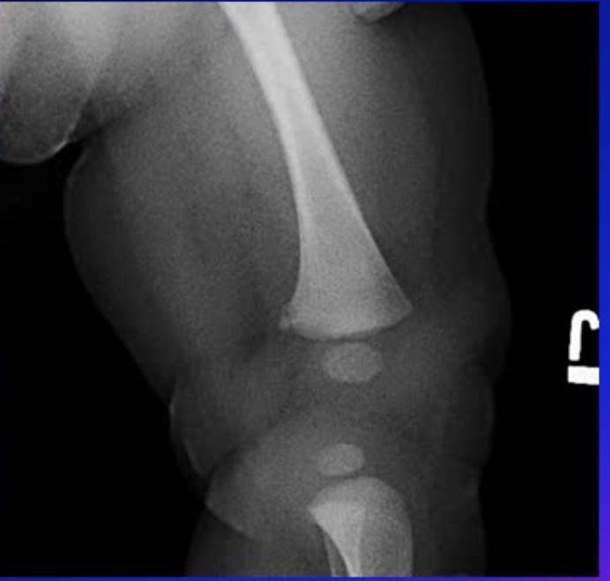
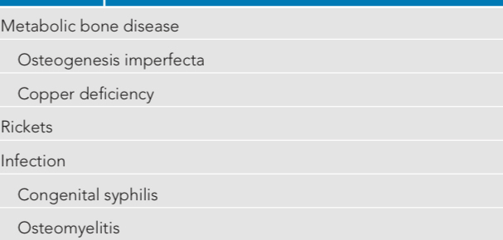
Ddx

Slide 19
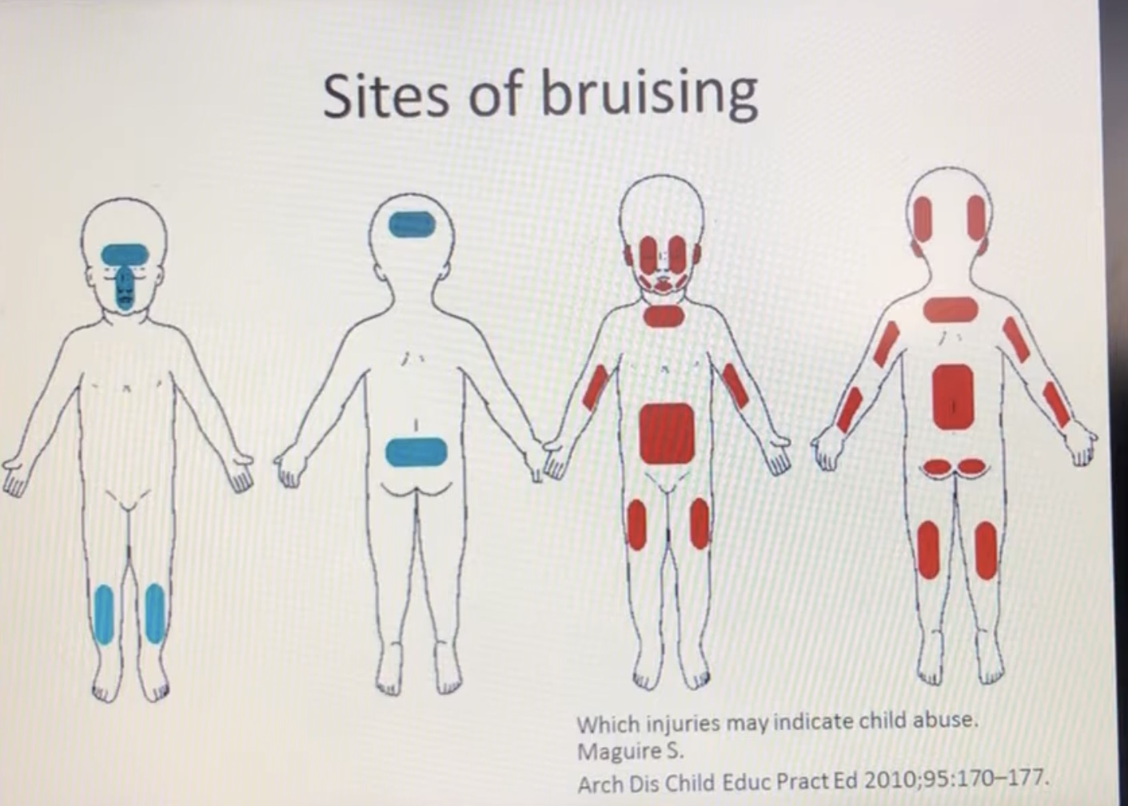
Bruising
Very common in pediatric.
Highly sensitive for child abuse.
When to suspect non-accidental bruises (i.e., caused by child abuse)?
Unusual distribution
Pattern
Multiple lesions
Different ages
Age <4 months
Other associated injuries

Slide 20
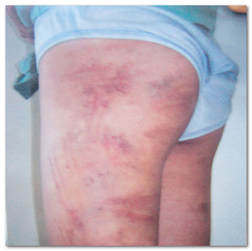
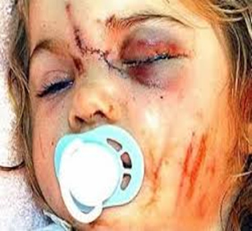

Slide 21
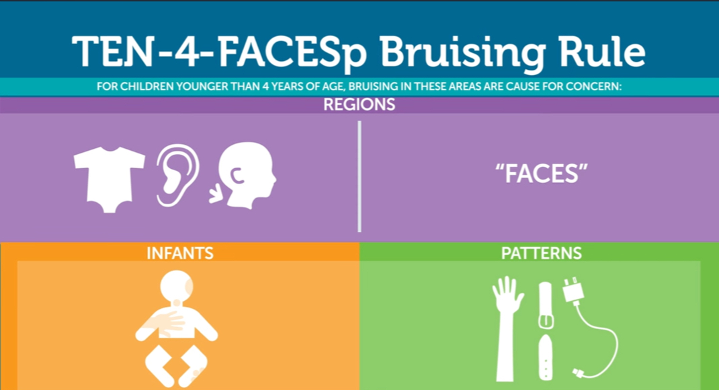
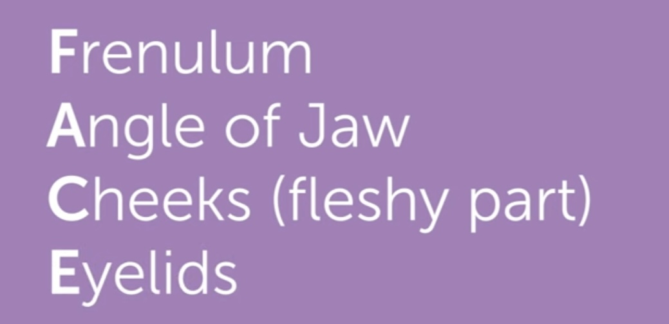
Age and developmental stage
Multiple brusies of different ages
Other associated injuries

Slide 22
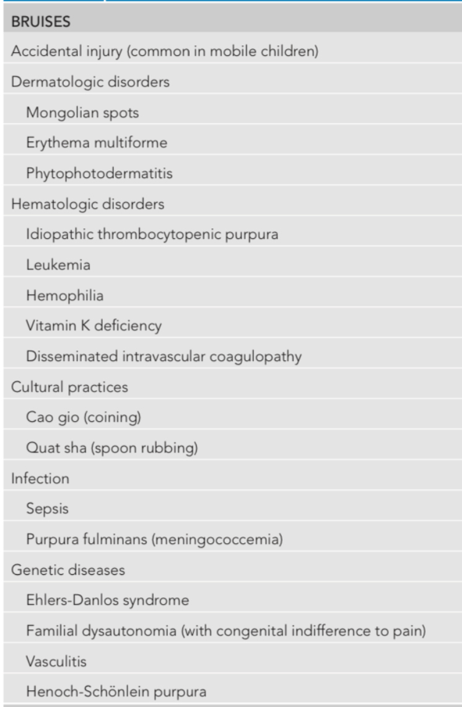
Ddx

Slide 23
Poisoning
Poisoning is quite common among children and not always due to abuse.
Features that increase the suspicion of abusive poisoning:
Delay in seeking medical advice
Ingestion of large amount of the poisonous material
Discrepancy between the patient’s history and the clinical presentation
Ingestion of unusual materials or medications
Previous history

Slide 24
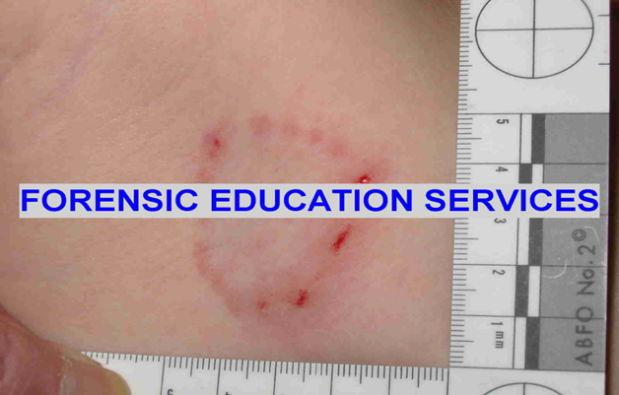
Bites
It is the only physical injury where there is the potential to identify exactly who has attacked the child.
Any bite with an intercanine distance of >3 cm, is more probably caused by an adult.
Bite marks in breasts or neck may be found in sexually abused children.
Animal bites are also common and usually lead to tearing injuries.

Slide 25
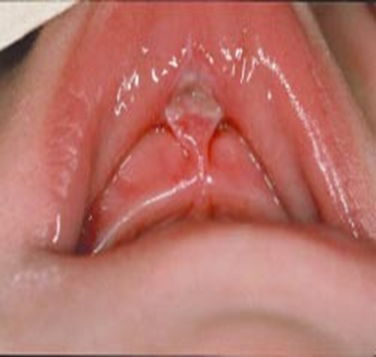
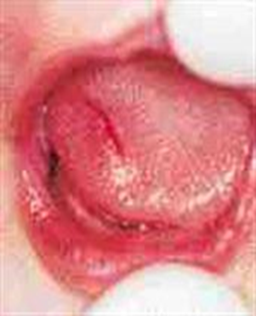
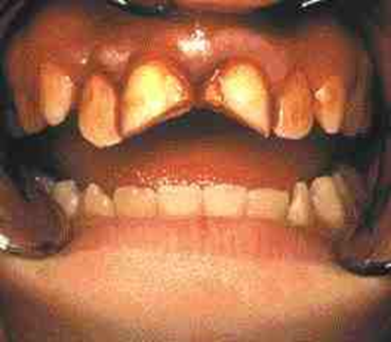
Oral injuries
Different mouth injuries that can be associated with child abuse, like:
Lips laceration or bruising ( the most common)
Missing or fractured teeth
Tongue laceration
Torn frenulum

Slide 26
burns
2 types:
Dry
Scald (spill/splash or immersion)
Accidental burn | Abusive burns
Reasonable history | History discrepancy
Irregular burn margins | Sharply demarcated burn margins
Variable burn depths | Uniform burn depth / Full thickness
Multiple splash marks | Absent splash marks
lessens in severity as liquid flows down body | Creases & opposing skin surfaces spared
Initial point of contact deeply burned | Geometric pattern or object imprint, (iron, cigarette lighter)
Usually, small | Larger burns

Slide 27
Munchausen syndrome by proxy
Also known as “Factitious disorder imposed on another”, is a psychiatric illness; in which the caregiver of a child, most often a mother, either fabricates symptoms or purposely causes harm to make it looks like the child is sick.
The primary motive is usually to gain attention or sympathy “not for the sake of external rewards” and frequently the caregivers themselves were abused during their childhood.
Mostly, the child age is < 6 years in about 75% of cases.
The child often presents with a strange symptoms and a history of many previous admissions, surgeries, tests and medical procedures or frequently presents with the same complain despite adequate medical intervention during his previous presentations.
In this case the child must be removed from the caregiver.

Slide 28
Diagnostic tests
CBC
Excludes some platelet abnormalities as a cause of bruising
Identifies other hematologic abnormalities (e.g., leukemia)
Highlights presence of anemia or blood loss
Clotting profile
Excludes many clotting abnormalities as a cause of bleeding and bruising
Dilated fundoscopy
Retinal hemorrhages

Slide 29
LFTs/amylase
Elevated ALT, AST and amylase
Serum calcium
Normal
Serum phosphate
Normal
Serum alkaline phosphatase
May be elevated due to fractures
Serum parathyroid hormone
Normal
Serum 25-hydroxyvitamin D
Normal

Slide 30
Photo documentation of injuries
Skeletal survey
Fractures on X-RAY
Brain CT
Subdural hemorrhage,
Subarachnoid
Hemorrhage
Complex skull fractures
Parenchymal injury
Cerebral edema

Slide 31
Other tests to consider
Radionuclide bone scan
Alternative for skeletal survey and appear as hotspot
MRI brain/spine
Subdural hemorrhage, Subarachnoid hemorrhage, parenchymal injury, cerebral edema, hypoxic-ischemic injury, diffuse axonal injury, and spinal injuries
Ultrasound abdomen
Free fluid or blood in the abdominal space
Abdomen CT
Hollow organ rupture, subcapsular hematomas, ruptures of liver or spleen, renal injury
Platelet function studies and von Willebrand factor assays
Normal

Slide 32
X-ray mouth
Dental or mandibular fracture
Forensic dental referral
May identify perpetrator
Forensic swabs for DNA
May identify perpetrator
Toxicology testing
Positive for specific agent used

Slide 33
Differential diagnosis
Work-up for physical abuse includes evaluation for occult injury as well as medical conditions that can mimic physical abuse. Children younger than 2 years with suspected physical abuse should undergo a skeletal survey looking for occult or healing fractures. Infants presenting with extracranial injuries may have occult head trauma, and therefore neuro-imaging may be indicated. Laboratory tests including ami-notransferase and aspartate aminotransferase can be used to screen for occult abdominal injury. Some medical conditions can be mistaken for abuse, emphasizing the need for careful, objective evaluation of all children.

Slide 34
Differential diagnosis
Coagulopathy
CBC, platelet function tests, prothrombin time (PT), prolonged thrombin time, thrombin, fibrinogen, von Willebrand factor and other clotting factor assays help identify the etiology.
Osteogenesis imperfecta
Type I and type IV. Type I frequently has associated blue sclera. Type II (lethal) and type III (severe, progressively deforming) OI: diagnosed clinically and radiologically
Rickets of prematurity
a reduction in bone mineral content which may occur 4 - 6 weeks after preterm birth
Clinical diagnosis

Slide 35
Phytophotodermatitis
cutaneous phototoxic inflammatory eruption resulting from contact with light-sensitizing botanical substances and long-wave ultraviolet A,The areas affected become acutely red, and often blister
Clinical diagnosis
Impetigo
Skin swap
Mongolian blue spot
Clinical diagnosis
Coining
Linear marks found on the back or chest and diagnosed clinically

Slide 36
The management of child abuse includes medical treatment for injuries and infections, and careful medical documentation of verbal statements and findings. Photographic documentation of physical examination hindings can be helpful when possible.
Medical providers play a role in preventing child abuse and its consequences through interventions and referrals that strengthen and educate families, recognition of abuse and mandated reporting, as well as through trauma-informed management of children who have experienced child mal-treatment.

Slide 37
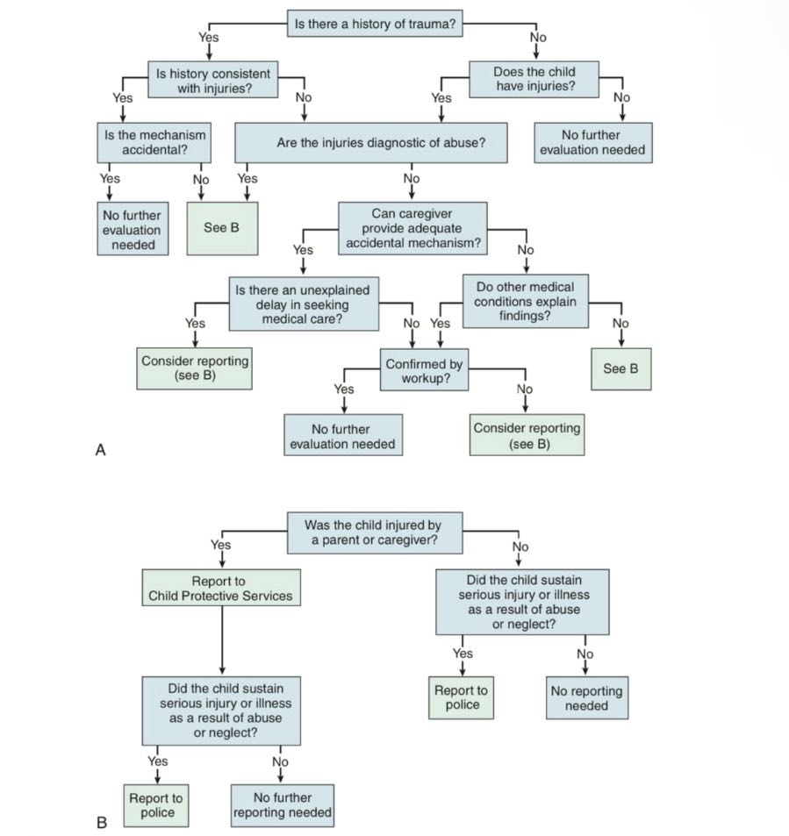

Slide 38
THANK YOU FOR BEING EFFECTIVLY ATTENTIVE!

