Slide 1
constipation
Done by :
Ahmad qatawneh
Rahaf qatawneh
Sereen mohawesh
Iman adeep
Supervised by :
Dr. Baker Alrawashdeh

Slide 2
Introduction
.
Constipation generally is defined as infrequent, hard , dry stool, difficulty in passing stool or painful bowel movements, Or two or less of defecation per week or passing hard (pellet-like) stool at least twice weekly.
Notes:
Physicians define it as: two or fewer stools per wk OR passage of hard stools for at least 2 wks

Slide 3
Epidemiology
Constipation is an extremely common problem in children and accounts for 25%-35% of all visits to pediatric gastrointerologists
Childhood constipation is most commonly seen in toddlers around the time of toilet training.
Before puberty, constipation appears to be equally common among girls and boys, After puberty and into young adulthood, females are more likely to develop constipation.
Notes:
3-5%
of all visits to pediatric outpatient clinics

Slide 4
Encopresis
Definition:
voluntary or involuntary Passage of feces in inappropriate situations after a chronological age of 4 years (or equivalent developmental level).
Notes:
Fecal incontinence (the preferred term over encopresis or soiling) is now included among the diagnostic criteria for functional constipation
Definition
voluntary or involuntary passage of feces into inappropriate places at least once a month for 3 consecutive months once a developmental age of 4 yr has been reached.
Encopresis (incontinence) : Voluntary or involuntary passage of stool in an appropriate place at least once
per month for three consecutive months.
- Developmental age should be more than 4 years

Slide 5
Encopresis is often classified variously as follows:
Type | Explanation
Retentive | With constipation and secondary overflow and leakage around obstruction; more common
Non-retentive | Without constipation
Type | Explanation
Primary | Seen in boys from infancy and often associated with global developmental delay and enuresis
Secondary | Seen in children after successful toilet training, often functional in nature, marked with a higher level of stressors and psychological disorders
Notes:
Subtypes :
1)Retentive encopresis : 65-95%
-w/ constipation & overflow incontinence
-often the result of chronic constipation and fecal impaction
2)Nonretentive encopresis
-w/o constipation & overflow incontinence
-no evidence of fecal impaction
-no evidence of anatomic, inflammatory, metabolic, endocrine, or neoplastic process that could explain the symptoms.
-It is more likely to have associated 1ry underlying psychological etiology

Slide 6
Normal stooling patterns
Infants:
The first bowel movement usually occurs within 36 hours after birth in term.
Breast fed infants usually have more frequent bowel movements than formula fed babies.
Children:
Most children have from 3 bowel movements per day to 3 per week.
Notes:
-90 percent of normal newborns pass meconium within the first 24 hours of life.
-The gradual decrease in bowel movement frequency with advancing age correlates with changes in transit time and varying patterns of colonic motility
-start to decrease gradually with age due to :
1. change in the transient time
2. pattern of colonic motility
. In childhood :most of them will

Slide 7
Pathophysiology
Retention
vicious circle
Withholding
Hard stools
Painful stool
Notes:
Voluntarily constrict anal sphincter (no evacuation)>stretching of ampulla >water absorbed and become
hard stool > with time > overstretched ampulla > decrease urge to defecate > stool pushed to anal canal
leading to soiling.
In most cases, childhood constipation develops when the child begins to associate pain with defecation
Child voluntarily constricts anal sphincters and does not evacuate his bowel
↓
Rectal ampulla stretches and accommodates increasing amount of stool
↓
Water is mainly absorbed and stool becomes harder
↓
With passage of time rectal ampulla overstretches
↓
Overstretching reduces the urge to daefecate
↓
Stool is pushed into the anal canal also and starts collecting there leading to soiling

Slide 8
Clinical Signs and Symptoms of Pediatric Constipation:
Symptom | Explanation
Stool withholding maneuvers | the typical features of such mannerisms are: Infants: back-arching Older infants/toddlers: moving back and forth, straightening legs, tip-toeing. Older children: stand stiff or squat.
Blood in stools | Painful bleeding per rectum in older children is associated with fissures, fistulae, infection, and maybe a harbinger of Crohn’s disease. Children with rectal polyps present with painless bleeding. In infancy, this is classically associated with cow milk protein allergy.
Pain | In pediatric constipation, pain is segregated as per location, character and timing. Pain can be present in the abdomen or locally around the anus

Slide 9
Symptom | Explanation
Infrequent stools | Reduced bowel movement is often synonymous with constipation and is a defining criterion for the same. However, almost half of the pediatric population with constipation does not have a reduced frequency of passage of stools.
Soiling | Though paradoxical and often mistaken as diarrhea; meager, involuntary fecal soiling is associated with constipation in almost 90% of children.
Enuresis and other urinary disturbances | Compression of the bladder by impacted stools in the rectum can simulate enuresis. Chronic pelvic muscular contraction often culminates in incomplete relaxation during voiding and post void residues.
Associated issues | Obesity, is often associated with constipation.

Slide 10
Causes of Constipation
Functional constipation 95%
Organic constipation 5%

Slide 11
Functional constipation
Defined :
by the ROME III classification, requires two or more of the following features in a child with developmental age ≥ 4 years and occurring at least once per week for at least two months before diagnosis.
Notes:
Functional constipation
It is responsible for more than 95% of cases of constipation in healthy children one year and older, and is particularly common among preschool-age children
1-functional: 95%
. At age of 1 year and older (especially in preschool age)
. No anatomical or biochemical causes

Slide 12
Rome III Criteria for Diagnosis of Functional Constipation:
1) Two or fewer defecations in the toilet per week.
2) At least one episode of fecal incontinence per week.
3) History of retentive posturing.
4) History of painful or hard bowel movements.
5) Presence of a large fecal mass in the rectum.
6) History of large diameter stools which may obstruct the toilet.
Notes:
The features of the ROME classification are summarized as below:
History of agonizing or rigid bowel movements
Passing of stools so large that they obstruct the toilet
At least one episode of fecal incontinence per week
History of retentive posturing(standing or sitting with legs extended and stiff or crossed legs) or excessive voluntary stool retention
Two or fewer defecations in the toilet per week
Presence of a large fecal mass in the rectum
The latest in the terminology of pediatric constipation is “non-retentive fecal soiling.”
Originally coined for children soiling albeit no difficult infrequent defecation; PACCT (The Paris Consensus on Childhood Constipation Terminology Group) define this pathology as “passage of stools in an inappropriate place, occurring in children with a mental age of 4 years and older, with no evidence of constipation on history or examination.”

Slide 13
Causes of functional constipation
Developmental: Cognitive handicaps, attention deficit disorder(ADHD)
Toilet training issues :
coercive toilet training toilet phobia school bathroom avoidance
sexual abuse.
Introducing solid food or cereal.
Depression .
Notes:
*here are three periods during which the infant and developing child are particularly prone to develop functional constipation. The first occurs after the introduction of cereals and solid food into the infant's diet, the second with toilet training, and the third during the start of school
Situational Coercive toilet training Toilet phobia Toilet training issues School bathroom avoidance Sexual abuse

Slide 14
Organic causes
responsible for fewer than 5 % of children with constipation.
-These usually can be distinguished from functional constipation by clinical features on the history or physical examination

Slide 15
Red Flags Suggesting an Organic Cause of Constipation in Children

Slide 16
1-Constipation starting extremely early in life (<1 month of age)
(Congenital malformation of anorectum or spine, Hirschsprung disease)
2-Delayed passage of meconium >48 hour
(Hirschsprung disease, cystic fibrosis, congenital malformation of anorectum or spine)
3- Failure to thrive / delayed growth
(malabsorption, cystic fibrosis, metabolic condition,HD)
4-Severe Abdominal distension (pseudo-obstruction,HD)
5-Explosive stool and air from rectum upon withdrawal of examining finger (Hirschsprung disease)
6- Blood in the stools in the absence of anal fissures (IBD,HD)

Slide 17
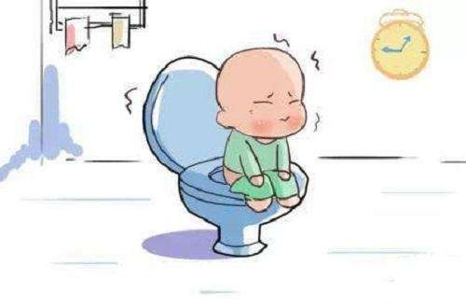
7-Fever,Bilious vomiting (HD)
8-hypothyroidism
9-Perianal fistula
10-Abnormal position of anus
11-Absent anal or cremasteric reflex( Spinal cord anomalies, trauma)
12-Decreased lower extremity strength/tone/reflex( Spinal cord anomalies, trauma)
13-Tuft of hair on spine
14-Sacral dimple
15-Gluteal cleft deviation
16-Extreme fear during anal inspection/Anal scars(child abuse)

Slide 18
Red flags …
17-Ribbon” like stools (very narrow in diameter) (anal stenosis,HD)
18-Urinary incontinence or bladder disease
19-Congenital anomalies or syndromes associated with Hirschsprung disease ( Down syndrome)
20-Family history of Hirschsprung disease or other GI diseases
21-No response to conventional treatment

Slide 19
Organic causes
Structural
neuromuscular
Anal stenosis
Anal stricture
Rectal abscess or fissure
Imperforate anus
Anterior dislocation of the anus
Hirschprung disease
Pseudoobstruction
Spinal cord lesions tumors or spina bifida,tethered cord)

Slide 20
Organic causes
Metabolic
Intestinal
Cystic fibrosis
Hypothyroidism
Hypokalemia
Hypercalcemia
Hypermagnesemia
Diabetes mellitus
Multiple endocrine neoplasia type 2B
Dietary protein allergy
Celiac disease

Slide 21
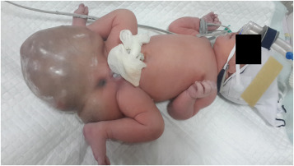
Organic causes
Drugs/toxics
Sacral teratoma
Lead
Narcotic
Anticholinergics
Antidepressants
Opiates
Chemotherapy
Vitamin D intoxication
Infant botulism

Slide 22
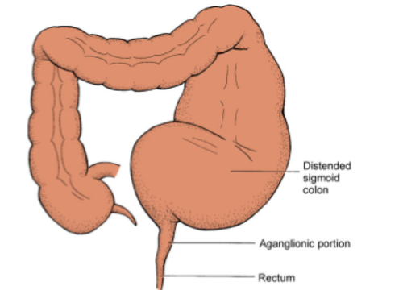
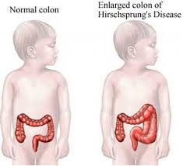
Hirsch-sprung disease

Slide 23
Hirschsprung disease
HD represents congenital aganglionosis of the colon results in megacolon proximal to the aganglionic segment due to stasis of stool within the normal part of the colon.
As a result, the affected segment of the colon fails to relax.
Should be considered as a diagnosis in any newborn who fails to pass meconium within the first 24 hours of life and requires rectal stimulation to pass stool.
In the majority of cases ,the aganglionic segment involves only the rectosigmoid colon

Slide 24
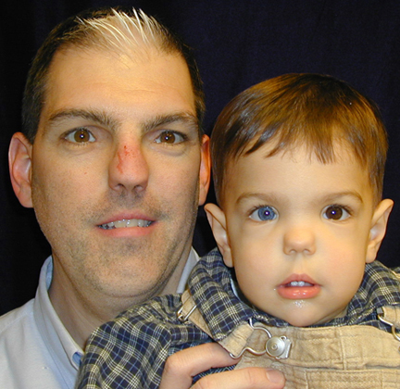
In the majority of cases ,the aganglionic segment involves only the rectosigmoid colon
In 3-5%of cases,there is total colonic aganglionosis
Incidence 1/5000
Male : female ( 3:1 )
Positive family history in nearly 10% of cases
8-20% are diagnosed after 3 years of age
Occurs as an isolated trait in 70%,in other cases,may be associated with down syndrome,waardenburg syndrome,cartilage hair hypoplasia,neonatal appendicitis,or multiple endocrine neoplasia type II

Slide 25
Clinical Presentation
Symptoms typically begin during the newborn period
Failure to pass meconium within the first 24 hours of life
Constipation with infrequent stools
Failure to thrive or delayed growth
Toxic megacolon ( bilious vomiting , abdominal distention , fever , dehydration )
On abdominal examination :
multiple fecal masses
On rectal examination :
a tight anal canal with an empty rectum ,
or explosion of stool after withdrawing finger from rectal exam (squirt sign)
-Stool is typically not hard and formed
-Overflow encopresis is rare

Slide 26
Complication of constipation
Abdominal & rectal pain
Encopresis.
Rectal fissures .
Enuresis.(because of dilated colon)
UTI/ ureteral obstruction.
Rectal prolapse.
Stasis syndrome →
Bacterial overgrowth.

Slide 27
Approach to constipation
History
Physical examination
Investigation
Treatment

Slide 28
History
Delayed passage of meconium (after 48 hours of life) Severe abdominal distension Fever, vomiting, or diarrhea Rectal bleeding
Constipation present from birth or early infancy
Ribbon stools (very narrow in diameter)
Urinary incontinence or bladder disease
Delayed growth (eg, decreasing height percentiles) Family history of MEN or associated neoplasms (medullary thyroid cancer, pheochromocytoma, or hyperparathyroidism)
as there delayed passage of meconium (ie, first meconium after 48 hours of life)?
Onset of constipation:
Was constipation present from birth or early infancy?
Was there a preceding change in diet or diarrheal illness?
Was the onset around the time of toilet training or around a precipitating event?
Were there problems with toilet training (eg, child resistance, fear, or late mastery)?

Slide 29
History
Family hx→ Hirschsprung, CF, hypothyroidism, neurofibromatosis, myopathies…
Dietary hx→ milk & fiber intake.
Drug history should be collected, including the use of oral laxatives, enemas, suppositories, herbal treatments, behavioral treatment, and other medications
Sexual or rectal abuse should be considered especially if resistant to treatment.
Response of parents to soiling
Birth history→ complication ,BW, time of passage meconium
tolerance of early feeding.
Recent transition of breast to formula milk.
Toilet training history → attempt to accomplish toilet training at an inappropriately early age, coercive toilet training can lead to toilet aversion, prime time for withholding
Don’t forget to ask and examine about the red flags which were mentione before.

Slide 30
Hirschsprung | Functional | History
At birth or <1mon | >2y | Onset of constipation
Very rare | Common | Encopresis
None | Usual | Forced bowel training
Small, ribbon-like | Very large | stool size
Possible | None | enterocolitis
Common | Common | Abdominal pain
Common | Uncommon | FTT
Yes, 10% | Variable | Family history

Slide 31
Physical examination
General physical examination : general appearance, vital signs, and assessment of growth (Height and weight should be measured and plotted on growth charts) .
Abdominal distension
Pelvic mass
Mass in suprapubic area
Cutaneous changes in the lumbosacral area (dimple, hair tuft, lipoma, or deviation of the gluteal cleft)
Soiled underwear (fecal incontinence)
Absent anal wink or cremasteric reflex, decreased lower extremity tone or strength
Anal fissure or scarring
Anteriorly displaced anus or perianal fistula
Digital rectal examination:
Anal sphincter tone
Size of rectal vault
Impacted stool (hard or soft)
Explosive expulsion of stool after the examination (squirt sign)
Notes:
The physical examination begins with general assessment of growth
Height and weight should be measured and plotted on growth charts.
The abdomen is inspected for distention, auscultated for bowel sounds, and palpated for masses and tenderness

Slide 32
Digital anorectal examination
A digital anorectal examination is not routinely necessary for the evaluation of patients with a typical history and symptoms of functional constipation if there is suspicion of organic cause we perform it. Inspection: anal fissure , fistula , perianal inflammation, hemorrhoids, ulcers, strictures, skin tags
Other aspects accessed in DRE: Anterior displaced anus (halfway between the posterior fourchette and the tip of the coccyx), Anal sphincter tone , Size of rectal vault , Impacted stool (hard or soft)
Explosive expulsion of stool after the examination (squirt sign)
Notes:
Also note the location of the anus on the perineum. In most children, the anus is approximately halfway between the posterior fourchette (base of the scrotum in boys; where the labia minora meet in girls) and the tip of the coccyx.
Whether children with anterior displacement of the anus

Slide 33
Investigations
In most cases, organic causes of constipation can be excluded on the basis of a careful history and physical examination.
If warning signs of possible organic constipation are present, focused laboratory and radiographic testing should be performed.
In addition, these tests may be appropriate for patients who fail to respond to a well-conceived and carefully administered intervention program, including disimpaction, frequent and effective use of laxatives, and behavioral management.

Slide 34
Investigations
Imaging
Laboratory tests
Motility testing

Slide 35
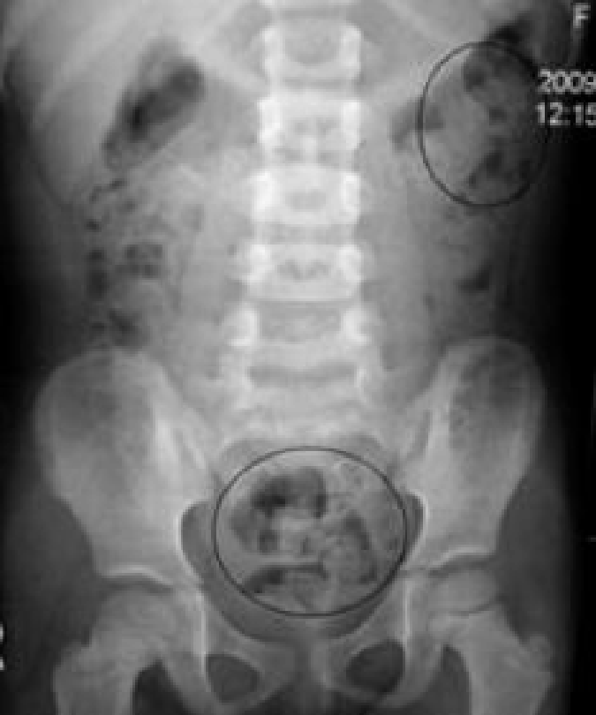
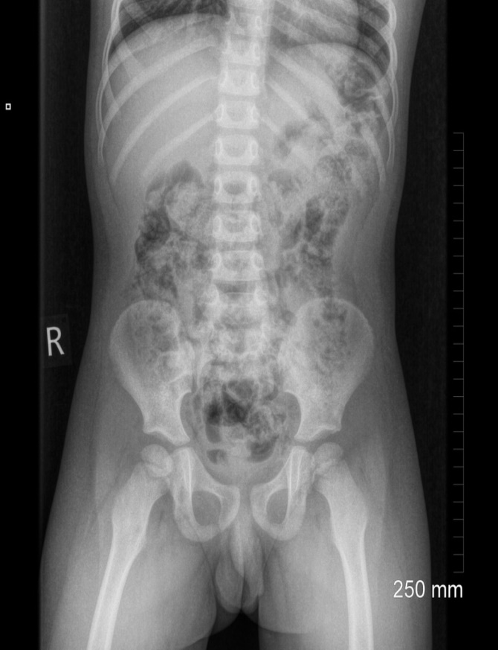
Imaging
Abdominal radiograph:
A plain abdominal radiograph is not indicated for the routine evaluation of functional constipation
Indications:
Inadequate historical information to determine if the patient has constipation
If the physical examination is limited by patient cooperation, obesity
Notes:
An abdominal radiograph can also be useful in assessing the colonic fecal burden among children who are obese or who refuse a rectal examination. It can also be helpful in assessing the efficacy of medical therapy when the child's history is unclear
for the presence of stools

Slide 36
Barium enema
A barium enema provides supportive evidence for Hirschsprung disease in children with features suggestive of this disorder, such as early onset constipation from the neonatal period, especially with delayed passage of meconium, or suggestive findings on anorectal examination (anorectal anomaly).
The study should be performed " unprepared ", i.e, without measures to remove stool from the rectum
By evacuating the colon prior to study, any caliber change may be masked
This transition zone is characteristic of Hirschsprung disease, & rectal manipulation may transiently dilate the narrowed distal segment, causing a false negative result.
Functional constipation  massive amounts of stool, no transition zone.
Hirschsprung disease transition zone, delayed evacuation (>24 hours).

Slide 37
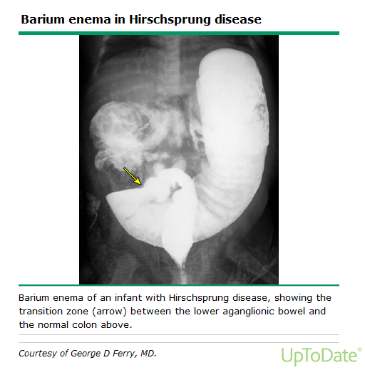

Slide 38
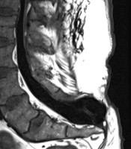
Spine radiographs
Just if the presence of suggestive Hx and PE
Plain films of the lumbosacral spine should be performed for children with evidence of spinal dysraphism or neurological impairment of the perianal area or lower extremities.
If there is a high suspicion of neurologic dysfunction, magnetic resonance imaging (MRI) should be considered to investigate the possibility of tethered cord and spinal cord tumors
Sacral spinal dysraphism with meningiocele

Slide 39
Laboratory tests
Its suggested at the time of the initial evaluation in patients with signs or symptoms of an organic cause of constipation
cow's milk allergy - consider elimination diet or allergy testing (specific IgE antibodies to cow’s milk) .
celiac disease - perform serologic testing with immunoglobulin A tissue transglutaminase antibody (tTG), consider endoscopy .
Metabolic conditions:
thyroid disease - thyroxine (T4) or thyroid stimulating hormone (TSH) .
hypercalcemia - serum calcium levels .
Urine analysis and culture – For children with a history of rectosigmoid impaction, especially in association with encopresis.

Slide 40
Motility testing
Motility testing is typically considered in patients who have no obvious organic cause of constipation and who fail to respond to vigorous treatment of functional constipation. So mainly used in patients with intractable constipation before considering surgical methods.
Anorectal manometry
Colon transit studies

Slide 41
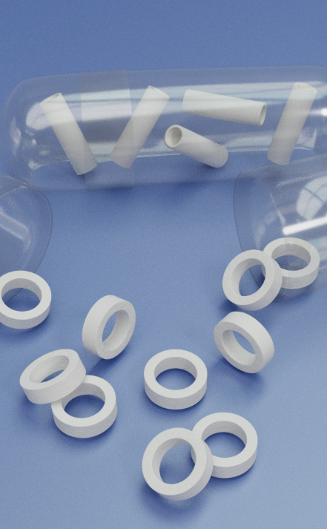
Colon transit studies
A colonic transit study is not helpful for the routine evaluation of a child with constipation
may be used to discriminate between functional constipation and functional nonretentive fecal incontinence or in cases of unclear diagnosis
Using radio-opaque markers (Sitzmark capsules) or scintigraphy techniques, One of the easiest techniques is to have the child swallow a capsule containing 24 radiopaque markers once a day for three days. Plain radiographs are taken on the fourth day (and sometimes also on the seventh day), and analyzed for the number and location of retained markers
generally reserved for the secondary evaluation of selected patients in whom the diagnosis is unclear.

Slide 42
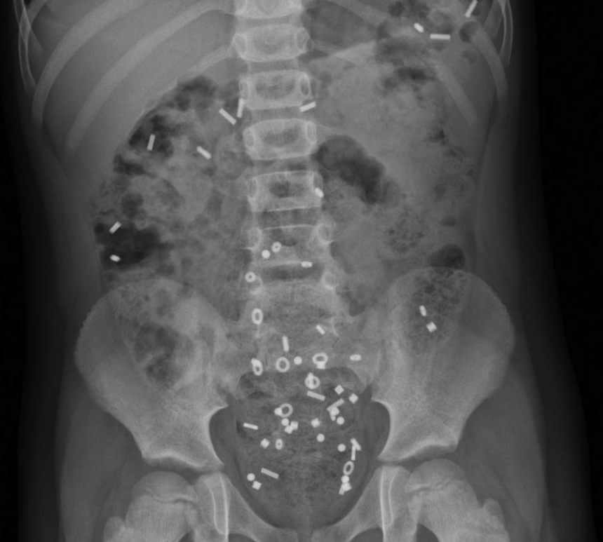
A seven-year-old boy with a delayed colonic transit time. The distribution of the markers, with a majority in the rectosigmoid region, is characteristic for anorectal retention.

Slide 43
Anorectal manometry
involves placement of a catheter containing pressure-transducing sensors into the rectum, thereby permitting measurement of neuromuscular function of the anorectum.
The procedure includes measurements of the rectoanal inhibitory reflex , rectal sensation and compliance, and squeeze pressures.

Slide 44
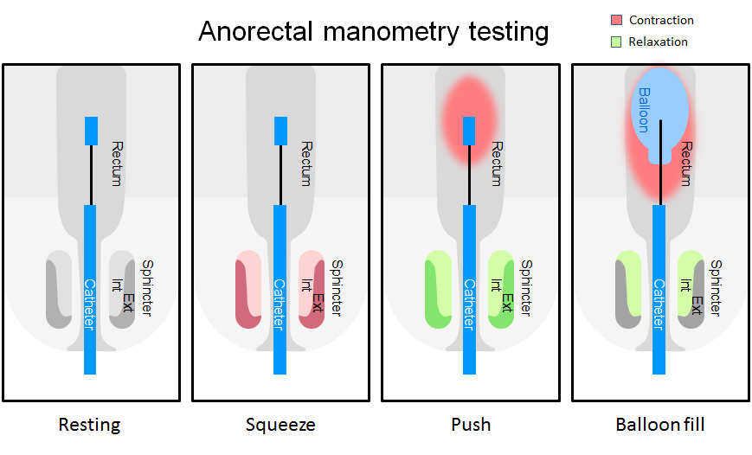
Notes:
Anorectal manometry can be useful in discriminating between functional constipation and Hirschsprung disease. A balloon catheter is inserted into the rectum during this test.
The procedure includes measurements of the rectoanal inhibitory reflex , rectal sensation and compliance, and squeeze pressures.
Normally, when the rectal balloon is inflated, the internal anal sphincter relaxes reflexively (anorectal reflex)
Among patients with Hirschsprung disease, the internal anal sphincter fails to relax in response to rectal distention.

Slide 45
Functional constipation  distension of the rectum causes relaxation of the internal sphincter.
Hirschsprung disease no sphincter relaxation
Anorectal manometry also can identify patients with dyssynergic defecation, which is a functional disorder characterized by the incomplete evacuation of fecal material from the rectum due to paradoxical contraction or failure to relax pelvic floor muscles when straining to defecate.

Slide 46
Rectal biopsy
The definitive means of establishing or excluding Hirschsprung disease.
The tissue is examined histologically for the presence or absence of ganglion cells in the submucosal plexus.

Slide 48
Management of chronic functional constipation
There are four general steps in bowel retraining:
Disimpaction.
Maintenance therapy :Prolonged laxative treatment and behavior therapy to achieve regular evacuation and avoid recurrent constipation.
Dietary changes (primarily increasing fiber content) to maintain soft stools.
Gradual tapering and withdrawal of laxatives as tolerated.

Slide 49
1) Disimpaction
“Fecal impaction” is a term used to describe markedly increased amounts of stool in the colon, which is a subjective judgment based on clinical findings.
- Clues suggest fecal impaction -
Constipation-associated fecal incontinence.
Significant stool mass palpable on digital rectal or abdominal examination, or on abdominal radiograph.
History of incomplete or infrequent evacuation.

Slide 50
Oral medications :
This method is noninvasive and may help the child feel in control. Oral medications also are particularly valuable for children with a history of painful defecation, perineal trauma, or difficulty tolerating enemas.
- Options -
Polyethylene glycol (PEG) without electrolytes, PEG-electrolyte solutions, or high-dose mineral oil have all been shown to be effective for initial disimpaction.
Notes:
The PEG without electrolytes is generally the most palatable of these options and better accepted by children

Slide 51
Polyethylene glycol 3350:
1 to 1.5 g/kg/day by mouth for up to six days. The daily dose is dissolved in approximately 10 mL/kg of water.
Polyethylene glycol-electrolyte solution (eg, GoLYTELY): 25 mL/kg per hour to a maximum of 1000 mL/hr by nasogastric tube until stool appears clear, or 20 mL/kg per hour for four hours per day.
Mineral oil:
3ml/kg per day by mouth. Mineral oil should not be used for infants, neurologically impaired children, and others at high risk for gastroesophageal reflux, because of risks of pneumonitis if the oil is aspirated.
Other oral agents:
Include magnesium hydroxide , magnesium citrate , lactulos, sorbitol, senna, and bisacodyl.
Notes:
The rate of the PEG-electrolyte infusion should be slowed if the child develops vomiting or abdominal distension. Bowel perforation has been reported in children undergoing bowel disimpaction with nasogastric PEG-electrolyte solutions, especially in patients with previous bowel surgeries, who may have unrecognized sub-acute bowel obstruction due to a stricture or an adhesion.

Slide 52
Rectal medications :
For patients with severe impaction, are more rapidly effective than oral medications for disimpaction and may be a powerful motivator for toilet sitting.
Enemas are invasive and may be difficult to administer to an uncooperative or fearful child.
Sodium phosphate enemas, or mineral oil enemas followed by a sodium phosphate enema may be used for rectal disimpaction.

Slide 53
Sodium phosphate enema :
(33 mL) enema for children 2 to <5 years; (66 mL) enema for children 5 to 12 years; and (133 mL) enema for children ≥12 years. This dose may be repeated once within 12 to 24 hours, if necessary.
Saline enema:
This can be administered using a dose of 10 to 15 mL per kg.
Mineral oil enema:
(66 mL) enema for children 2 to 12 years of age, and (133 mL) enema for children ≥12 years.
Bisacodyl suppositories:
May be used for older children, and glycerin suppositories for infants.
Notes:
several case reports of life-threatening hyperphosphatemia and hypocalcemic tetany, particularly in young children, those with colonic dysmotility, and/or with repeated administration of enemas [45-48]. Phosphate-based enemas should be avoided in children with renal insufficiency

Slide 54
Oral and rectal — Combination treatment with oral and rectal medications is often the most effective approach for moderate or severe fecal impaction
Notes:
the initial treatment is with oral medication to soften the stool, and rectal medication is added on day two to help evacuate the impacted stool. An alternative combination approach consists of three to four consecutive three-day cycles in which a phosphate sodium enema is administered on day one, a bisacodyl suppository on day two, and bisacodyl tablet (10 mg) on day three [5,24].

Slide 55
2) Maintenance
Laxatives:
After disimpaction, patients should be treated with a maintenance regimen of oral laxatives to “retrain” the bowel and avoid re-impaction.
Adequate doses of medication should be given to maintain a pattern of soft bowel movements once or twice a day.
Polyethylene glycol 3350, magnesium hydroxide (milk of magnesia), lactulose, and mineral oil.

Slide 56
Parents should be advised to adjust the laxative dose according to the response, and to increase the dose every two days until the child has one or two soft stools each day, or to decrease it if the patient develops diarrhea.
After starting the laxative treatment, parents should be advised to encourage the child to use the toilet for 5 to 10 minutes at the same time each day, preferably after breakfast or dinner.
Notes:
In young children, eliminating any pain associated with the passage of bowel movements is extremely important. Using very large doses of laxatives to produce very soft stools may be necessary.

Slide 58
The choice of laxative is less important than using an adequate dose and assuring compliance.
The dose should be based upon age, body weight, and severity of constipation.

Slide 59
Behavior modification
Is used to recondition the child to normal bowel habits.
Toilet-sitting :The child should sit on the toilet shortly after a meal, for 5 to 10 minutes, two to three times per day Toilet sitting episodes should occur at the same time each day and be timed with a timer or stopwatch.

Slide 60
3) Dietary changes
Fiber:
Increasing the intake of fiber, through dietary changes or fiber supplements, is often recommended for acute and chronic constipation.
For children with acute or mild chronic constipation, a reasonable target for dietary fiber can be calculated as the child’s age plus 5 to 10 grams/day (ie, 11 to 16 grams/day for a six year old child).
Notes:
For children with acute or mild chronic constipation, a reasonable target for dietary fiber can be calculated as the child’s age plus 5 to 10 grams/day (ie, 11 to 16 grams/day for a six year old child).

Slide 61
Fluid intake:
There is no evidence that constipation can be successfully treated by increasing fluid intake unless the patient is clinically dehydrated.
Children with chronic constipation or fecal incontinence should be encouraged to consume at least (960 to 1920 mL) of water or other non-milk liquids per day, particularly if they are using fiber supplements.

Slide 62
Cow's milk:
In children whose constipation is unresponsive to other measures, and especially in those with atopic symptoms, we suggest a trial for at least two-weeks of eliminating all cow's milk protein from the diet.
Switching the patient to a low-iron formula is not necessary, as several studies have shown that ingestion of iron-supplemented formulas is not associated with an increased incidence of constipation.

Slide 63
Follow-up
After entering the maintenance phase, the child should have regular follow-up visits, initially on a monthly basis and then less frequently (eg, every three to four months). The clinician should review the child's stool records and repeat the abdominal and rectal examinations.

Slide 64
DISCONTINUATION OF LAXATIVES
The goal of therapy is passage of soft normal caliber stools every one to two days, without fecal incontinence.
Once the child has achieved regular bowel habits (and independently uses the toilet), the frequency of mandatory toilet sitting and the use of laxatives can be reduced.
The laxative dose is gradually decreased to a dose that will prevent soiling, and maintain one to two bowel movements per day.
Typically wait until optimal bowel habits are achieved and stable for at least six months before laxative use is further decreased.
Notes:
In many cases, laxatives need to be taken for months and sometimes years to induce daily soft stools

Slide 65
TREATMENT FAILURE
Failure of treatment, manifested by continued soiling and recurrent impaction.
Most treatment failures are caused by inadequate medication or premature discontinuation.
Repeated failure despite adequate compliance requires reconsideration of the diagnosis and the possibility of further testing.

Slide 66
SURGERY
Anal sphincter release:
Some children with constipation refractory to medical therapy may respond to an intervention to release the internal anal sphincter through myectomy or injection of botulinum toxin.

Slide 67
Acute episodes of constipation
Children:
Usually be treated with dietary changes, including increasing fiber and ensuring adequate fluid intake if the symptoms are mild.
For those with stool withholding behavior, pain while defecating, rectal bleeding or anal fissure, Suggestion for initial treatment with an osmotic or lubricant laxative, rather than dietary intervention alone.

Slide 68
Infants:
Treated by the addition of undigestible, osmotically active carbohydrates to the formula, such as sorbitol-containing juices (eg, apple, prune, or pear).
For infants who have begun solid foods, sorbitol-containing fruit can be used.
Glycerin suppositories or rectal stimulation with a lubricated rectal thermometer can be used occasionally if there is very hard stool in the rectum, but should not be used frequently.

Slide 69
In infants older than six months who have ongoing or recurrent constipation despite dietary interventions, osmotic laxatives such as lactulose or PEG3350 may be required. Infants with severe or recurrent constipation, especially those with constipation from birth, should be carefully evaluated for possible organic causes.

Slide 70
THANK YOU

