Slide 1
Peripheral Nervous System
THE EYEBALL
Dr. Aiman Qais Afar
Surgical Anatomist
College of Medicine / University of Mutah
2022-2023

Slide 2
Eyeball
The eyeball contains the optical apparatus of the visual system. It occupies most of the anterior portion of the orbit, suspended by six extrinsic muscles that control its movements, and a fascial suspensory apparatus
It measures approximately 25 mm in diameter.
All anatomical structures within the eyeball have a circular or spherical arrangement

Slide 3
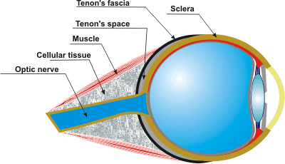
Eyeball
The eyeball proper has three layers; however, there is an additional connective tissue layer that surrounds the eyeball, supporting it within the orbit.
The connective tissue layer is composed posteriorly of the fascial sheath of the eyeball (bulbar fascia or Tenon capsule), which forms the actual socket for the eyeball, and anteriorly of bulbar conjunctiva

Slide 4
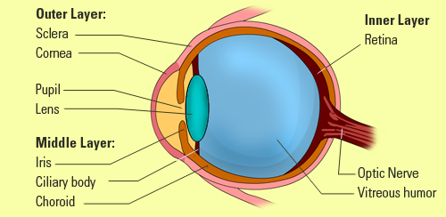
Eyeball
The fascial sheath is the most substantial portion of the suspensory apparatus.
A very loose connective tissue layer, the episcleral space (a potential space), lies between the fascial sheath and the outer layer of the eyeball, facilitating movements of the eyeball within the fascial sheath (Tenon space).
The three layers of the eyeball are the:
1. Fibrous layer (outer coat), consisting of the sclera and cornea
2. Vascular layer (middle coat), consisting of the choroid, ciliary body, and iris
3. Inner layer (inner coat), consisting of the retina, which has both optic and nonvisual parts

Slide 5
Eyeball
1. FIBROUS LAYER OF EYEBALL
The fibrous layer of the eyeball is the external fibrous skeleton of the eyeball, providing shape and resistance. The sclera is the tough opaque part of the fibrous layer (coat) of the eyeball, covering the posterior five sixths of the eyeball and providing attachment for both the extrinsic (extra-ocular) and the intrinsic muscles of the eye

Slide 6
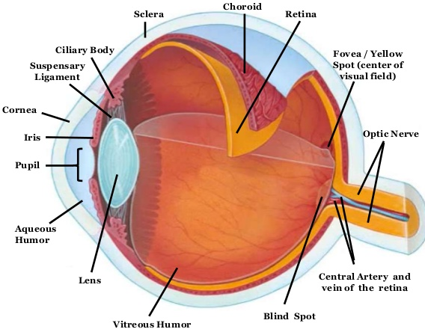
1. FIBROUS LAYER OF EYEBALL
The anterior part of the sclera is visible through the transparent bulbar conjunctiva as “the white of the eye” .
The cornea is the transparent part of the fibrous layer covering the anterior one sixth of the eyeball.
The convexity of the cornea is greater than that of the sclera and so it appears to protrude from the eyeball when viewed laterally.

Slide 7
1. FIBROUS LAYER OF EYEBALL
Whereas the sclera is relatively avascular, the cornea is completely avascular, receiving its nourishment from capillary beds around its periphery and fluids on its external and internal surfaces, the lacrimal fluid and aqueous humor, respectively .
Lacrimal fluid also provides oxygen absorbed from the air

Slide 8
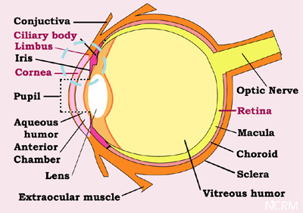
1. FIBROUS LAYER OF EYEBALL
The cornea is highly sensitive to touch; its innervation is provided by the ophthalmic nerve (CN V1). Even very small foreign bodies (e.g., dust particles) elicit blinking, flow of tears, and sometimes severe pain. Drying of the corneal surface may cause ulceration
The limbus of the cornea is the angle formed by the intersecting curvatures of sclera and cornea at the corneoscleral Junction.
The junction is a 1-mm wide, gray, and translucent circle including numerous capillary loops involved in nourishing the avascular cornea.

Slide 9
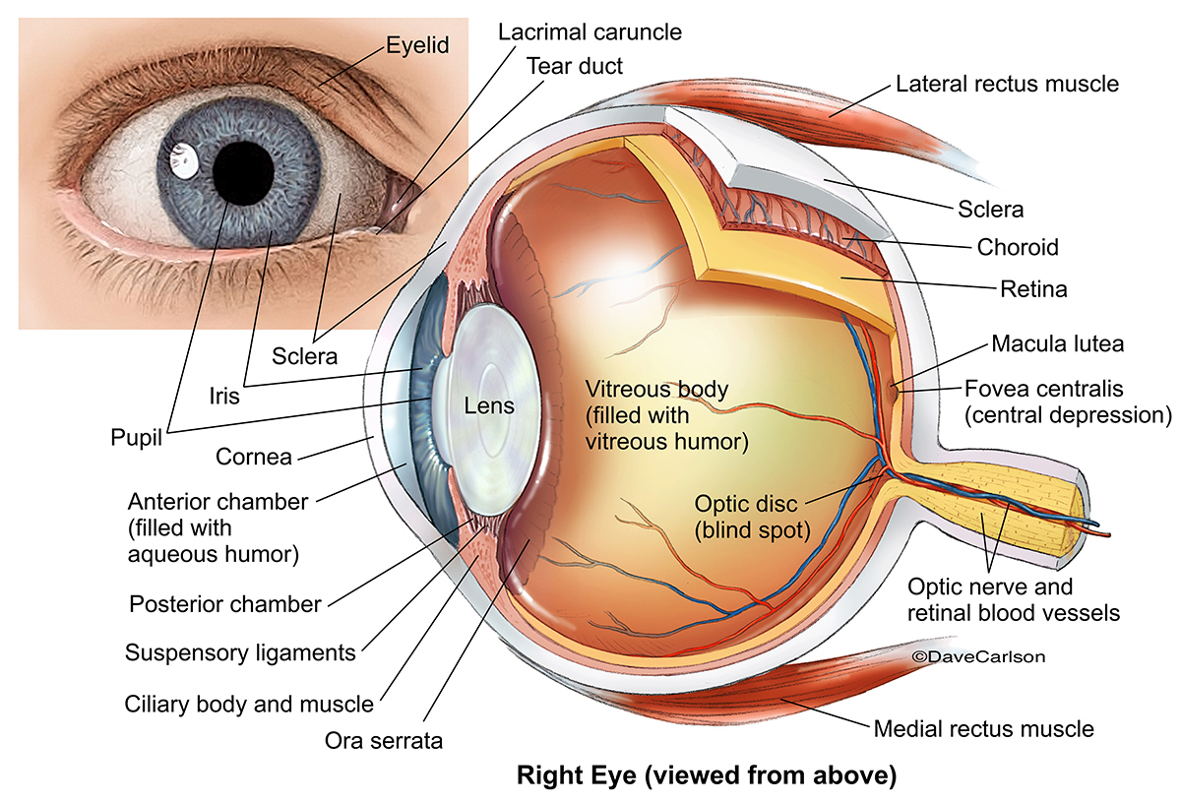
2. VASCULAR LAYER OF EYEBALL
The vascular layer of the eyeball (also called the uvea or uveal tract) consists of the choroid, ciliary body, and iris.
The choroid, a dark reddish-brown layer between the sclera and the retina, forms the largest part of the vascular layer of the eyeball and lines most of the sclera.
Within this pigmented and dense vascular bed, larger vessels are located externally (near the sclera).

Slide 10
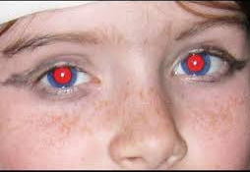
2. VASCULAR LAYER OF EYEBALL
The finest vessels (the capillary lamina of the choroid or choriocapillaris, an extensive capillary bed) are innermost, adjacent to the avascular light-sensitive layer of the retina, which it supplies with oxygen and nutrients. Engorged with blood in life (it has the highest perfusion rate per gram of tissue of all vascular beds of the body),
this layer is responsible for the “red eye” reflection that occurs in flash photography

Slide 11
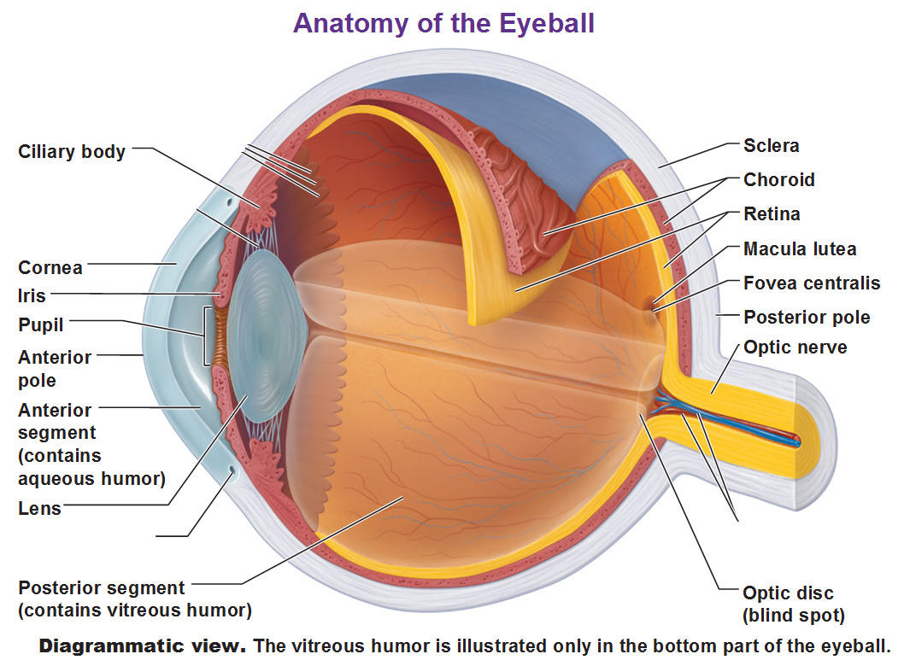
2. VASCULAR LAYER OF EYEBALL
The ciliary body is a ring-like thickening of the layer posterior to the corneoscleral junction that is muscular as well as vascular.
It connects the choroid with the circumference of the iris.
The ciliary body provides attachment for the lens.
The contraction and relaxation of the circularly arranged smooth muscle of the ciliary body controls thickness, and therefore the focus, of the lens.

Slide 12
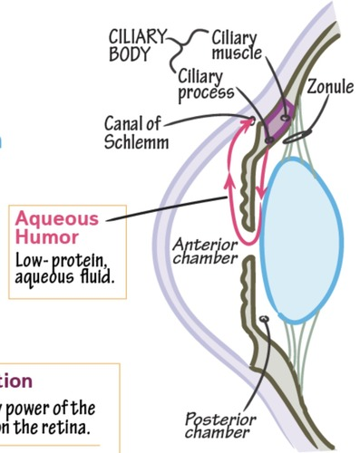
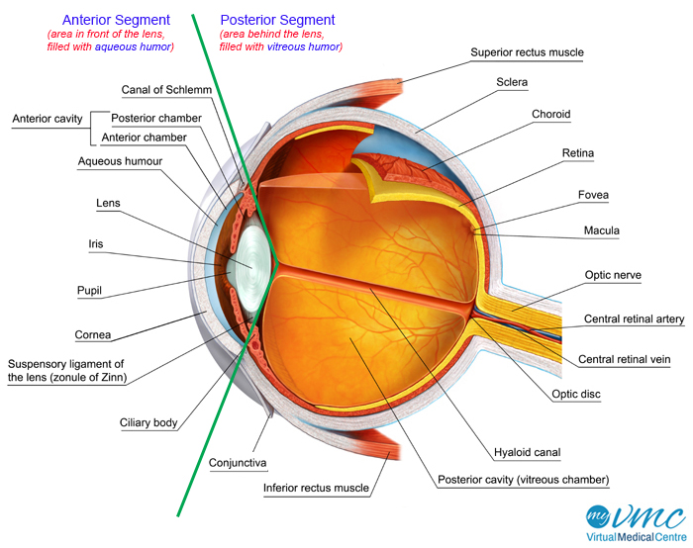
2. VASCULAR LAYER OF EYEBALL
Folds on the internal surface of the ciliary body, the ciliary processes, secrete aqueous humor.
Aqueous humor fills the anterior segment of the eyeball, the interior of the eyeball anterior to the lens, suspensory ligament, and ciliary body .

Slide 13
2. VASCULAR LAYER OF EYEBALL
The iris, which literally lies on the anterior surface of the lens, is a thin contractile diaphragm with a central aperture, the pupil, for transmitting light .
When awake, the size of the pupil varies continually to regulate the amount of light entering the eye

Slide 14
2. VASCULAR LAYER OF EYEBALL
Two involuntary muscles control the size of the pupil:
the parasympathetically stimulated, circularly arranged sphincter pupillae decreases its diameter ( constrict or contracts the pupil, pupillary miosis)
and the sympathetically stimulated, radially arranged dilator pupillae increases its diameter (dilates the pupil).

Slide 15
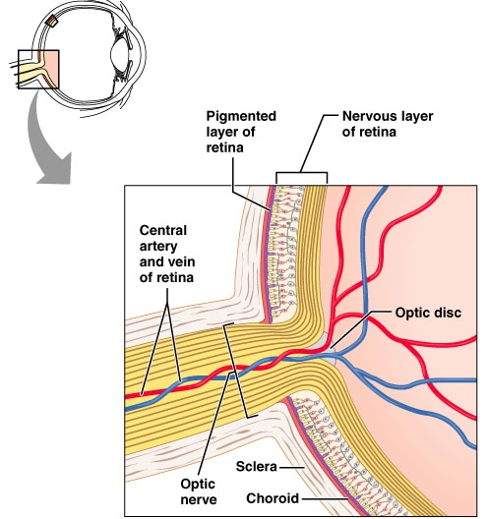
3. INNER LAYER OF EYEBALL
The inner layer of the eyeball is the retina.
It consists grossly of two functional parts with distinct locations: the optic and nonvisual parts.
A. The optic part of the retina;
is sensitive to visual light rays and has two layers:
a neural layer and pigmented layer.

Slide 16
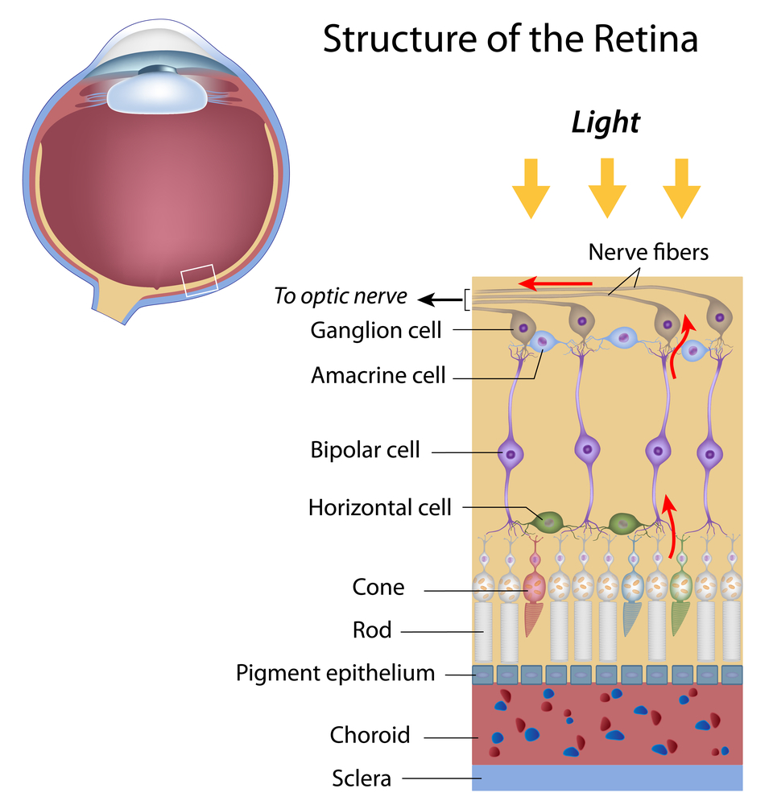
3. INNER LAYER OF EYEBALL
The neural layer is light receptive.
The pigmented layer consists of a single layer of cells that reinforces the light-absorbing property of the choroid in reducing the scattering of light in the eyeball

Slide 17
3. INNER LAYER OF EYEBALL
B. The nonvisual retina is an anterior continuation of the pigmented layer and a layer of supporting cells.
The nonvisual retina extends over the ciliary body (ciliary part of the retina) and the posterior surface of the iris (iridial part of the retina) to the pupillary margin

Slide 18
3. INNER LAYER OF EYEBALL
Clinically, the internal aspect of the posterior part of the eyeball, where light entering the eyeball is focused, is referred to as the fundus of the eyeball (ocular fundus).
The retina of the fundus includes a distinctive circular area, the optic disc (optic papilla), where the sensory fibers and vessels conveyed by the optic nerve (CN II) enter and radiate to the eyeball.

Slide 19
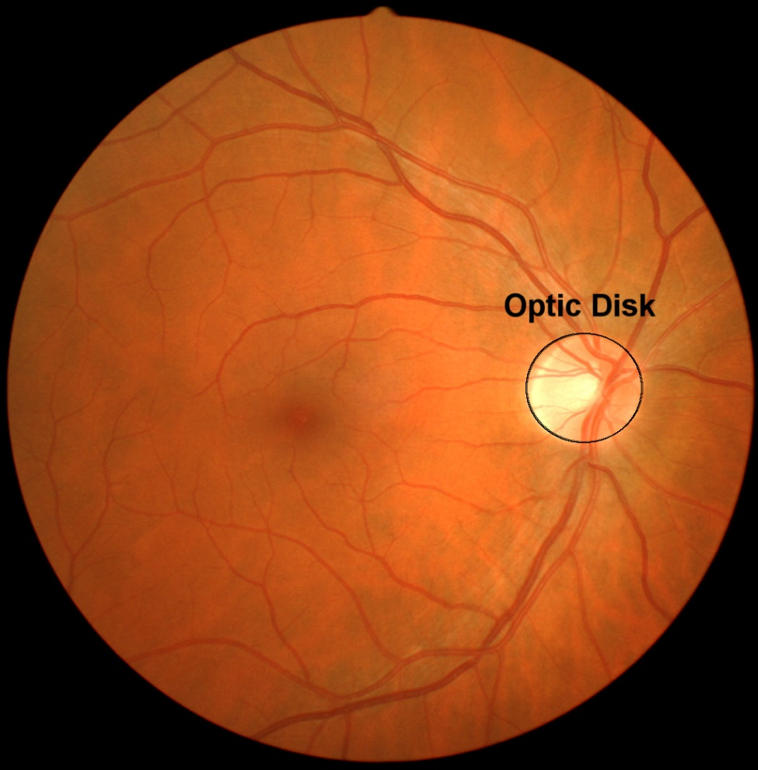
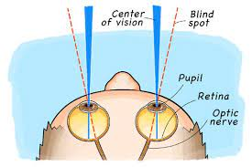
3. INNER LAYER OF EYEBALL
Because it contains no photoreceptors, the optic disc is insensitive to light. Hence, it is commonly called the blind spot.

Slide 20
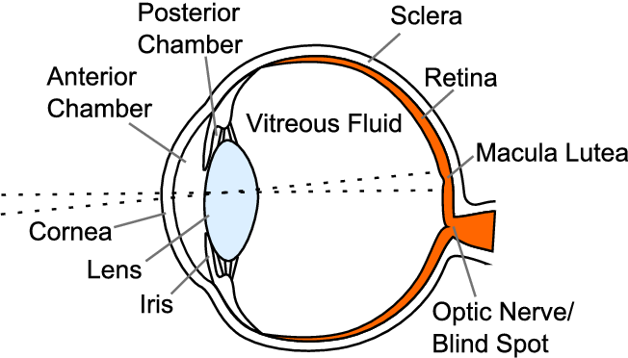
3. INNER LAYER OF EYEBALL
Just lateral to the optic disc is the macula of the retina or macula lutea (L. yellow spot). The yellow color of the macula is apparent only when the retina is examined with red-free light.
The macula lutea is a small oval area of the retina with special photoreceptor cones that is specialized for acuity of vision.
It is not normally observed with an ophthalmoscope

Slide 21
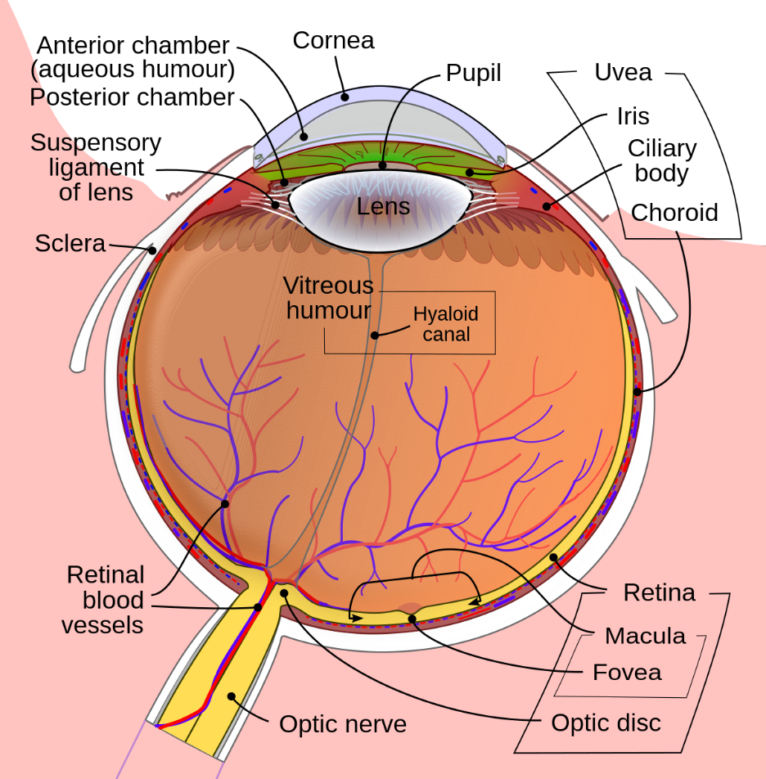
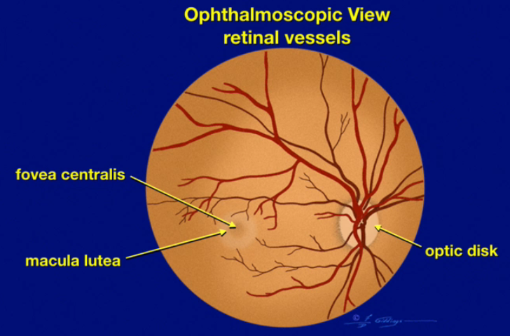
3. INNER LAYER OF EYEBALL
At the center of the macula lutea is a depression, the fovea centralis (L. central pit), the area of most acute vision.
The fovea is approximately 1.5 mm in diameter; its center, the foveola, does not have the capillary network visible elsewhere deep to the retina.

Slide 22
3. INNER LAYER OF EYEBALL
The optic part of the retina terminates anteriorly along the ora serrata (L. serrated edge), the irregular posterior border of the ciliary body
Except for the cones and rods of its neural layer, the retina is supplied by the central retinal artery, a branch of the ophthalmic artery.

Slide 23
Ophthalmoscopy
Physicians view the fundus (inner surface of the posterior part) of the eye with an ophthalmoscope.
The retinal arteries and veins radiate over the fundus from the optic disc. The pale, oval optic disc appears on the medial side, with retinal vessels radiating from its center in the ophthalmoscopic view of the retina
Pulsation of the retinal arteries is usually visible.
Centrally, at the posterior
pole of the eyeball, the macula lutea appears darker than the reddish hue of surrounding areas of the retina.

Slide 24
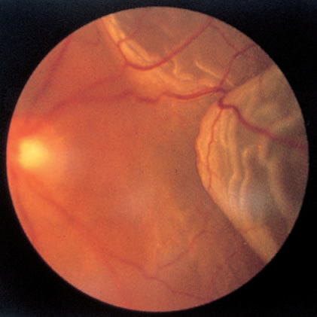
Detachment of Retina
The layers of the developing retina are separated in the embryo by an intraretinal space. During the early fetal period, the embryonic layers fuse, obliterating this space. Although the pigment cell layer becomes firmly fixed to the choroid, its attachment to the neural layer is not firm.
Consequently, detachment of the retina may follow a blow to the eye.
A detached retina usually results from
seepage of fluid between the neural and pigmented layers of the retina, perhaps days or even weeks after trauma to the eye.
People with a retinal detachment may complain of flashes of light or specks floating in front of their eye.

Slide 25
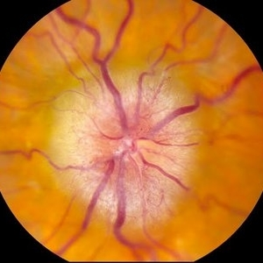
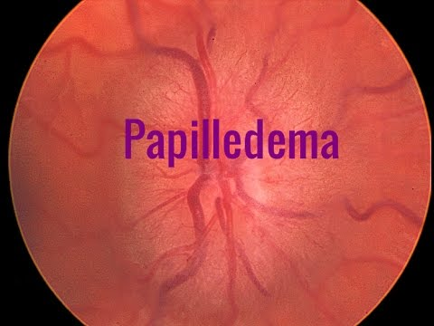
Papilledema
An increase in CSF pressure slows venous return from the retina, causing edema of the retina (fluid accumulation). The edema is viewed during ophthalmoscopy as swelling of the optic disc, a condition called papilledema.

Slide 26
Eyeball

Slide 27
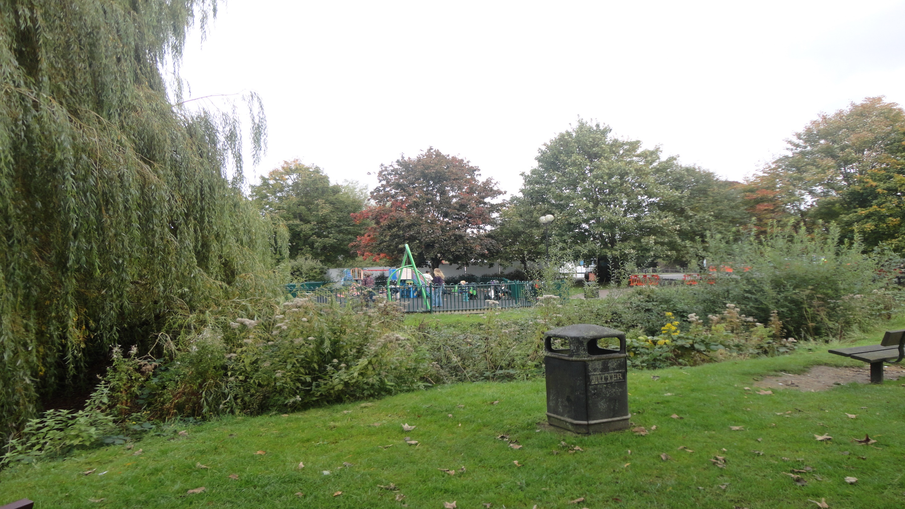
Dr. Aiman Qais Afar
Wednesday 8 March 2023

