Slide 1
Dysbarism
Dysbarism is the collective term used to describe the pathological changes that occur when the human body is exposed to altered environmental pressure (rapid changes) and from the resulting abnormal behavior of gases in the body.
The inverse relationship between the pressure and the volume of a gas explain the change of gas volume inside the body with changes in environmental pressure.
The ambient pressure which we normally reside is defined (at sea level) as, one atmosphere of barometric pressure (760 mmHg at 33 feet or 10 meter of sea water). Hyperbaric exposures add to ambient pressure and hypobaric exposures subtract from it.
The risk of dysbaric disorders can be reduced if the altered pressure to which an individual is exposed be Gradually Returned to normal according to recommended schedules.

Slide 2
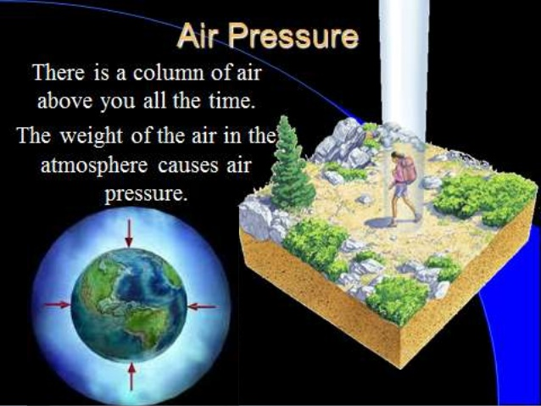

Slide 4
Nitrogen Narcosis (Inert Gas Narcosis):
It occurs most commonly in deep diving while breathing compressed air, it also occurs with other inert gases (e.g. hydrogen because of their Lipid Solubility and thus the condition is called also inert gas narcosis.
The resultant increase in partial pressure of inert gas (e.g. nitrogen) in compressed air generates additional nitrogen load which due to its lipid solubility and the well perfusion of brain tissue, easily saturates the brain exerting its narcotic effect.
The narcotic effect begins at depth 20 - 30m (3 - 4 ATA)* causing symptoms quite similar to alcohol intoxication called rapture of the depth متعة ,: سكر الأعماق characterized by:
Euphoria. سعادة وانتعاش
Impaired judgment & intellectual functions. قدرات ذهنية
Incoordination of neuromuscular functions and performance.
*The ATA is an acronym for atmospheres absolute and is defined to be one standard atmosphere of pressure at sea level

Slide 5
At depth of 90 meters (10 ATA) loss of consciousness occurs & the risk of drowning accidents and death is very high.
The narcotic effect is believed to be exacerbated by: Cold Water - Hypercarbia (↑ CO2) - Strenuous Activity & Fatigue & Alcohol Consumption
Upon decompression during ascent rapid and complete recovery occurs.
High – Pressure Nervous Syndrome (HPNS):
It occurs when breathing mixtures of compressed helium, oxygen was used to allow deep dives (exceeding depth of 100 meters) while avoiding the development of nitrogen narcosis.
The syndrome is due to the effect of high pressure by itself. The pathogenesis of this effect is still unclear, but it is supposed to be due to disturbances in neurotransmission :This will lead to N.S hyperexcitibility.

Slide 6
HPNS is characterized clinically by hyperexcitibility of the central nervous system that lead to: Euphoria - Headache, vertigo, nausea, vomiting,- Tremors, Hypereflexia
- Sleeping disturbances with a wake periods at 300m (30 ATA).
Barotrauma:
The 2nd leading cause of death in divers during ascent due to pulmonary complications (they call it bubble trouble). The primary (First Leading) cause of death is drowning due to nitrogen narcosis.
Barotrauma may occur during ascent or descent whenever a gas filled space such as pulmonary alveoli, middle ear, Para nasal sinuses, stomach or dental fillings, fail to equalize its internal pressure relative to changes in ambient pressure.

Slide 7
Barotrauma Of Descent (referred to as squeeze are characterized clinically by: Middle ear squeeze, Para nasal and sinus squeeze, Inner ear squeeze
Barotrauma Of Ascent (referred to reverse squeeze) are characterized by:
N.B. Prevention of barotraumas of descent can be accomplished by use of systemic or local decongestants & anti-inflammatory corticosteroids sprays.
Pneumothorax | Arterial Gas Embolism
Subcutaneous Emphysema | Gastric Rupture
Pneumopericardium | Pneumomediastinum

Slide 8
Arterial Gas Embolism (AGE):
AGE and DCS (decompression sickness) share similar pathophysiology (formation of arterial gas bubbles and treatment (recompression).
Clinically there are two main presentation of AGE
Isolated central nervous system (CNS) symptoms.
Cardiovascular collapse. (sudden effect)
CNS symptoms:
Symptoms & signs occur immediately upon surfacing.
Brain is the most frequent target (in contrast to DCS).
Embolization affects multiple brain arteries & this explains. the diversity of neurological clinical finding which include:
Vertigo, confusion and faintness.
Signs rapidly progress from sensory disturbances and aphasia to hemiplegia, cortical blindness, gas in retinal arteries, convulsions & coma.

Slide 9
5% of individuals die but 60% improve within minutes after recompression, but 30% frequently relapse.
All individuals who have suffered AGE should permanently refrain from diving.
Decompression sickness : (2nd cause of death)
Decompression sickness (DCS) results from mechanical & physiopathologic effect of expanding gases & bubbles in blood & tissue.
Bubbles occur intra & extravascularly and even intracellularly. The high fat content of nervous tissue combined with the low fluid solubility of N2 may account for its vulnerability to bubble formation.
DCS occurs upon return from a hyperbaric (e.g. during diver's ascent) or from a hypobaric exposure i.e. barotrauma of ascent (e.g. hypobaric or altitude DCS in aviators).

Slide 11
When the body is exposed to an environment of higher than atmospheric gas pressure as in tunneling or diving, it absorbs more of the inhaled gases than it does at sea level. N2 concentration in tissues increases particularly those of the nervous system, bone marrow & fat.
N2 enters & leaves these tissues more slowly than O2 & CO2 as the surrounding pressure decrease (during rapid decompression), N2 expands & will form gas bubbles because of the absence of sufficient time necessary for dissolution by diffusion from the tissues. Because O2 & CO2 have greater fluid solubility & move easily between tissue compartments, then tendency for bubble formation is reduced.
Multiple organ involvement is more frequent in DCS than in barotraumas of ascent. While in the latter signs & symptoms and that of arterial gas embolism, occur sudden & immediate on surfacing; while DCS symptoms frequently delay for 6- 48hours.

Slide 12
DCS is classified into 2 types and a late 3rd type of chronic complication of dysbaric osteonecrosis.
The types (type I & II) and severity of symptoms depend on age, weight, and physical condition of the patient, the degree of physical exertion, the depth or altitude before decompression & the rate & duration of decompression.
Type I DCS ( bone and skin) has the best prognosis & is ChCh by:
Acute pain usually around major joints. It usually occur either soon after decompression or delay up to 12hours after.
Skin may show urticarial and blush-red mottling & itching (diver's lice).
Type II DCS primarily neurological including spinal, vestibular, cerebral involvement & other systemic symptoms

Slide 14
The typical presentation of DCS in CNS begins with transient back pain. Subsequently, parasthesia & hypoesthesia develop in legs.
Without medical intervention this situation progress to urinary retention, paresis of lower limb and even paralysis, impaired speech, tremors & convulsions, coma.
Pulmonary System Effects:
In most cases of DCS, no pulmonary symptoms occur.
The syndrome called "the chokes" by divers, develops in 2-8% of DCS patients & is characterized by paroxysmal cough, dyspnea, and sub sternal chest pain.
Without appropriate therapeutic intervention (Recompression), this syndrome may pass to non-cardiogenic pulmonary edema, circulatory collapse & death.

Slide 15
Inner ear effects:
Inner ear decompression sickness occurs most common when breathing mixture is used for diving.
Symptoms include: Vertigo, tinnitus, Hearing loss
These symptoms are similar to inner ear barotrauma of descent ( squeeze) which on the contrary occur during compression and treatment is the opposite for both conditions (recompression for inner ear DCS, but not for barotrauma of descent).

Slide 16
Type III DCS (Chronic dysbaric osteonecrosis):
Chronic dysbaric osteonecrosis (aseptic necrosis) is a late and chronic complication of exposure to hyperbaric environment (e.g. caisson workers or divers) and rarely occur in aviators exposed to hypobaric environment (barotraumas of ascent).
The lesions develop only in long bones and in sites where fatty bone marrow is found in mature adult.
Treatment DCS cases (and barotrauma of ascent)
Rapid transport of the patient to a recompression facility is the single and most important measure and the probability of recovery decreases with delay. Portable one person decompression chamber is now available for initiation of immediate treatment.

Slide 17
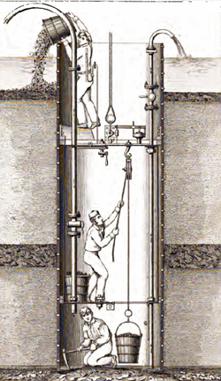
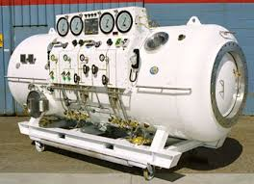
Decompression chamber

Slide 18
The patient is placed in the hyperbaric chamber in an atmosphere of raised pressure. The pressure is then reduced at slow rate, with decompression pressures & schedules determined on the phases of the duration and pressure exposure of the incident. This accompanied by alternating 100% O2 & air breathing or helium O2 mixes.
Recompression pressure causes bubbles to become smaller and breathing pure O2 produces a gradient by which inert gas in bubbles and tissue can diffuse out of the body & thus shortens the period of decompression.
Anti coagulant (heparin) can be given as necessary and symptomatic treatment.

