Slide 1
GASTROINTESTINEAL SYSTEM
THE STOMACH & DUODENUM
Dr. Aiman Q. Afar
Surgical Anatomist
College of Medicine / University of Mutah

Slide 2
Stomach
The stomach is the dilated portion of the alimentary canal
It has a capacity of about 1500 mL
It stores food & mixes the food with gastric secretions, and it controls the rate of delivery of the chyme to the small intestine
The stomach is situated in the upper part of the abdomen, extending from beneath the left costal margin region into the epigastric and umbilical regions

Slide 3
Stomach
It is roughly J-shaped and has two openings, the cardiac and pyloric orifices;
two curvatures, the greater and lesser curvatures; and two surfaces, an anterior and a posterior surface

Slide 4
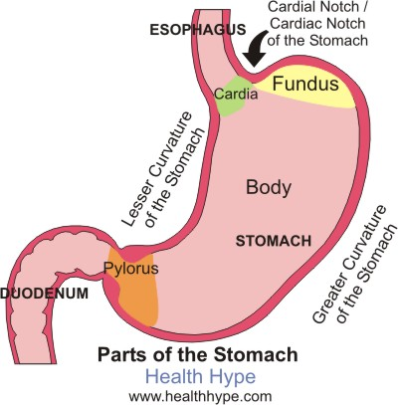
Stomach
The stomach is divided into the following parts
Fundus: This is dome-shaped and projects upward and to the left of the cardiac orifice. It is usually full of gas
Body: This extends from the level of the cardiac orifice to the level of the incisura angularis, a constant notch in the lower part of the lesser curvature .

Slide 5
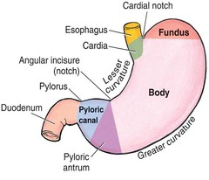
Stomach
Pyloric antrum: This extends from the incisura angularis to the pylorus
Pylorus: This is the most tubular part of the stomach. The thick muscular wall is called the pyloric sphincter, and the cavity of the pylorus is the pyloric canal

Slide 6
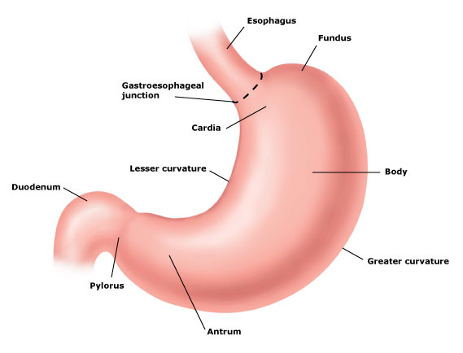
Stomach
The lesser curvature forms the right border of the stomach and extends from the cardiac orifice to the pylorus. It is suspended from the liver by the lesser omentum
The greater curvature is much longer than the lesser curvature and extends from the left of the cardiac orifice, over the dome of the fundus, and along the left border of the stomach to the pylorus

Slide 7
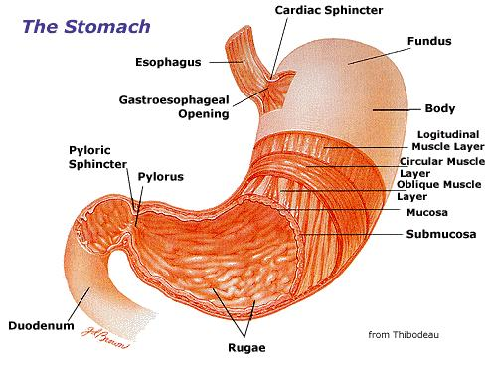
Stomach
The cardiac orifice is where the esophagus enters the stomach. that prevents regurgitation of stomach contents into the esophagus.
The pyloric orifice is formed by the pyloric canal, which is about (2.5 cm) long. The circular muscle coat is much thicker.
The pylorus lies on the transpyloric plane.

Slide 8
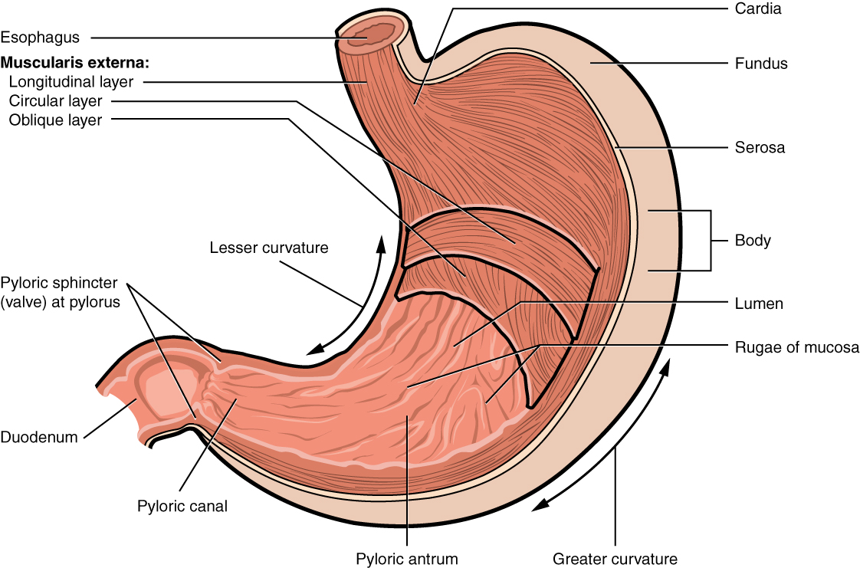
Stomach
The mucous membrane of the stomach is thick and vascular and is thrown into numerous folds, or rugae, that are mainly longitudinal in direction
The muscular wall of the stomach contains longitudinal fibers, circular fibers, and oblique fibers

Slide 9
Stomach
The peritoneum (visceral peritoneum) completely surrounds the stomach. It leaves the lesser curvature as the lesser omentum and the greater curvature as the gastrosplenic omentum and the greater omentum

Slide 10
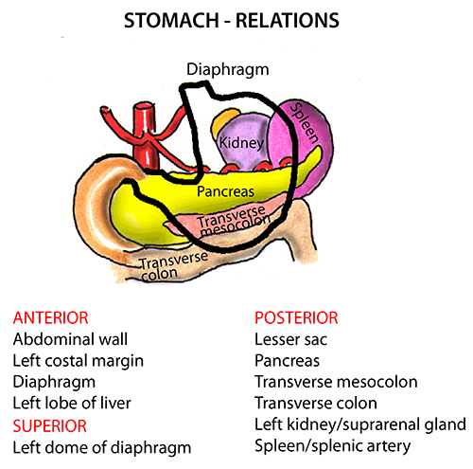
Stomach
Relations
Anteriorly: The anterior abdominal wall, the left costal margin, the left pleura and lung, the diaphragm, and the left lobe of the liver
Posteriorly: The lesser sac, the diaphragm, the spleen, the left suprarenal gland, the upper part of the left kidney, the splenic artery, the pancreas, the transverse mesocolon, and the transverse colon

Slide 11
Stomach
Blood Supply
Arteries
The arteries are derived from the branches of the celiac artery
The left gastric artery
The right gastric artery
The short gastric arteries
The left gastroepiploic artery
The right gastroepiploic artery

Slide 12
Stomach
Veins
The veins drain into the portal circulation.
The left and right gastric veins drain directly into the portal vein.
The short gastric veins and the left gastroepiploic veins join the splenic vein.
The right gastroepiploic vein joins the superior mesenteric vein.

Slide 13
Stomach
Lymph Drainage
The lymph vessels follow the arteries into the left and right gastric nodes, the left and right gastroepiploic nodes, and the short gastric nodes.
All lymph from the stomach eventually passes to the celiac nodes located around the root of the celiac artery on the posterior abdominal wall

Slide 14
Stomach
Nerve Supply
The nerve supply includes sympathetic fibers derived from the celiac plexus and parasympathetic fibers from the right and left vagus nerves
The anterior vagal trunk, which is formed mainly from the left vagus nerve, enters the abdomen on the anterior surface of the esophagus., then divides into branches that supply the anterior surface of the stomach.
A large hepatic branch passes up to the liver, and from this a pyloric branch passes down to the pylorus

Slide 15
Stomach
Nerve Supply
The posterior vagal trunk, which is formed mainly from the right vagus nerve, enters the abdomen on the posterior surface of the esophagus.
The trunk supply mainly the posterior surface of the stomach.
A large branch passes to the celiac and superior mesenteric plexuses

Slide 16
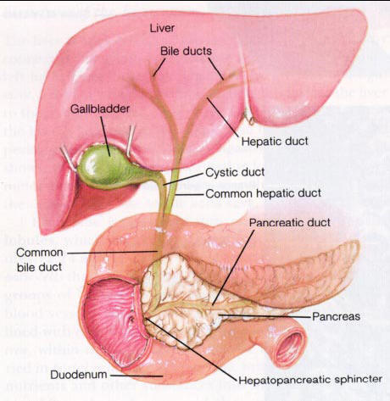
Small Intestine
Duodenum
The duodenum is a C-shaped tube, about 10 in. (25 cm) long, which joins the stomach to the jejunum.
It receives the openings of the bile and pancreatic ducts. The duodenum curves around the head of the pancreas
The first inch (2.5 cm) of the duodenum resembles the stomach in that it is covered on its anterior and posterior surfaces with peritoneum and has the lesser omentum attached to its upper border and the greater omentum attached to its lower border

Slide 17
Duodenum
The remainder of the duodenum is retroperitoneal, being only partially covered by peritoneum.
Parts of the Duodenum
The duodenum is situated in the epigastric and umbilical regions and, for purposes of description, is divided into four parts:

Slide 18
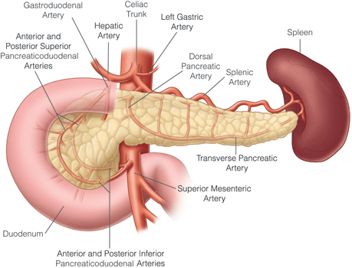
Duodenum
First Part of the Duodenum
begins at the pylorus and runs upward and backward on the transpyloric plane at the level of the first lumbar vertebra.
The relations of this part are as follows:

Slide 19
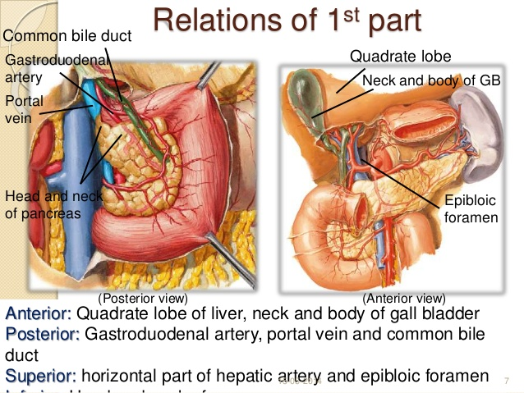
Duodenum
Anteriorly: The quadrate lobe of the liver and the gallbladder
Posteriorly: The lesser sac (first inch only), the gastroduodenal artery, the bile duct and portal vein, and the inferior vena cava.
Superiorly: The entrance into the lesser sac (the epiploic foramen)
Inferiorly: The head of the pancreas.

Slide 20
Duodenum
Second Part of the Duodenum
Runs vertically downward in front of the hilum of the right kidney on the right side of the second and third lumbar vertebrae.

Slide 21
Duodenum
About halfway down its medial border, the bile duct and the main pancreatic duct pierce the duodenal wall
They unite to form the ampulla that opens on the summit of the major duodenal papilla.
The accessory pancreatic duct, if present, opens into the duodenum a little higher up on the minor duodenal papilla.

Slide 22
Duodenum
The relations 2nd part are as follows:
Anteriorly: The fundus of the gallbladder and the right lobe of the liver, the transverse colon, and the coils of the small intestine
Posteriorly: The hilum of the right kidney and the right ureter.

Slide 23
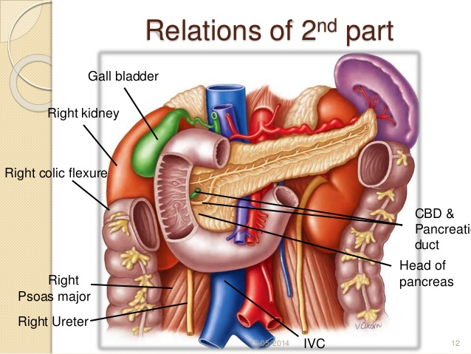
Duodenum
The relations 2nd part are as follows:
Laterally: The ascending colon, the right colic flexure, and the right lobe of the liver.
Medially: The head of the pancreas, the bile duct, and the main pancreatic duct.

Slide 24
Duodenum
Third Part of the Duodenum
Passing in front of the vertebral column and following the lower margin of the head of the pancreas
The relations :
Anteriorly: The root of the mesentery of the small intestine, the superior mesenteric vessels (contained within it), and coils of jejunum.
Posteriorly: The right ureter, the right psoas muscle, the inferior vena cava, and the aorta

Slide 25
Duodenum
Third Part of the Duodenum
Superiorly: The head of the pancreas
Inferiorly: Coils of jejunum

Slide 26
Duodenum
Fourth Part of the Duodenum
runs upward and to the left to the duodenojejunal flexure.
The flexure is held in position by a peritoneal fold, the ligament of Treitz, which is attached to the right crus of the diaphragm.

Slide 27
Duodenum
Fourth Part of the Duodenum
The relations are as follows:
Anteriorly: The beginning of the root of the mesentery and coils of jejunum
Posteriorly: The left margin of the aorta and the medial border of the left psoas muscle

Slide 28
Duodenum
Mucous Membrane and Duodenal Papillae
The mucous membrane of the duodenum is thick. In the first part of the duodenum it is smooth.
In the remainder of the duodenum it is thrown into numerous circular folds called the plicae circulares.

Slide 29
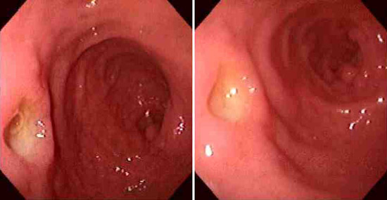
Duodenum
At the site where the bile duct and the main pancreatic duct pierce the medial wall of the second part is a small, rounded elevation called the major duodenal papilla
The accessory pancreatic duct, if present, opens into the duodenum on a smaller papilla about 0.75 in. (1.9 cm) above the major duodenal papilla called minor duodenal papilla.

Slide 30
Duodenum
Blood Supply
Arteries
The upper half is supplied by the superior pancreaticoduodenal artery, a branch of the gastroduodenal artery.
The lower half is supplied by the inferior pancreaticoduodenal artery, a branch of the superior mesenteric artery.
Veins
The superior pancreaticoduodenal vein drains into the portal vein
The inferior vein joins the superior mesenteric vein .

Slide 31
Duodenum
Lymph Drainage
The lymph vessels follow the arteries and drain upward via pancreaticoduodenal nodes to the gastroduodenal nodes and then to the celiac nodes and
Downward via pancreaticoduodenal nodes to the superior mesenteric nodes around the origin of the superior mesenteric artery.
Nerve Supply
The nerves are derived from sympathetic from the celiac and superior mesenteric plexuses and parasympathetic (vagus) nerves

Slide 32
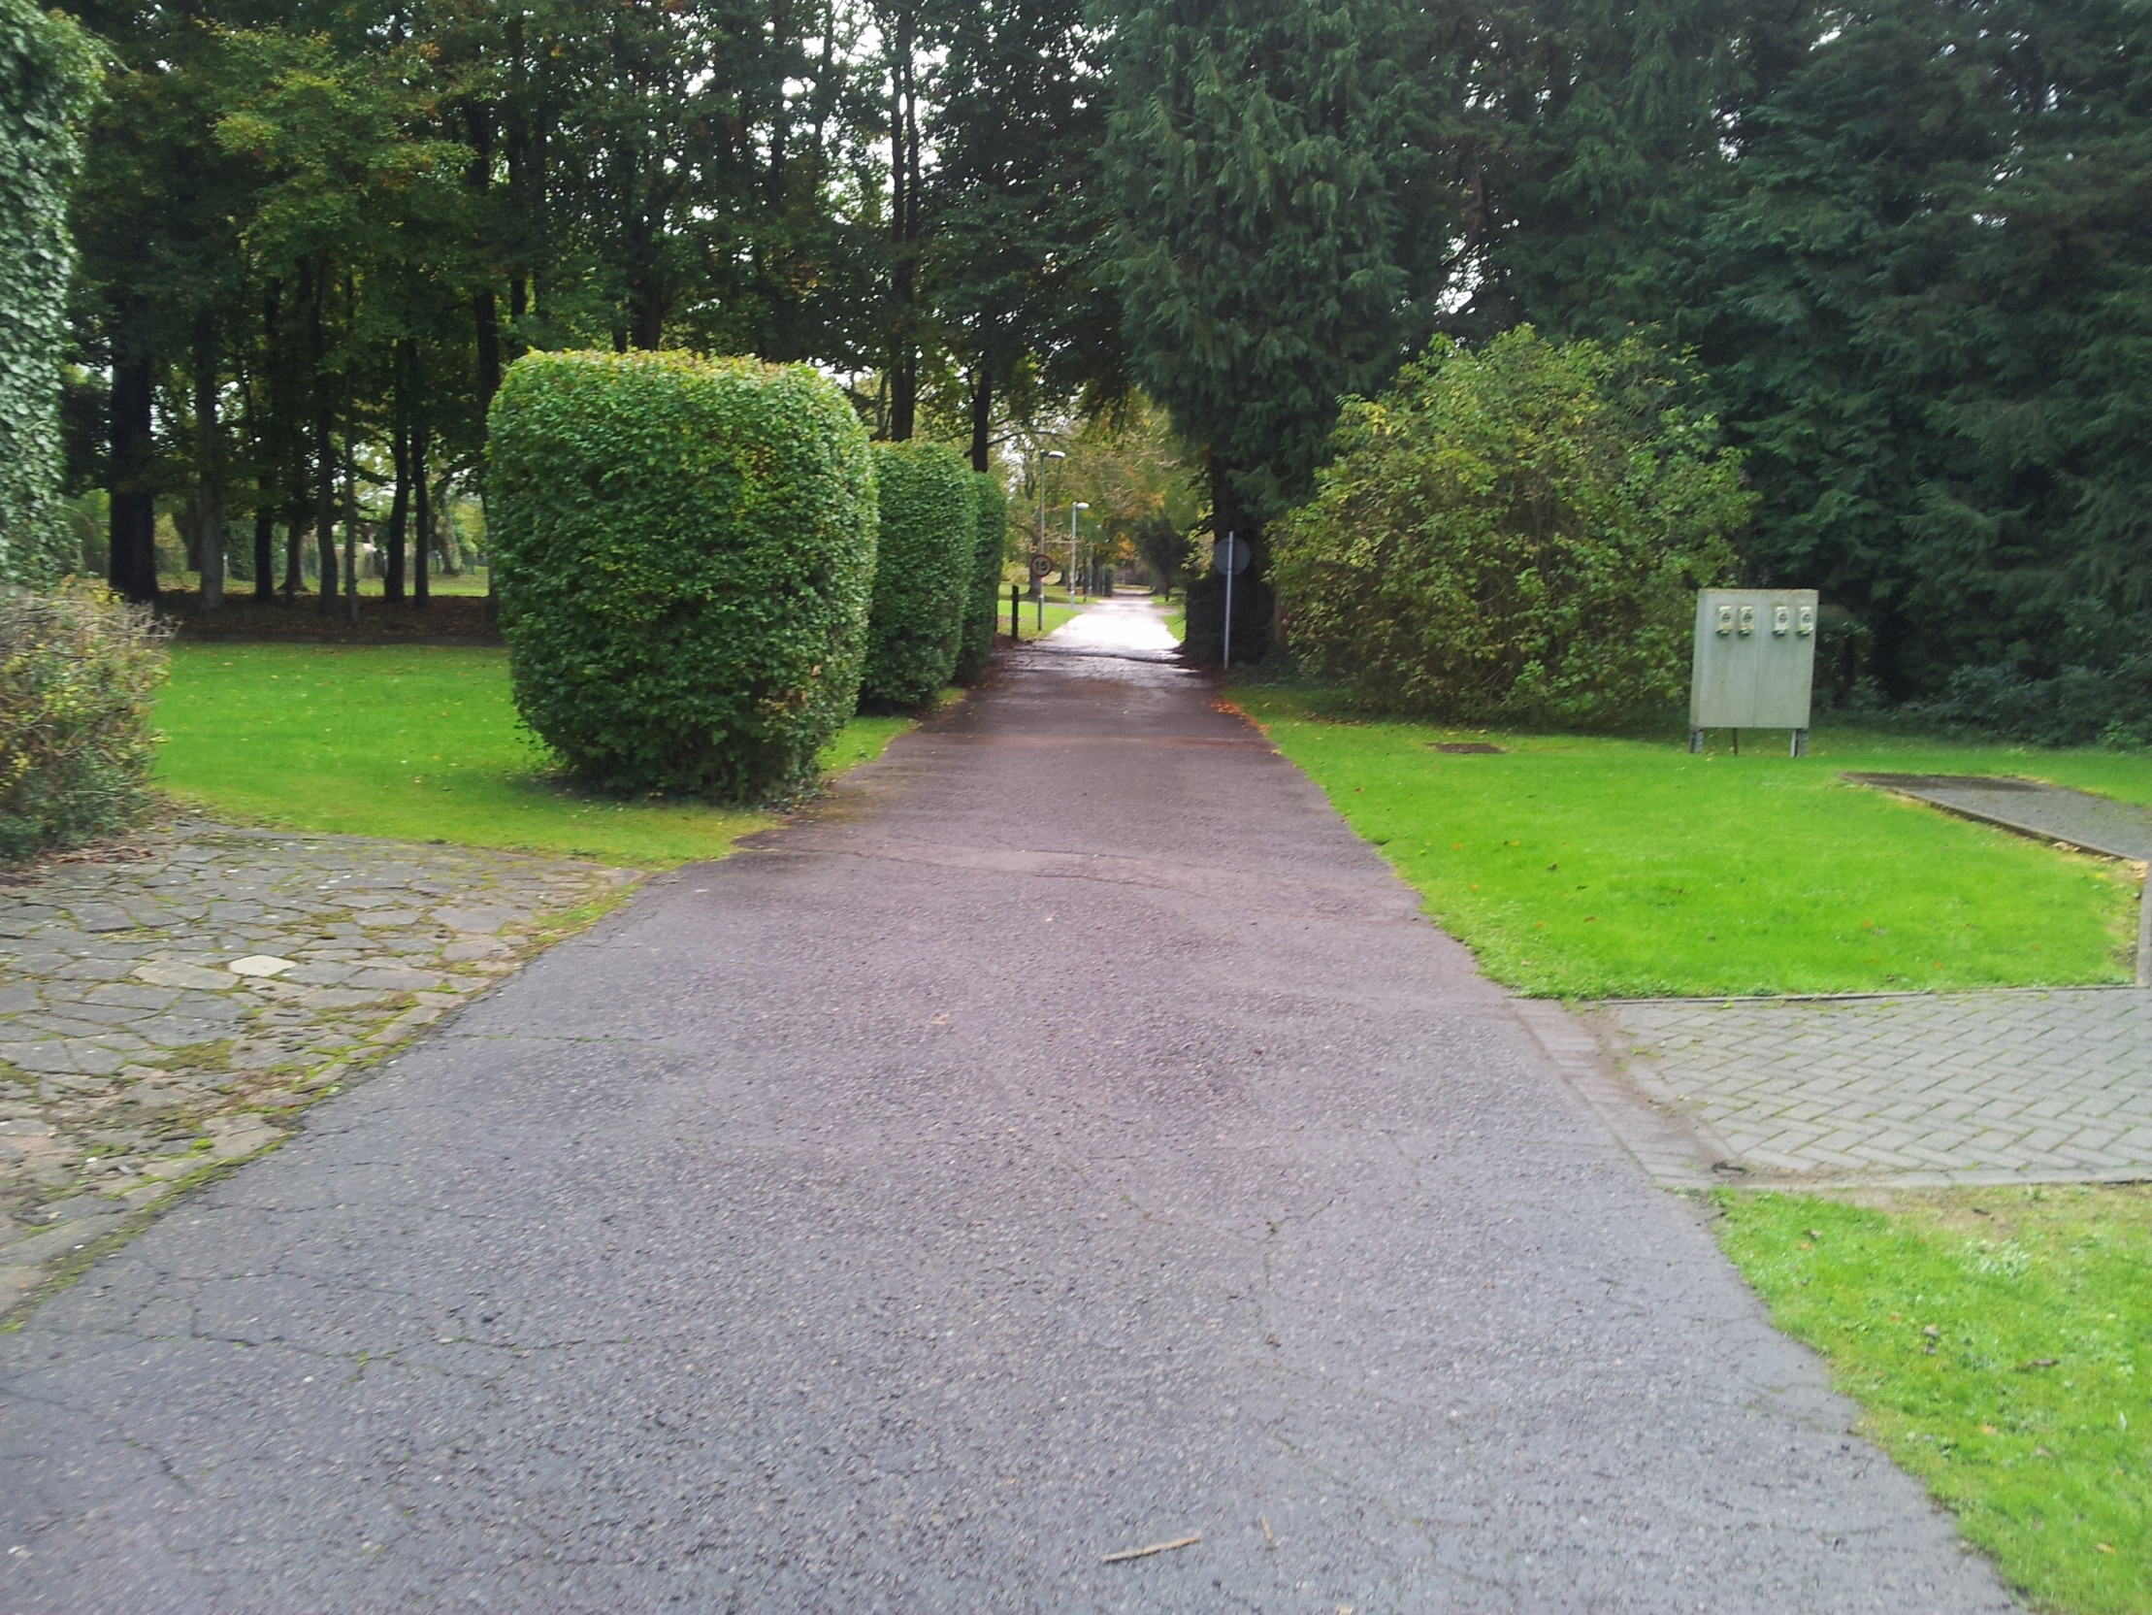
Dr Aiman AL Maathidy
Mon. 24 February 2020

