Slide 2
The development of Fetal Membranes

Slide 3
Blastocyst ---second week
8th day
Inner cell mass differentiates into two layers:
A top layer of high or columnar epithelium, that is the Epiblast
A layer of small cuboidal cells adjacent to the Blastocyst cavity, that is the Hypoblast.
Some cells between the epiblast and the trophoblast, called amnioblasts, will form a cavity on the top of epiblast, that is the amniotic cavity.

Slide 4
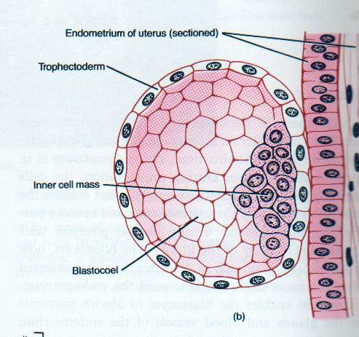
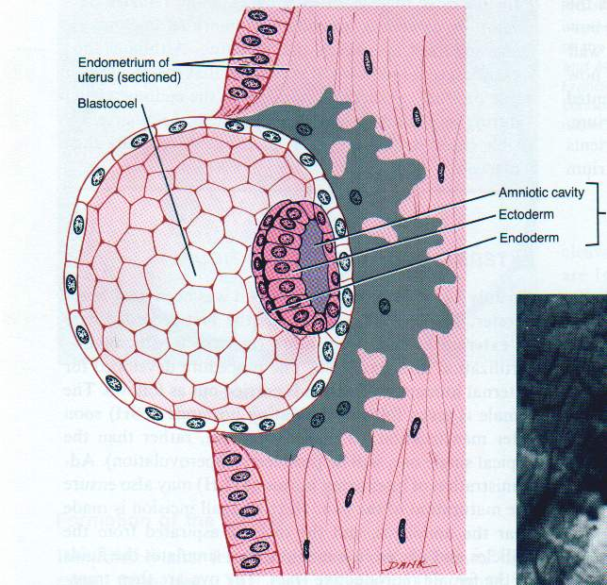

Slide 5
Amnion:
---amniotic membrane: amniotic epi. + extraembryonic mesoderm
---amniotic fluid:
/secrete by amniotic epi.and excreted urine of fetus.
/slight basic fluid: 1000-1500ml
/function:
-intraenvironment(movement,temperature,neutrition and excretion).
-protecting(against trauma and antiseptic).
-preventing from adherence
-wash germ tract and lubricant(during normal labour).
Abnormalities:
-polyhydramnios: >2000ml(twins,abnormal digestive system or CNS,diabetic mother).
-oligohydramnios: <500 ml(abnormal urinary system)…..Adhesions

Slide 6
9th day
In the blastocyst, a new membrane-like layer is formed to the inner side of cytotrophoblast, this membrane is formed by flattened cells originate from the hypoblast, and its called exocoelomic (primary)membrane.
The cavity of the blastocyst is now called exocoelomic cavity or primitive(primary)yolk sac.

Slide 7
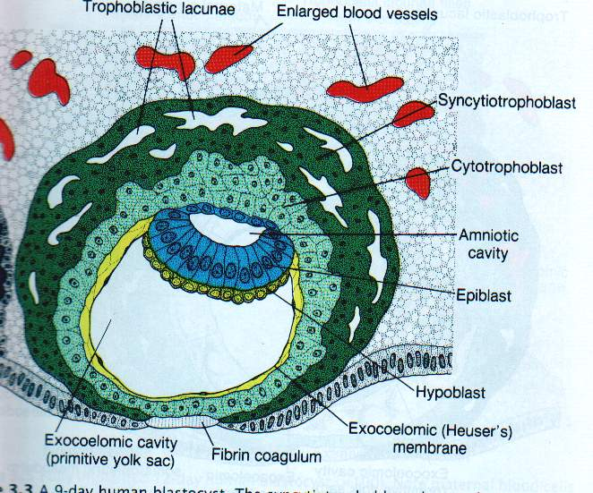

Slide 8
11 – 12 days
In the blastocyst, loose connective tissue appears between the cytotrophoblast and the exocoelomic membrane, that is called extraembryonic mesoderm and extends to surround the amnion also.
A cavity appears within the extraembryonic mesoderm, known as extraembryonic coelom or chorionic cavity. This space surrounds the primitive yolk sac and amniotic cavity except where the embryonic disc is connected to the trophoblast by connecting stalk.

Slide 9
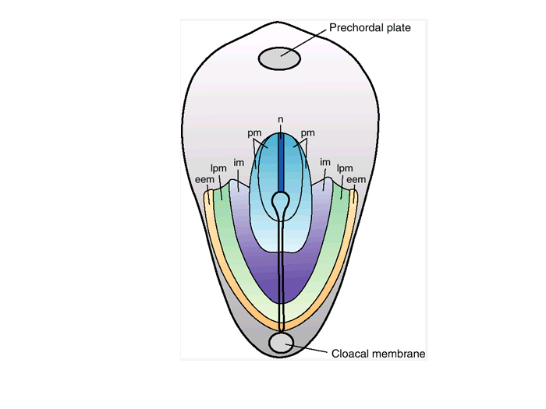

Slide 10
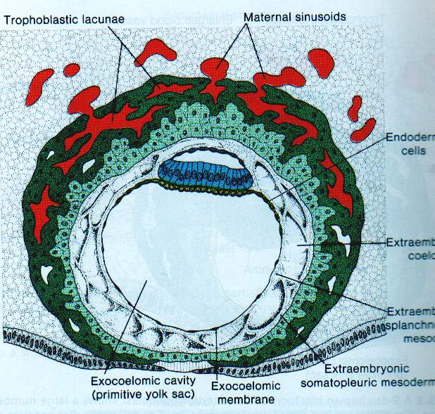

Slide 11
Inside the blastocyst, the hypoblast produces cells that migrate along the inside of exocoelomic membrane to enclose a smaller cavity within the primitive yolk sac, that is called the secondary yolk sac or definitive yolk sac.

Slide 12
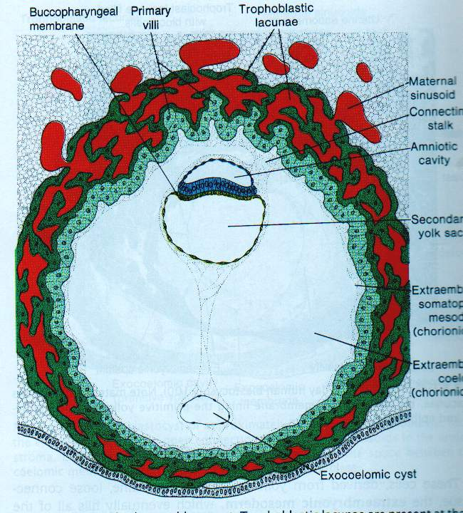

Slide 13
A temporary communication is established between the amniotic cavity and the yolk sac, termed the neurenteric canal.

Slide 14
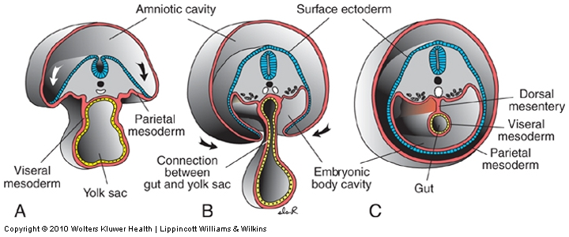
Lateral folding
Carlson fig 6-20
Langman’s fig 6-18
Lateral folding of the embryo completes the gut tube
Notes:
Fig 13.3

Slide 15
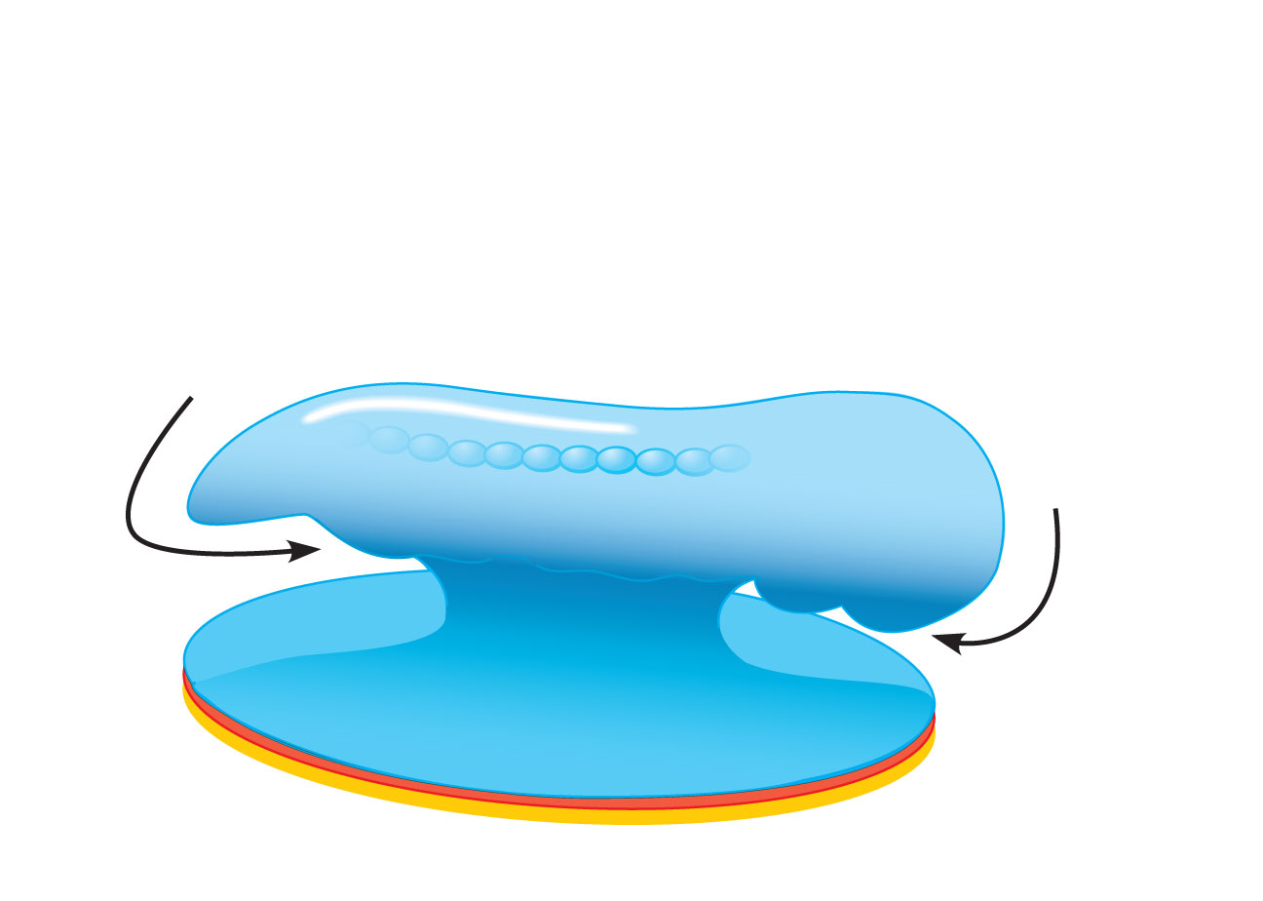
Somites (seen
through ectoderm)
Tail
fold
Head
fold
(c)
Yolk sac
Figure 28.11c

Slide 16
Yolk sac
Function:
---neutrition before placenta
---blood island: primitive blood cell- derived from extraembryonic mesoderm on the wall of yolk sac
---primordial germ cells: derived from endoderm of yolk sac
----The endodermal cells form the epithelial lining of the gut (except lower part of the anal canal), respiratory system and urinary bladder (except trigone).
Anomalies in the vitello-intestinal duct:
Vitelline fistula-Vitelline cyst-Vitelline sinus –Meckel’s diverticulum(may cause left appendicitis )-Fibrous band Volvulus neonatorum and intestinal obstruction.

Slide 18
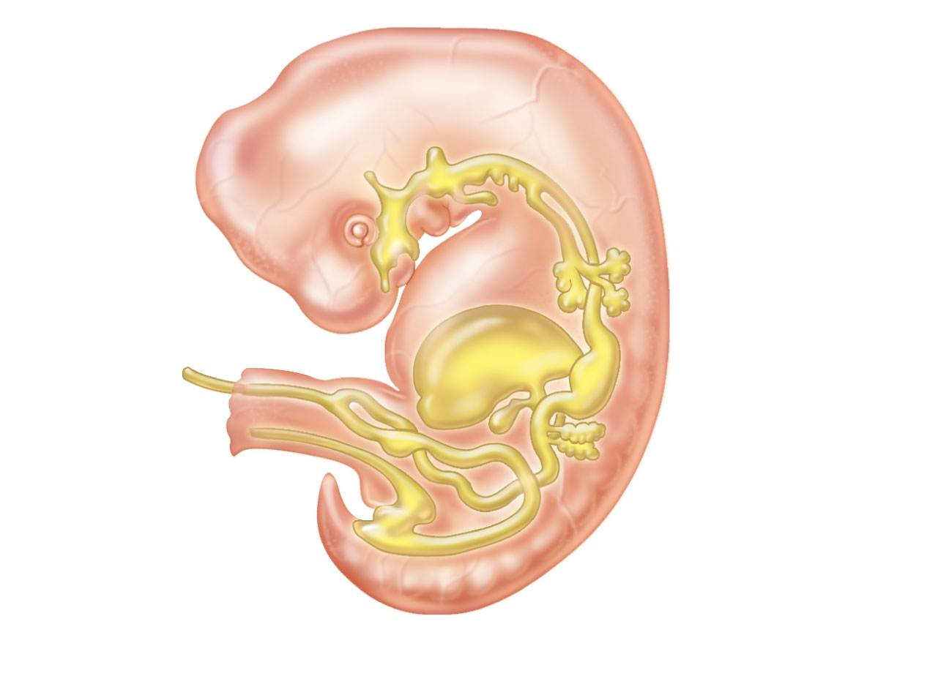
Pharynx
Parathyroid glands
and thymus
Thyroid gland
Esophagus
Trachea
Connection
to yolk sac
Right and
left lungs
Stomach
Liver
Umbilical
cord
Pancreas
Gallbladder
Small intestine
Allantois
5-week embryo
Large intestine
Figure 28.12

Slide 19
The endoderm of hind gut forms a small outgrowth or diverticulum that is called the allantoenteric diverticulum or the allantois.
Allantois---urachus-----median umblical ligament
Allantoic As: paired, →umbilical As(Rt&Lt)(oxygen-poor blood from fetus to placenta)----medial umbilical ligaments.
Allantoic Vs: paired
right: degenerate
left: umbilical V(oxygen-rich blood)from placenta to fetus-------ligamentum teres of liver.
Anomalies:
Fistula-sinus-cyst(urachal)

Slide 20
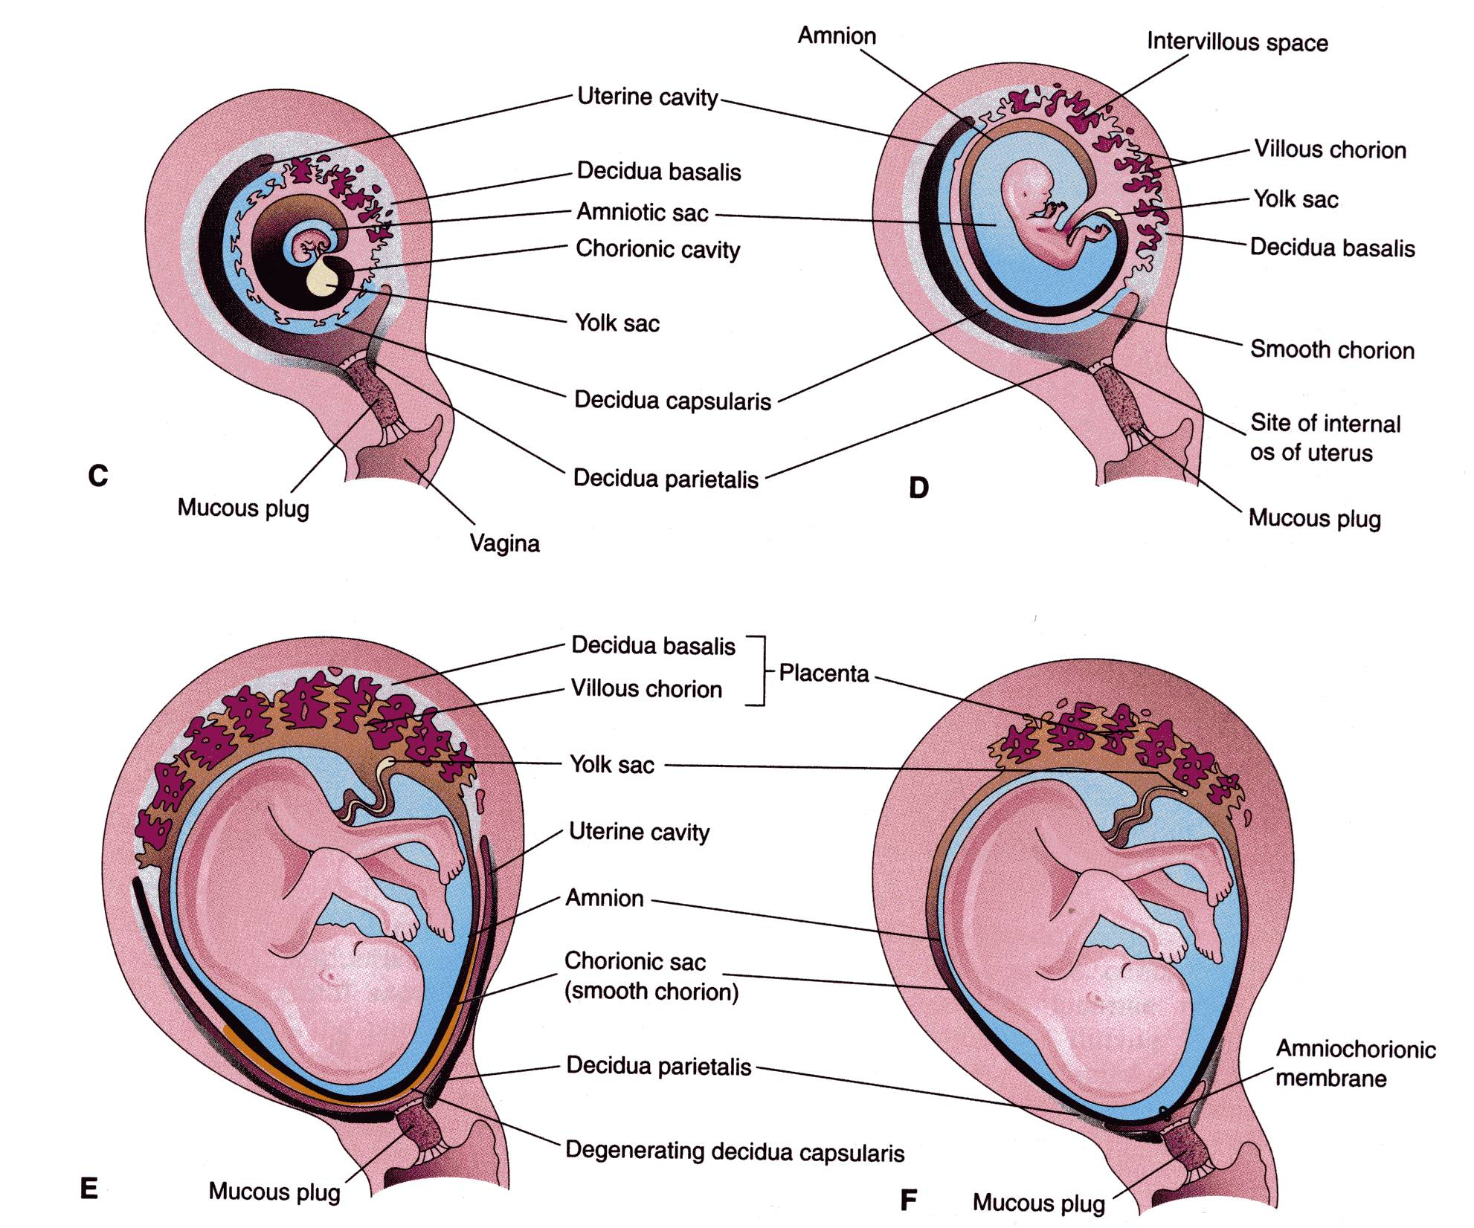

Slide 22
FULL-TERM UMBILICAL CORD
Usually it is attached near the center of the fetal surface of placenta.
Length: about 40-60 cm
Diameter: 1-2 cm
Contains two arteries and one vein, surrounded by mucoid connective tissue (Wharton jelly)
The vessels are longer than the cord and may have loops (false knots).
Anomalies:
1-Abnormal attachment of umbilical cord: A- Velamentous attachment: The cord does not reach the placenta itself but is attached to amniotic membrane over the fetal surface of placenta. The umbilical vessels pass in the membrane to reach the placenta. It is easly torn. B- Battle- dore placenta (marginal attachment of the cord)
2-Abnormal length of umbilical cord:
A---> 80 cm(long)-----True knots,surround neck or limbs
B--- < 35 cm(short)-----Premature separation of placenta(hge)
3-Anomalies of contents:VID,urachus,intestinal loop(exomphalos).

Slide 23
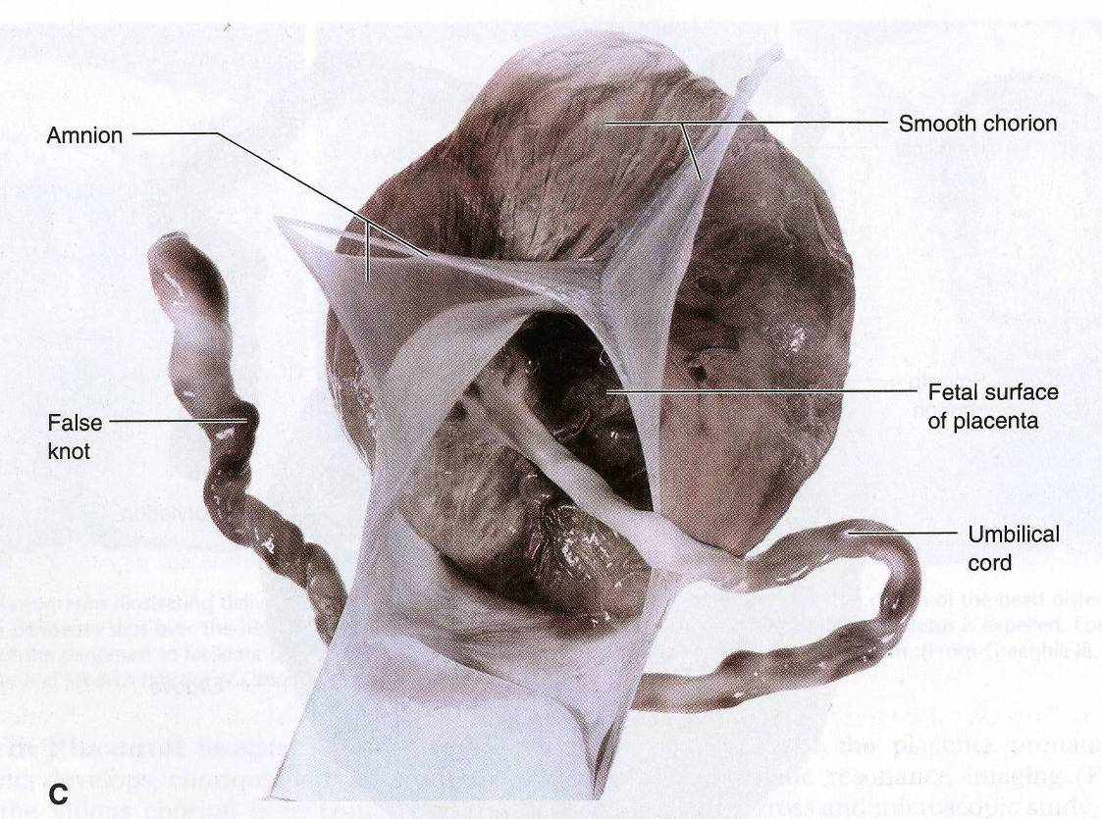

Slide 24
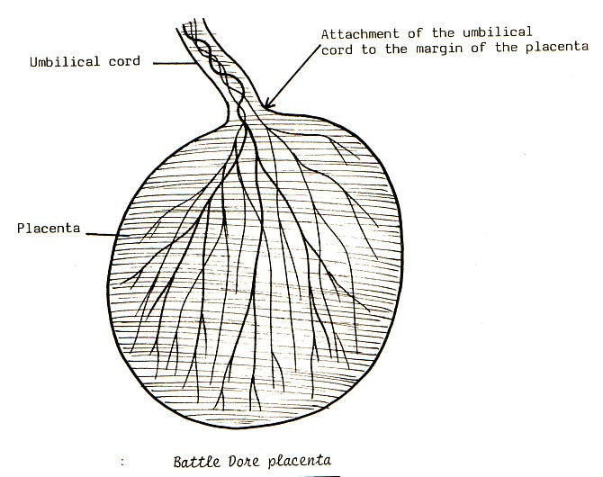
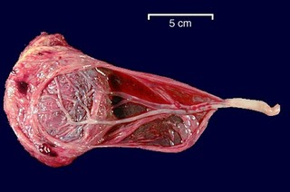

Slide 25
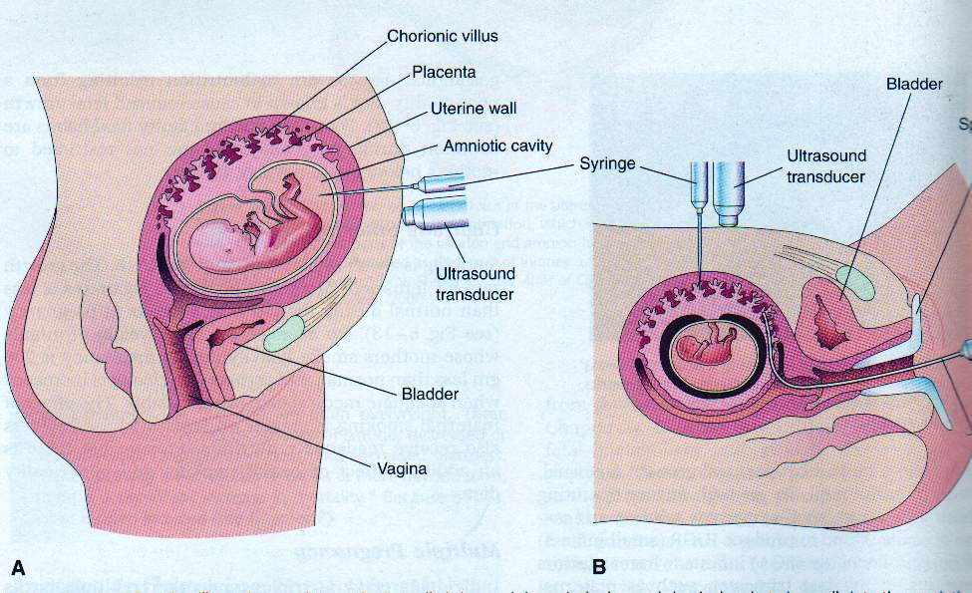

Slide 26
Prenatal Diagnosis
To asses the fetal conditions or to diagnose suspected diseases before birth
Amniocentesis: aspirating a sample of amniotic fluid, and perform analysis: chemical(surfactant of respiratory system), culture of cells and chromosomal and genetic studies…
Ultrasonography.
Fetoscopy
Umbilical cord blood sampling

Slide 27
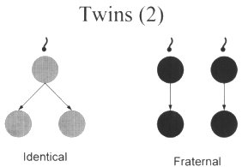
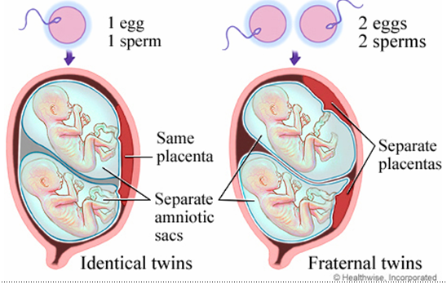
Twin conception
Now that we understand how single babies are formed, let us move on to the conception of twins.
Two types of twins:
Identical (monozygotic)
Fraternal (dizygotic)

Slide 28
Fraternal(dizygotic)twins
Aetilogy
Dizygotic twins may arise spontaneously from the release of two eggs at ovulation
Causes
1.Familial. 2.Racial. 3.Increasing maternal age.
4.Induction of ovulation. 5.IVF: in-vitro fertilization.
-Two-thirds of all twins are dizygotic
-Occur when two sperms fertilize two distinct eggs.
-Fertilization of two separate ovum results in two distinct embryos.
-However, if these embryos implant very near to each other along the endometrium, the two placentas can become fused.
-Genetically similar, not identical.

Slide 29
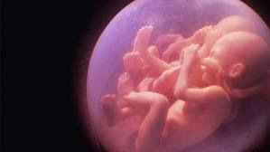
Multiples births
Multiple births can also be carried out using this process if more eggs are released
For example, if three eggs are released and fertilized, the children born would be known as trizygotic triplets.

Slide 30
Monozygotic(identical) twins
Occurs when one sperm fertilizes one egg
Instead of having the blastocyst remaining as one cell group, it splits in two.
The two balls of cells then develop into two different embryos.
Since the twins come from the same fertilzed egg, they will share identical features such as same gender.
*70% are diamniotic monochorionic.
*30% are diamniotic dichorionic.

Slide 31
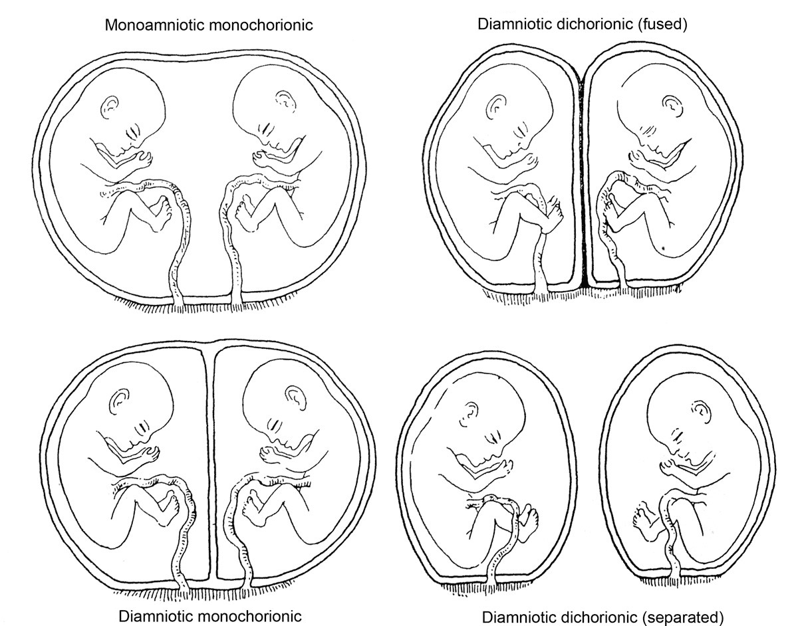
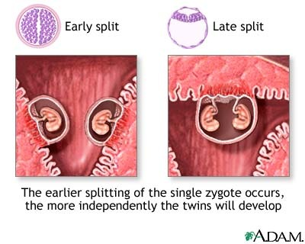
Types of monozygotic twins
When the split occur within 3 days of conception , two placentas &two amniotic cavities result (DC,DA)
When splitting occur between 4-8 days ,monochorionic diamniotic twins will result (MC,DA)
Later splitting results in two fetuses in a single amniotic cavity sharing single placenta (MC.MA)
If splitting delayed beyond 12 days , conjoined or Siamiese twins will result
The incidence of monozygotic twins is not influence by race ,family history or parity.

Slide 32
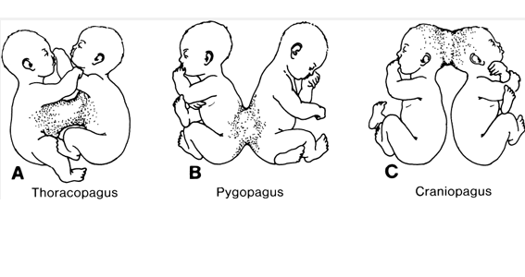
Conjoined twins or Siamese twins
*Anterior (thoracopagus)
*Posterior (pygopagus)
*Cephalic (craniopagus)
*Caudal (ischiopagus)

Slide 33
thank you

