Slide 1
Maxillofacial Injuries
- تم تفريغ اضافات الدكتور باللون الأخضر , وما تم شرحه باللون الأحمر, واضافة صور توضيحية لفهم بعض النقاط
تمارا الزيود محمد ربعي

Slide 2
Maxillofacial Injuries
Dr. Saleh Abualhaj
Plastic Surgeon

Slide 3
Emergency department (ED) evaluation
A. History
1. Mechanism of injury determines the degree of force
a. Interpersonal violence (usually low energy)
b. Motor vehicle accident (usually higher energy) ( high speed )
2. History of deformity , prior facial trauma
3. Time of injury ( early / late)
4. Loss of consciousness → intracranial pathology
5. Subjective complaints: Diplopia ( due to extraocular ms entrapment not edema → surgical emergency  ) , blindness (compression on optic nerve ) , hearing loss, malocclusion تطابق الاسنان , and rhinorrhea ( CSF leak)→ risk of meningitis
* Ms entrapment → lead to necrosis → so its an surgical emergency
6. Environmental considerations: Chemical exposure?
7. Past medical/surgical history, medications, smoking, and drug abuse
3 type :
1: normal
Type 2 : med face ant. And mandible posterior
Type 3 : mandible protrusion/anterior

Slide 4
Physical exam
1. Trauma patients: ABCs (airway, breathing, circulation) must be first priority
a. *Most facial trauma patients need clinical/radiographic cervical
spine (c-spine) evaluation and management
b. *Over 10% of facial trauma patients have associated c-spine injury
2. Control hemorrhage—nasal packing, pressure dressing to lacerations
3. Adequate lighting, irrigation, and suction are required

Slide 5
4. Inspection: don’t forget the ears , oral cavity , nose .
Lacerations (traumatic), abrasions, burns, edema, symmetry , septal hematoma , and dental occlusion
5. Palpation
a. Skull, orbital rims, zygomatic arches, maxilla, and mandible
b. Assess for symmetry , step-offs in orbital rim , crepitus, and pain
6. Complete cranial nerve exam (prior to administration of local anesthetic) with emphasis on :
a. Sensation: Light touch in three divisions of CN V—ophthalmic, maxillary, and mandibular - ( trigeminal nerve )
b. Motor: Test all CN VII branches (temporal, zygomatic, buccal, marginal mandibular, and cervical) and look for asymmetry – ( facial nerve )

Slide 6
اكثر اشي بسال عنهم

Slide 7
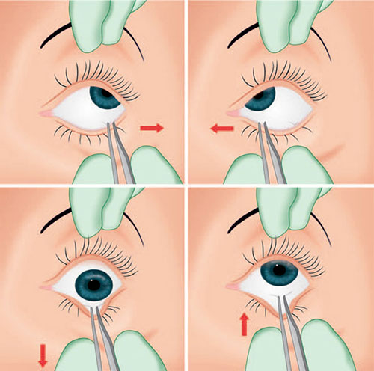
Eyes
a. Test visual acuity with pocket card
b. Pupillary response to light
c. Swinging flashlight test to rule out afferent papillary defect (optic nerve injury)
d. Diplopia (horizontal versus vertical)
e. Extraocular movements
i. *Perform forced duction test to rule out muscle entrapment if intubated/
sedated and periorbital fractures present :
→ Grasp the sclera (away from cornea) with fine forceps and move the
globe into upward/downward/lateral gaze positions to test for entrapment
of extraocular muscles
f. Hyphema or globe injury
g. Enophthalmos /exophthalmous
h. Eyelid position
i. Medial canthal tendon stability (versus telecanthus)

Slide 8
Ears
a. Inspect external ear on all surfaces for lacerations, perichondral hematoma .
b. Observe for Battle sign: Bruising of mastoid process indicative of skull base fracture
c. Otoscopy: Hemotympanum, cerebrospinal fluid (CSF) leak, perforation of tympanic membrane , otorrhea
d. *Hematoma on external ear must be evacuated  and bolster placed

Slide 9
Nose
a. Assess contour of nasal bones
b. *Use nasal speculum for intranasal exam: Assess for lacerations, nasal obstruction, rule out septal hematoma (can lead to septal necrosis if untreated) → need drainage

Slide 10
Midface, cheek
*Lacerations should be examined for proximity to Stenson’s canal (parotid) branch of facial nerve
Laceration medial to lateral canthus → no need to facial nerve examination
duct (runs in middle third of a line drawn from oral commissure to tragus)
b. Look for malar flattening and down sloping of palpebral fissure
c. Assess for midface mobility while stabilizing the skull

Slide 11
Mandible, oral cavity, occlusion
a. Assess occlusion
i. *Ask patient “Does your bite feel normal?”
ii. Inspect wear facets of teeth—these will intercuspate if occlusion is normal.
iii. Anterior or posterior open bite, cross bite
b. Document loose/missing/broken teeth
c. Inspect oral lining for lacerations or ecchymosis
d. Measure incisal opening distance
e. Submucosal hematoma may indicate mandible fracture
f. Palpate temporomandibular joint (TMJ) in external auditory canal with opening and closing of mouth
g. Note oral hygiene and any carious teeth that may serve as source of infection
Mandible >> Usually fracture in more than one side

Slide 13
Diagnostic studies
Maxillofacial CT is the gold standard* to evaluate for facial fractures with or without 3D reconstruction
Note : no need for x-ray !
a. Coronal views usually done
i. Accurate assessment of nasal bones
ii. Orbital walls and potential herniation of contents into maxillary sinus
b. Three-dimensional reformats are useful in planning complex panfacial fracture reconstruction
c. Herald findings of fracture
i. Osseous deformity
ii. Sinus opacification
iii. Pneumocephalus or soft tissue air/edema

Slide 14
2. Obtain Panorex in cases of mandible fracture (this requires a patient to sit up in the panoramic radiograph device and therefore cannot be done in unresponsive patients)
3. Consider plain films, three views, to evaluate for missing mandibular segments (e.g., gunshot wounds); also useful when Panorex not available

Slide 15
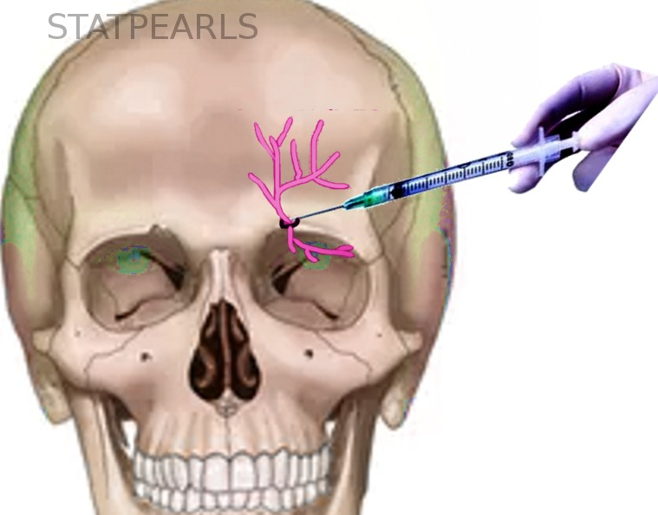
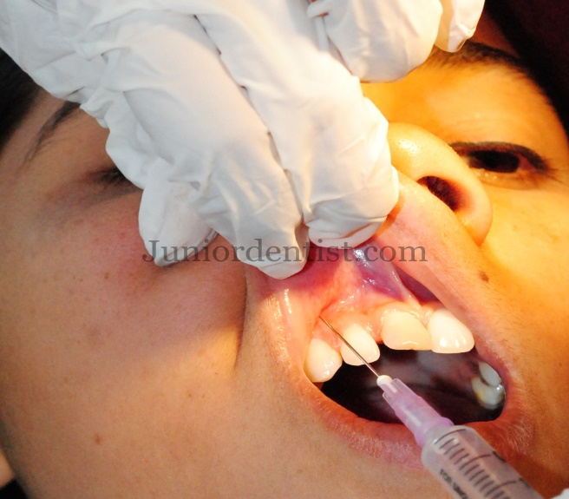
Soft-tissue injuries
Facial field blocks are useful for providing local anesthesia in awake patients
a. Supraorbital, supratrochlear, and infratrochlear nerve
i. Forehead/anterior scalp/upper eyelid/glabella
ii. Insert needle in midpupillary line at supraorbital rim, advance medially to capture supratrochlear nerve
b. Infraorbital nerve
i. Lateral nose/upper lip/lower eyelid/medial cheek
ii. Insert needle into superior buccal sulcus above the canine tooth root at midpupillary line 6 to 10 mm below the infraorbital rim

Slide 16
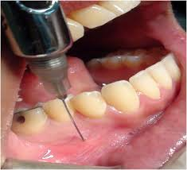
c. Mental nerve
i. Lower lip/chin
ii.*Insert needle into inferior buccal sulcus
at second premolar
d. Cervical plexus, great auricular, transverse cervical nerves
i. Posterior auricle/mandibular angle/anterior neck
ii. *Both great auricular and transverse cervical nerves emerge at
Erb’s point
a) 7 cm inferior to tragus
b) Posterior border of sternocleidomastoid (SCM) muscle
iii. Mark patient’s SCM when flexed, locate midpoint from clavicle to mastoid for injection

Slide 17
i. Ear “ring block”
ii. Begin with needle at junction of lobule and cheek and proceed with four injections circumferentially
iii. Avoid superficial temporal artery
iv. Separate injection in external auditory canal for Arnold’s nerve
)auricular branch of the vagus nerve, CN X)

Slide 18
Laceration repair
a. The face has a robust vascular supply; avoid excessive debridement
b. Repair in layers under minimal tension ,, 1ry repair ( refreshment and closure )
c. Copious irrigation with normal saline, remove foreign bodies
d. Deep dermis: 5-0 interrupted buried absorbable sutures (e.g., vicryl and
monocryl)
e. Skin: 5-0 or 6-0 interrupted or running permanent suture (e.g., nylon and prolene (mono filament non absorbable)
f. In young children, skin closure may be performed with 6-0 fast absorbing
gut to eliminate the need for suture removal
g. Nonabsorbable sutures are removed in 5 to 7 days; delayed removal will
result in suture tract epithelialization
h. Avoid undermining and/or local tissue rearrangement
Partial avulsions: Tissue present on small pedicles will usually survive
Any wound after 6h → contaminated , except in the face → after 24h its considered as contaminated ( due to rich blood sup.) .
And these are the intervals for 1ry repair .

Slide 19
Scalp
a. Close with surgical staples or running locking absorbable suture (e.g., chromic gut)
b. Avulsions ( sever scalp injury ) are indication for microvascular replantation in the golden period
i. Scalp can tolerate 12 to 18 hours cold ischemia time
ii. Superficial temporal or occipital vessels can serve as recipient vessels during scalp replantation

Slide 20
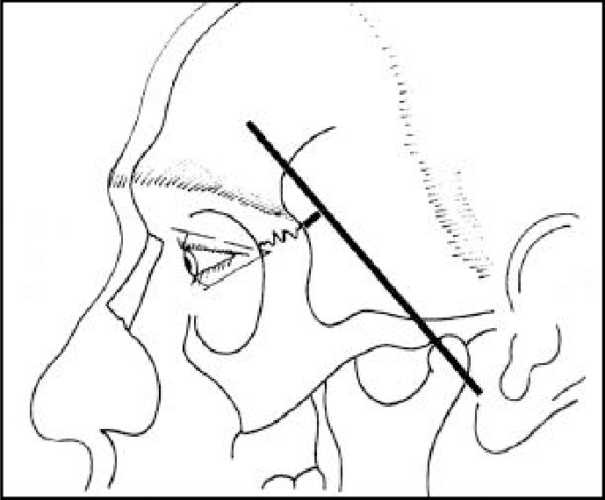
Eyebrows
a. Direction of hair growth helpful in realigning wound edges
b. Inspect within the wound for occult fracture
c. Avoid cautery: Cicatricial alopecia
d. *Temporal branch of facial nerve: Pitanguy’s line
i. 0.5 cm inferior to tragus to 1.5 cm superior to lateral margin of
eyebrow
ii. Deep surface of superficial temporal fascia (i.e., temporal parietal
fascia) with superficial temporal artery
e. Advance lateral brow if necessary to close, medial brow position more aesthetically important

Slide 21
Eyelids
a. Conjunctiva meets the skin at grey line on lid margin
b. Ptosis on exam may indicate levator injury
c. *Rounding and mobility of medial canthus may indicate nasoorbitoethmoid
(NOE) fracture (telecanthus) (normal intercanthal distance 32mm)
d. Epiphora (excessive tearing) indicates possible lacrimal canalicular injury
e. Repair techniques
i. Repair conjunctiva only if large defect present (e.g., 5-0 fast absorbing
chromic)
ii. Repair tarsal plate (e.g., 5-0 Vicryl)
iii. Repair lid margin with vertical mattress at gray line using polyfilament
(e.g., 6-0 Vicryl)
a) Eversion of closure prevents notching of lid margin
b) Avoids corneal abrasion from monofilament suture
c) May be removed in 5 to 7 days
iv. Keep all suture tails long, tied into an inferior suture knot away from globe

Slide 22
f. Lacrimal system injury
i. Canaliculus courses 2 mm perpendicular to lid margin then heads medially to lacrimal sac and nasolacrimal apparatus
ii. *Drains into nose at inferior meatus
iii. Laceration to medial third of eyelid ⇒ suspect canaliculus injury
a) Exploration: Place lacrimal probe in punctum and pass it into canaliculus, look for probe within the wound
b) Place silastic lacrimal stent; “Crawford tubes” (±suture repair of duct)
c) Stent remains in place for 2 to 3 months
d) *Jones I and II tests may be used clinically

Slide 23
Cheek
a. Stenson duct penetrates buccinator to enter oral cavity opposite second molar; travels with buccal branches of facial nerve
i. Probe intraoral papilla with 22G angiocath peripheral venous catheter and inject hydrogen peroxide: If duct is injured, visualize gas bubbles in wound
ii. Repair duct to prevent sialocele, or leave drain
iii. *If sialocele develops, aspirate and apply pressure dressing
b. Nerve injury—can use nerve stimulator up to 48 to 72 hours later give false +ve
i. Considerable crossover between zygomatic and buccal CN VII branches
ii. Does not require repair if medial to lateral canthus
1ry closure

Slide 24
Nose
a. Redundant arterial supply: Lateral nasal, external nasal, septal, and columellar arteries
b. Septum composed of septal cartilage, vomer bone, perpendicular plate of
ethmoid, maxillary crest, and premaxilla
c. Septal hematoma
i. Evacuate with needle aspiration or blade to prevent necrosis and septal perforation
ii. Place running quilted 4-0 gut suture
d. Laceration repair 1ry repair
i. Mucosal lining: 4-0 chromic with knots in nasal cavity
ii. Cartilage: 5-0 clear nylon or monocryl
iii. Skin: 6-0 nylon in the skin
e. Avulsion injuries: Consider composite graft (replantation if possible)
i. 50% failure
ii. All grafted material must be within 5 mm of viable tissue

Slide 25
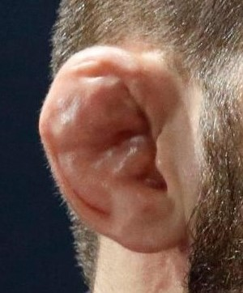
Ears
a. Arterial supply: Superficial temporal and postauricular arteries
b. Great auricular, auriculotemporal, Arnold, lesser occipital nerves provide
sensation
c. Otohematoma → drainage
i. Evacuate with needle or blade to avoid “cauliflower ear”
ii. Compression dressing
a) Xeroform bolster mattressed with 3-0 through and through sutures
b) Remove in 1 week
d. Lacerations
i. May require figure-of-eight sutures in cartilage (clear nylon or absorbable
monofilament)
ii. Evert skin margins in key locations (e.g., helix) with mattress sutures
e. Amputation
i. Partial amputation—suture repair
ii. Complete amputation—attempt replantation
iii. Consider leech therapy for venous congestion
iv. Consider dermabrasion of ear part and banking cartilage in dermal pocket

Slide 26
Mouth
Anatomic landmarks: Philtral columns, philtral dimple, Cupid bow, vermillion border, and white roll
b. Lacerations: Repair mucosa, orbicularis, and skin in layers. Mark white roll with methylene blue or marking pen prior to administration of local anesthetic

Slide 27
Fracture evaluation and management

Slide 28
Mandible fractures
a. Mental nerve (CN V3)
b. Muscles of mastication (CN V3) exert deforming forces of mandible
i. *Lateral pterygoid: Protracts (lowers) mandible
ii. Medial pterygoid: Closes mouth
iii. Temporalis: Elevates and retracts mandible
iv. Masseter: Elevates mandible
v. Geniohyoid, genioglossus, mylohyoid, digastric muscles: Depress
mandible

Slide 30
2. The mandible is like a pretzel: Difficult to break in only one location ! ; look for second fracture 
3. Classification of fracture—location on mandible, simple versus comminuted, open versus closed, and intracapsular/extracapsular
4. Teeth in line of fracture should be retained if roots are not fractured
5. MMF (maxillomandibular fixation; also called intermaxillary fixation, or IMF) may be used as a single modality (controversial) for 4 to 6 weeks

Slide 31
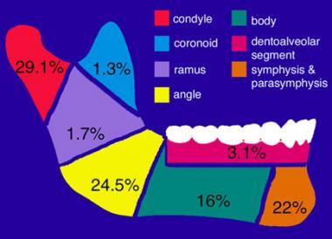
Fracture subtypes
a. Symphyseal/parasymphyseal fractures. Miniplate fixation with at least
two points of fixation
b. Body fractures. Miniplate fixation
c. Angle fractures. Highest complication rate
d. Coronoid fractures-MMF for 2 weeks usually enough
e. Condylar and subcondylar fractures ( most common)
i. Intracapsular
a) Condylar fractures (head and upper neck)
b) Closed reduction and limited (2 weeks) MMF with early controlled
mobilization; rarely ORIF
c) *Open treatment warranted if: (1) Cannot reduce fracture and it
precludes ranging the mandible, (2) a foreign body is present within
the TMJ, (3) the condyle has displaced into the middle cranial fossa,
and (4) bilateral condyle fractures with midface fractures to restore
vertical height
ii. Extracapsular
a) Subcondylar fractures
b) IMF × 4 to 6 weeks, weekly observation of occlusion after release
# Bilateral subcondylar fracture → decrease facial high , malocclusion !!
# Management = ORIF

Slide 32
Pediatric mandible fractures
i. *Avoid immobilization; early active therapy; growth potential
allows improvement of occlusion with time
ii. May require MMF
iii. In the absence of permanent dentition
a) Piriform drop wires
b) Circum-mandibular wires
g. Edentulous mandible
i. Closed fractures with minimal displacement: No dentures, soft diet
ii. Open fractures or those with displacement: ORIF with load-bearing plate
h. Dislocations
i. Anterior displacement of condyle from glenoid fossa
ii. Closed reduction necessary
a) Conscious sedation
b) Intraoral downward and posterior pressure at ramus

Slide 33
8. Indications for tooth removal
a. Grossly mobile
b. Severe periodontal disease
c. Root fracture
d. Exposed apices
9. Common complications
a. Malocclusion/malunion/nonunion
b. Increased facial width, rotation of mandible
c. TMJ ankylosis: Stiffness, pain, limited range of motion
d. Infection: Often treated with I&D, hardware removal generally not required

Slide 34
Zygoma fractures
a. Zygoma has a quadrilateral shape: Articulates with maxilla, sphenoid, temporal, and frontal bones; fractures are therefore “tetrapod fractures”
b. Muscle attachments: Masseter, temporalis, zygomaticus major and minor
2. Clinical presentation
a. *Flattening of malar eminence with downslanting palpebral fissure:
Lateral canthus attaches to zygoma via Whitnall tubercle
b. Zygomatic arch fractures may limit the motion of coronoid, resulting in
Trismus ( lock jow ) → pt cant open his mouth
c. Enophthalmos → infraorbital fracture (increase size of orbital room)
d. Infraorbital paresthesia → compression or edema or injury
3. ORIF : Required to restore facial width, malar projection, and orbital
dystopia

Slide 35
Orbital fractures
Anatomy
a. Orbit is constructed of seven bones—maxilla, zygoma, sphenoid, frontal,
palatine, lacrimal, and ethmoid
b. *Conical/pyramid shape: Optic nerve is ∼4 cm posterior to orbital rim → so unlikely to be injured
c. Thinnest region is medial wall (lamina papyracea) → most commonly injured + inferior wall → blowout fracture
2. All orbital fractures require consultation with ophthalmologist to evaluate
for ocular trauma
3. Fractures most common in orbital floor and medial wall (lamina papyracea
of ethmoid
4. Dystopia occurs if loss of bony support
5. Enophthalmos
a. Fractures of orbit result in increased intraorbital volume and disrupt ligamentous support of globe
b. During healing, periorbital takes on shape with smaller volume

Slide 37
6. Clinical presentation
a. Periorbital edema
b. Periorbital ecchymosis
c. Diplopia ( due to edema ) or (entrapment : surgical emergency)
d. Infraorbtial nerve paresthesia
e. Enophthalmos
f. Orbital rim step-off
g. Limited globe excursion from edema or entrapment
7. Indication for ORIF ( open reduction internal fixation )
a. Persistent diplopia (>2 weeks)
b. Fractures that involve >50% orbital floor or >2 cm2
c. Clinically significant enophthalmos
d. *Entrapment of extraocular muscles (requires emergent intervention,
i.e., less than 24 hours, to release ischemic muscle). Entrapment is
determined by assessing extraocular movements or by forced duction testing
(see above, under ED Evaluation and Physical Examination) if unconscious
# Entrapment is specific in pediatric (why ?!) → greenstick fracture in the inferior and medial wall ( tape door fracture ) → act as trapped door on the surrounding muscels

Slide 38
e. *Superior orbital fissure syndrome (3rd , 4th , 6th nerve )
i. Effects oculomotor, trochlear, abducens, and trigeminal (lacrimal,
frontal, and nasociliary branches) nerves and ophthalmic vein
ii. Signs
a) Ptosis
b) Proptosis
c) Ophthalmoplegia
d) Numbness in VN V1
e) Dilation and fixation of ipsilateral pupil
f. *Orbital apex syndrome: Same as superior orbital fissure syndrome
but with loss of vision due to injury to optic nerve
g. Traumatic carotid cavernous sinus fistula
i. Proptosis
ii. Ocular bruit
iii. Ophthalmoplegia of CN III, IV, or VI
iv. Treatment: Surgical ligation of carotid artery or coils to block off
fistula

Slide 39
Nasal bone fractures
1. Nasal anatomy
a. Upper one-third of the nose: Paired nasal bones
i. Fractures common in thinner lower halves of paired nasal bones
ii. Younger patients experience fracture–dislocations of larger segments
iii. Older patients develop comminuted patterns
b. Lower two-thirds of the nose: Paired upper lateral cartilage, lower lateral cartilage
c. Septum consists of quadrangular cartilage, vomer, perpendicular
2. Treatment goals
a. Restoration of function and appearance
b. Wait 6 months before considering revision rhinoplasty or secondary closed
reduction plate of ethmoid bone
c. Acutely before edema begins (uncommon) or after swelling resolves (3 to
5 days)
d. Closed reduction should be accomplished within 2 weeks of injury to avoid
Osteotomies
# if there is no edema > closed reduction
# if there is Septal hematoma > manage as soon as possible

Slide 40
NOE (naso orbital ethmoid ) fractures
1. Fractures of nasal bones, frontal processes of maxilla, lacrimal bone, and ethmoid bone
2. Markowitz classification: Based on central fragment with medial canthal tendon
a. Type I: Single, noncomminuted, central fragment without medial canthal tendon disruption
b. Type II: Comminuted central fragment without medial canthal disruption
c. Type III: Severely comminuted central fragment with disruption of medial canthal tendon
3. Clinical presentation
a. *Telecanthus (not always seen acutely): Normal intercanthal distance is 30 to 34 mm : increase the distant between inner corners of eyeleds
b. Foreshortened and depressed nose
c. Lack of nasal support on palpation
d. Subconjunctival hemorrhage
e. CSF rhinorrhea
f. Mobility of the medial canthus on bimanual exam

Slide 41
4. *Commonly includes medial canthal ligament-bearing bone
a. Fracture line through anterior and posterior lacrimal crest
b. Leads to traumatic telecanthus
c. Possible damage to nasolacrimal system, leading to epiphora
5. Septal cartilage fractures: Progressive deviation from warping forces due to perichondrium

Slide 42
Frontal bone/sinus fractures
1. Anatomy
a. Thick anterior table, thin floor (orbital roof), and thinner posterior table
b. Nasofrontal duct is posterior medial in location and runs through anterior
ethmoid bone
c. Drains into middle meatus
d. *Not present at birth, begins to develop at 2 years old, and does not
reach adult size until 12 years old
2. Fracture classification
a. Anterior table management only cosmetic
b. Posterior table management according to degree of displacement
c. Nasofrontal duct involvement ( open / close )
3. *Forces of 800 to 2,200 lb are required for frontal sinus fractures, 2 to
3× greater than any other facial bone
4. Frequently associated with NOE and midface fractures

Slide 43
5. Clinical presentation
a. Palpable deformity to frontal bone
b. CSF rhinorrhea
c. Paresthesia in pattern of supraorbital and supratrochlear nerves
d. Inferior globe displacement of orbital roof
6. Complications
a. Mucocele; pyomucocele
b. Osteomyelitis
c. Infection of orbital contents
d. CSF rhinorrhea
i. Halo test/ring sign: Fluid is placed on gauze and concentric rings of
blood and CSF form, indicating CSF leak
ii. Fluid can be sent for beta transferrin level to confirm leak

Slide 44
7. Indications for operative management
a. Displaced anterior table (leads to contour deformity)
b. Nasofrontal duct involvement or obstruction (leads to mucocele)
c. Depressed posterior table
8. Treatment goals
a. Restoration of contour
b. Isolation of cranial cavity from upper airway
c. Construction of safe sinus

Slide 45
1
2
3

Slide 46
Maxillary fractures
1. Anatomy
a. Four processes: Frontal, zygomatic, palatine, and alveolar
b. Contains maxillary sinus
c. Muscle attachments include facial expression muscles anteriorly and pterygoid muscles posteriorly
d. Three major buttresses that provide strength
i. Nasomaxillary
ii. Zygomatic
iii. Pterygomaxillary

Slide 47
بنحط عليهم ال (plates) blade and screws
لانها اكثر اماكن قوية و بنعمل fixation

Slide 48
2. *Le Fort classification maxillary
a. Alternating thick buttresses and thinner segments create distinct fracture patterns
b. Usually involve pterygoid plates
c. Le Fort I: Transverse
i. Fracture at the level of tooth apices above the palate and alveolus
ii. Separates tooth-bearing maxilla from midface
iii. Extends from pyriform aperture posteriorly through nasal septum,
anterior maxillary wall, lateral nasal wall, and pterygoid plates
d. Le Fort II: Pyramidal
i. Fracture crosses nasal bones along zygomaticomaxillary suture
ii. May involve frontal sinus
iii. Upper jaw and nasal bones mobile as single unit
e. Le Fort III: Craniofacial disjunction → total separation
i. May be minimally displaced with subtle occlusion problems
ii. Entire midface is mobile and detached from cranial base
iii. Fracture though pterygoid plates at a high level
iv. Simultaneous mobility of maxilla and nasofrontal and zygomaticofrontal
regions

