Slide 1
وسهلا
أهلا
الأستاذ الدكتور/ يوسف حسين
أستاذ التشريح وعلم الأجنة
كلية الطب – جامعة الزقازيق- مصر
كلية الطب-جامعة مؤتة-الأردن
دكتوراة من جامعة كولونيا المانيا

Slide 2
Male
genital system

Slide 3
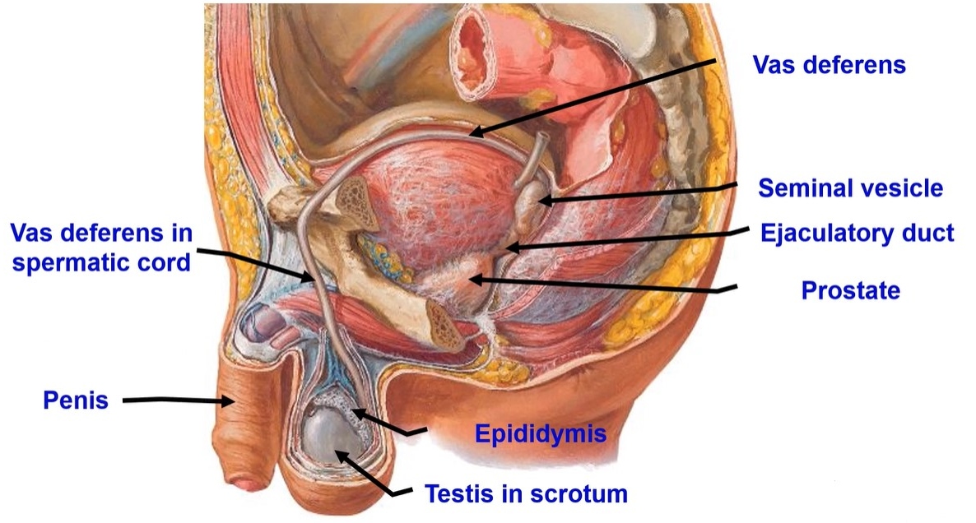

Slide 5
Testis

Slide 6
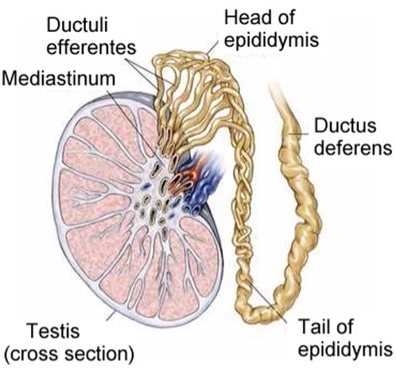
Testis
- It is the primary male sex organ.
- Functions: spermatogenesis
- Secretion of testosterone hormone.
* Site; in the scrotum
** Shape, it is oval in shape.
** Size, 1.5 inches long, 1 inch broad and 0.5 inch thick.
- External features,
a- 2 poles (upper and lower)
- Upper related to the head of epididymis.
- Lower related to the tail of epididymis.
- The Left testis is Lower than the right.
b- 2 borders: Anterior (smooth)
- Posterior where the epididymis attached
c- 2 surfaces (lateral and medial).

Slide 7
** Structure of the testis;
- It is divided into lobules by septa.
- Each lobule contains 2-3 seminiferous tubules supported by interstitial tissue.
- Leydig cells lie in the interstitial tissue are responsible for testosterone secretion
- Seminiferous tubules lined by Sertoli cells
- Spermatogenic cells are responsible for Spermatogenesis.
- The seminiferous tubules communicate with each other at mediastinum forming rete testis.
- Vasa efferentia join rete testes with epididymis.

Slide 8
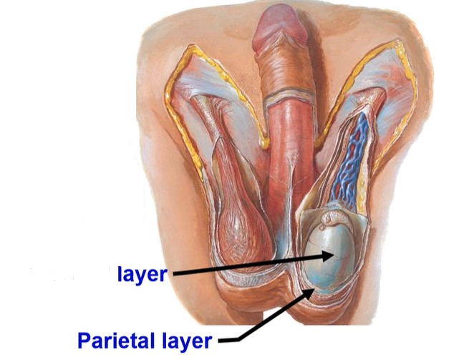
The testes are surrounded by three tunica
a- Innermost layer, Tunica vasculosa (thin layer of blood vessels)
b- Middle layer, Tunica albuginea is a thick protective capsule
c- Outermost layer, Tunica vaginalis (derived from vaginal process of the peritoneum during descend of the testes)
- It is formed of inner visceral layer and outer parietal layer, in between them a cavity containing a thin fluid layer
Visceral

Slide 9
• Arterial supply: Testicular artery from the abdominal aorta.
• Venous drainage pampiniform plexus of vein that form testicular vein:
a. Right vein ends in the inferior vena cava.
b. Left vein ends in the left renal vein.
• Why varicocele is common in the left side
1. Left testicular vein is Longer than right
2. It opens in the left renal vein by right angle.
3. Compression by a full sigmoid colon in chronic constipation.
4. Vascular spasm by adrenaline coming from left suprarenal gland.
** Applied anatomy, undescended testes
- undescended testes leading to arrest of the spermatogenesis.
- In bilateral cases occurs permanent sterility.
- If neglected, the testis transforms into malignant

Slide 10
Spermatic cord

Slide 11
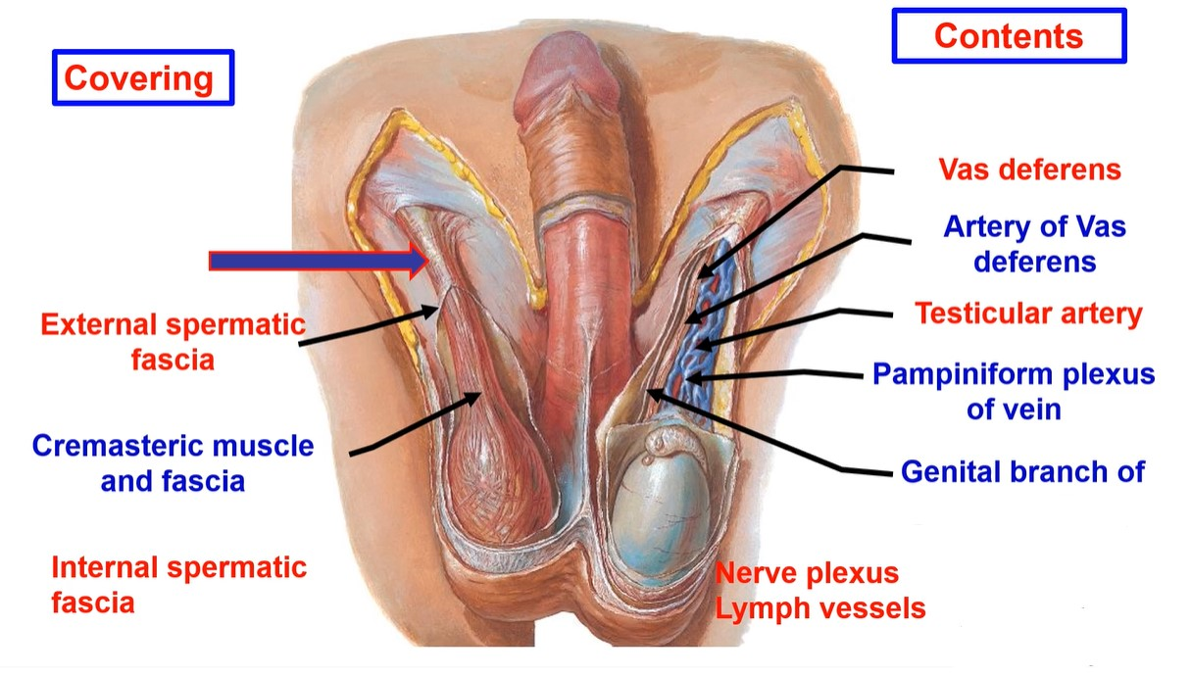
genitofemoral N

Slide 12
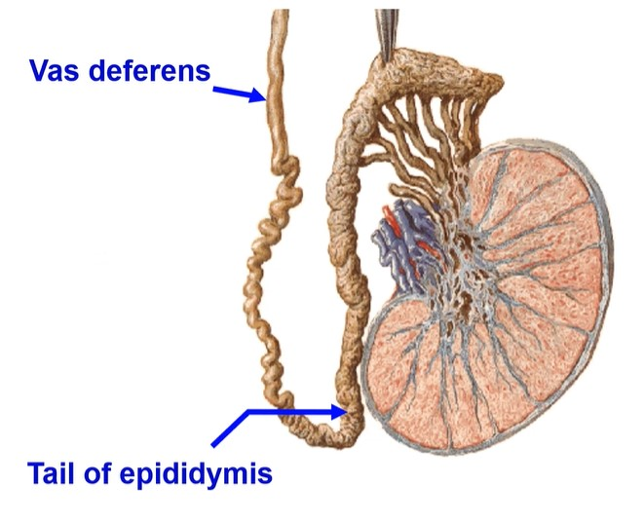
Vas deferens
Vas deferens is a thick cord- like tube, about 45 cm long.
- It carries and stores the sperms.
- It begins from the tail of the epididymis.
** Course
- Scrotal part: ascends on the back of the testis.
- Inguinal part: runs in the inguinal canal through the spermatic cord.

Slide 13
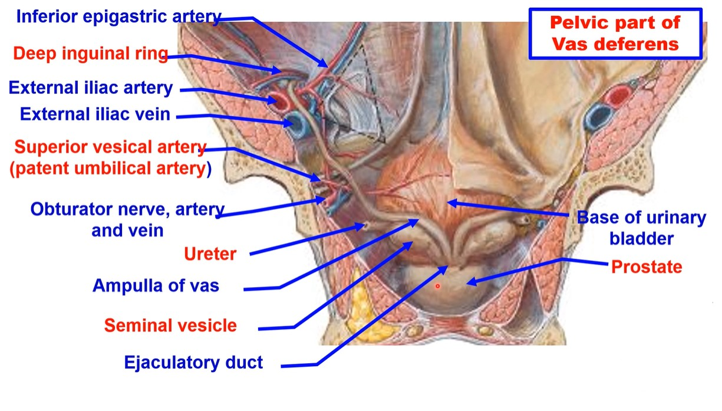

Slide 14
- Pelvic part: curves around inferior epigastric artery.
- Then, it descends downwards and backwards on the following structures;
1- External iliac artery. 2- External iliac vein.
3- Superior vesical (patent umbilical) artery. 4- Obturator nerve.
5- Obturator artery. 6- Obturator vein
7- Ureter 8- Base of urinary bladder
** End behind the base of the urinary bladder by forming the ampulla of vas which joins the seminal vesicle to form the ejaculatory duct, that open into the seminal colliculus of the prostatic urethra.
** Function of seminal vesicles (glands) secrets great amount of the seminal fluid, which contract during ejaculation.

Slide 15
Prostate

Slide 16
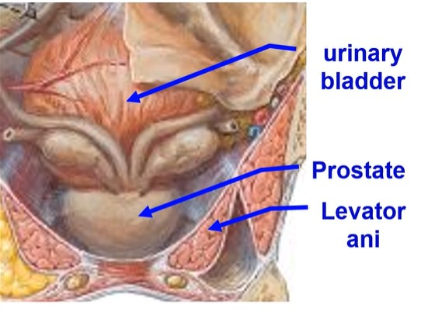
Prostate
** Site, It lies just below the urinary bladder and surrounds the prostatic part of urethra.
** Dimensions (measurements)
2 cm Anteroposterior diameter at the base.
3 cm Vertical diameter:
4 cm Transverse diameter at the base.
** Relations
- Base: directed upwards and related to neck of urinary bladder. It is pierced by urethra.
- Apex: directed inferiorly and rests on pelvic fascia.
- Inferolateral surfaces: related to anterior part of the levator ani.

Slide 17
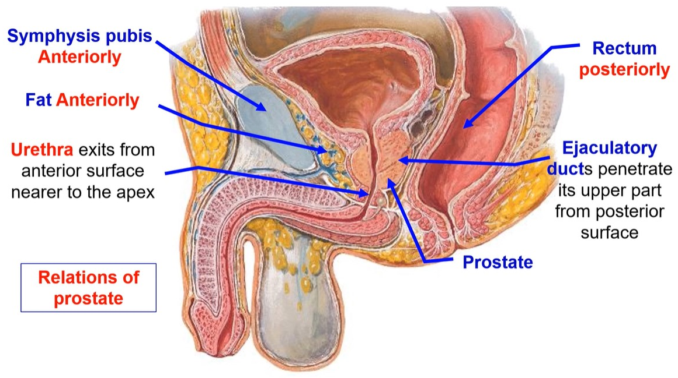

Slide 18
uvula.

Slide 19
**Structures of the prostate;
A- Glandular tissues are formed of 2 layers:
1- Outer large zone formed of glands that open into the prostatic sinus. It is the commonest site of the cancer prostate.
2- Inner small zone formed of submucosal glands that open into the prostatic sinus. It is the commonest site of the benign prostatic hypertrophy.
B- Muscular tissue: arranged into 3 layers (Peripheral, Central and intermediate layer form meshes in which the glandular tissues embedded).
** Arterial supply: 1) inferior vesical. 2) Middle rectal. 3) Internal pudendal.
** Venous drainage: The veins form a prostatic venous plexus.
** Lymphatic drainage: into 1) internal iliac. 2) Sacral lymph nodes
** Nerve supply: from the pelvic plexus.
** Applied anatomy
- Cancer prostate commonly spreads to vertebrae because prostatic venous plexus is connected to internal vertebral venous plexuses by valveless veins.

Slide 20
Benign prostatic hyperplasia (BPH), prostate enlargement
Cause: unknown, hormonal changes as a man gets older
Symptoms: Frequent or urgent need to urinate, Increased frequency of urination at night (nocturia), Difficulty starting urination, weak stream, inability to urinate, or loss of bladder control; sexual problems in men, Erectile dysfunction (inability to attain and maintain an erection sufficient for sexual intercourse), Reduced sex drive, Decreased sexual satisfaction.
7 Natural Ways To Keep Your Prostate Healthy
1. Eating more vegetables and fruits
2. Eat more legumes (beans, peas, and lentils) and whole grains
3. Limit red meat and dairy
4. Eat more fatty fish
5. Drink green tea, Reduce caffeine, soda, energy drinks and alcohol
6. Maintain a healthy weight
7. Exercise regularly.

Slide 21
Penis
The male
copulatory organ

Slide 22
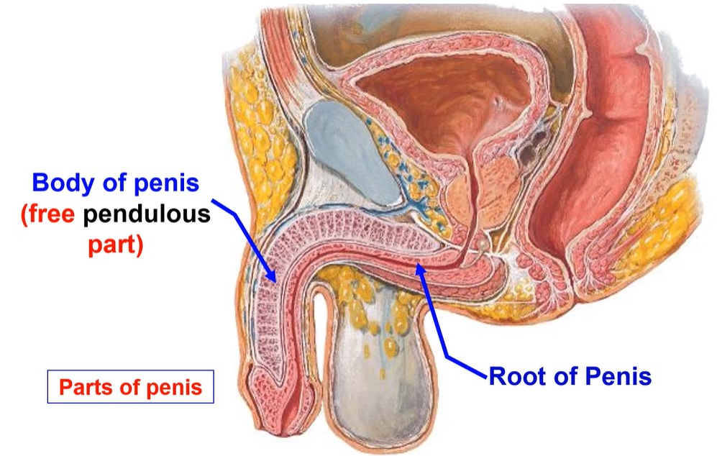

Slide 28
Thank you
Questions

