Slide 1
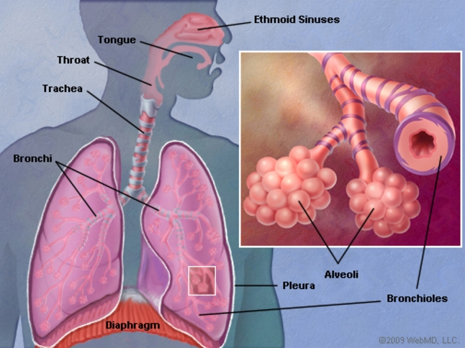
Stridor and Hoarseness of voice
Ahmad Al- Saraireh Rakan Al- Habashneh supervised by : Dr. Osama Al- Btoosh

Slide 2
Introduction
Stridor is an abnormal, high-pitched sound produced by turbulent airflow through a partially obstructed airway at the level of the supraglottis, glottis, subglottis, or trachea.
Any obstruction above those levels will cause a stertor sound and obstruction at the level of the bronchi or below will cause a wheeze.
Stridor is a symptom, not a diagnosis or a disease, and the underlying cause must be determined.

Slide 3
Stridor may be inspiratory (most common), expiratory, or biphasic. Each suggest different causes, as follows:
Inspiratory stridor: supraglottic obstruction
Expiratory stridor: implies tracheobronchial obstruction
Biphasic stridor: suggests a subglottic or glottic anomaly.
Stridor is mainly classified to acute and chronic according to the onset and severity of the stridor

Slide 4
Clinical presentation
History
The most common presenting symptom is loud, raspy, noisy breathing.
Age of onset, duration, severity, and progression of the Stridor.
Precipitating events (eg. crying or feeding)
Positioning (eg. prone, supine, or sitting)
Presence of aphonia.
Other associated symptoms (eg. paroxysms of cough, aspiration, difficulty in feeding, drooling, or sleep-disordered breathing)
history of color change (cyanosis)

Slide 5
Examination
On initial presentation, especially if the symptoms are of acute onset, the child should immediately be assessed for severity of stridor and respiratory compromise. Special attention should be paid to the following:
Heart and respiratory rates
Pulse oximetry , O2 sat.
Cyanosis
Use of accessory muscles of respiration
Nasal flaring
Level of consciousness
Responsiveness

Slide 6
- The patient may prefer certain positions that alleviate the stridor.
It is important to observe the character of the cough, cry, and voice.
The presence of fever and toxicity generally implies serious bacterial infections.
Note: Any form of airway examination should be avoided in cases of suspected epiglottitis or croup, as can predispose to sudden airway closure

Slide 7
Investigations
On initial evaluation, pulse oximetry may be useful to determine the extent and severity of the stridor and respiratory compromise.
Fiber-optic nasal endoscopy
A quick and minimally invasive method to differentiate where the pathology lies.
Note: Fiber-optic nasal endoscopy is contraindicated in patient suspected of croup or epiglottitis.

Slide 8
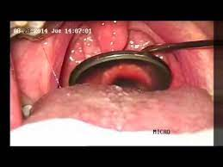
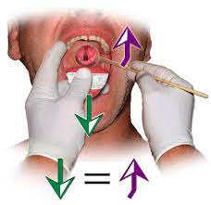
indirect laryngoscopy - for local laryngeal causes

Slide 9
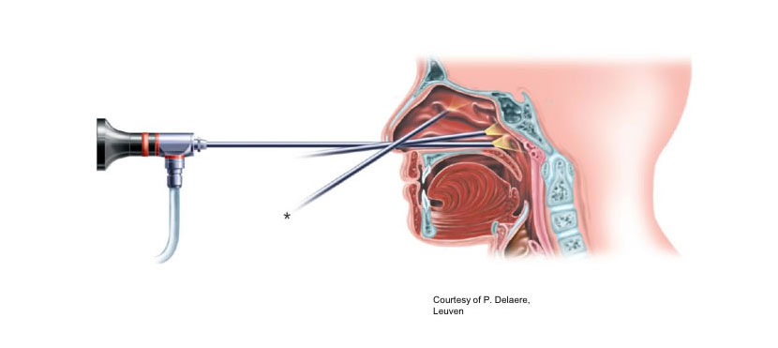
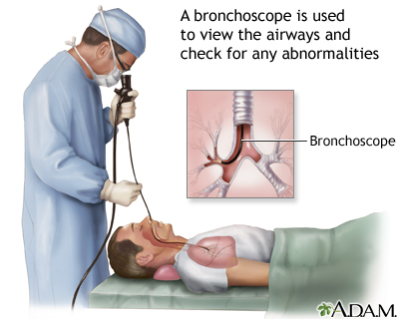
CT Scan
Used in the case of abscess or malignancy.
Bronchoscopy
Bronchoscopy can be used if visualization below the vocal cords is warranted, such as suspected subglottic stenosis.

Slide 10
Triple endoscopy : endoscopic evaluation of the pharynx, larynx, esophagus, trachea, and bronchi . Usually in malignancy . - Direct laryngoscopy - Bronchoscopy - esophagoscopy then biopsy .

Slide 11
Acute Stridor
Laryngotracheobronchitis (Croup)
Epiglottitis
Foreign body inhalation
Anaphylaxis
Neck space abscess
Laryngitis

Slide 12
Laryngotracheobronchitis (cRoup)
Laryngotracheobronchitis (also known as croup) is inflammation of the larynx, trachea, and bronchus, including the vocal cords.
Croup is the most common cause of acute stridor in children aged 6 months to 2 years.
The cause of croup in 95% of cases is viral infection, common organisms including parainfluenza, influenza and rhinovirus
It is typically preceded by an upper respiratory infection, before developing into dyspnoea and a characteristic barking cough, with potential fever. Symptoms are usually worse at night.
Most cases do not require any investigations and can be made as a clinical diagnosis.

Slide 13
The steeple sign is a radiologic sign found on an AP neck radiograph where subglottic tracheal narrowing produces the shape of a church steeple within the trachea itself

Slide 14
Management
all children with croup should receive single dose of oral dexamethasone (0.15mg/kg) to reduce the inflammation and symptoms.
Pain and fever can be controlled with paracetamol and ibuprofen, as needed.
In the presence of any of the following signs, hospital admission should be considered:
Known structural upper airway obstruction, a history of severe croup, or immunocompromise
Uncertain diagnosis
An unwell child with inadequate oral intake
Less than 6 months old
In hospital, inhaled corticosteroids can be given, alongside nebulised adrenaline, to decrease airway inflammation. In severe cases, intubation may be warranted

Slide 15
Epiglottitis
Most commonly caused by H. Influenzae type B infections.
Typically affects children between 2-7 years.
Patients will initially present with a sore throat, a fever, and dyspnoea, characteristically in the absence of a cough. Late signs of the condition if left untreated include drooling, dysphagia, and stridor.
Hot potato voice
The patient will look unwell and is classically seen, in late stages on the disease, sitting in the tripod position (to allow gravity to assist in keeping the airway open).

Slide 16
Investigations and management
All cases of epiglottitis need urgent assessment by senior anesthetist or ENT surgeon, in a HDU or ICU setting (the airway should not be examined without such support due to the high risk of airway narrowing).
Nebulised adrenaline and IV dexamethasone should be started in all suspected cases.
Blood and throat cultures should be taken and IV broad-spectrum antibiotics should be given, alongside analgesia and IV fluids.

Slide 17
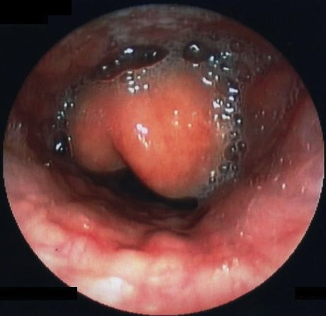
Tripod position
Epiglottitis

Slide 18
The thumb sign in epiglottitis is a manifestation of an edematous and enlarged epiglottis which is seen on lateral soft-tissue radiograph of the neck, and it suggests a diagnosis of acute infectious epiglottitis.

Slide 19
Management of acute stridor
For acute causes that require urgent management, initial steps should involve:
Stabilize the patient, start high-flow oxygen, and alert suitable senior specialists (ENT and / or anesthetist)
Try to suction secretions or clear any foreign body from airway if obvious or visible
Give adrenaline or steroids (IV or inhaled), as necessary
Take bloods, including an ABG or cultures if indicated
In emergency situations, be prepared to perform or assist with an emergency tracheostomy or intubation

Slide 20
Chronic stridor
Laryngomalacia
Subglottic stenosis
Vocal cord paralysis
Subglottic haemangioma
Macroglossia or micrognathia
Malignancy

Slide 21
Laryngomalacia
The most common cause of inspiratory stridor in the neonatal period and early infancy and accounts for as many as 75% of all cases of stridor.
Stridor may be exacerbated by crying or feeding. Placing the patient in a prone position with the head up alleviates the stridor; a supine position exacerbates the stridor.
Laryngomalacia is usually benign and self-limiting and improves as the child reaches age 1 year. In cases where significant obstruction or lack of weight gain is present, surgical correction or supraglottoplasty may be considered
Subglottic stenosis
Most commonly seen secondary to prolonged intubation.

Slide 24
Vocal cord dysfunction
Probably the second most common cause of stridor in infants. Unilateral vocal cord paralysis can be either congenital or secondary to birth or surgical trauma (eg, from cardiothoracic procedures, thyroid surgery).
Patients with a unilateral vocal cord paralysis present with a weak cry and biphasic stridor that is louder when awake and improves when lying with the affected side down.
Bilateral vocal cord paralysis is a more serious entity. Patients usually present with aphonia and a high-pitched biphasic stridor that may progress to severe respiratory distress.

Slide 26
Management of chronic stridor
For non-emergency or chronic cases, visualisation of the upper airway will normally be done via fibreoptic nasal endoscopy.
Further imaging studies, such as CT scanning, can be used in the case of abscess or malignancy, whilst bronchoscopy can be used if visualisation below the vocal cords is warranted, such as suspected subglottic stenosis.
Definitive management steps will then vary between the underlying causes.

Slide 27
hoarseness of voice
A hoarse voice refers to a weak or altered voice. It is a relatively common presentation, and can represent a wide range of pathologies.
Patients with hoarse voice should undergo a full investigation to identify the cause of the symptom and should be treated accordingly.

Slide 28
Investigations
flexible nasal endoscopy
Any patient presenting with a hoarse voice should undergo a flexible nasal endoscopy (FNE). FNE allows visualisation of the larynx and the vocal cords
Microlaryngobronchoscopy
Another procedure that allows for visualize the larynx, vocal cords, and the bronchi. Similar to FNE, however MLB is performed in a theatre setting under general anesthesia.
Stroboscopy
Used in specialist voice clinics and can be a very useful diagnostic test in vocal cord dysfunction. It involves the use of synchronised flashing lights to make vocal fold movements appear slower, allowing for complete assessment of their movement.

Slide 29
Differential Diangosis
Benign Laryngeal Conditions
Vocal cord nodules
Commonly secondary to chronic phonotrauma (vocal abuse)They are benign lesions that are frequently bilateral, occurring at the junction of the anterior 1/3rd and posterior2/3rd.
Management is mainly from the Speech and Language Therapy (SALT) team, however in severe or resistant cases, surgical intervention may be warranted.

Slide 30
Pathophysiology : abuse (yelling), or misuse (hyperfunction) may produce excessive amounts of mechanical stress by increasing the rate and/or force with which the vocal folds collide. This may lead to trauma that is focalized to the mid-membranous vocal fold and subsequent wound formation. Repeated or chronic mechanical stress is thought to lead to the remodeling of the superficial layer of the lamina propria.
It is this process of tissue remodeling that results in the formation of benign lesions of the vocal folds such as nodules.

Slide 31
Vocal cord polyps
Benign lesions
Differ from nodules in that :
Unilateral, more vascular, usually larger.
Vocal abuse, smoking, alcohol use, sinusitis, allergies, and rarely, hypothyroidism.
may need surgical excision to exclude malignancy.

Slide 33
Recurrent respiratory papillomatosis
benign lesions in the larynx, commonly caused by HPV infection. If left untreated, papillomas can grow to cause airway obstruction and hence need surgical excision or debulking. It is common for patients to need repeat procedures as papillomas can recur.

Slide 34
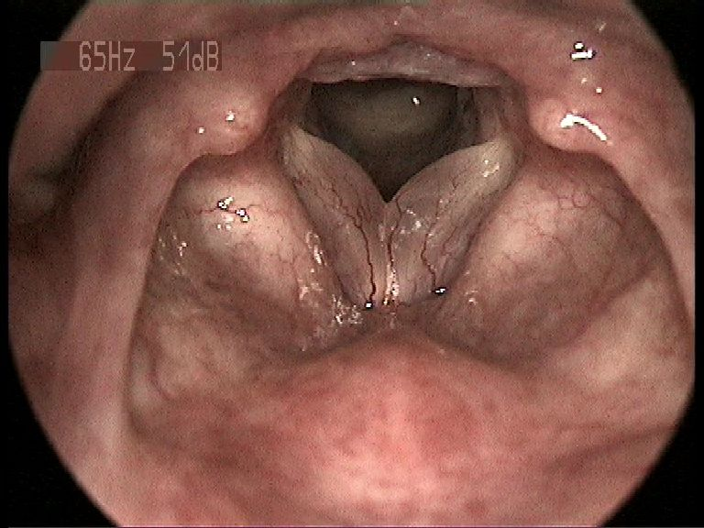
Reinke’s edema
Reinke’s edema almost always occurs due to longstanding smoking.
Literature suggests that it may occur secondary to thyroid disease, hormonal change, stomach acid reflux, or voice overuse.
Reinke’s edema does not disappear after smoking cessation, however it may stop growing in size.

Slide 35
The edema develops by degrees, as a nonspecific reaction of the vocal folds to various irritative noxious agents
Treatment : stop smoking, control reflux, microlaryngoscopic surgery

Slide 36
Vocal fold cysts
benign masses of the membranous vocal folds.
These cysts are enclosed, sac-like structures that are typically of a yellow or white colour.
They occur unilaterally on the midpoint of the medial edge of the vocal folds
Initial treatment of the cysts involves voice therapy to reduce harmful vocal behaviours. If symptoms remain after voice therapy, patients may require surgery to remove the cyst. Surgery is typically followed by vocal rest and further voice therapy to improve voice function. Cysts may also be treated using vocal fold steroid injection.

Slide 37
Vocal cord cysts
There are several possible causes of vocal fold cysts:
They can be congenital.
They can result from the blockage of a mucous gland's excretory duct. In this case, they are sometimes referred to as retention cysts.
They can be the result of phonotrauma

Slide 38
Thank you !

