Slide 1
INTEGUMENTARY SYSTEM
Primary Components of the Integumentary System:
The integumentary system consists of the:
1. Skin (epidermis , dermis and subcutaneous tissue ).
* epidermis : stratified squamous epithelium , has no blood vessels or lymphatic . its thickness is different between different persons depending on the mechanical friction to which it is exposed.
2. Its accessory organs (skin appendages) :
The hair ( except the palm and the sole of the foot )
Nails
Sebaceous glands
Sweat glands

Slide 2
The skin is the largest organ in the body and performs many vital functions:
1) It shields the body forming a protective barrier between the body and the external environmen (biological protection) .
2) Injuries (mechanical protection) .
3) Protects against microbial Infection .
5) Protects against Harmful ultraviolet rays and other radiations
6) Protection against toxic compounds and insecticides …. This protection
ability differs between different creatures and against different materials . so some materials can easily penetrate the skin .
7) Has endocrine functions : the skin can form certain hormones , steroids and pheromones which are responsible for things as pheromonal activity which cause sexual attraction .
some steroids are transformed into vitamin D up on exposure to U.V rays .

Slide 3
Beneath the skin’s surface is an intricate network of sensory receptors that interact with the skin cells and register various modalities of sensations as:
1. Temperature : have different types of receptors , ones for wide temperature difference and ones for narrow temperature difference .
2. Pain
3. Touch
4. Pressure
5. Proprioceptive sensations , learned sensations and measurements such as the force needed to left a cup while its empty and while its full , which include:
A. Spatial aspect (place of sensation)
B. Temporal aspect ( time & continuity of sensation)

Slide 4
The millions of sensory receptors and a vascular network aid the functions of the entire body in maintaining homeostasis, a stable internal environment of the body.
Sweat glands are everywhere and sebaceous glands are at the roots of the hair mostly .
Sebaceous glands keep the hair from breaking .
we notice that the blood vessels don’t reach the epidermis

Slide 5
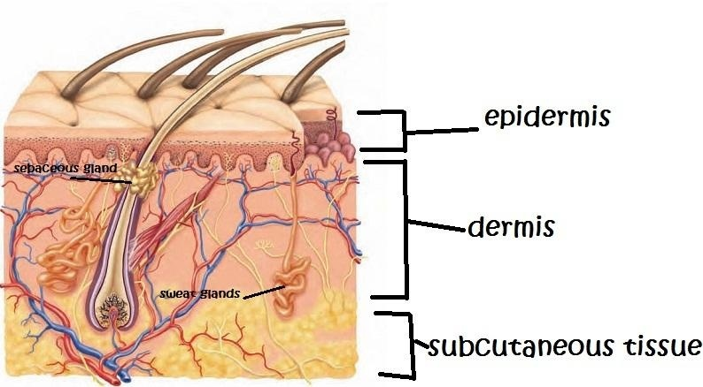

Slide 6
Adip/o fat
adip/o/cele (A˘ D-ı˘-po- -se-l): an enlargement or swelling that contains fat. -cele: hernia, swelling
cutane/o skin
cutane/ous (ku- -TA - -ne--u˘s): pertaining to the skin.
-ous: pertaining to, relating to
derm/o
hypo/derm/ic (hı--po- -DE˘ R-mı˘k): under or inserted
under the skin, as in a hypodermic injection .
hypo-: under, below, deficient . -ic: pertaining to or relating to .
hidr/o sweat
hidr/aden/itis (hı--dra˘d-e˘-NI--tı˘s):inflammation of a sweat gland .
aden: gland .
-itis: inflammation .
* Do not confuse hidr/o (sweat) with hydr/o (water).
sudor/o :sweating sudor/esis (su- -do- -RE- -sı˘s): profuse sweating
- esis: condition

Slide 7
ichthy/o dry, scaly
ichthy/osis (ı˘k-the--O- -sı˘s): any of several dermatologic conditions characterized by noninflammatory dryness and scaling of the skin, often associated with other abnormalities of lipid metabolism as well as some thyroid gland disease such as hypothyroidism. May be accompanied b accumulation of a certain lipid under the skin .
kerat/o horny tissue; hard
kerat/osis (ke˘r-a˘-TO - - sı˘s): any condition of the skin characterized by an overgrowth and thickening of skin.
-osis: abnormal condition; increase (used primarily with
blood cells)
myc/o fungus (plural, fungi)
dermat/o/myc/osis (de˘r-ma˘- to- -mı--KO- -sı˘s): fungal
infection of the skin dermat/o: skin .

Slide 8
onych/o nail
onych/o/malacia (o˘n-ı˘-ko- -ma˘-LA - -she--a˘) ): abnormal softening of the nails . malacia: softening
pil/o hair
pil/o/nid/al (pı--lo- -NI--da˘l): growth of hair in a dermoid cyst or in a sinus opening on the skin (pilonidal sinus or cyst : an invagination of the skin in the subcutaneous tissue which can include other skin components , they secrete and grow and then get inflamed . commonly develops in the sacral region of the skin , specially in well built and fat people
nid: nest -al: pertaining to
trich/o hair
trich/o/pathy (trı˘k-O˘ P-a˘-the-): any disease of the hair , may cause atrophy . has different origins and reasons .
-pathy: disease , neuromyopathy : a muscle disease from a neurological origin .

Slide 9
scler/o hardening;
scler/o/derma (skle˘r-o- -DE˘R- ma˘): chronic disease with abnormal hardening of the skin caused by formation of new abnormal hard collagen , it’s an auto immune collagen disease. -derma: skin
seb/o sebum, sebaceous
seb/o/rrhea (se˘b-or-E- -a˘): increase in the amount sebum with formation of oily scales and often an alteration of the quality of the fats secreted by the sebaceous glands. Usually accompanied by itchy feeling .
-rrhea: excessive discharge, flow .
squam/o scale
squam/ous (SKWA - -mu˘ s): flattening of cells, scale like
-ous: pertaining to, relating to.

Slide 10
xer/o dry
xer/o/derma (ze--ro- -DE˘R-ma˘): chronic skin condition characterized by excessive roughness and dryness
-derma: skin
Xeroderma is a mild form of ichthyosis .
-derma skin
py/o/derma (pı--o- -DE˘R-ma˘): any pyogenic (a pus producing ) infection of the skin , pus maybe produced under neath the surface of the skin .
py/o: pus
-phoresis carrying, transmission
dia/phoresis (dı--a˘-fo- -RE- -sı˘s): condition of profuse sweating; sudoresis;
hyperhidrosis .
dia-: through, across
-plasty surgical repair
dermat/o/plasty (DE˘R-ma˘-to- -pla˘s-te-): surgical repair of the skin , the incisions here are clean and usually along the skin creases .
dermat/o: skin .

Slide 11
-therapy : treatment
cry/o/tomy : cutting thin sections of frozen tissues , to prevent protein denature(corruption of the three-dimensional structure of the protein) .
we commonly use liquid nitrogen for freezing ( lower than -170 C).
cry/o/therapy (krı--o--THE˘R-a˘-pe-): treatment using cold as a destructive medium , repeated freezing to destroy the cause of the disease (may be a virus ) or the damaged tissue
cry/o: cold.
Warts and actinic keratosis are some of the common skin disorders responsive to cryotherapy.
Freezing may be used instead of anesthetics.

