Slide 1
Cardiovascular Pathology
Vasculitis
Ghadeer Hayel, MD Histopathologist 22/11/2020

Slide 2
Inflammation of the walls of vessels is called vasculitis
It is encountered in diverse clinical settings.
Vessels of any type in virtually any organ can be affected.
Clinical manifestations often include:
constitutional signs & symptoms: e.g., fever, myalgias, arthralgias, & malaise.
local manifestations of downstream tissue ischemia.

Slide 3
Several vasculitides tend to affect only vessels of a particular size or location, but Most vasculitides affect small vessels; from arterioles to capillaries to venules
20 primary forms of vasculitis → classification schemes → according to: vessel diameter, role of immune complexes, presence of specific autoantibodies, granuloma formation, organ specificity, & even population demographics
The two most common mechanisms of vasculitis are:
- direct invasion of vascular walls by infectious pathogens
- Immune-mediated mechanisms .
Physical & chemical injury, such as irradiation,
mechanical trauma, & toxins can also cause
vascular damage.

Slide 4
Pathogenesis of Noninfectious Vasculitis
Immunologic injury in noninfectious vasculitis may be caused by:
(1) Immune complex deposition
(2) Antineutrophil cytoplasmic antibodies (ANCA)
(3) Anti-endothelial cell antibodies. (Anti-EC)
(4) Autoreactive T cells

Slide 5
Immune Complex–Associated Vasculitis
This mechanism is supported by the fact that the vascular lesions resemble those found in experimental immune complex - mediated conditions.
Also in some cases contain readily identifiable antibody and complement.
is a diagnostic challenge; rarely is the specific antigen responsible for immune complex formation known, & in most instances it is not clear whether the pathogenic antigen-antibody complexes are deposited into the vessel wall from the circulation or form in situ.
Systemic lupus erythematosus & polyarteritis nodosa

Slide 6
ANCA associated
Patients have circulating antibodies react with neutrophil cytoplasmic antigens (antineutrophil cytoplasmic antibodies (ANCAs).
ANCAs are a heterogeneous group of autoantibodies directed against constituents (usually enzymes) of neutrophil primary granules, monocyte lysosomes.
Two main patterns are recognized by IF studies:
1. Cytoplasmic localization of the staining (c-ANCA), target antigen is proteinase-3 (PR3), a neutrophil granule constituent. (Anti-proteinase-3)→ granulomatosis with polyangiitis
2. Perinuclear staining (p-ANCA) & target antigen is myeloperoxidase (MPO). (Anti-myeloperoxidase) microscopic polyangiitis & Churg-Strauss syndrome

Slide 7
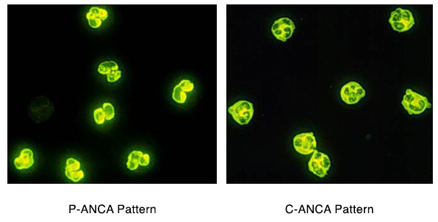
ANCA associated
These auto-antibodies are directed against cellular constituents without circulating immune complexes. Lesion does not contain antibody and complement; so often described as “pauci-immune.”
Notes:
https://unckidneycenter.org/kidneyhealthlibrary/glomerular-disease/anca-vasculitis/

Slide 8
Anti-Endothelial Cell Antibodies & Autoreactive T Cells
Antibodies to ECs underlie certain vasculitides, such as Kawasaki disease
Autoreactive T cells cause injury in some forms of vasculitides characterized by formation of granulomas.

Slide 9
Classification of Vasculitis
Vessel | Disease | summary
Large | Giant-cell arteritis | F, >50. Arteries of head.
 | Takayasu arteritis | F, <40. “Pulseless disease”
Medium | Polyarteritis nodosa | Young adults. Widespread.
 | Kawasaki disease | <4. Coronary disease. Lymph nodes.
Small | Wegener granulomatosis | Lung, kidney. c-ANCA.
 | Churg-Strauss syndrome | Lung. Eosinophils. Asthma. p-ANCA.
 | Microscopic polyangiitis | Lung, kidney. p-ANCA.

Slide 10
Temporal (giant cell, cranial) arteritis
A chronic inflammatory disorder affects principally large- to small-sized arteries in the head (the temporal, vertebral, ophthalmic arteries), also affect the aorta, & may cause thoracic aortic aneurysm.
It is the most common form of vasculitis among older adults in developed countries.
Ophthalmic arterial involvement may lead to permanent blindness. Therefore, giant cell arteritis is a medical emergency that requires prompt recognition & treatment.

Slide 11
Temporal (giant cell, cranial) arteritis
Histology
granulomatous inflammation
chronic non-specific panarteritis
fragmentation of the internal elastic lamina
Pathogenesis
T Cell mediated immunity

Slide 12
Temporal (giant cell, cranial) arteritis
Clinical features
Females > males (~X4)
> 50 years (rare before 50 years of age)
non-specific constitutional symptoms
Headache, local facial pain & tenderness
ocular symptoms, 50 % (range from diplopia to blindness)
Diagnosis
Biopsy (at least 1cm)→ Could be negative (very focal involvement)
Rx: corticosteroids are effective.

Slide 13
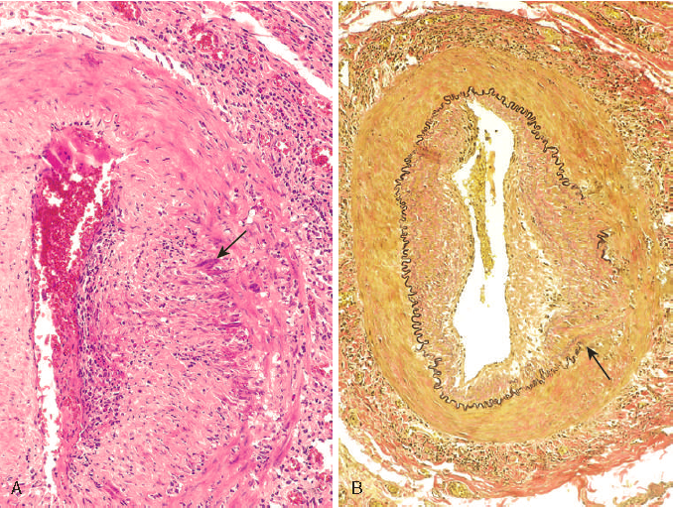

Slide 14
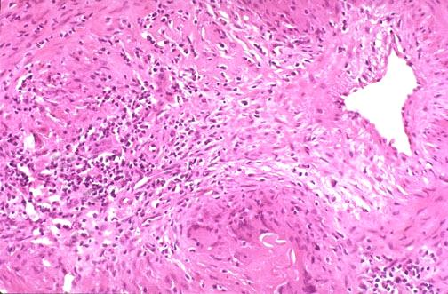

Slide 15
Takayasu Arteritis (pulseless disease)
A granulomatous vasculitis of medium & larger arteries affects mainly arch of aorta.
Characterized by transmural fibrous thickening & obliteration of aortic arch & great vessels → luminal narrowing of the major branch vessels → the origin of great vessels.
Symptoms are secondary to luminal narrowing:
ocular disturbances & marked weakening of the pulses in the upper extremities →(pulseless disease).
More common in females younger than 40 years and more frequently in Asian countries.
Course of disease is variable ,may enter in quiescent stage.

Slide 17
Polyarteritis nodosa (PAN)
A systemic disease characterized by necrotizing inflammation of small - to medium - sized arteries throughout the body (renal and visceral), sparing the pulmonary circulation.
The involvement of the vessels is focal, random & episodic.
It often produces irregular aneurysmal dilatation (coz it weakens the arterial wall) nodularity, and vascular obstruction leading to infarctions.
Acute lesions show segmental transmural necrotizing inflammation extending around the vessel.

Slide 18
Polyarteritis nodosa (PAN)
Healed lesions show marked fibrotic thickening of the arterial wall ,with associated elastic lamina fragmentation.
All stages of activity may coexist in different vessels or even in the same vessel and this is so characteristic of PAN → ongoing and recurrent insults.
Clinical features
young adults, males > females , vascular involvement is widely scattered → clinical picture can be varied & puzzling.
Diagnosis .... Biopsy
Rx … immunosuppression

Slide 19
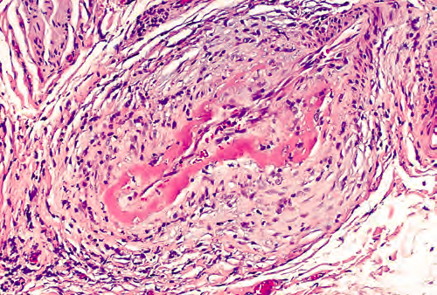

Slide 20
Kawasaki disease (mucocutaneous lymph node syndrome)
Acute febrile illness, large- to medium-sized vasculitis of infants & children (< 4 years) characterized by
- Fever, - Lymphadenopathy, - Skin rash - Oral / conjunctival erythema.
20% have coronary vasculitis ,often with aneurysm.
Histology like PAN
Etiology ; unknown (auto-antibodies to ECs)
Self-limited disease, rarely fatal(1%) → complications of coronary involvement.

Slide 21
Granulomatosis With Polyangiitis
Previously called Wegener granulomatosis.
Classical cases consist of a triad:
Granulomatous or necrotizing vasculitis mainly in the lung & upper respiratory tract.
Necrotizing granulomas of upper &/or lower respiratory tract
Renal involvement
focal necrotizing glomerulonephritis
rapidlly progressive glomerulonephritis
Clinical picture
overlaps with PAN
Males > females, peak at 5th decade

Slide 22
Granulomatosis With Polyangiitis
Diagnosis
Lung biopsy, kidney biopsy, or nasal biopsy,
Prognosis
80% die within a year (if not treated)
90% respond to treatment
Pathogenesis
T Cell Mediated.
> 95% PR3-ANC positive (Mirrors the clinical coarse )

Slide 23
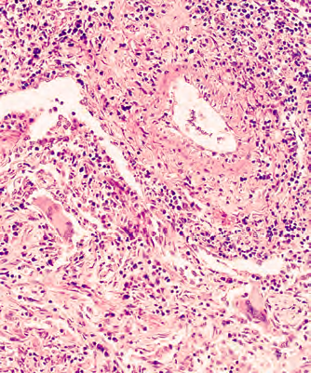
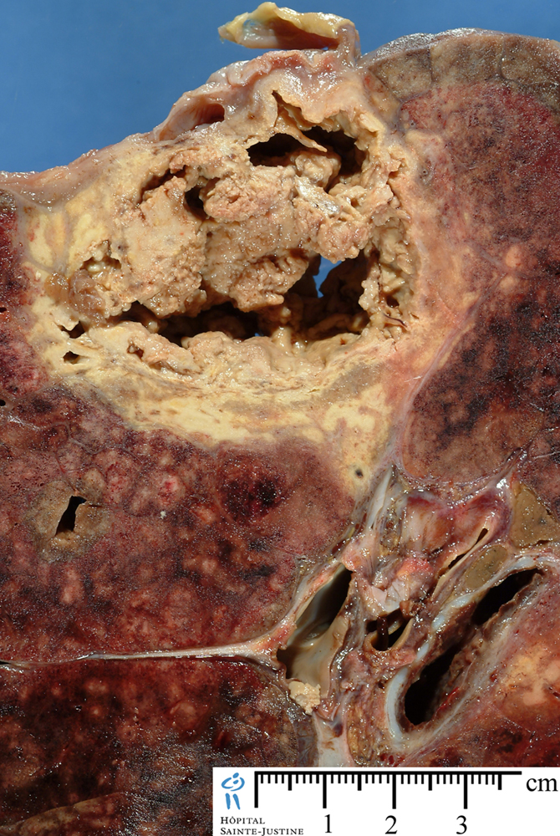

Slide 24
Microscopic polyangiitis (microscopic polyarteritis) or HYPERSENSITIVITY vasculitis OR LEUKOCYTOCLASTIC vasculitis
Most cases of microscopic polyangiitis are associated with MPO-ANCA , Although immunoglobulins and complement components can be demonstrated in early skin lesions, most lesions are “pauci-immune”

Slide 25
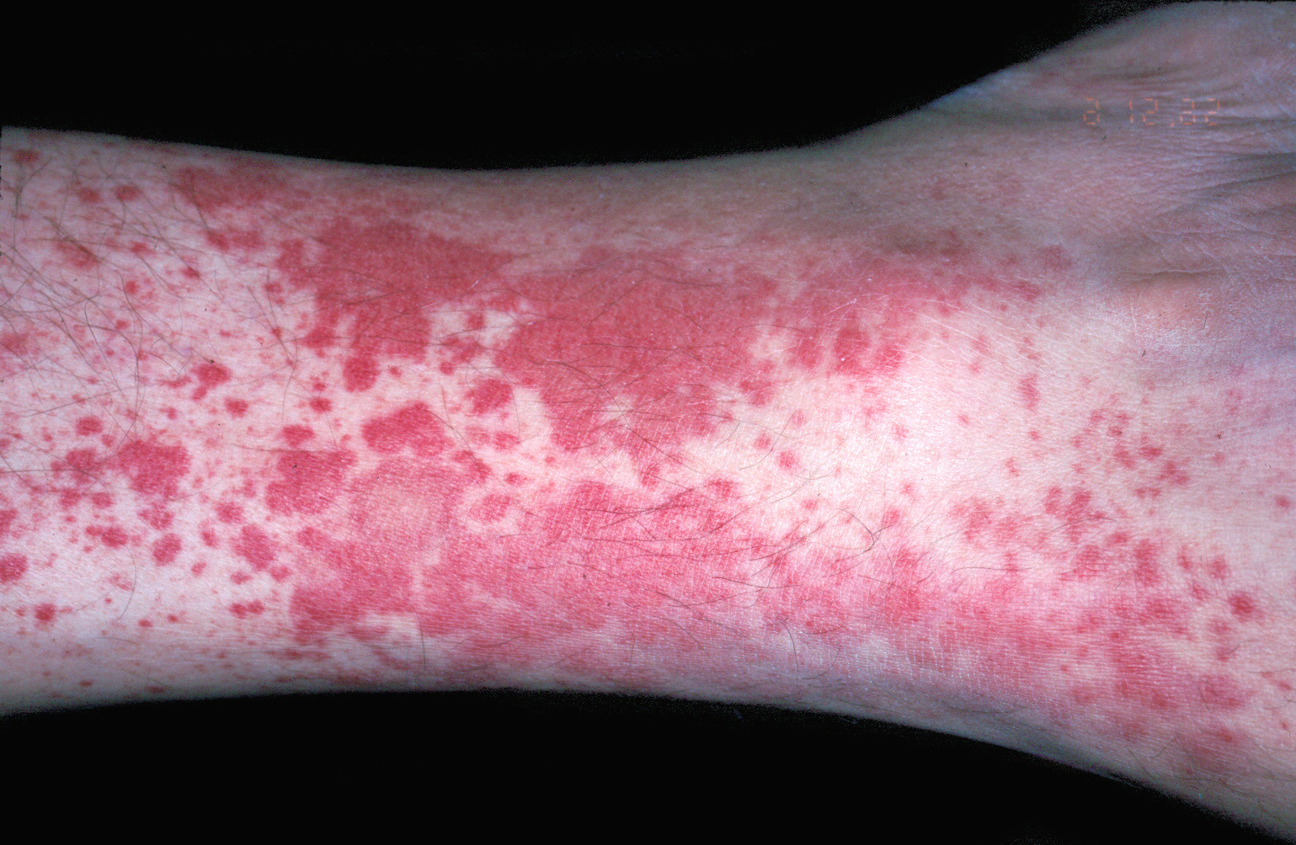
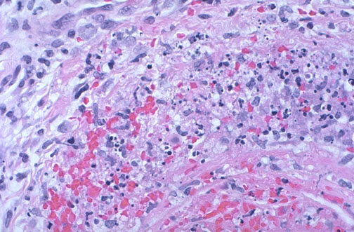
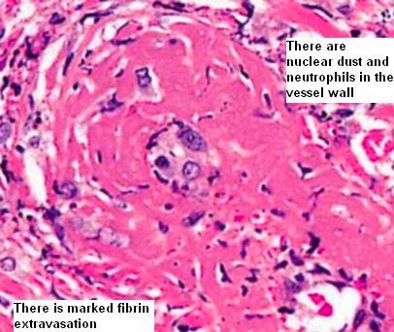
Involvement of small vessels (arterioles, capillaries, & venules).
all lesions of the same stage/age.
Skin, mucous membranes, lungs, brain, heart, GIT, kidney & muscles.
In contrast to PAN, necrotizing glomerulonephritis (90%) & pulmonary capillaritis are common
Segmental fibrinoid necrosis of media.
No granulomatous inflammation
Sometimes limited to infiltration of vessel wall by neutrophils with nuclear fragmentation (leucocytoclasia), leukocytoclasatic vasculitis.
A reaction to an Ag such as drugs, microorganisms or hetrologous protein in a previously sensitized patients.
Clinical: hemoptysis, arthralgia, abdominal pain, hematuria, proteinuria, hemorrhage, & muscle pain or weakness.
Except in brain or renal involvement most patients respond to removal of offending antigens & immunosuppression.
Ass : Henoch -schonlein purpura, essential mixed cryoglobulinemia, vasculitis with malignancy

Slide 26
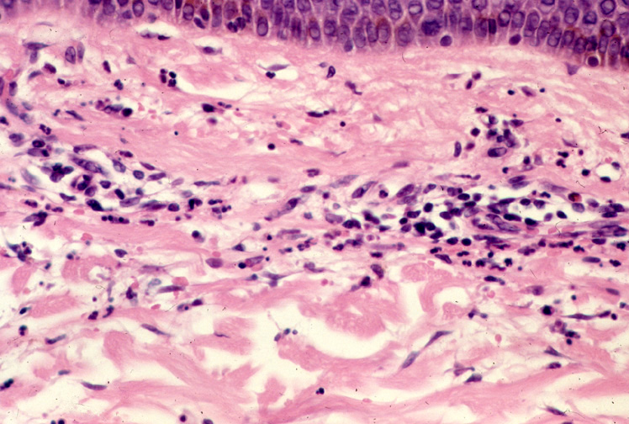

Slide 27
In allergic granulomatosis and angiitis (Churg-Strauss syndrome)
Rare disease characterized by
- necrotizing vasculitis accompanied by granulomas
with eosinophilic necrosis.
- p-ANCAs are present in A minority of patients.
- There is a strong association with allergic rhinitis,
bronchial asthma, and peripheral eosinophilia.
- Coronary arteritis & myocarditis are the principal
causes of morbidity and mortality.

Slide 28
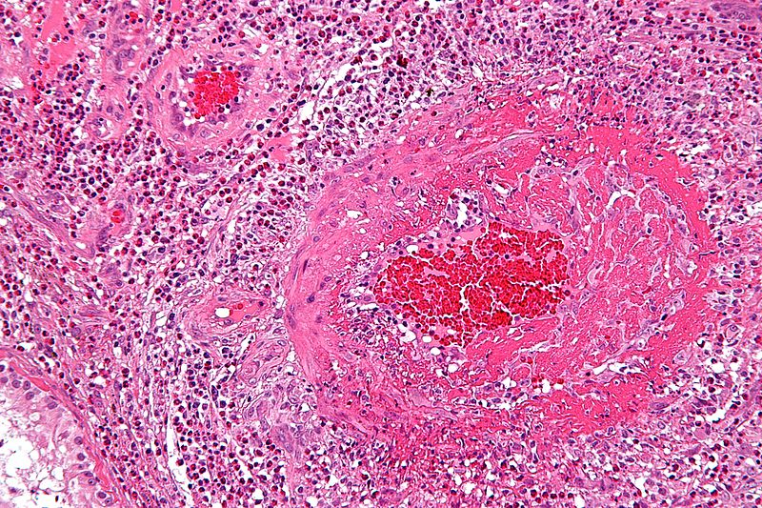

Slide 29
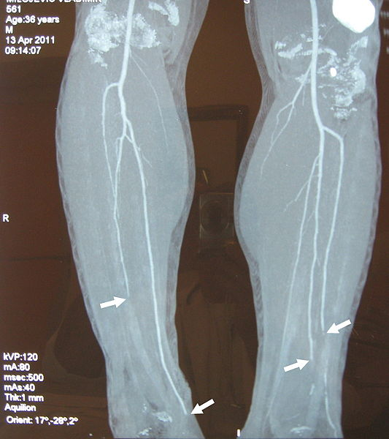
Thromboangiitis obliterans (Buerger’s Disease)
A condition marked by segmental, thrombosing, acute & chronic inflammation of intermediate & small arteries & veins in the limbs with extension to accompanying nerves.
Exclusively seen in heavy smokers males before the age of 35.
Instep claudication followed by pain at rest, might end in gangrene.
Etiology ? Endothelial cell injury by toxins in tobacco.

Slide 30
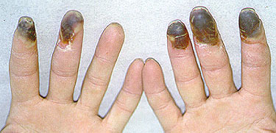
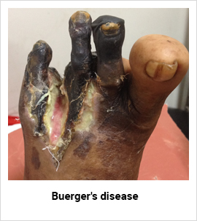

Slide 31
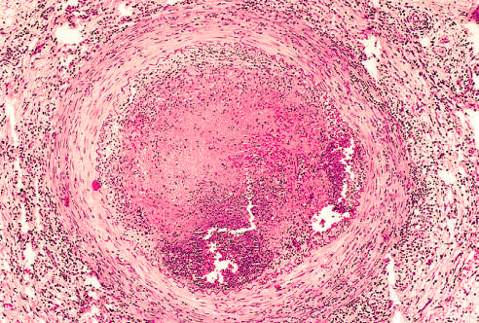

Slide 32
THANK YOU
Insert Image

