Slide 1
Common Upper Respiratory Tract Infections
Dr. Haneen Abu Al-Rous

Slide 2
Lecture Outline
Sinusitis
Acute pharyngitis and tonsillitis
Acute otitis media
Viral Laryngotracheobronchitis
Acute Epiglottitis (Supraglottitis)
Bacterial Tracheitis

Slide 3
Sinusitis

Slide 4
A common illness of childhood and adolescence.
Classification : According to
1) Etiology :Viral , bacterial or fungal .
2) Duration :
Acute sinusitis : duration of <30 days
Subacute: duration of 1-3 months
Chronic : duration of longer than 3 months
The ethmoid and maxillary sinuses are present at birth. The sphenoid sinuses are pneumatized by age 5 years, and the frontal sinuses appear by age 7 years but are not completely developed until adolescence. Thus, children are predisposed to sinus infection at an early age.

Slide 6
Epidemiology
Acute bacterial sinusitis can occur at any age. In young children, the most common sinuses involved are the ethmoid and maxillary sinuses. Acute sinusitis is much less common in young children than routine URTI or adenoiditis.mIn an older child, the sphenoid and frontal sinuses are more likely to be involved with disease.
Predisposing conditions include :
viral upper respiratory tract infections: This is the most significant predisposing factor for sinusitis
allergic rhinitis:This is the second most common predisposing factor for sinusitis
cigarette smoke exposure.
immune deficiencies particularly of antibody production (immunoglobulin IgG, IgG subclasses, IgA), abnormalities of phagocyte function.
cystic fibrosis .
ciliary dysfunction.
gastroesophageal reflux.
anatomic defects (cleft palate), nasal polyps.
nasal foreign bodies (including nasogastric tubes).

Slide 7
Etiology
Acute bacterial sinusitis causes :
1) Streptococcus pneumoniae (~30%).
2) Nontypeable Haemophilus influenzae (~20%) .
3) Moraxella catarrhalis (~20%).
4) Streptococcus pyogenes (5%)
Approximately 50% of H. influenzae and 100% of M. catarrhalis are β-lactamase positive.
Approximately 25% of S. pneumoniae may be penicillin resistant.
H. influenzae, α- and β-hemolytic streptococci, M. catarrhalis, S. pneumoniae, and coagulase-negative staphylococci are commonly recovered from children with chronic sinus disease.
Immunosuppression predisposes to severe fungal sinusitis.

Slide 8
Clinical Manifestations
Children with sinusitis can present with nonspecific complaints, including :
nasal congestion and purulent nasal discharge (unilateral or bilateral).
Fever and cough.
bad breath (halitosis) and a decreased sense of smell (hyposmia).
periorbital edema.
Headache, pressure exacerbated by bending forward, maxillary tooth pain and facial pain.
Physical examination reveal erythema and swelling of the nasal mucosa with purulent nasal discharge. Sinus tenderness and Transllimination opaque sinuses in adults.
Differentiating bacterial sinusitis from a cold
1-Persistence of nasal congestion, rhinorrhea (of any quality) and daytime cough ≥10 days without improvement.
2-Severe symptoms of temperature ≥39°C (102°F) with purulent nasal discharge >=3 days.
3-Worsening symptoms either by recurrence of symptoms after an initial improvement or new symptoms of fever, nasal discharge and daytime cough.

Slide 9
Diagnosis
The clinical diagnosis of acute bacterial sinusitis is based on history and physical examination
Laboratory tests are normally not particularly helpful in making the diagnosis of sinusitis.
Sinus aspirate culture is the only accurate method of diagnosis but is not practical but necessary for immunosuppressed patients with suspected fungal sinusitis.
Findings on radiographic studies (sinus plain films, CT scans) including opacification, mucosal thickening, or presence of an air–fluid level are not diagnostic and are not recommended in otherwise healthy children.

Slide 10
Treatment
Typically, uncomplicated cases of acute sinusitis are responsive to amoxicillin- clavulanate
Treat for 10-14 days or for 1 week beyond symptom resolution.

Slide 13
Failure to respond to these regimens necessitates referral to an otolaryngologist for further evaluation because maxillary sinus aspiration for culture testing may be necessary.
Frontal sinusitis can rapidly progress to serious intracranial complications and necessitates initiation of parenteral ceftriaxone until substantial clinical improvement is achieved.
The use of decongestants, antihistamines, mucolytics, and intranasal corticosteroids are not recommended for the treatment of acute uncomplicated bacterial sinusitis.

Slide 14
Complications
1) Orbital complication: Periorbital cellulitis and orbital cellulitis.
2) Intracranial complications: epidural abscess, meningitis, cavernous sinus thrombosis, subdural empyema, and brain abscess.
3) Osteomyelitis of the frontal bone (Pott puffy tumor), which is characterized by edema and swelling of the forehead and mucoceles, a chronic inflammatory lesions, causing displacement of the eye with resultant diplopia.

Slide 15
Orbital complications of acute sinusitis.
A, an infant with a swollen left eye and limited ocular movement.
B, Axial CT shows opacification of sinuses and an inflammatory mass with an air–fluid level displacing the medial rectus laterally.

Slide 16
A, Frontal sinusitis and epidural abscess.
Axial computed tomography image shows a frontal sinus air–fluid level (long arrow).
There is also an intracranial air–fluid level associated with an epidural abscess (short arrow)

Slide 17
Acute Pharyngitis and Tonsillitis

Slide 18
Pharyngitis refers to inflammation of the pharynx, including erythema, edema, exudates, or an enanthem (ulcers, vesicles).
Pharyngeal inflammation could be due to :
*infectious agents.
*environmental exposures, such as tobacco smoke, air pollutants.
*contact with caustic substances, hot food, and liquids.
*various inflammatory conditions such as the periodic fever, aphthous stomatitis, pharyngitis, adenitis (PFAPA) syndrome, Kawasaki disease, inflammatory bowel disease, Stevens-Johnson syndrome, and systemic lupus erythematous.

Slide 19
Etiology
Viruses
viruses predominate as acute infectious causes of pharyngitis.
Important viruses that cause pharyngitis include influenza, parainfluenza, adenoviruses, coronaviruses , enteroviruses, rhinoviruses, respiratory syncytial virus, cytomegalovirus, Epstein-Barr virus, herpes simplex virus, and human metapneumovirus.
Bacteria
Account for approximately 30% of cases of pharyngitis in children. These include the following:GAS (common), Group C streptococci (uncommon), Group G streptococci (uncommon), Neisseria gonorrhoeae (uncommon), Corynebacterium diphtheriae (rare)

Slide 23
Group A Streptococcus:
Streptococcal pharyngitis is relatively uncommon before 2-3 yr of age, is quite common among children 5-15 yr old.
Illness occurs throughout the year but is most prevalent in winter and spring.
GAS causes 15-30% of pharyngitis in school-age children.
Spread via respiratory particle droplets – NO school attendance until 24 hours after initiation of appropriate antibiotic therapy
Colonization result in asymptomatic carriage or acute infection.
The M protein is the GAS virulence factor that facilitates resistance to phagocytosis. The M protein is immunogenic; an individual can experience multiple episodes of GAS pharyngitis in a lifetime because natural immunity is M type-specific and we have numerous GAS M types (90 types).

Slide 24
Pharyngeal infection with GAS classically presents as
rapid onset of significant sore throat and fever.
The pharynx is red, the tonsils are enlarged and covered with a white, grayish exudate.
There may be petechiae or “doughnut” lesions on the soft palate and pharynx.
Enlarged and tender anterior cervical lymph nodes are frequently present.
Headache, abdominal pain, and vomiting.
Ear pain is a frequent complaint but the tympanic membranes are usually normal.
Fine red, papular (“sandpaper”) rash of scarlet fever. It begins on the face and then becomes generalized. With circumoral pallor. The rash blanches with pressure and it may be more intense in skin creases, especially in the antecubital fossae, axillae, and inguinal creases (Pastia’s lines or Pastia’s sign). The tongue Initially is “white” then “red” strawberry tongue.

Slide 25
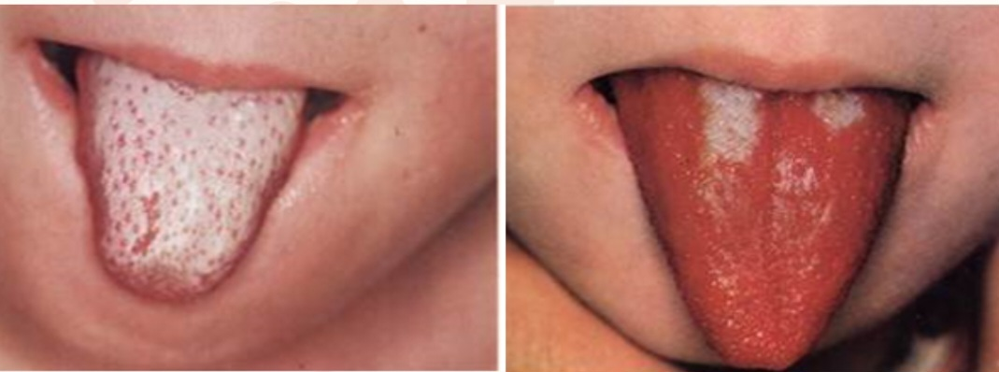
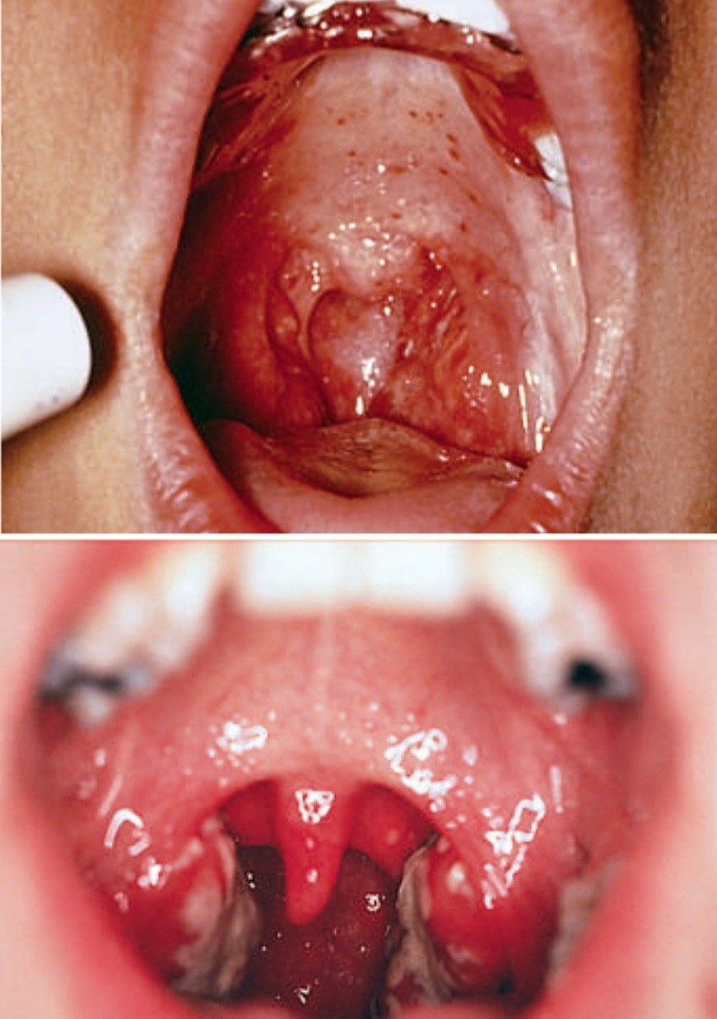
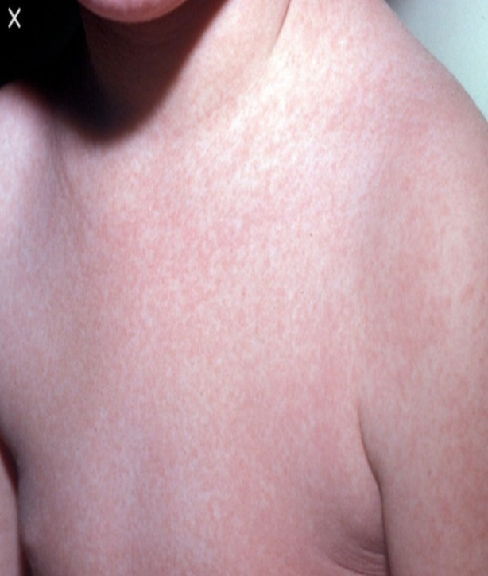

Slide 26
Diagnosis
Although no single finding or combination of physical findings distinguishes GABHS from a viral etiology, several findings are suggestive, including the following:
Enlarged tonsils
Pharyngeal erythema
Tonsillar exudates with necrotic crypts
Soft-palate petechiae
Tender cervical adenopathy
Sandpaper rash
Conjunctivitis (more common with adenovirus infections)
High fever.
Viral pharyngitis is usually associated with sneezing, rhinorrhea, cough, diarrhea, viral exanthema

Slide 27
A throat culture remains the standard for diagnosis, though results can take as long as 48 hours. Throat culture results are highly sensitive and specific for group A beta-hemolytic streptococci
Rapid antigen test
Rapid screening with throat culture backup for rapid screen–negative cases has continued to be the most proven strategy.
Streptococcal antibody tests are not useful in assessing patients with acute pharyngitis.
A child who is chronically colonized with GAS (streptococcal carrier) can have a positive culture if it is obtained when the child is evaluated for pharyngitis that is actually caused by a viral infection.
Testing for bacteria other than GAS is performed infrequently, and should be reserved for patients with persistent symptoms.
Polymerase chain reaction can identify a variety of viral and bacterial agents within a few hours

Slide 28
Treatment
Specific therapy is unavailable for most viral pharyngitis, mainly supportive treatment with An oral antipyretic/analgesic agent (acetaminophen or ibuprofen) can relieve fever and sore throat pain.
Oral penicillin is often suggested for patients with group C streptococcal isolates and oral erythromycin is recommended for patients with A. haemolyticum.
Most untreated episodes of GAS pharyngitis resolve uneventfully within 5 days, but early antibiotic therapy hastens clinical recovery by 12-24 hr.
Antibiotic therapy should not be delayed for children with symptomatic pharyngitis and a positive GAS RADT or throat culture.
The primary benefit and intent of antibiotic treatment is the prevention of acute rheumatic fever (ARF); it is highly effective when started within 9 days of onset of illness. Antibiotic therapy does not prevent acute poststreptococcal glomerulonephritis (APSGN).
Presumptive antibiotic treatment can be started when there is a clinical diagnosis of scarlet fever, a symptomatic child has a household contact with documented streptococcal pharyngitis, or a history of ARF in the patient or a family member, but a diagnostic test should be performed to confirm the presence of GAS.

Slide 29
Group A streptococci are universally susceptible to penicillin, Amoxicillin and all other β-lactam antibiotics.
The duration of oral penicillin and amoxicillin therapy is 10 days.
A single intramuscular dose of benzathine penicillin or a benzathine-procaine penicillin G combination.
Follow-up testing for GAS is unnecessary and is not recommended unless symptoms recur.
Patients allergic to penicillin can be treated with course of a narrow-spectrum (first-generation) cephalosporin (cephalexin or cefadroxil) if the previous reaction to penicillin was not an immediate, type I hypersensitivity reaction. Mostly are treated for 10 days with erythromycin, clarithromycin, or clindamycin, or for 5 days with azithromycin.

Slide 30
Chronic Group A Streptococcus Carriers
It is usually unnecessary to attempt to eliminate chronic carriage. Instead, evaluation and treatment of pharyngitis should be undertaken without regard for chronic carriage, treating test-positive patients in routine fashion and avoiding antibiotics in patients who have negative tests.
Expert opinion suggests that eradication might be attempted in select circumstances:
1- a community outbreak of ARF or APSGN; or in a closed or semiclosed community, nursing home or healthcare facility;
2- personal or family history of ARF;
3- when tonsillectomy is being considered because of chronic carriage or recurrent streptococcal pharyngitis.
Clindamycin given by mouth for 10 days is effective therapy.

Slide 31
Recurrent Pharyngitis
True recurrent GAS pharyngitis can occur for several reasons:
1) reinfection with the same M type if type-specific antibody has not developed;
2) poor compliance with oral antibiotic therapy;
3) macrolide resistance if a macrolide was used for treatment;
4) infection with a new M type.
Treatment with intramuscular benzathine penicillin eliminates nonadherence to therapy.
Recurrent GAS pharyngitis is rarely, if ever, a sign of an immune disorder.
Recurrent pharyngitis can be part of an autoinflammatory syndrome, neutropenia, a recurrent fever syndrome, or an autoimmune disease

Slide 32
Complications
Acute bacterial middle ear infections and acute bacterial sinusitis.
Local suppurative complications, such as parapharyngeal abscess.
Nonsuppurative illnesses (immunological) , such as ARF, APSGN, poststreptococcal reactive arthritis, and possibly PANDAS (pediatric autoimmune neuropsychiatric disorders associated with S. pyogenes) or CANS (childhood acute neuropsychiatric symptoms).

Slide 33
Retropharyngeal Abscess ,Lateral Pharyngeal (Parapharyngeal) Abscess

Slide 34
Retropharyngeal abscess occurs most commonly in children younger than 3-4 yr of age; as the retropharyngeal nodes involute after 5 yr of age.
Clinical manifestations of retropharyngeal abscess are nonspecific and include
*fever, irritability, decreased oral intake, and drooling.
*Neck stiffness, torticollis, and refusal to move the neck.
*sore throat and neck pain.
*muffled voice (hot potato), stridor, respiratory distress, or even obstructive sleep apnea.
Physical examination can reveal bulging of the posterior pharyngeal wall.
Cervical lymphadenopathy may also be present.
Lateral pharyngeal abscess commonly presents as fever, dysphagia, and a prominent bulge of the lateral pharyngeal wall, sometimes with medial displacement of the tonsil.

Slide 35
Diagnosis
Incision and drainage and culture of an abscessed node provides the definitive diagnosis.
CT.
Soft-tissue neck films taken during inspiration with the neck extended might show increased width or an air–fluid level in the retropharyngeal space.
Retropharyngeal and lateral pharyngeal infections are most often polymicrobial; the usual pathogens include group A streptococcus, oropharyngeal anaerobic bacteria, and Staphylococcus aureus .

Slide 36
Treatment
Intravenous antibiotics with or without surgical drainage. A third-generation cephalosporin combined with ampicillin-sulbactam or clindamycin to provide anaerobic coverage is effective
>50% successfully treated without surgical drainage.
Drainage is necessary in
respiratory distress
failure to improve with intravenous antibiotic treatment.
Complications of retropharyngeal or lateral pharyngeal abscess include
upper airway obstruction .
rupture leading to aspiration pneumonia .
extension to the mediastinum.
Thrombophlebitis of the internal jugular vein and erosion of the carotid artery sheath.

Slide 37
Peritonsillar Abscess and Cellulitis

Slide 38
Peritonsillar cellulitis and/or abscess is caused by bacterial invasion through the capsule of the tonsil, leading to cellulitis and/or abscess formation in the surrounding tissues.
The typical patient with a peritonsillar abscess is an adolescent with a recent history of acute pharyngotonsillitis.
Clinical manifestations include sore throat, fever, trismus, and dysphagia.
Physical examination reveals an asymmetric tonsillar bulge with displacement of the uvula. Which is diagnostic.
CT is helpful for revealing the abscess.
Group A streptococci and mixed oropharyngeal anaerobes are the most common pathogens.

Slide 39
Treatment includes surgical drainage and antibiotic therapy effective against group A streptococci and anaerobes.
Surgical drainage may be accomplished through needle aspiration, incision and drainage, or tonsillectomy.
The feared complication is rupture of the abscess, with resultant aspiration pneumonitis.

Slide 40
Otitis Media

Slide 41
The second most common disease of childhood, after upper respiratory infection (URI).
OM is any inflammation of the middle ear, without reference to etiology
OM with effusion (OME), also termed serous OM or secretory OM, is MEE of any duration that lacks the associated signs and symptoms of infection (eg, fever, otalgia, and irritability). OME usually follows an episode of AOM.
MEE is most common cause of conductive hearing loss
Chronic suppurative OM is a chronic inflammation of the middle ear that persists for at least 6 weeks

Slide 42
Epidemiology
The peak incidence and prevalence of OM is during the 1st 2 yr of life.
More than 80% of children experience at least one episode of OM by the age of 3 yr.
OM has a propensity to become chronic and recur. The earlier in life a child experiences the 1st episode, the greater the frequency of recurrence, severity, and persistence of MEE.

Slide 43
The occurrence of OM depend on several factors including :
age :
-rates are highest at 6-20 mo of age.
-the incidence and prevalence of OM then decline progressively,
-most likely due to less-well–developed immunologic defense and less favorable eustachian tubal factors involving both the \ structure and function of the tube.
Gender :
Boys > girls ??
Genetic background
socioeconomic status
breast milk feeding :protective effect
degree of exposure to tobacco smoke .
degree of exposure to other children .
presence or absence of respiratory allergy .
season of the year
pneumococcal vaccination status.
Children with certain types of immune deficiencies and congenital craniofacial anomalies (cleft palate) are particularly prone to OM.

Slide 44
Etiology
Bacterial pathogens
The most common bacterial pathogen in AOM is Streptococcus pneumoniae, followed by nontypeable Haemophilus influenzae and Moraxella (Branhamella) catarrhalis. These three organisms are responsible for more than 95% of all AOM cases with a bacterial etiology.
Viral pathogens
The viruses most commonly associated with AOM are respiratory syncytial virus (RSV), influenza viruses, parainfluenza viruses, rhinovirus, and adenovirus.

Slide 45
Clinical Manifestations
Symptoms of are variable, especially in infants and young children.
- Otalgia - Young children may exhibit signs of otalgia by pulling on the affected ear or ears or pulling on the hair; otalgia apparently occurs more often when the child is lying down
- Otorrhea
- Headache - Concurrent or recent symptoms of upper respiratory infection (URI), such as cough, rhinorrhea, or sinus congestion
- Fever; may occasionally be the only sign
- Irritability may be the sole early symptom in a young infant or toddler
- occasionally there may be no symptoms, the disease having been discovered at a routine health examination.
OME
1.Hearing loss.
2.Balance difficulties or disequilibrium
3.Mild discomfort or a sense of fullness in the ear.

Slide 46
Physical Examination
Normal TM:
1.Translucent pale gray
2.Mobile on pneumatic otoscopy
3.Landmarks are preserved

Slide 47
Pneumatic otoscopy is the standard examination technique for patients with suspected OM. When performed correctly, it is 90% sensitive and 80% specific for diagnosis of AOM,
TM in Acute Otitis Media:
1.Erythematous
2.Bulging with fluid
3.Landmarks obscured
4.Likely NOT mobile on pneumatic otoscopy

Slide 48
Diagnosis

Slide 49
Treatment
Antibiotics →
1st line = Amoxicillin (High-dose → 80-90 mg/kg)
2nd line = Augmentin or 2nd generation cephalosporins or macrolides
3rd line = high dose Augmentin (80-90 mg/kg)
4th line = Clindamycin/ IM Rocephin
Pain assessment – If present treat with Acetaminophen or Ibuprofen
Duration →
< 2 yo = 10 days
> 2 yo = 5 – 7 days
Improvement within 72 hours – if not, reconsider diagnosis &/or antibiotic choice

Slide 50
Viral Laryngotracheobronchitis

Slide 51
Epidemiology
Viral LTB is the most common cause of infective upper airway obstruction in the pediatric age group.
Affected children are usually of preschool age, with a peak incidence between 18 and 24 months of age.
less than 5% of these require hospital admission, and only 1% to 2% of those admitted require endotracheal intubation and intensive care.
This proportion has fallen dramatically since the use of corticosteroids has become routine.
There is a male preponderance in children younger than 6 years of age (1.4 : 1), although both sexes appear to be affected equally at an older age.
Infection is transmitted via droplet spread or direct inoculation from the hands.

Slide 52
Etiology
Parainfluenza viruses (types 1, 2, 3) are responsible for about 80% of croup cases, with parainfluenza types 1 and 2, accounting for nearly 66% of cases.
Other infectious causes for croup-like illnesses include the following: Adenovirus, Respiratory syncytial virus, Rhinovirus, Metapneumovirus, Influenza A and B
Rarer causes – Measles virus, herpes simplex virus, varicella

Slide 53
Clinical Manifestations
Mild
Most children are affected mildly by viruses that cause LTB.
The exact incidence remains unknown, because many of them do not receive medical attention, but are managed by parents at home.
Children have a barking cough and a hoarse cry or voice; these symptoms are worse in the evening and at night.
They may also have inspiratory stridor on exertion, but stridor at rest is usually absent, as are other signs of respiratory distress.
There is most commonly a coryzal prodrome accompanied by a low-grade fever .
Children are well looking , remain interested in their surroundings, playful, and still eat and drink.

Slide 54
Moderate
Same features PLUS :
inspiratory stridor present at rest
respiratory distress manifest by chest wall recession, tachypnea,and the use of accessory muscles of respiration.
tachycardia
children remain interactive and are able to take at least liquids orally.

Slide 55
Severe
Progression from moderate to severe infection can occur rapidly and may be precipitated by the distress caused by clinical examination.
Worrisome signs include :
- increasing respiratory distress
- appearing anxious or preoccupied and tired.
- Drooling may occur (but not as commonly as in epiglottitis),
- refuse liquids or be unable to coordinate swallowing and breathing.
- Restlessness and agitation are late signs of airway obstruction of any cause as is cyanosis, pallor, or decreased level of consciousness
- Desaturation may be seen in children with relatively mild airway obstruction (presumably reflecting lower airway involvement and ventilation-perfusion mismatch).
- Pulsus paradoxus

Slide 56
Diagnosis
The diagnosis of croup is clinical .
no role for laboratory test or radiography in the assessment of acute airways obstruction.
plain AP and lateral neck radiographs may demonstrate sites of obstruction(steeple sign)
Investigations needed in case of :
1.atypical presentation
2.fail to respond to conventional treatment.

Slide 57
Although further evaluation is not necessary in every case , it should be considered in:
1) cases that are particularly severe or frequent .
2) if symptoms are particularly slow to resolve .
3) if symptoms occur between or in the absence of obvious infections.
why ???
Evaluation of patients in this group is aimed at identifying an underlying airway abnormality that would predispose the child to more severe airway narrowing with viral infections, or that could cause problems independently of such infection.
Investigation is usually centered on airway endoscopy

Slide 58
Spasmodic Croup
Symptoms are similar to those of viral LTB, but children are often :
- older
- do not have the same coryzal prodrome
- may be afebrile during the episode.
There may be links with atopy, often with a positive family history.
Attacks often occur suddenly, at night, and may resolve equally quickly.
Treatment is guided by the degree of severity, and is similar to that for viral LTB.
Some practitioners prescribe oral or inhaled corticosteroids (via a nebulizer) to be kept at home and administered by the parents in case of an episode .

Slide 59
Children with croup should be hospitalized for any of the following:
progressive stridor .
severe stridor at rest .
respiratory distress .
hypoxia, cyanosis .
depressed mental status .
poor oral intake .
the need for reliable observation.

Slide 60
Treatment
Supportive Care
fluids and antipyretics as required.
there is no role for the routine use of antibiotics in the absence of other features suggestive of bacterial infection.
Corticosteroids
The efficacy of oral dexamethasone used a single dose of 0.15-0.6 mg/kg.
Oral dosing of dexamethasone is as effective as intramuscular administration
Nebulized Epinephrine (Adrenaline )
Heliox (70% to 80% helium with 20% to 30% oxygen) has been used in both upper airway obstruction .
Endotracheal Intubation .

Slide 61
Acute Epiglottitis (Supraglottitis)

Slide 62
This now rare, but still dramatic and potentially lethal condition is characterized by an acute rapidly progressive and potentially fulminating course of high fever, sore throat, dyspnea, and rapidly progressing respiratory obstruction.
Drooling is usually present and the neck is hyperextended in an attempt to maintain the airway. The child may assume the tripod position.
A period of air hunger with restlessness may be followed by rapidly increasing cyanosis and coma.
Stridor is a late finding and suggests near-complete airway obstruction.
Complete obstruction of the airway and death can ensue unless adequate treatment is provided.

Slide 63
The diagnosis requires visualization under controlled circumstances such as an operating room or intensive care unit of a large, cherry red, swollen epiglottis by laryngoscopy.
Anxiety-provoking interventions such as phlebotomy, intravenous line placement, placing the child supine, or direct inspection of the oral cavity should be avoided until the airway is secure.

Slide 64
If epiglottitis is thought to be possible but not certain in a patient with acute upper airway obstruction, the patient may undergo lateral radiographs of the upper airway first if stable.
Classic radiographs of a child who has epiglottitis show the thumb sign.
If the concern for epiglottitis still exists after the radiographs, direct visualization should be performed.
A physician skilled in airway management and use of intubation equipment should accompany patients with suspected epiglottitis at all times.
Establishing an airway by endotracheal intubation or, less often, by tracheostomy is indicated in patients with epiglottitis, regardless of the degree of apparent respiratory distress.
In general, children with acute epiglottitis are intubated for 2-3 days, because the response to antibiotics is usually rapid.
Most patients have concomitant bacteremia.

Slide 65
Treatment
After insertion of the artificial airway, the patient should improve immediately, and respiratory distress and cyanosis should disappear.
Epiglottitis resolves after a few days of antibiotics, and the patient may be extubated; antibiotics should be continued for at least 10 days.
Third-generation cephalosporins are preferred as first-line agents
Chemoprophylaxis is not routinely recommended but there are some Indications for rifampin prophylaxis for all household contact .

Slide 66
Bacterial Tracheitis

Slide 67
S. aureus is the most commonly isolated pathogen with isolated reports of methicillin resistant S. aureus, S. pneumoniae, S. pyogenes, Moraxella catarrhalis, nontypeable H. influenzae, and anaerobic.
The mean age is between 5 and 7yr.
Bacterial tracheitis often follows a viral respiratory infection.
This life-threatening entity is more common than epiglottitis in vaccinated populations.

Slide 68
Clinical Manifestations
Typically, the child has a brassy cough, apparently as part of a viral croup.
High fever and “toxicity” with respiratory distress can occur immediately or after a few days of apparent improvement.
The patient can lie flat, does not drool, and does not have the dysphagia associated with epiglottitis.
The usual treatment for croup (racemic epinephrine) is ineffective.
50-60% of patients require intubation for management.
The major pathologic feature appears to be mucosal swelling at the level of the cricoid cartilage, complicated by copious, thick, purulent secretion.
Suctioning these secretions, although occasionally affording temporary relief, usually does not sufficiently obviate the need for an artificial airway.

Slide 69
Diagnosis
The diagnosis is based on evidence of bacterial upper airway disease, which includes high fever, purulent airway secretions, and an absence of the classic findings of epiglottitis.
X-rays are not needed but can show
pseudomembrane detachment in the trachea,
Subglottic narrowing
a rough and ragged tracheal air column .
Purulent material is noted below the cords during endotracheal intubation.

Slide 70
Treatment
Empiric therapy recommendations for bacterial tracheitis include vancomycin or clindamycin and a third generation cephalosporin (e.g., cefotaxime or ceftriaxone).
When bacterial tracheitis is diagnosed by direct laryngoscopy or is strongly suspected on clinical grounds, an artificial airway should be strongly considered.
Supplemental oxygen is usually necessary.

Slide 71
Thank you

