Slide 1
Chest 4
Dr.Anwar Al-Naimat

Slide 2
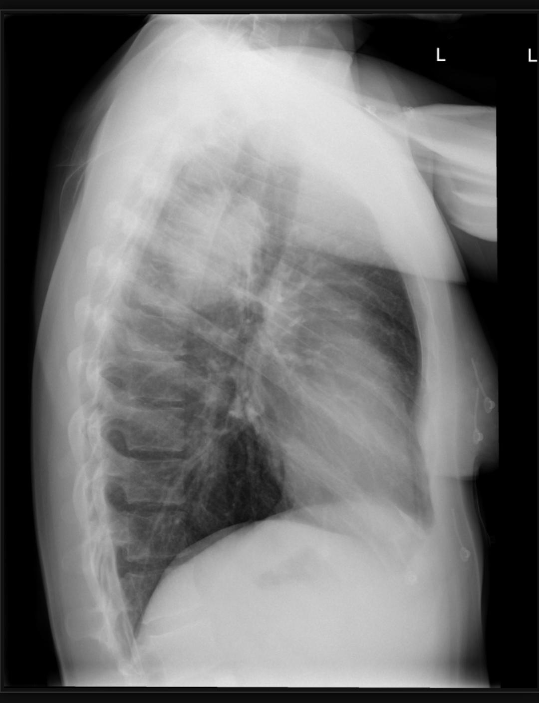
Notes:
Round opacity seen in the upper lobe of right lung with air Bronchogram
Round pneumonia(streptococcus)

Slide 3
Notes:
.
Right upper lobe opacification an elevated and medially oriented horizontal fissue.
Elevated right hilum.
Loos of right lung volume
Left lung clear

Slide 4
Notes:
Lucent left diaphragm and left deep sulcus sign indicating left pneumothorax. Left clavicle fracture.

Slide 5
Notes:
Underexposure

Slide 6
Notes:
Large amount of air noted in the anterior and middle mediastinum especially in the left paracardiac region. There is mild subcutaneous emphysema noted along the left lateral chest wall underneath the axilla. Features are indicative of pneumomediastinum.

Slide 7
Notes:
Central sub-diaphragmatic lucency (continuous diaphragm sign) in keeping with pneumoperitoneum.

Slide 8
Notes:
There is a moderate bilateral hilar lymphadenopathy. There are diffused, multiple small nodular opacities predominantly located in the upper lung lobes

Slide 9
Notes:
Opacity in the upper lobe of right lung with bulging of minor fissure
(Bulging fissure sign )
Klebsiella pneumonia

Slide 10
Notes:
Well defined opacity seen in the superior aspect of chest adjacent to right paratracheal line extended above the clavicle with well defined superior and lateral wall
posterior mediastinum (
Anterior mediastinum doesn’t extends above the clavicle

Slide 11
Notes:
Widening of mediastinal structures extending superior to thoracic inlet
The mass continous with neck
(Cervico thoracic sign
Retrosternal goiter

Slide 12
Notes:
Large right sided pneumothorax with knife seen in lateral chest wall

Slide 13
Notes:
Pulmonary Ct angiography
Evidence of felling defect seen in both pulmonary arteries (Saddle pulmonary embolism(

Slide 14
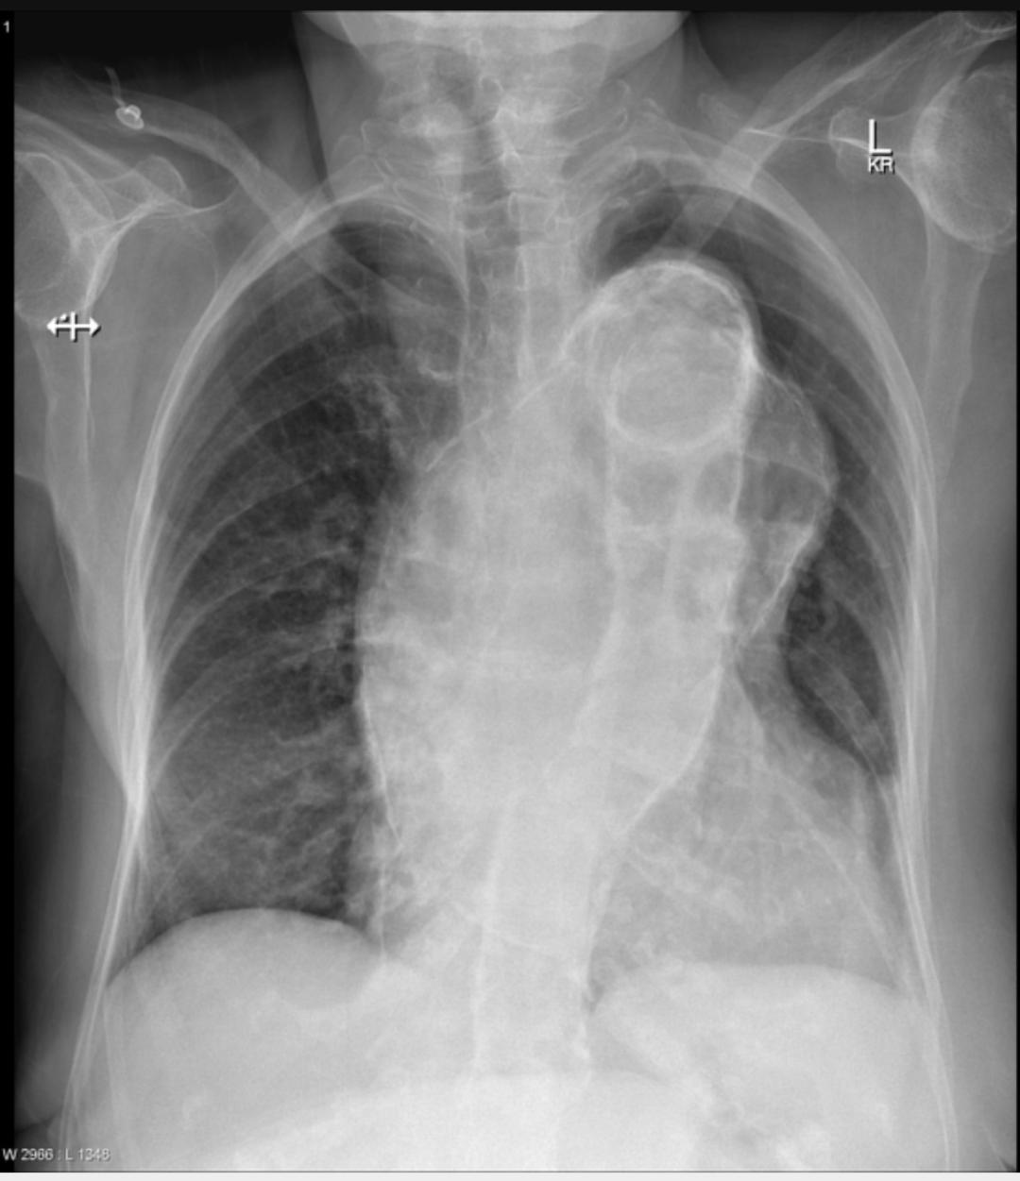
Notes:
Peripherally calcified ascending aortic aneurysm

Slide 15
Notes:
Overexposure

Slide 16
Notes:
Bilateral granular opacity with air bronchogram
RDs

Slide 17
Notes:
High resolution ct scan
Signet ring sign (broncheactasis)

Slide 18
Notes:
Triangular shaped opacity medially in the right lower zone, with effacement of the right heart border silhouette.
Middle lobe collapse

Slide 19
Notes:
Bilateral calcified granuloma more right sided with apical fibrosis changes and lung volume loss more right sided
Healed Tb

Slide 20
Notes:
Radiopaque foreign body )battery( seen in the trachea

Slide 21
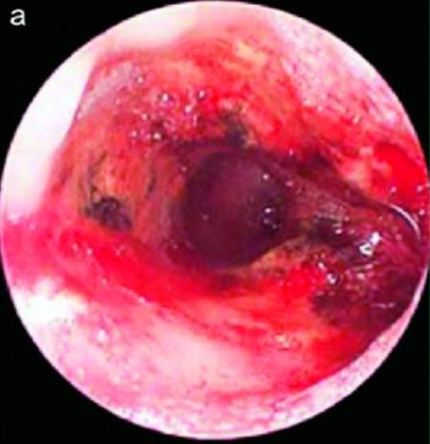

Slide 22
Notes:
Well defined opacity in the lower zone of right lung with air fluid level
Pathology proved it as a hydatid cyst

