Slide 1
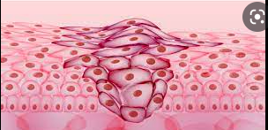
Neoplasia 1
Sura Al-Rawabdeh, M.D.
16-11-2021.

Slide 2
Introduction.
Characteristics of Benign and Malignant Neoplasms.
Epidemiology.
Cancer Genes.
Carcinogenesis: A Multistep Process Hallmarks of Cancer.
Etiology of Cancer: Carcinogenic Agents.
Clinical Aspects of Neoplasia.

Slide 3
cancer
Cancer is the second leading cause of death in the United States.
Even more agonizing than the associated mortality is the emotional and physical suffering inflicted by neoplasms.

Slide 4
Most common characteristics of cancers:
1. Cancer is a genetic disorder caused by DNA mutations: spontaneous or induce.
2. Genetic alterations in cancer cells are heritable, being passed to daughter cells upon cell division.
3. • Mutations and epigenetic alterations impart to cancer cells a set of properties that are referred to collectively as cancer hallmarks

Slide 5
NOMENCLATURE
Neoplasia means “new growth’’ referred to a tumor.
They continue to replicate, apparently oblivious to the regulatory influences that control normal cells.
They increase in size regardless of their local environment.
All neoplasms depend on the host for their nutrition and blood supply.

Slide 6
NOMENCLATURE
In common medical usage, a neoplasm often is referred to as a tumor, and the study of tumors is called oncology (from oncos, “tumor,” and logos, “study of”).
The division of neoplasms into benign and malignant categories is based on a judgment of a tumor’s potential clinical behavior.

Slide 7
NOMENCLATURE
1. Benign:
it will remain localized and is amenable to local surgical removal.
Affected patients generally survive.
2. Malignant:
as applied to a neoplasm, implies that the lesion can invade and destroy adjacent structures and spread to distant sites (metastasize) to cause death.
Malignant tumors are collectively referred to as cancers.

Slide 8
All tumors, benign and malignant, have two basic components:
(1) The parenchyma, made up of transformed or neoplastic cells.
determines its biologic behavior
(2) Non-neoplastic stroma :
The supporting, host-derived, non-neoplastic stroma, made up of connective tissue, blood vessels, and host-derived inflammatory cells.
The stroma is crucial to the growth of the neoplasm,

Slide 9
1. Benign Tumors
Benign tumors are designated by attaching the suffix -oma to the cell type from which the tumor arises.
For example:
A benign tumor arising in fibrous tissue is a fibroma.
A benign cartilaginous tumor is a chondroma.
Adenoma is applied to benign epithelial neoplasms

Slide 10
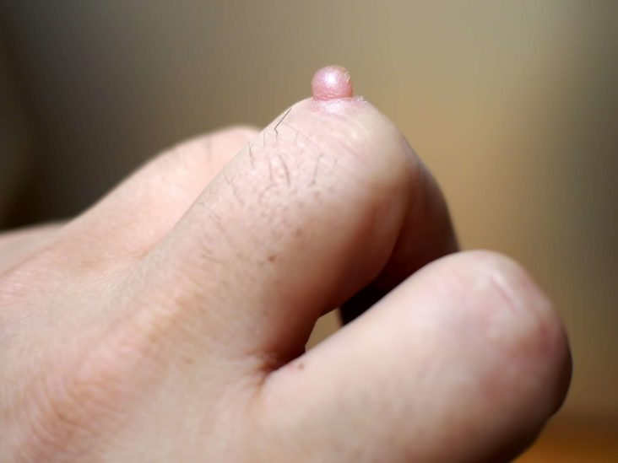
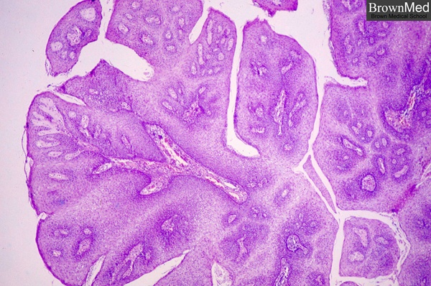
Papillomas are benign epithelial neoplasms, growing on any surface with fingerlike fronds.

Slide 11
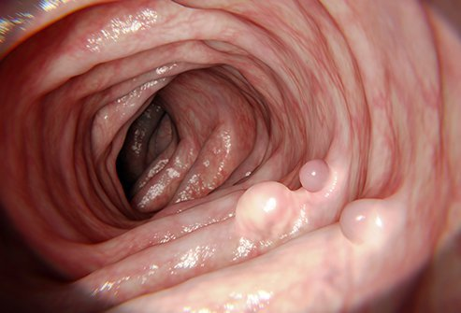
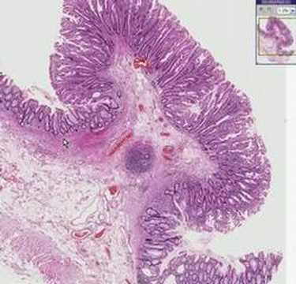
A polyp is a mass that projects above a mucosal surface, as in the gut.

Slide 12
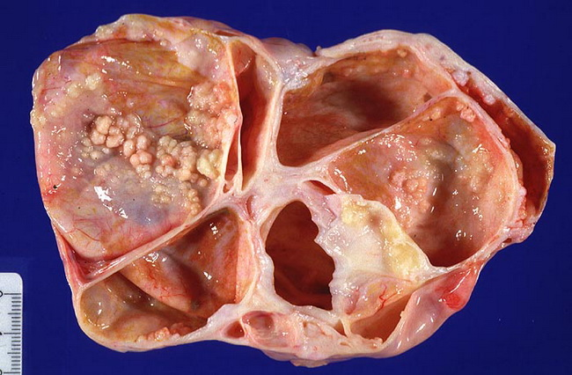
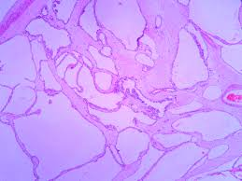
Cystadenomas are hollow cystic masses that typically arise in the ovary

Slide 13
2. Malignant Tumors
Malignant neoplasms arising in “solid” mesenchymal tissues are called sarcomas, e.g:
Malignant neoplasm comprised of fat-like cells is a liposarcoma,
Malignant neoplasm composed of chondrocyte-like cells is a chondrosarcoma.
Those arising from cells of the blood are called leukemias or lymphomas.

Slide 14
Malignant neoplasms of epithelial cells are called carcinomas:
Carcinomas are subdivided further:
That grow in a glandular pattern are called adenocarcinomas.
That produce squamous cells are called squamous cell carcinomas.
Some carcinoma show little or no differentiation. Such tumors are referred to as poorly differentiated or undifferentiated carcinoma.

Slide 15
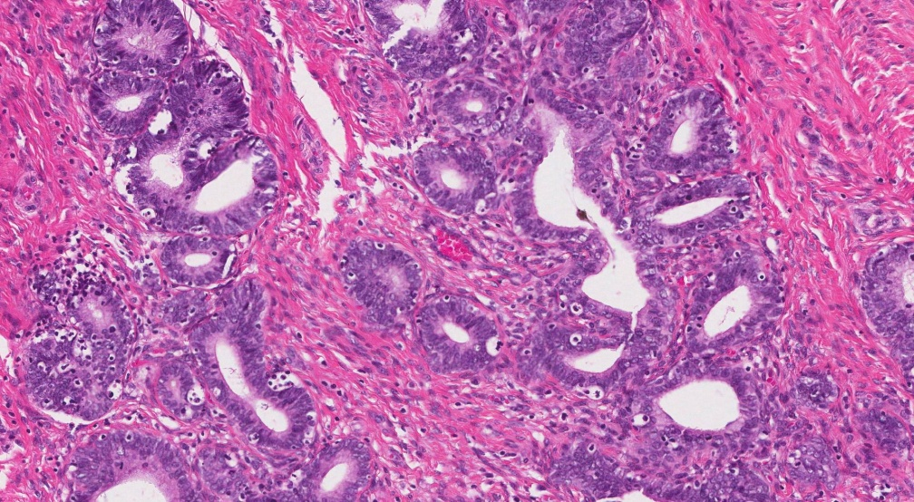
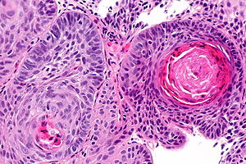
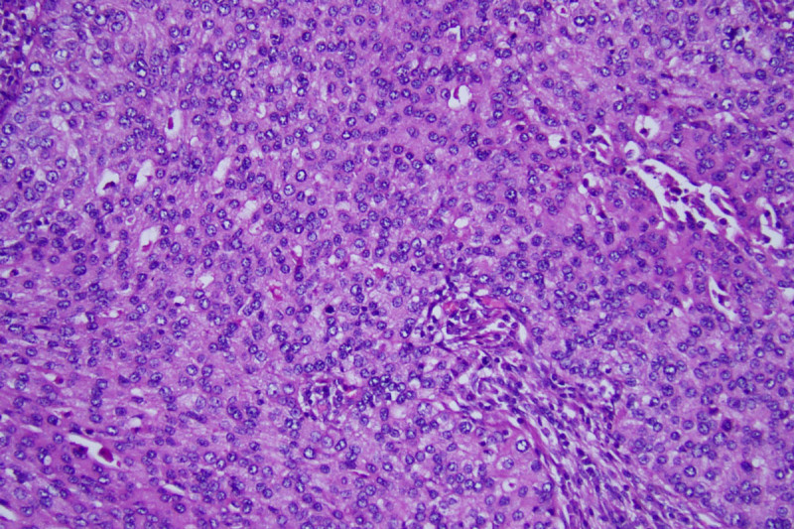
???

Slide 16
Mixed tumors
Tumor undergo divergent differentiation.
Such tumors has the capacity to differentiate down more than one lineage.
The best example is mixed tumor of salivary gland and the Fibroadenoma of the female breast

Slide 17
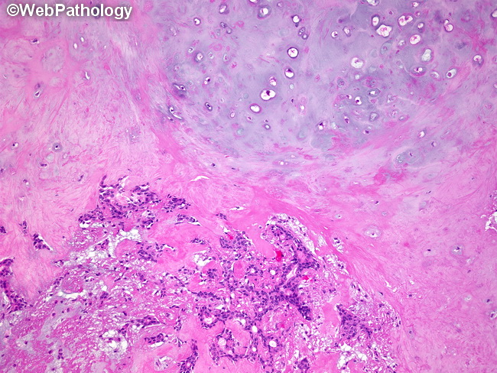
Mixed tumor of salivary gland= pleomorphic adenoma
It contain epithelial components with islands of cartilage or bone.

Slide 18
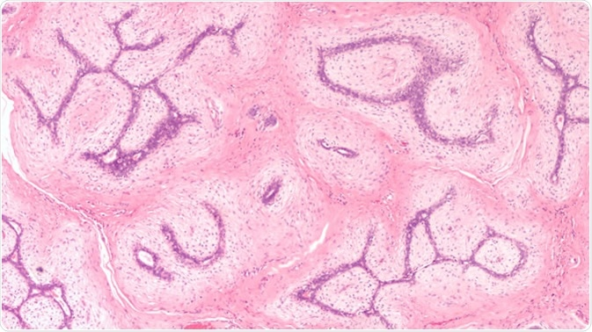
Fibroadenoma of the female breast contain:
proliferating ductal elements (adenoma)
embedded in loose fibrous tissue.

Slide 19
Teratoma:
is a special type of mixed tumor that contains recognizable mature or immature cells or tissues derived from more than one germ cell layer, and sometimes all three.
Germ cells have the capacity to differentiate into any of the cell types found in the body.
they may give rise to neoplasms that contain elements resembling bone, epithelium, muscle, fat, nerve, and other tissues,

Slide 20
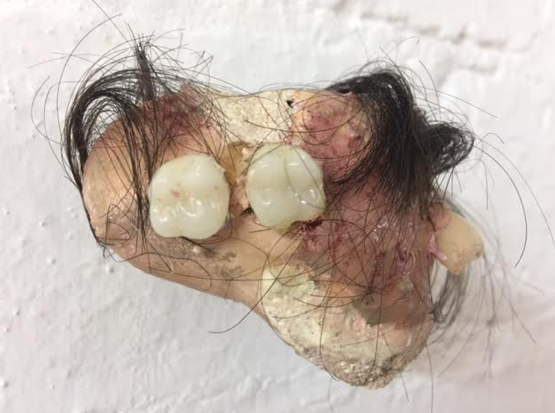

Slide 21
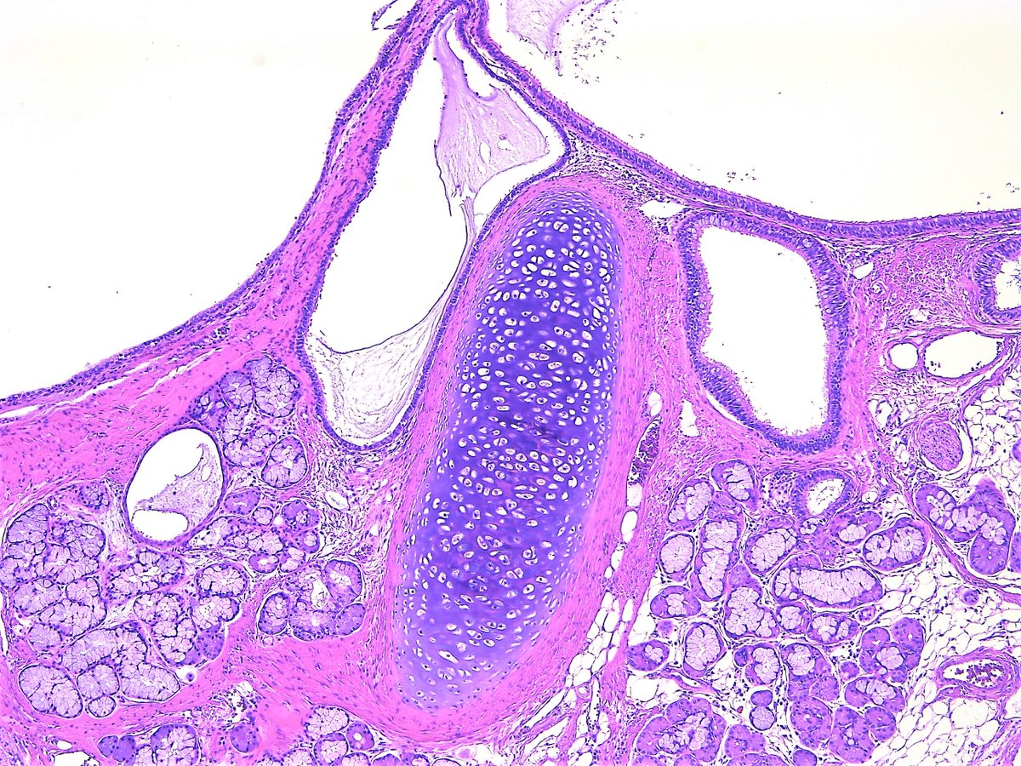
Mixture of mature, benign tissues

Slide 22
confusing terminology
Hamartoma:
is a mass of disorganized tissue indigenous to the particular site, such as the lung or the liver.
Choristoma:
is a congenital anomaly consisting of a heterotopic nest of cells.
Notes:
2. For example, a small nodule of well-developed and normally organized pancreatic tissue may be found in the submucosa of the stomach,

Slide 23
