Slide 1
Upper respiratory infection
Mohammed khaled abd-alfattah

Slide 2
Introduction
upper respiratory tract infection (URTI) is an illness caused by an acute infection, which involves the upper respiratory tract, including the nose, sinuses, pharynx, or larynx. This commonly includes nasal obstruction, sore throat, tonsillitis, pharyngitis, laryngitis, sinusitis, and the common cold.
URIs range from the common cold—typically a mild, self- limited—to life-threatening illnesses such as epiglottis and its generally self-limiting and mild, but may last for > 10 days. The cough can last for 2-3 weeks.
Notes:
Upper respiratory tract infection (URI) represents the most common acute illness evaluated in the outpatient setting.

Slide 3
COMMON URI TERMS YOU HAVE TO KNOW
Rhinitis:
sinusitis:
01
02
Inflammation of the nasal mucosa.
Inflammation of the nares and paranasal sinuses, including frontal, ethmoid, maxillary, and sphenoid
Nasopharyngitis
03
Pharyngitis:
Inflammation of the nares, pharynx, hypopharynx, uvula, and tonsils
04
Inflammation of the pharynx, hypopharynx, uvula, and tonsils

Slide 4
COMMON URI TERMS YOU HAVE TO KNOW
Epiglottitis
Laryngitis:
05
06
Inflammation of the superior portion of the larynx and supraglottic area
Inflammation of the larynx
Tracheitis:
07
Laryngotracheitis
Inflammation of the trachea and subglottic area
08
Inflammation of the larynx, trachea, and subglottic area
Notes:
Epiglottits :
This condition is more often found in children aged 1-5 years, who present with a sudden onset of the following symptoms:
➢ Sore throat
➢ difficulty or pain during swallowing, globus sensation of a lump in the throat
➢ Muffled dysphonia or loss of voice
➢ Dry cough or no cough, dyspnea
➢ Fever, fatigue or malaise

Slide 5
ETIOLOGY
Most URIs are viral in origin.
generally viral in origin, leading causes include:
○ rhinovirus (up to 50%)
○ coronavirus (10%-15%)
○ influenza (5%-15%)
○ respiratory syncytial virus and parainfluenza (5%)
less common causes include:
○ adenovirus
○ enterovirus
○ human metapneumovirus

Slide 6
Risk factors
exposure to someone with common cold
younger age (infants and young children at higher risk)
weakened immune system or use of drugs that weaken immune system
smoking (also increased risk of more severe symptoms)
heavy physical training (while moderate physical activity is thought to potentially be
protective)
autumnal time of year (for rhinovirus, other viruses may have other patterns of
seasonality)
genetic factors might increase susceptibility
sleep duration < 6 hours nightly may increase susceptibility to developing cold after
exposure to rhinovirus (level 2)

Slide 7
Incidence
URI is reported to be most common acute illness in United States.
Although URIs may occur year round, mostly its occur during fall and winter.
URI was specific diagnosis in 33% of patients presenting with cough in study of 267,897 patient encounters (including all age groups) with 54 Dutch family physicians over 10 years.

Slide 8
history
examination
- Itchy, watery eyes
- Nasal discharge
-➢Nasal congestion
- Sneezing
➢ - Sore throat more than 5 days
➢ - Cough
➢ - Headache
➢ - high temperature
➢ - Duration
➢ - Malaise
➢ - Fatigue, weakness
Findings include :-
- Nasal mucosal erythema and edema are common
- Nasal discharge: Profuse discharge is more characteristic of viral infections than bacterial infections; initially clear secretions typically become cloudy white, yellow, or green over several days, even in viral infections.
- Foul breath
- Fever.
- Erythema, swelling, or exudates of the tonsils or pharynx
- Tender anterior cervical nodes
Notes:
● nasal congestion and postnasal drip in the setting of temporal triggers or seasonal triggers suggest non-infectious rhinitis
○ headache or stiff neck suggesting meningitis
symptoms worsen rapidly and usually peak at days 2-3, resolve or significantly improve by
day 7, usually last 1-2 weeks,
- Fever: Less common in adults but may be present in children with rhinoviral infections • Temperature of 38.3°C pr higher

Slide 9
Diagnosis
more serious illness
noninfectious rhinitis
Bacterial respiratory infection
Clinically, by using symptoms, duration of symptoms, and presentation to distinguish URI from :-
such as :-
■ pneumonia
■ epiglottitis
■ pertussis (whooping cough)
■ meningitis
● nasal congestion and postnasal drip in the setting of temporal triggers or seasonal triggers suggest non-infectious rhinitis
respiratory infections in which antibiotics may be warranted, such as bacterial sinusitis
Notes:
t's marked by a severe hacking cough followed by a high-pitched intake of breath that sounds like "whoop."

Slide 10
Diagnosis
testing usually not needed for diagnosis but you can do several tests to exclude other suspected diagnosis or to confirm yours like :-
rapid antigen detection testing or throat culture for streptococcus.
rapid antigen testing for influenza
Throat culture for Neisseria gonorrhoeae in suspected to Gonococcal pharyngitis.
chest x-ray for pneumonia in case of :
- symptoms persisting more than 3 weeks.
- URI with comorbid conditions.
Notes:
Influenza: Rapid tests have over 70% sensitivity and more than 90% specificity

Slide 11
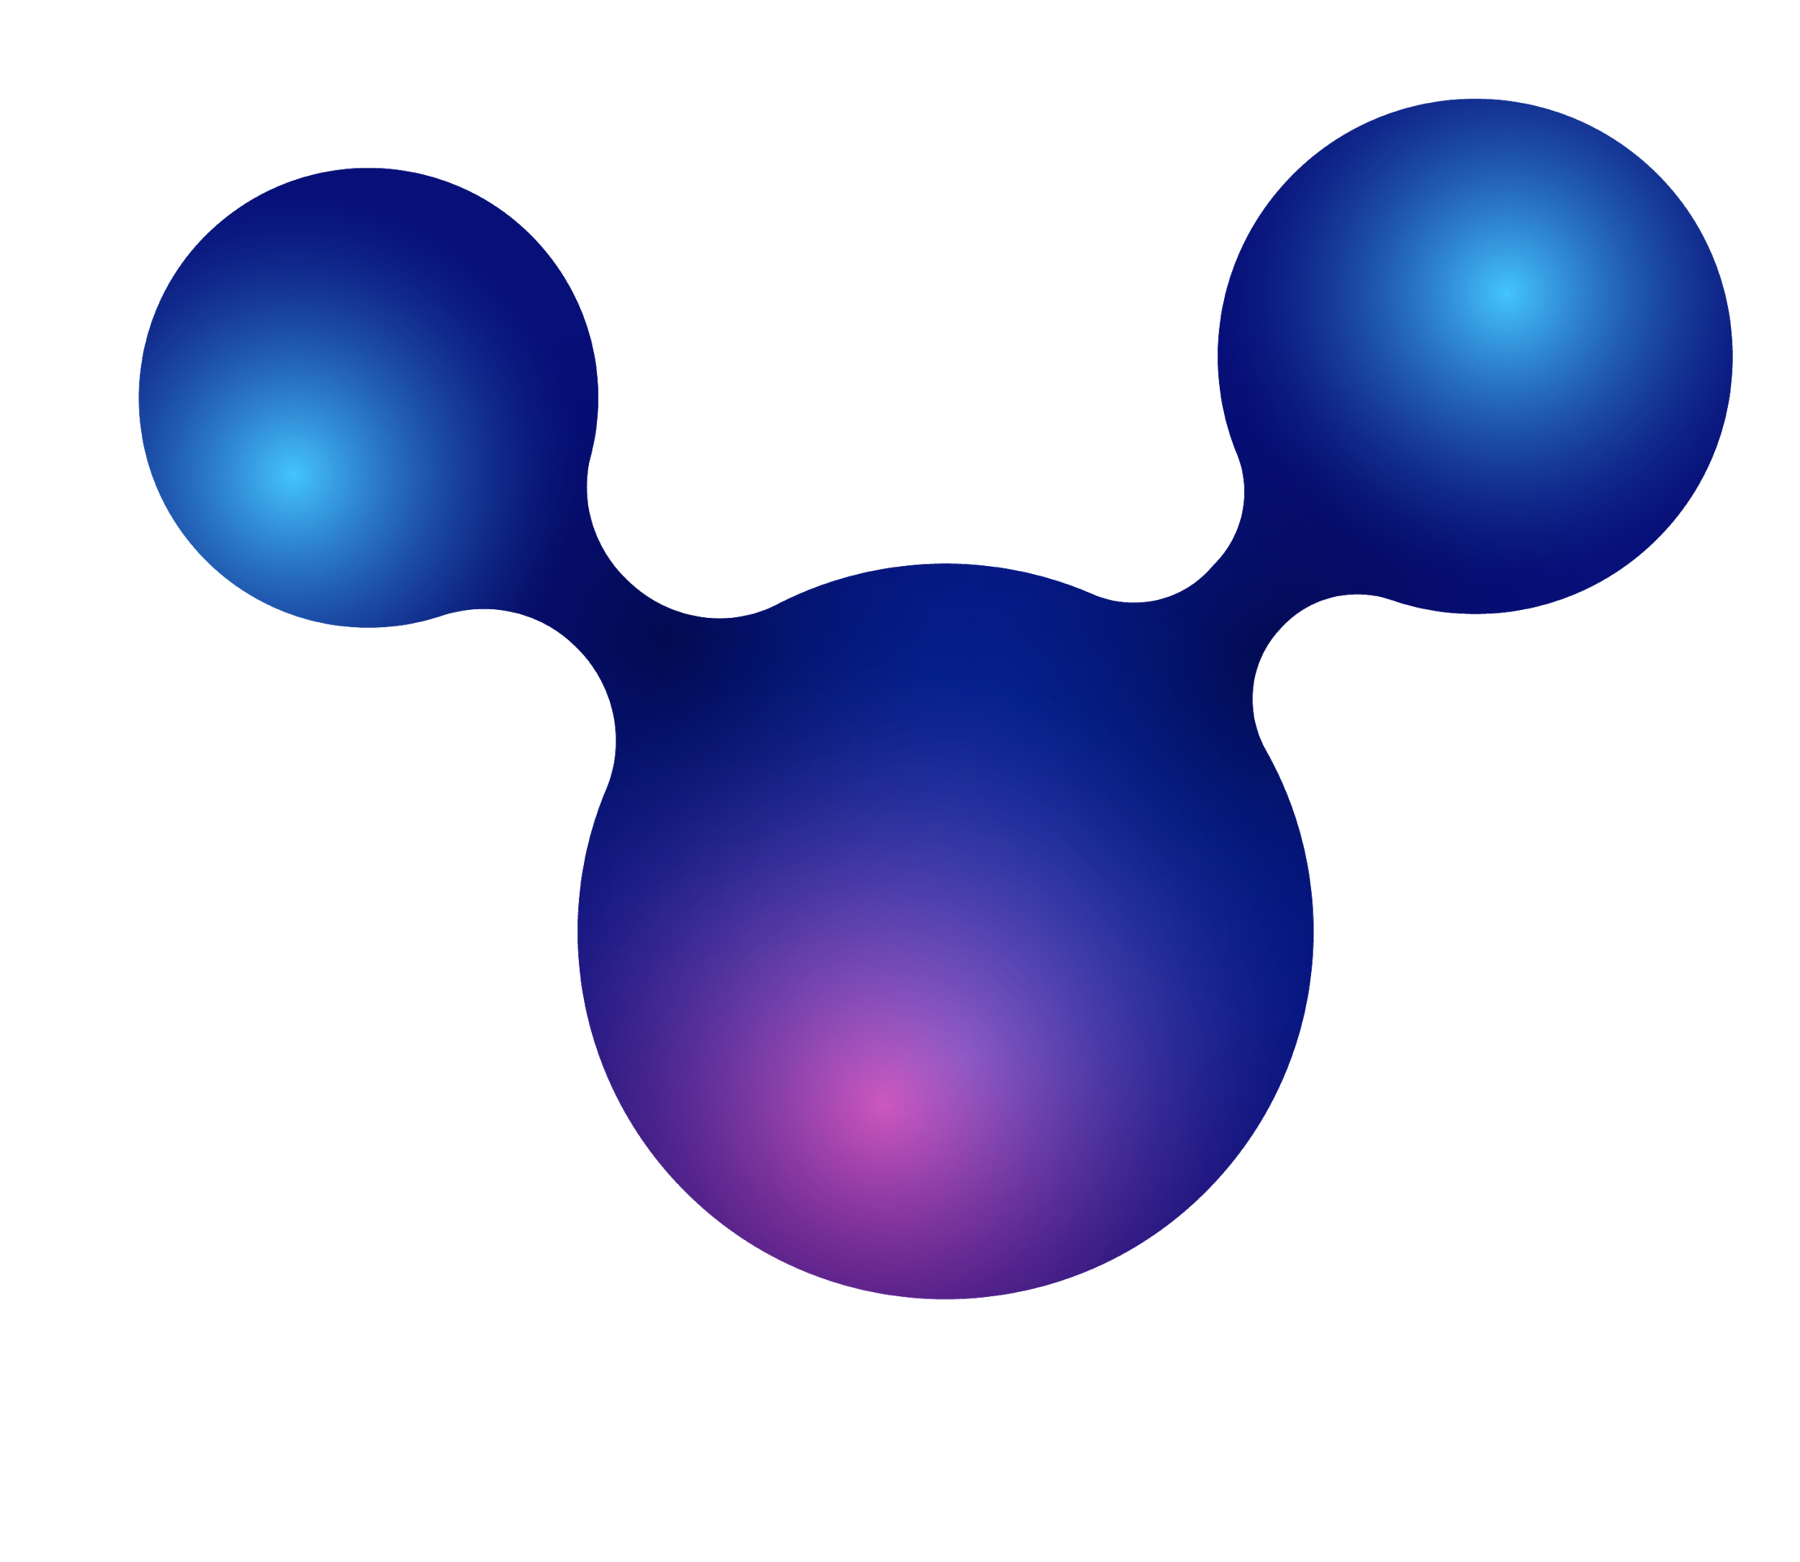
Management
No antibiotic
Do not prescribe antibiotics for treatment of nonspecific URIs, as they are likely viral in origin (Strong recommendation).
No specific treatment
In the vast majority of patients, no specific treatment is required, although rest, hydration, and antipyretics are usually recommended.
Receiving reassurance
Receiving information and reassurance is strongly associated with patient
satisfaction in patients with acute respiratory symptoms.
Notes:
education about
1. the importance of hand
washing and oral and nasal
hygiene (especially when
sneezing, coughing, or blowing
the nose)
2. appropriate disposal of tissues
3. avoiding close contact with
others.
4. expected duration of
symptoms
5. when to report worsening
symptoms.

Slide 12
For syptoms relief :-
NSAID
decongestants
acetaminophen (paracetamol) or nonsteroidal anti-inflammatory drugs (NSAIDs) to
reduce fever or discomfort.
decongestants (nasal or oral) for short-term relief of nasal congestion
short term antihistamine
ipratropium
a nonprescription short term antihistamine/decongestant (such as dexbrompheniramine /pseudoephedrine) which may reduce cough.
ipratropium nasal spray to improve rhinorrhea.
Notes:
Ipratropium is a bronchodilator that is used to to prevent bronchospasm in people with COPD (chronic obstructive pulmonary disease), including bronchitis and emphysema.

Slide 13
What are the potential complications of upper respiratory tract infection (URI)?
Otitis media.
Bronchitis.
COPD.
Pneumonia.
acute bacterial sinusitis
Sepsis.
Meningitis.

Slide 14
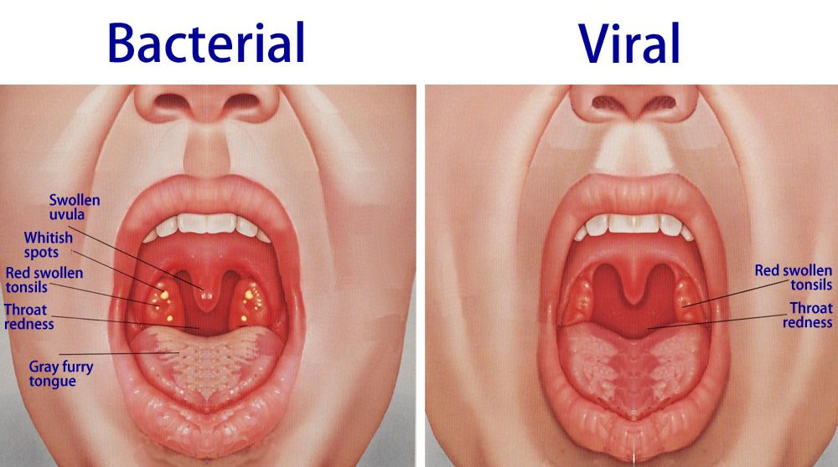
viral VS bacterial pharyngitis
Notes:
Viral pharyngitis typically resolves in 1-2 weeks, but immunocompromised persons may have a more severe.
The history alone is rarely a reliable differentiator between viral and bacterial pharyngitis
symptoms beyond 10 days or progressive worsening after the first 5-7 days suggests a bacterial illness.

Slide 15
Streptococcal pharyngitis
pharyngitis is most often viral in origin. Recognition of group A streptococcal pharyngitis is vital because serious complications may follow untreated disease.
Streptococcal pharyngitis, also known as strep throat, is an infection of the back of the throat including the tonsils caused by group A streptococcus (GAS). Common symptoms include fever, sore throat, red tonsils, and enlarged lymph nodes in the neck. A headache, and nausea or vomiting may also occur.
Mortality from group A streptococcal pharyngitis is rare, but serious morbidity or death may result from one of its complications.
Its common illness in children aged 5-15 years.
Notes:
It is usually benign but can have
suppurative complications including
acute otitis media, mastoiditis,
bacterial meningitis, infective
endocarditis, peritonsillar abscess,
retropharyngeal abscess, bacteremia,
cervical lymphadenitis, and
pneumonia.
★ Other complications include acute
rheumatic fever, poststreptococcal
glomerulonephritis, toxic shock
syndrome, and reactive arthritis

Slide 16
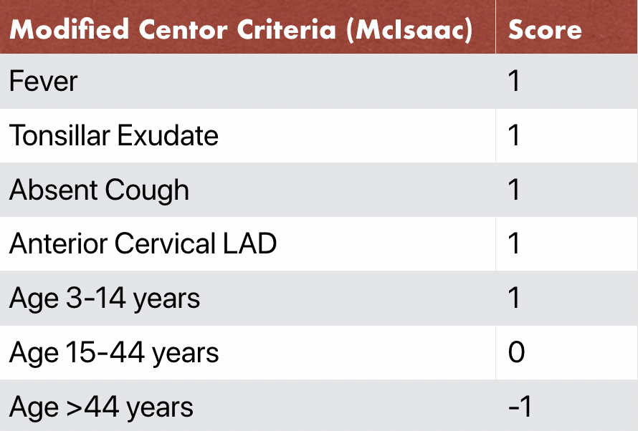
modified centor criteria
The Modified Centor Score (also known as the McIssac Score) helps predict the probability of streptococcal pharyngitis by taking into consideration risk factors such as patient's age, symptoms, and physical exam.
If its :-
(0-1) no further tests& no antibiotic.
(4) Treat with antibiotic without . further testing.
(2-3) rapid antigen test :-
. * negative = throat culture
. * positive =treat with antibiotic

Slide 17
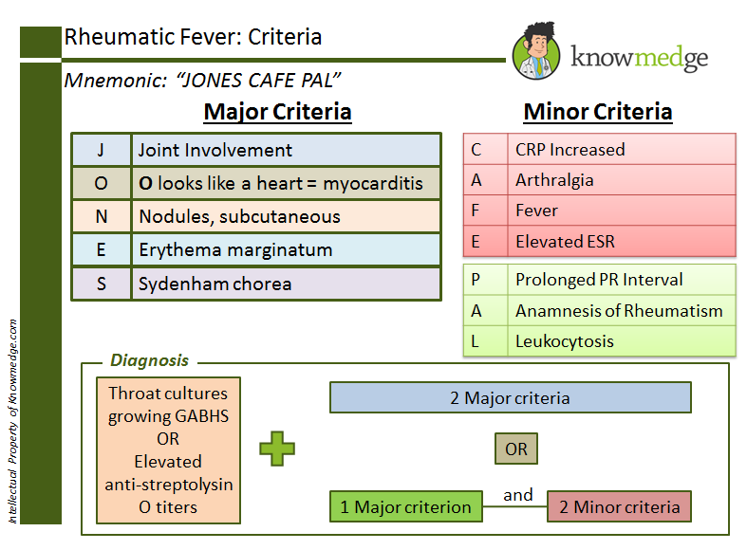
strept can cause several complications include acute
rheumatic fever, post streptococcal
glomerulonephritis, toxic shock
syndrome, and reactive arthritis.
- Rheu.Fevere treated mainly by penicilline..
Notes:
Sydenham chorea (SC) is a neurological disorder of childhood resulting from infection via Group A beta-hemolytic streptococcus s characterized by rapid, irregular, and aimless involuntary movements of the arms and legs, trunk, and facial muscles.

Slide 18
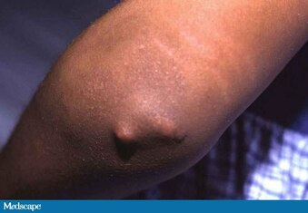
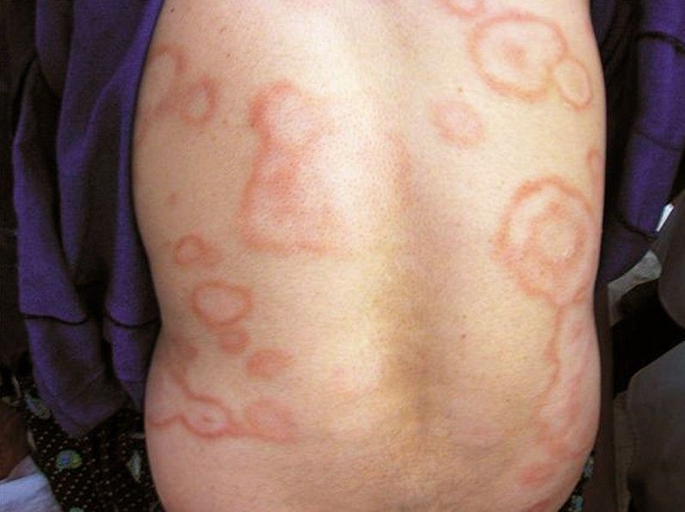
Notes:
Erythema marginatum is a rare skin rash that spreads on the trunk and limbs. The rash is round, with a pale-pink center, surrounded by a slightly raised red outline.
The painless nodules are found over joints (such as the elbows, knees, ankles, and knuckles), the back of the scalp, and the vertebrae (backbone).

Slide 19
Management
patient is not allergic to penicillin
If allergic to penicillin:
The preferred antibiotic regimens for treatment of acute GABHS pharyngitis if the patient is not allergic to penicillin are 1 of::-
cephalexin
cefadroxil
clindamycin
azithromycin
clarithromycin
penicillin V
Drug of choice
benzathine penicillin G
amoxicillin
Notes:
In patients with penicillin-sensitive streptococcal pharyngitis, symptomatic improvement is expected within 24-72 hours if antibiotic treatment is started in the first 24 hours after onset.

Slide 20
DO YOU HAVE QUESTIONS?
Mohammed Khalid abd-alfattah

