Slide 1
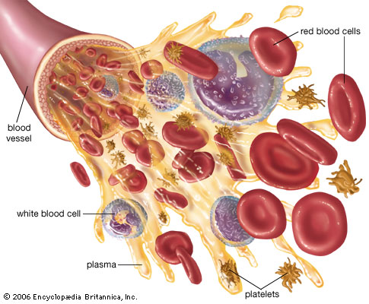
Blood
Lecture 2
Granular leucocytes

Slide 2
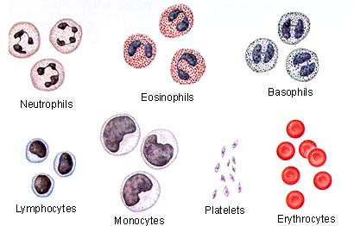
The formed blood elements
45 % of blood volume
Red blood corpuscles
=Erythrocytes
(RBCs)
Blood platelets
= Thrombocytes
White blood cells
=Leukocytes
(WBCs):
1- Granular leucocytes
(neutrophils, eosinophils, basophils)
2- Agranular leucocytes
(lymphocytes, monocytes)
Stains of blood film
Giemsa’s / Leishman’s
= methylene blue+ eosin
►basophilic (violet)
►eosinophilic (pink)
►azurophilic (red purple)

Slide 3
Difference between RBCs & WBCs
RBCs
4-5.5million/micro-liter/ mm3
Biconcave
No nuclei. / no organelles (only cell membrane)
Contain hemoglobin
Life span=120 days
No ameboid movement
Function : carry O2&CO2
WBCs
4000-11000/micro-liter
Rounded
(nuclei+ organelles)
No hemoglobin
From days to years
Amoeboid movement
Defense & immunity

Slide 4
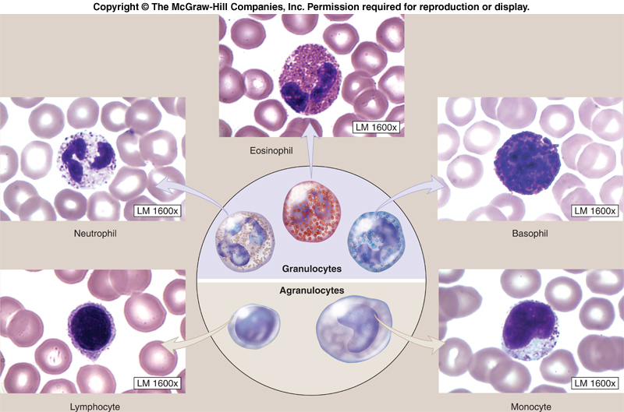
Leukocytes (WBCs)
Normal total Count
4000-11,000 / mm³ blood.
I-Granular leukocytes: II-Agranular leukocytes:
1-Neutrophils. 60-70-% 1- lymphocytes.20-30%
2-Eosinophils. 1-4% 2- Monocytes. 3-8%
3-Basophils. 1/2- 1%

Slide 5
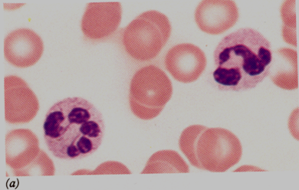
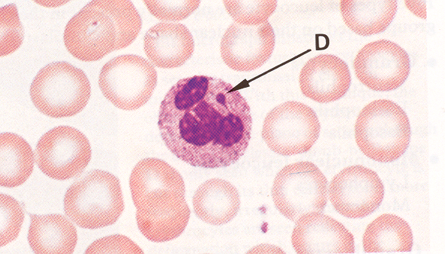
1-Neutrophils= Microphage (polymorphnuclear leucocytes
Differential count 60-70%
Diameter=10-12 microns
Shape: rounded
LM:
Nucleus : multilobulated.
2-8 lobes
Barr body ?? Condensed chromatin inactive X- Chromosome in females
Cytoplasm: contains
1- specific granules
(neutral & small )
2- non specific:
azurophilic granules (few
& large ,stained by azure)

Slide 6
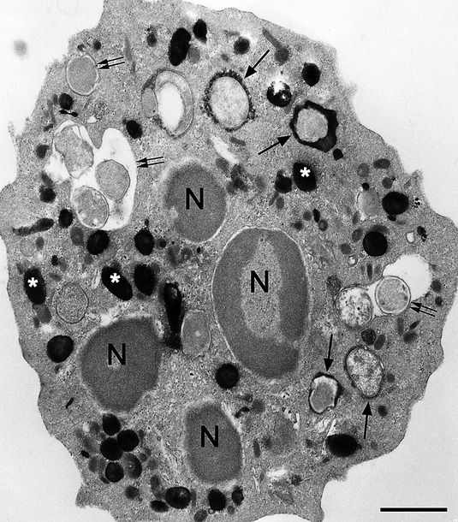
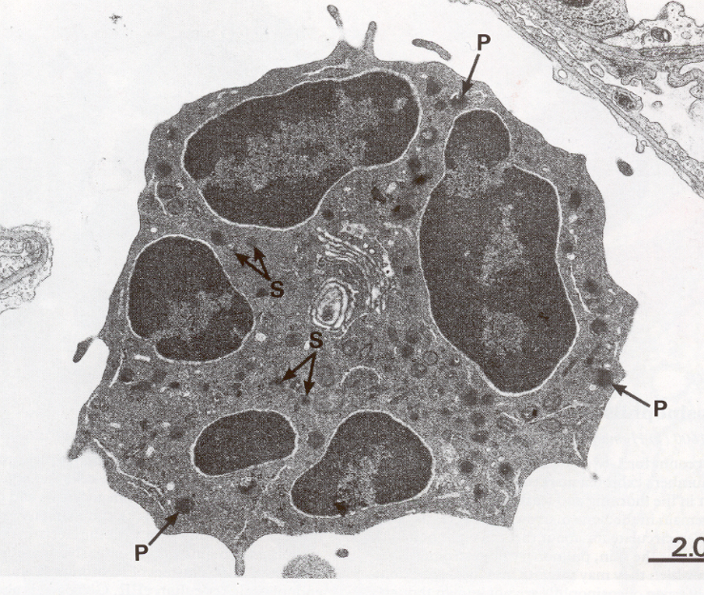
EM of Neutrophils
1- specific granules
Small
Numerous
Rice grain appearance
Functional enzymes e.g.
Collagenase
2- azurophilic granules
Large
few
Dense
Lysosomal hydrolytic enzymes.
Shape: irregular. When active
Cytoplasm:
Few organelles.
Granules:
1- Specific.
2- non specific (Azurophilic)

Slide 7
Neutrophils(polymorphs)
Functions
1- Phagocytosis & destruction of
micro-organisms in the C.T. How…?
Chemotaxis→ migration → phagocytosis → killing of bacteria by phagocytins (specific secondary granules) →
digestion by lysosomal enzymes (1ry, azurophilic granules) → death of neutrophils (pus cells)
2- Attraction of monocytes to the site of infection.
3- Production of pyrogens & pus
4- Stimulation of bone marrow to form new neutrophils
Life span: 1- 4 days in blood ► ► CT
The first line of defense.
Pus cells
Secretion of cytokines:
Chemotaxis
bone marrow stimulation

Slide 8
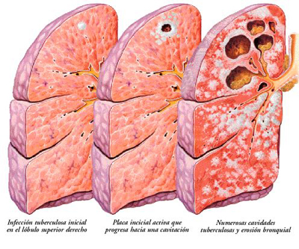
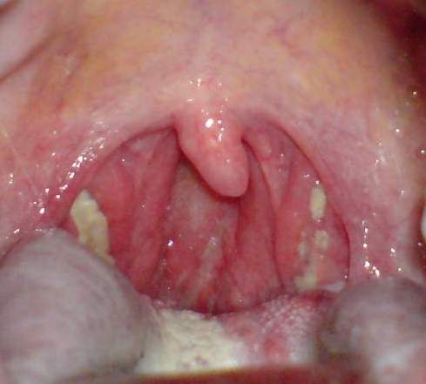
Abnormal neutrophil count
Neutrophilia:
=in acute pyogenic Pus = acute inflammations e.g.:
Appendicitis
Tonsillitis
Neutropenia:
TB
Influenza
Measles

Slide 9
2-Eosinophils
Differential count : 1- 4%
Diameter=12-15 microns.
Shape: rounded
L.M :
*Nucleus: bilobulated with thick chromatin thread
(horse shoe).C- shape
**Cytoplasm contains large specific acidophilic granules.
*Few azurophilic granules

Slide 10
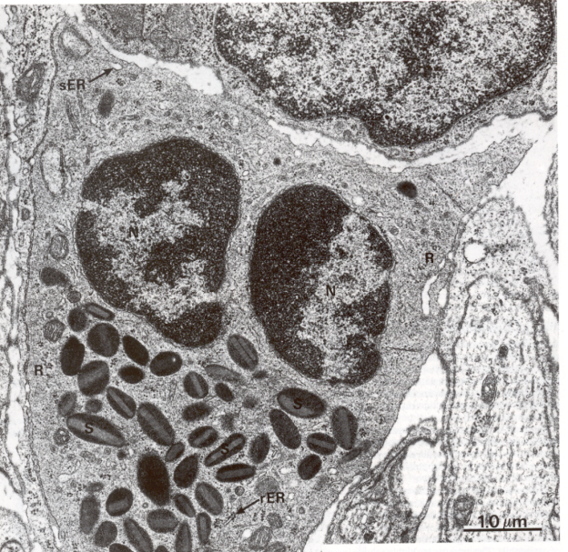
2-Eosinophils
E.M:
Multilobed nucleus
Cytoplasm contains also glycogen, some mitochondria, rER, & sER
Specific granules with crystalloid dense cores contain many hydrolytic enzymes.
Few non specific granules (primary lysosomes)
1- specific granules
large
ovoid
crystalloid core
Functional proteins & enzymes
Histaminase
Eosinophil peroxidase
2- azurophilic granules
Small
spherical
Lysosomal hydrolytic enzymes

Slide 11
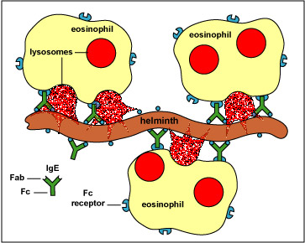
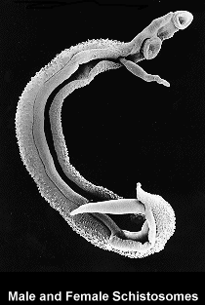
Eosinophils
Function of Eosinophils
Migrate to mucosa of GIT, respiratory, genito-urinary& skin.
▼ ▼ regulation of allergic reactions.
Parasitic infestation. (Not phagocytic)
Abnormal Eosinophil Count
Eosinophilia:
Allergic reactions e.g. bronchial asthma, urticaria.
Parasitic infections e.g. Bilharziasis.
Eosinopenia:
Steroid therapy. Bone marrow depression.

Slide 12
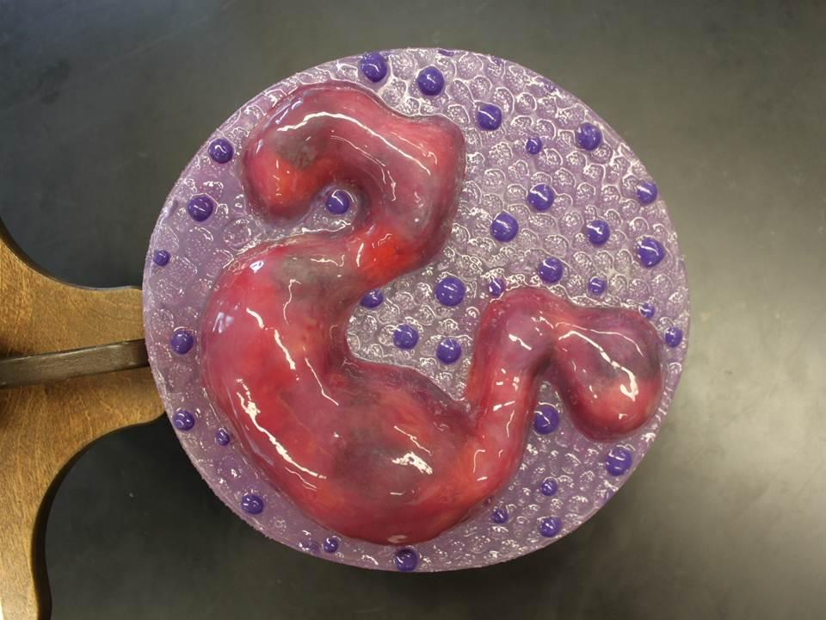
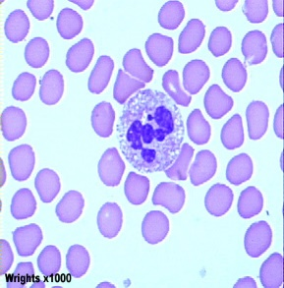
3-Basophils Mast cell of the blood
Differential count : ½ - 1%
Size : 10 microns
Shape : Rounded
LM:
Nucleus:
Bilobed, (S-shaped)
obscured by
Cytoplasm:
abundant deep blue granules.
Metachromasia.

Slide 13
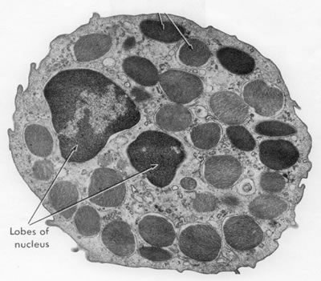
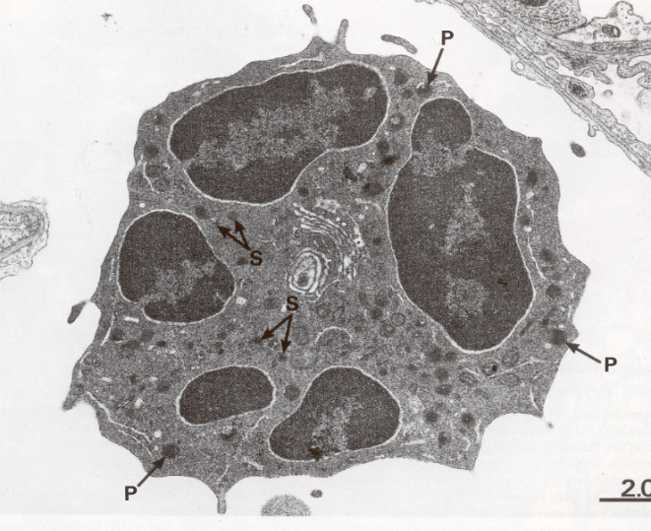
Basophils
1- specific granules
large
coarse
Functional histamine, heparin
2- azurophilic granules
Lysosomal hydrolytic enzymes.
E.M.
*Bilobed S shape nucleus
*Multiple large specific granules
*Few lysosomes (nonspecific granules).
Mitochondria, ribosomes, glycogen in cytoplasm.

Slide 14
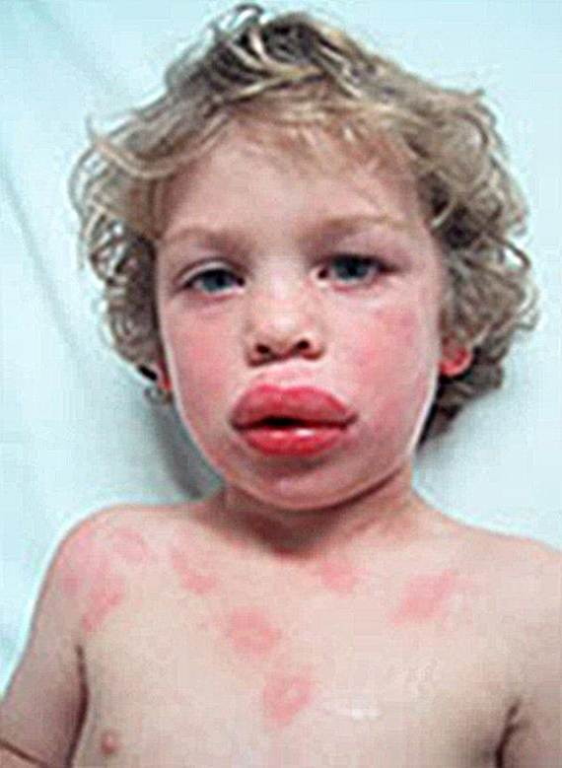
Functions
Secretion of histamine which initiates allergic reactions.
Secretion of heparin which is a natural anti-coagulant.
Secretion of eosinophil chemotactic factor to limit allergic reaction.
=Mast cell of blood:= hypersensitivity reaction
1- heparin: anticoagulant
2- histamine: (anaphylaxis)

Slide 15
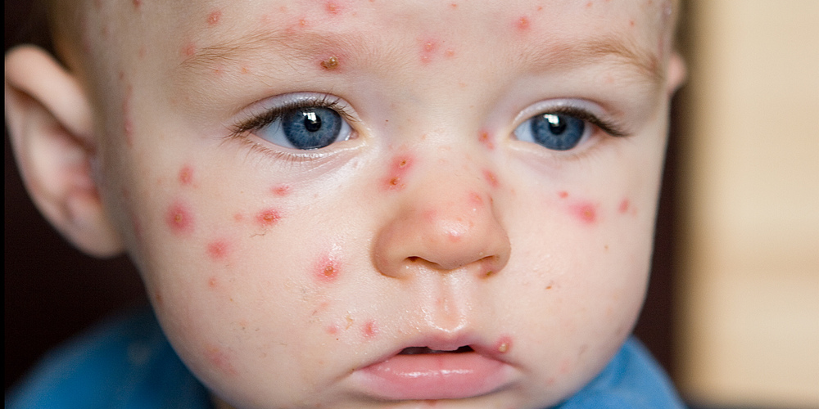
Basophils abnormal count
Basophilia:
viral infections as small pox and chicken pox.
Systemic allergy

Slide 16
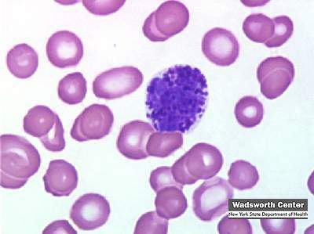
 | Neutrophils | Eosinophils | Basophils mast cell of the blood .
Number | 60-70% of leukocytic count | 1-4% of leukocytic count | 0-1% of leukocytic count
Size | 10-12 µm in diameter | larger than neutrophils (12-15 µm in diameter, | (10 mm) in diameter,
Shape | spherical in shape + Neutral granules | spherical in shape + Acidophilic granules | spherical in shape (basophilic) specific granules with heparin and histamine
Structure | multi-lobed nucleus human females may have inactivated second X chromosome (Barr body drum stick | bi-lobed nucleus C-shape or | S-shape lobed nucleus, obscured by basophilic granules
Life span | lifespan 1-4 days in circulation; | several days Up to week | 1-2 weeks
Function | first line of defense against any invading micro-organism | Kill parasites, associated with allergic reactions | Basophils are responsible for the release of Histamine in systemic allergic reaction
Abnormality | Neutrophilia: i.e. abnormal increase in the number of neutrophils. This is observed in acute inflammations e.g. appendicitis, tonsillitis. Neutropenia: i.e. abnormal decrease in the number of neutrophils e.g. in influenza, typhoid fever. | 1-Eosinophilia: i.e. abnormal increase in the number - Allergic reactions e.g. asthma, urticaria -Parasitic infections e.g. Bilharziasis. 2-Eosinopenia: i.e. l decrease in the number prolonged corticosteroid therapy . | Basophilia in systemic allergic reaction

