Slide 1
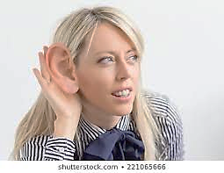
THE EAR

Slide 2
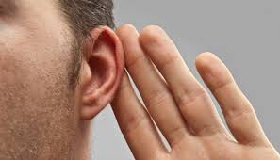
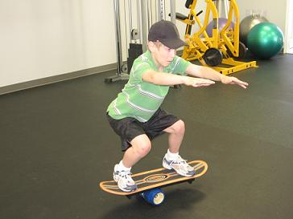
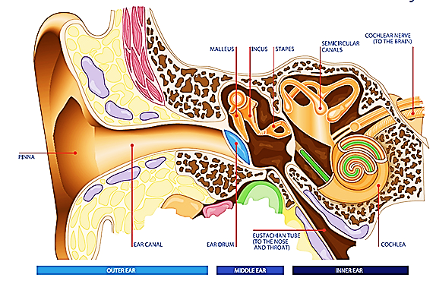
Functions of the ear:
1- Hearing
2- balance & equilibrium
Parts of the ear:
composed of 3 parts:
external ear
middle ear
inner ear

Slide 3
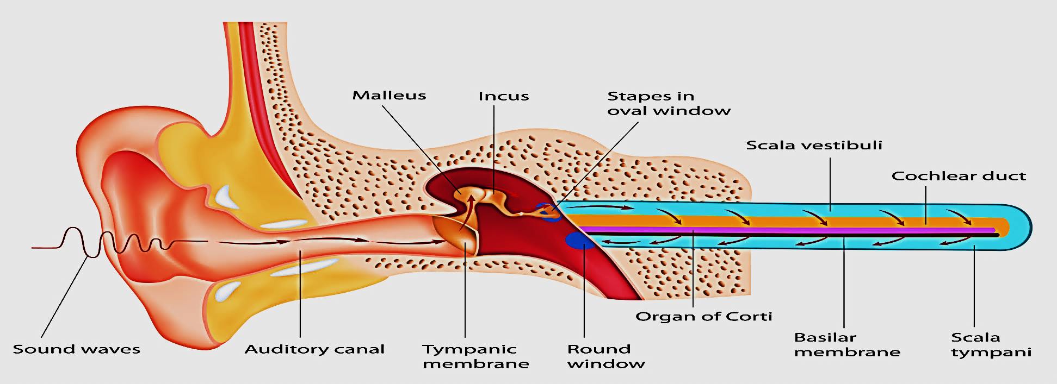
External ear: receives sound waves
Middle ear: cavity contains 3 small bones which transmit sound waves (mechanical vibration) to inner ear
Inner ear: contains fluid which movement are transduced to
(signals) nerve impulses → CNS →
(a) hear sounds
(b) equilibrium (vestibular organs)

Slide 4
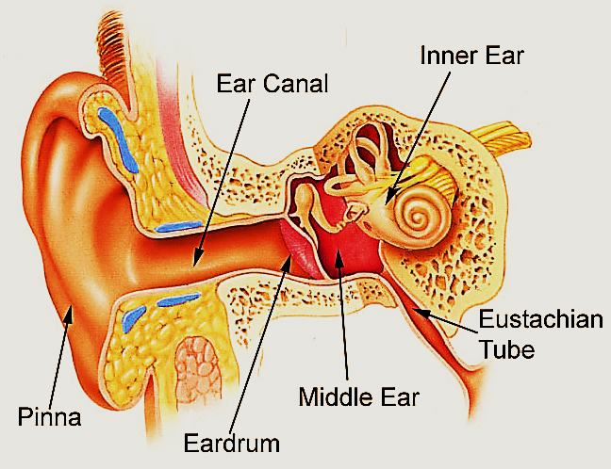
The External ear
Composed of: 1- Auricle ( pinna)
2- External auditory canal(meatus)
3- Tympanic membrane

Slide 5
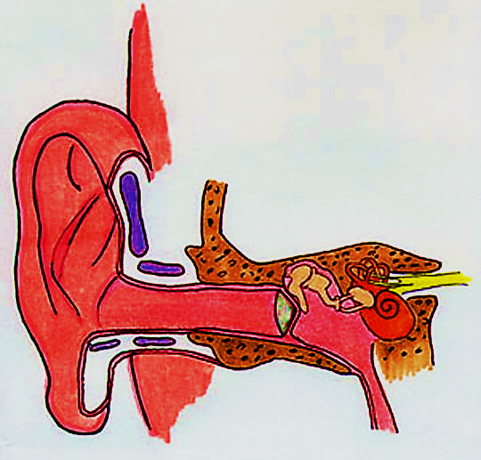
Auricle: funnel shaped, elastic cartilage, covered with skin, directs sound waves into the ear canal
External auditory canal:
its outer 1/3 is cartilage , inner 2/3 is bone (temporal bone)
lined with keratinized stratified squamous epithelium
its anterior 2/3 has hair follicles,
sebaceous glands,
ceruminous glands
( modified apocrine sweet glands)
Cerumen: a waxy yellowish
material, is mixture of secretions
of both glands
Elastic cartilage
Temporal bone
Tympanic membrane

Slide 6
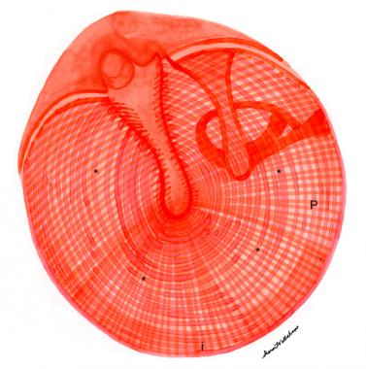
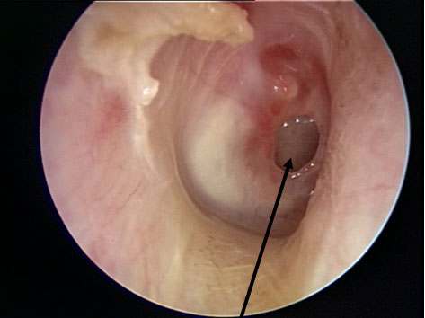
Tympanic membrane (ear drum): layers (outside → inside)
Stratified squamous epithelium : it is thin at the center & thick at periphery of drum. Mitosis is present at marginal cells which responsible for regeneration of perforated drum
collagenous fibers Radially arranged
collagenous fibers Circularly arranged
simple cuboidal epithelium cover the
inner surface of drum

Slide 7
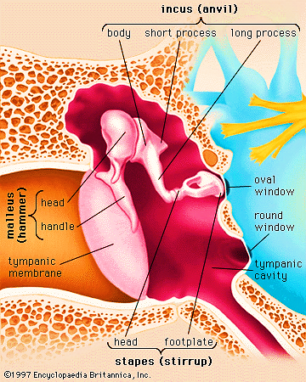
The Middle Ear (tympanic cavity)
Air filled cavity , within temporal bone. Lined with simple cuboidal epithelium
Laterally: tympanic membrane,
Medially : oval & round windows of inner ear
Anteriorly: communicate with pharynx via Eustachian tube Posteriorly: temporal bone

Slide 8
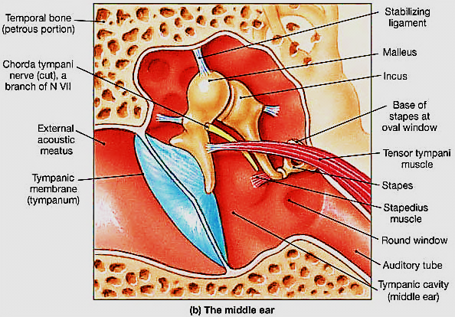
Contents of Middle ear : (3221)
3 bony ossicles, 2 muscles, 2 windows, 1 chorda tympani n.

Slide 9
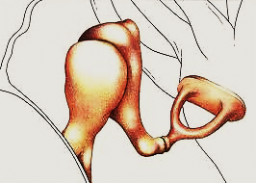
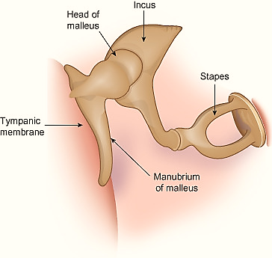
I
Auditory ossicles : malleus, incus , stapes
( hammer, anvil, stirrup)
Malleus attached to tympanic membrane, Stapes to membrane of oval window.
The auditory ossicles transmit vibration of ear drum to perilymph of inner ear
They are compact bone without epiphysis, they articulate with each other by synovial joints & held together by ligaments.
Muscles (2 striated involuntary ms):
Tensor tympani & Stapedius
M
Oval window
S
Tympanic membrane

Slide 10
Tensor tympani:
attach to handle of malleus. Its contraction → stretch ear
drum →protect against loud sounds
Stapedius :
Attach to neck of stapes. Its contraction →pull stapes out → protect inner ear against loud noise

Slide 11
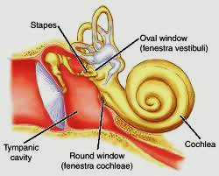
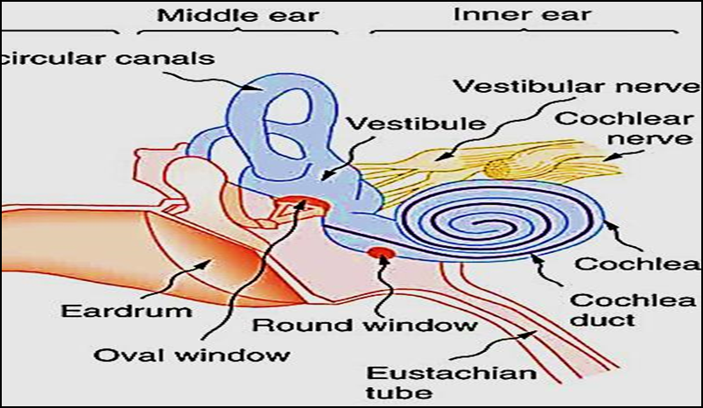
Windows: 2 openings covered by membranes, between middle and inner ear
Oval window( fenestra vestibule): closed by annular ligament which attached to foot plate of stapes. It transmits vibration to perilymph of vestibule of inner ear
Round window( fenestra cochlea):closed by elastic membrane called 2ry tympanic membrane

Slide 12
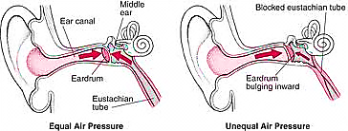
Eustachian tube:
It connects the middle ear e nasopharynx, open during swallowing
serves to balance the air pressure in middle ear with atmospheric pressure.
It has 2 parts:
→ Bony part (tympanic): posteriorly, formed of compact bone & lined with simple columnar ciliated epithelium
→ Cartilaginous part (pharyngeal): anteriorly, formed of elastic cartilage, lined with pseudo-stratified columnar ciliated e goblet cells

Slide 13
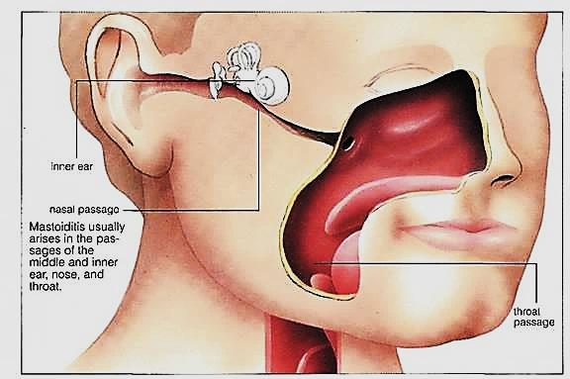
Eustachian tube

Slide 14
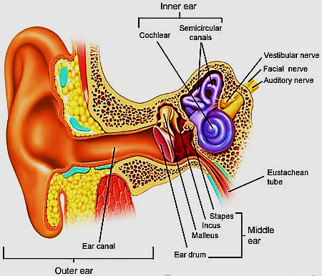
The Inner Ear ( labyrinth)
Located completely within temporal bone
Consists of: bony labyrinth
membranous labyrinth

Slide 15
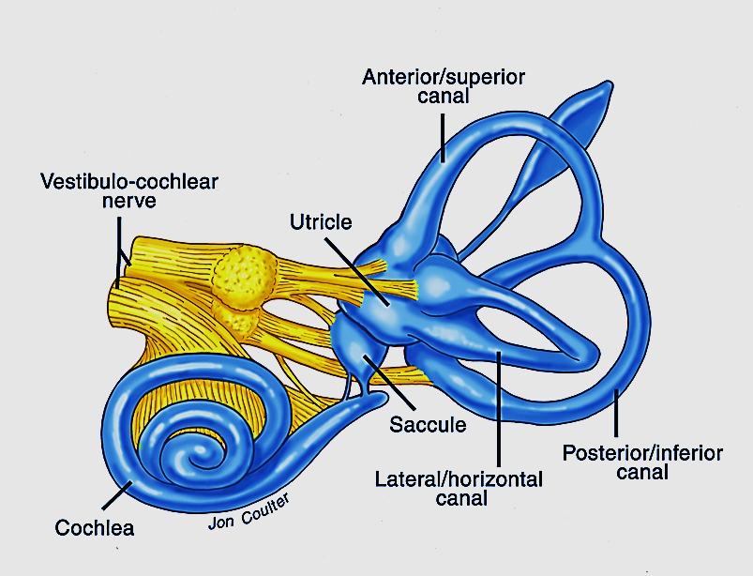
Bony labyrinth
Formed of bony canals & cavities lined with endosteum, & is filled with fluid called
perilymph
It Consists of 3 parts:
Cochlea
3 semicircular canals
Vestibule → utricle
→ saccule

Slide 16
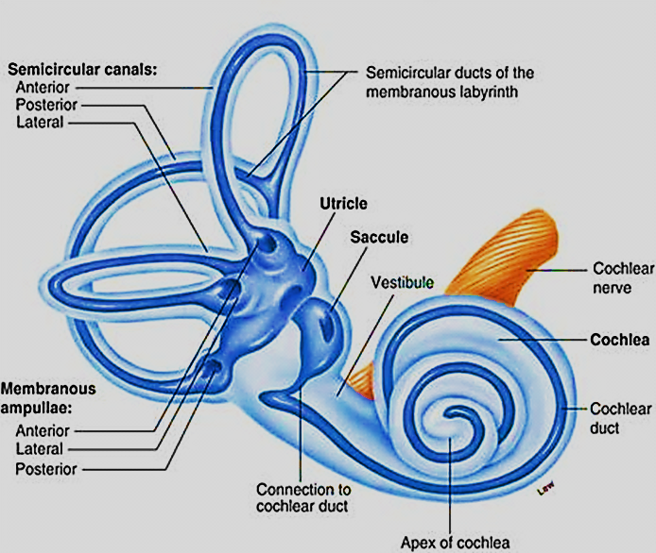
Membranous labyrinth
They are membranous tubules & sacs present within the bony labyrinth connected with each other & filled with fluid called endolymph

Slide 17
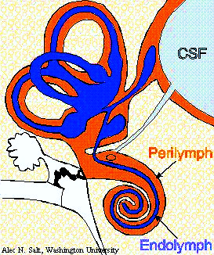
The Cochlea is responsible for the sense of hearing
The vestibular organs for the sense of equilibrium & balance :
• saccule
• utricle
• semicircular canals
Membranous labyrinth
Bony labyrinth

Slide 18
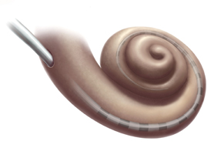
The Cochlea
The auditory organ of the inner ear
Snail-like (spiral) shape
Makes 2½ turns around a bony axis called modiolus.
The modiolus is a spongy bone contains: blood vessels, spiral ganglia & cochlear nerve
Cochlea has bony part & membranous part
The membranous part of the cochlea called cochlear duct

Slide 19
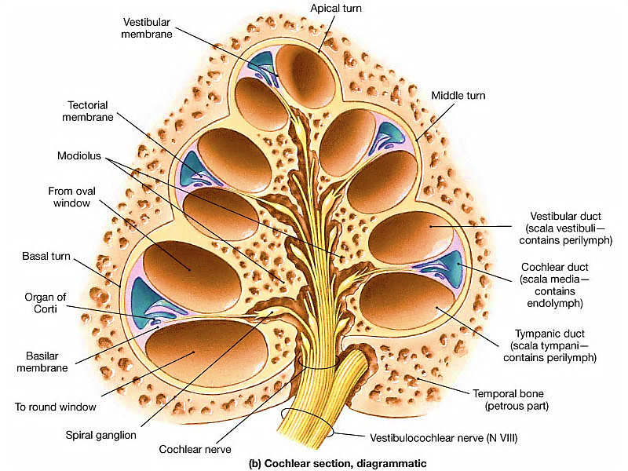

Slide 20
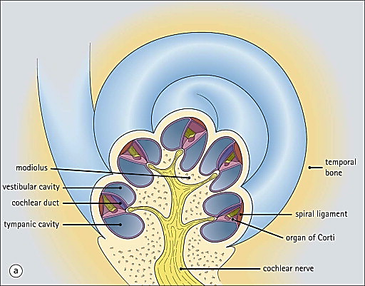
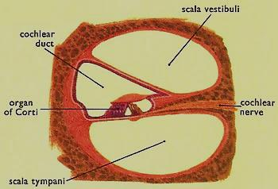
In axial section in the cochlea, the bony canal appear circular and the membranous cochlear duct appears triangular in shape
Modiolus

Slide 21
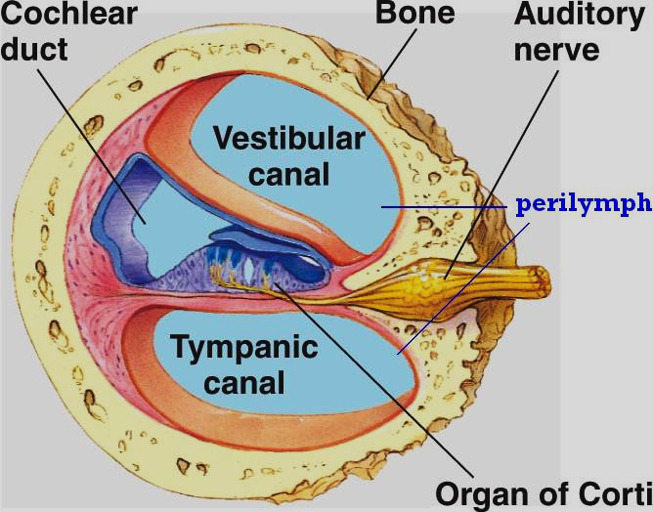
The cochlear duct divides the bony canal into 3 spaces :
Scala vestibuli (above)
Scala media (middle)
Scala tympani (below)
Scala vestibuli: communicates with the vestibule, contains perilymph
Scala tympani: communicate e middle ear through the round window, contains perilymph

Slide 22
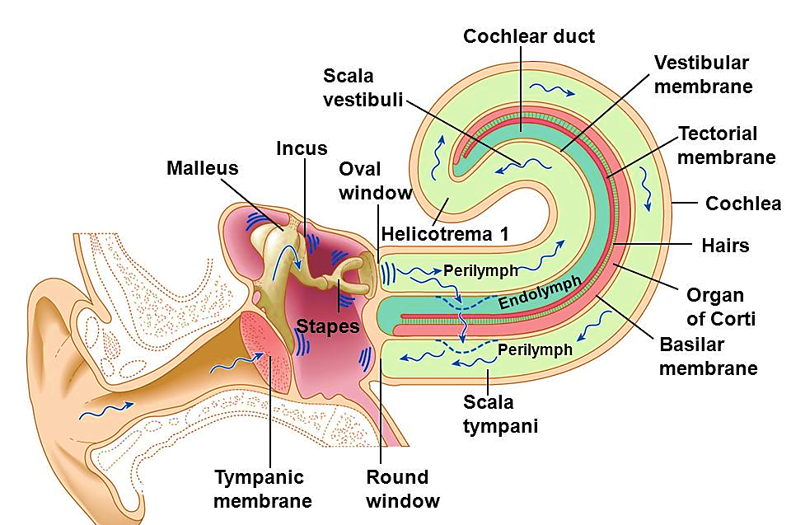

Slide 23
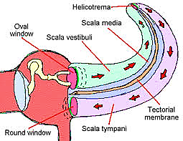
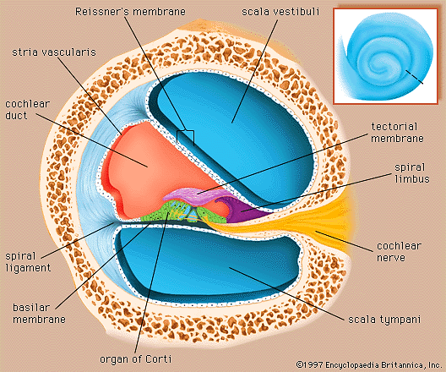
Scala media ( cochlear duct):
is the membranous part of the cochlea
contains endolymph, & organ of Corti

Slide 24
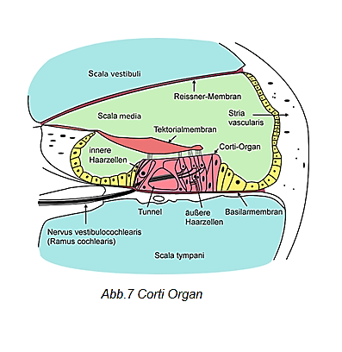
The cochlear duct is triangular in shape
The base is formed by stria vascularis, which is vascular C.T., covered e pseudo-stratified columnar cells, its cells secrete endolymph
The roof is formed by
vestibular membrane,
thick membrane covered on
both sides e simple squamous epi
c. The floor is formed by basilar membrane (keratin –like fibers) its upper surface support organ of Corti, its under surface covered e simple squamous epithelium

Slide 25
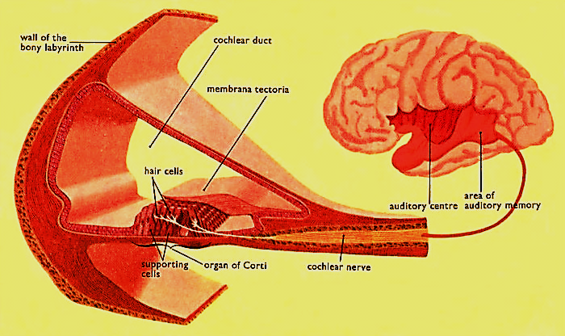
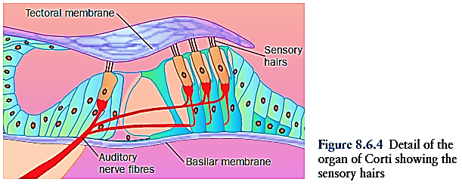
Organ of Corti
Neuroepithelium , found in the cochlear duct on the basilar membrane responsible for hearing
The organ of Corti is covered e Tectorial membrane

Slide 26
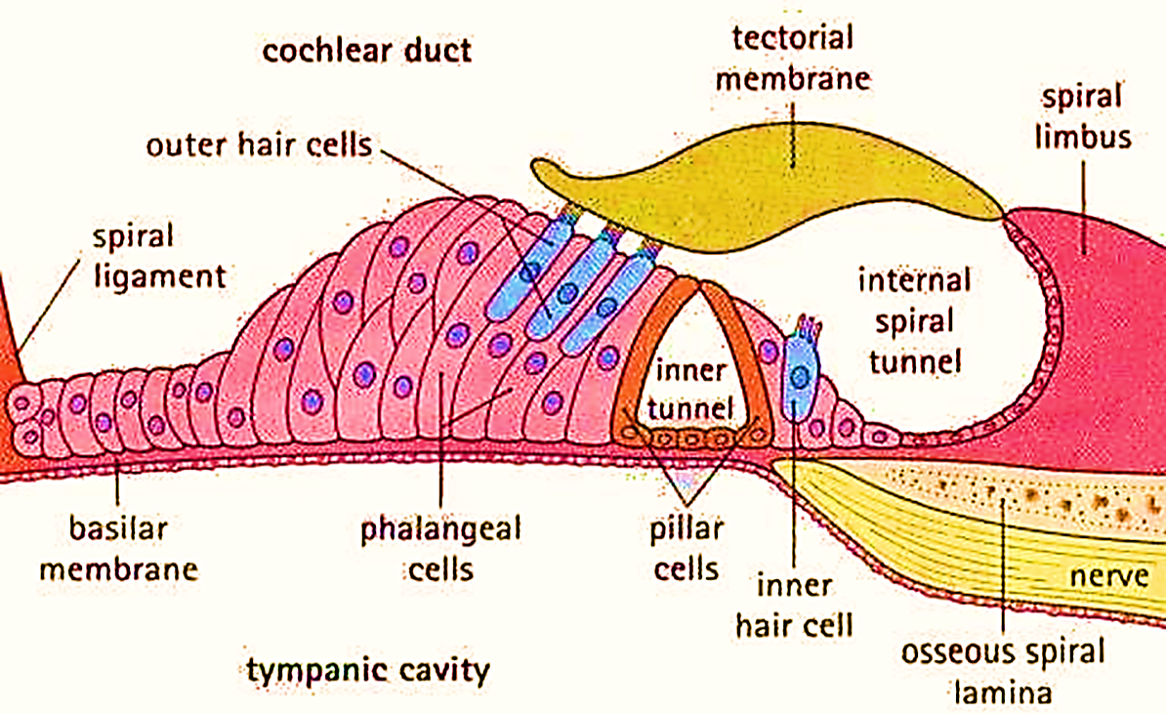
Structure of organ of Corti:
Hair cells (receptors)
supporting cells ( pillar, phalangeal, Hensen & claudius)
The supporting cells (4 ):
1- Inner & outer pillar cells:
Tall cells their upper ends
attach by junctional complexes, together e basilar m. form triangular space called tunnel of Corti

Slide 27
2- Inner & outer phalangeal cells:
Columnar cells support the inner and outer hair cells &their nerve fibers
Inner ph. cells are 1 row
Outer ph. Cells are 3 rows
3- Hensen cells: tall cells, lateral
to the outer phalangeal cells
4- Cells of Claudius: form the
outermost border

Slide 28
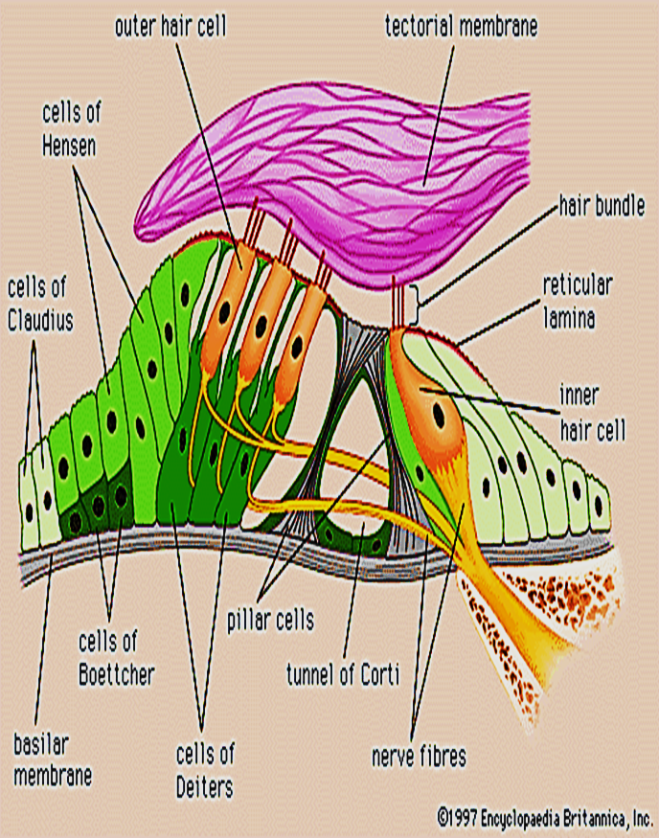
Hair cells (sensory, neuroepithelial) cells
Outer hair cells: columnar cells, arranged in 3 rows
Inner hair cells: flask-shaped cells, arranged in 1 row
Supported by inner & outer phalangeal cells,
Their apical ends have stereocilia.
Their bases have afferent nerves
that synapse e bipolar nerve cells
of spiral ganglion
The tips of the stereocilia
are in contact with the tectorial
membrane

Slide 29
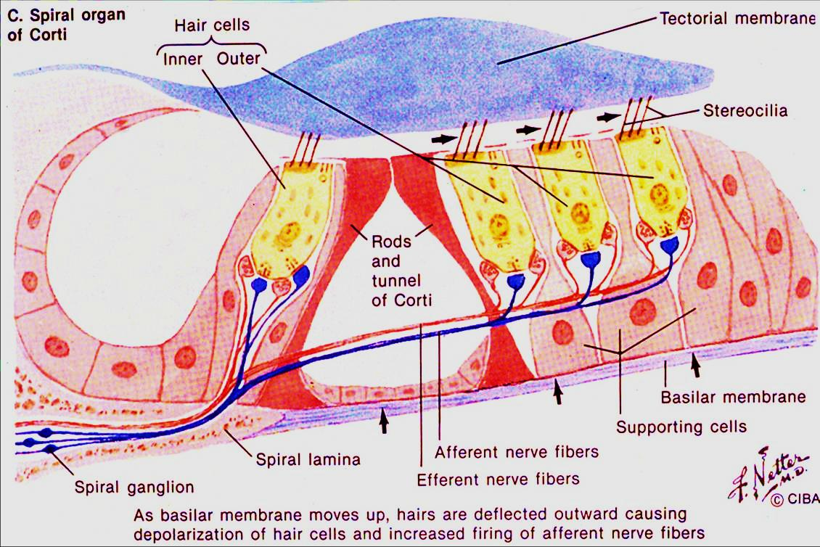
Axons of bipolar nerve cells form cochlear nerve

Slide 30
Mechanism of Hearing
External ear collect sound waves → tympanic membrane → The vibration of tympanic membrane will be conducted & magnified along the 3 bony ossicles → movement of stapes → vibration of perilymph in scala vestibule → vibrations of vestibular membrane → endolymph in cochlear duct ( as pressure waves) → vibrate basilar membrane →movement of hair cells of organ of corti → initiate n.impluses → cochlear n.→ brain

Slide 31
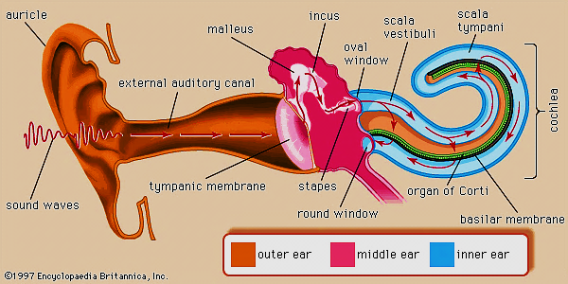

Slide 32
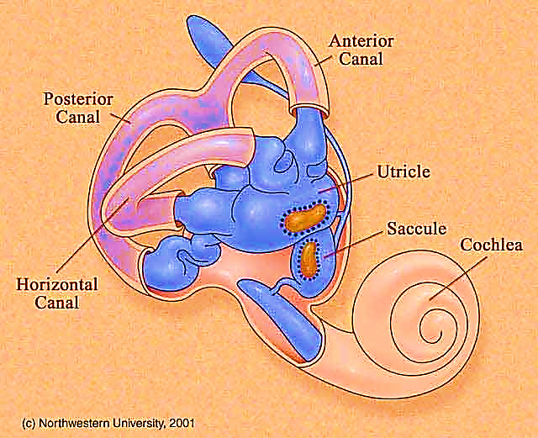
The vestibule
Contains 2 structures :Utricle
Saccule
Maintain the equilibrium of the
body
The utricle & saccule are
membranous sacs lined with
simple squamous epith. Filled with endolymph
They contain 2 neuroepithelial structures, similar histologically: macula utriculi, macula sacculi

Slide 33
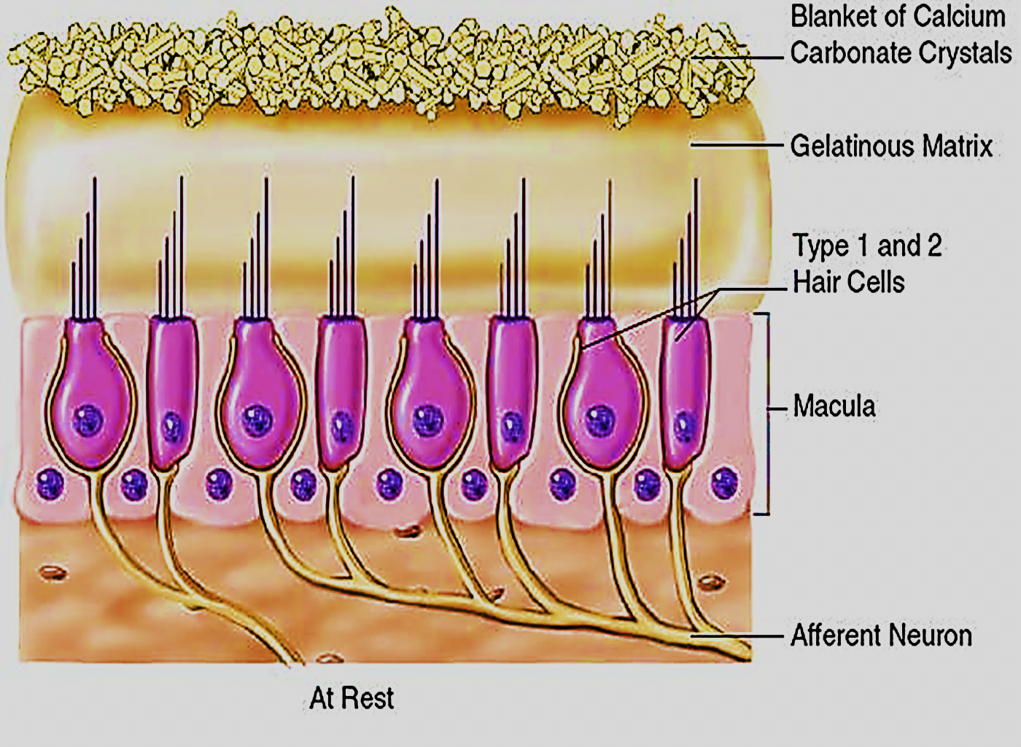
Structure of maculae of utricle & saccule:
Formed of: I- Hair cells II- supporting cells
The hair cells:
Type I (Flask- shaped)
Type II (cylindrical- shaped)
The apical surfaces of both types
Show single central kinocilium
surrounded e several stereocilia
(40 -70)
both cell types are surrounded
at their base with afferent fibers of vestibular nerve

Slide 34
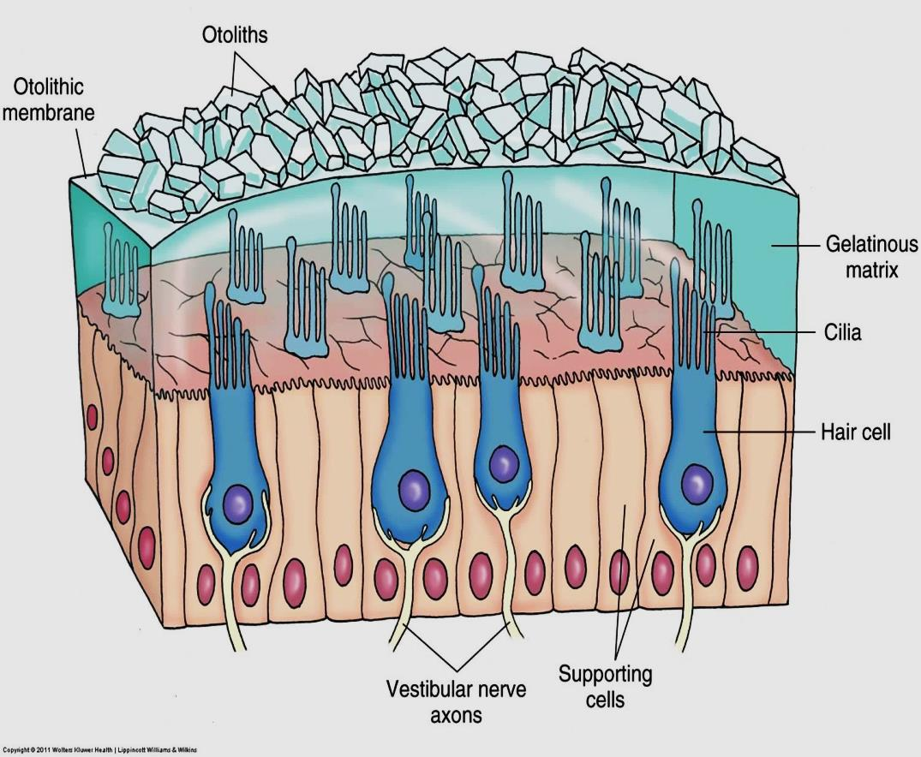
Otolithic membrane
The hair cells of both maculae are covered with gelatinous membrane made of protein & crystals of Ca⁺ carbonate (Otoconia)
The membrane has Critical role in the brain's interpretation of equilibrium
Movement of head & Linear acceleration (horizontal &vertical)
M utriculi
M sacculi

Slide 35
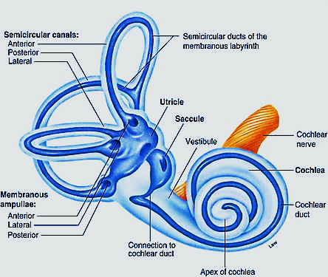
The Semicircular canals
3 canals, open into the utricle of the vestibule by 5 openings as 2 of them share one open.
The membranous labyrinth inside
the canals take the same shape, &
is called the semicircular ducts
Each duct has one expanded end
called ampulla which contains
the neuroepithelial structure
Called Crista ampullaris (3/ ear)

Slide 36
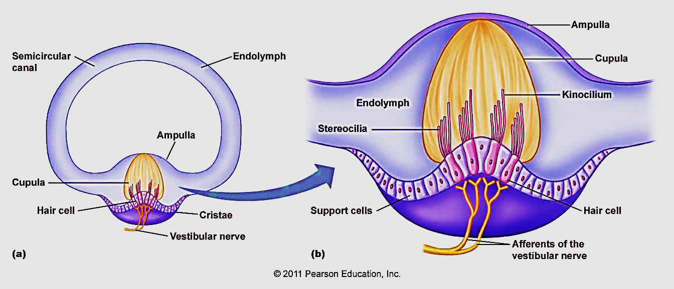
Structure of Crista ampullaris
Each crista is projects from the inner wall of each ampulla
Each crista has 2 types of cells: hair cells & supporting cells

Slide 37
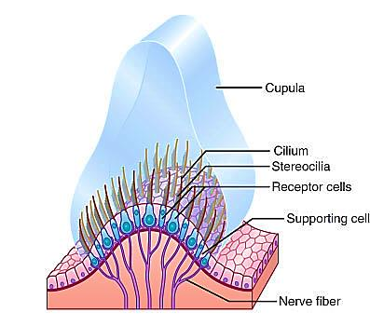
The hair cells of crista ampullaris: 2 types
Type I (flask- shaped) & Type II ( columnar) cells
Their bases surrounded with afferent fibers of vestibular nerve
Both types have stereocilia and kioncilium embedded in
gelatinous membrane called Cupula
Cupula : glycoprotein Cap
without Ca⁺ carbonate crystals
Detect angular acceleration (rotation)
of head

Slide 38
Difference between macula of vestibule & crista ampullaris of semicircular canals

Slide 39
Thank you

