Slide 1
Prenatal screening and diagnosis of congenital anomalies
Dr. Seham Abufraijeh

Slide 2
Congenital anomalies can be defined as structural or functional anomalies, including metabolic disorders, which are present at the time of birth.
WHO 2014
● Congenital anomalies (also referred as birth defects) affect an estimated 1 in 33
infants and result in approximately 3.2 million birth defect-related disabilities every
year.
● An estimated 270 000 newborns die during the first 28 days of life every year from
congenital anomalies.
● The most common severe congenital anomalies are heart defects, neural tube
defects (NTDs) and Down syndrome.

Slide 3
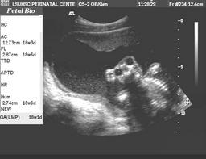

Slide 4
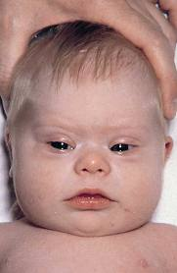
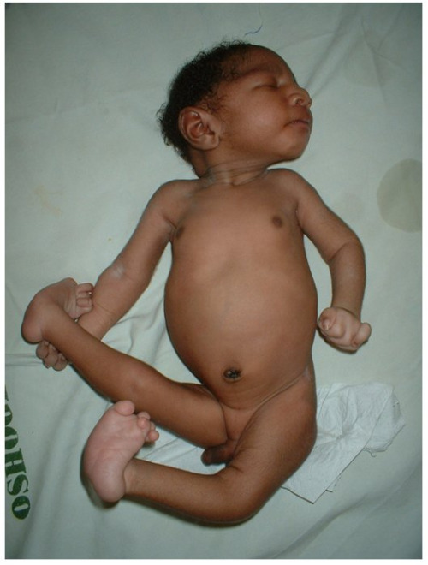

Slide 5
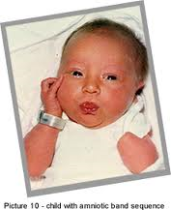
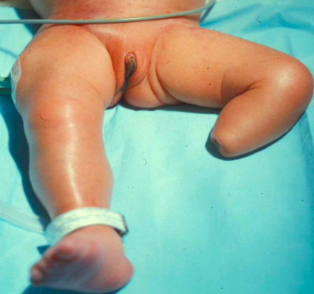

Slide 7
Terminology

Slide 8
Malformations :
Defects of organs or body parts due to an intrinsically abnormal
developmental process. In this process a structure is not formed, is partially formed, or is formed in an abnormal fashion.
− Malformations often result from a defect in embryonic development due to
genetic or environmental forces.
Classification:
Major malformations : Have medical and/or social implications &
often require surgical repair.
NTDs: Meningomyelocele or orofacial clefting (cleft lip and palate)
2) Minor malformations : Have mostly cosmetic significance, rarely medically
significant or require surgical intervention and might represent part of the normal variation in the general population.
E.g, ear tags, clinodactyly (incurving of the fifth finger), and single transverse palmar creases

Slide 9
Deformations : Abnormalities of the position of body parts due to extrinsic
intrauterine mechanical forces that modify a normally
formed structure.
− Intrauterine forces: Decreased amniotic fluid, uterine tumors, and uterine
malformations (eg, bicornuate or septated uterus) can lead to fetal
compression.
Fetal crowding due to multiple gestations.
− Common deformations: Clubfoot, congenital dysplasia of the hip (CDH),
and plagiocephaly (lopsided or flattened skull due to compression).
− These often can be corrected by physical therapy, casting, or the use of a
special helmet to remodel the skull while the fontanelles are still open.

Slide 10
Disruptions : Defects of organs or body parts that result from destruction of
or interference with normal development.
− Result from vascular or mechanical processes that lead to tissue
compromise, such as compression, strangulation, hemorrhage, or
thrombosis.
− Most cases of disruption are single events that are sporadic rather than
inherited. Thus, their recurrence risk is very low.
− Amniotic band sequence ( ABS ) is perhaps the most common example of
intrauterine disruption.
(ABS) is a group of structural abnormalities that involve mostly the limbs, but also may affect the craniofacial region and trunk. ABS occurs in association with amniotic bands, The typical appearance consists of amputations and malformations caused by the encircling constrictions of the limbs or other body structures, but the clinical spectrum is highly variable. The specific malformations caused depend upon the time of the disruption.

Slide 11
Dysplasias : anomalies that result from the abnormal organization
of cells into tissues.
− An example is abnormal growth of bone resulting in skeletal dysplasias, such as achondroplasia. This disorder is caused by mutations in the fibroblast growth factor receptor 3 gene, leading to abnormalities in endochondral ossification.

Slide 12
Pattern of defects :
Multiple malformations are often grouped in a recognizable pattern as follows:
Syndrome : a pattern of anomalies that occur together and are pathogenetically
related.
2) Sequence : a pattern of anomalies in which a single known defect in
development causes a cascade of subsequent abnormalities .
(Potter sequence)
Association : Two or more anomalies that are not pathogenetically related and
occur together more frequently than expected by chance.
The etiology of associations is not defined.
(VATER or VACTERL association).

Slide 13
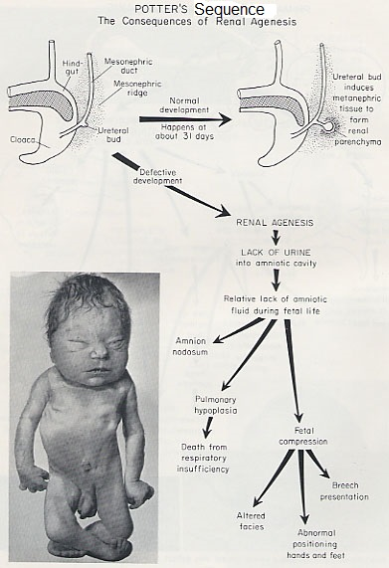
Potter Sequence: P Pulmonary Hypoplasia O Oligohydramnios T Twisted skin(wrinkling skin) T Twisted face(POTTER face) E Extremities defects R Renal Agenesis (Bilateral)

Slide 15
Etiology :
− Genetic abnormalities
*** Chromosomal disorders: Down syndrome
*** Single gene (monogenic) disorders: Autosomal recessive (cystic fibrosis),
autosomal dominant (Marfan syndrome), or X-linked (Hemophilia).
*** Multifactorial disorders: Interaction of multiple genes and environmental
factors. (Cleft lip/palate, congenital heart disease, and NTDs).
− Non-genetic etiologies include environmental factors: maternal
phenylketonuria (PKU) or diabetes, teratogens (eg, alcohol, oral isotretinoin),
infections (cytomegalovirus [CMV], rubella), and twinning.
→ About 40-50% of cases the etiology is unknown.

Slide 16
Detection
Screening can be conducted during the following three periods :
● Preconception screening
● Antenatal screening
● Newborn screening

Slide 17
Prenatal screening and diagnosis of trisomy 21 and other aneuploidies
Prenatal screening and diagnosis of neural tube defects
Role of ultrasound in screening and diagnosis of congenital anomalies
Amniocentesis
Chorionic villus sampling (CVS)
Prenatal diagnosis using cell-free nucleic acids in maternal blood

Slide 18
Prenatal screening and diagnosis of trisomy 21 and other aneuploidies
Down syndrome: The most common chromosome abnormality among live
births caused by a demonstrable chromosomal aberration.
- Moderate to severe learning disability (average IQ approximately 40) in combination with
short stature, characteristic facial features, heart defects (40 to 50 %), intestinal
malformations (10 %), problems with vision and hearing (50 %), an increased
frequency of infection, and other health problems.
● The risk:
- Increases with maternal age( > 35 years ).
- Decreases with gestational age.
● The majority of fetuses with trisomy 21 are in the women aged under 35 years.
● Trisomies 18 and 13 are the second and third most common chromosomal
abnormalities. The risk for these trisomies increases with maternal age and decreases with
gestation. The rate of fetal death between the 12th and 40th week is about 80%.

Slide 19
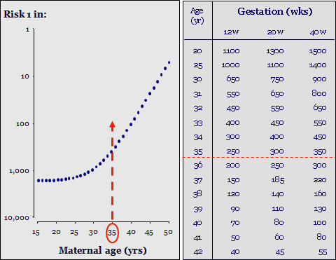

Slide 20
Candidates for prenatal screening:
● Maternal age alone was the initial risk factor used for screening pregnancies for
Down syndrome.
● In 2007, the American College of Obstetricians and Gynecologists (ACOG)
recommended that :
(1) all women be offered aneuploidy screening before 20 weeks of gestation.
(2) all women should have the option of invasive testing, regardless of maternal age.
Candidates for diagnostic testing:

Slide 21
Screening tests :
1) First trimester combined test.
2) Second trimester Quadruple test.
3) Integrated tests.

Slide 22
First trimester combined test :
● 11-14 weeks of gestation.
● Consists of three markers :
1- Maternal serum beta human chorionic gonadotropin (beta-hCG)
2- Maternal serum pregnancy-associated plasma protein-A (PAPP-A)
3- Ultrasound measurement of nuchal translucency (NT)
● These three markers "combined test" and together with maternal age provide a patient-
specific risk, (Down syndrome risk 1 in 10).
Positive test means the patient's risk of having a baby with Down syndrome
is at or above a chosen cut-off level (eg, Down syndrome risk ≥1 in 250).
● Detection rate [DR] = sensitivity of the test is 85 % of Down syndrome
with a false positive rate (FPR) of 5 %.

Slide 23
● In trisomy 21 pregnancies maternal serum free ß-hCG is about twice as high
and PAPP-A is reduced to about half compared to chromosomally normal
pregnancies.
-In euploid pregnancies the average free ß-hCG is 1.0 MoM and PAPP-A is 1.0 MoM.
In chromosomal defects the values are:
PAPP-A | free ß-hCG
0.5 | 2 | Trisomy 21
0.2 | 0.2 | Trisomy 18
0.4 | 0.3 | Trisomy 13
0.5 | 1.2 | Turner

Slide 24
Nuchal translucency (NT) :
● The sonographic appearance of a collection of fluid under the skin behind the fetal
neck in the first trimester of pregnancy.
● During the second trimester, the translucency usually resolves and, in a few cases, it
evolves into either nuchal fold or cystic hygromas with or without generalized
hydrops.
● An increase in NTmeasurement ( > 95th centiles or >99th centiles) is associated with
an increased risk of fetal aneuploidy, structural anomalies and genetic syndromes.
The risk increases as NT increases.
● 75-80% of trisomy 21 fetuses, NT is above the 95th centile of the
normal range.
● In the distribution of NT thickness in euploid fetuses:
The median, 1st, 5th and 95th centiles increase with fetal CRL.
- The 99th centile is about 3.5 mm and does not change with CRL.

Slide 25
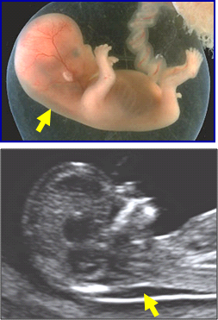

Slide 26
Second trimester Quadruple test :
● Four maternal serum markers:
alpha-fetoprotein (AFP), unconjugated estriol (uE3), human chorionic gonadotropin (hCG), and
inhibin A.
Maternal serum AFP and uE3 levels are reduced by 25 to 30 % in pregnancies
affected by Down syndrome, while hCG and inhibin A levels are twice as high as
those in unaffected pregnancies.
● Ideally, sampling should occur between 15 to 18 weeks of gestation.
{screening time frame (15 to 22 weeks of gestation)}.
● The detection rate of the quadruple test is 80 % with a false positive rate of
about 5 %. So it is considered the best available screening test for Down syndrome in
women who present for care in the second trimester.

Slide 27
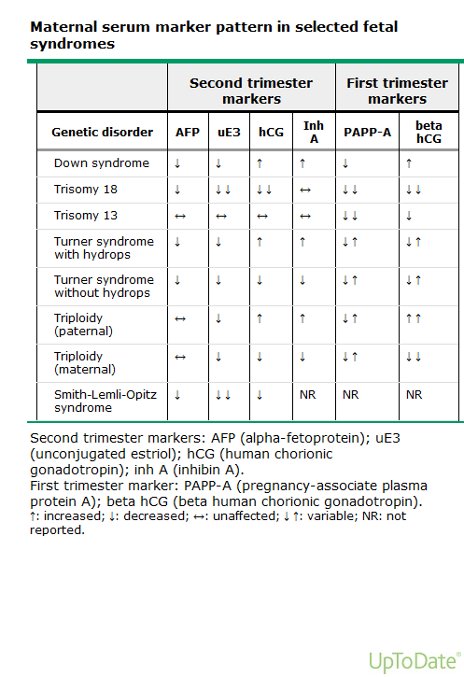

Slide 28
Integrated tests :
● It uses markers measured in both the first and second trimesters to provide a single estimate of risk for Down syndrome pregnancy.
● The advantage of the integrated test is that at an equivalent DR, it has a substantially
lower FPR than the combined or quadruple test.
Full integrated test : Combined tests + Maternal serum markers in second
trimester. It has the lowest false positive rate
among Down syndrome screening tests, leading to the
lowest rate of procedure-related losses per woman screened.
(2) Serum integrated test : Same as the full integrated test, but NO ultrasound
measurement of NT. This test provides an option to
patients in areas where expertise in measurement of
NT is not available.
Disadvantage of integrated tests is that the patient has to wait until the second trimester to obtain her risk estimate.

Slide 29
Sequential and contingent testing :
Step-wise sequential testing: Performance of the first trimester portion of the integrated screen and then offer chorionic villous sampling (CVS) only to women whose results place them at very high risk of an affected fetus (≥1 in 50). Those whose screen does not place them at very high risk go on to complete the second trimester portion of the test.
Contingent testing : defined in terms of three risk cut-offs:
(1) women at very high risk (≥1 in 50) of having a fetus with Down syndrome after
first trimester testing would be offered immediate invasive prenatal diagnosis.
(2) women at very low risk (<1 in 2000) would be provided with their risk estimate
and would require no additional testing.
(3) women at intermediate risk (>1 in 2000 but <1 in 50) would receive second
trimester marker testing.

Slide 30
A negative test means the patient's risk of having a baby with Down syndrome is less than a specific cut-off level; it does not exclude the possibility of Down syndrome

Slide 31
Chorionic villus sampling (CVS)
● Small samples of the placenta are obtained under real-time ultrasound guidance for prenatal genetic diagnosis
(PGD).
● 10 and 14 weeks of gestation.
The procedure is delayed until 10 weeks of gestation because most spontaneous pregnancy
losses will have occurred by this time and performance very early in pregnancy is associated
with an increased risk of limb-reduction defects.
After 14 weeks of gestation, CVS can be performed but amniocentesis is preferred
at gestations ≥15 weeks because it is technically easier, more comfortable for the
patient, and avoids diagnostic uncertainty related to confined placental mosaicism.
● Chorionic tissue can be obtained transabdominally (TA-CVS) or
transcervically (TC-CVS). Operator preference generally guides the decision, but technical factors
predominantly related to placental location favor one approach over the other in up to 5 % of procedures.

Slide 32
● TA-CVS is generally preferable to TC-CVS:
- Fewer procedure-related fetal losses.
- lower risk of bleeding and infectious complications.
- lower need for multiple insertions.
- higher sampling success rate at the first attempt, and less maternal cell
contamination.
● At least 5 mg of villus tissue is generally required. Rapid karyotyping can be achieved within 24 to 48 hours of
sampling by direct examination of cytotrophoblast (ie, direct method) since these cells have a high mitotic index
and can be examined in metaphase. Final results (based on long-term culture) are reported in 7 to 10 days.

Slide 33
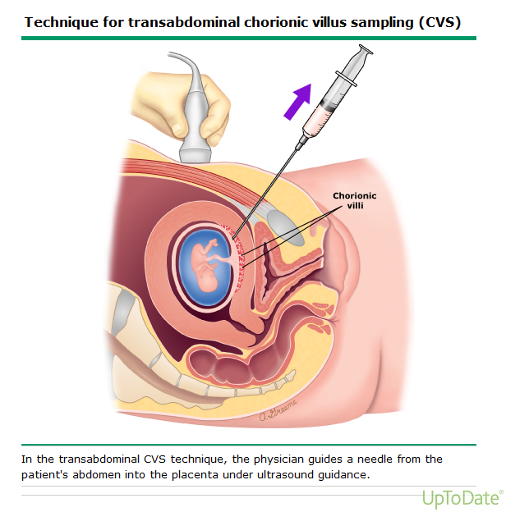

Slide 34
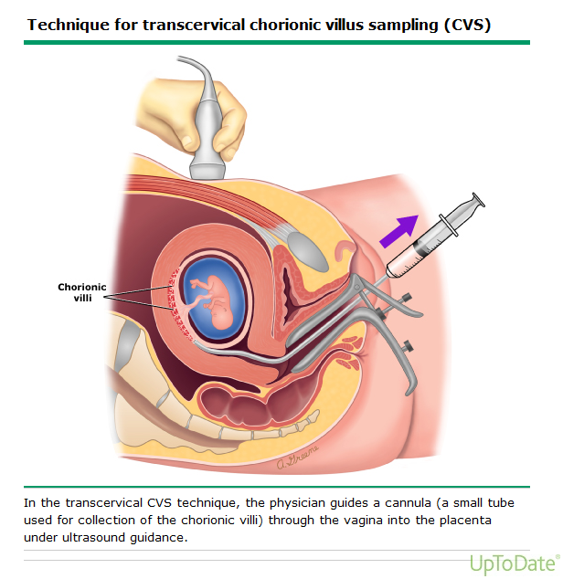

Slide 35
Complications:
Fetal loss: 0.6 to 1.0 %.
Failure to obtain a sample , Maternal cell contamination.
Limb-reduction defects and oromandibular hypogenesis : if performed before 9 weeks of gestation.
Bleeding.
Infection.
Fetomaternal hemorrhage.
Rupture of membranes: Acute rupture of membranes is rare. Delayed rupture of membranes days to weeks after the procedure has been reported in 0.3% of cases.

Slide 36
Amniocentesis
● A technique for withdrawing amniotic fluid (AF) from the uterine cavity using a needle
via a trans-abdominal approach under ultrasound guidance.
● The most common diagnostic indications:
Prenatal genetic diagnosis (PGD) and assessment of fetal lung maturity.
Other indications: Evaluation of the fetus for infection, degree of hemolytic anemia,
blood or platelet type, hemoglobinopathy, and NTDs.
● For prenatal genetic studies, optimally to be done at 15-17 weeks of
gestation. Procedures performed before 15 weeks are associated with higher fetal
loss and complication rates, including culture failure, and should be avoided.
● No need for antibiotic prophylaxis for amniocentesis.
Amnioreduction : Remove excess AF, such as in symptomatic polyhydramnios
or twin-to-twin transfusion syndrome (TTTS), or to reduce volume and
pressure of AF in cases of prolapsed fetal membranes in the second
trimester to facilitate placement of an emergency cerclage.

Slide 37
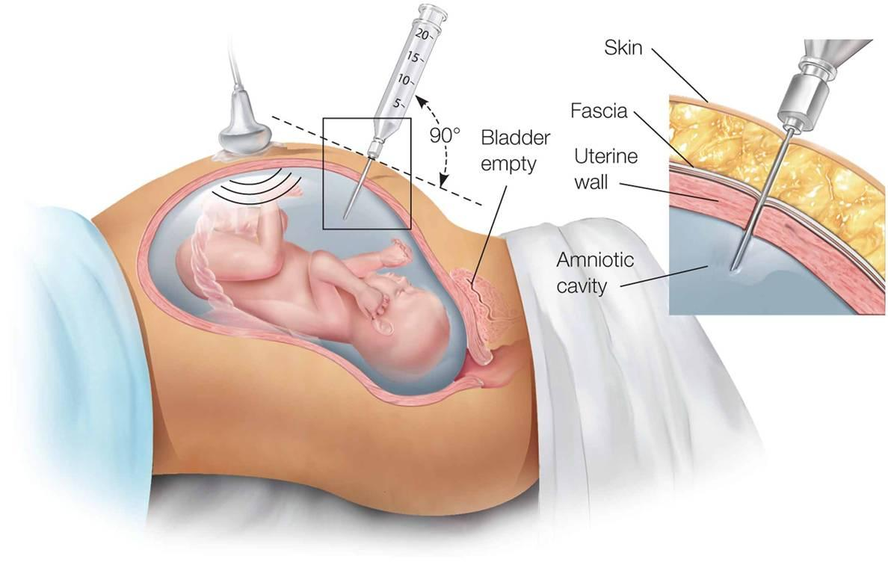
Amniocentesis

Slide 38
Complications:
1) Leakage of amniotic fluid.
2) Direct fetal needle injury.
3) Vertical transmission: Case reports have described mother-to-infant transmission of infections, such as hepatitis virus, cytomegalovirus (CMV), toxoplasmosis, and human immunodeficiency virus (HIV), where transmission was presumed to be related to amniocentesis.
4) Innoculation by bowel flora: Traversing the bowel, which is rare, can introduce bowel flora into the amniotic fluid leading to intrauterine infection, pregnancy loss and, rarely, septic shock.
5) Fetal loss: 0.6 to 1.0 %. Most fetal losses occur up to four weeks following amniocentesis.
6) Cell culture failure: Amniocytes fail to grow in culture in 0.1 % of samples.

Slide 39
→ Fetal karyotype can be determined by studying cells obtained via amniocentesis, CVS, or fetal blood sampling. Test results are available sooner when blood is the source of cellular material: 24 to 48 hours versus 7 to 10 days when amniocytes or chorionic villus cells are cultured. This is because cells from amniotic fluid and chorionic villi need to be stimulated to grow before they can be captured in metaphase for conventional G-banding, whereas cells from a blood sample are rapidly dividing and can be captured in metaphase immediately.
→ Interphase fluorescence in situ hybridization (FISH) provides a limited karyotype within 24 to 48 hours, but only detects aneuploidy of chromosomes 13, 18, 21, X, and Y, which are the most common causes of aneuploidy. Irrevocable actions (eg, pregnancy termination) should not be undertaken based on FISH results alone because rare false positives occur. The American College of Medical Genetics monograph Standards and Guidelines for Clinical Genetics Laboratories states that "abnormalities detected by interphase FISH that are also considered reliably detectable by chromosome analysis should be confirmed by conventional cytogenetic analysis"

Slide 40
Prenatal screening and diagnosis of neural tube defects (NTDs)
● NTDs are the second most prevalent congenital anomaly worldwide after cardiac
malformations.
● Caused by failure of the neural tube to close normally during the third and fourth
weeks after conception (the fifth and sixth weeks of gestation).
● There are several anatomic types of NTDs that affect the spine (vertebrae, meninges,
spinal cord) and/or cranium (skull, scalp, brain).
They can be classified as open (neural tissue exposed) or closed (neural tissue not
exposed). Open NTDs often involve both the spine and cranium, while closed NTDs
are usually localized and confined to the spine.
NTDs of the spine are often associated with cerebral ventriculomegaly.

Slide 41
● The most common types of NTDs, anencephaly, encephalocele, and spina bifida.
● The risk of recurrence for NTDs is approximately 2-4 % with one
affected sibling and reaching 10% with two affected siblings.

Slide 42
Etiology and risk factors :
The majority of NTDs are isolated malformations of multi-factorial origin (traits/conditions influenced by both environmental and genetic factors).
Environmental factors:
Inadequate folate, which may be related to inadequate intake, use of folic acid antagonists (methotrexate, aminopterin), or genetic factors causing abnormal folate metabolism.
Antiepileptic drugs (Valproate, carbamazepine). The mechanism for antiepileptic drug mediated NTDs is poorly understood.
Maternal diabetes mellitus.
Obesity.
Amniotic bands.
Hyperthermia.

Slide 43
Screening :
● All pregnant women should be offered screening for NTDs.
Selective screening based on risk factors performs poorly since 90-95 % of cases occur in pregnancies without any risk factors. Universal screening for NTDs identifies the majority of affected pregnancies.
● The two approaches to NTDs screening are measurement of maternal serum AFP
(MSAFP) and ultrasound (U/S) examination. U/S is both a screening and
diagnostic test.
First trimester transvaginal ultrasound generally have reported
detection rates >90% for anencephaly and 80 % for encephalocele, but lower rates for spina bifida (44 %).
Second trimester U/S increases detection of spina bifida to approximately 92-95 % and detection of anencephaly to 100 %.

Slide 44
(2) Maternal serum alpha- fetoprotein (MSAFP) :
● AFP is a fetal specific globulin, synthesized by the fetal yolk sac, gastrointestinal tract and liver. The function of AFP is unknown. It may be involved in immuno-regulation or may function as an intravascular transport protein. It is secreted by the fetal kidney into the urine and then excreted into the amniotic fluid. The concentration of amniotic fluid AFP (AFAFP) is highest early in pregnancy, peaks between 12 and 14 weeks of gestation, then declines until it becomes undetectable at term.
● MSAFP concentration is much lower than that in amniotic fluid or fetal plasma. It
rises in early pregnancy, peaks between 28 and 32 weeks of gestation, and then
falls. Increasing feto-placental permeability and advancing gestation may explain the rise in MSAFP
that occurs when amniotic fluid and fetal serum concentrations are declining.
* Measurement of MSAFP is performed ideally at 16 to 18 weeks of gestation, but can
be performed as early as 15 weeks or as late as 20 weeks. First trimester screening is
not recommended because of low sensitivity .

Slide 45
● MSAFP screening is primarily intended for the detection of open spina bifida and
anencephaly. It does not identify fetuses with closed spina bifida.
● Results are expressed as multiples of the median (MoM) for each gestational week .
A value above 2.0 to 2.5 MoM is designated an abnormal result, depending upon the
laboratory's preference for balancing the detection and false-positive rates in their
population.
● When MSAFP is >2.5 MoMs, 85 % of singleton pregnancies with an affected fetus are
identified.
● Many factors influence the correct interpretation of MSAFP results:
gestational age, maternal weight, ethnicity, maternal diabetes mellitus, fetal
viability, exclusion of other anomalies, and multiple pregnancy.
Prenatal diagnosis of neural tube defects (NTDs) is based on characteristic findings on ultrasound imaging.

Slide 46
Role of ultrasound in screening and diagnosis of congenital anomalies
● First trimester screening: It is limited by the small size of the fetus and ongoing fetal
development, which can result in later development of markers suggestive of an
underlying abnormality (eg, hydramnios related to esophageal atresia).
The overall detection rate for fetal structural anomalies was 51%, but detection rates for specific abnormalities varied widely from 0 to 100 %. For example, no cases of renal agenesis were detected in this gestational age range, < 50 % of cases of spina bifida were detected, > 50 % of cases of omphalocele, gastroschisis, and tetralogy of Fallot were detected, and 100 % of anencephalic fetuses were detected.
● Second trimester screening : (approximately 50 to 70 %) of congenital anomalies
can be diagnosed in second trimester ( 18-24 weeks ). Recommended to be done for
all pregnant women.

Slide 47
Soft markers
Ultrasound findings of uncertain significance. They are often associated with normal fetuses (ie, normal variants), usually have no clinical sequelae, and are transient, resolving with advancing gestation or after birth. They do carry an increased risk for fetal aneuploidy, however, and correlation with the patient's biochemical risk status should be done.
● Include:
---Increased NT/Nuchal fold
---Absent nasal bone
---Echogenic bowel
----Pyelectasis
---- Shortened long bones (humerus, femur)
----Echogenic intracardiac focus
----Choroid plexus cysts.
● Isolated soft markers are identified in 11-17 % of normal fetuses. The prevalence is
higher in aneuploid fetuses and the likelihood of aneuploidy is significantly
increased when more than one marker is present .

Slide 48
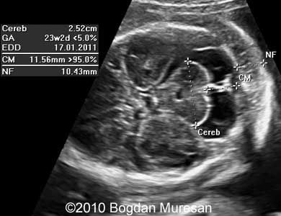
→ Nuchal fold : The nuchal fold, rather than NT, is measured in second trimester.
The measurement between the outer edge of the occipital bone to the outer
margin of the skin and is taken in the axial plane. An increase in this
measurement is also associated with aneuploidy.
An increased nuchal fold is detected in 20 to 33 % of fetuses with Down syndrome and 0.5 to 2 % of euploid fetuses.

Slide 49
Prenatal diagnosis using cell-free nucleic acids in maternal blood
● Fetal genetic material can be found in the maternal circulation, raising the possibility
of using maternal blood to diagnose fetal disease.
● Intact fetal cells can be identified in maternal blood, but are not a reliable source of
fetal genetic material because these cells are extremely rare and may persist for
years after prior pregnancies.
● By comparison, fetal "cell-free (cf)" nucleic acids not contained within cell
membranes (cfDNA and cfRNA) are plentiful in the maternal circulation and unique
to the current pregnancy. Thus, they have great potential for use in prenatal
diagnosis.

Slide 50
● Fetal cfDNA can be isolated from maternal blood as early as the fifth postmenstrual
week, and almost always by the ninth postmenstrual week. The maternal clearance
rate of fetal cfDNA is extremely rapid; in healthy pregnant women, the half-life is
approximately one hour, with essentially all fetal cfDNA eliminated within two days
of delivery.
● Fetal cfRNA has been detected as early as the sixth postmenstrual week, and also is
cleared rapidly from maternal circulation. Fetal cfRNA levels, in contrast to DNA
levels, are relatively stable in maternal blood throughout pregnancy.

Slide 51
Prenatal diagnostic applications :
Noninvasive screening for aneuploidy using cfDNA in the maternal blood was made available for clinical use in 2011. Because of the small, but real, risk of a false-positive result, most experts advise using these assays as screening tests, and confirming a positive result with invasive prenatal diagnosis.
Fetal autosomal aneuploidies: A series of validation studies demonstrated high sensitivity for diagnosis of Down syndrome (sensitivity 99 to 100 %, with false positive rates below 1 %), trisomy 18 (sensitivity 97 to 100 %), and trisomy 13 (sensitivity 80 to 100 %).
Fetal sex determination: nearly 100 % determination by the 10th postmenstrual week.
Sex-chromosome aneuploidy: for monosomy X, Klinefelter’s syndrome (XXY), XYY syndrome, and other sex-chromosome aneuploidies
Rhesus typing. Commercially available in the United States, and is widely used in Europe to reduce the need for unnecessary fetal surveillance in isoimmunized Rh(D)-negative women carrying an Rh(D)-negative fetus

Slide 52
GOOD LUCK

