Slide 1
Sexually transmitted infections (Public Health Perspective)
Dr. Israa Al-Rawashdeh MD,MPH,PhD
Faculty of Medicine
Mutah University
2023

Slide 2
Sexually Transmitted Infection (STI): are infections that result from the transmission of a pathogenic organism predominantly through sexual contact. Sexually Transmitted Disease (STD): refers to a recognizable disease state that has developed from an infection.
Definition:

Slide 3
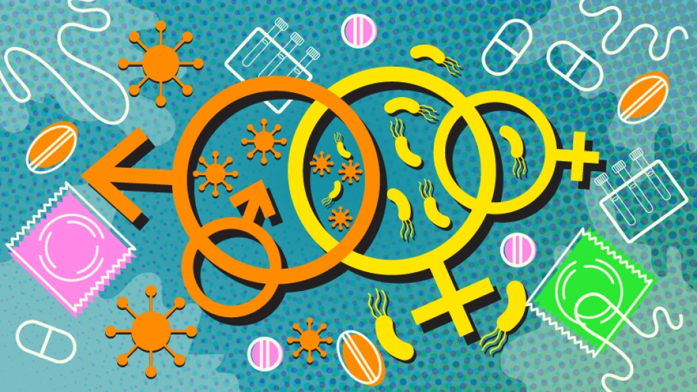
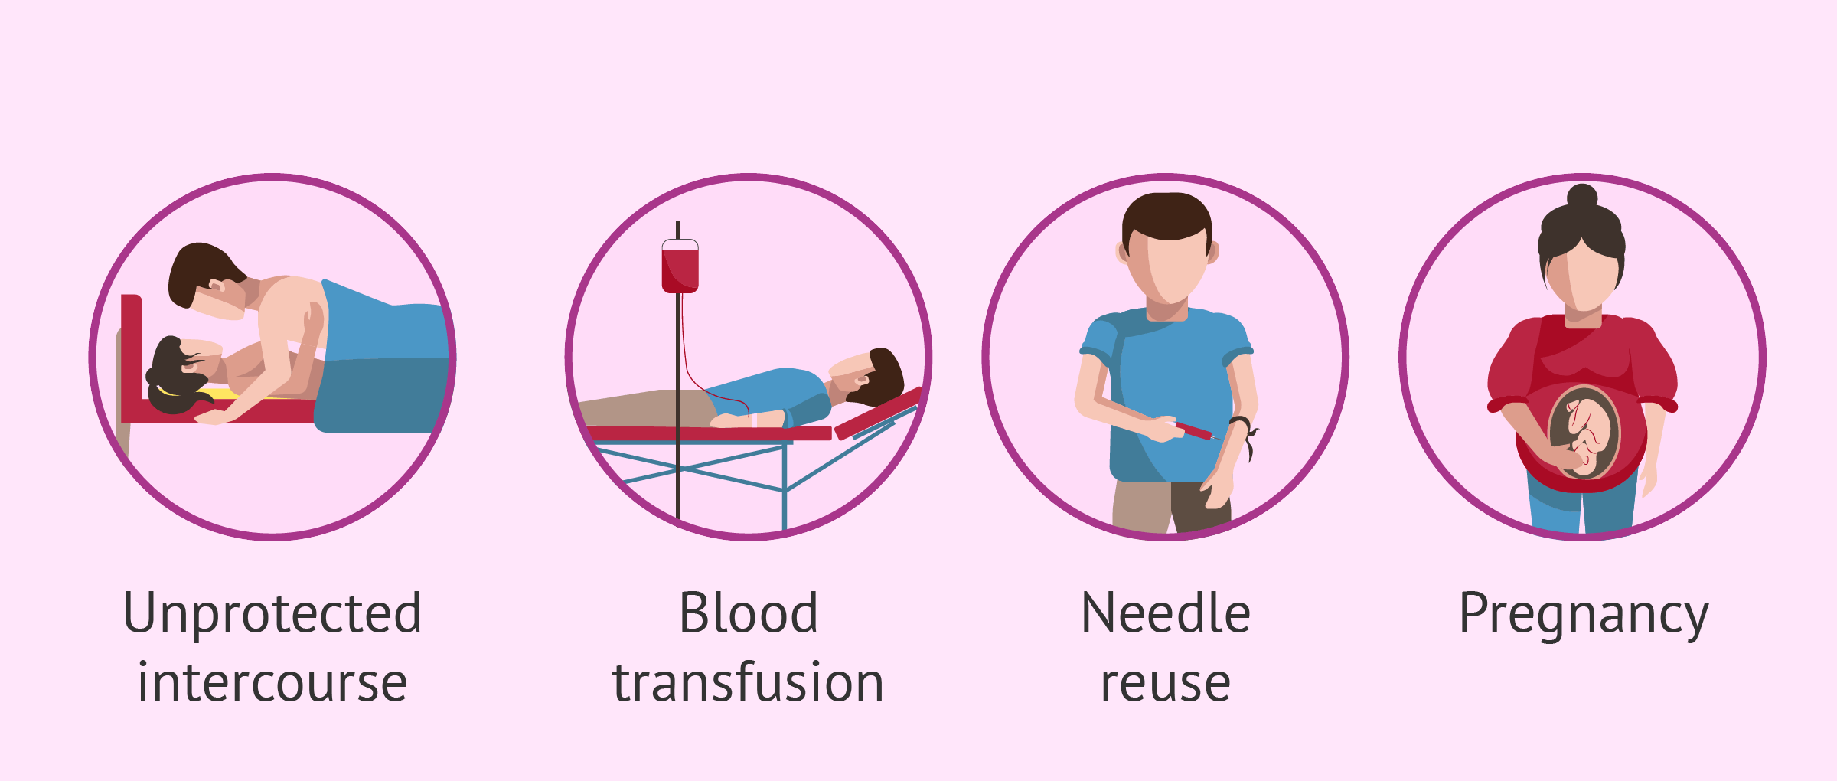
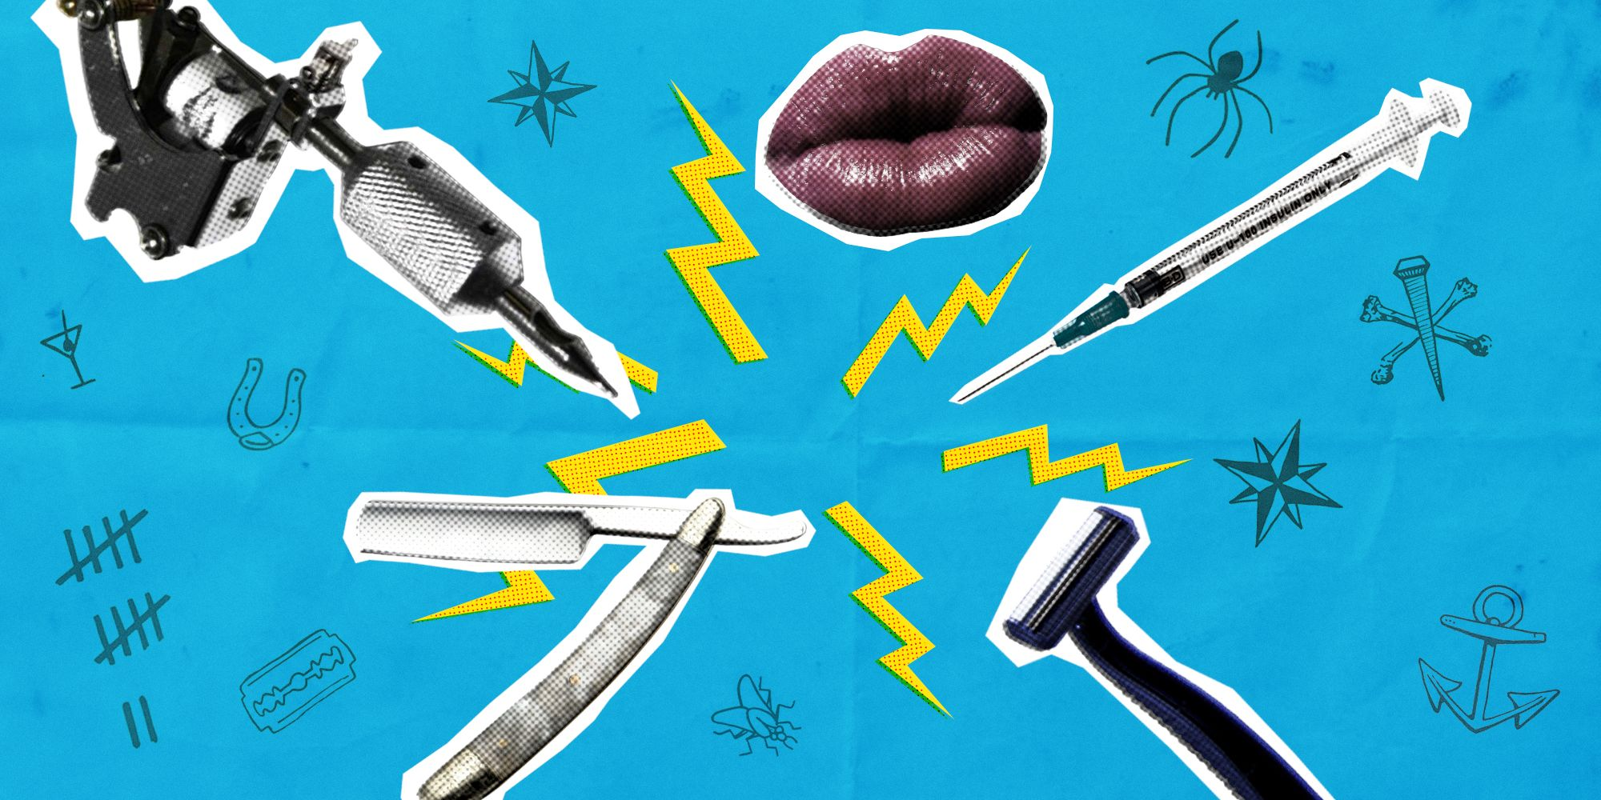
STIs are spread predominantly by sexual contact, including vaginal, anal and oral sex. Person-to person after infected individuals (with acute, chronic or asymptomatic clinical forms).
Some STIs can also be spread through non-sexual means such as mother to child (during pregnancy and childbirth.) or through blood products and tissue transfer (organ transplants), contaminated needles and fomites such as toothbrushes or towels.

Slide 4
Human beings are the only natural reservoir for STI etiological agents.
A person can have an STI without having obvious symptoms of disease (asymptomatic)
Several STI can occur in one same individual.
Albrecht Durer's (1471-1528) woodcut of a syphilitic man covered in chancres.

Slide 5
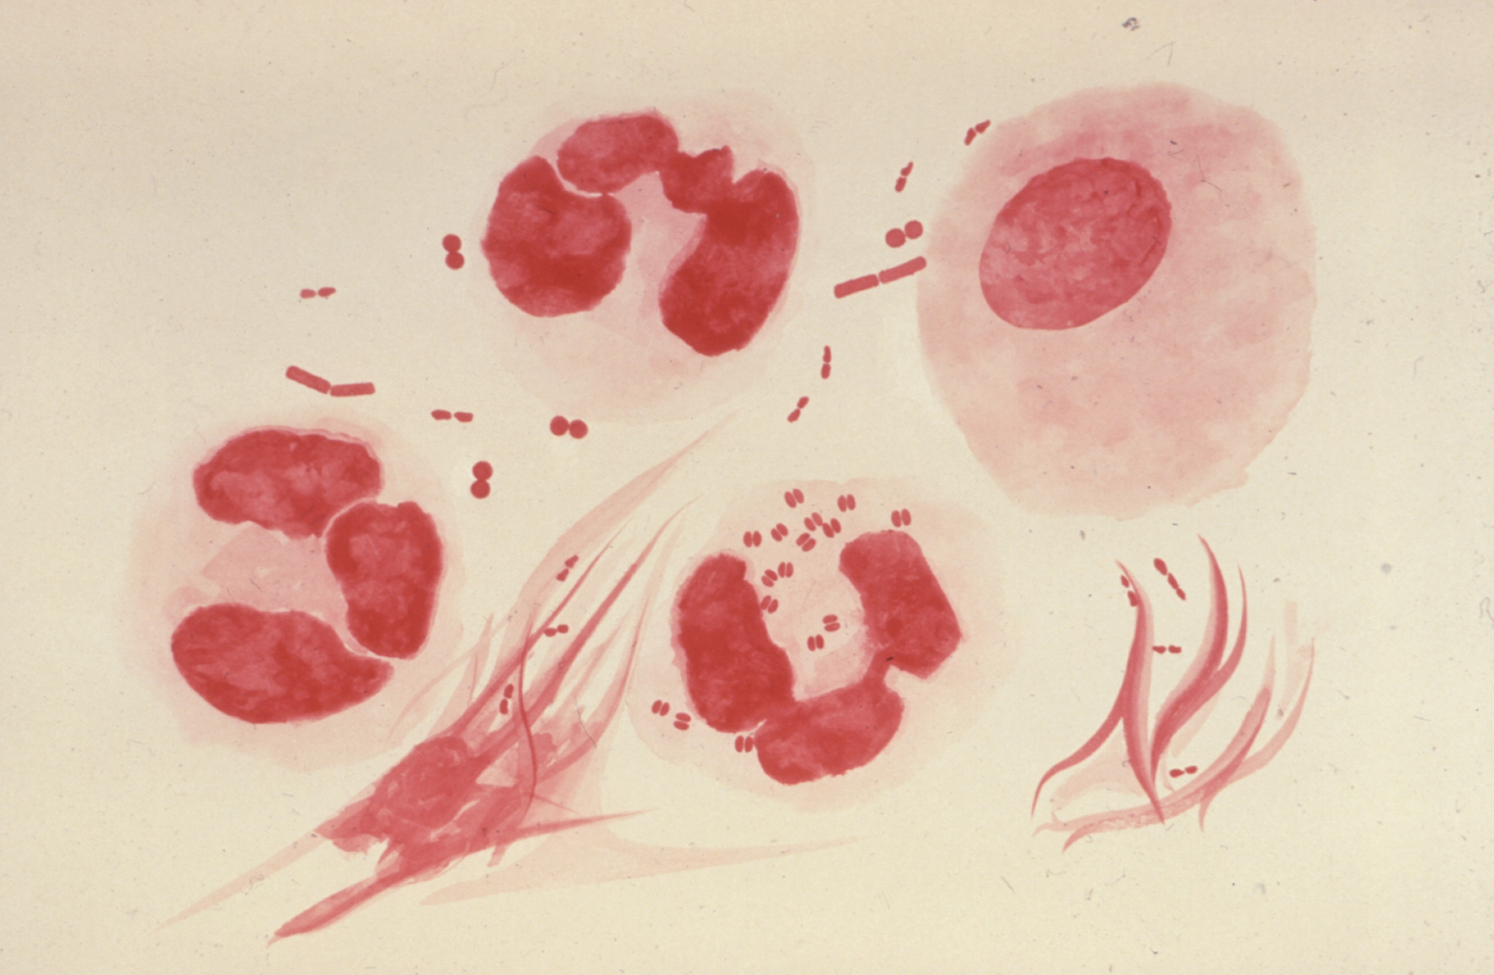
Sexually Transmitted Infections Magnitude:
STIs have a great impact on sexual and reproductive health worldwide.
More than 1 million STIs are acquired every day.
There are approximately 36.7 million people living with HIV by the end of 2015 , 2.1 million of which were newly infected.
More than 500 million people are living with genital HSV (herpes) infection.
In 2016, WHO estimated 376 million new infections with 1 of 4 STIs among people 15–49 years of age :
Chlamydia (127 million),
Gonorrhoea (87 million),
Syphilis (6.3 million), and
Trichomoniasis (156 million).

Slide 6
Risk factors
Factors that may increase STIs’ risk include:
Age (Half the new STIs occur in people between the ages of 15 and 24)
Unprotected sexual activities.
Having sexual contact with multiple partners.
Previous history of STIs.
Misuse of alcohol or use of recreational drugs. Increase susceptibility to participate in risky behaviors.
Injecting drugs. Needle sharing spreads many serious infections, including HIV, hepatitis B and hepatitis C.
Transmission from mothers to infants Certain STIs — such as gonorrhea, chlamydia, HIV and syphilis — can be passed from mothers to their infants during pregnancy or delivery.
Immune status of the individual
The rate of spread (Ro) of STIs in populations: infectivity (β), rate of exposure between infected and susceptible individuals (C), and duration of infection (D), and the factors that affect those variables.

Slide 7
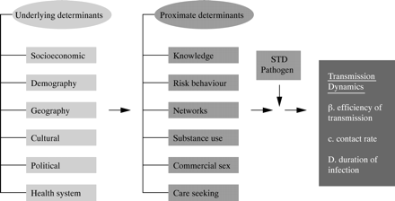
Framework:
https://sti.bmj.com/content/78/suppl_1/i3

Slide 8
Sexually Transmitted Infections
More than 30 different bacteria, viruses and parasites are known to be transmitted through sexual contact.
Eight of these pathogens are responsible for the greatest incidence of STIs.
Of these 8 infections; 4 are currently curable: syphilis, gonorrhoea, chlamydia and trichomoniasis.
The other 4 are viral infections which are incurable: hepatitis B, herpes simplex virus (HSV or herpes), HIV, and human papillomavirus (HPV).
Symptoms or disease due to the incurable viral infections can be reduced or modified through long term treatment.

Slide 9
STIs: Pathogens
Bacteria :
Gonorrhea (Neisseria gonorrhoeae)
Chlamydia (Chlamydia trachomatis)
Syphilis (Treponema pallidum)
Chancroid (Haemophilus ducreyi)
Viruses:
Genital warts and cervical—mainly-cancer (human papillomavirus)
Genital herpes (herpes simplex virus)
Hepatitis B (hepatitis B virus)
AIDS (HIV)
Parasites and protozoa:
Trichomoniasis (Trichomonas vaginalis)
Pubic lice (Phthirus pubis)
Candidiasis or "yeast infection“??

Slide 11
Sexually Transmitted Infections
300 million women have an HPV infection, the primary cause of cervical cancer.
An estimated 240 million people are living with chronic hepatitis B globally.
Both HPV and hepatitis B infections are preventable with vaccination.

Slide 12
Sexually Transmitted Infections: Impact
Impact: STIs can have serious consequences beyond the immediate impact of the infection itself.
HIV risk – the presence of a sexually transmitted infection, such as syphilis, gonorrhoea, or HSV, increases the risk of acquiring or transmitting HIV infection (by two to three times, in some populations)

Slide 13
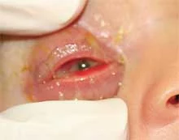
Sexually Transmitted Infections
Mother-to-child transmission of STIs can result in Fetal and neonatal impact:
Stillbirth, neonatal death,
Low-birth-weight and prematurity,
Sepsis, pneumonia, neonatal conjunctivitis, and congenital deformities.
Syphilis in pregnancy leads to over 300 000 fetal and neonatal deaths each year, and places an additional 215 000 infants at increased risk of early death
Worldwide, up to 4000 newborn babies become blind every year because of eye infections attributable to untreated maternal gonococcal and chlamydial infections.

Slide 14
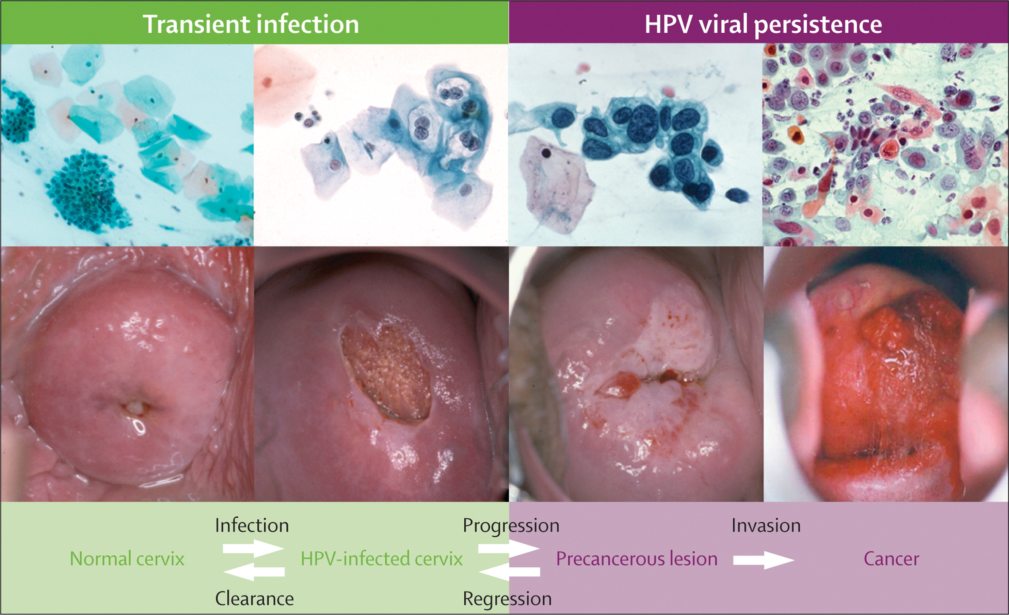
Sexually Transmitted Infections
Impact:
Cervical cancer – the human papillomavirus HPV (16 and 18) infection is responsible for an estimated 530 000 cases of cervical cancer and 264 000 cervical cancer deaths each year
STIs such as gonorrhoea and chlamydia are major causes of pelvic inflammatory disease (PID) and infertility in women.

Slide 15
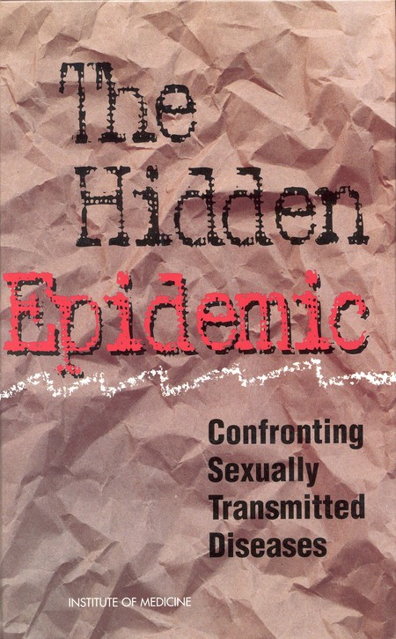
STI: Impacts
The physical, psychological and social consequences of sexually transmitted infections severely compromise the quality of life of those infected.

Slide 16
Sexually Transmitted Infections
Sign and symptoms of STIs:
Male:
Urethral discharge
Burning and pain during urination
Female:
Abnormal vaginal discharge
Burning and/or increased frequency of urination
Lower abdominal pain
Both:
Pain, itch, Papules, vesicles, erosion/ulcers or fleshy growths in and around genitalia, perineum and anus/rectum, oral cavity and occasionally on other sites.
Swelling in inguinal, anal region or scrotum.

Slide 17
Prevention and control:
Prevention and control of STIs are based on the following five major strategies :
Accurate risk assessment and education and counseling of persons at risk regarding ways to avoid STIs through changes in sexual behaviors and use of recommended prevention services
Pre-exposure vaccination for vaccine-preventable STIs
Identification of persons with an asymptomatic infection and persons with symptoms associated with an STI
Effective diagnosis, treatment, counseling, and follow-up of persons who are infected with an STI
Evaluation, treatment, and counseling of sex partners of persons who are infected with an STI

Slide 18
Primary Prevention Methods
1. Pre-Exposure Vaccination:
Pre-exposure vaccination is one of the most effective methods for preventing transmission of HPV, HAV, and HBV.
HPV vaccination is recommended routinely for males and females aged 11 or 12 years and can be administered beginning at age 9 years.
Hepatitis B vaccination is recommended for all unvaccinated, uninfected persons who are sexually active with more than one partner or are being evaluated or treated for an STI. hepatitis B vaccines are recommended for MSM, persons who inject drugs, persons with chronic liver disease, and persons with HIV or hepatitis C infections who have not had hepatitis B.

Slide 19
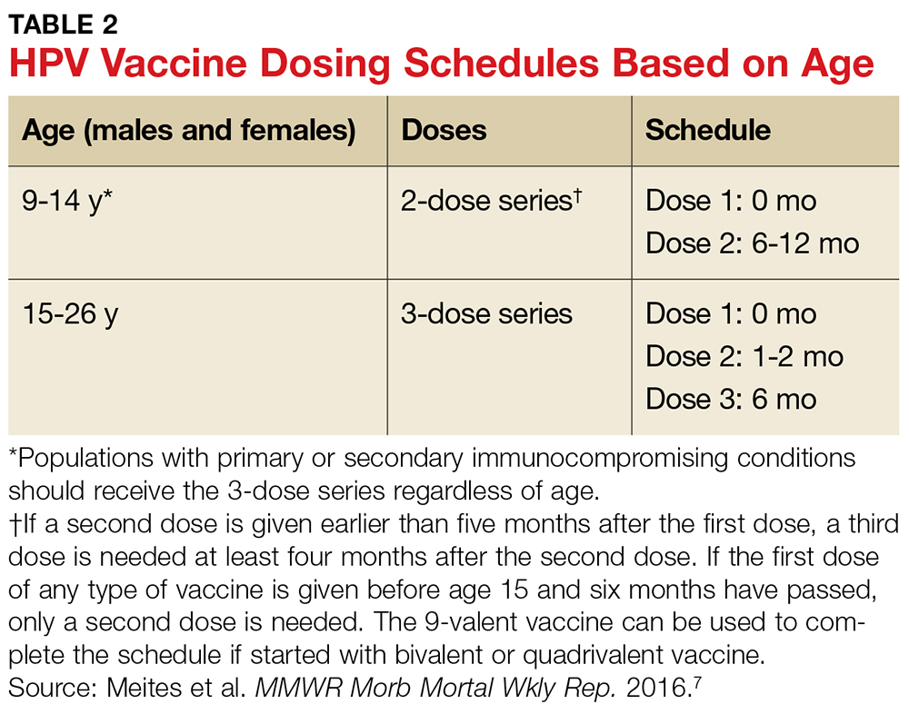
three-dose schedule also applies for immunocompromised persons initiating vaccination at ages 9 through 26 years; and to adults initiating vaccination at ages 27 through 45 years.

Slide 20
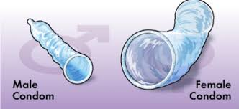
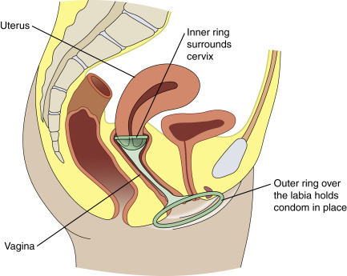
Primary Prevention Methods
2. Barrier methods
When used correctly and consistently, condoms offer one of the most effective methods of protection against STIs, including HIV.
Female condoms are effective and safe, but are not used as widely by national programmes as male condoms.
Contraceptive methods that are not mechanical barriers offer no protection against HIV or other STIs
3. Male Circumcision
Male circumcision reduces the risk for HIV infection by 50%–60% and certain STIs including high-risk genital HPV infection and genital herpes among heterosexual men.

Slide 21
Sexually Transmitted Infections
4. Counselling and behavioural approaches
Comprehensive sexuality education, STI and HIV pre- and post-test counselling;
Safer sexual behaviours/risk-reduction counselling, condom promotion;
STI interventions targeted to key populations, such as sex workers, men who have sex with men (MSM) and people who inject drugs;
Improve people’s ability to recognize the symptoms of STIs and increase the likelihood they will seek care or encourage a sexual partner to do so.
Abstinence and Reduction of Number of Sex Partners Abstinence from oral, vaginal, and anal sex and participating in a long-term, mutually monogamous relationship (Commitment) with a partner known to be uninfected are prevention approaches to avoid transmission of STIs.

Slide 22
Sexually Transmitted Infections
5. Pre and Post- exposure Prophylaxis for STIs and HIV.
Example:
Doxycycline prophylaxis has been examined for preventing bacterial STIs
Antiviral drugs: fixed-dose combination of emtricitabine (FTC) and either tenofovir disoproxil fumarate (TDF) or tenofovir alafenamide (TAF)

Slide 23
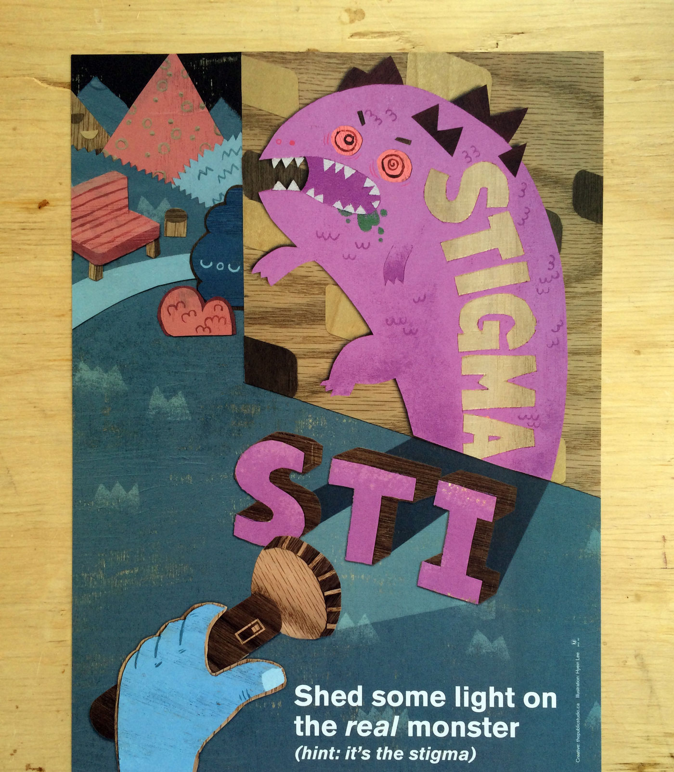
Sexually Transmitted Infections
Unfortunately,
Lack of public awareness,
Lack of training of health workers,
Long-standing, widespread stigma around STIs remain barriers to greater effective use of these interventions.

Slide 24
Sexually Transmitted Infections
Management:
Case management:
STI case management is the care of a person with an STI-related syndrome or with a positive test for one or more STI.
The components of case management include:
History taking, examination, correct diagnosis, early and effective treatment,
Advice on sexual behaviour, promotion and/or provision of condoms,
Partner notification and treatment,
Case reporting and
Clinical follow-up as appropriate

Slide 25
Treatment of STIs
Effective treatment is currently available for several STIs.
Three bacterial STIs (chlamydia, gonorrhoea and syphilis) and one parasitic STI (trichomoniasis) are generally curable with existing, effective single dose regimens of antibiotics.
For herpes and HIV, the most effective medications available are antivirals that can modulate the course of the disease, though they cannot cure the disease.
For hepatitis B, immune system modulators (interferon) and antiviral medications can help to fight the virus and slow damage to the liver.
Resistance of STIs – in particular gonorrhoea – to antibiotics has increased rapidly in recent years and has reduced treatment options.
The emergence of decreased susceptibility of gonorrhoea to the “last line” treatment option (oral and injectable cephalosporins) + antimicrobial resistance already shown to penicillins, sulphonamides, tetracyclines, quinolones and macrolides make gonorrhoea a multidrug-resistant organism.

Slide 26
Sexually Transmitted Infections
Management:
The identification of consistent groups of symptoms and easily recognized signs (syndromes) to guide treatment, without the use of laboratory tests.
This is called syndromic management.
This approach mainly followed (In poor countries), allows health workers to diagnose a specific infection on the basis of observed syndromes as:
vaginal discharge,
urethral discharge,
genital ulcers,
abdominal pain

Slide 27
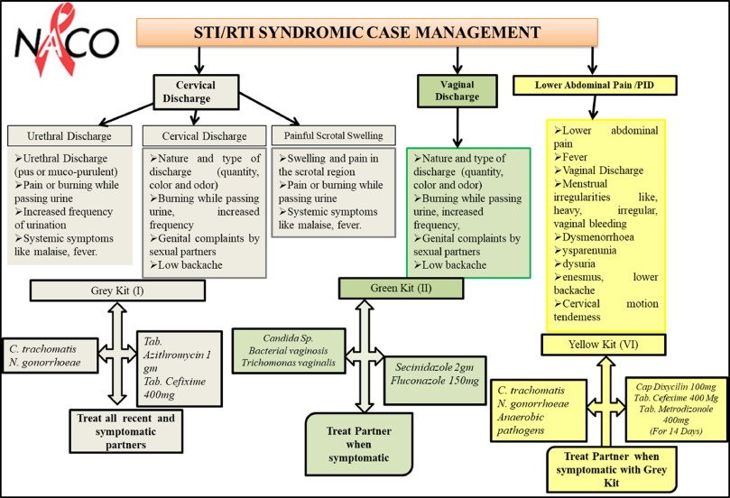

Slide 28
Sexually Transmitted Infections
Management:
STI case management
Syndromic management is simple, assures rapid, same-day treatment, and avoids expensive or unavailable diagnostic tests for patients that present with symptoms.
This approach results to overtreatment and missed treatment as majority of STIs are asymptomatic.
Therefore, in addition to syndromic management, screening strategies are essential.
To interrupt transmission of infection and prevent re-infection, treating sexual partners is an important component of STI case management.

