Slide 1
Chest pain

Slide 2
Background

Slide 3
Our goal

Slide 4
Differential diagnosis

Slide 5
Life Threatening Causes of Chest Pain {the deadly six} PET MAC

Slide 6
Visceral Pain

Slide 7
Parietal Pain

Slide 8
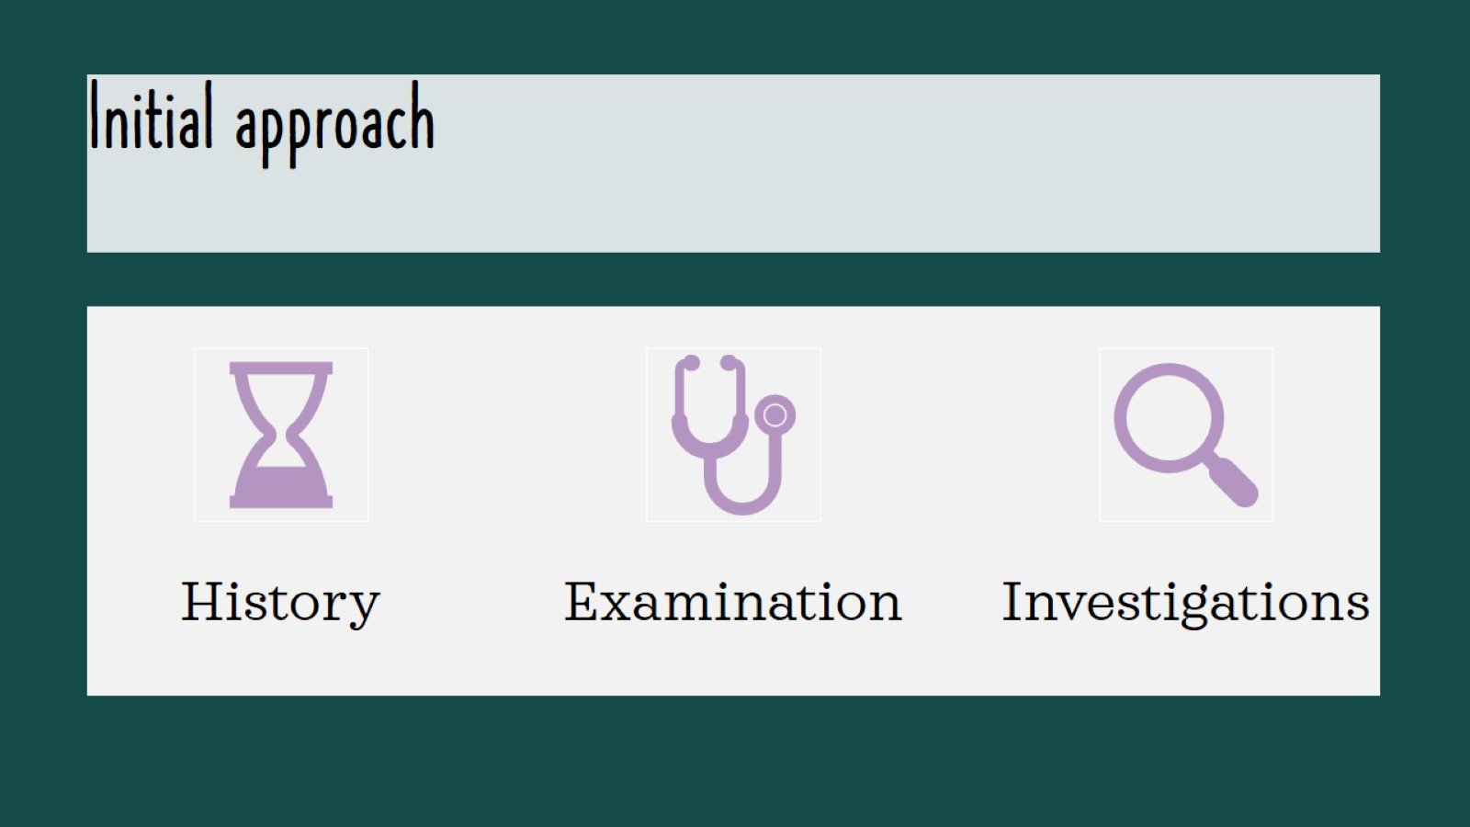
Initial approach

Slide 10
History

Slide 12
Examination

Slide 16
(1) Acute coronary syndrome

Slide 21
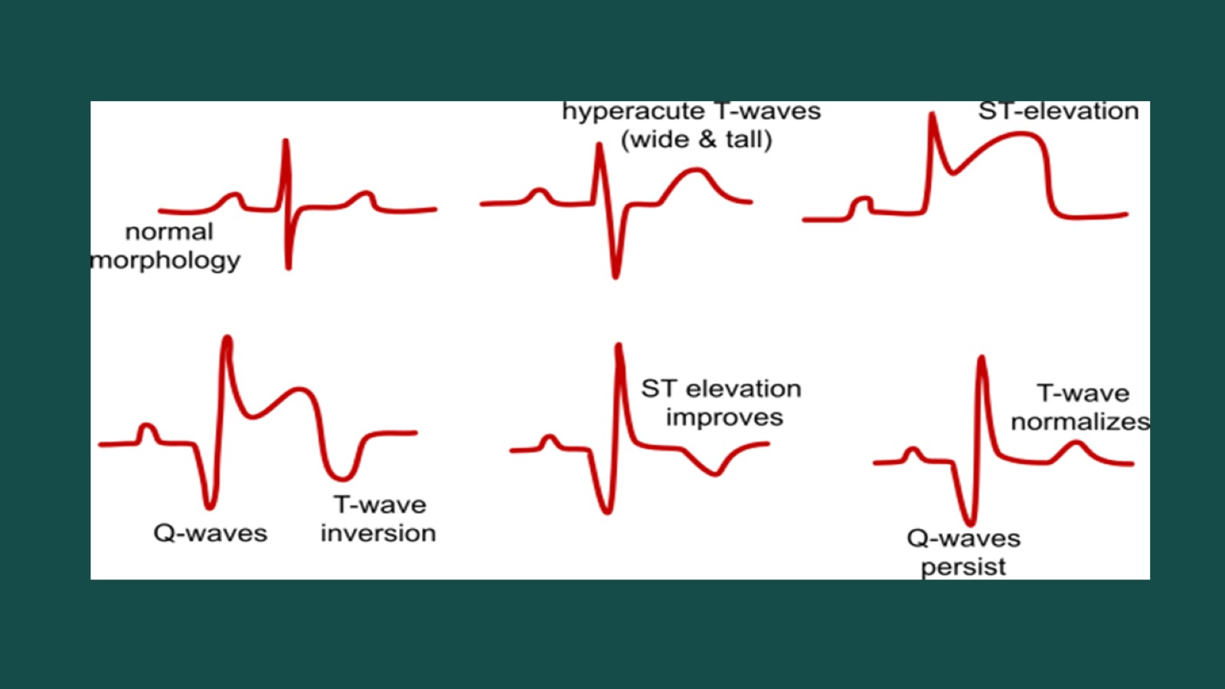

Slide 23
Investigations

Slide 24
Cardiac markers

Slide 25
Treatment

Slide 27
Chest pain- discharge plan

Slide 30
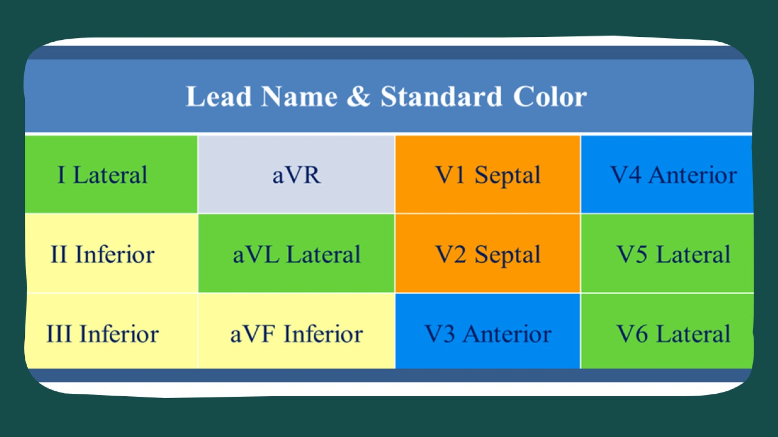

Slide 31
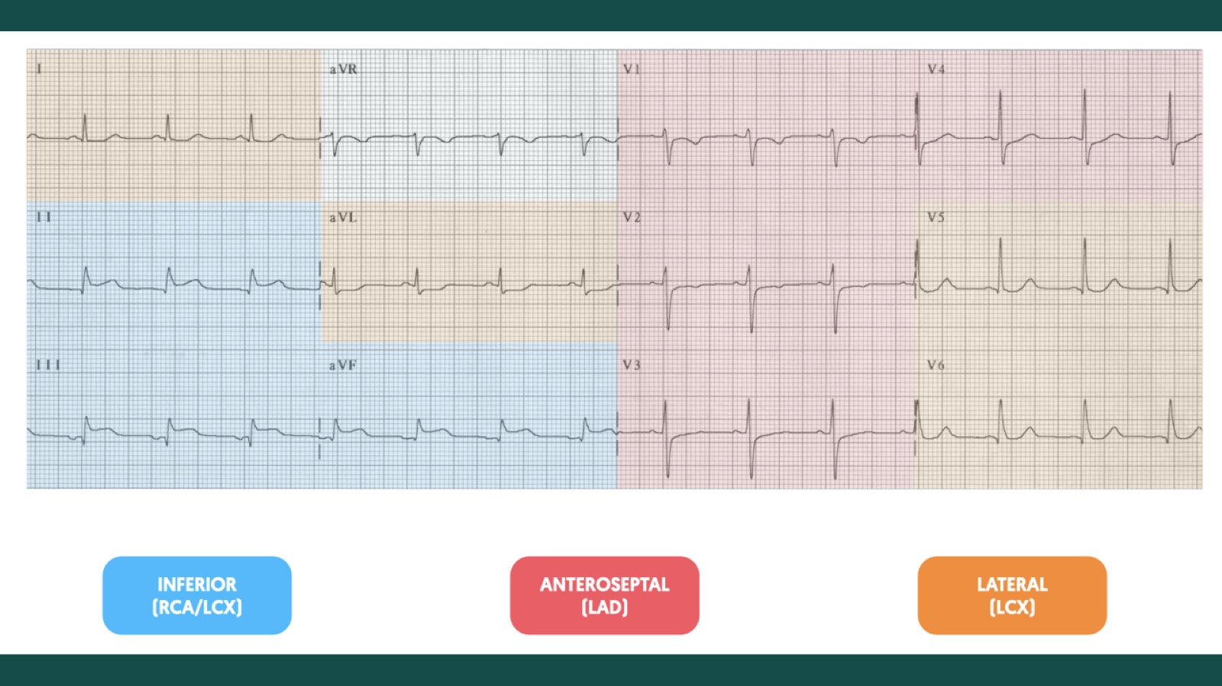

Slide 32
(2) Pulmonary embolism

Slide 35
(3) Aortic dissection

Slide 36
Classification

Slide 40
(4) Tension pneumothorax

Slide 42
(5) Esophageal Rupture

Slide 43
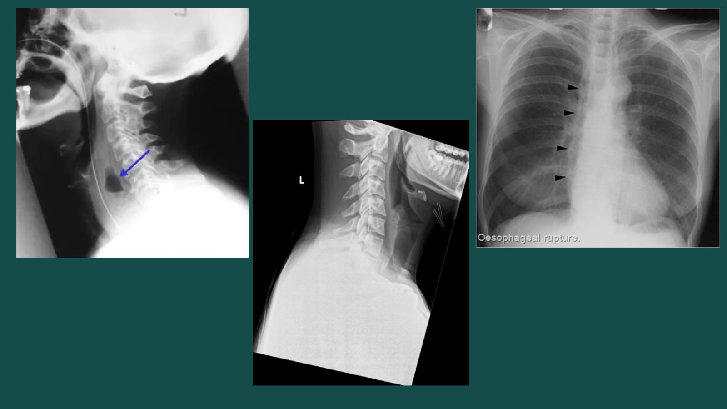

Slide 44
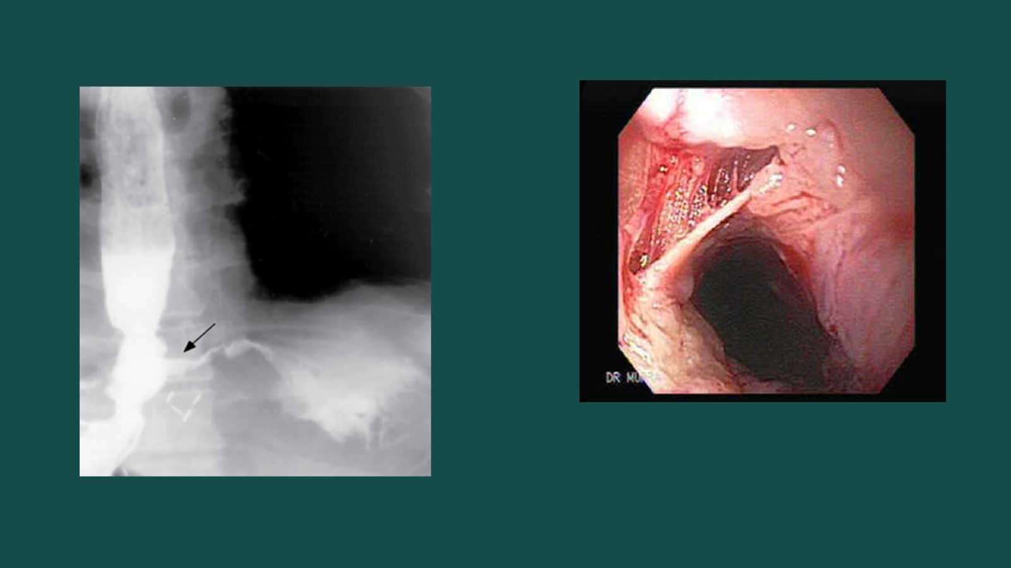

Slide 46
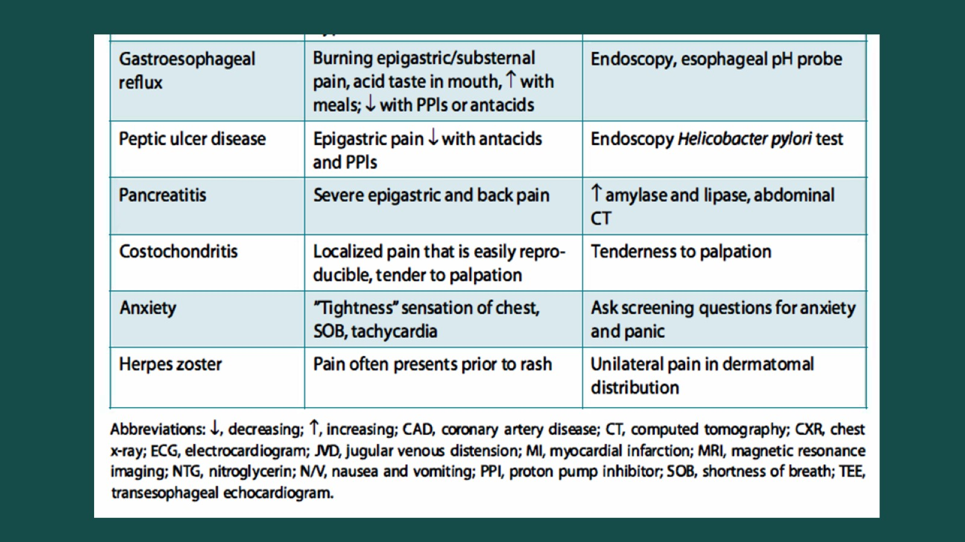

Slide 47
Rule out chest pain in primary care (Marburg Heart Score {MHS})

