Slide 1
Wateen Group 3
Orthopedic archive
10-10-2024
Done by:
Shahed Hayel
Hana'a Al jalodi

Slide 2
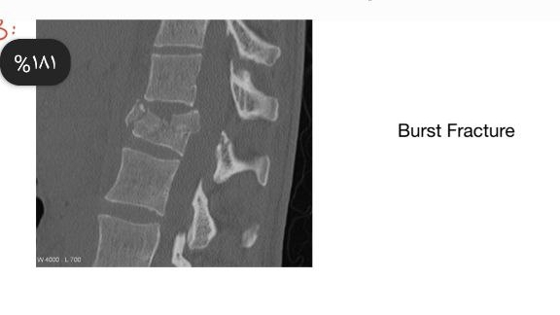
What is the type of this fracture?

Slide 3
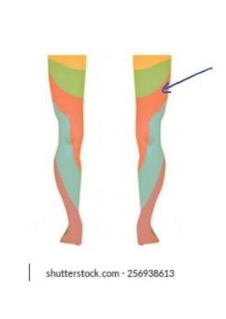
One of the following jerks is related to an injury
of the dermatome indicated by the arrow ?
Knee jerk L3

Slide 4
All of the following muscles are affected by this fracture except?
Tibialis posterior

Slide 5
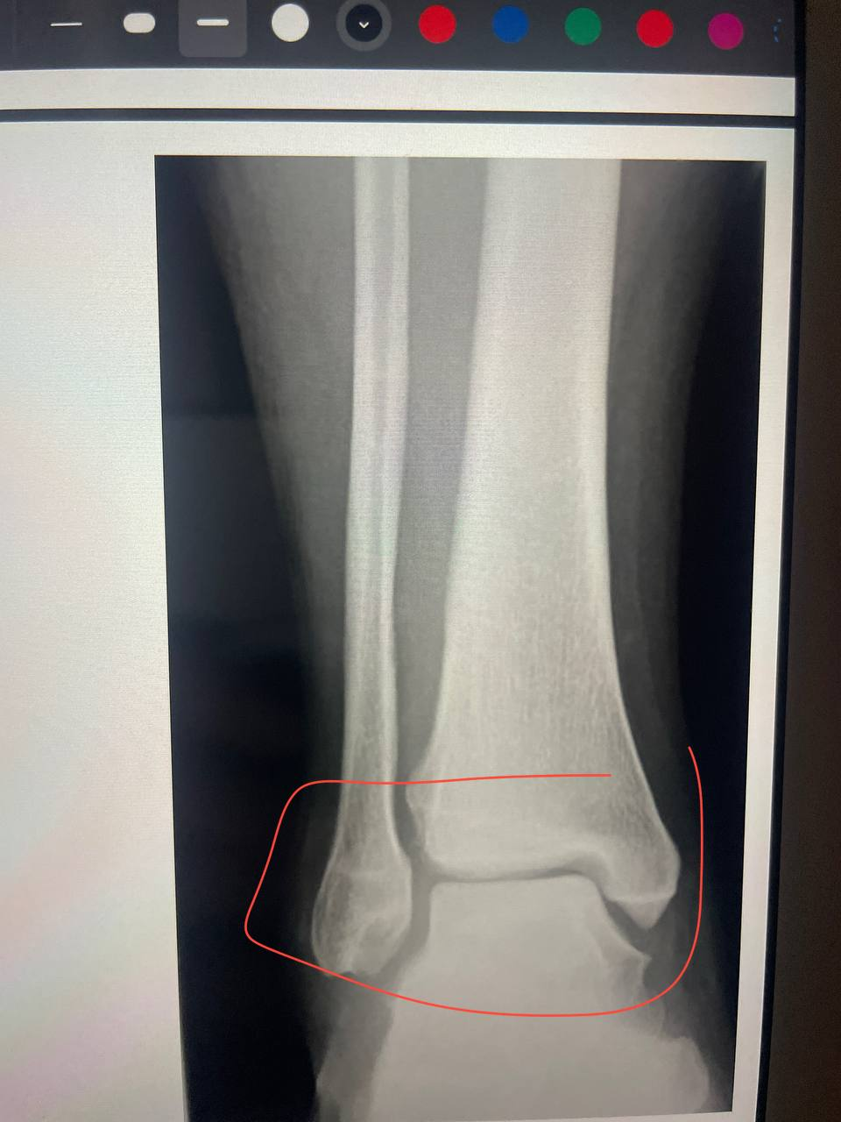
A classification used for fractures in this region ?
Weber classification

Slide 6
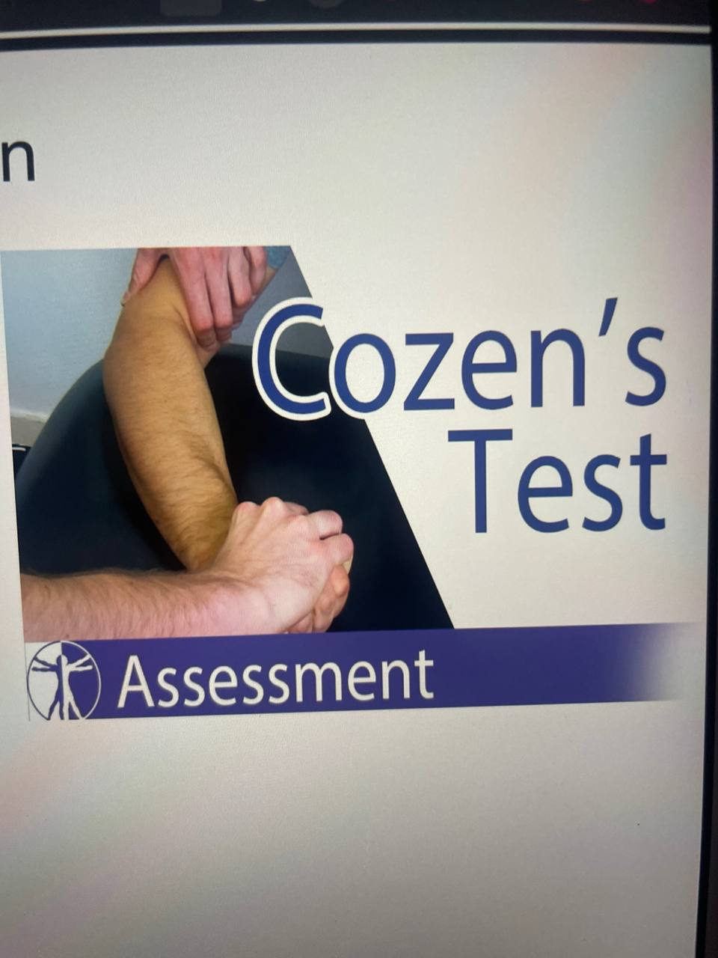
This examination used for ?
Lateral epicondylitis

Slide 7
.

Slide 8
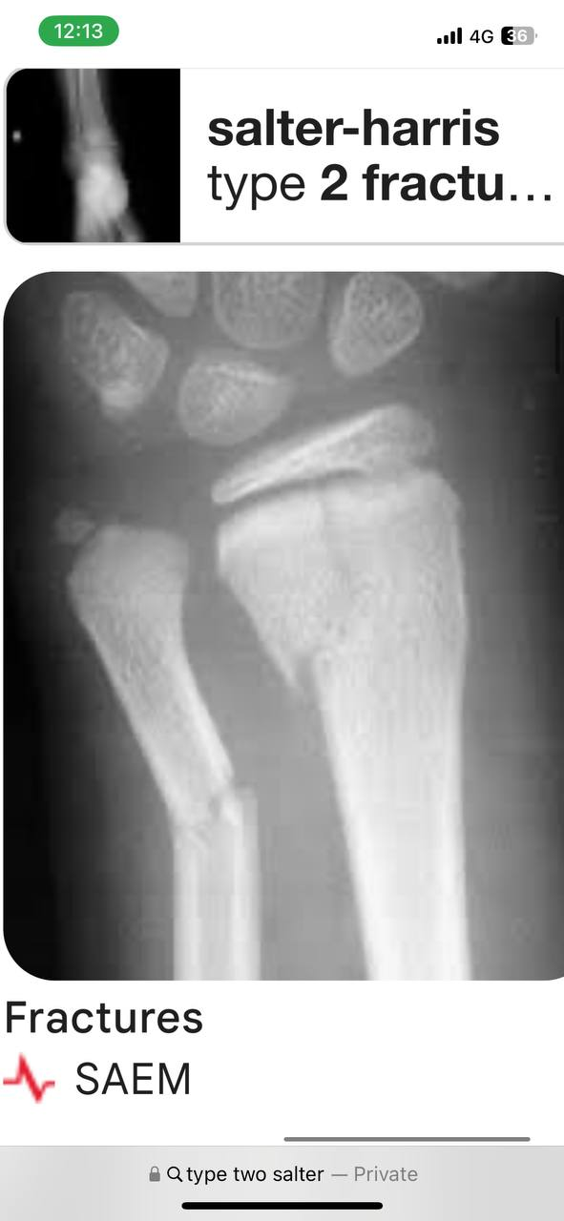
Type of salter harris fx?
Type 2

Slide 9
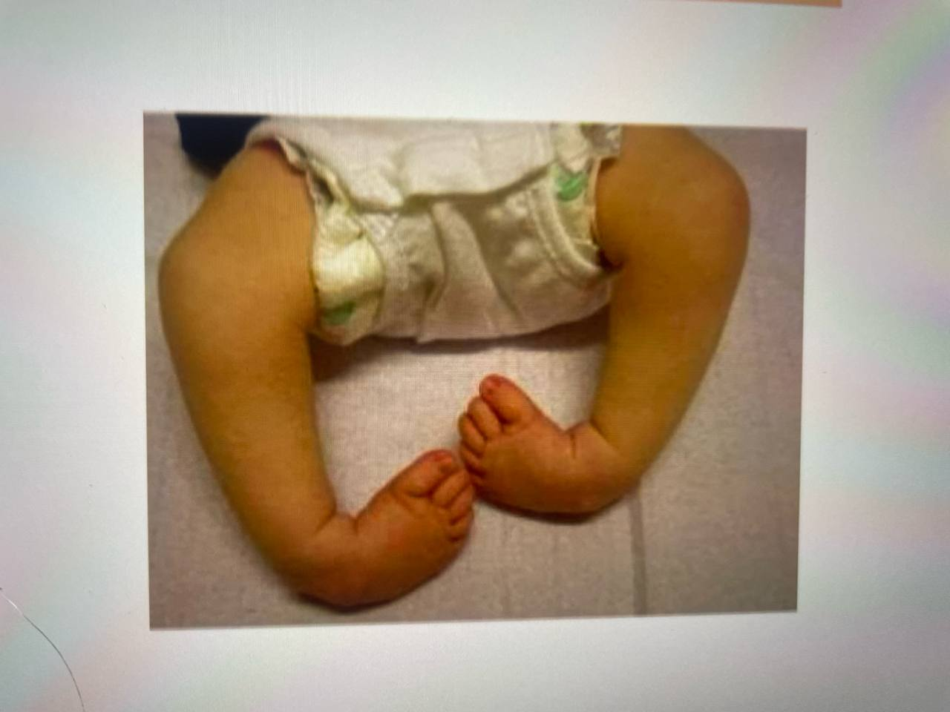
One of the following findings is seen in this disease?
Equines

Slide 10
.

Slide 11
.

Slide 12
One of the following is wrong about the muscle indicated by brown color?
a long head that originates from the ischial tuberosity and a short head that originates at the linea aspera of the femur.

Slide 14
All of the following are done in supine position except ?
Apply grinding test

Slide 15
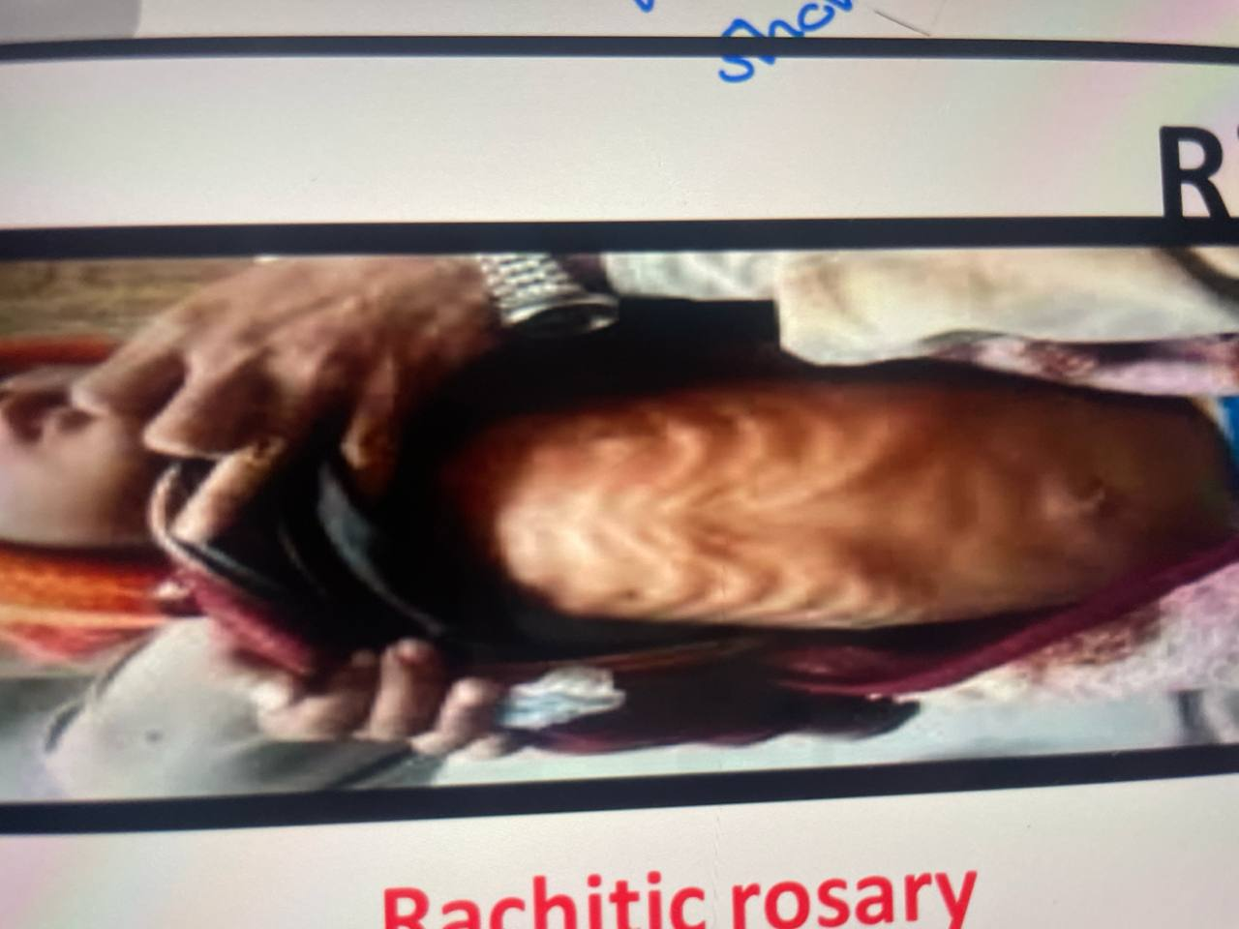
One of the following is wrong about this disease?
It is found in adult more than in children

Slide 16
Management for toddler fracture?
Long sling

Slide 17
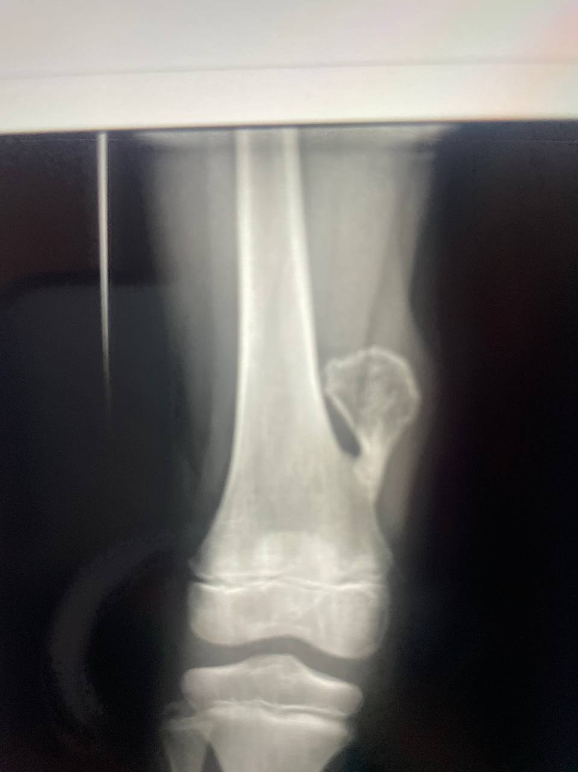
Which is true?
There is a small risk for malignancy

Slide 18
.

Slide 19
(case senario)
Pt came with suprachondylar fracture, and then he couldn't oppose his thumb with little finger, what is the affected nerve?
Median n.

Slide 20
Which of the following pairs are true?
ASIS& Sartorius

Slide 21
. Type of fracture?
Segmental fx
تقريبًا نفس الصورة اللي اجت
بس كانت non displaced

