Slide 1
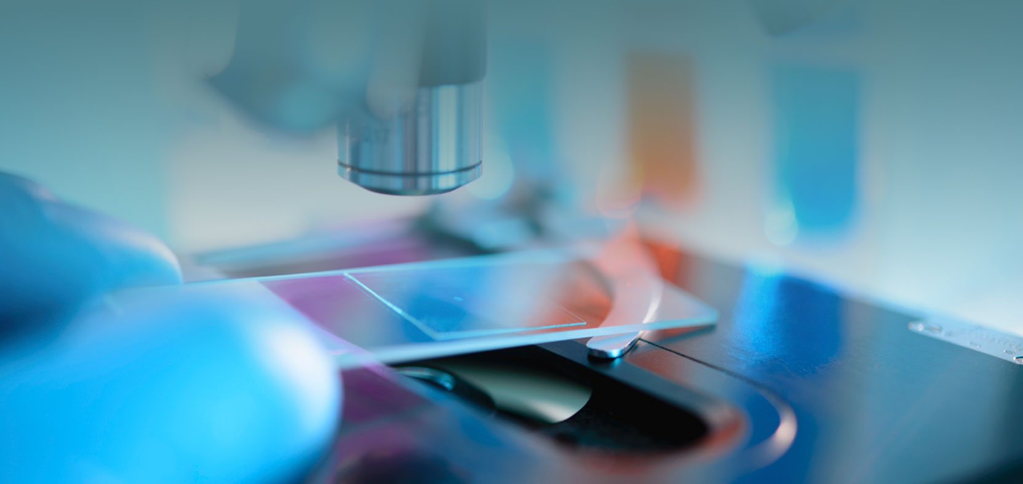
Introduction to pathology
Ghadeer Hayel, MD 11/10/2021

Slide 2
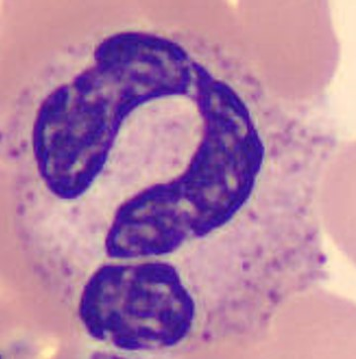
So what is pathology ?
Pathology comes from an Ancient Greek roots; literally to the study of suffering; pathos: "suffering“ (disease) & logia "study of“
So it is.. The scientific study of disease!

Slide 3
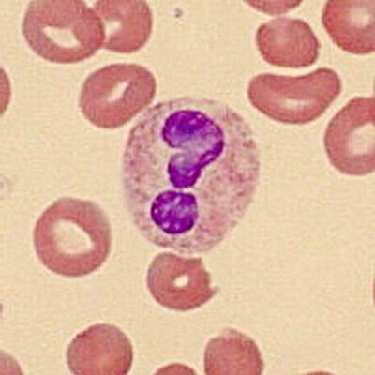
The study of the structural & functional changes in cells, tissues, & organs that underlies diseases

Slide 4
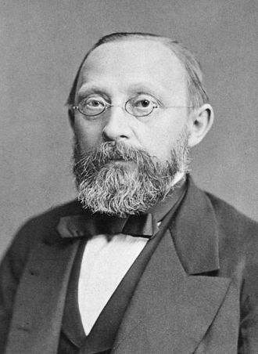
Rudolf Virchow 1821-1902
+ Cellular pathology → to emphasize that all diseases originate at the cellular level.
+ "the father of modern pathology“
+ NOW, cellular disturbances arise from alterations in molecules (genes, proteins, and others) that influence the survival and behavior of cells.
+ SO the foundation of modern pathology is understanding the cellular & molecular abnormalities that give rise to diseases.

Slide 5
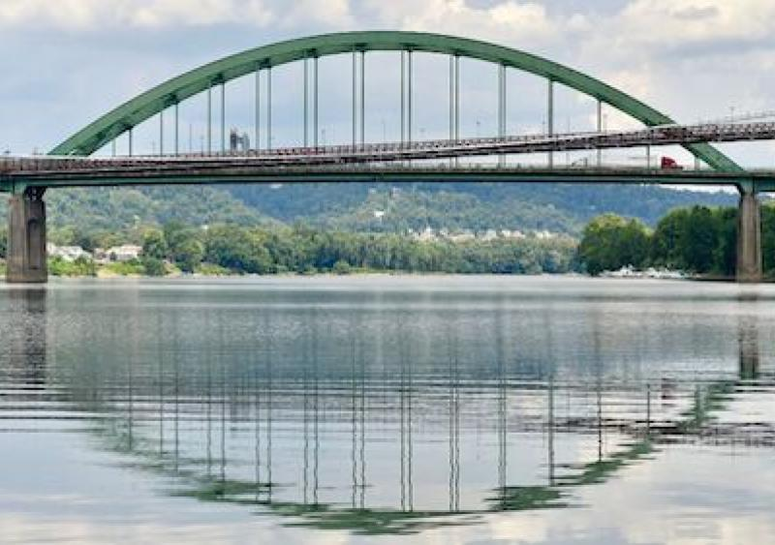
anatomy, physiology, biochemistry, pharmacology, microbiology, community, ..etc
medicine , surgery, orthopedic, gyne-obs, pediatrics,
ENT, Psychiatry, Radiology
Pathology

Slide 6
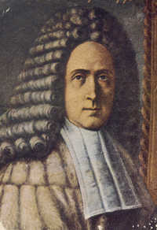
Giovanni Battista Morgagni 1682 –1771
+ Physician – anatomist
+ Introduced clinicopathologic methodology in the study of disease, by correlation of clinical findings (signs, symptoms) with findings at posmortem examination

Slide 7
+ General pathology:
basic concepts that are shared among various disease in multiple organs/systems (Ex: Inflammation, cell injury and neoplasia) + Systematic Pathology: discuss pathology of diseases of a specific organs/systems
Anatomical pathology
+Cytopathology
+Dermatopathology
+Forensic pathology
+Histopathology
+Neuropathology
+Pulmonary pathology
+Renal pathology
+Surgical pathology
Clinical pathology
+Hematopathology
+Immunopathology
+Radiation pathology
Molecular pathology

Slide 8
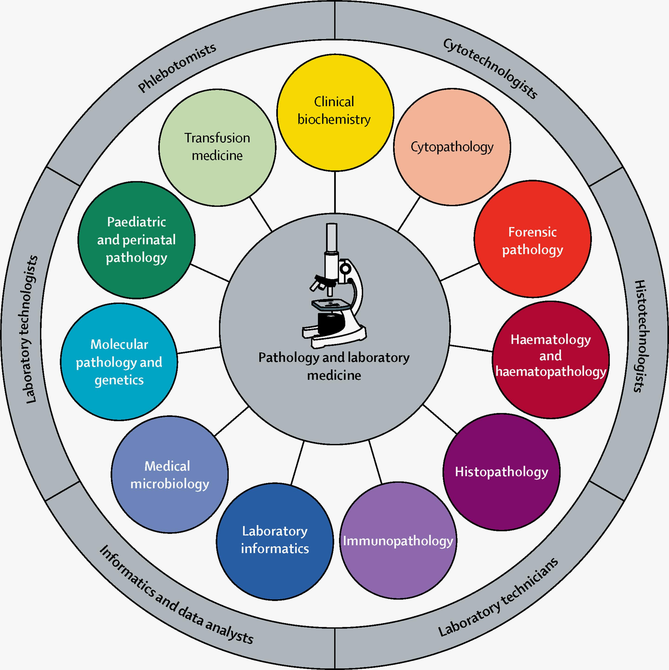

Slide 9
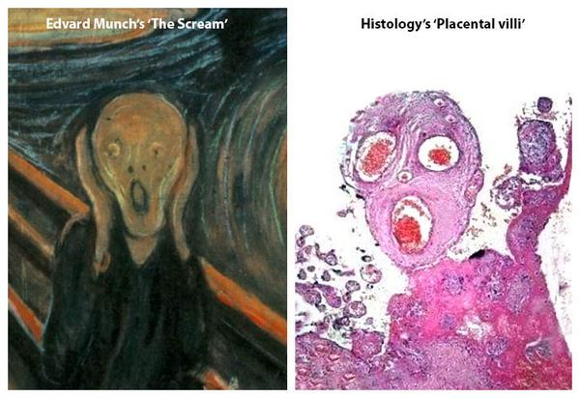

Slide 10
the study of disease Includes:
The study of causes that leads to these changes >> WHY <<
Sequence of events that leads from structural and functional abnormalities to clinical manifestations >> HOW <<
The basic structural and functional changes associated with disease >> Morphology<<

Slide 11
Etiology ..The “why’’
+underlying causes and modifying factors that are responsible for the initiation and progression of disease.
+ genetic and environmental factors

Slide 12
Pathogenesis ..The “HOW’’
+the mechanism through which Etiology causes the development & progression of disease,
+the cellular & molecular changes that give rise to the specific functional & structural abnormalities that characterize the disease.

Slide 13
Etiology and pathogenesis of disease are essential for understanding disease ++ also is the basis for developing rational treatments and effective preventive measures. Thus, pathology provides the scientific foundation for the practice of medicine. EBM

Slide 14
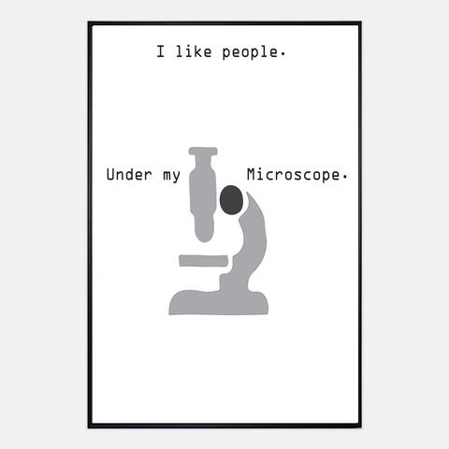
Morphology is structural alteration of cell and tissue as a result of the pathogenesis:
+ gross : naked eye
+ microscopic
+Pathologists also use a variety of molecular, and other techniques to define the biochemical, structural, and functional changes that occur in cells, tissues, and organs in response to injury.

Slide 15
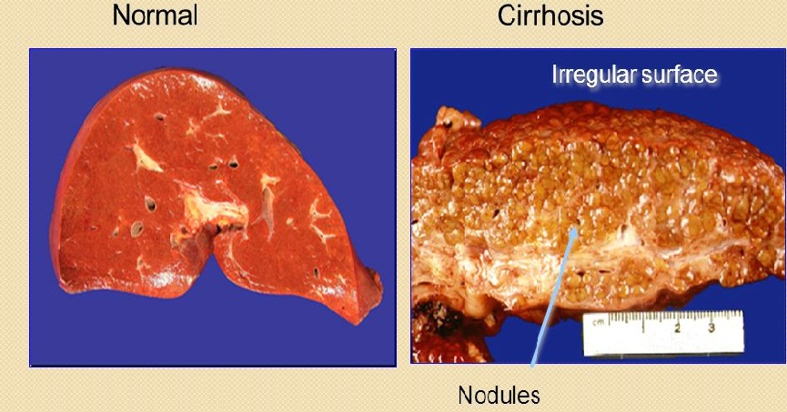
Morphology, Gross (Naked eye)

Slide 16
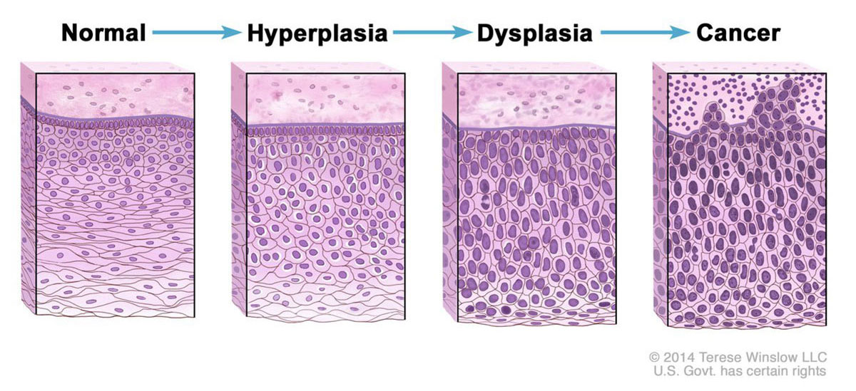
Morphology, microscopic

Slide 17
Etiology
Pathogenesis
Morphology
Clinical manifestations

Slide 18
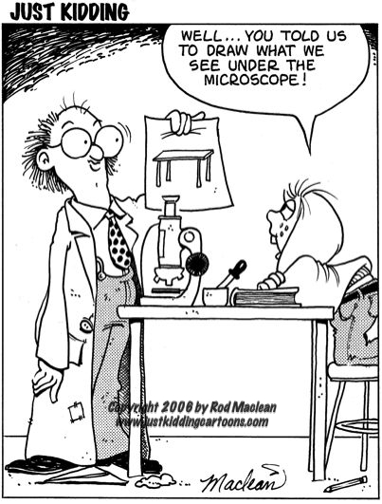

Slide 19
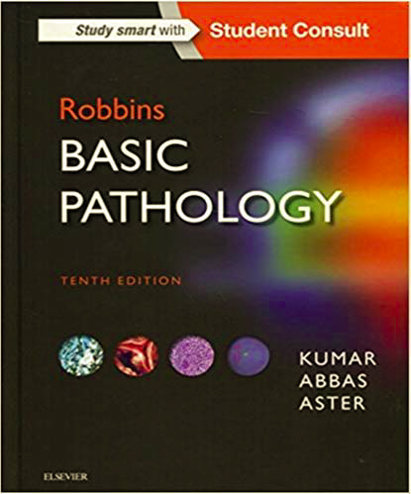
The book .. ☺

Slide 20
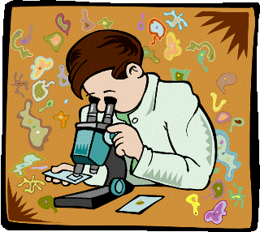
So what do pathologist do?

Slide 21
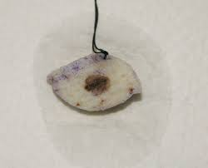
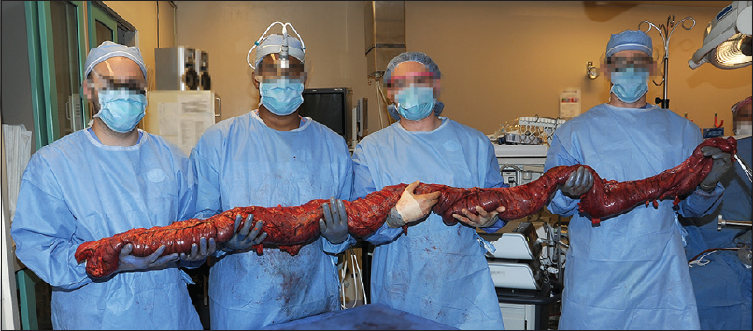
1st: The Sample .. What do we get?
Biopsy, like :
Bone marrow aspiration and biopsy
Cardiac biopsy
Core biopsy
Endometrial biopsy, D&C
Endoscopic biopsy
Bronchoscopic biopsy
Excisional and incisional biopsy
Fine-needle aspiration biopsy
Lymph node biopsy
CT guided Needle biopsy
Punch biopsy
Shave biopsy
Resections

Slide 22
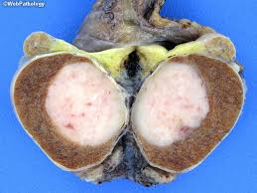
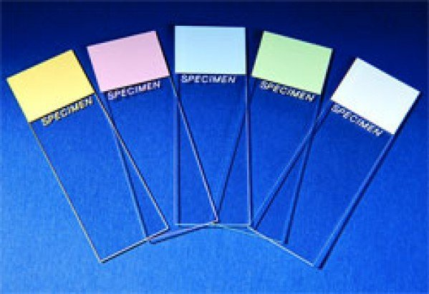
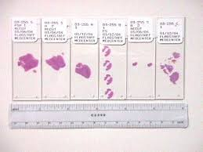
Pathology Lapratory

Slide 23
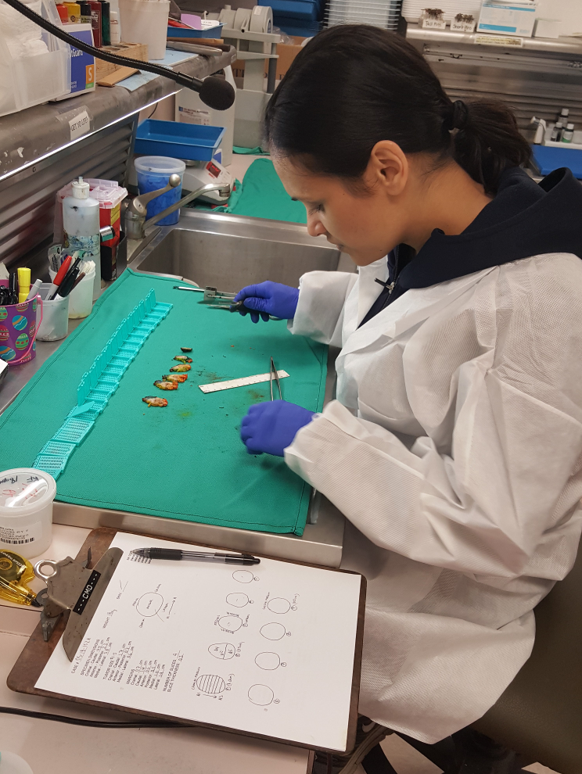
Grossing

Slide 24
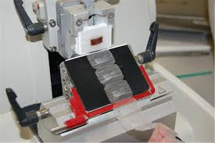
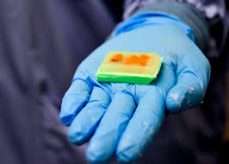
Processing into a paraffin block
Microtome

Slide 25
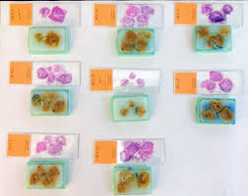
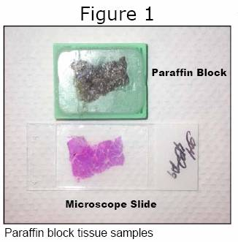
Staining H&E ☺

Slide 26
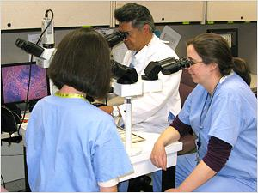
Diagnosis

Slide 27
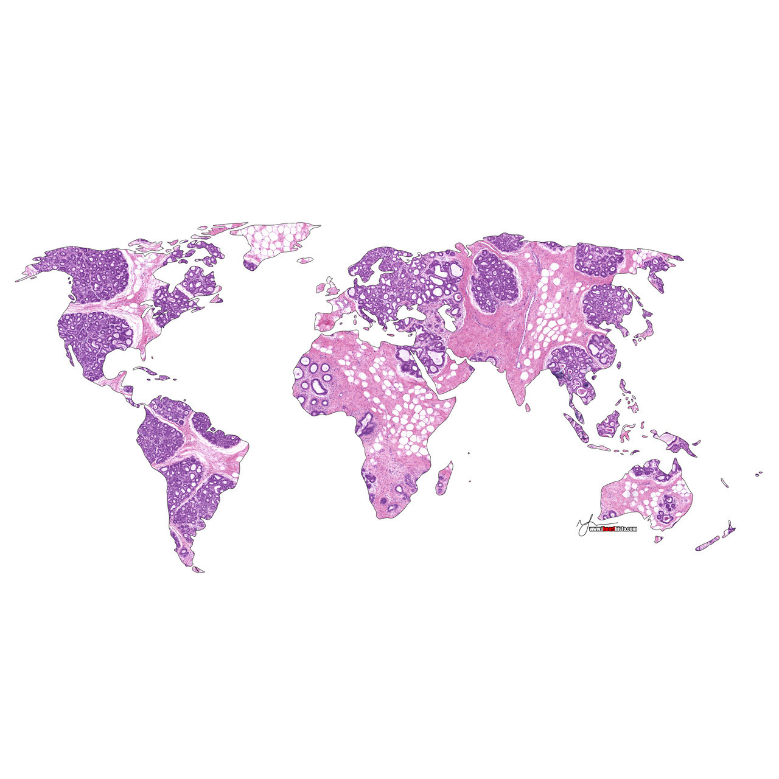
✋👆👉👍👤👦👧👨👩👪💃🏃💑😂😉😋😒😭👶😸🐟🍒🍔💣📌📖🔨🎃🎈🎨🏈🏰🌏🔌🔑 Thank You!

