Slide 1
وسهلا
أهلا
الأستاذ الدكتور/ يوسف حسين
أستاذ التشريح وعلم الأجنة
كلية الطب – جامعة الزقازيق- مصر
دكتوراة من جامعة كولونيا المانيا
جروب الفيس
د. يوسف حسين (استاذ التشريح)

Slide 3
Position of the parotid gland
* Size: the largest salivary gland.
* Position: it lies in the gap below the auricle between:
- Ramus of the mandible (anteriorly).
- Mastoid process & sternomastoid muscle (posteriorly).

Slide 4
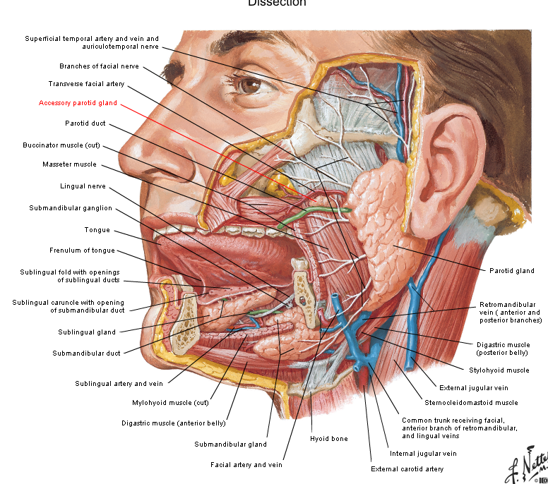

Slide 6
Buccal mucosa
Buccinator muscle
Buccopharyngeal fascia
Buccal pad of fat
Parotid duct
Structures pierced by parotid duct

Slide 7
The parotid duct ( Stensen's duct )
- Length: 5 cm long.
- Beginning: at the anterior border of the gland.
- Course & relations:
It runs horizontally forwards on masseter muscle.
At the anterior border of masseter, it pieces 4 B structures
Buccal pad of fat.
Buccopharyngeal fascia.
Buccinator muscle.
Buccal mucosa (mucous membrane lining the cheek).
It ends by opening into the vestibule of mouth opposite the upper 2nd molar tooth.
N. B: the duct pierces the buccinator further back and runs forward beneath the mucus membrane to its orifice. This oblique course providing a flap valvular mechanism that prevents inflation of the gland when intra-oral pressure increased.

Slide 8
Capsule of parotid gland:
1- True (inner) capsule formed of the condensed fibrous tissue.
2- False (outer) capsule; It is derived from the investing layer of deep fascia of neck which splits at the lower end of the gland into 2 layers;
Superficial layer, covering the outer surface of the gland.
Deep layer, covering the inner surface of the gland. This deep layer forms the stylomandibular ligament which separates the parotid gland from the submandibular gland.
Applied anatomy; Mumps (viral infection of the gland) is painful because the gland swells within the tight fibrous capsule.

Slide 9
Structures inside the parotid gland (FARED):
Facial nerve (the most superficial structure):
Retromandibular vein ( intermediate in position):
External carotid artery : (the deepest structure)
Auriculo- temporal nerve : (in the upper part of the gland).
Deep parotid lymph nodes: inside the gland.

Slide 10
Extracranial part of the Facial nerve
temporal branch
zygomatic branch
Parotid gland
buccal branch
Posterior auricular nerve
mandibular branch
cervical branch
Nerve to posterior belly of digastric & stylohyoid

Slide 11
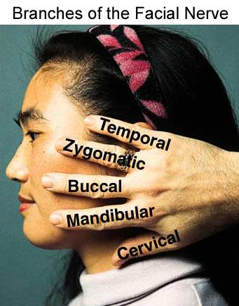
To the muscles of the face and scalp

Slide 12
Paralysis of the facial nerve Bell’s palsy Lower motor :
1) Paralysis of the frontal belly leading to Loss of skin creases of the forehead (expressionless of the face).
2) Pa­ralysis of the orbicularis oculi can not close eyelid.
3) Paralysis of the muscles of the mouth leading to drop of the angle of the mouth.
4) Paralysis of the buccinator leading to falling of the food into the vestibule and failure of whistle.

Slide 13
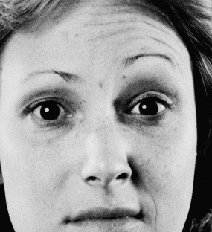
Paralysis of occipito-frontalis
Inability to elevate eyebrow
Loss of wrinkles in the forehead on the affected side of lesion

Slide 14
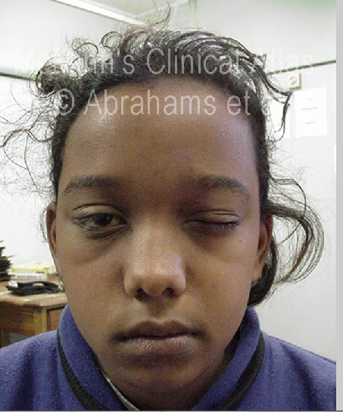
Paralysis of orbicularis oculi
Inability to close the eye and to blink
Dryness of cornea and ulceration
Scar impairs vision
Bell’s palsy

Slide 15
Paralysis of buccinator, orbicularis oris
Inability to whistle or to blow air
Dribbling of saliva
Food accumulates in vestibule of mouth on affected side
Bell’s palsy

Slide 16
Paralysis of muscles of lip and angle of mouth
Ask the patient to show his teeth
The mouth is drawn towards the unaffected side by showing his teeth

Slide 17
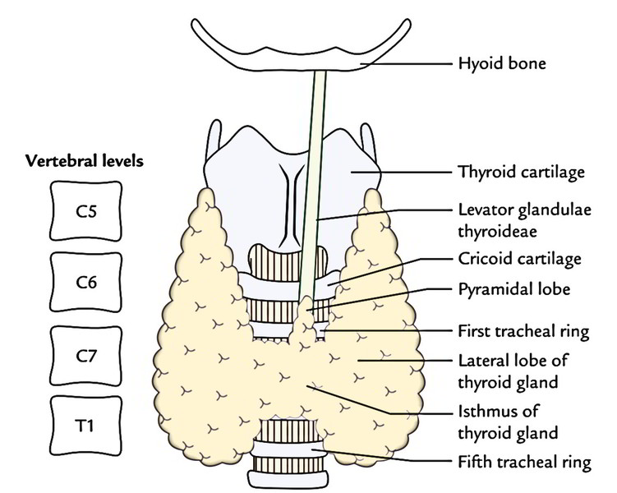
Thyroid gland
- is a butterfly-shaped highly vascular
Retrosternal goiter: The gland may extend down behind the sternum leading to compression on the trachea and great vessels.
It does not extend upward due to attachment of the sternothyroid to the oblique line of the thyroid cartilage.
Oblique line of thyroid cartilage
6th

Slide 18
THYROID GLAND
Size: it is the largest endocrine gland in the body.
Weight is about 25 grams (slightly heavier in female).
Aspect (Shape): butter-fly, it is formed of the following parts:
1- 2 lateral lobes: each lobe is pear-shaped (apex above).
(Dimension; 5 cm long, 3 cm wide and 2 cm thick).
2- A narrow median isthmus connecting the 2 lateral lobes.
(1 cm long, 1 cm wide and 1 cm thick).
3- A small pyramidal lobe project upwards from the isthmus and may be connected to the hyoid bone by a fibromuscular band called levator glandulae thyroidae (remnant of thyroglossal duct).
Site and extensions (surface anatomy):
- It lies on the front and sides of the lower part of neck
The apex of each lobe directed upward and reaching up to the oblique line of the thyroid cartilage.
The base of each lateral lobe reaches the level 5th tracheal ring.
The isthmus opposite the 2nd, 3rd and 4th tracheal rings.

Slide 19
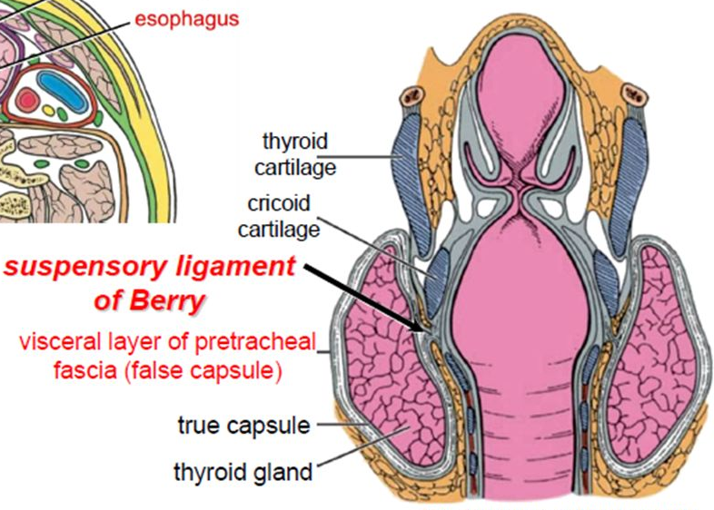
Capsules of the thyroid gland:
the gland has 2 capsules:
Inner true fibrous capsule enclosing the gland.
Outer false fascial capsule derived from the pretracheal fascia.
- The fascial capsule is thickened laterally forming suspensory ligament of Berry which fixes the gland to the cartilage of the larynx that is responsible for movement of the gland up and down during swallowing.
False capsule
Inner

Slide 20
ECA
Arterial supply and Nerves related
External laryngeal nerve
Superior thyroid artery
Inferior thyroid artery
Thyrocervical trunk
recurrent laryngeal n.
Subclavian artery

Slide 21
Nerves related to the gland
External laryngeal nerve:
- It descends downwards with the superior thyroid artery to the apex of the lateral lobe.
- To avoid injury of the nerve during thyrodectomy, we must legate the superior thyroid artery at the upper pole of the gland.
2- Recurrent laryngeal nerve
- It ascends to the neck between trachea and oesphagus closely related to the inferior thyroid artery.
- To avoid injury of the nerve during thyrodectomy, we must legate the artery away from the gland.

Slide 22
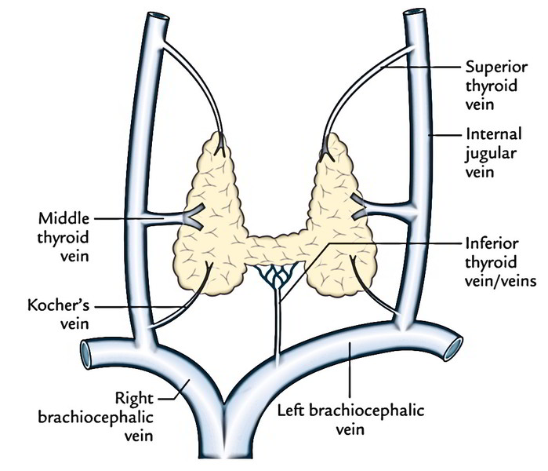
Venous drainage

Slide 23
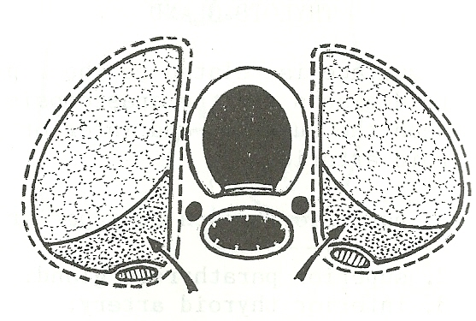
Parathyroid Glands
- These are four small glands, two on each side: superior and inferior.
- They are lie behind the posterior aspect of the thyroid gland.
- The superior developed from the 4th pharyngeal pouch.
- The inferior developed from the 3rd pharyngeal pouch.
- They are supplied by inferior thyroid vessels.
- Subtotal thyrodectomy must be done to avoid injury of the parathyroid glands
Subtotal Thyroidectomy
Removed
Part
Removed
Part
Parathyroid glands

Slide 24
Thank you
Questions
I/Azzam - 2004

