Slide 1
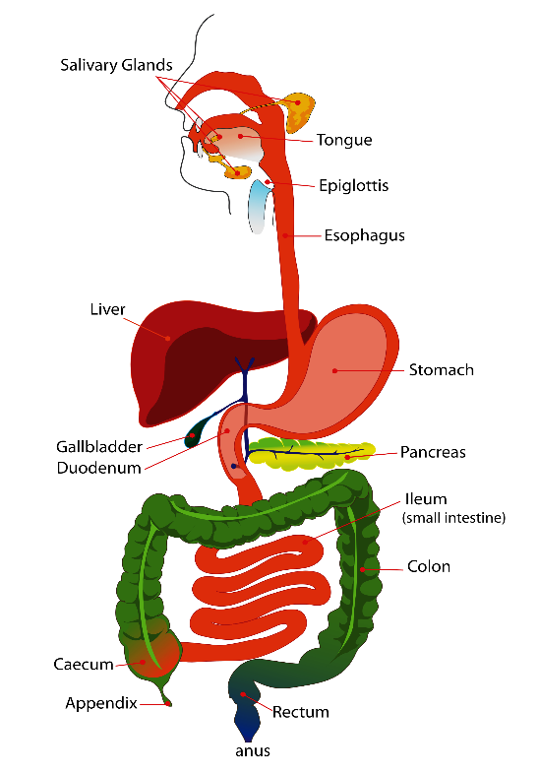
4. PANCREATIC SECRETION.
Prof. Sherif W. Mansour
Physiology dpt., Mutah School of medicine
2020-2021

Slide 2
Pancreatic secretion
-The pancreas has both :
1- Endocrine gland : Alpha cells → glucagon. Beta cells → insulin.
2- Exocrine gland : consisted of blind secretory acini, ducts which drain in pancreatic duct which unites with common bile duct and open together at the ampulla of Vater in the duodenum. The common opening is surrounded by sphincter of Oddi.
-Exocrine pancreatic secretion :
•Volume : 1 – 1.5 L/day.
- PH : 7.8 – 8.3
• Osmolarity : iso-osmotic with plasma.
•Ions :
- Na+ & K+ : the same conc. of plasma.
- HCo3 : higher than in plasma (140 mEq/L).
CL- : lower conc. than plasma.

Slide 3
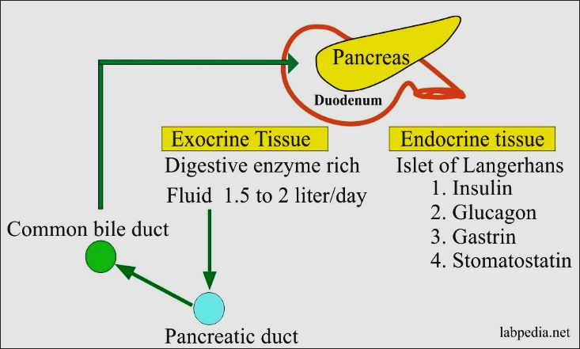

Slide 4
Types :
1- Aqueous alkaline juice:
-Large in volume, rich in bicarbonate.
-Secreted by duct cells.
-Stimulated by secretin hormone & inhibited by sympathetic.
- Mechanism of secretion:
- In duct cells : Co2 + H2O Hco3- + H+.
- Hco3- is actively secreted in lumen.
- H+ ion is pumped out to the plasma (acid tide) in exchange for sodium which is pumped into the cell then diffuse to lumen.
- H2O diffuse passively into the lumen by osmotic forces of Na+ & Hco3-.
N.B.: Acid- tide: ↑ H+ conc. in venous blood drain the pancreas to neutralize alkaline tide of gastric secretion → acid – base balance.

Slide 6
2- Enzymatic juice :
- Small in volume, rich in enzymes.
- Secreted by Acinar cells.
- Stimulated by CCK – PZ & vagus nerve.
- There are 3 classes of enzymes :
•Pancreatic amylase: starch → maltose.
•Pancreatic lipolytic enzymes: Lipase and phospholipase (facilitated by bile).
-Triglycerides → FFA & monoglycerate.
-Phospholipase A: act on lecithin → lysolecithin.
•Proteolytic enzymes:
-Endopeptidases as trypsin & chemotrypsin.
-Exopeptidases : carboxypeptidases.
It issecreted in inactive form and activated by enterokinase and the active trypsin to prevent auto digestion of pancreas (also the pancreas has trypsin inhibitor).

Slide 7
Control of exocrine pancreatic secretion
1) Nervous : as a part of conditioned & unconditioned reflexes → vagal stimulation of enzymatic secretion from acini.
2) Hormonal :
•Secretin →↑ aqeous secretion from duct.
•CCK. PZ →↑ enzymes from acini.

