Slide 1
Anatomy of
Spleen
(Lien)

Slide 2
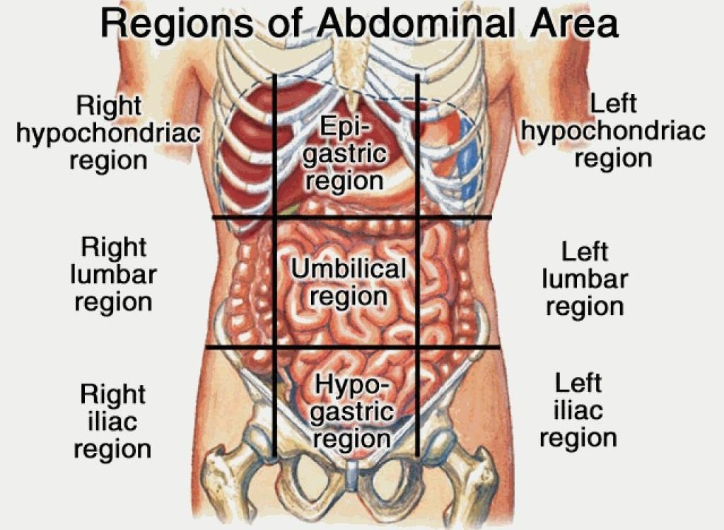
- Spleen is the largest mass lymphatic organ connected to the vascular system.
** Position: in the left hypochondriurm.
Subcostal plane (L3)
Intertubercular plane (L5)

Slide 3
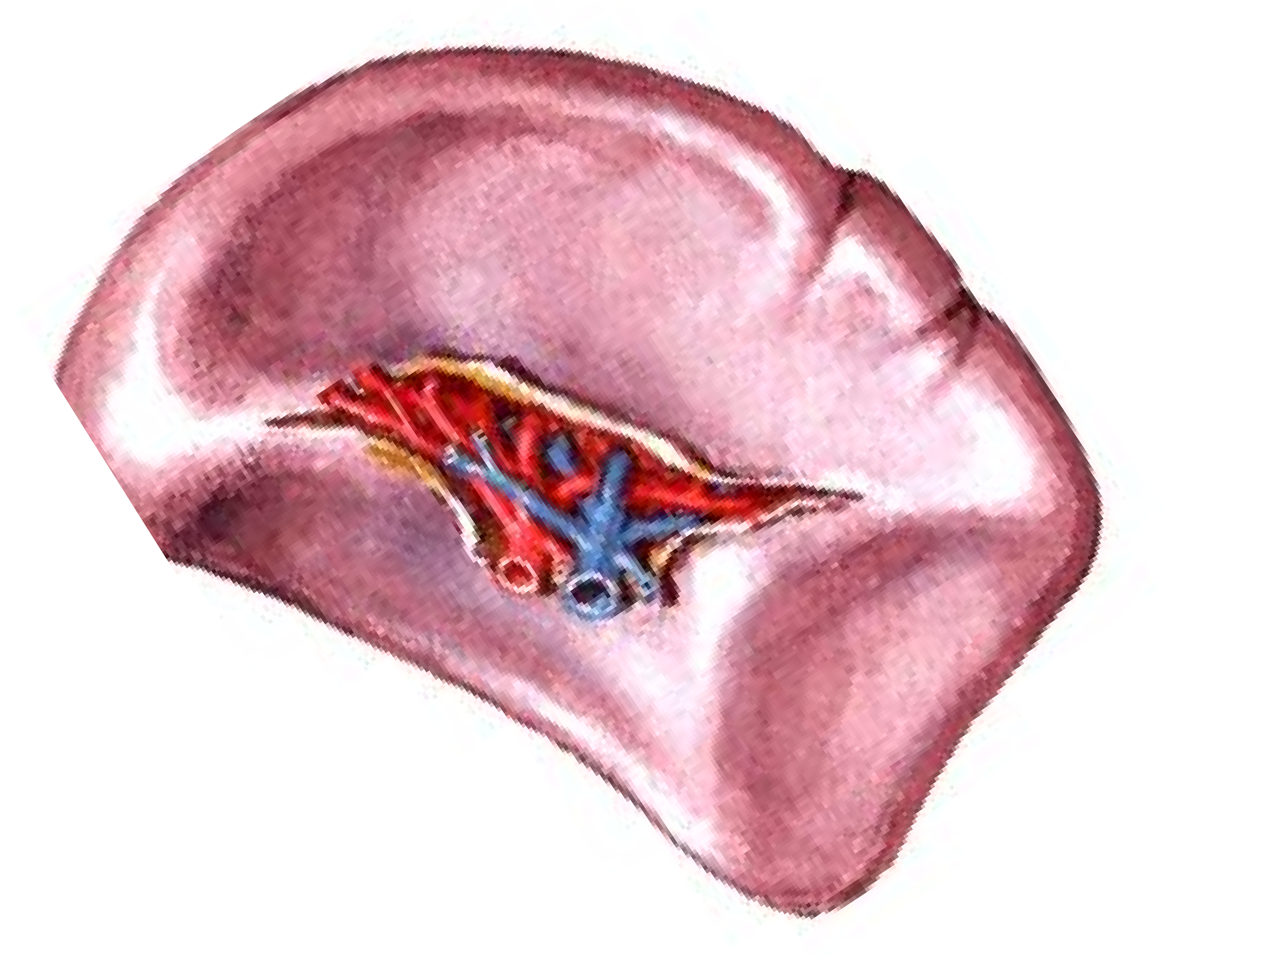
Anterior end (broad) directed downwards, forwards and laterally
N.B.; always
remember the odd numbers 1, 3, 5, 7,
9, and 11.
1 inch thick
3 inch broad
5 inch long
7 ounces (200 gm) weight
lies between 9 & 11 ribs.
Posterior end (tapering) directed upwards, backwards and medially

Slide 4
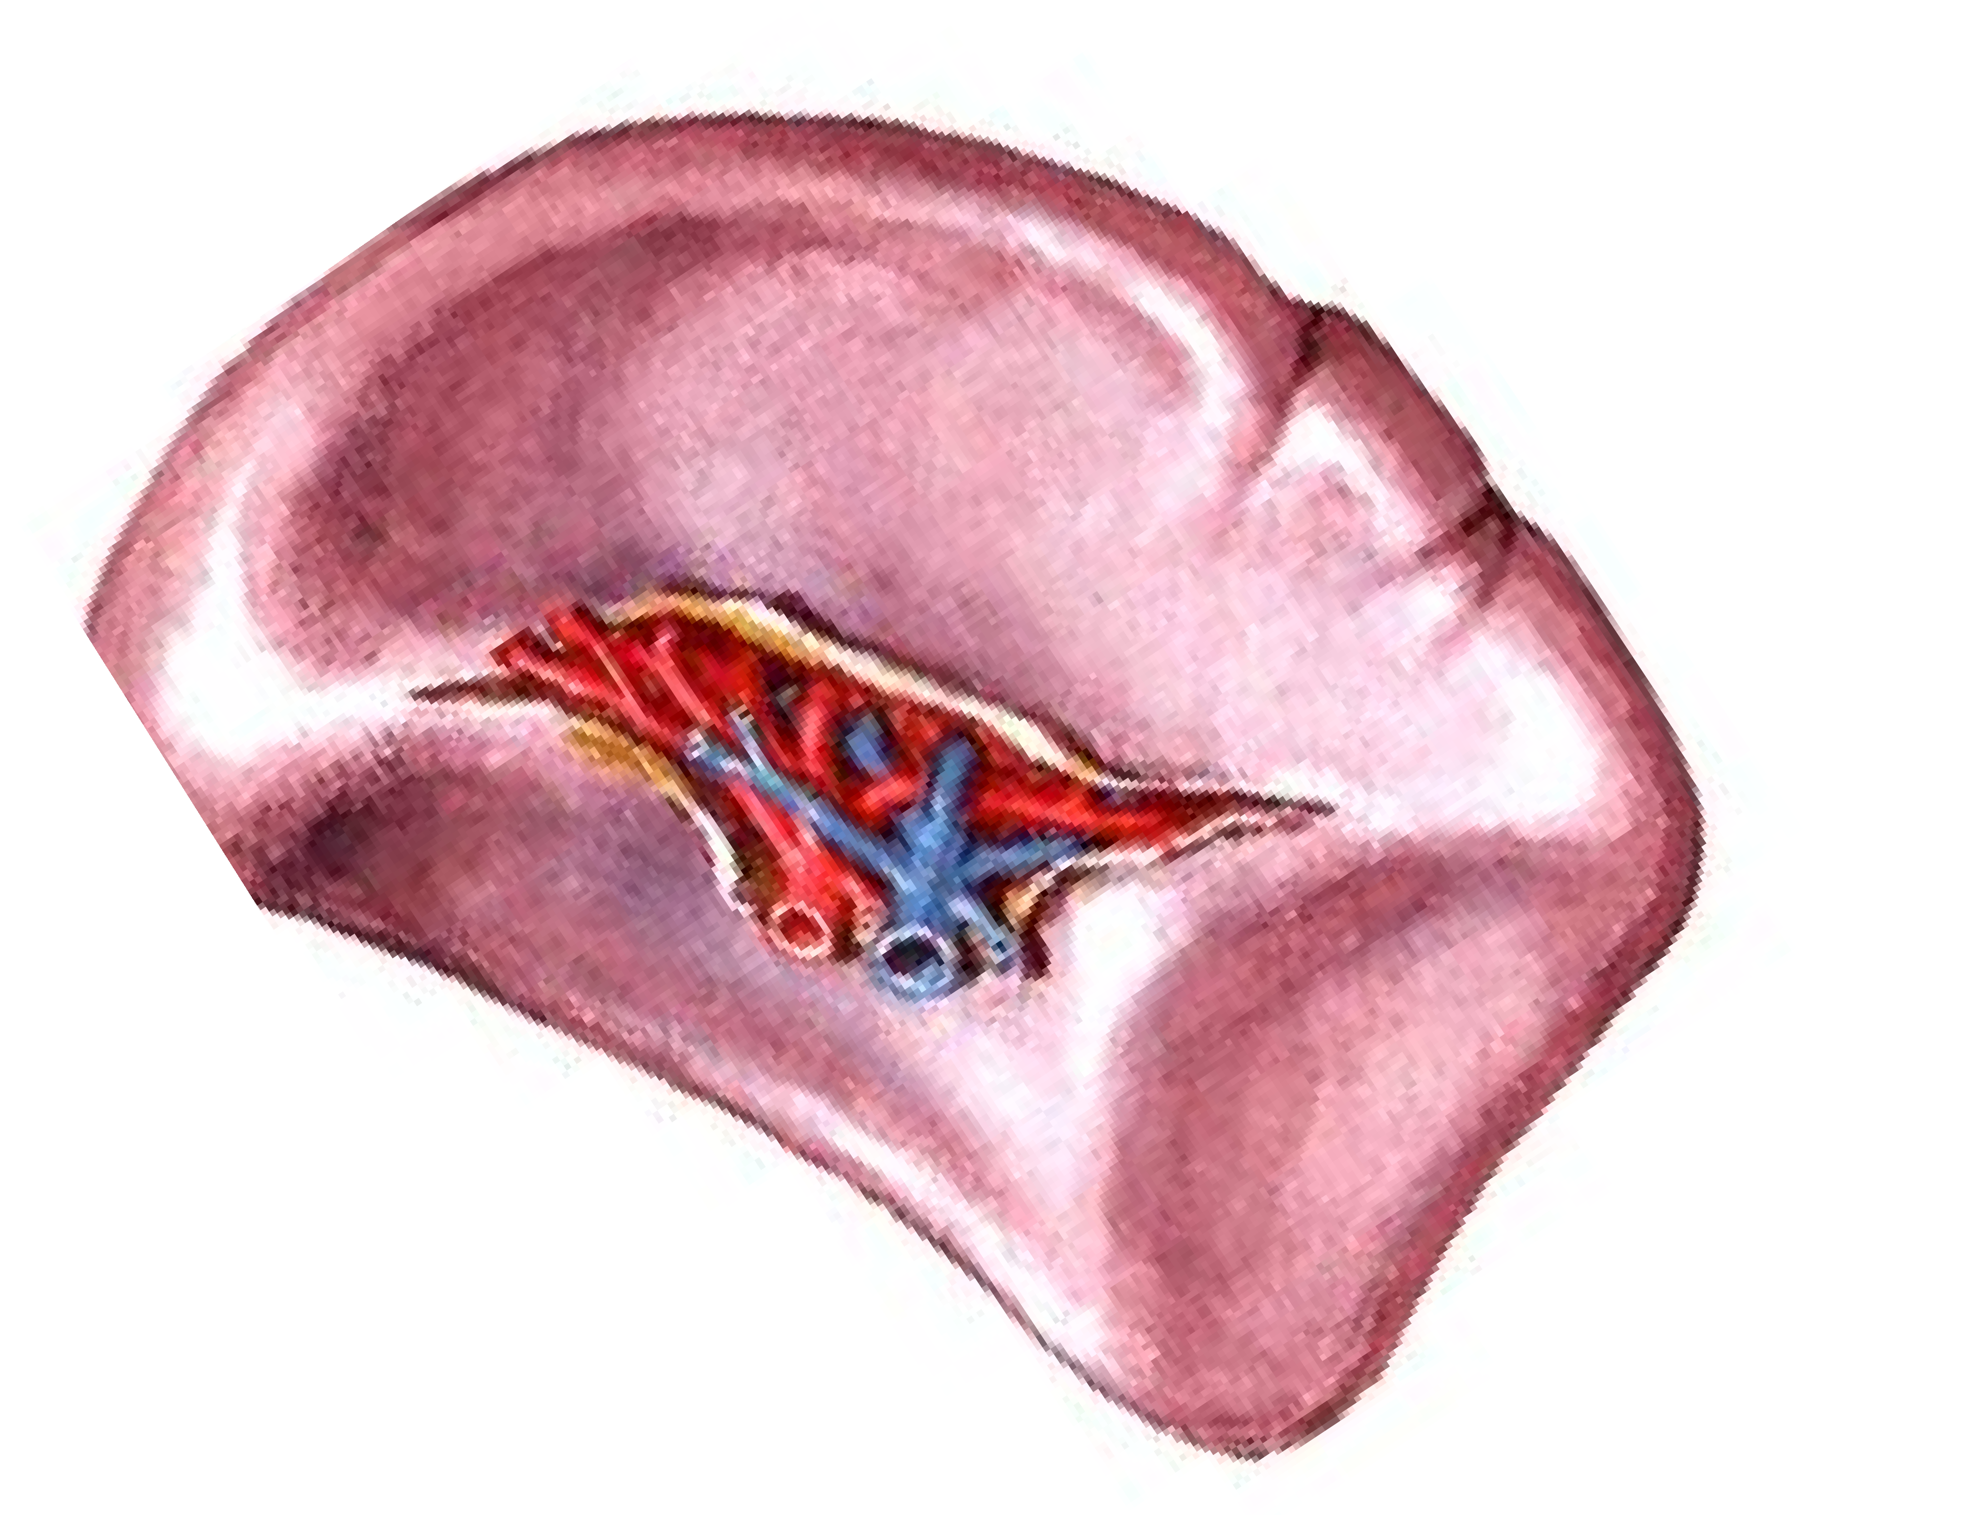
Upper border, sharp
Upper border shows more Notches near its anterior end
Angle between upper border and anterior end
Lower border, thick and round

Slide 5
** How to place the spleen in the correct anatomical position
1- Hold the spleen in your left hand with
Convex surface applied to the palm
Round posterior end towards the wrist
Broad anterior end towards the tips of fingers
Notched upper border applied to the thumb.
2- Put your hand behind the left midaxillary line with an angle 45 degrees with the horizontal.

Slide 6
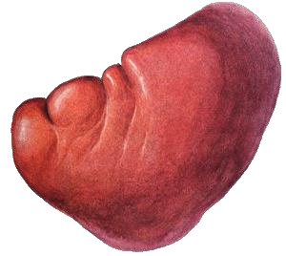
Upper border is parallel to the
upper border of the 9th rib
T10
long axis along the
10th rib
Posterior end one and half inches lateral to the 10th thoracic spine
Anterior end just behind the left midaxillary line
Left Midaxillary line
Lower border is parallel to the lower border of 11th rib

Slide 7
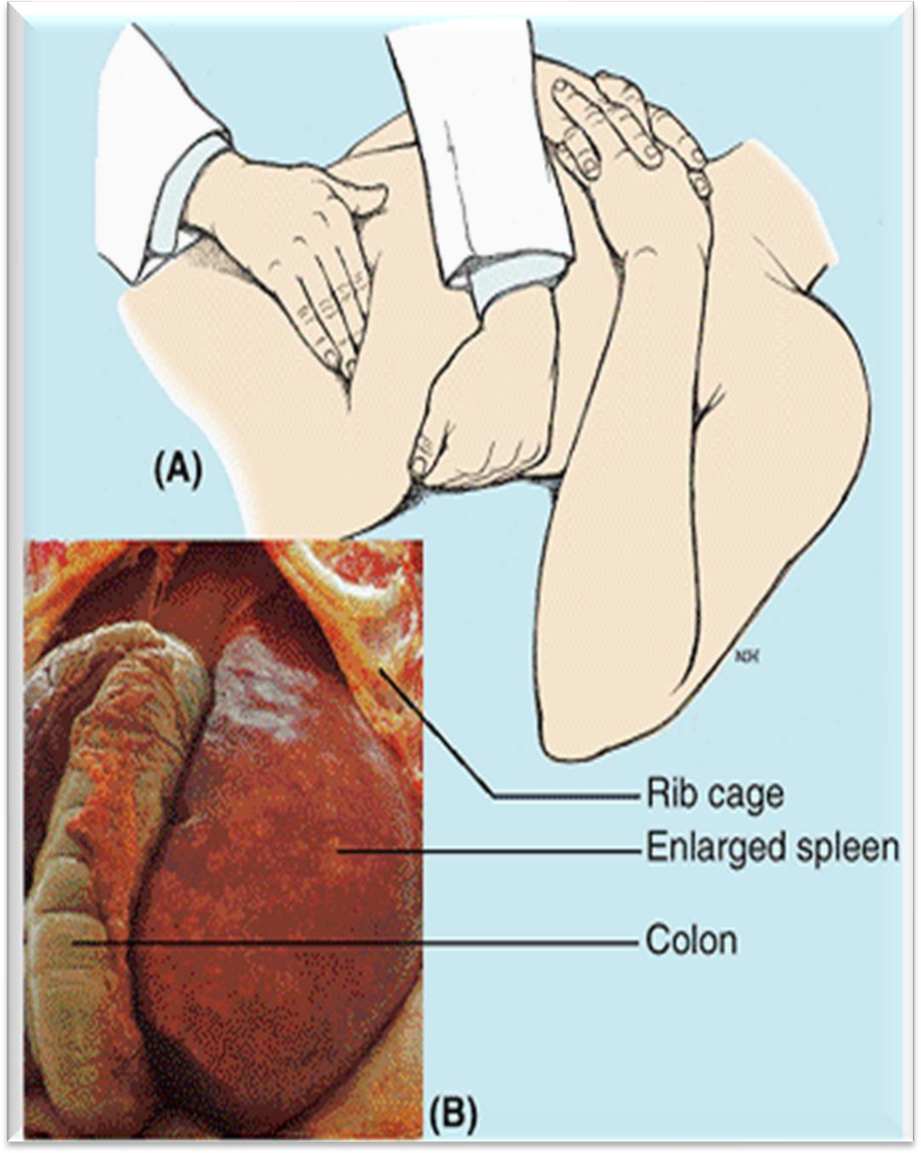
Normal spleen is not palpable.
- If the spleen is felt below the costal margin, it is enlarged at least 3 times of its normal size.

Slide 8
Diaphragmatic surface
It is smooth and convex
surface and related to the diaphragm which separates it from
a- The 9th, 10th and 11th ribs
and the intercostal structures. b- Left pleura and the left lung.
Relations of diaphragmatic surface

Slide 9
Gastric impression: between
Pancreatic impression: below the lateral end of the hilum.
- It is related to the tail of pancreas.
the upper border and the hilum.
- It is related to the stomach.
Hilum between gastric and renal impression.
- It transmits Terminal branches of the splenic artery, Tributaries of the splenic vein, Autonomic nerves and lymphatic.
Renal Impression: between the
hilum and lower borders.
- It is related to the left kidney
Colic impression, close to the anterior end of the spleen.
- It is related to the left
colic flexure.
Relations of visceral surface

Slide 10
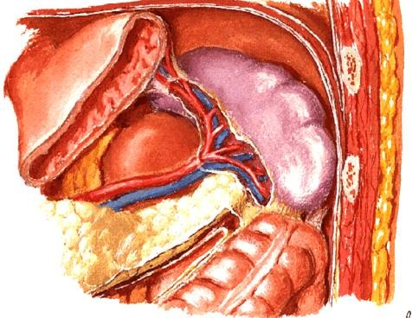
Diaphragm
Spleen
Stomach
Tail of pancreas
Left kidney
Left colic flexure
Splenic vessel

Slide 11
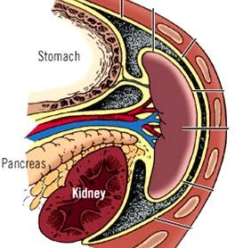
Gastrosplenic ligament (peritoneal fold), between hilum of the spleen and greater curvature stomach
** Contents ; Short gastric vessels and left gastroepiploic vessels.
Lienorenal ligament (peritoneal fold), between hilum of the spleen and left kidney.
* Contents: Tail of pancreas and Splenic vessels.

Slide 12
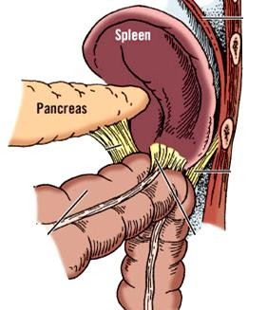
Phrenic colic ligament: extends from the left colic flexure to the diaphragm.
It supports the lateral end (anterior) of the spleen.
As a result of splenomegaly; the spleen extends towards the umbilicus and not directly downwards.

Slide 13
Blood supply
** Splenic artery from coeliac trunk
It runs as a tortuous course along the upper border of pancreas, divided into 5-6 branches.
** Splenic vein runs a straight course
behind the neck of pancreas.
It ends by joining the superior mesenteric vein to form the portal vein.
* Lymphatic drainage
To the pancreatico-splenic lymph nodes.
Red bulb of the spleen has no lymphatic.

Slide 14
Rupture of the spleen
It occurs frequently by fractured ribs or severe blows to the left hypochondrium
It is an emergency medical condition that occurs when the capsule-like covering of the spleen breaks open causing profuse bleeding.
The ruptured spleen is difficult to repair; consequently, splenectomy is performed to prevent the person from bleeding to death.
During splenectomy, tail of pancreas may be damage during ligation of Splenic vessels near hilum
The spleen be removed surgically with minimal effect on body function because its functions are assumed by other reticuloendothelial organs (e.g., the liver and bone marrow).

Slide 15
Splenomegaly
Enlargement of the spleen
The most common causes are tropical diseases as Bilharzial, blood diseases such as haemolytic anemia, thrombosis of the splenic vein, portal hypertension and lymphoma, granulocytic leukemia ( it may enlarge to 10 or more times its normal size and weight)
** Functions of spleen
1- Responsible for most immunity of the body (produces lymphocytes, macrophages, and antibodies in the white pulp). 2- Storage of blood and platelets cells.
Destruction of old RBCs.
During intrauterine life, formation of RBCs.
Filters blood (removes aged erythrocytes, particulate matter, and cellular residue from the blood) (Phagocytotic function)

Slide 16
Axillary lymph nodes

Slide 17
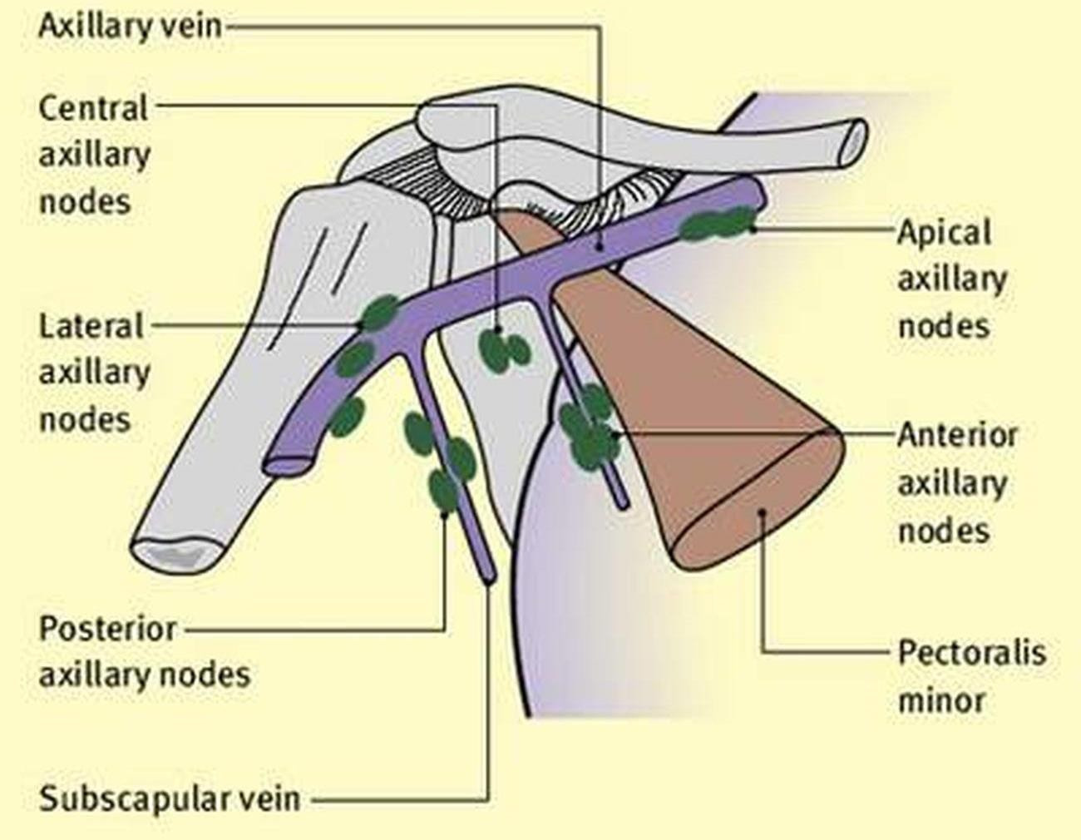
4
5
3
1
2

Slide 18
Axillary lymph nodes
Subclavian lymph trunk
which ends in
Thoracic duct (left side)
Right lymph duct (right side).
Apical group along
axillary vein
Few vessels run with cephalic vein from upper limb
Upper part of the breast
Central group base of the axilla
(2nd part of axillary artery)
Anterior (pectoral) group
Lateral (brachial) group along axillary vessel
Posterior (subscapular) group
Along lateral thoracic vessel below pectoralis minor
along the subscapular vessels
Lymph of the upper limb except few vessels pass to the apical group with the cephalic vein
Central and lateral part of breast
Anterior and lateral wall of the trunk above the umbilicus
Lower part of the neck
Back above level of iliac crest 3- Tail of the breast

Slide 19
Lymphatic drainage of breast

Slide 20
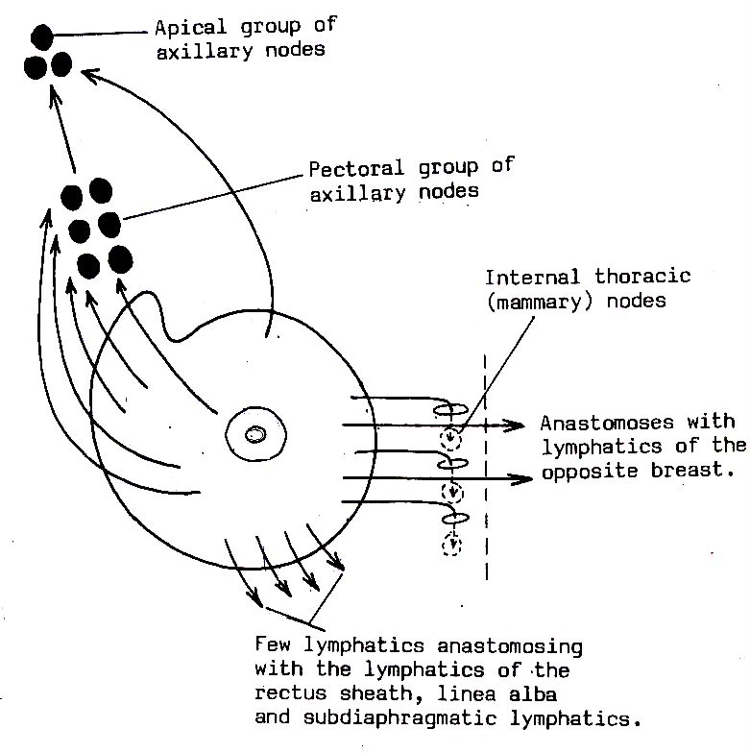
Lymphatic drainage of breast
Upper
(parasternal)
The nipple and areola; drained by subareolar plexus of Sappy that pass to the anterior (pectoral) axillary lymph nodes.
N&A
Lateral
Medial
Inferomedial
The axillary tail of Spence; to the posterior (subscapular) axillary lymph nodes

Slide 21
** Lymphatic drainage of the breast
The nipple and areola; drained by subareolar plexus of Sappy that pass to the anterior (pectoral) axillary lymph nodes.
Deep parts of the breast; drained by the deep lymphatic plexus
Lateral and central parts to the anterior (pectoral) axillary lymph nodes.
Medial part pass through intercostal spaces to the parasternal (internal thoracic) lymph nodes of the same and opposite sides along the internal thoracic artery.
Upper part, to the apical axillary lymph nodes and subclavicular lymph nodes.
inferomedial part drains to the lymph vessels of the rectus sheath of anterior abdominal wall and sub-diaphragmatic lymph nodes.
- Some vessels pass deeply through the falciform ligament to the liver.
e) The axillary tail of Spence; to the posterior (subscapular) axillary lymph nodes.
N.B: 75 % of the lymph drains into the axillary lymph nodes.
- 25 % of the lymph drains into the para-sternal and other lymph nodes.

Slide 22
Lymphatic of Head and Neck

Slide 23
Lymphatic system
Lymphatic system, made up of lymphoid tissues known as nodes and vessels
It is part of the human immune system.
It is involved in protecting the body against infection, by delivering immune cells, known as lymphocytes.
Lymph bodes palpable when enlarged

Slide 24
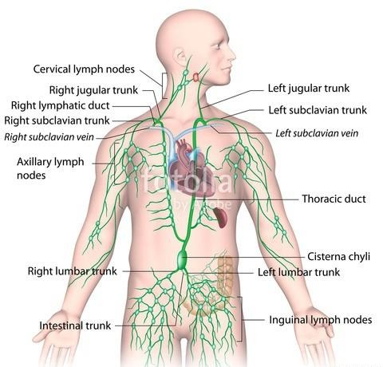

Slide 25
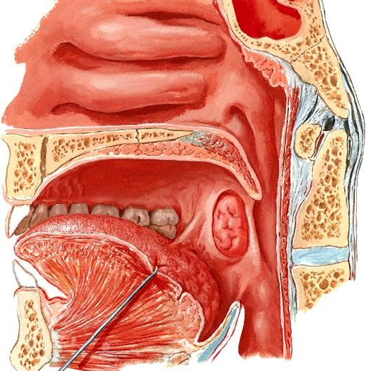
Pharyngeal tonsil
I- Waldeyer,s lymphatic ring: Found at the entrance of the pharynx:
A- Pharyngeal tonsil (Adenoid) in the
roof of the nasopharynx.
B- Lingual tonsil, situated at the base of the tongue.
C- Palatine tonsils, situated in the tonsillar fossa, one on each side.
Palatine tonsil
Lingual tonsil

Slide 26
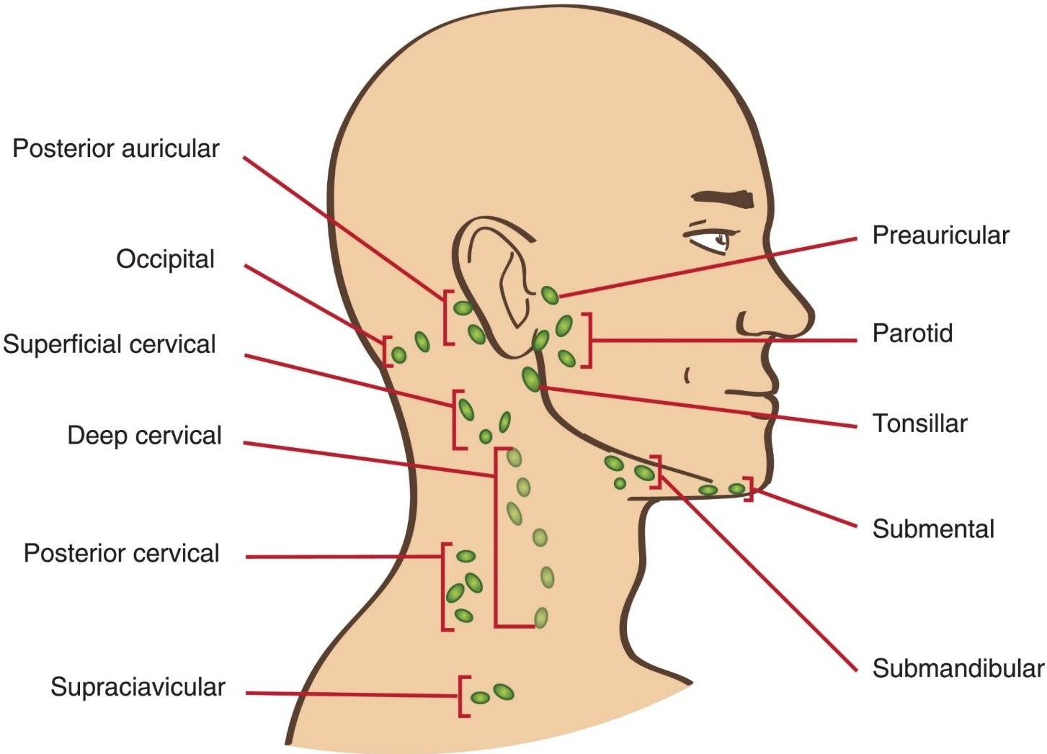
Superficial cervical lymph nodes
1- Pre-auricular:
Site: in front of the tragus superficial
to fascia covering the parotid gland
Afferent: outer surface of the auricle and side of the scalp.
2- Parotid:
Site: in substance of parotid gland.
Afferent: parotid, Lateral part of eyelids, front of the scalp, and
external acoustic meatus.

Slide 27
Superficial cervical lymph nodes
3- Tonsillar:
Site: posterior of jawline
Afferent: The tonsil.
4- Submental:
Site: in the submental triangle.
Afferent: central part of the lower lip, floor of the mouth, apex of the tongue and incisor teeth.

Slide 28
Superficial cervical lymph nodes
5- Submandibular:
Site: in the digastric triangle
Afferent: scalp, nose, cheeks, lips (except central part of lower lip), side of the tongue, teeth (except incisors), paranasal
(except sphenoidal
sinuses and posterior of mouth,
ethmoidal), floor
submental group.

Slide 29
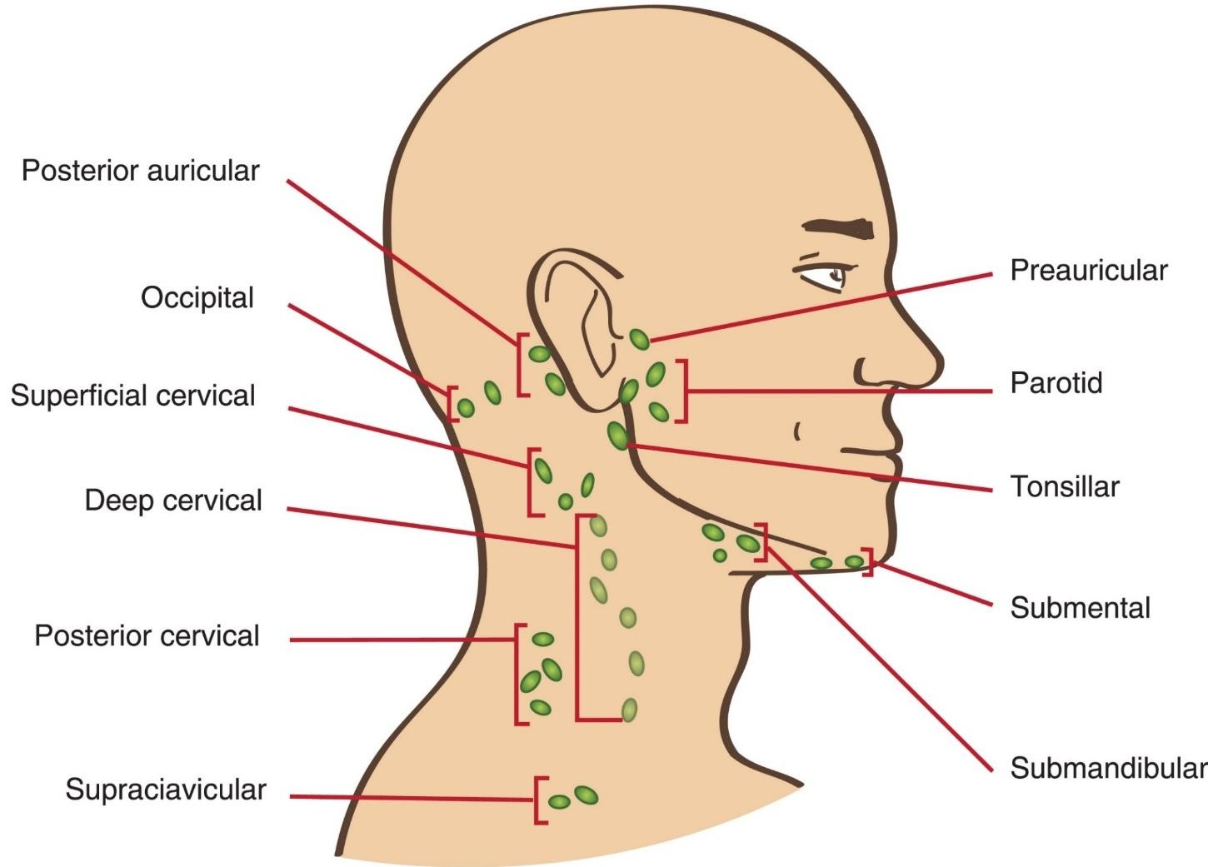
Superficial cervical lymph nodes
Buccal on the buccinator muscle
Posterior auricular (mastoid):
Site: on the mastoid process
Afferent: temporal region of the scalp and external acoustic meatus.
8- The occipital:
Site: Apex of the posterior triangle.
Afferent: back of the scalp.
9- Superficial cervical:
Site: around the external jugular vein.
Afferent: parotid region and the lower part of the ear.
All above lymph nodes pass to deep cervical lymph nodes
10- Supraclavicular above clavicle

Slide 30
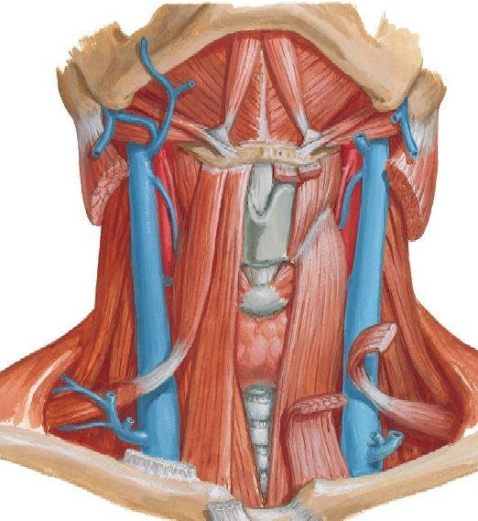
Deep cervical lymph nodes
A- Middle line
Infrahyoid on the thyrohyoid membrane
Prelaryngeal, on the cricothyroid membrane 3- Pretracheal on the tracheal rings.
4- Paratracheal on each side of trachea
Afferent: lymph from larynx , trachea, thyroid gland
Efferent to superior or inferior deep cervical
lymph nodes

Slide 31
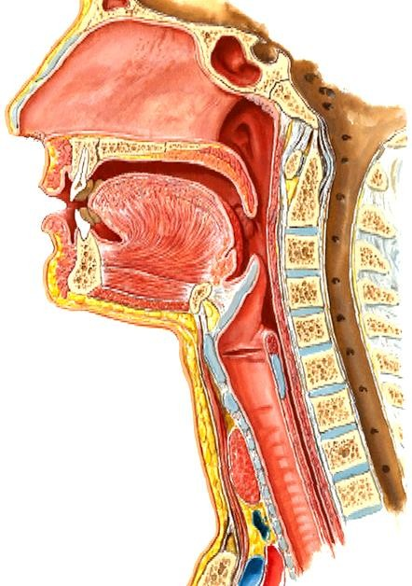
Deep cervical lymph nodes
5- Retropharyngeal:
Site: between pharynx & prevertebral fascia
Afferents: pharynx, auditory tube, sphenoidal sinus and posterior ethmoidal sinus and prevertebral region
When enlarged, these nodes can cause difficulty in swallowing (dysphagia) due to pressure on the pharynx

Slide 32
Deep Cervical Lymph Nodes on side of neck
Upper deep cervical lymph nodes: Jugulo- digastric lymph node at junction of internal jugular vein and posterior belly of digastric muscle.
Lower deep cervical lymph nodes: Jugulo omohyoid lymph node at junction of internal jugular vein and intermediate tendon of omohyoid muscle.
They concerned with lymphatic drainage of the tongue
All above lymph nodes, the lymph vessels pass to
the deep cervical lymph nodes then to jugular lymph trunk, ends in
Left drains into thoracic duct
Right drains right lymphatic duct

Slide 33
5- Bronchomediastinal trunk
lymph trunk, ends in
Left drains into thoracic duct
Right drains right lymphatic duct
4- Paratracheal
nodes
3- Superior tracheobronchial nodes
3- Inferior tracheobronchial nodes
2- Bronchopulmonary nodes
1- Pulmonary nods

Slide 34
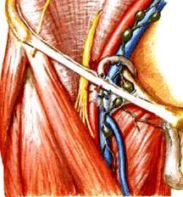
A- Upper (Horizontal) group: below the
inguinal ligament.
B- Lower (Vertical) group; around the upper part of the great saphenous vein.
** Afferent:
From whole of the lower limb.
Anterior abdominal wall below the level of umbilicus.
External genital organs.
Perineum and Lower part of the anal canal. 5- Fundus of the uterus related to the opening
External iliac vein
Femoral vein
Inguinal Lig
of the uterine tubes along the round
ligament of the uterus.
** Efferent: to deep inguinal lymph nodes close to femoral vein then to external iliac lymph nodes close to external iliac vein
Great saphenous vein

Slide 35
Thoracic duct

Slide 36
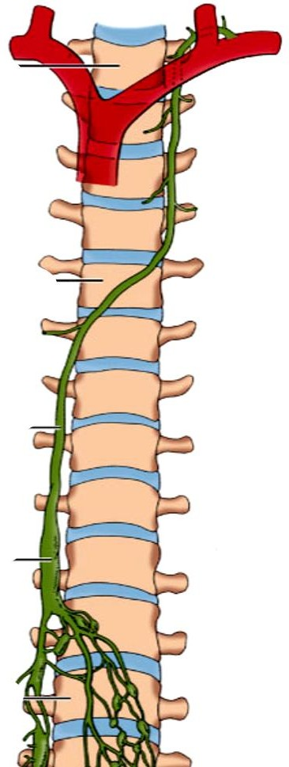
Thoracic Duct
- It is the largest lymphatic vessels in the body.
** Beginning, from the upper end of the cisterna chyli at lower border of T12 in the abdomen.
** Shape; It is a thin-walled vessel which has a
beaded appearance due to presence of many
valves.
** Course :
- It enters the thorax through the aortic opening of the diaphragm between the aorta (on the left) and azygos vein (on the right).
Thoracic duct
Cisterna chyli

Slide 37
Thoracic Duct
Posterior mediastinum, It ascends
- Behind right border of esophagus.
- In front of the anterior longitudinal ligament of the vertebral column, right posterior intercostal arteries, and hemiazygos veins.
At the level of T4-T6, it crosses the median plane from right to left behind the esophagus.
Superior mediastinum, it ascends behind left border of
esophagus.
Esophagus
T5

Slide 38
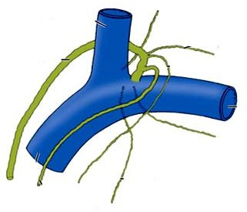
Thoracic duct
Left internal jugular vein
Left subclavian vein
In the neck, at the level of C7, it curved behind the carotid sheath.
Finally, it descends to end into the junction of the left subclavian and left internal jugular veins to from left brachiocephalic vein.
N.B; at the end of the duct there are 2 valves to prevent regurgitation of the lymph.
Left brachiocephalic vein

Slide 39
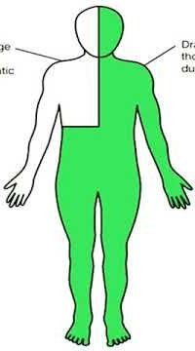
** Tributaries of thoracic duct:
Cisterna chyli, receives lymphatic from the lower part of the body through;
Intestinal lymph trunk from abdomen and pelvis
Right lumbar lymph trunk (from right lower limb).
Left lumbar lymph trunk (from left lower limb).
Left broncho-mediastinal lymph trunk: drains left 1/2 of thoracic cavity.
Left subclavian lymph trunk: drains the left upper limb.
Left jugular lymph trunk: drains the left 1/2 of the head and neck.
Right
Right lymphatic duct
- It ends at the junction of the right internal jugular vein and subclavian vein.
** Tributaries:
I- Right broncho-mediastinal lymph trunk.
2- Right subclavian lymph trunk. 3- Right jugular lymph trunk.

