Slide 1
Adrenal Masses
Presented by :
Bana Jarah
Dania Mbaideen
Rayah Rawashdeh
Rama Shamayleh

Slide 2
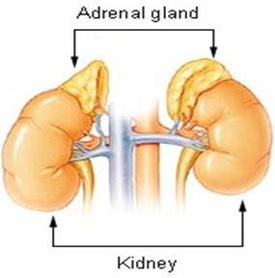
ANATOMY
The adrenal glands are paired endocrine organs situated at the upper poles of the kidneys .
The weight of a normal adrenal gland is approximately 4 g.
retroperitoneal organs.
EMBRYOLOGY
Adrenal cortex: derived from mesoderm
Adrenal medulla: derived from the neural crest
Arterial blood supply
Superior suprarenal artery which arise from the inferior phrenic artery .
Medial suprarenal artery which arise from the abdominal aorta .
Inferior suprarenal artery which arise from the renal artery .
Venous drainage
Right suprarenal vein into the inferior cava vein .
Left suprarenal vein into the left renal vein.

Slide 3
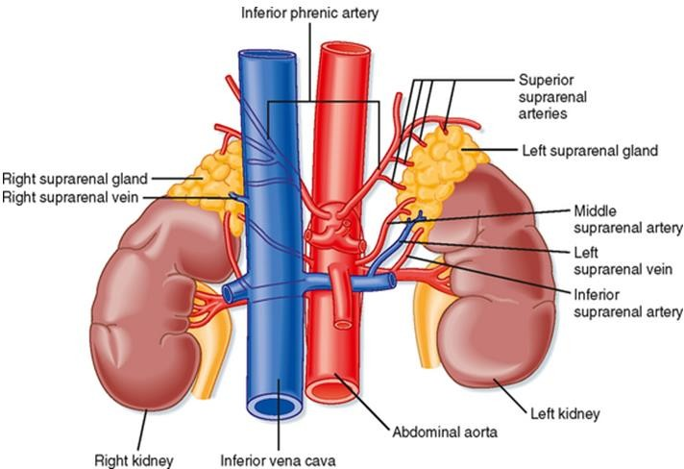
Lymph drainage
left aortic lymph nodes; right caval lymph nodes
HISTOLOGY
ADRENAL CORTEX
zona glomerulosa : secretes the Aldosterone .
zona fasciculata : secretes glucocorticoids (cortisol).
zona reticularis : secrete androgenic steroid.
ADRENAL MEDULLA
its cells called chromaffin which secrete the catecholamines ((( adrenaline (epinephrine), noradrenaline (norepinephrine) and dopamine )))

Slide 4
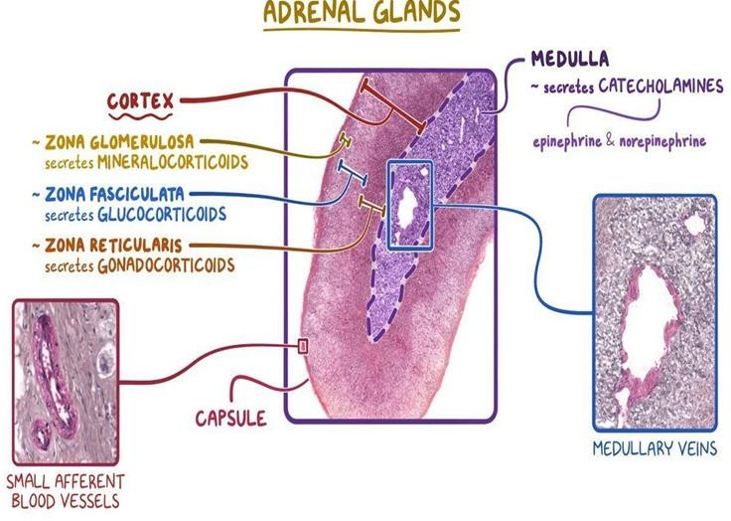
PHYSIOLOGY OF THE ADRENAL CORTEX
The zona glomerulosa cells produces the hormone aldosterone. Aldosterone increases the blood pressure by promoting sodium and water retention in the kidneys. It also promotes potassium loss at the same site.
The two well-known stimulators of aldosterone secretion are angiotensin II (released by activation of the renin-angiotensin system after hyponatremia or hypovolemia ) and an increase in the level of serum potassium (hyperkalemia) .
Cells of the zona fasciculata and zona reticularis synthesize cortisol and the adrenal androgens.
Cortisol secretion is regulated by adrenocorticotrophic hormone (ACTH), which is produced by the anterior pituitary gland. The hypothalamus controls ACTH secretion by secreting corticotropin- releasing hormone (CRH). The cortisol level inhibits the release of CRH and ACTH via a closed-loop system .

Slide 5
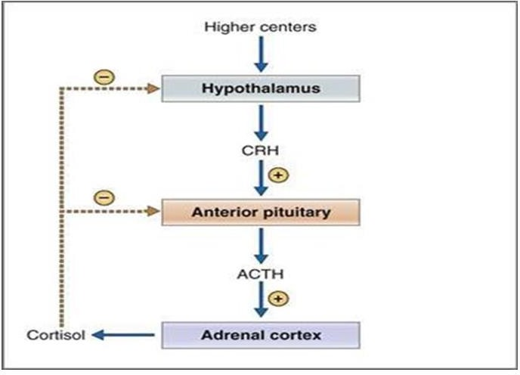
Cushing’s syndrome
(Hypercortisolism)
ETIOLOGY :
Exogenous : Iatrogenically by Excessive or prolonged administration of cortisol-like drugs.
Endogenous : endogenous production of corticosteroids , it can be:
1. ACTH-dependent
A pituitary adenoma 85% (that secretes an excessive amount of ACTH) .
Ectopic ACTH-producing tumours as ( small cell lung cancer ) .
2. ACTH-independent : In about 15 per cent of patients , causes :
Adrenal adenoma ( most common ) .
Adrenal carcinoma .
Clinical features of Cushing’s
The typical patient is characterised by a facial plethora, a buffalo hump and a moon face in combination with hypertension, diabetes and central obesity.

Slide 6
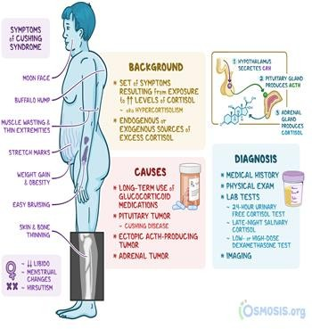
Other symptoms :
Hirsutism
Skin changes (abdominal striae, ecchymosis, acne)
Muscle weakness
Diagnosis
24_hr urine cortisol level (is raised ).
Morning and midnight plasma cortisol levels are elevated
,possibly with loss of diurnal rhythm. **
Low dose dexamethasone suppresion test ( dexamethasone fails to suppress 24-hour urinary cortisol excretion )… (↑ Early morning serum cortisol levels) .
Treatment
Exogenous Cushing's syndrome

Slide 7
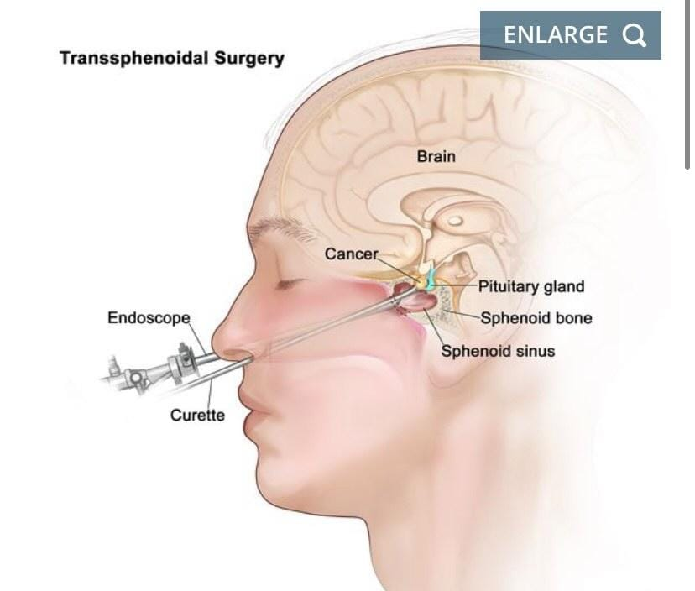
-Lowering dose of glucocorticoids and Using of alternatives of glucocorticoids as (azathioprine) .
Endogenous Cushing's syndrome
Treatment Depend On Diagnosis:
Diagnosis depend on Serum ACTH levels ( discriminate ACTH- dependent from ACTH-independent disease ) :
patients with elevated ACTH levels (ACTH-dependent)
MRI of the pituitary gland must be performed
----- If pituitary MRI +ive → Pituitary adenoma (ACTH-producing pituitary adenoma are treated by trans-sphenoidal resection or radiotherapy )
----- If pituitary MRI –ive → a CT scan of the chest and abdomen is warranted to detect an ectopic ACTH producing tumour . (If an ectopic ACTH source is localised, resection will correct hypercortisolism.)
2. patients with suppressed ACTH levels (ACTH-independent)
Abdominal CT or MRI scan is performed to assess the adrenal glands .
A unilateral adenoma is treated by adrenalectomy.
A Bilateral adenoma …bilateral adrenalectomy is the primary treatment .
----- if surgery is not possible ... Medical therapy with metyrapone or ketoconazole reduces steroid synthesis and secretion can be used .

Slide 8
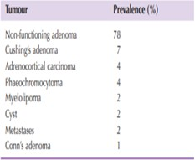
Incidentaloma
(DISORDERS OF THE ADRENAL CORTEX)
Incidentaloma is an adrenal mass, detected incidentally by imaging studies conducted for other reasons, not known previously to have been present or causing symptoms.
Incidentalomas may be detected on imaging studies in 1 per cent of patients.
The prevalence of adrenal masses in autopsy studies ranges from 1.4 to 8.7 per cent and increases with age.
More than 75 per cent are non- functioning adenomas but Cushing’s adenomas, phaeochromocytomas, metastases, adrenocortical carcinomas and Conn’s tumours may be present .
Diagnosis
When an incidentaloma is identified, a complete history and
clinical examination are required. A biochemical work-up for hormone excess is needed and sometimes additional imaging studies are also required.
The main goal is to exclude a functioning or malignant adrenal tumour. Hormonal evaluation includes:
morning and midnight plasma cortisol measurements.
a 1-mg overnight dexamethasone suppression test.
24-hour urinary cortisol excretion.

Slide 9
12 or 24-hour urinary excretion of metanephrines or plasma free metanephrines;
serum potassium, plasma aldosterone and plasma renin activity;
serum DHEAS, testosterone or 17-hydroxyestradiol (virilising or feminising tumour).
Computed tomography (CT) or magnetic resonance imaging (MRI) should be performed in all patients with adrenal masses.
The likelihood of an adrenal mass being an adrenocortical carcinoma
increases with the size of the mass (25 per cent >4 cm).
Adrenal metastases are likely in patients with a history of cancer elsewhere and the sole indications for biopsy of an adrenal mass
is to confirm a suspected metastasis from a distant primary site
Never biopsy an adrenal mass until phaeochromocytoma has been biochemically excluded
The indication for adrenal gland biopsy is to confirm
adrenal gland metastasis
Treatment
Any non-functioning adrenal tumour greater than 4 cm in diameter and smaller tumours that increase in size over time should undergo surgical resection.
Non-functioning tumours smaller than 4 cm should be followed-up after 6, 12 and 24 months by imaging (MRI) and hormonal evaluation.

Slide 10
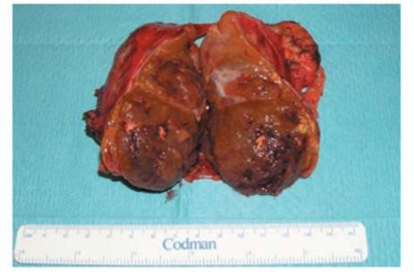
Adrenocortical carcinoma
Adrenocortical carcinomas (ACs) are uncommon malignancies that can have protean clinical manifestations (variable presentations ).
A majority of cases are metastatic at the time of diagnosis, with the most common sites of spread being the local periadrenal tissue, lymph nodes, lungs, liver, and bone.
Adrenocortical carcinoma is a rare malignancy with an incidence of 1–2 cases per 1 000 000 population per year and a variable but generally poor prognosis.
A slight female predominance is observed (1.5:1).
The age distribution is bimodal with a first peak in childhood and a second between the fourth and fifth decades
Pathology
The differentiation between benign and malignant adrenal tumours is challenging, even in the hands of an experienced pathologist.
Criteria for malignancy are :
tumour size
presence of necrosis or haemorrhage
microscopic features such as capsular or vascular invasion

Slide 11
Clinical presentation
1. Non functioning varients
-These hormonally silent tumors account for approximately 40% of patients with AC.
- Nonfunctional variants of AC tend to be more common in older patients
and appear to progress more rapidly than functional tumors do.
- In some cases they are found incidentally (incedentaloma).
- Typically present with any of the following:
abdominal pain and tenderness
fever
weight loss
back pain
abdominal fullness
2. Hormonally active variants
The hormonally active variants of AC constitute approximately 60% of cases.
- Approximately 30-40% of adult patients with these present with the
typical features of Cushing syndrome, while 20-30% present with
virilization syndromes.
Signs of Cushing syndrome include a round face, a double chin, buffalo- hump fat distribution, generalized obesity, failure of growth velocity, and hypertension.

Slide 12
Diagnosis
The diagnostic work-up should include measurements of DHEAS, cortisol and catecholamines to exclude aphaeochromocytoma and a dexamethasone suppression test.
MRI and CT are equally effective in imaging adrenocortical carcinoma
Treatment
Complete tumor resection is associated with favorable survival and should be attempted whenever possible.
In order to prevent tumour spillage and implantation metastases, the capsule must not be damaged.
En bloc resection with removal of locally involved organs is often required.
Patients can be treated postoperatively with mitotane.(adjuvant chemotherapy).
Adjuvant radiotherapy may reduce the rate of local recurrence.
DISORDERS OF THE ADRENAL MEDULLA
Phaeochromocytoma
Definition : tumour of the adrenal medulla which arise from chromaffin cells that produce catecholamines .

Slide 13
The prevalence of phaeochromocytoma in patients with hypertension is 0.1–0.6 per cent with an overall prevalence.
4 per cent of incidentalomas are phaeochromocytomas .
Sporadic phaeochromocytomas occur around the fourth decade whereas patients with hereditary forms are diagnosed earlier.
Phaeochromocytoma is known as the ‘10 per cent tumours or The rule of 10s as :
10 per cent of tumour’s are inherited,
10 per cent are extra-adrenal,
10 per cent are malignant,
10 per cent are bilateral
10 per cent occur in children
Hereditary phaeochromocytomas occur in several tumour syndromes :
Multiple endocrine neoplasia type 2 (MEN 2): an autosomal dominant inherited disorder that is caused by activating germline mutations of the RET proto-oncogene , In patients with MEN 2, the onset of phaeochromocytoma is preceded by adrenomedullary hyperplasia, sometimes bilateral. Phaeochromocytoma is rarely malignant in MEN 2.
Familial paraganglioma (PG) syndrome (EXTRA ADRENAL PHAEOCHROMOCYTOMA)
III.
von Hippel–Lindau (VHL) syndrome
Multiple endocrine neoplasia
Multiple endocrine neoplasia (MEN) is a term used to describe three autosomal dominant syndromes that are associated with certain hormone-producing neoplasias.
There are three subtypes: MEN 1, MEN 2A and MEN 2B.

Slide 14
MEN 1 is caused by an altered menin protein expression and presents with primary hyperParathyroidism, often in association with endocrine Pancreatic tumors and/or Pituitary adenomas.
MEN 2A and MEN 2B are caused by a mutated RET proto-oncogene and both present with medullary thyroid carcinoma (almost %100 of cases) and sometimes pheochromocytoma (around %40 of cases) .
MEN 2A is further associated with primary hyperparathyroidism (%20-
%30) as well, while MEN 2B causes a Marfanoid habitus (more than %95) .
If any of the individual conditions associated with MEN are suspected, especially in patients with a positive family history, it is important to consider a diagnostic workup for any of the other associations. Those positive for mutated genes should be closely monitored and should undergo a total thyroidectomy if positive for the RET proto-oncogene
Management of MEN
Thyroidectomy including cervical lymph nodes , Pheochromocytoma should first be ruled out or treated before undergoing surgery
If pheochromocytoma (adrenalectomy)
If hyperparathyroidism: remove pathologic parathyroid glands (parathyroidectomy)
Clinical features of phaeochromocytoma
Classical tried of phaeochromocytoma: palpitation, sweating and headache .
-Paroxysms (usually <30 ) may be precipitated by :
physical training .
induction of general anesthesia .
numerous drugs and agents (contrast media, tricyclic antidepressive drugs.
*This patients is at high risk to have angina and MI due increase myocardial O2 consumption and coronary vasospasm .

Slide 15
Diagnosis
1. Biochemical tests
A - the determination of adrenaline and noradrenaline breakdown products, metanephrine and normetanephrine level, in a 12- or 24-hour urine collection.
Levels that exceed the normal range (meta 24-96 mcg/24h and normeta 75-375 mcg/24h ) by 4–40 times will be found in affected patients .
B - Determination of plasma-free metanephrine levels also has a high sensitivity .
Biochemical tests should be performed at least twice.
2. The localisation of the phaeochromocytoma : MRI is preferred because contrast media used for CT scans can provoke paroxysms.
Preoperative
With adequate medical pretreatment, the perioperative mortality rate has decreased from 20–45 per cent to less than 3 per cent .
α-adrenoreceptor blocker (phenoxybenzamine) is used to block catecholamine excess and its consequences during surgery .
A dose of 20 mg of phenoxybenzamine initially should be increased daily by 10 mg until a daily dose of 100–160 mg is achieved and the patient reports symptomatic postural hypotension.
Additional β-blockade is required if tachycardia or arrhythmias develop; this should not be introduced until the patient is α-blocked.
Treatment
Laparoscopic resection is now routine in the treatment of phaeochromocytoma.

Slide 16
If the tumour is larger than 8–10 cm or radiological signs of malignancy
are detected, an open approach should be considered.
Postoperative
Patients should be observed for 24 hours in the intensive care or high dependency unit as hypovolaemia and hypoglycaemia may occur.
Yearly lifelong follow up :Lifelong yearly biochemical tests should be performed to identify recurrent, metastatic .
Malignant phaeochromocytoma
Approximately 10 per cent of phaeochromocytomas are malignant. This rate is higher in extra-adrenal tumours (paragangliomas).
Treatment Surgical excision is the only chance for cure.
Phaeochromocytoma in pregnancy
With mother and unborn child are threatened by hypertensive crisis ** during delivery.
In the first and second trimesters, the patient should be scheduled for laparoscopic adrenalectomy after adequate α-blockade; the risk of a miscarriage during surgery is high.
In the third trimester, elective Caesarean with consecutive adrenalectomy should be performed.
The maternal mortality rate is 50 per cent when a phaeochromocytoma remains undiagnosed.

