Slide 1
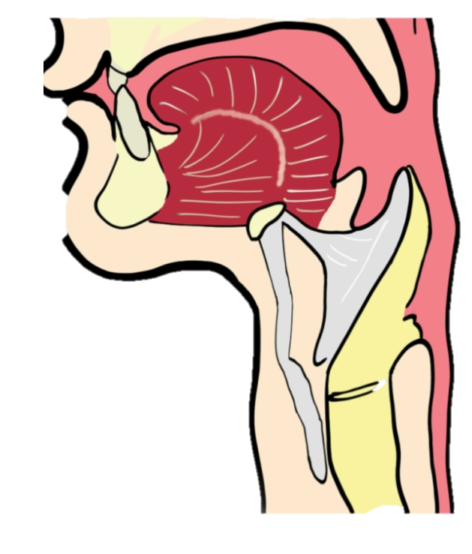
Laryngeal
carcinoma
Done by :
Waleed Azayzeh
Monther Qatawneh
Supervision :
DR. Hani Alhamaydah

Slide 2
Definition
Cancer of the larynx is a malignant tumor in the Larynx (voice box) .
- Squamous center carcinoma is the most common form (95%)
It occurs more frequently in men than women .
Most common in people between the ages of (50-70)

Slide 3
Carcinogens associated with laryngeal cancer :
Tobacco
Alcohol
Exposure to
Asbestos / Mustard gas / Wood dust / Tar products / Leather and metals

Slide 4
Contributing Factors :
Chronic laryngitis
Nutritional deficiency
Family predispositions

Slide 5
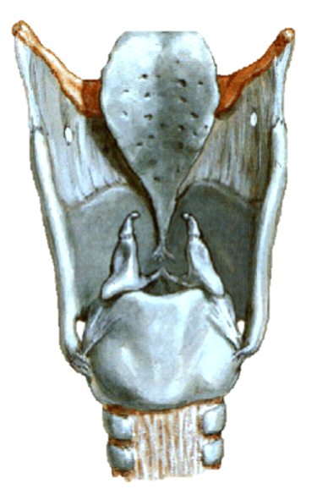
Anatomy

Slide 6
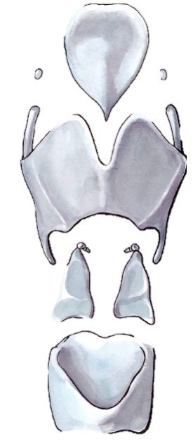
Cartilages
Epiglottis
Thyroid cartilage
Cuneiform cartilage
Corniculate cartilage
Arytenoid
cartilage
Cricoid
cartilage

Slide 7
Membranes and ligaments
Median thyrohyoid
Ligament
lateral thyrohyoid
Ligament
Thyrohyoid
membrane
Internal laryngeal nerve
Superior laryngeal artery
Median cricothyroid
ligament
lateral cricothyroid
ligament
Cricotracheal
ligament

Slide 8
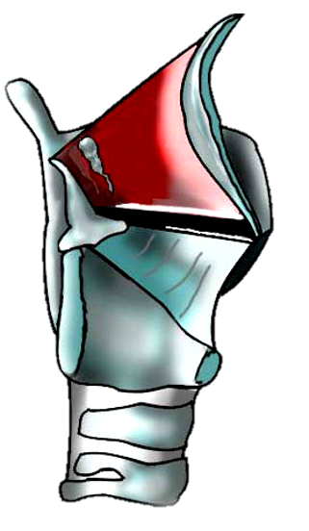
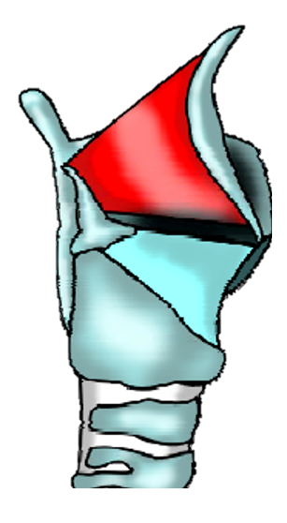
Cricothyroid membrane
Conus elasticus
Quadrangular
membrane
Vocal
ligament
Vestibular
ligament
Vocal process of Arytenoid cartilage
Cricothyroid
membrane

Slide 9
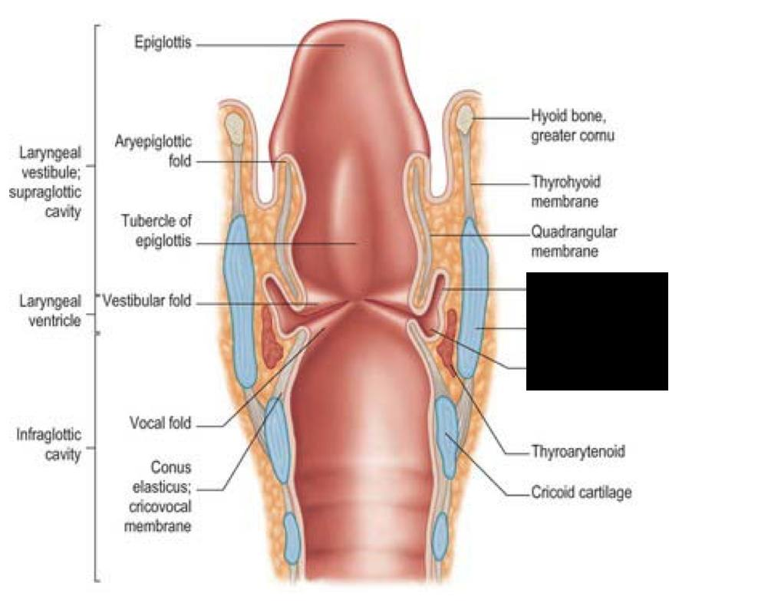

Slide 10
So we divide the larynx into the following three anatomical regions :
1- The supraglottic larynx (epiglottis / false vocal cords / ventricles / aryepiglottic folds / arytenoids)
2- The glottis (true vocal cords / anterior and posterior commissures)
3- The subglottic region
(begin about 1cm below the true vocal cords and extends to the lower border of the cricoid cartilage or the first tracheal ring)

Slide 11
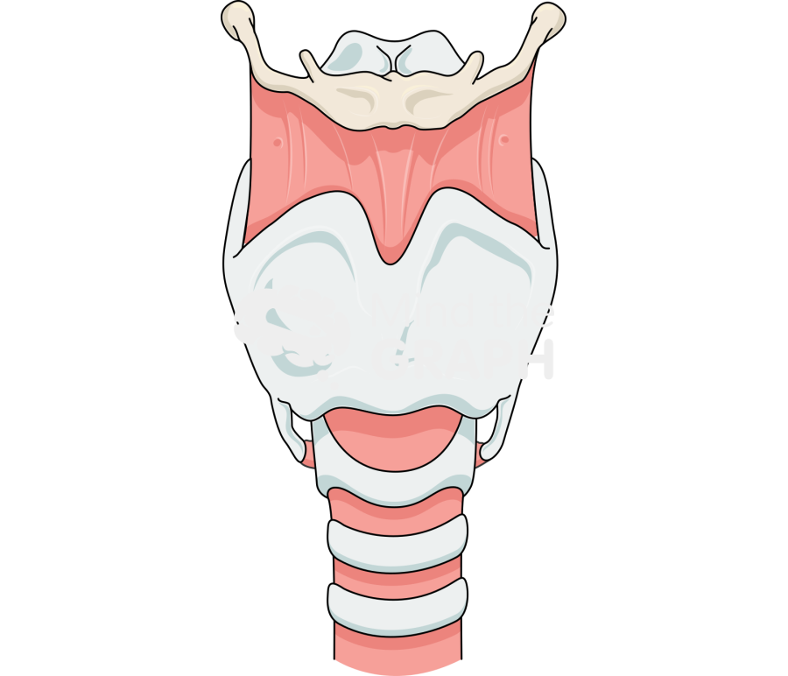
Types

Slide 12
1- Glottic 59%
2- Supraglottic 40%
3- Subglottic 1%

Slide 13
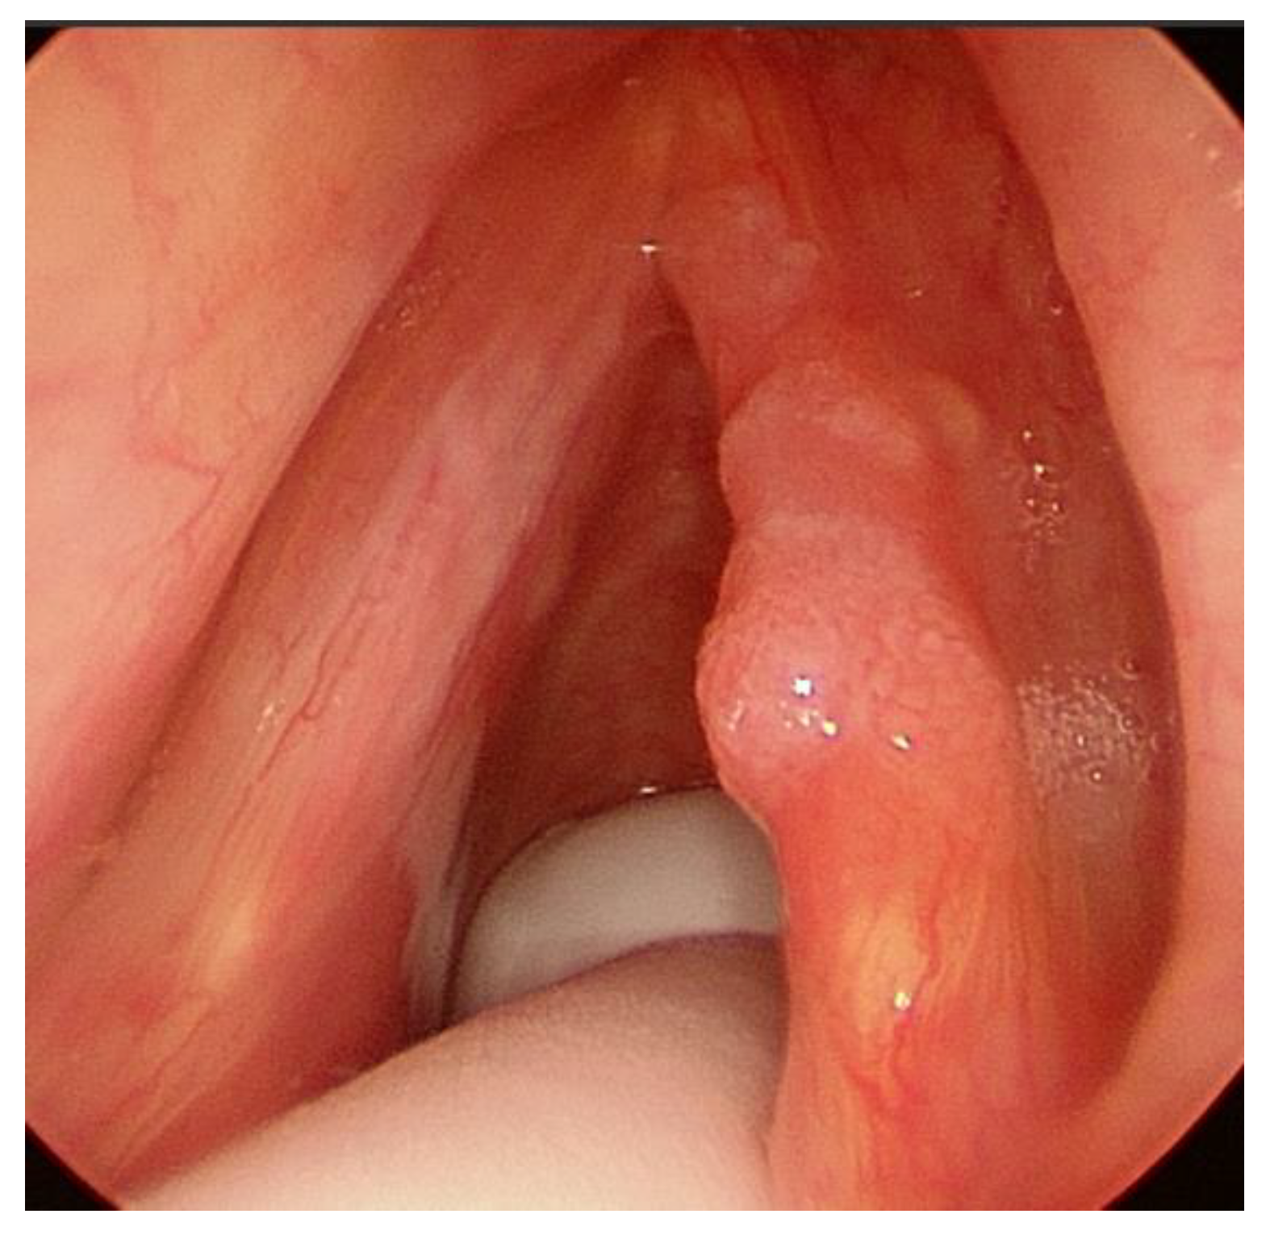
1- Glottic (most common)
It has a GOOD Prognosis (because of early presentation and late spread)
Symptoms
Hoarseness of voice (early sign)
Stridor (when growth becomes larger in size)
“There are a few lymphatics in vocal cords and nodal metastasis are never seen unless the disease spread beyond the region of membranous cords”
Spread → Anteriorly → anterior commissure
posteriorly → vocal process and
arytenoid process
Upward → ventricle and false cord
Downward → subglottic region

Slide 14
1- Glottic (most common)
Spread → Anteriorly → anterior commissure
posteriorly → vocal process and
arytenoid process
Upward → ventricle and false cord
Downward → subglottic region
“There are a few lymphatics in vocal cords and nodal metastasis are never seen unless the disease spread beyond the region of membranous cords”
Symptoms
Hoarseness of voice (early sign)
Stridor (when growth becomes larger in size)
It has a GOOD Prognosis (because of early presentation and late spread)

Slide 15
Clinical manifestation :
Voice change
Hemoptysis
Dyspnea
Respiratory obstruction
Dysphagia
Weight loss
Pain

Slide 16
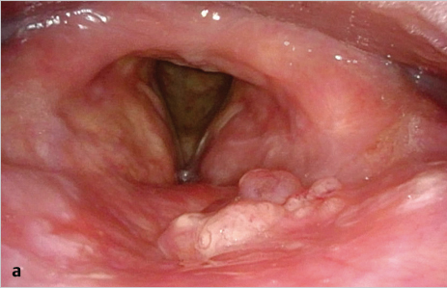
2- Supraglottic
- It may spread locally and invade adjoining areas → vallecula → base of tongue → pyriform fossa
Symptoms
Often silent
Hoarseness (late symptom)
May present with throat pain associated with dysphagia and referred to the ear
- Upper and middle jugular nodes are often involved
(bilateral metastasis may be seen in cases of epiglottic cancer)
- Majority of lesion are seen on → Epiglottis / False cord / aryepiglottic fold

Slide 17
2- Supraglottic
- It may spread locally and invade adjoining areas → base of tongue → vallecula → pyriform fossa
Symptoms
Often silent
Hoarseness (late symptom)
May present with throat pain associated with dysphagia and referred to the ear
- Upper and middle jugular nodes are often involved
(bilateral metastasis may be seen in cases of epiglottic cancer)
- Majority of lesion are seen on → Epiglottis / False cord / aryepiglottic fold

Slide 18
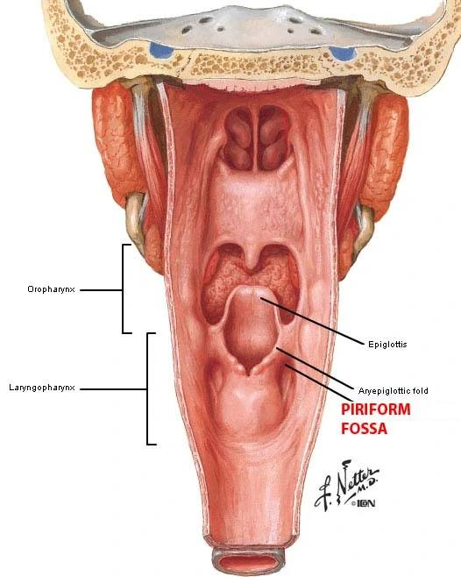
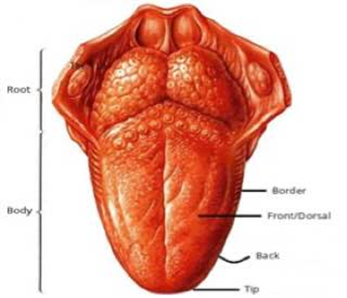

Slide 19
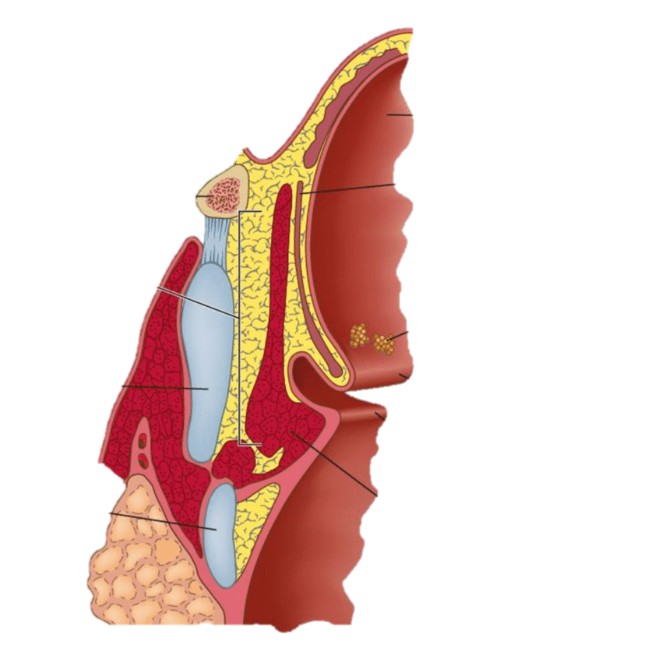
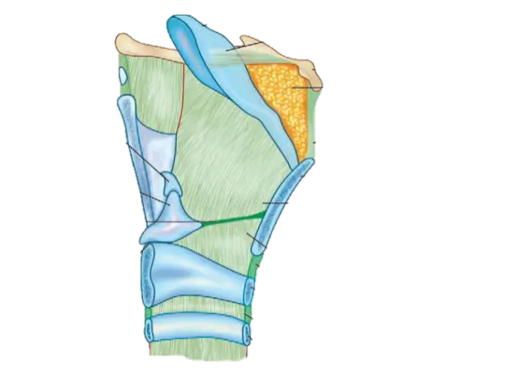
Pre epiglottic space involvement
(through foramen in infrahyoid epiglottis)
Para glottic space involvement
(through mucosa of the ventricle)

Slide 20
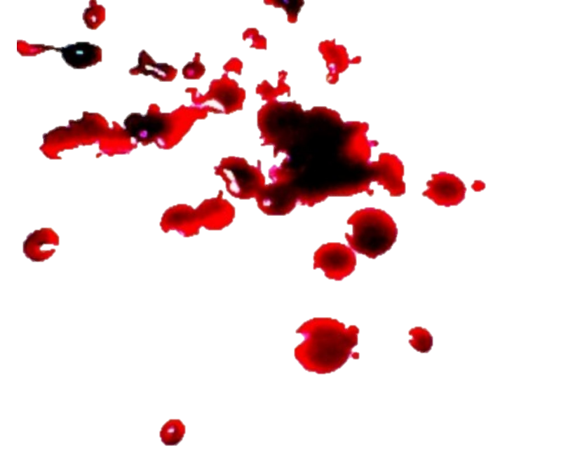
Clinical manifestation :
Aspiration on swallowing
Soar throat
Dysphagia
Neck masse
Hemoptysis
Dyspnea
Pain in the throat referred to the ear

Slide 21
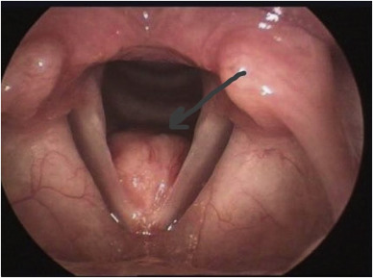
3- Subglottic (rare)
Spread → anterior wall
to the opposite side
downwards to the trachea
May invade → cricothyroid membrane / thyroid gland / muscles of the neck
Paratracheal LN involved
Symptoms
- Stridor (the earliest presentation)
- Hoarseness (late symptom because upward spread to the vocal cord is late)

Slide 22
3- Subglottic (rare)
Spread → anterior wall
to the opposite side
downwards to the trachea
May invade → cricothyroid membrane / thyroid gland / muscles of the neck
Paratracheal LN involved
Symptoms
- Stridor (the earliest presentation)
- Hoarseness (late symptom because upward spread to the vocal cord is late)

Slide 23
Clinical manifestation :
Airway obstruction
Dysphagia
Weight loss
Hemoptysis

Slide 24
What hoarseness of voice indicates ?
Spread of the disease to undersurface of vocal cords
Infiltration of thyroarytenoid muscle
Involvement of recurrent laryngeal nerve

Slide 25
Diagnosis

Slide 26
Diagnosis Evaluation
History
Physical examination
Laryngoscopy
Endoscopy
Biopsy
CT scan and MRI
Barium swallow

Slide 27
History
Different types symptoms

Slide 28
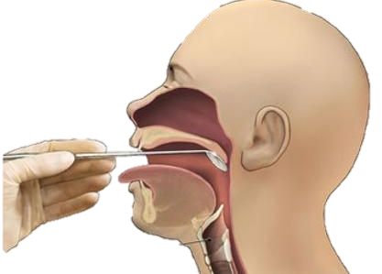
Indirect laryngoscopy
Why we do indirect laryngoscopy ?
A- to see the appearance of lesion
B- Vocal cord mobility
(fixation of vocal cords indicate deeper infiltration)
C- Extent of the disease

Slide 29
Direct laryngoscopy
Why we do direct laryngoscopy ?
A- to see the hidden areas of larynx
B- Extent of the disease
C- To take biopsy

Slide 30
Neck Examination
To find extra laryngeal spread
and
nodal metastasis

Slide 31
Radiography
Chest X Ray
Essential for co-existent lung disease , pulmonary metastasis and mediastinal nodes
CT Scan
Useful investigation to find the extent of the tumor , invasion of pre and para epiglottic space , destruction of cartilage and lymph node involvement

Slide 32
Micro-laryngoscopy
“For smaller lesion”
Laryngoscopy + Microscope → for better visualization

Slide 33
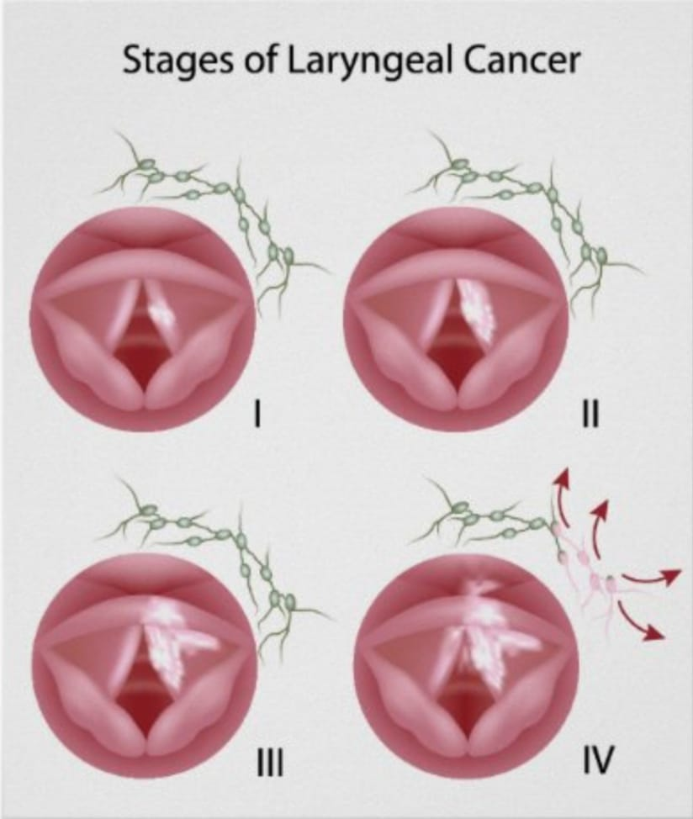
Staging and Management of Laryngeal Cancer

Slide 34
TNM Staging

Slide 35
TNM Staging

Slide 36
TNM Staging

Slide 37
TNM Staging

Slide 38
TNM Staging

Slide 39
Cancer Staging

Slide 40
Management
Carcinoma in situ : Laser surgery.
Early laryngeal cancer ( Stage I and Stage II) : Radiation or Surgery ( both have 85-95% cure rate).
Advanced laryngeal cancer ( Stage III and Stage IV) : Total laryngectomy +/- Chemoradiotherapy.

Slide 41
Total laryngectomy
Indications:
Advanced laryngeal cancer with extensive cartilage destruction and extra laryngeal spread.
Involvement of posterior commissure with both arytenoids.
Completion procedure after failed partial laryngectomy/irradiation.
Severe aspiration following partial/near total laryngectomy.
Massive nodal metastasis.

Slide 42
MANAGEMENT OF NODAL METASTASES
For early laryngeal cancer, the risk of metastasis, especially for glottic cancer, is negligible. Therefore, the nodal basins are not treated electively.
In advanced laryngeal cancer, there is high risk of occult nodal metastases, of up to 60 %, esp. when supraglottis is involved. Therefore, in the N0 neck, the primary nodes are treated electively either by radiotherapy or surgery.
For the N1 neck, if treatment of primary is by surgery, then treatment is by selective II-IV neck dissection, followed by chemo radiotherapy where appropriate.
If the primary is treated by chemo radiotherapy, then the treatment of the nodal metastases can also be performed by chemo radiotherapy followed by assessment of neck.

Slide 43
MANAGEMENT OF NODAL METASTASES
In advanced nodal disease ( N2 or N3 ), if the primary treatment is being treated by surgery then a MRND should be performed with consideration of postoperative radiotherapy or chemo radiotherapy.
If the primary treatment is being treated by chemotherapy, further treatment is controversial. The options are neck dissection or Chemoradiotherapy followed by PET scan.
Notes :
RND ( Radical neck dissection): Removal of
The 6 levels of LNs.
Spinal accessory nerve .
Internal jugular vein .
Sternocleidomastoid.
RND is not done anymore and replaced by MRND or SND.
MRND ( Modified radical neck dissection) : Removal of
The 6 levels of LNS while preserving atleast one of the non-lymphatic tissue (Spinal accessory nerve or Internal jugular vein or SCM).
SND (selective neck dissection): Removal of one level or sublevel of LNs , with the aid of sentinel lymph node biopsy.

Slide 46
Morbidity
Functional alterations following total Laryngectomy:
Loss of smell.
Changes in normal swallowing mechanism.
Changes in the pattern of respiration due to permanent tracheostomy.
Most importantly Loss of speech.

Slide 47
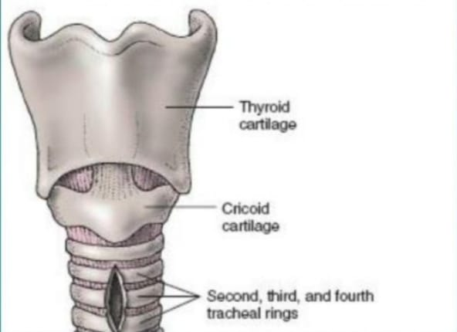
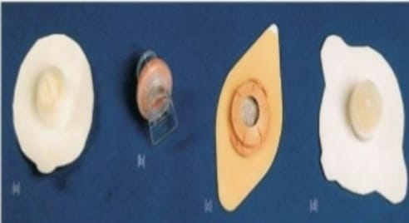
Tracheostomy
Heat moisture exchange devices

Slide 48
Voice rehabilitation

Slide 49
Esophageal speech

Slide 50
Esophageal speech
Physiology :
Air is swallowed into cervical esophagus.
The swallowed air is expelled out causing vibrations of pharyngeal mucosa.
These vibrations along with articulations of tongue cause speech to occur.
The exact vibrating portion of pharynx is the pharyngoesophageal segment.
The vibrating muscles and mucosa of cervical esophagus cause speech.
Cricopharyngeal spasms can lead to failure in developing esophageal speech in these patients , Cricopharyngeal myotomy may help these patients in developing esophageal speech.

Slide 51
Esophageal speech
Advantages:
Patient’s hands are free.
No additional surgery /prosthesis needed , hence no extra cost for the patient.
Patients get easily adapted to esophageal voice.
Disadvantages:
Nearly 40% of pts fail to develop esophageal speech.
Quality of voice generated is rather poor.
Patients will be able to speak only in short bursts.
Significant training is necessary.
Loudness/pitch control is difficult.

Slide 52
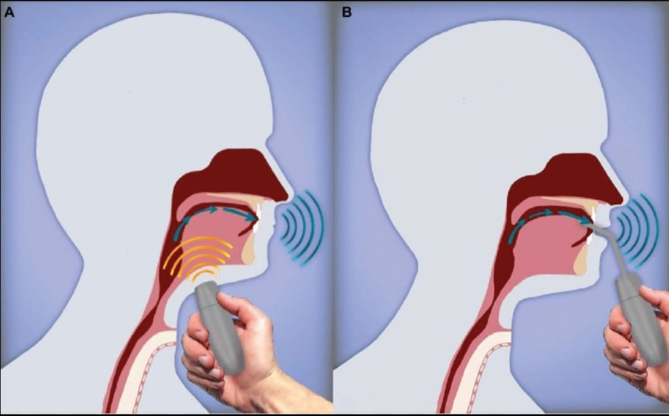
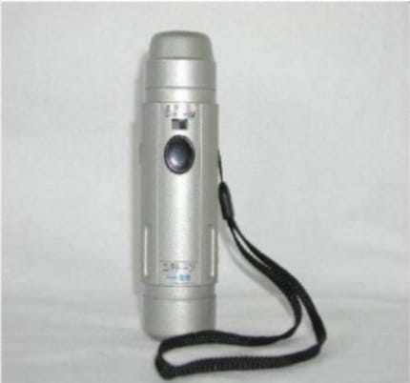
Electrolarynx

Slide 53
Electrolarynx
These are battery operated vibrating devices.
It is held in the submandibular region.
Muscle contraction and changes in facial muscle tension causes rudiments of speech.
Initial training to use this equipment should begin even before surgery.
Two types:
External /neck , which is commonly used.
Intraoral type.

Slide 54
Electrolarynx
Advantages:
Can be easily learnt.
Immediate communication is possible.
Additional surgery is avoided.
Can be used as interim measure till the patient masters the technique of esophageal speech or gets TEP inserted.
Disadvantages:
Expensive to maintain.
Speech generated is mechanical in quality.
Difficult while speaking over telephone.

Slide 55
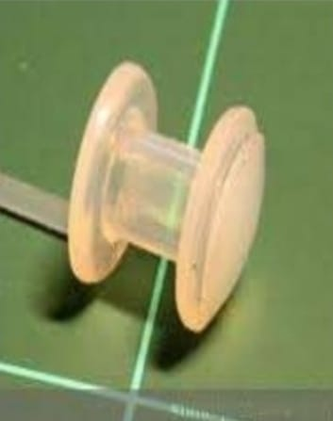
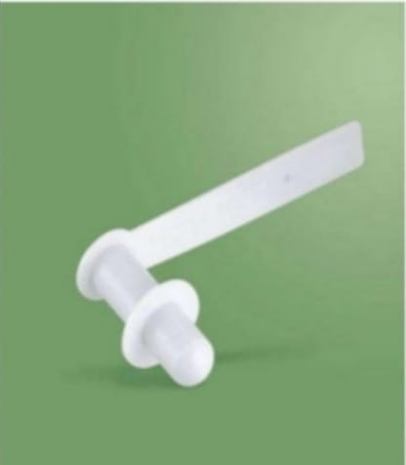
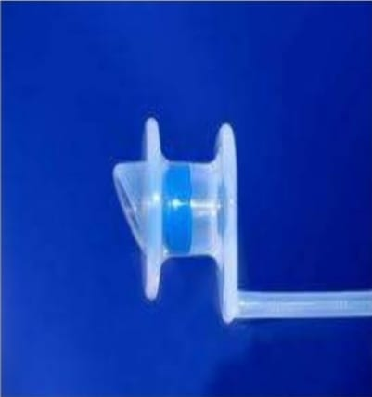
Shunts

Slide 56
Shunts
Involves creation of shunt (Fistula) between trachea and esophagus.
Basic aim : to divert air from the trachea into the esophagus.
Causes of failure :
Aspiration through the fistula.
Closure of the fistula.
To avoid these problems , prosthesis was introduced .
One way silicone valve is introduced via the fistula.
This valve served as one way conduit for air into esophagus while preventing aspiration.
This prosthesis has two flanges , one enters the esophagus while the other rests on the trachea.

Slide 57
Shunts
Advantages:
Can be performed after laryngectomy /irradiation/chemotherapy/neck dissection.
Fistula can be used for esophago-gastric feeding during immediate PO period.
Easily Reversable.
Speech develops faster than esophageal speech.
Closely resembles laryngeal speech.
Disadvantages:
Patient should manually cover the stoma during voicing.
Good pulmonary reserve is a must.
Additional surgical procedure is needed to introduce it.
Dislodgement may happen accidentally.

