Slide 1
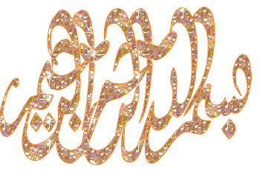

Slide 2
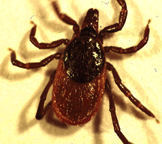
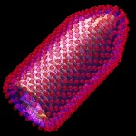
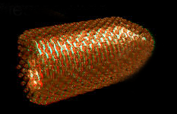
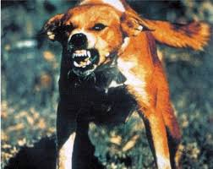
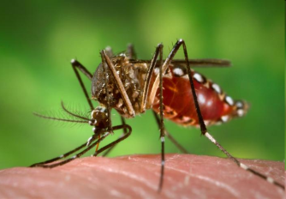
RABIES – ARBOVIRUSES
&
PRION
By:
Prof. Dr. Ghada Fahmy Helaly
Microbiology Department
Faculty of Medicine
Mu’tah University
NS II Module

Slide 3
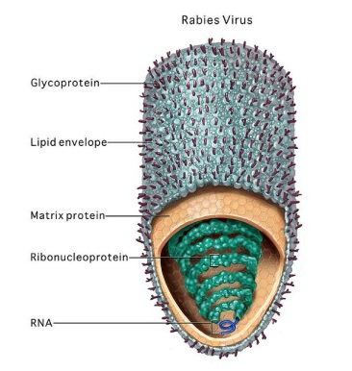
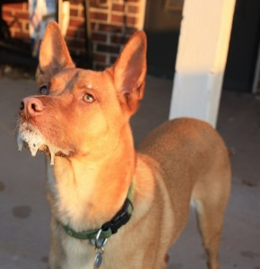
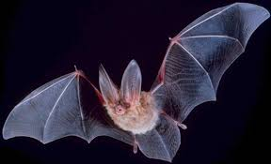
RABIES
Characteristics:
Bullet-shaped capsid - lipoprotein envelope - ssRNA, negative polarity- RNA polymerase in the virion. single serotype.
Transmission:
Bite of a rabid animal such as dogs and cats.
“Non-bite” exposure: Exposure to aerosols of bat secretions containing rabies virus.

Slide 4
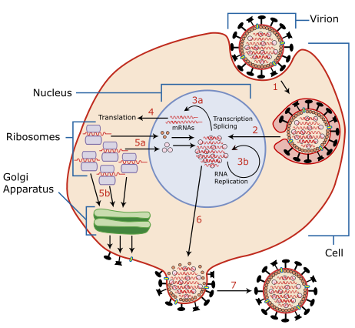
Replication Cycle and Pathogenesis:

Slide 5
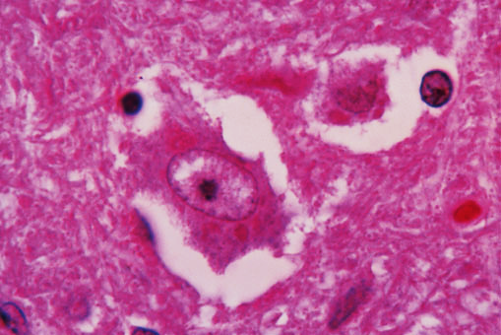
After replication in the brain the virus migrates to the salivary glands→ saliva.
There is no viremic stage.
Infected neurons contain cytoplasmic inclusion called a Negri body.
Rabies virus - Negri body.

Slide 6
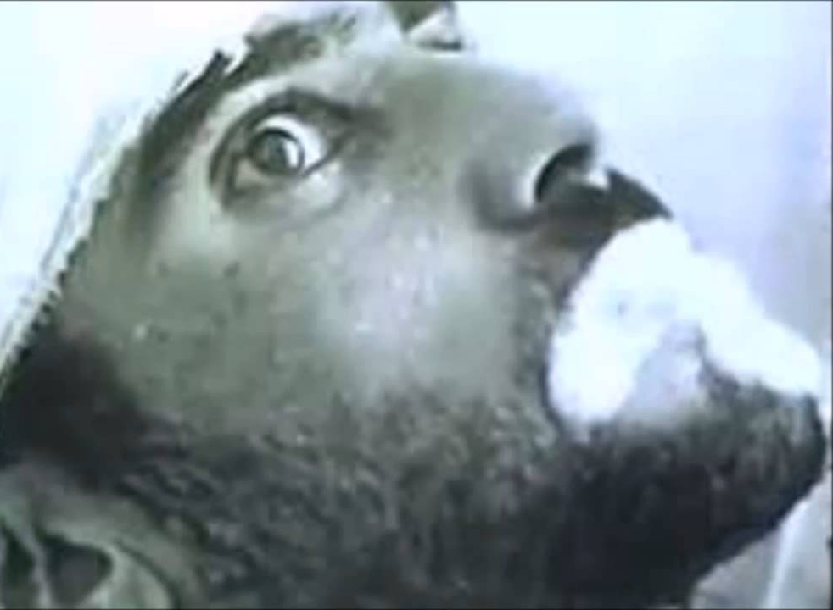
Clinical Findings:
The incubation period: 20–90 days.
Earliest symptom: Neuritic pain at bite site.
• The clinical spectrum can be divided into three phases:
Short prodromal phase.
Acute neurologic phase: Encephalitic (Hydrophobia, ….) or dumb rabies.
Coma and death: 14 days (encephalitic) and 30 days (dumb rabies).

Slide 7
Laboratory Diagnosis:
Epidemiology and clinical findings.
Rabies antigen detection: Direct IF test.
Viral Isolation.
Antibody detection.
RT-PCR.
Negri body detection: post mortem diagnosis of rabies.

Slide 8
Treatment:
no antiviral therapy
Prevention:
Pre-exposure: inactivated vaccine human diploid cell vaccine (HDCV)]. only for high-risk groups, three doses on day 0, 7, 28 days and booster every 2 years.
Post-exposure:
Washing the wound.
Immune serum (RIG)
Inactivated vaccine. Five doses of HDCV are given (on days 0, 3, 7, 14, and 28), and booster at 90 days.

Slide 9
Arboviruses
Arthropod-borne viruses.
Transmitted by arthropods, primarily mosquitoes and ticks from the wild animal reservoir to humans.
> 400 viruses. Named (disease, place…)
Transmission
These viruses multiply in both the vertebrate host and the bloodsucking vector (female).

Slide 10
The virus must be present in the bloodstream of the vertebrate host (viremia) in sufficiently high titer.
The virus replicates in the gut of the arthropod → salivary glands.
The extrinsic incubation period ranges from 7 to 14 days. Vertical “trans-ovarian” passage from the mother tick to her offspring.
Humans are dead-end hosts, or reservoir (e.g., yellow fever and dengue),
No disease either in the arthropod vector or in the vertebrate animal (natural host).

Slide 11
Clinical Findings & Epidemiology:
Tropics , temperate zones,….
mild to rapidly fatal.
The clinical picture usually fits one of three categories:
Encephalitis;
Hemorrhagic fever;
Fever with myalgias, arthralgias, and non- hemorrhagic rash.
Pathogenesis :
Cytocidal , immunopathologic .
Immunity is usually lifelong.

Slide 12
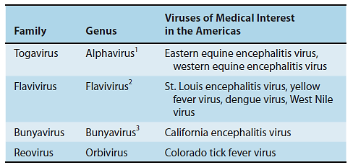
Classification of Major Arboviruses

Slide 13
Virus | Vector | Host(s) | Disease | Diagnosis | Prevention
West Nile virus (flavivirus) | Mosquito (Culex) | Birds | Encephalitis | isolation of the virus detection of antibodies. PCR-based assays | Vector control
Dengue (flavivirus) | Mosquito (Aedes) | Humans (monkeys) | Classic dengue: Break bone fever (rash, muscle and joint pain), reinfection, can result in dengue hemorrhagic shock | As above | Vector control
Yellow Fever Virus (flavivirus) | Mosquito (Aedes) | Humans (monkeys) | Yellow fever( Jungle and Urban) | As above | Vector control/ live, attenuated vaccine
CHIKUNGUNYA VIRUS Togavirus | Mosquito (Aedes) | Humans (monkeys) | Chikungunya feverof high fever and joint pains. A macular or maculopapular rash | As above | Vector control

Slide 14
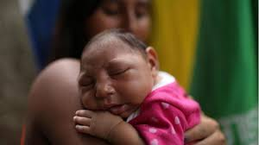
ZIKA VIRUS (Flavivirus):
Zika virus current outbreak began in April 2015 in Brazil.
Transmission:
• Mosquito borne.
• Mother-to-child transmission
• Sexual transmission
Clinical Manifestations:
• IP: few days to 1 week
• Majority Asymptomatic
• fever, rash and conjunctivitis.
• Microcephaly
• Guillain-Barré syndrome
Lab Diagnosis:
• IgM ELISA, RT-PCR,….
Treatment : Symptomatic.
Prevention: protection from mosquito bite, prevent sexual transmission (condom).

Slide 15
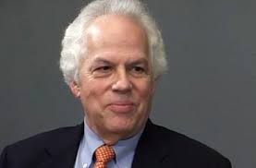
Prions
In 1982, Stanley Prusiner: Scrapie was caused by proteinaceous infectious particles, or prions. which is resistant to inactivation by most procedures that modify nucleic acids.
Nobel Prize in Physiology or Medicine in 1997.
A prion is a misfolded rogue form of a normal protein (PrPc) found in the cell. This rogue prion protein (PrPsc) can be infectious, stimulating other endogenous normal proteins to become misfolded, forming plaques.

Slide 16
prions and conventional viruses
Feature | Prions | Conventional viruses
Nucleic acid | No | Yes
Proteins | Yes, encoded by cellular genes | Yes, encoded by viral genes
Inactivation | No | Yes
Electron microscope | Filamentous rods (Amyloid like) | Icosahedral or helical
Antibodies | No | Yes
inflammation | No | Yes

Slide 17
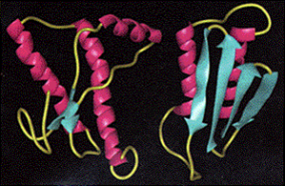
PrP^{C} | PrP^{Sc}
Sensitive to Proteolysis | Resistant to proteolysis
Associated with cellular membrane | Located within the cell as aggregates
Mainly alpha helical structure | Mainly beta sheet structure
Prions cause various forms of transmissible spongiform encephalopathy (TSE) in human and animals.

Slide 18
Transmissible Spongiform Encephalopathies (TSEs) in Humans
Disease | Mechanism(s) of Transmission
Sporadic CJD (sCJD) | Possibly by alteration of normal prior protein (PrP) to rogue form due to somatic mutation.
Variant CJD (vCJD) | Eating contaminated cattle products.
Familial CJD (fCJD) | Mutation in germline PrP gene.
Iatrogenic CJD (iCJD) | Contaminated neurosurgical instruments, corneal graft, gonadotrophic hormone, and, blood transfusion.
Kuru | Eating infected meat through ritualistic cannibalism.
Gerstmann-Straussler- Scheinker disease (GSS) | Mutation in germline PrP gene.
Fatal familial insomnia (FFI) | Mutation in germline PrP gene.
Transmissible Spongiform Encephalopathies (TSEs) in Humans
Disease Mechanism(s) of Transmission[10]
Sporadic CJD (sCJD) Not known; possibly by alteration of normal prior protein (PrP) to rogue form
due to somatic mutation
Variant CJD (vCJD) Familial CJD (fCJD) Mutation in germline PrP gene
Iatrogenic CJD (iCJD) Contaminated neurosurgical instruments, corneal graft, gonadotrophic
hormone, and, secondarily, by blood transfusion
Kuru Eating infected meat through ritualistic cannibalism
Gerstmann-Straussler-
Scheinker disease (GSS)
Mutation in germline PrP gene

Slide 19
TSEs in animals include mad cow, scrapie (in sheep and goats), and chronic wasting disease (in elk and deer).
Currently, there is no treatment or cure for TSE disease, and contaminated meats or infected animals must be handled according to certain guidelines to prevent transmission.

