Slide 1
Kyphosis

Slide 3
Normal lordosis is the two forward curves seen in the neck (cervical spine) and low back (lumbar spine).
Normal kyphosis is the two backward curves seen in the chest (thoracic spine) and hip areas (sacral spine).
Each of the naturally occurring and normal soft curves serves to distribute mechanical stress incurred as the body is at rest and during movement.

Slide 4
Definition
Abnormal forward bending of spine.
Excessive dorsal curvature ( hyperkyphosis), kyphos or gibbus due to localized collapse or wedging of one or more vertebrae . It can result from degenerative diseases such as arthritis; developmental problems, most commonly Scheuermann's disease ; osteoporosis with compression fractures of the vertebra ; multiple myeloma or trauma

Slide 5
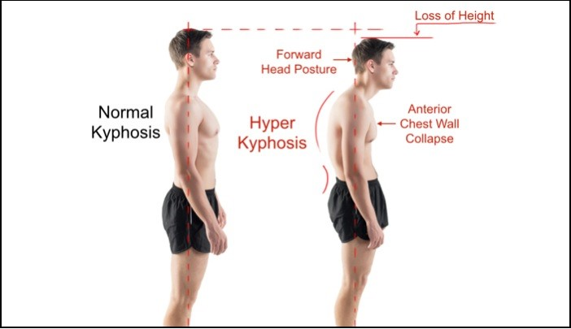

Slide 6
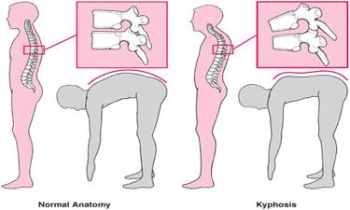
Examination

Slide 7
Types :
Postural Kyphosis:
This is the most common form of kyphosis .
Caused by poor posture .
Usually occurs in adolescents .
F>M .
In most cases, this type of kyphosis can be corrected with physical therapy and exercise, and doesn’t require any medical treatment.
May be associated with other postural defects such as flat-feet .

Slide 9
Types (Cont.)
Congenital kyphosis
A) failure of formation (type 1)
B) failure of segmentation (type 2)
Adolescent kyphosis (Scheuermann’s disease)

Slide 10
Congenital Kyphosis:
This is the rarest form of kyphosis.
- Congenital kyphosis (found at birth) is caused by abnormal development of the vertebrae before birth, and can cause vertebrae to fuse together.
- Surgery is usually recommended when kyphosis affects an infant, and can help treat the disorder before it worsens.

Slide 11
There are two basic types of congenital kyphosis: 1.Failure of formation
2.Failure of segmentation.
1.The failure of formation (Type I deformity) : of a portion of one or more vertebral bodies most often occurring in the thoracolumbar spine, results in a kyphosis that usually worsens with growth .
The deformity is usually visible at birth as a lump or bump on the infant's spine..

Slide 12
2.The failure of segmentation deformity (Type II deformity) : occurs as two or more vertebrae fail to separate and to form normal discs and rectangular bones. This type of congenital kyphosis is often more likely to be diagnosed later, after the child is walking

Slide 13
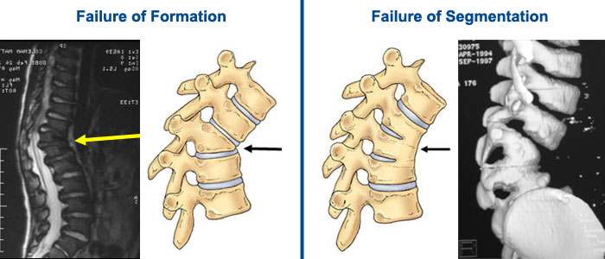

Slide 14
Treatment
Congenital kyphosis :
Treated by surgical intervention.

Slide 15
Adolescent kyphosis (Scheuermann’s disease)
‘Developmental ’ disorder in which there
is abnormal ossification (and possibly some
fragmentation) of the ring epiphyses.
As a consequence these cartilaginous end-plates are weaker than normal and the affected vertebrae in the thoracic spine (which is normally mildly kyphotic) may
give way slightly and become wedge shaped.
If this happens, the normal kyphosis is exaggerated.

Slide 16
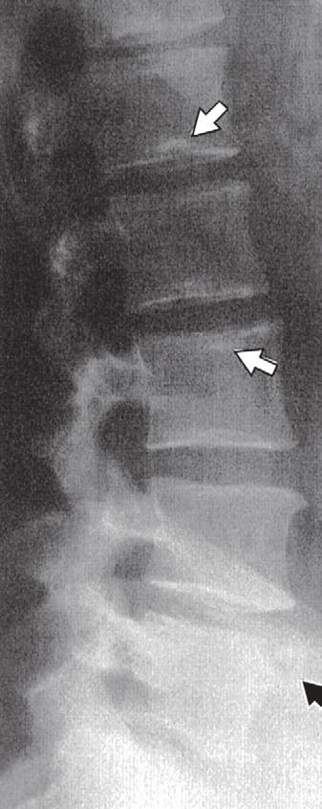
Sometimes there may also be small central herniations of disc material into the vertebral body; these are called Schmorl’s nodes .

Slide 17
No discrepancy on x-ray
So we need MRI

Slide 20
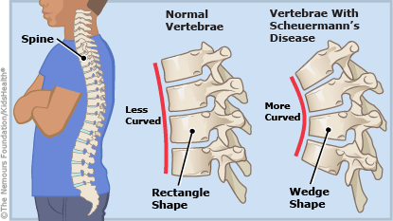
Exaggeration of the normal thoracic ‘rounding’ of the back, in this case due to Scheuermann’s disease

Slide 21
Thoracic Scheuermann’s disease
M>F
Starts at or shortly after puberty .
The patient may complain of backache and fatigue.

Slide 22
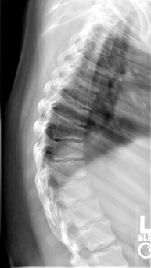
X-ray features are typical: in the lateral views one can see patchiness or irregularity of the vertebral end-plates and, in some cases, Schmorl’s nodes at several intervertebral levels. Later, the vertebral bodies become noticeably wedge shaped.

Slide 23
Managment
- physical therapy and mild pain medications most of the time.
- If the patient is still growing and the spine curve measures 45-degrees, a brace is recommended .
- Kyphotic spinal curves that measure greater than 75-degrees may require surgery to treat the deformity and stabilize the spine.

Slide 24
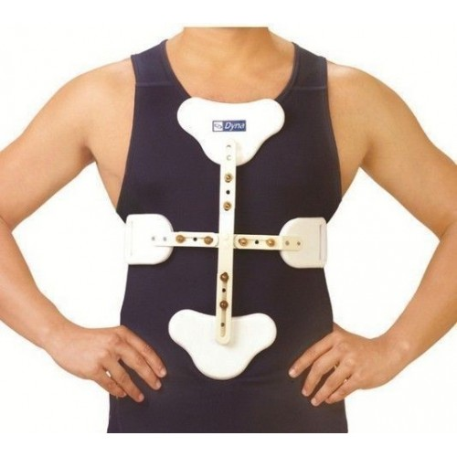
Extension brace worn for 1 year or 18 months

Slide 25
Thoracolumbar Scheuermann’s disease
less common
Late adolescence or early adulthood .
Usually presents as : low back pain with no local deformity
X-ray changes are similar to those seen in the thoracic spine, but with little or no vertebral wedging.

Slide 26
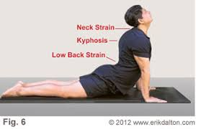
back-strengthening exercises

Slide 27
Complications
Body image problems
Back pain
Breathing difficulties
Numbness or weakness in arm , leg
Loss of normal bladder or bowel control (urinary incontinence)

Slide 28
Surgical Treatment
The goal of surgery is to correct the deformity and remove any neural compression .
The correction can be done anteriorly, posteriorly, or both
Posterior surgery is most commonly described and performed.
Posterior arthrodesis for kyphosis can be an extensive operation, with many spinal segments typically included in the fusion mass. This procedure is most helpful for long, sweeping, flexible curves.
In cases of rigid deformity, osteotomies can be performed to improve the correction as : Smith-Peterson osteotomy, pedicle subtraction osteotomy, and vertebral column resection .

Slide 29
Surgeical Tx (Cont.)
Anterior surgery :
Anterior surgery can include single or multiple diskectomies to increase the flexibility of the spine, followed by a posterior arthrodesis .
The transthoracic approach allows for decompression of the neural elements before the spine is corrected with posterior instrumentation.
Anterior-only fusion is most useful in relatively short and focal kyphosis, such as posttraumatic or postinfectious kyphosis .

