Slide 1
Upper limb lecture two
Claviopectrol fascia
Axilla

Slide 2
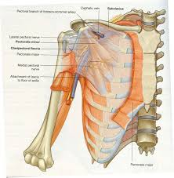
Clavipectoral fascia
clavipectoral fascia→ (costocoracoid membrane; coracoclavicular fascia)
The clavipectoral fascia is a thick, bilateral deep fascia--→ deep to the clavicular portion of the pectoralis major.

Slide 3
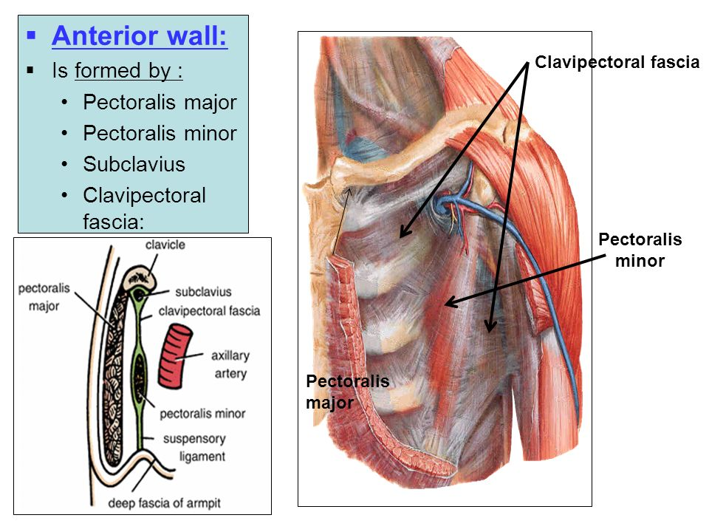
Clavipectoral Fascia
The clavipectoral fascia is a strong sheet of connective
tissue that is attached above to the clavicle Below, it splits to enclose the pectoralis minor muscle and then continues downward as the suspensory
ligament of the axilla and joins the fascial floor of the armpit.

Slide 4
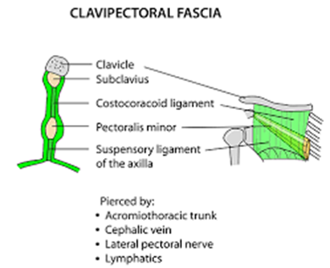
Border
Superiorly: extends from the clavicle,
Medially: from the costochondral joints
Superolaterally: from the coracoid process.
Insertion: The fascia converges in the AXILLA.
Function: it acts as a protective structure over the neurovascular structure of the axilla.

Slide 5
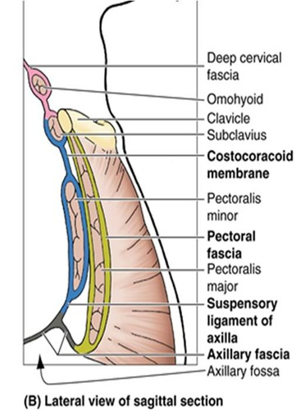
Clavipectoral fascia
Upper part thick – Costocoracoid ligament
continues downward as the suspensory
ligament of the axilla

Slide 6
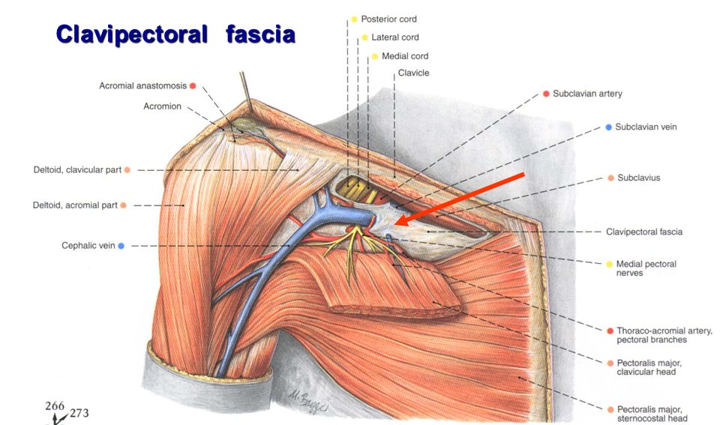
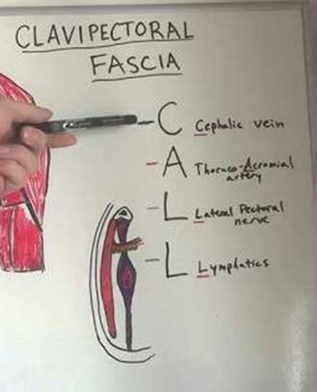
Clavipectoral fascia
Pierced by
– Lateral pectoral nerve
– Cephalic vein
– Thoraco acromial vessels
– Lymphatics from breast and pectoral region to apical group of lymph node

Slide 7
AXILLA
A pyramid-shaped space between the upper part of the arm and the side of the chest through which major neurovascular structures pass between neck & thorax and upper limbs.
Axilla has an apex, a base and four walls.

Slide 8
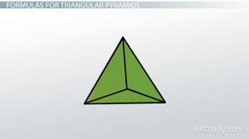
Boundaries of the Axilla
scapula
Apex:
Is directed upwards & medially to the root of the neck.
It is called
Cervicoaxillary canal.
It is bounded, by 3 bones:
Anteriorly: Clavicle posteriorly: Upper border of the scapula.
Medially: Outer border of the first rib
1
C
L
A
R
I
B
V
I
C
L
E

Slide 9
Anterior wall:
Is formed by :
Pectoralis major
Pectoralis minor
Subclavius
Clavipectoral fascia:
Clavipectoral fascia
Pectoralis minor
Pectoralis major

Slide 10
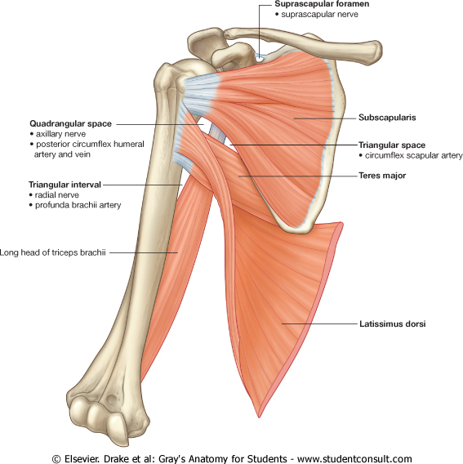
Posterior wall:
Is formed by:
Subscapularis.
Latissimus dorsi.
Teres major muscles.

Slide 11
The medial wall:
It is wide and formed by:
Serratus anterior.
Upper 4-5 ribs & Intercostal muscles .
The lateral wall:
It is narrow and formed by:
Coracobrachi-alis.
Biceps brachii.
Bicepital groove of the humerus.

Slide 12
Contents of The Axilla
Axillary a. & v.
Cords and braches of the brachial plexus
Axillary artery and its branches.
Axillary vein and its tributaries.
Axillary lymph nodes.
Axillary fat.
Loose connective tissue.
Brachial plexus
The neurovascular bundle is enclosed in connective tissue sheath, called ‘axillary sheath’

