Slide 1
Pathology lab
28-12-2022

Slide 2
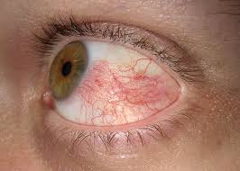
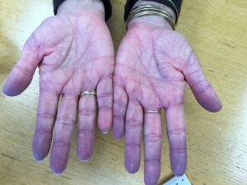
Hyperemia
Congestion

Slide 3
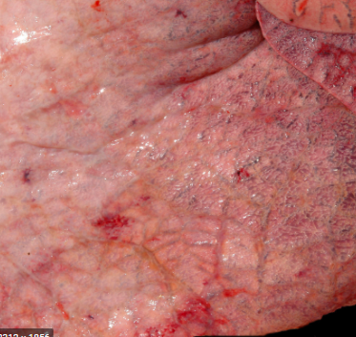
LUNG CONGESTION Cut surfaces of hyperemic or congested tissues feel wet and typically ooze blood

Slide 4
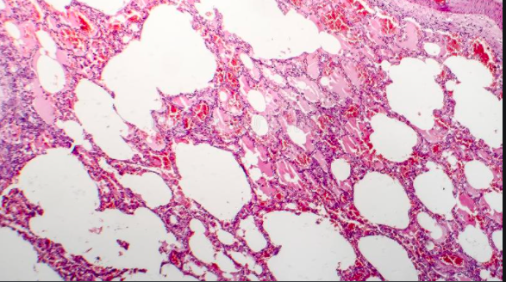
acute pulmonary congestion is marked by blood-engorged alveolar capillaries and variable degrees of alveolar septal edema and intraalveolar hemorrhage

Slide 5
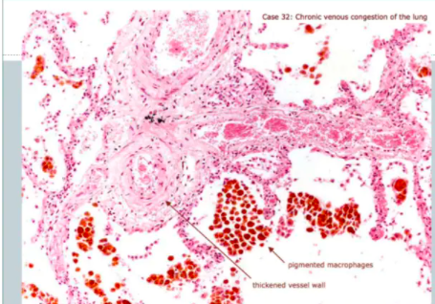
chronic pulmonary congestion, the septa become thickened and fibrotic, and the alveolar spaces contain numerous macrophages laden with hemosiderin (“heart failure cells”) derived from phagocytosed red cells.

Slide 6
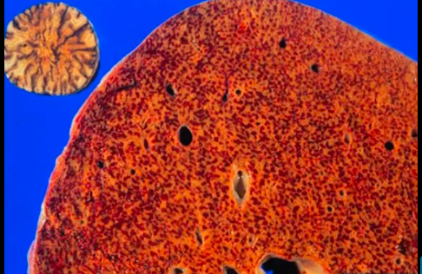
HEPATIC CONGESTION

Slide 7
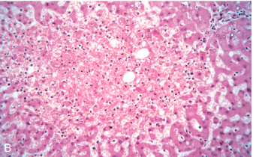
centrilobular hepatocyte necrosis. Hemorrhage. hemosiderin-laden macrophages

Slide 8
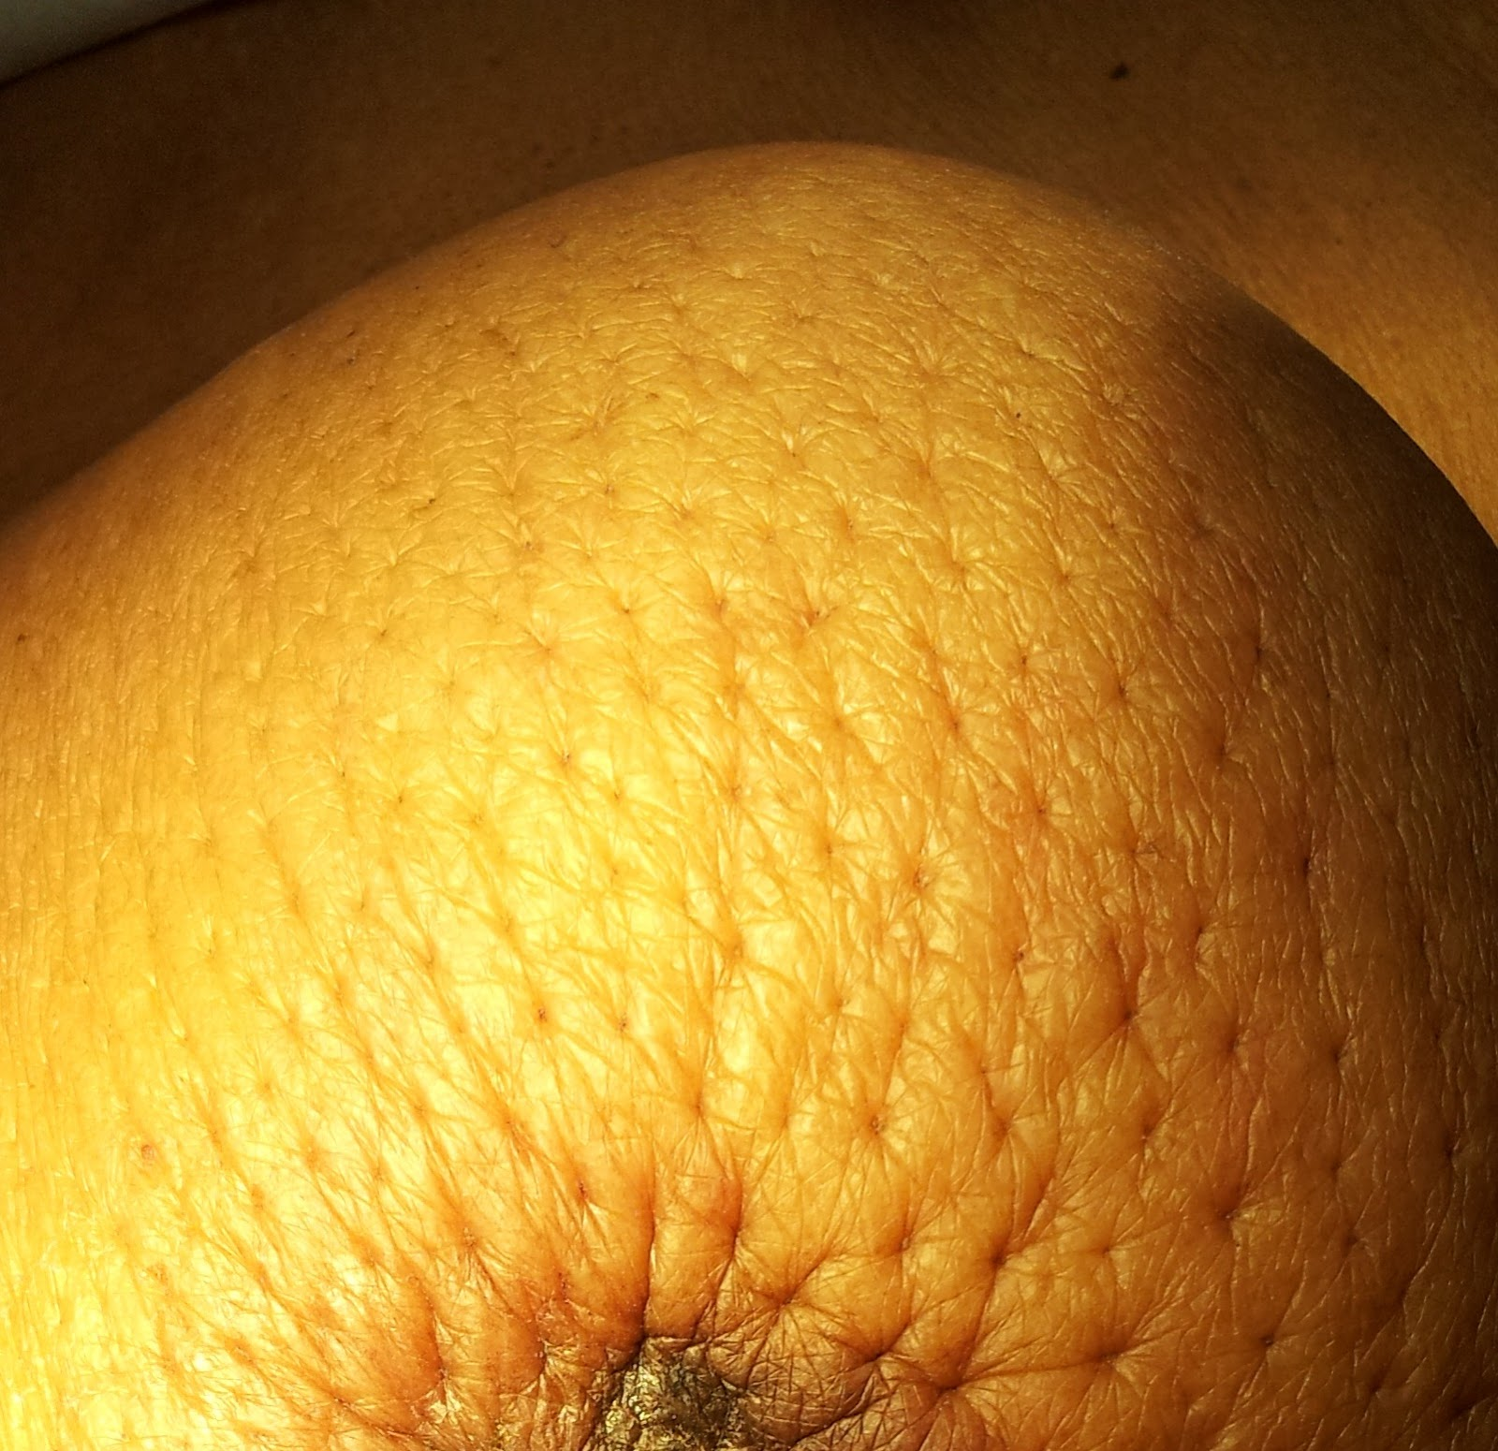
peau d’orange caused by Infiltration and obstruction of superficial lymphatics by breast cancer

Slide 9
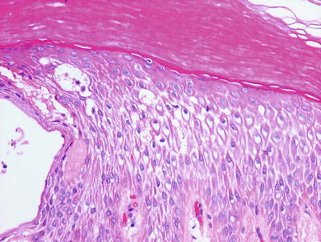
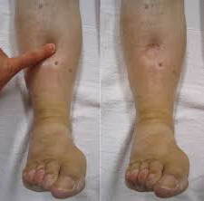
microscopic examination:
1.skin : clearing and separation of the extracellular matrix
Subcutaneous edema can be diffuse but usually accumulates preferentially in the legs with standing and the sacrum with recumbency, a relationship termed dependent edema.
Finger pressure over edematous subcutaneous tissue displaces the interstitial fluid, leaving a finger-shaped depression; this appearance is called pitting edema

Slide 10
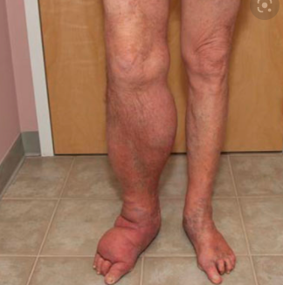
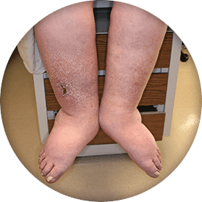
Edema is easily recognized on gross inspection;

Slide 11
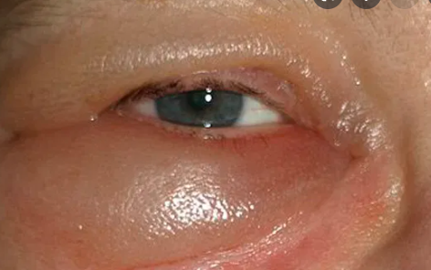
Edema resulting from renal dysfunction or nephrotic syndrome often manifests first in loose connective tissues (e.g., the eyelids, causing periorbital edema).

Slide 12
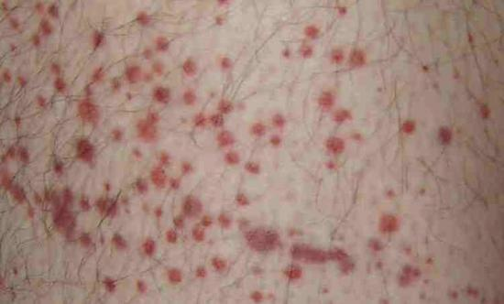
Petechiae : are minute (1 to 2 mm in diameter) hemorrhages into skin, mucous membranes, or serosal surfaces .

Slide 13
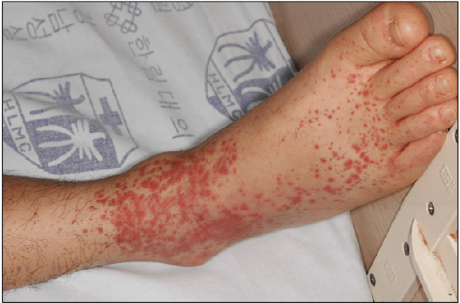
Purpura are slightly larger (3 to 5 mm) hemorrhages.

Slide 14
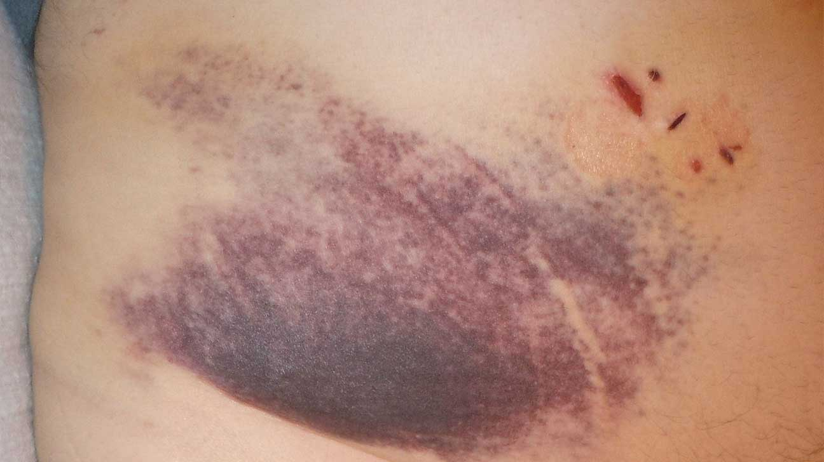
Ecchymoses: are larger (1 to 2 cm) subcutaneous hematomas (also called bruises).

Slide 15
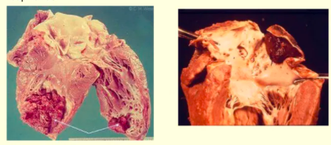
Mural thrombi: Thrombi occurring in heart chambers or in the aortic lumen

Slide 16
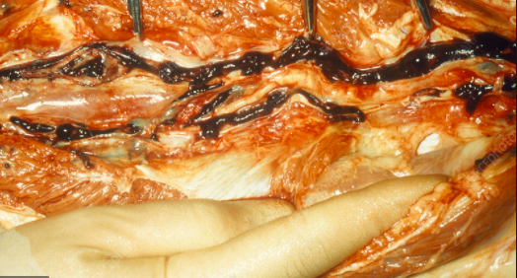
Venous thrombi (phlebothrombosis):

Slide 17
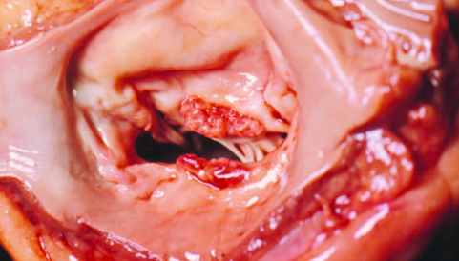
Cardiac Vegetations

Slide 18
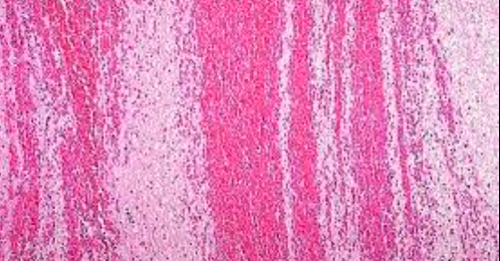
lines of Zahn

Slide 19
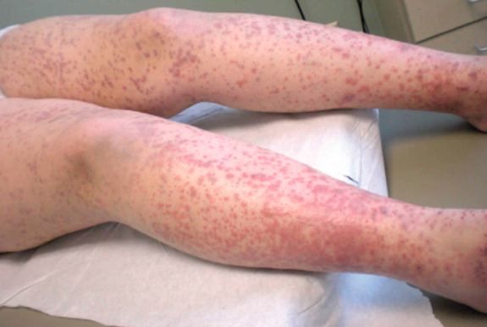
DIC

Slide 20
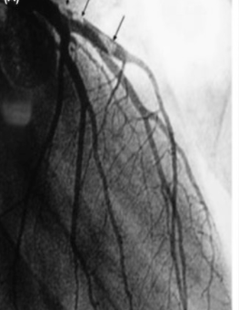
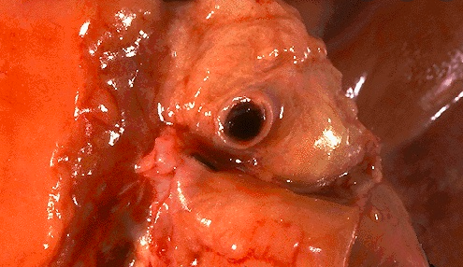
thrombosis of a coronary artery
Massive thrombosis (arrows) from distal portion of left main coronary artery

Slide 21
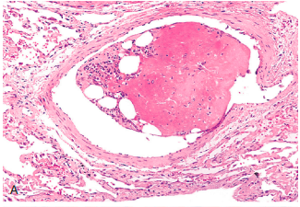
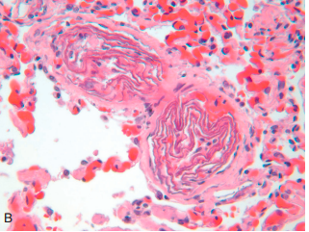
Bone marrow embolus
Amniotic fluid emboli

Slide 22
DVT

Slide 23
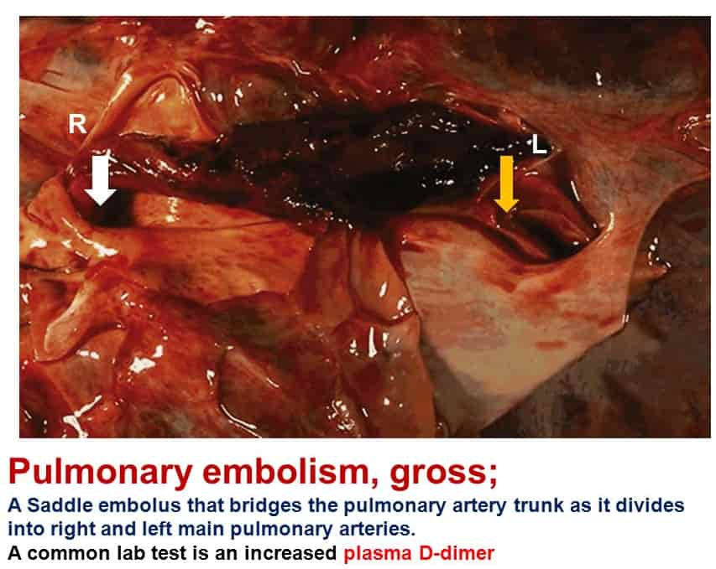

Slide 24
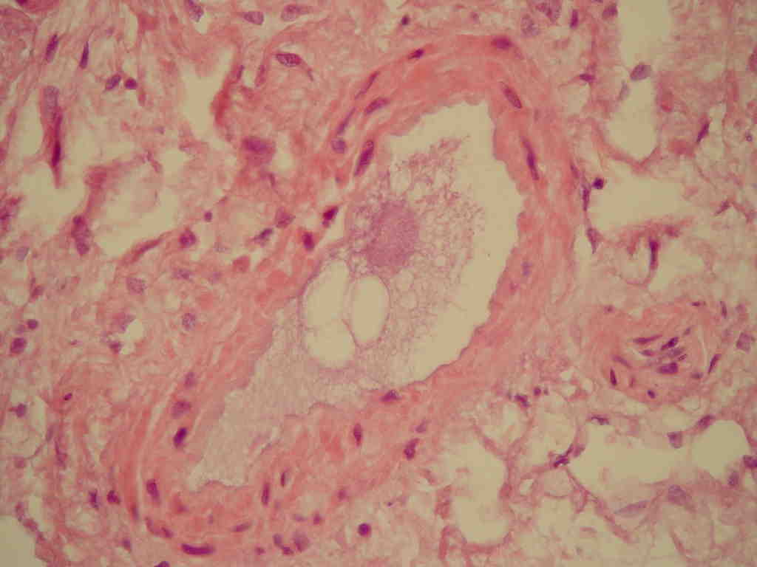
Fat Embolism

Slide 25
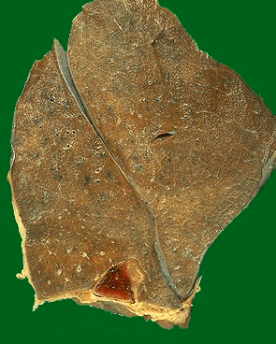
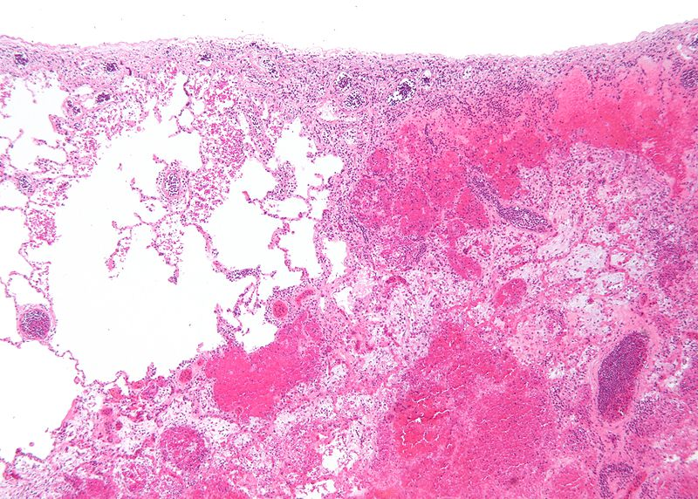
Red infarction
1.Necrosis of alveolar walls - loss of nuclei.
2.Alveolar hemorrhage.
classic wedge-shaped infarct

Slide 26
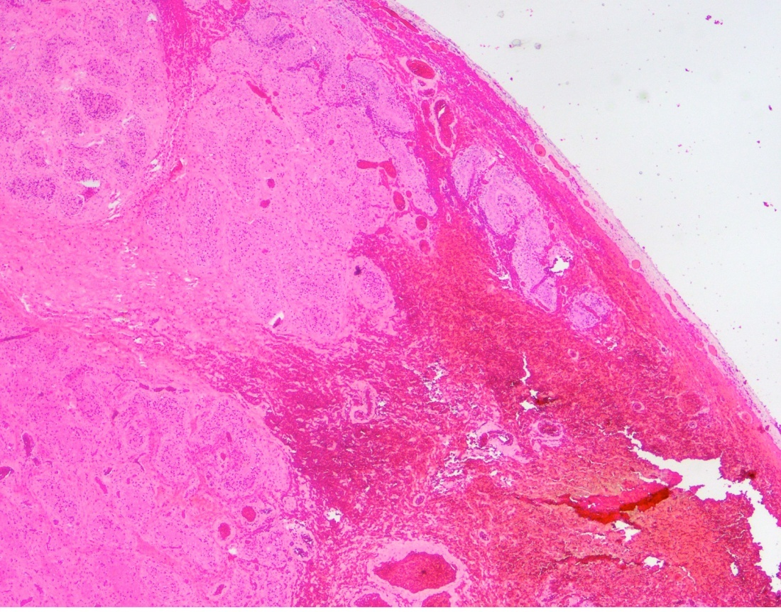
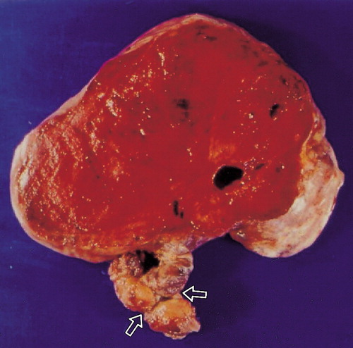
Red infarction
dark brown, ovarian mass with a twisted, thickened left fallopian tube (arrows).
Hemorrhage and necrosis

Slide 27
white infarction

