Slide 1
Body fluid
Dr .Arwa Rawashdeh

Slide 2
Objectives
Total blood volume
Tonicity
Oncotic or colloid osmotic pressure
osmolarity

Slide 3
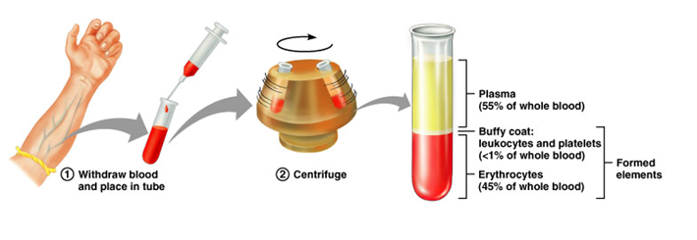
Total blood volume( Other names)
Hematocrit ( Hct) or Packed cell volume ( PCV) (very easy procedure )
Blood volume = The blood cells 3% of body weight + blood plasma 5% of body weight =8% of our body weight expressed in kg
8% × 70kg = to 5.6L = 5.6 kg
L= Kg
To facilitate calculations we will consider them 5
Total Blood Volume (TBV) = Plasma Volume / 1- Hematocrit (PCV)
Total Blood Volume (TBV)= 2.8 / 1- 45%= 5.6L
Blood Plasma =55% × 5.6L
Blood cell =45% × 5.6L
Note :
3%of whole body weight
45% of whole blood
In the test tube there is a type of anticoagulant ( like heparin) ( to prevent blood coagulation )
the test tube will be running around itself in centrifuge at a rate 1000 round/ minute
the blood splits into two parts : 1-water of the blood ( plasma ) 55% 2-Cells at the bottom of capillary 45% (a- leukocytes and platelets < 1%of whole blood B- erythrocytes [ red blood cells ] 45% of whole blood
Notes:
With polycythemia vera the bone marrow produces red blood cells without a stimulus from erythropoietin. The hematocrit is very high, even up to 60%. With the elevated hematocrit there is a feedback suppression of erythropoietin and the erythropoietin levels are very low
Secondary polycythemia would have an elevated EPO level. to exposure to low oxygen. have increased HCT, and thus increased RBC count, but normal WBC count. The cells are normal so the MCV will be normal.
A patient suffering from an iron deficiency or anemia, a condition where the body does not have enough red blood cells, may receive a Red Blood Cell Transfusion. This type of transfusion increases a patient’s hemoglobin and iron levels, while improving the amount of oxygen in the body.
Plasma is the liquid part of the body’s blood. It contains important proteins and other substances crucial to one’s overall health. Plasma transfusions are used for patients with liver failure, severe infections, and serious burns.
Platelets are a component of blood that stops the body from bleeding. Often patients suffering from leukemia, or other types of cancer, have lower platelet counts as a side effect of their chemotherapy treatments. Patients who have illnesses that prevent the body from making enough platelets have to get regular transfusions to stay healthy.

Slide 4
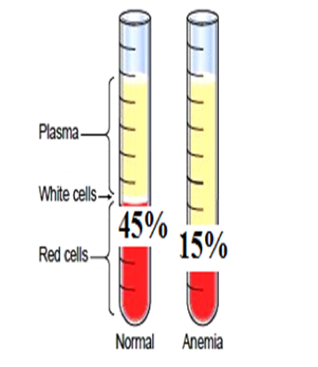
Blood Transfusion(transfer the blood from person to another by IV drip *IV = intravenous )
Whole Blood transfusion increases a patient’s hemoglobin and iron levels
Iron is a very important component of hemoglobin for transporting oxidized red blood cells to tissues.
A patient suffering from an iron deficiency or anemia.
=> so we need transfusion of whole blood to increase account of RBC in patient .
Plasma is the liquid part of the body’s blood.
Plasma transfusions are used for patients with liver failure, severe infections, and serious burns.
Platelets are a component of blood that stops the body from bleeding.
Patients who have illnesses like leukemia and chemotherapy treatment must get regular platelet transfusions to stay healthy.
Decrease in red blood cells
Reduce the amount or total account number of red blood cell in whole blood volume

Slide 5
Blood Donation ( Donate an entire unit of blood ) * Standard
One pint (blood unit)= 500ml or half a court ( one quart = 2 pints)
In this example you got 10pints in your blood .
1 pints=500 ml
It is not possible to donate less or more than the standard value
So, when you donate 1 pint you giving less than 1/10 of your blood body.
If you gave twice that you will lose a liter of blood, half a court of blood then you need a medical attention.
A person weighing 70 kg
5L blood = 5000 ml
To donate blood we will take 500 ml of his blood
500/5000=1/10 of his total blood body .
So, the person who less than 100 pounds doesn’t give blood. In other word when you donate blood you given 10% or less
100 pounds ≈ 50 kg
Can he donate blood? No Why ?
80%*50=4 L =4000 ml
When we take 500 ml we will have taken more than 10% of his total blood body .

Slide 6
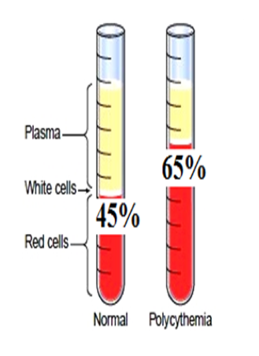
Polycythemia ( increasing the number of Red Blood cells)
Primary polycythemia very rare: slow growing blood cancer such as polycythemia vera
increasing HCT => it is blood cell cancer * very slow growing so it rare
It is cancer of RBC we call it polycythemia Vera it had increased of RBC
Secondary polycythemia
Exposure to low oxygen
living in high attitudes
Normal deficiency—> To compensate for this deficiency,the body increases the number of RBCs —> to keep oxygenation of tissue in normal
2. Pulmonary disease
increasing the number of Red Blood cells
Secondary polycythemia
Normally Pathologically
(Exists in normal people)
* Both are exposure to low oxygen
pulmonary * respiratory system
*Specific to the lungs it may cause obstruction , infection ,etc

Slide 7
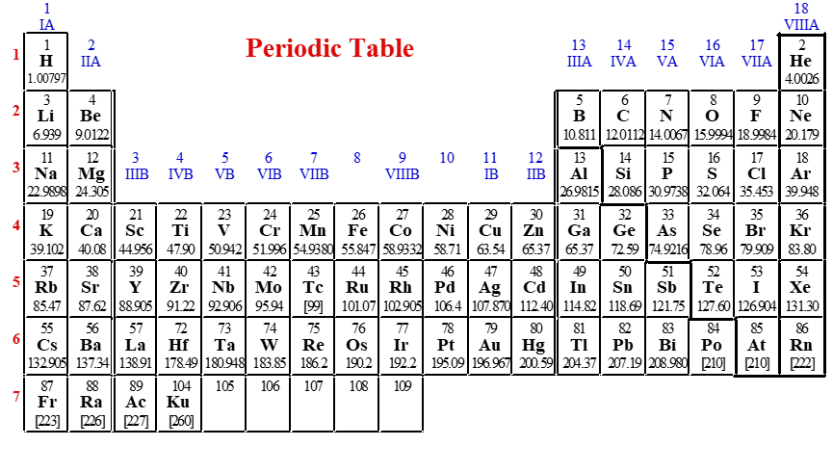
Tonicity ( It depends on malls)
The Mole (Avogadro’s Number) = 6.022 x 1023
1 dozen cookies = 12 cookies
1 mole of cookies = 6.02 X 1023 cookies
How much 1 mole of salt molecules weigh?
First, you need to find the molar mass of NaCl. To do that, just add up the masses of Na and Cl:
22.989 g/mol + 35.453 g/mol = 58.442 g/mol. So 1 mole of table salt weights 58.442 grams

Slide 8
The total amount of different solutes in the fluid is called tonicity
The unit we used to quantify the tonicity is osmoles. osmole is a combination of two words osmosis and moles
For each milli osmo of solute particle difference between inside and outside will create an osmotic pressure of 19.3 millimeters of mercury.
282-300mosmol/L times 19.3/mosmol/L
it will create 5443mmHg osmotic pressure which is very high
19,3*282=Total osmotic pressure

Slide 9
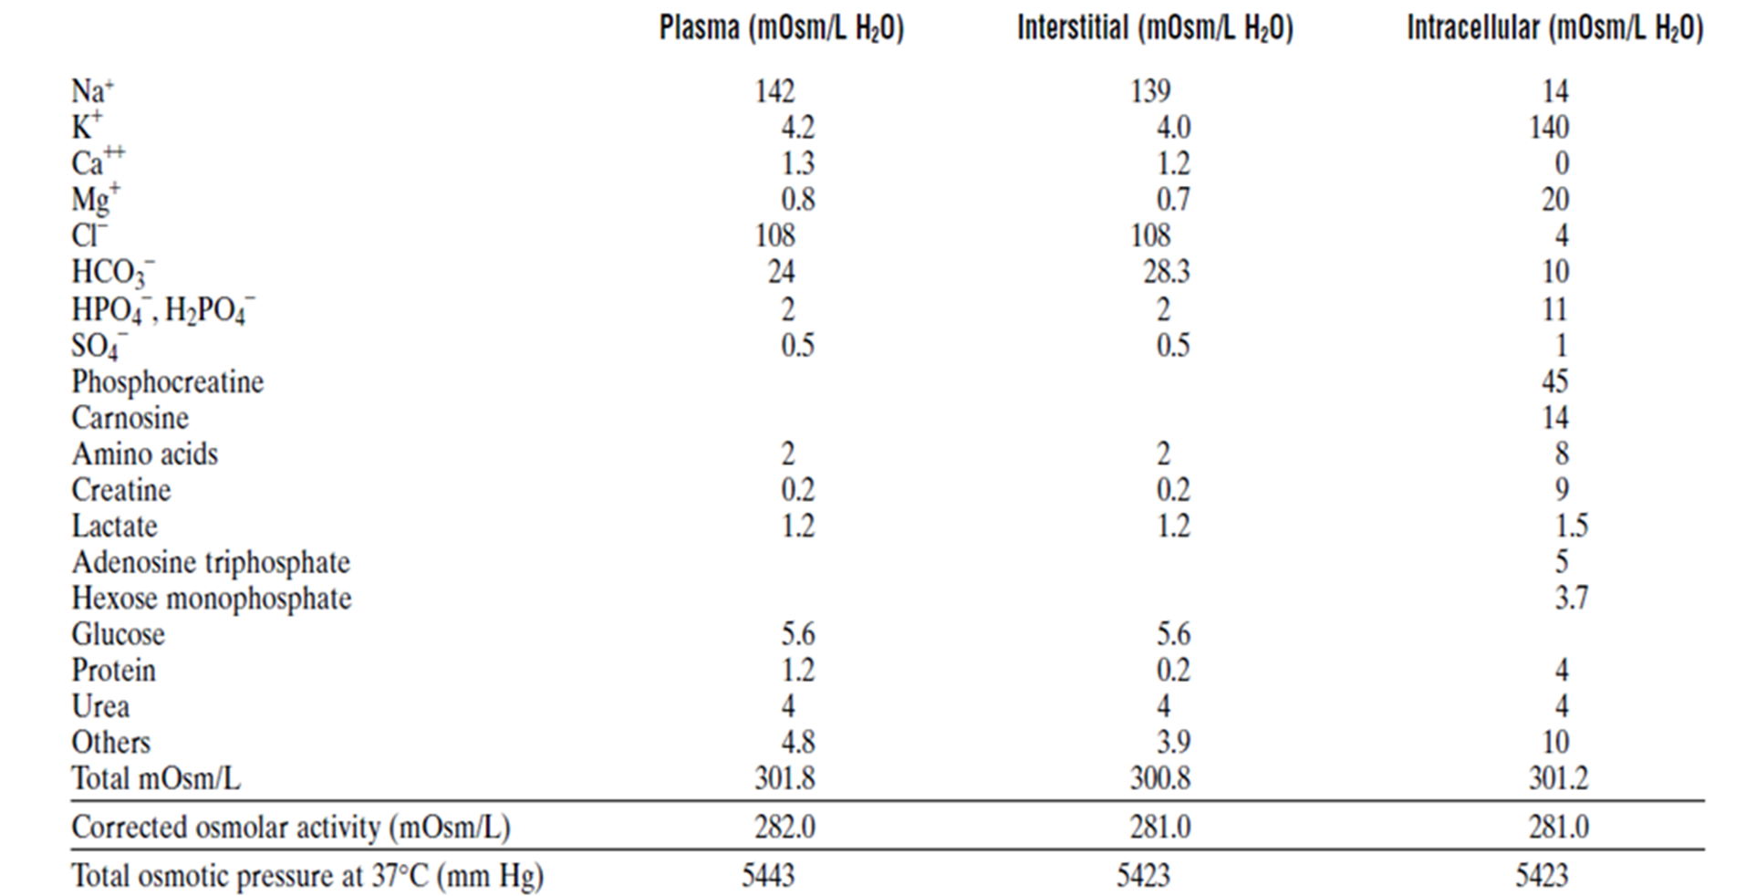
قيم تقريبية
the ratio of the amount of mOsm/L in each kind of fluid
- 300
متقاربة جدا
A 20% increase in plasma is not found in the other components

Slide 10
Oncotic or colloid osmotic pressure
As a result of the difference between blood plasma and others(20 millimeter of mercury )
blood plasma likes to any other extracellular fluid except protein. The total amount of solute particles is small higher than intra and extra which make it hypertonic.
The difference will be around 20 millimeter of mercury (albumin)
Which means that the blood plasma is about 20 mmHg higher than it anywhere else and this is called osmotic pressure or colloid pressure
Increased Hydrostatic ( transfer water from high water to low water )
Increased Oncotic —> decreased water ( water comes from area with higher water to area with lower of oncotic pressure)

Slide 11
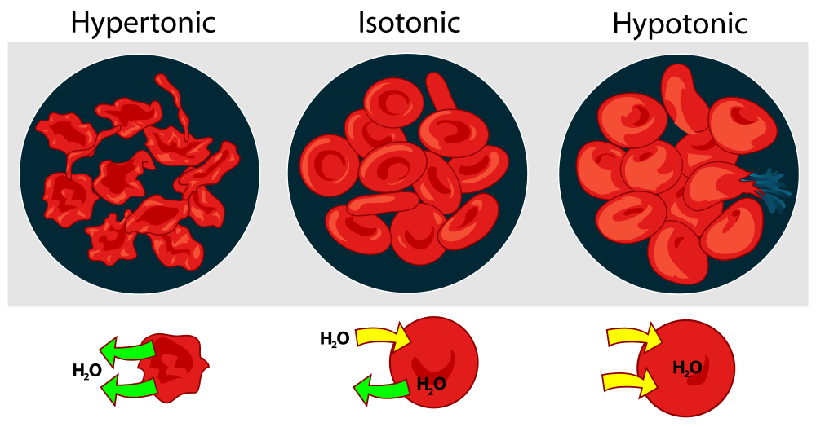
depending on normal mOsm/L
Osmolarity of the solutions
On what basis it is classified into
282-300 mOsm/L
same tonicity like fluid inside the body
Done by Shams Arman
بالتوفيق للجميع ……
# لجنة الطب و الجراحة
# لجنة التبيض
> 282-300
< 282-300
Cell shrinkage

Slide 12
How to quantify numerically the tonicity of solution?
4millimole of KCL will end up with 8 millimole of K and Cl 8 osmole
If we add 2 millimole cacl2 into water, you will end up with 6millosmole
If you add 5 millimole of glucose into water, it will stay as one particle so it will end up with 5 milliosmole

Slide 13
mole/L of solution or M: Molarity - it is the # molecules of EACH solute found in a solution per unit of volume of solution. It is expressed in mole/ liter of solution
mole/kg of solvent or m: Molality - it is the # molecules of EACH solute found in a solution per unit of weight of solvent. It is expressed in mole / 1000g of solvent
How to compute the total osmolarity of 150 mM Nacl solution?
150 mM solution is equal to 0.15 M solution .
First of all, what we mean by this question is the total of solute particle in a Liter of solution.
If you take 150 mmole of Nacl molecule in each salt particle you will multiply times two since it will break up into 150moml Na and 150mmol cl for the total of 300 mosmol/L

Slide 14
Physiological saline is 0.9% NaCl. This means that 100 ml's of physiological saline contains 0.9 g of NaCl. One liter of physiological saline must contain 9 g of NaCl. We can determine the molarity of a physiological saline solution by dividing 9 g by 58 g... since we have 9 g of NaCl in a liter of physiological saline, but we have 58 grams of NaCl in a mole of NaCl. When we divide 9 g by 58 g, we find that physiological saline contains 0.154 moles of NaCl per liter. That means that physiological saline (0.9% NaCl) has a molarity of 0.154 molar. We might express this as 0.154 M... or 154 millimolar (154 mM).
A 0.9% NaCl and a 0.154 M NaCl solution are the same thing. They are physiologic isotonic solution

