Slide 1
SOMATIC PAIN
&
THERMAL Sensation
By
Dr. Nourelhuda Mohammed
PHYSIOLOGY Dept.
Mut'ah school of medicine

Slide 2
Sensations
They are divided according to the site of origin into
Somatic sensations (comes from soma or body)
Visceral sensations (from viscera). As visceral pain and fullness of the bladder.
Special sensations (vision, hearing, smell, taste)
Hypothalamic or organic sensations (thirst-hunger-fear).

Slide 3
Somatic sensations
further subdivided according to site of receptors into :
Cutaneous sensations (pain-touch-temperature-pressure).
Deep sensations : as sense of position, movements, muscle tension, deep pressure, relation of the body parts to each other and relation of the body to the space.
Mixed sensations (receptors in skin and deep structures):
a) Stereognosis
b) Vibration sense.

Slide 4
Pain sensation
characters:
unpleasant sensation resulting from tissue damage and resulting in protective mechanisms as withdrawal reflex.
Pain is a specific type of sensation and is not due to over stimulation of other sensations.
The threshold of excitation of pain receptors is much higher than other sensations.
Pain is a "pre-potent stimulus" during pain; any other sensations are inhibited as hunger sensation .

Slide 5
Types of pain :
According to the site, pain is classified to:
Cutaneous
Deep
Visceral

Slide 6
pain receptors : they are specific naked free nerve endings (slowly or even not adapt at all) called nociceptors & subdivided into 3 types according to the mode of stimulation.
1. Mechanosensitive pain receptors stimulated by excessive mechanical stress as crushing or server trauma.
2. Thermosensitive pain receptors stimulated by extremes of either cold or hot i.e., above °45 or below 10 c°.
3. Chemosensitive pain receptors which respond to chemical injurious stimuli.
The first two types are connected to (A delta) myelinated fibers. (5-15 meters/sec) while the third type is attached to C-fibers-non myelinated a slowly conducting fibers (0.2 - 2 meters/sec.).

Slide 7
Mechanism of stimulation of pain receptors
Painful stimuli ð tissue damage ð liberation of pain mediators ð stimulation of nociceptors.
Pain mediators like substance P & Prostaglandins & Potassium & Bradykinin.

Slide 8
(1) Cutaneous pain:
It arises from the skin.
Usually described as pricking , stitching or burning
There are 2 types of cutaneous pain: fast & slow pain
Cutaneous pain is accompanied by sympathetic reactions as increase in heart rate and blood pressure, sweating and dilatation of the pupil. Also, protective withdrawal reflexes occur in this type of pain.

Slide 9
slow pain | fast pain
burning delayed and persists for long time Poorly localized by "C" un-myelinated fibers(paleo-lat.spinothalamic tract) local anesthesia block "C" fibers Relay mainly in reticular- formation then to all areas of cerebral cortex. | bricking immediate and persist for short time. well localized Conducted by fast myelinated group "A delta " fibers(neo-lat.spinothalamic tract) Moderate compression on nerve, blocks "A" fibers Relay in thalamus then to somatic sensory cortex

Slide 10
(2) Deep pain
It arises from deep structures (muscle, ligaments, joints, capsules).
It is described as dull aching pain and is not well localized.
Transmitted by "C" fibers.
Deep pain is accompanied by reflex muscle spasm, bradycardia ,drop of the blood pressure, miosis ,nausea and even vomiting.
Important type of deep pain is (intermittent claudication)
Occurs in skeletal muscles due to ischemia or atherosclerosis.

Slide 11
Reactions to pain :
1. Somatic reflexes :
protective withdrawal reflex
reflex spasm of skeletal muscle over diseased viscera.
The mechanism is that the nerve fibers which carry pain sensations on entering the spinal cord will give collaterals to the anterior horn cells which innervate the surrounding muscles.
2. Emotional reactions: AS impulses carrying pain sensations to sensory cortex send collaterals to the hypothalamus which is one of the higher centers of emotions. This causes emotional reactions like crying, anger or depression. Very severe pain on the other hand may cause even complete loss of consciousness or fainting attacks.
3. Autonomic reactions BY impulses that reaches the reticular formation from ascending pain fibers. Autonomic reactions include changes in heart rate, respiratory rate, dilation of pupil, sweating and even inhibition of gastrointestinal activity. Mild pain as a rule causes sympathetic stimulation ; while very severe or visceral pain stimulates parasympathetic activity

Slide 12
4. Hyperalgesia: it is state of pathological skin condition in which non painful stimuli become painful.
Primary hyperalgesia: (at site of the lesion itself )
It becomes edematous, red, hot and very painful
The mechanism is by local axon reflex. Destroyed tissues release mediators that lower threshold of pain receptor and cause local vasodilatation and anti-dromic impulses that cause arteriolar dilation, odema occurs which cause continuous pressure on the hypersensitive nerve endings causing maintained pain.

Slide 13
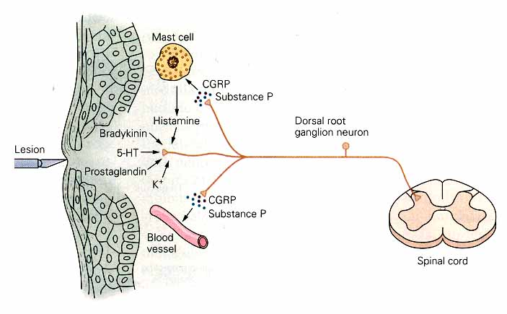
Mechanisms associated with peripheral sensitization to pain

Slide 14
b) Secondary hyperalgesia:
In the surrounding area of the lesion.
It appears normal but painful stimulus to it induces severe pain.
It is explained by convergence- facilitation theory.
As pain from primary area is carried by sensory nerve that converge on a certain neuron in the spinal cord. This neuron becomes "facilitated" have a lot of chemical transmitter, now if painful sensation reach this neuron from the surrounding secondary area, it will transmit it to sensory cortex as if it is very painful sensation.

Slide 15
Secondary hyperalgesia

Slide 16
Temperature Sensation
"Cold" sensation between 10° and 30c°.
"warm" sensation between 30° and 45c°.
Below 10° and above 45° tissue damage begins to occur, and this is described as pain sensation.
At 0 °C No action potential is recorded from nerves.
Thermo receptors adapt between 20c° and 40c°

Slide 17
Types of thermoreceptors:
A. Superficial receptors in skin: they are free nerve endings.
1) Warm spots: transmitted by "C " fibers.(Free nerve ending receptor)
2) Cold spots: transmitted by " A δ " fibers. (Krause's end bulb receptors !)
B. Deep receptors in hypothalamus: detect body temperature from blood.

Slide 18
Mode of stimulation of thermoreceptors:
Chemically by change in their metabolic activity.
Paradoxical cold sensation:
On taking hot shower at 45 °C, we 1st feel cold (shivering) followed by warm
sensation. Because cold receptors are:
a) 10 Times More numerous & More superficial than warm receptors.
b) Momentary Brisk discharge at 45°C.
Temperature pathway: Through Lateral spinothalamic tract

Slide 20
Thank You

